Slide 1

Pheno Security Management
Soc Hackathon 2023
Paul Clark

Slide 2

Currently:
Zeek
MISP
Elastic
Filebeat for log movement
Auditbeat
Kibana
Shared-F2B
Vuls
HIDS
DITO
Trial
HUB

Slide 3

ZEEK
Worked wonderfully…. Until we went 40gb
Currently up but we experience high percentage of packet loss.
Planning to redesign with new hardware including:
Bluefield 1 Test – Free time may arrive
Optical Taps
Spread the load using older Lenovo nodes (High CPU/Memory, 8 to a chassis).

Slide 4

MISP
RPM Build on C7 – Looking to migrate/containerize
Variety of Threat sources
  TOR
  Shared-F2B
  CIRCL
Still not yet linked to STFC/CERN instance due to poor communication on our part
Currently in Maintenance mode due to Zeek refresh
Integrate with Hiveproject

Slide 5

ELASTIC - Current
3x Elastic nodes
1x Master, 2x Data
Large amounts of data, mixed use between security/Grid which isn’t great.
Kibana for sweet sweet visuals
Filebeat for log movement
Auditbeat for Endpoints
  Not a HID but will show individual user commands/filter against certain commands.

Slide 6

Elastic - Future
Rebuild/Redesign
Opensearch looking attractive
If funding available purchase new elastic nodes, older elastic nodes becoming cold storage.
Need to test opensearch for close feature match such as log movment

Slide 7

Shard-F2B
Persistent operation
  Grid
  IPPP
  Wider Physics Planned
No Further core feature updates planned

Slide 8

Vuls
Features of Note
Scanning attributes from a number of sources
Fast non Privilege scan or Root Scan
Offline Scans
Push results to server, no requirement for server to login
Basic Webui (Vupsrepo) or email notifications/reports
Linux support
https://vuls.io

Slide 9
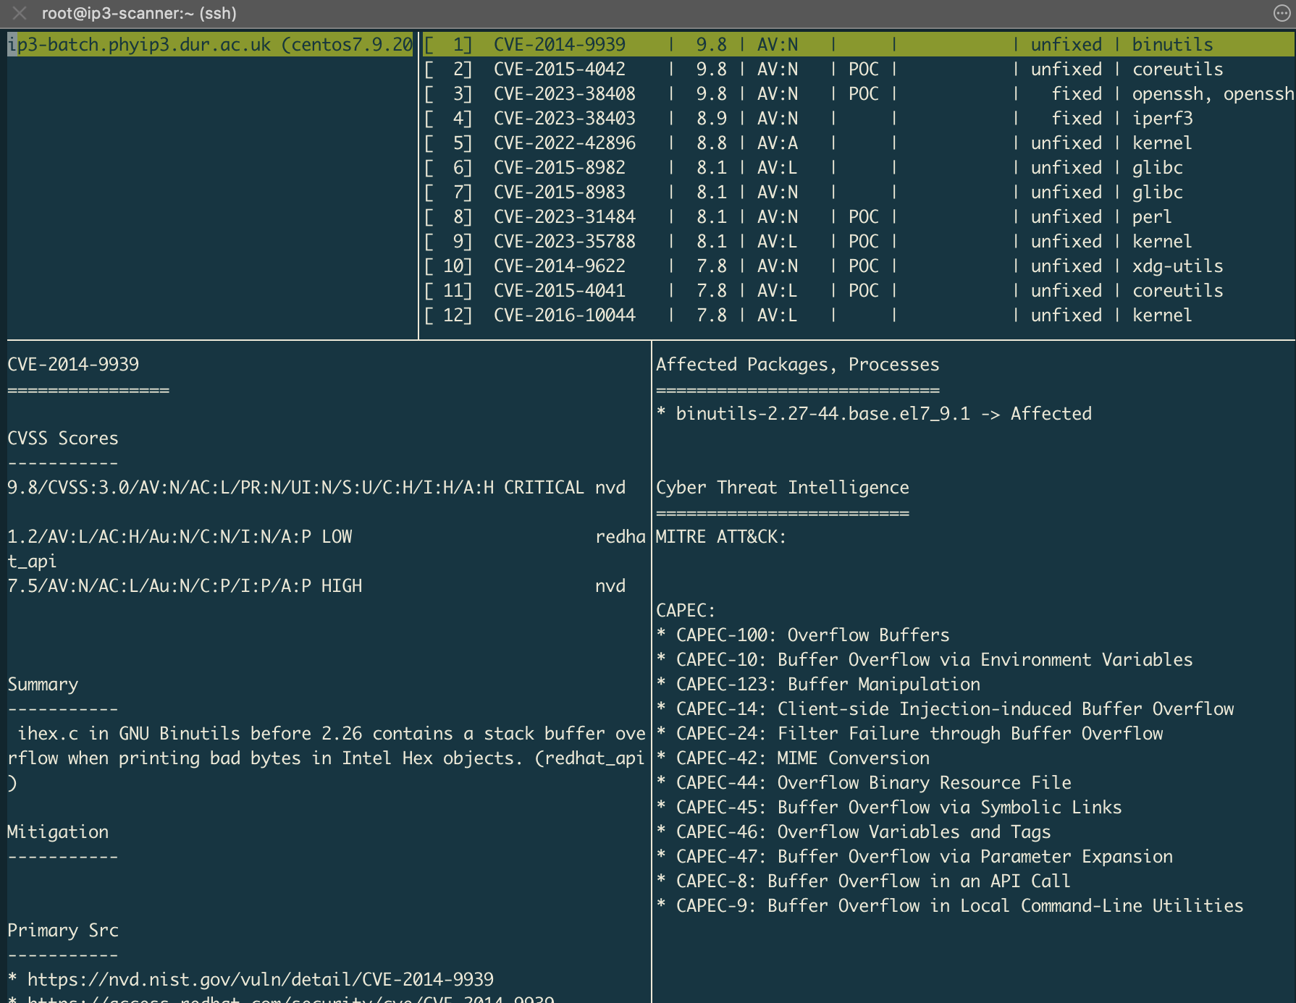
Local Setup
Central Vuls server within IPPP
Clients push to server
Sources
  NVD
  ExploitDB
  OVAL – Redhat Daily feed

Slide 10

Vuls – To work on
Get service owners on side
Meaningful Report – Too complex, details include CVE with zero patch availability/very low risk/highly complex
Windows alternative for standalone device that provides visibility

Slide 11

Host Based Intrusion Detection (HIDS)
Current implementation a mix between:
Auditbeat
Legacy OSSEC
Moving Forward:
Auditbeat will retire with elastic
Ossec vs Wazuh – Faceoff testing

Slide 12

End Goals - Buzz buzz buzz words
Anticipate
Identify
Protect
Detect
Alerts/Anomaly Detection
Respond
Containment
Remediation

Slide 13

Boxes to tick
People
Assess/Advise to wider physics
Security Intelligence sourced from Third party Soc, Central Compute and MISP associations + Other
Secure Infrastrcuture – Management/Design
Cloud Security – (Grid/Azure/Physics)
How to simplfy all of the above
Operational Tech/Industrial Control Ssytem. (Fire, Swipe card, Lab machinery)
End point security
Identitity Access management (Internal/Central/Grid)

Slide 14

DITO – Freedom at what cost
Core framework integration using the term ”Golden Thread”
DITO (Durham IT Operations) Governance group
  Academics
  Corporate
  IT
  Provides oversight to departmental IT decision making that goes against standard corporate policy.
NIST framework heavily condensed to make it more manageable to end users.
Roughly 100 Rules

Slide 15
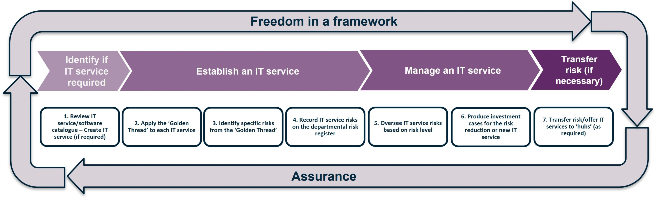
DITO – Framework

Slide 16

Local to Core Communication
Communication External to DITO
Access to Third Party SOC – Helped Tender
  Some sort of view planned for DITO members however expect this to take a long time and be heavily restricted in terms of view
Reporting of known CVEs
Working with security teams for testing purposes:
Example:
    Papercut
    Zenbleed
    etc

Slide 17

Questions?

