Slide 1
Simulating Cosmic Ray Collisions With Pythia8-Angantyr
Jake McCool
20 April 2023

Slide 2
Presentation Structure
Reminder of what I am doing
Goals from last presentation
What I will do next
Troubleshooting/Progress

Slide 3
Presentation Structure
Reminder of what I am doing
Goals from last presentation
What I will do next
Troubleshooting/Progress

Slide 4
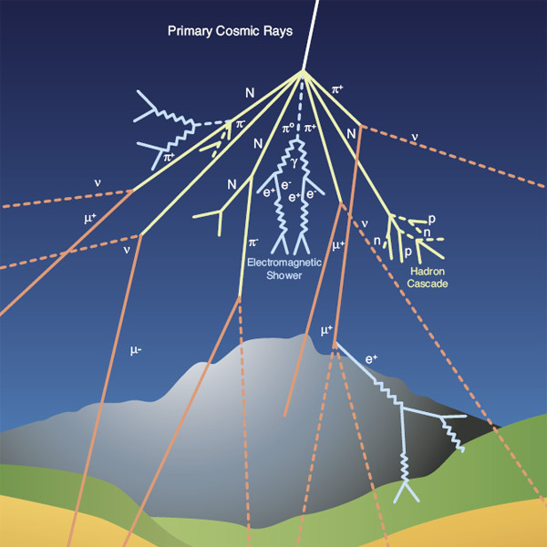
As a Reminder about Cosmic Rays…
Generally, Protons or light atomic nuclei
  Accelerated in supernovae or our sun (solar wind) for example
Collide with our atmosphere and create a particle shower
  ~ 10 billion particles, ~20 km2 for UHECR
We put detectors on satellites above the atmosphere
Not enough data for higher energies
  lower flux at high energies
So, we use the atmosphere as a detector
  And Monte Carlo Generators

Slide 5
Presentation Structure
Reminder of what I am doing
Goals from last presentation
What I will do next
Troubleshooting/Progress

Slide 6
What Were My Goals?
Start Simulating proton-Ion collisions
  I had been able to make p-p work, but not p-ion
Select for final state charged particles within η < |2.5|
Get a handle of basic manipulation with the simulated data
Retrieve cross sections for p-O and p-N, then take weighted avg

Slide 7
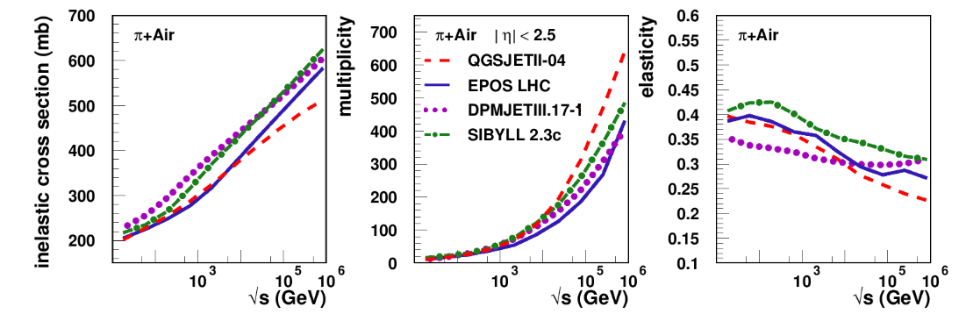
The Kind of Graphs We Would Like

Slide 8
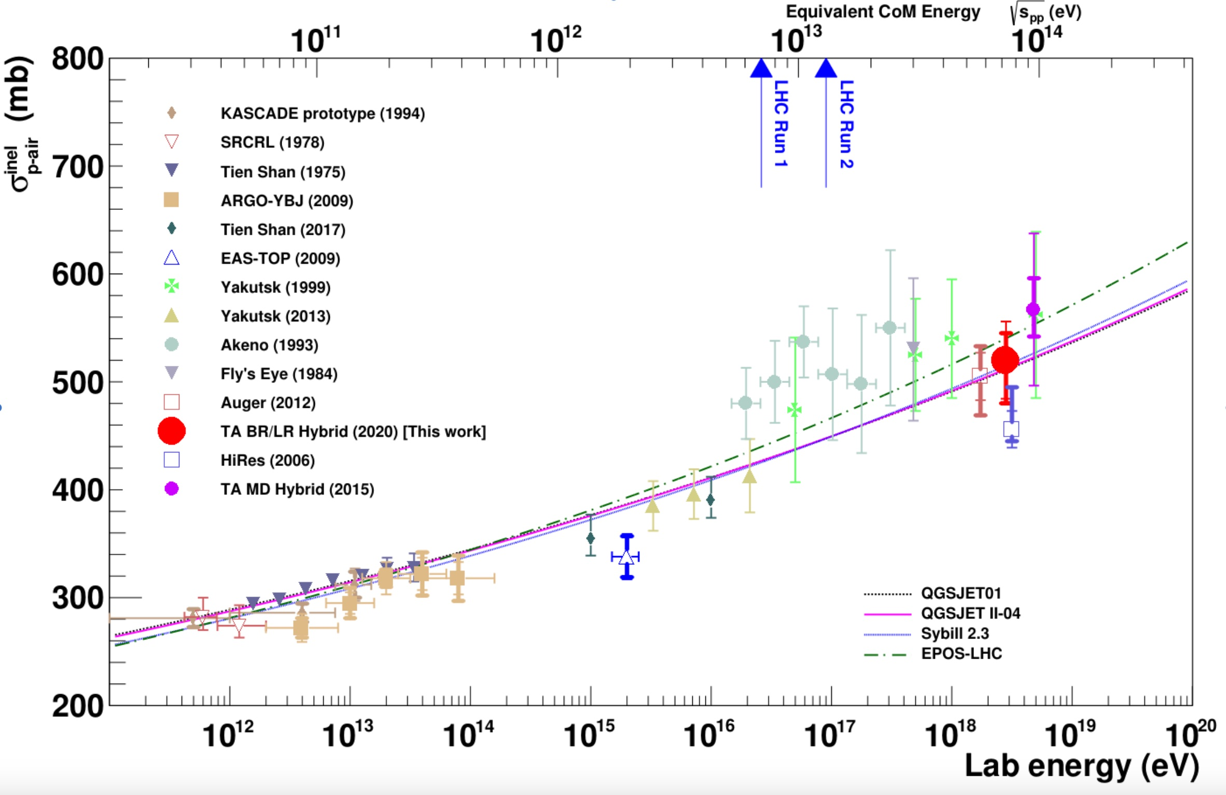

Slide 9
Presentation Structure
Reminder of what I am doing
Goals from last presentation
What I will do next
Troubleshooting/Progress

Slide 10
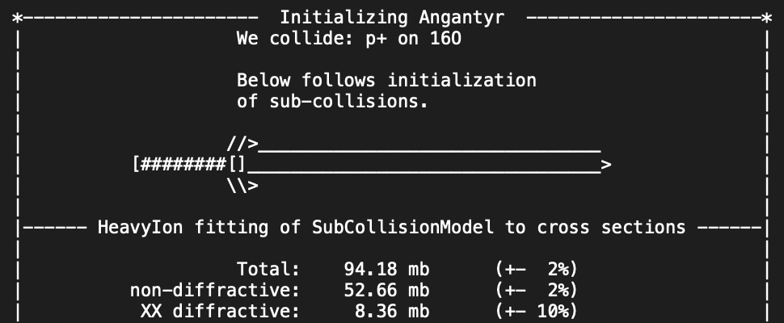
Proton-Ion Collisions
Function to run any number of Ion collisions at a given energy level and retrieve multiplicity/ Cross sections
Notes:
Norse mythology
Angantyr's father Arngrim had given him the magic sword Tyrfing, Tirefing which cut through anything as if through cloth, and which killed a man every time it was unsheathed. He was the tallest of the twelve sons of the berserker Arngrim, and he and his eleven brothers spread fear and destruction through the North.

Slide 11
Issue With Retrieving Cross sections
This is certainly wrong
double xsection = pythia.info.hiInfo->sigmaTot();
Notes:
Quite low because only for 100 events and sigmatot includes a huge elastic xsections ~1500 mb

Slide 12
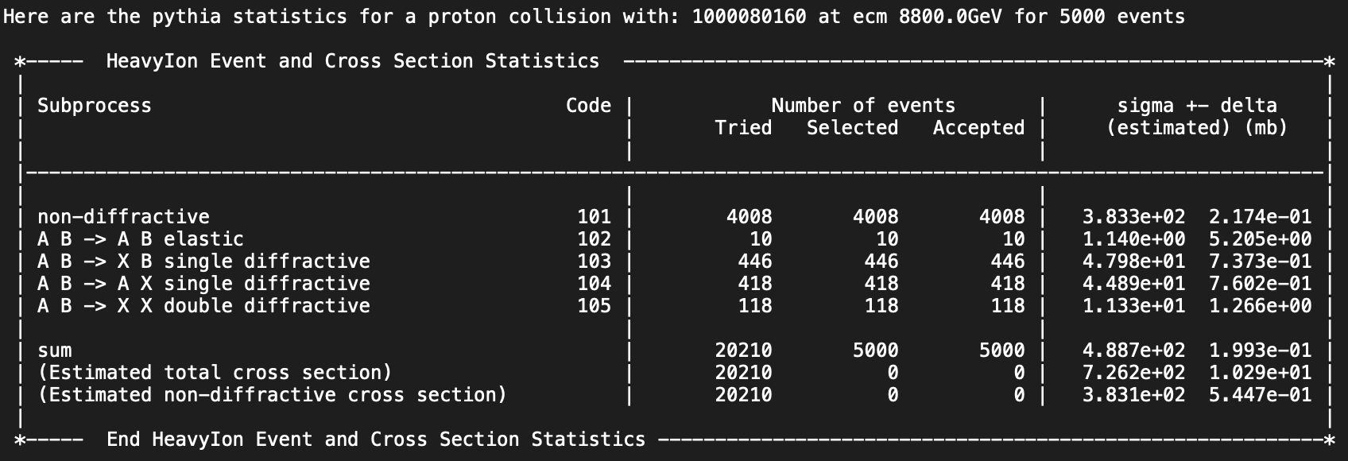
So Many Cross Sections
Notes:
There are two ways of calculating xsections.
Sigma tot includes the elastic cross section , which we don’t care about
This model is a work in progress, so there is no way to retrieve sigma sum
There are two ways that they can find the cross section, optically with two disks colliding and quantum mechanical affects , another way is running the monty carlo and seeing how many times they collide inelastically
So the sigmaelastic there is also wrong
Then we go through by hand and grab all the things we need

Slide 13
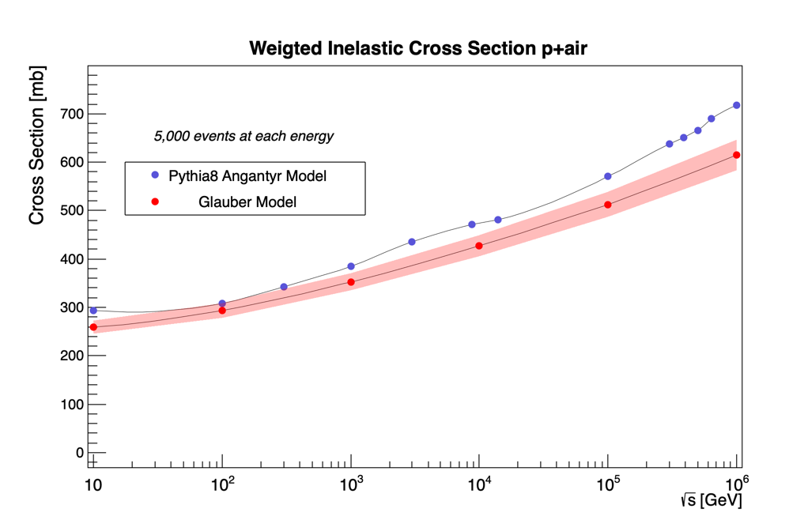
After doing things by hand

Slide 14
Presentation Structure
Reminder of what I am doing
Goals from last presentation
What I will do next
Troubleshooting/Progress

Slide 15
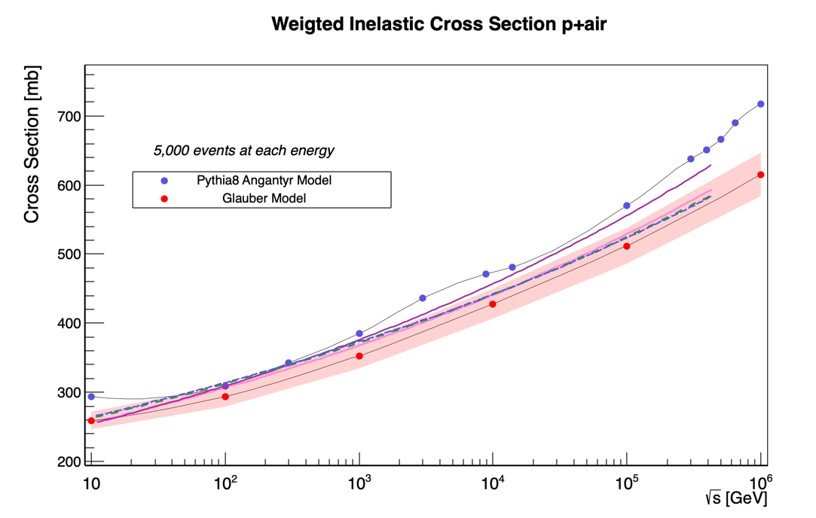
Making This Better

Slide 16
Also hopefully
Add experimental data to master graph
Produce the same plot but for Pion-Air
Then Graph Multiplicity for both
Graph p-p cross section vs p-air cross section

Slide 17
Thank you :)

