Slide 1

Data Scouting for Low-Energy Events
Sandro Orjuela

Slide 2
Recap of Project
How does the CMS trigger system work?
What is our objective?
What is data scouting?

Slide 3
What I’ve been doing
For a while, struggled with different uncooperative IDEs
  Eventually Jake helped me set up a conda environment with root, many thanks to him!
Learning about/making plots with RDataFrames

Slide 4
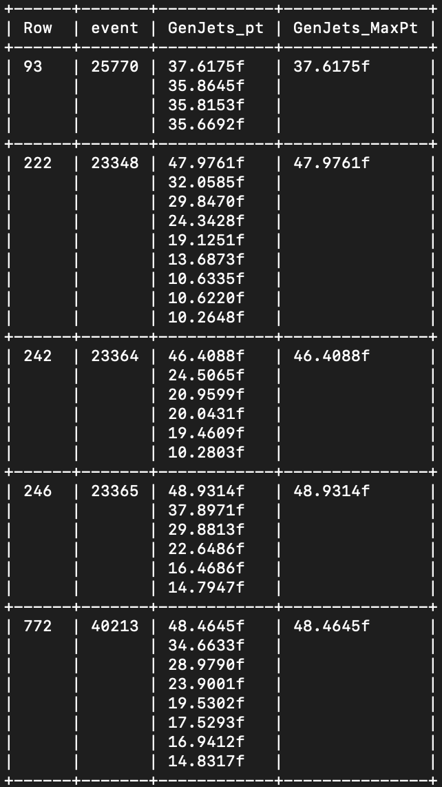
RDataFrames
Useful for unwrapping TTrees
  Especially when there’s RVecs in the trees
Allows us to very easily perform calculations on data

Slide 5
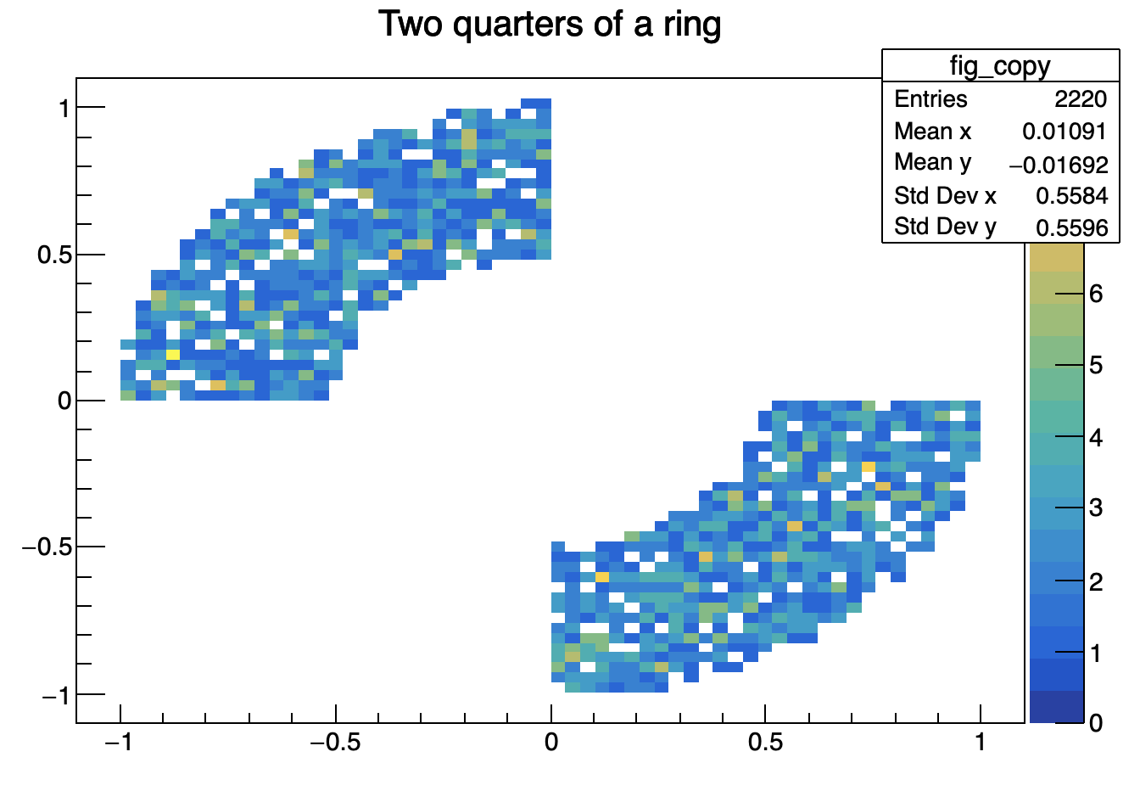
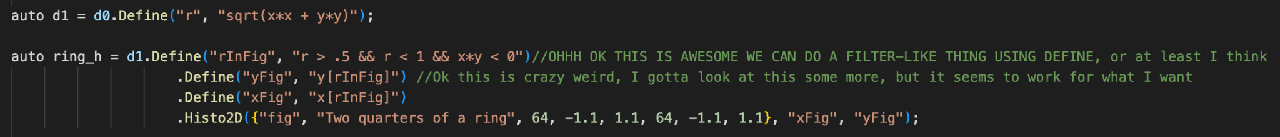
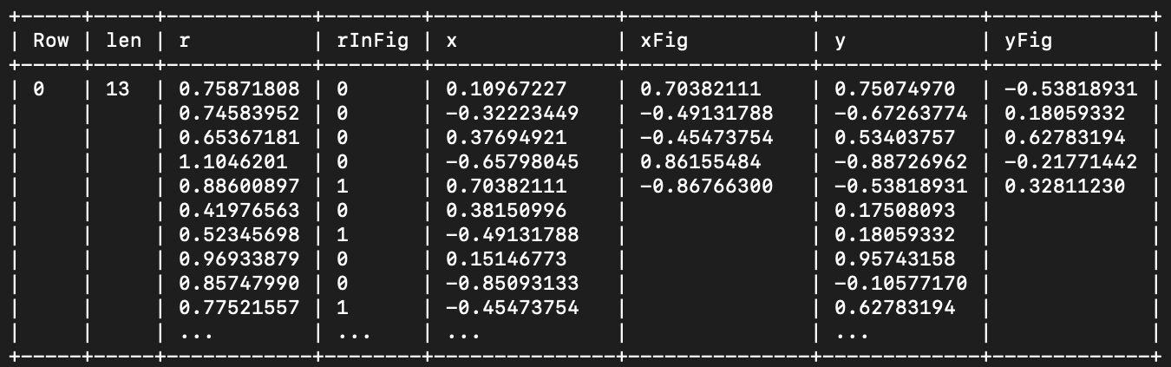
RDataFrames - code
RDataFrames - code
Basics of Define and Filter
Really cool things

Slide 6
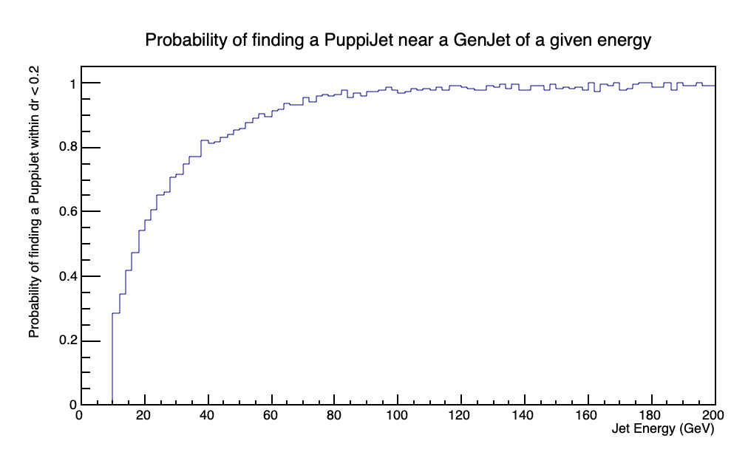
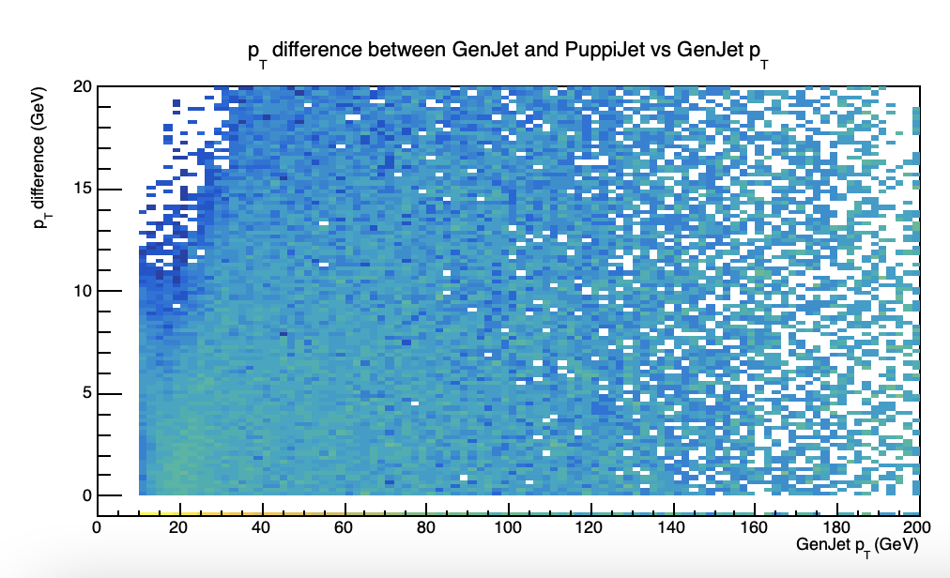
Examples of plots I’ve made

Slide 7
Next Steps
Looking through a few more example data analyses my mentor sent me
Probably starting to look at actual low-energy event data, but my mentor’s been away this week and I was obviously out last week so not super sure what’ll come next

