Slide 1
Continued ADC Chip Study
Greg Powers
April 20, 2023

Slide 2
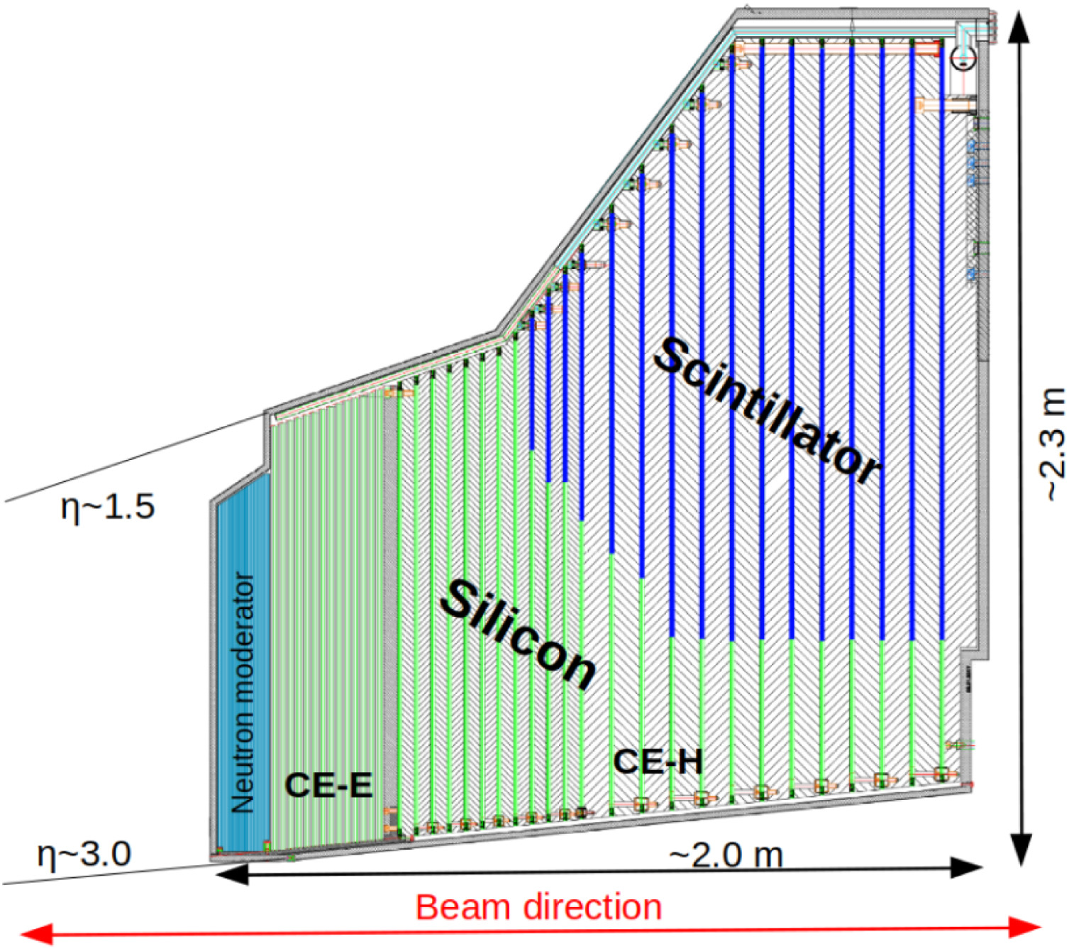
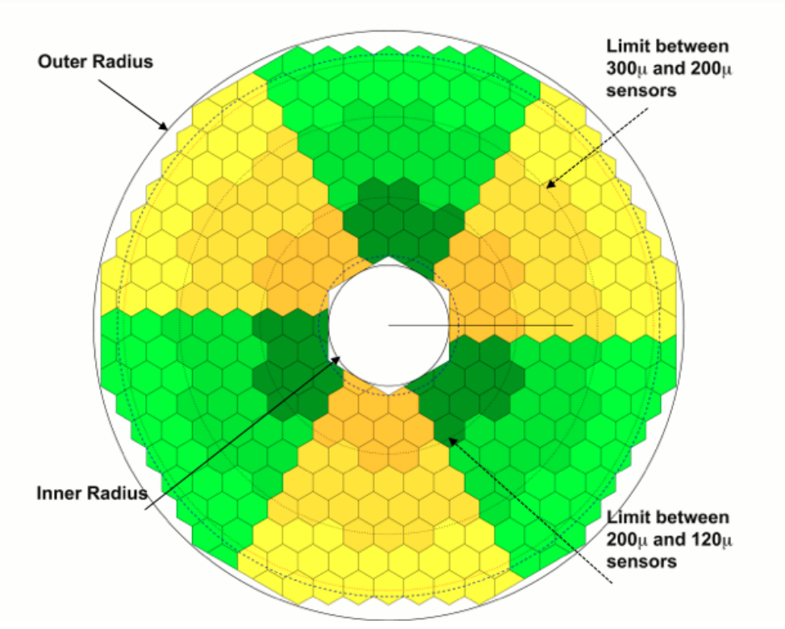
HGCAL Overview
https://cds.cern.ch/record/2293646/files/CMS-TDR-019.pdf

Slide 3
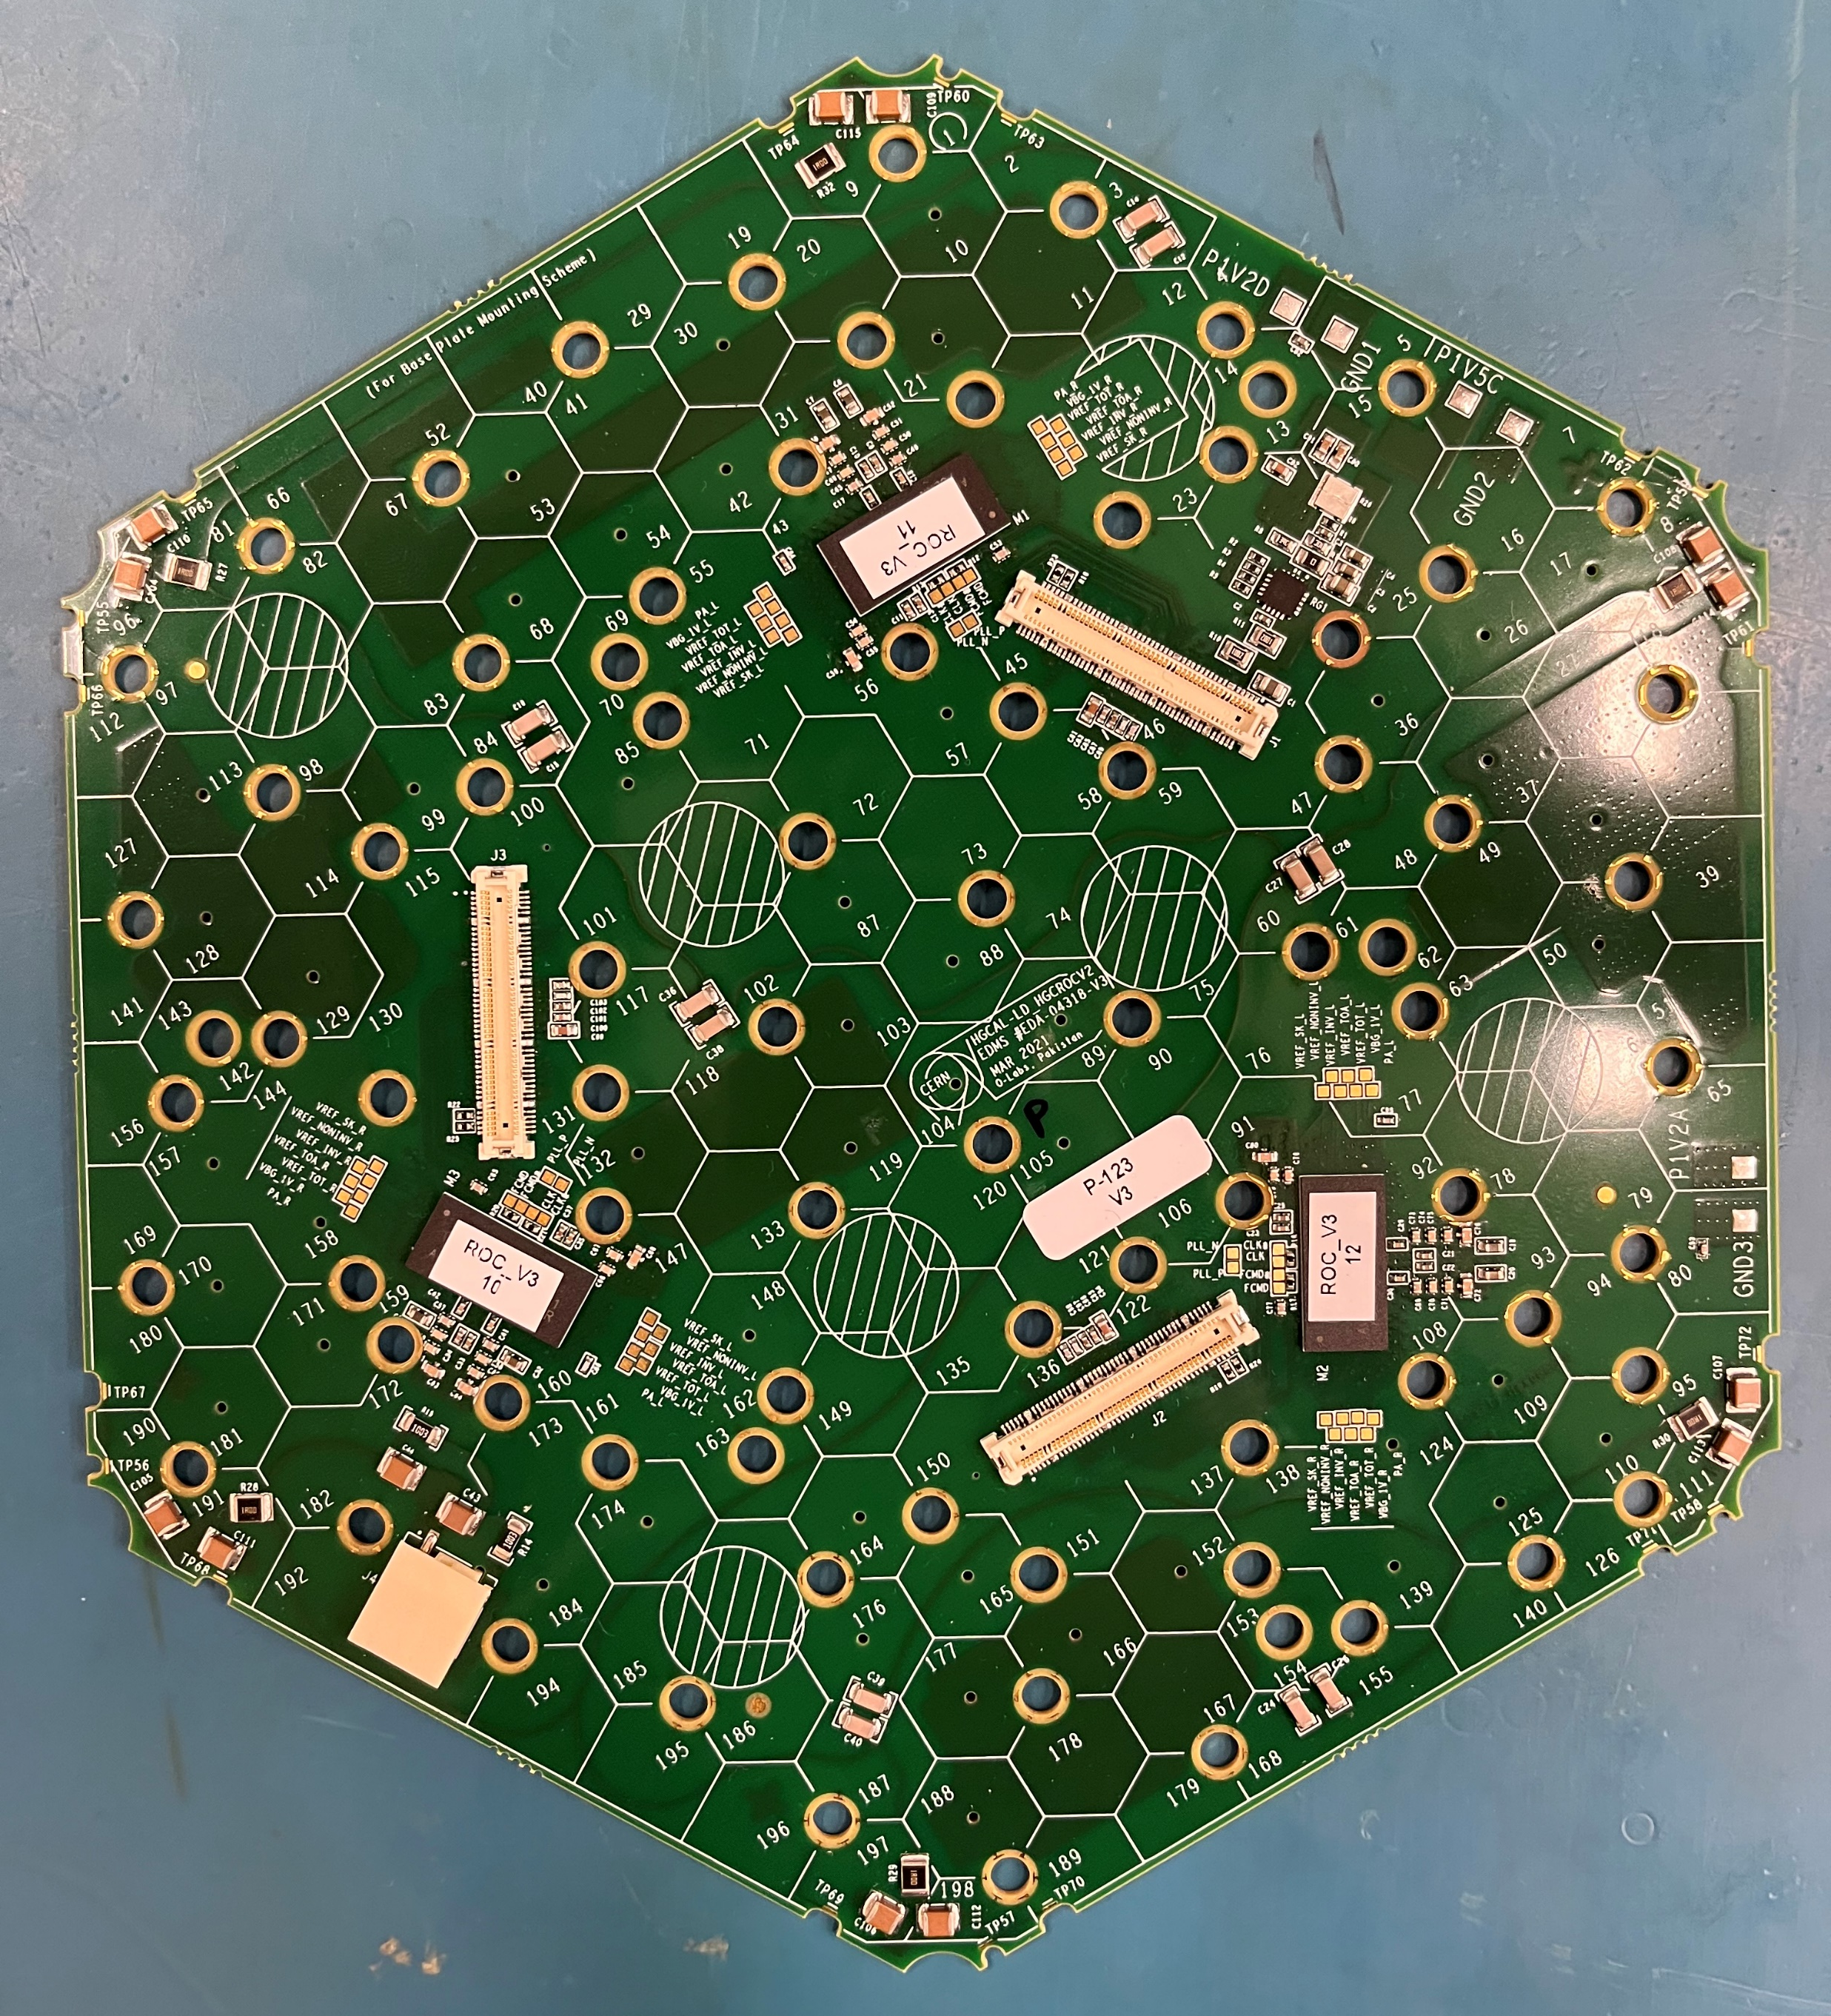
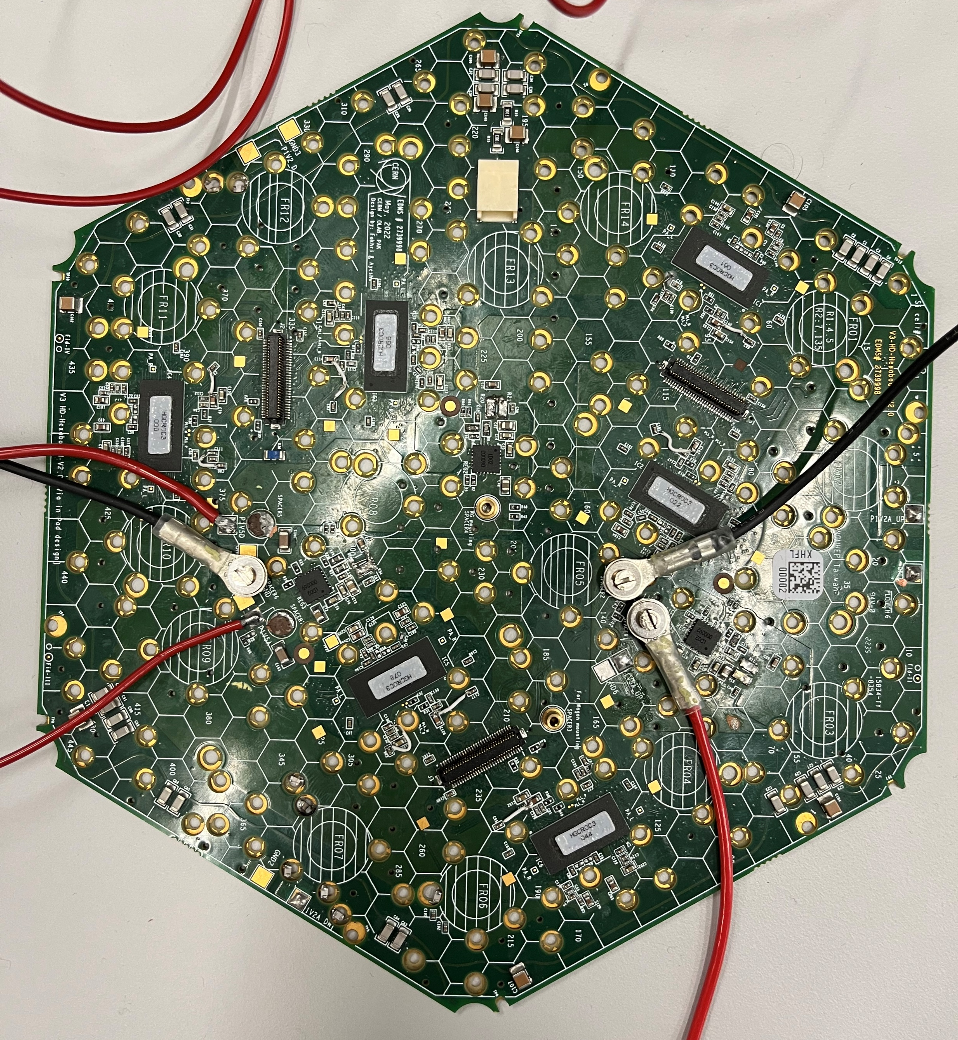
Chips
Low Density
High Density

Slide 4
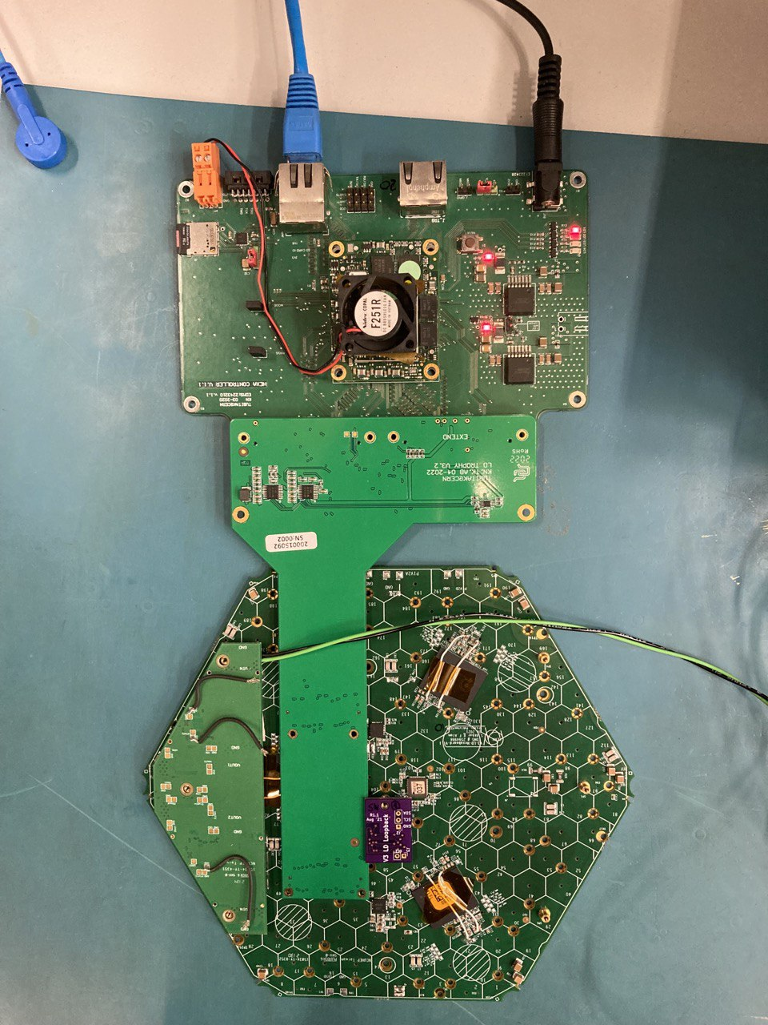
Testing Setup
FPGA
ADCs
Trophy Board
Power
ROCs
Hexaboard

Slide 5
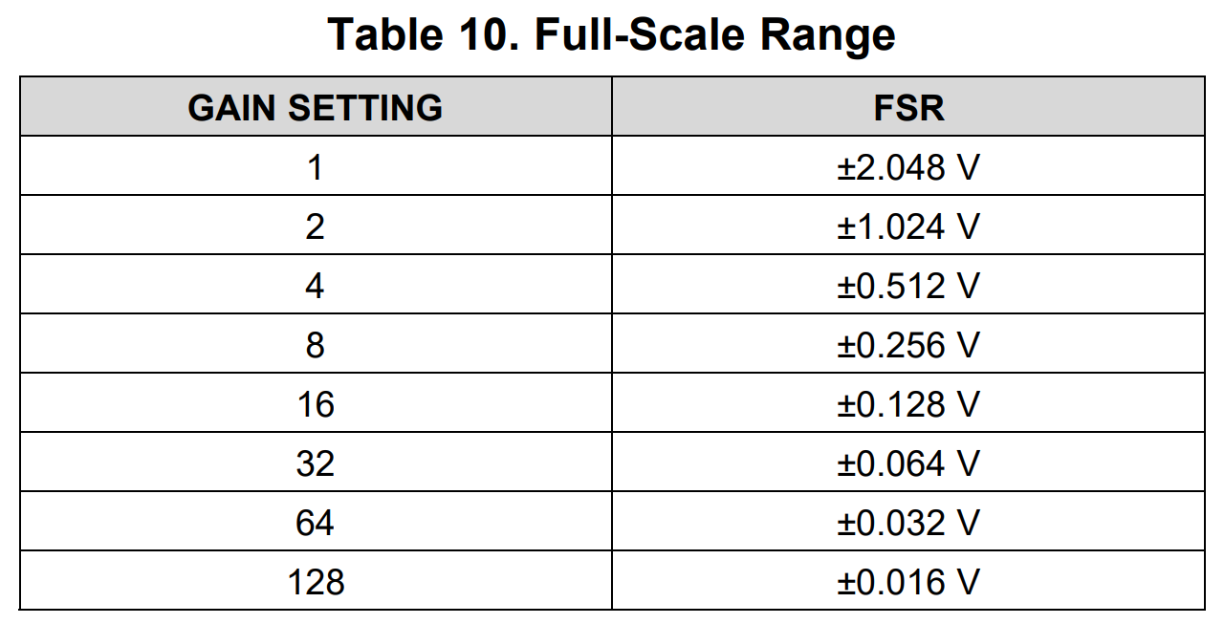
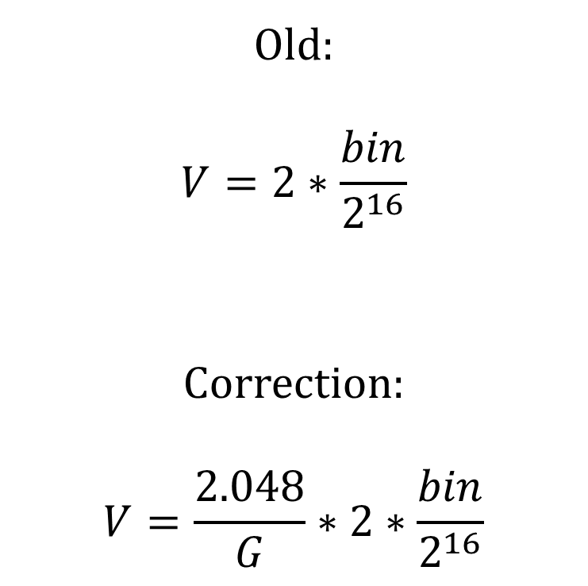
Gain Adjustment
Old:
$$V=2∗\frac{bin}{2^{16}}$$
Correction:
$$V=\frac{2.048}{G}∗2∗\frac{bin}{2^{16}}$$

Slide 6
Offset Calibration
Client Side
Server Side
Measuring average deviation from measurement of 0V
To be done automatically, must interact with server
Setup ZMQ Server and Detect Boards
Run Script
String Interpreter
Configuration File
I2C
Communication Script
Configure and
Executables
I2C
Save Results
Board

Slide 7
Streamlining Board Detection
Determine what board is attached by searching for different signatures on the I2C bus
From series of if statements to a more robust system searching for entries in a dictionary
  Easier to update
  Less likely to have niche failure cases

Slide 8
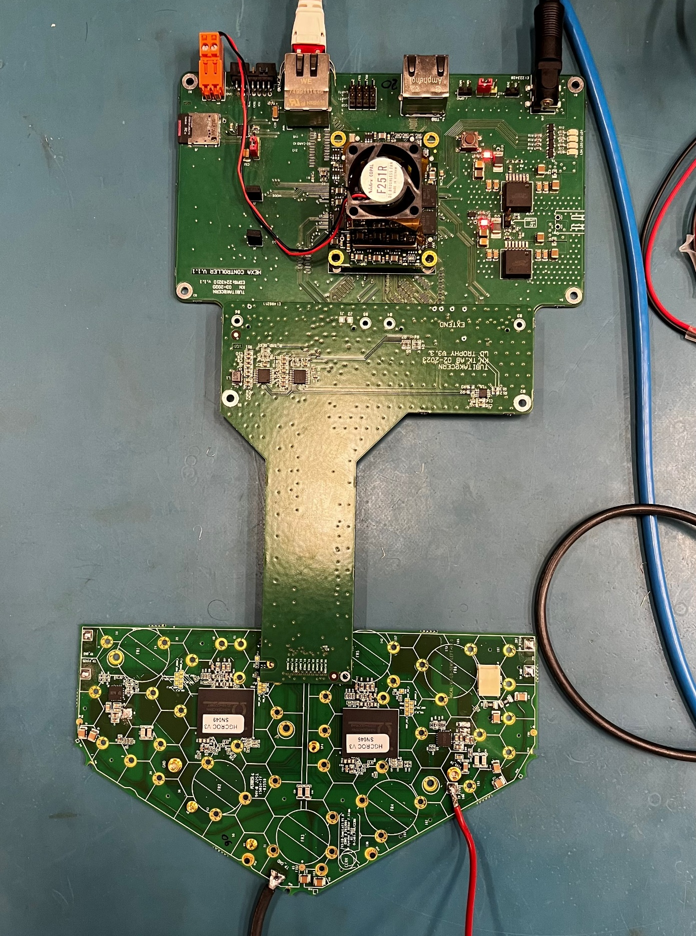
Next: Testing on Semi-Board

