Slide 1


Radioactive Bi207 Source Simulation for LArTPC Calibration
Luke Saunders
Progress Report, CERN
Luke Saunders | Progress Report | April 20th, 2023 1

Slide 2
General Updates
All decay products of Bi207 are now factored into our code with the probabilities taken from the National Nuclear Data Center (NNDC).
The code is fully generalizable to any given number of induction strips and collection strips, as well as with the full ability to adjust the pitch.
  This generalization only works for the design of the small-scale LArTPC at the Meyrin, CERN site. Changing it for the protoDUNE detectors is simple.
All simulation code is neatly stored on the GitLab repository.
  The only file that should concern other users is the global variables folder (inc), allowing for easier use of the simulation code.
This presentation uses a data set of ten million events for analysis.
The geometric cut imposed in simulation is the region covered by the area of the source container.
Luke Saunders | Progress Report | April 20th, 2023 2

Slide 3
Additional Notes
While many of the probability and energy values listed on the NNDC website correspond with those found through Eckert and Ziegler, some do not.
  There is a large probabilistic discrepancy concerning the annihilation photon produced during beta decay.
The emission of a beta particle during decay produces a positron whose energy is constrained by a spectrum of values. In the simulation, the average energy value is used.
The energy analysis of simulated data will sometimes fail to run for data sets of less than 10,000 events.
Luke Saunders | Progress Report | April 20th, 2023 3

Slide 4
X and Y Position of Electrons and Photons
The present simulation code creates 2D histograms of the x and y position of the electrons and photons produced by the radioactive source.
  This is fully generalizable as the limits of the plot can be adjusted according to the cut imposed on the simulated particles.
A combined 2D histogram of both electrons and photons exists with the same generalizability as previously mentioned.
As will be the case with all other graphs, there is a pre- and post-energy cut version of every plot.
  The pre-energy cut means that the position was taken regardless of the particle’s energy, even if that energy would be undetectable to the detector.
Luke Saunders | Progress Report | April 20th, 2023 4

Slide 5
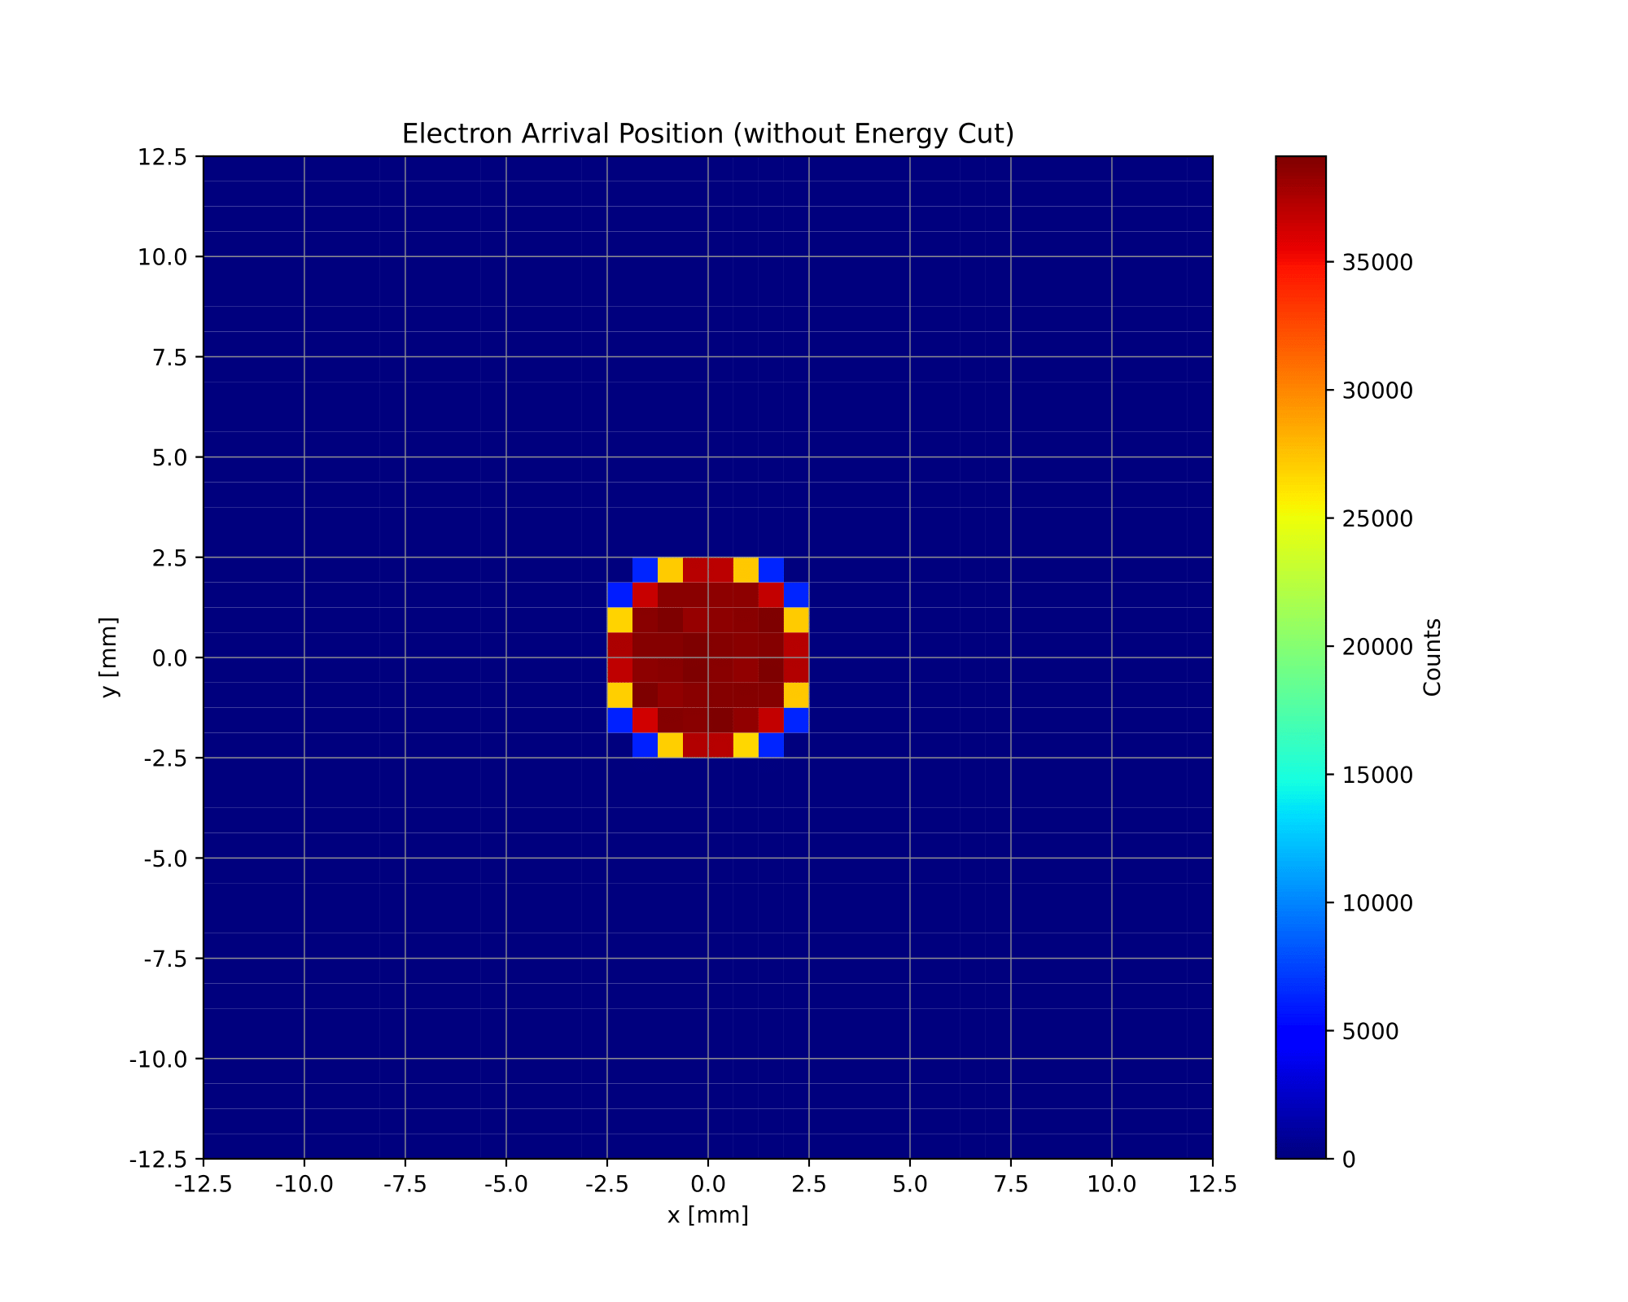

Electron X and Y Position
Luke Saunders | Progress Report | April 20th, 2023 5

Slide 6
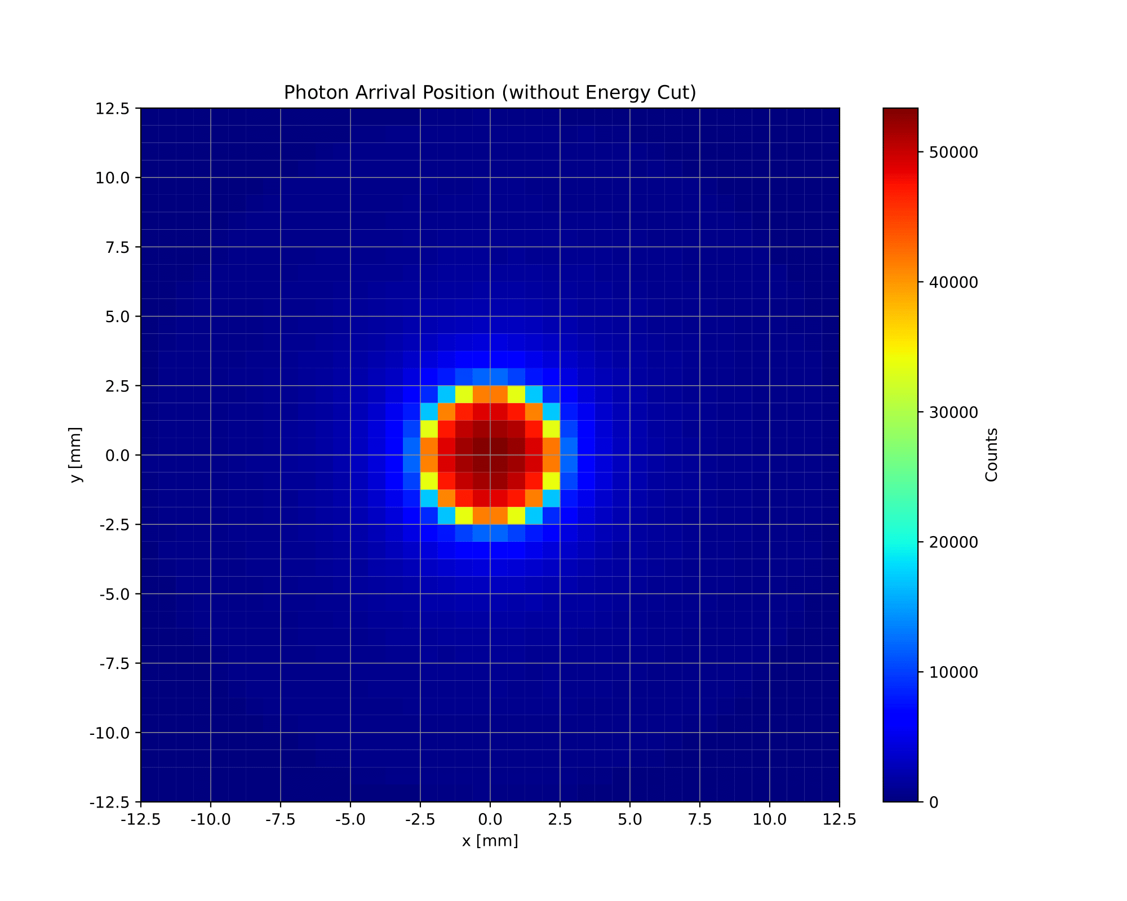
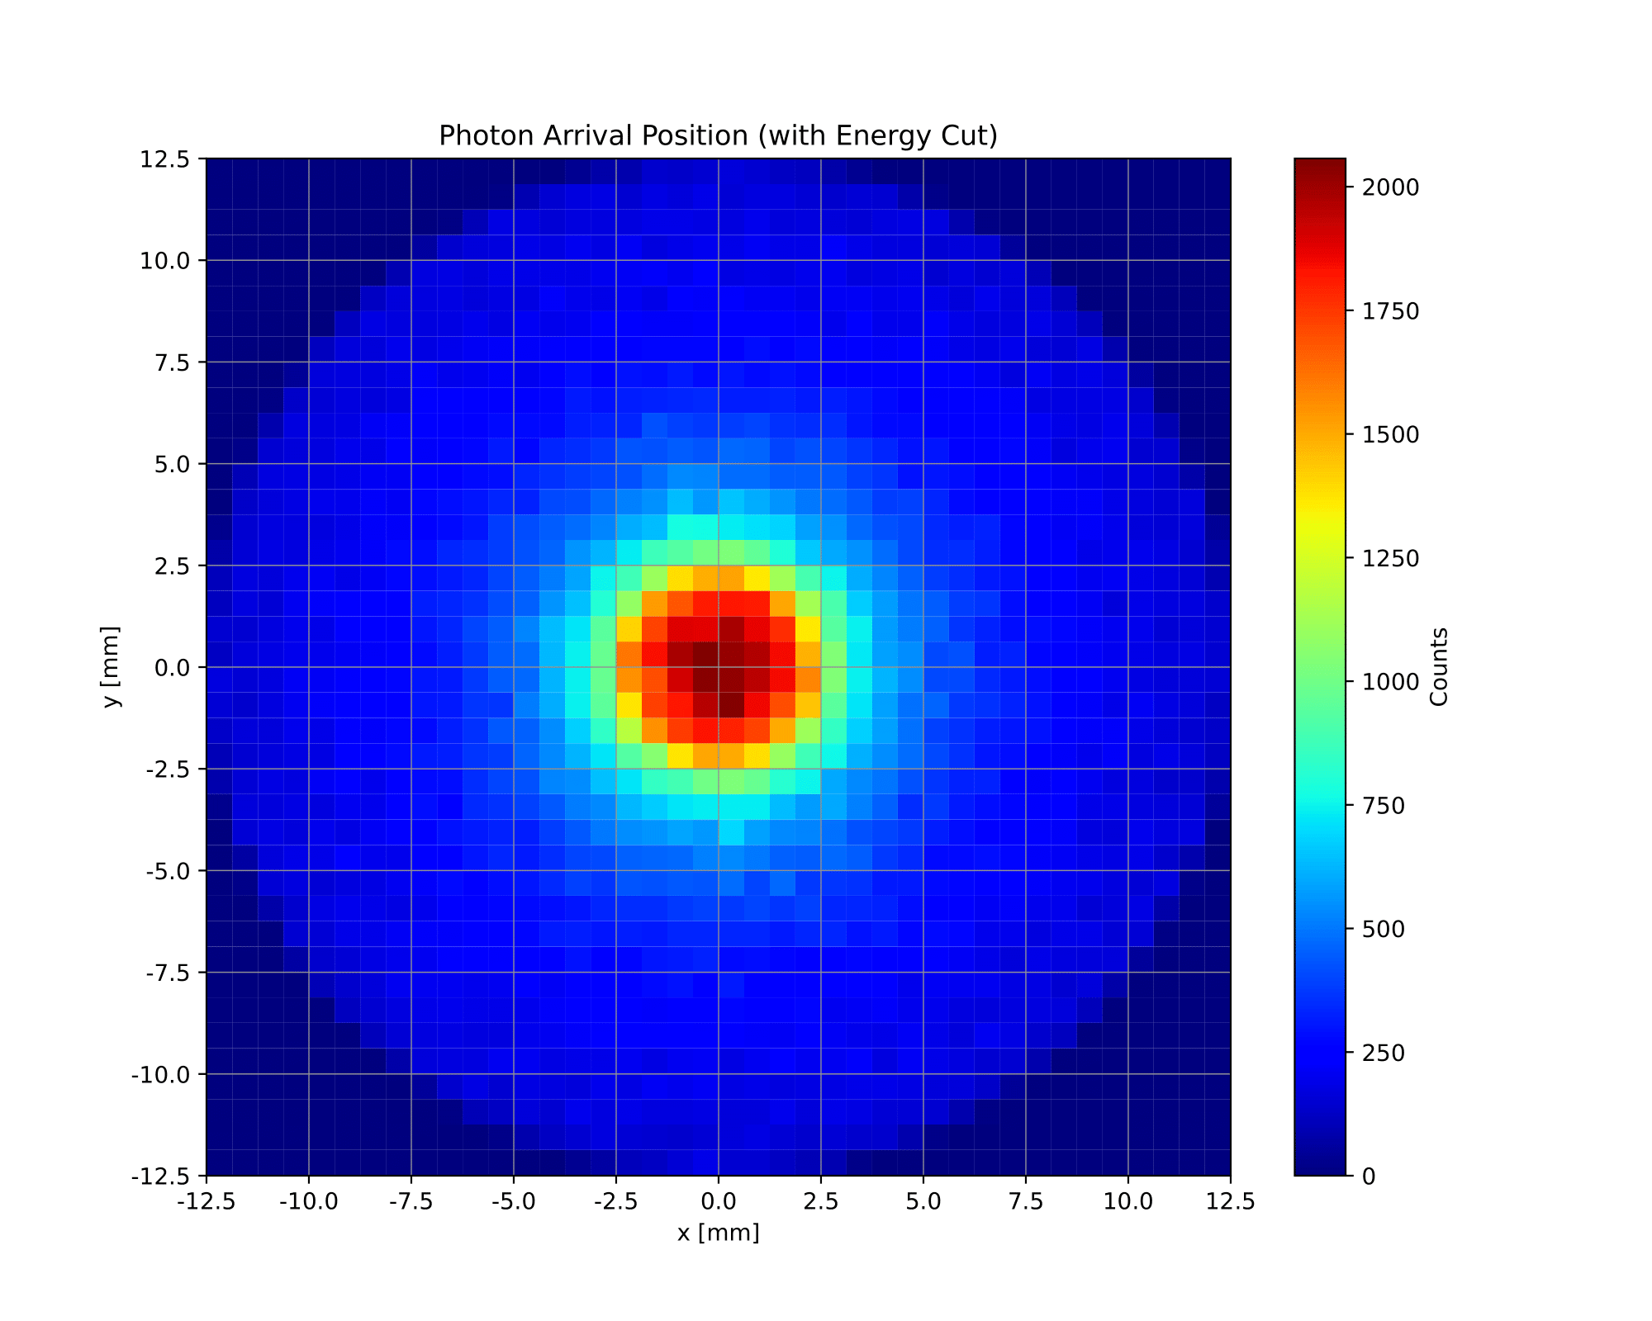
Photon X and Y Position
Luke Saunders | Progress Report | April 20th, 2023 6

Slide 7
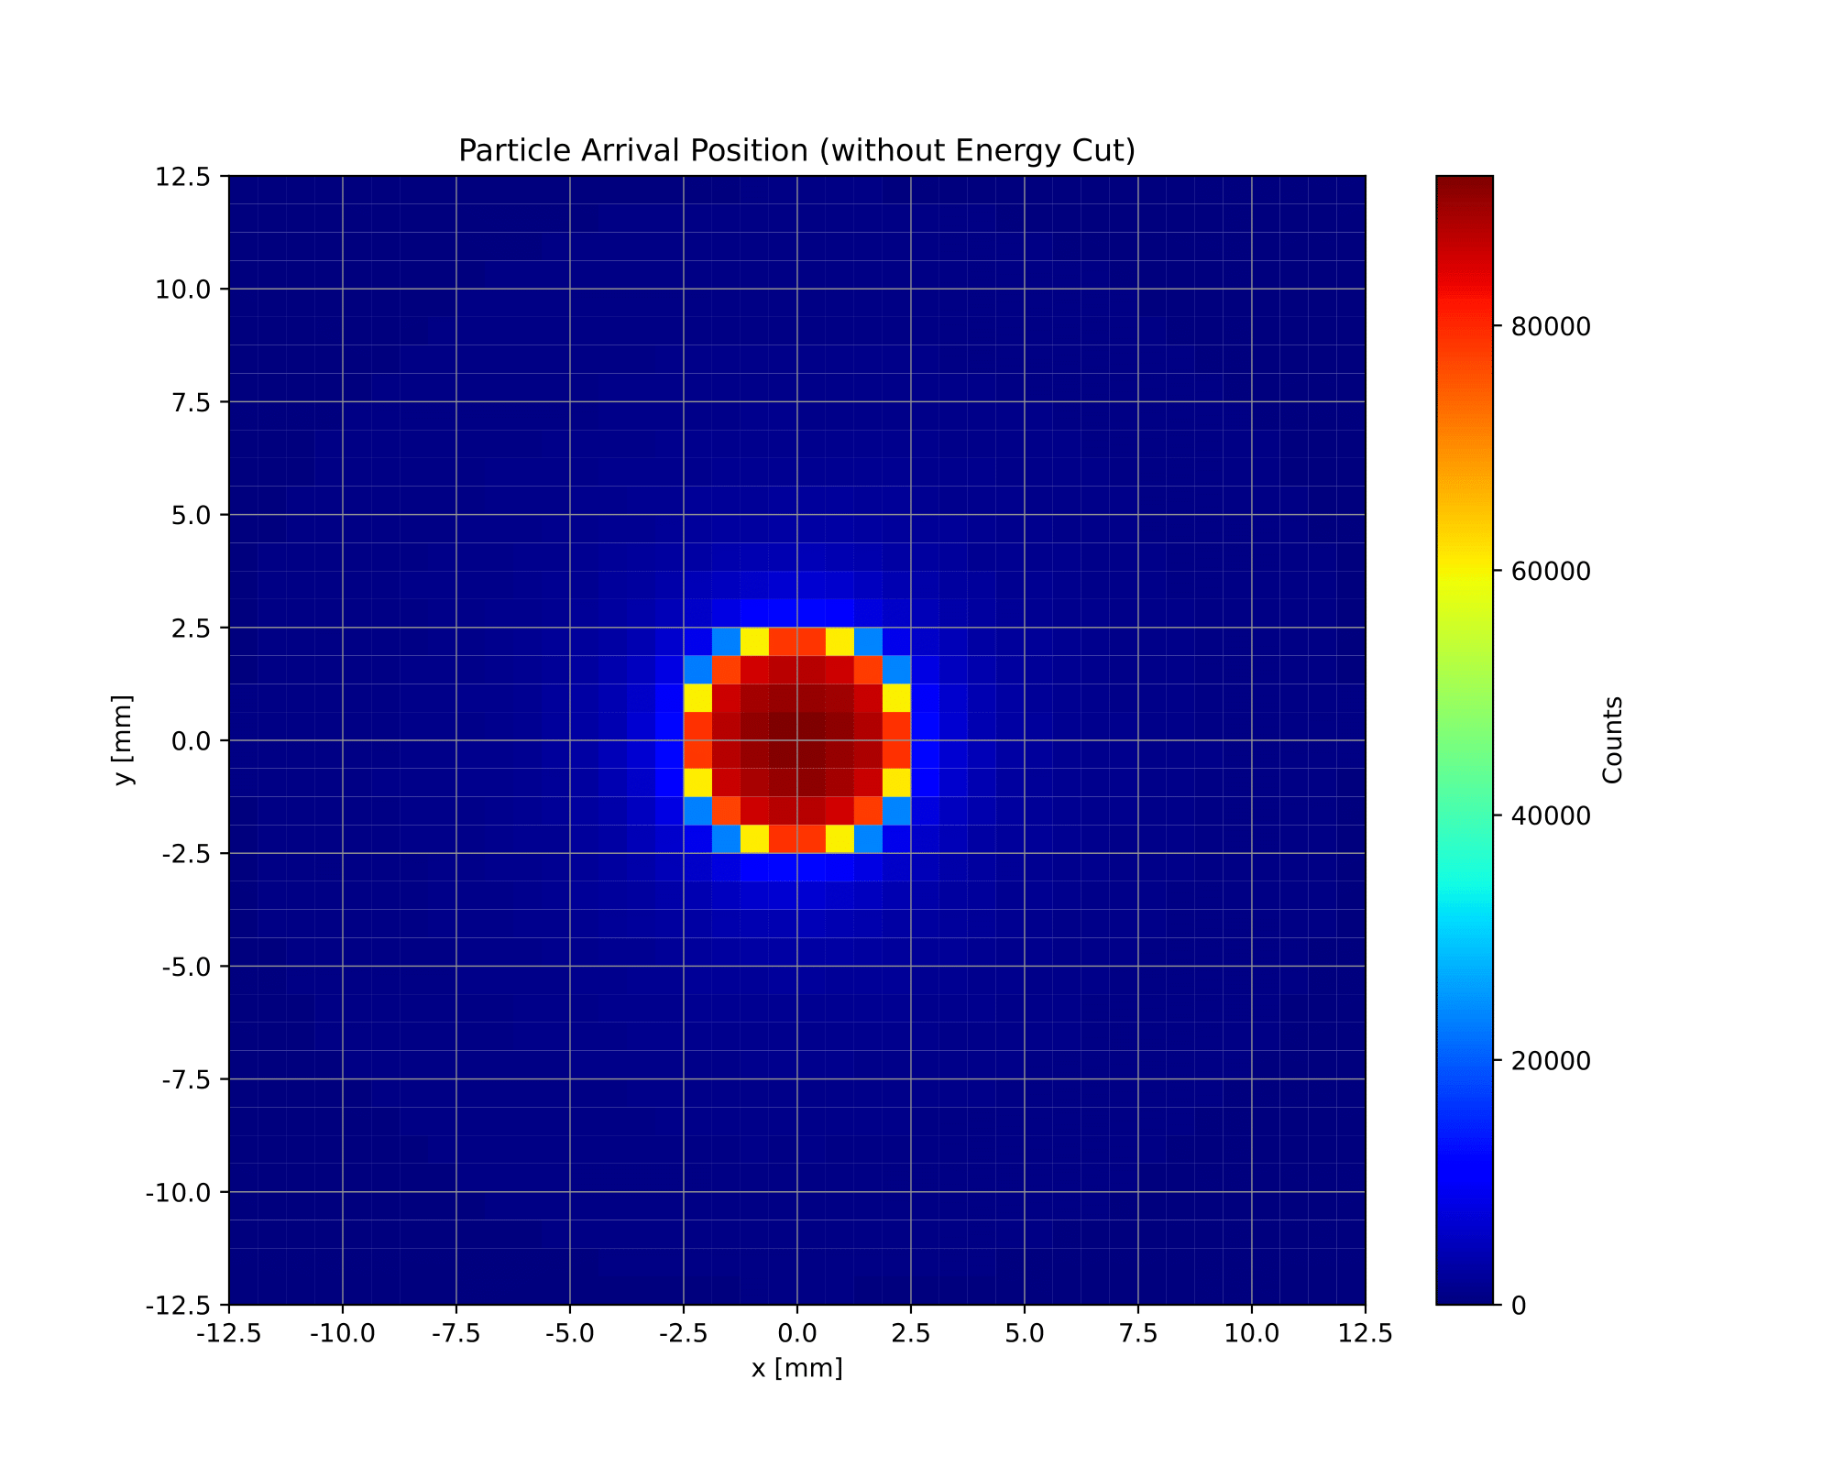

Combined X and Y Position
Luke Saunders | Progress Report | April 20th, 2023 7

Slide 8
Electron and Photon Arrival Channels
At present, the simulation code creates a 1D histogram giving information concerning the channels that photons and electrons are arriving at.
  This plot scales with any external cut applied to the simulated particles when they are generated. It is also fully generalizable to any number of channels in either collection, induction 1, and/or induction 2.
While the photons and electrons are split, there is also a graph that combines the data into one concise plot.
As one saw before, there are pre- and post-energy cut versions of each graph.
Luke Saunders | Progress Report | April 20th, 2023 8

Slide 9
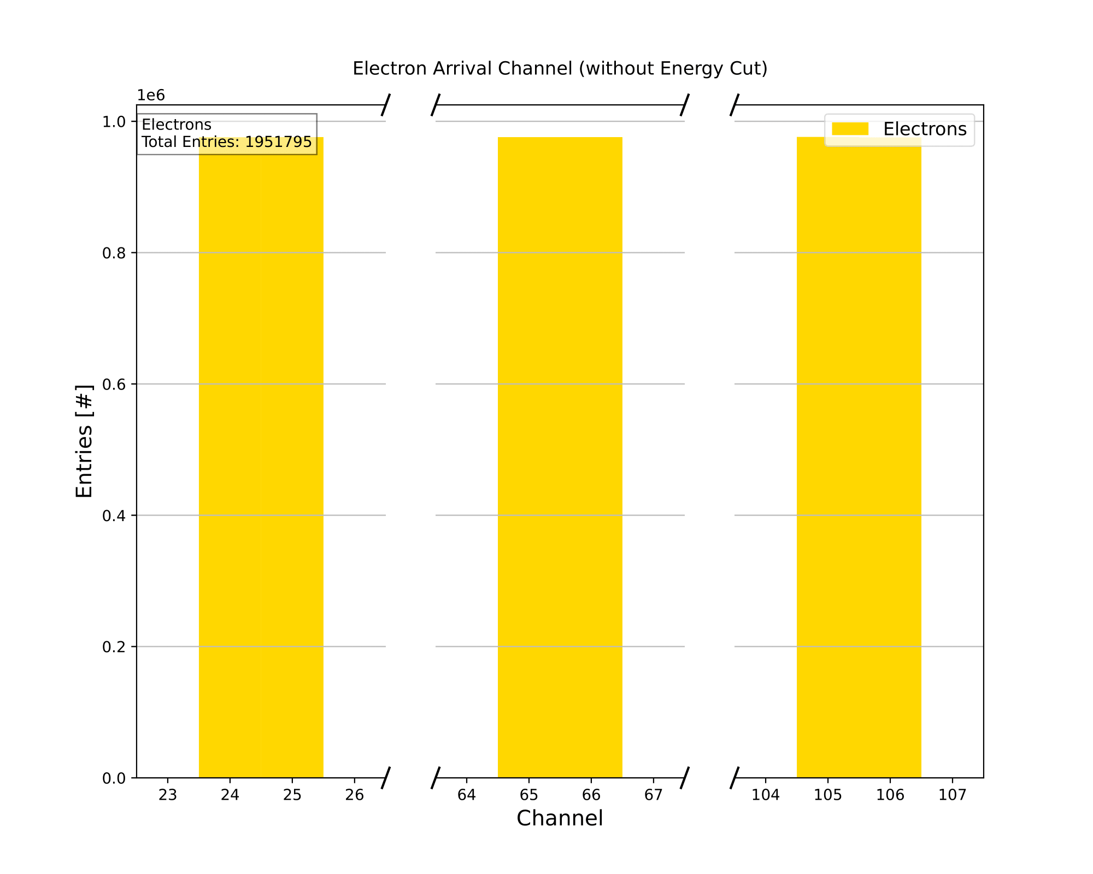
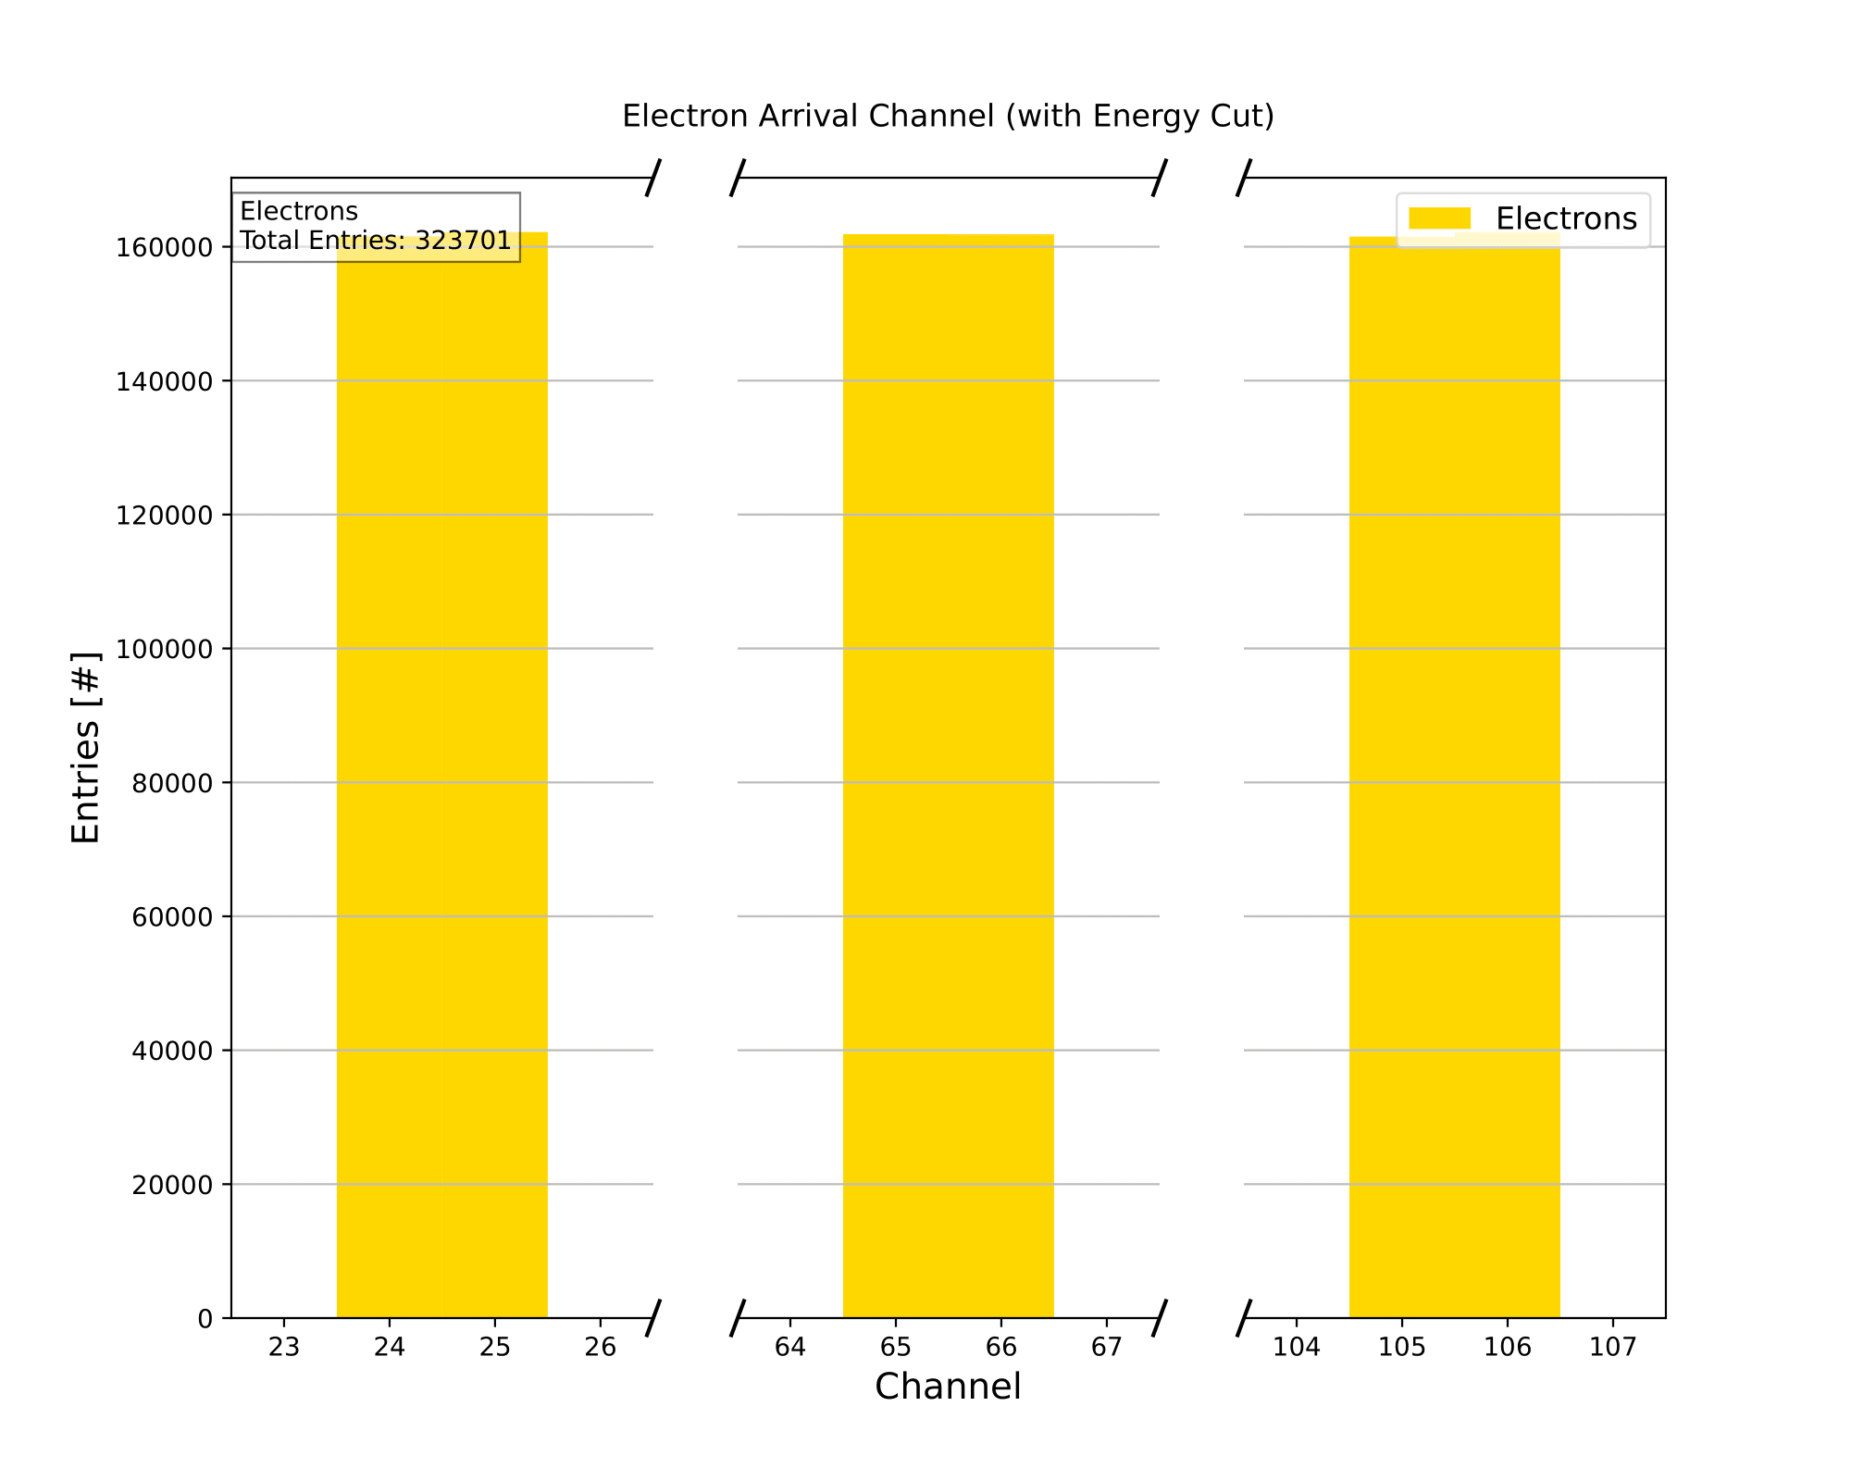
Electron Arrival Channels
Luke Saunders | Progress Report | April 20th, 2023 9

Slide 10
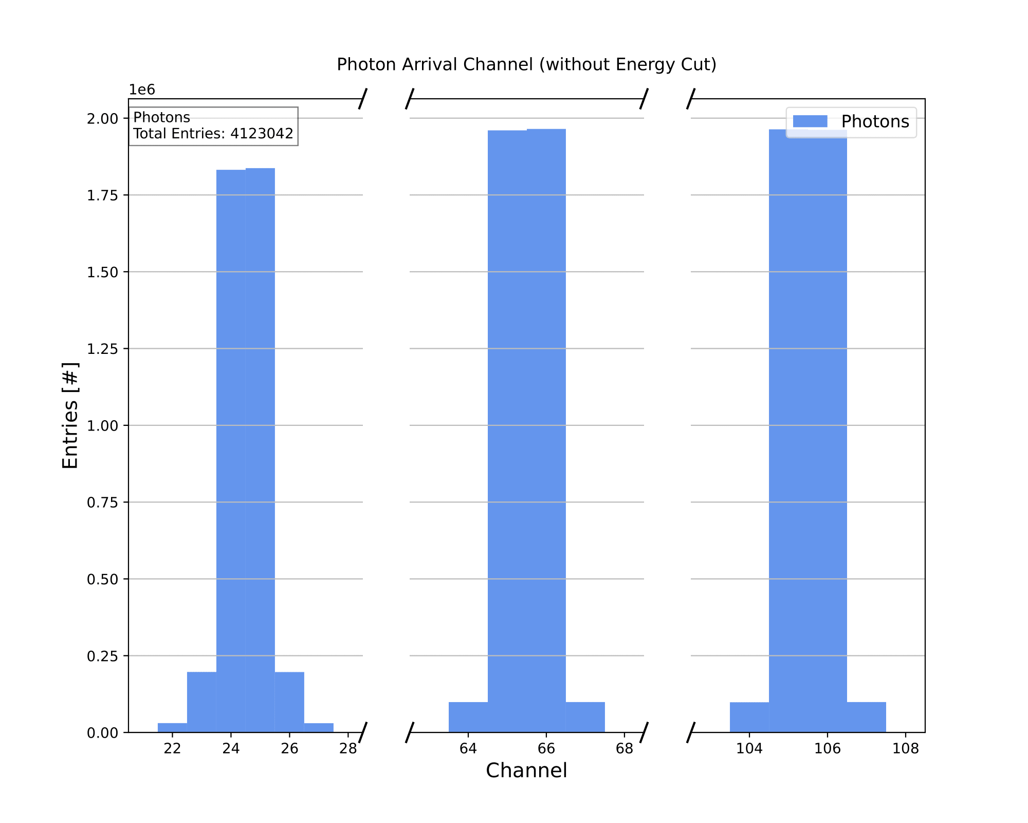
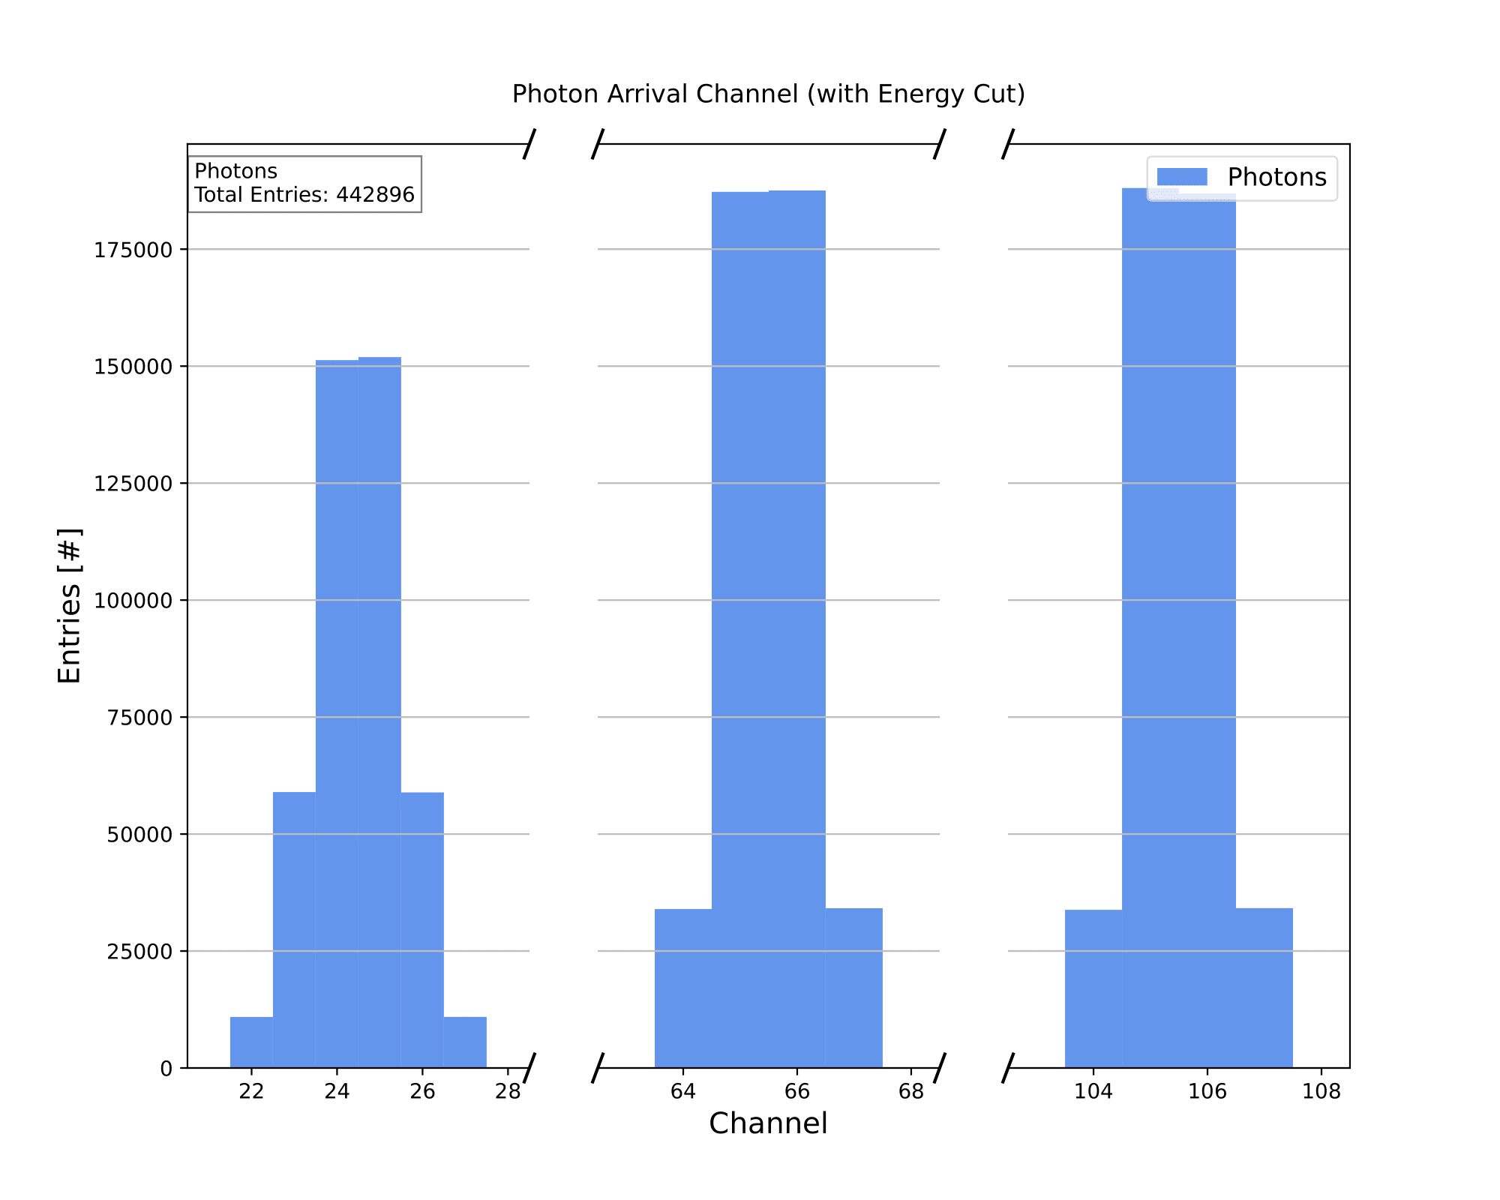
Photon Arrival Channels
Luke Saunders | Progress Report | April 20th, 2023 10

Slide 11
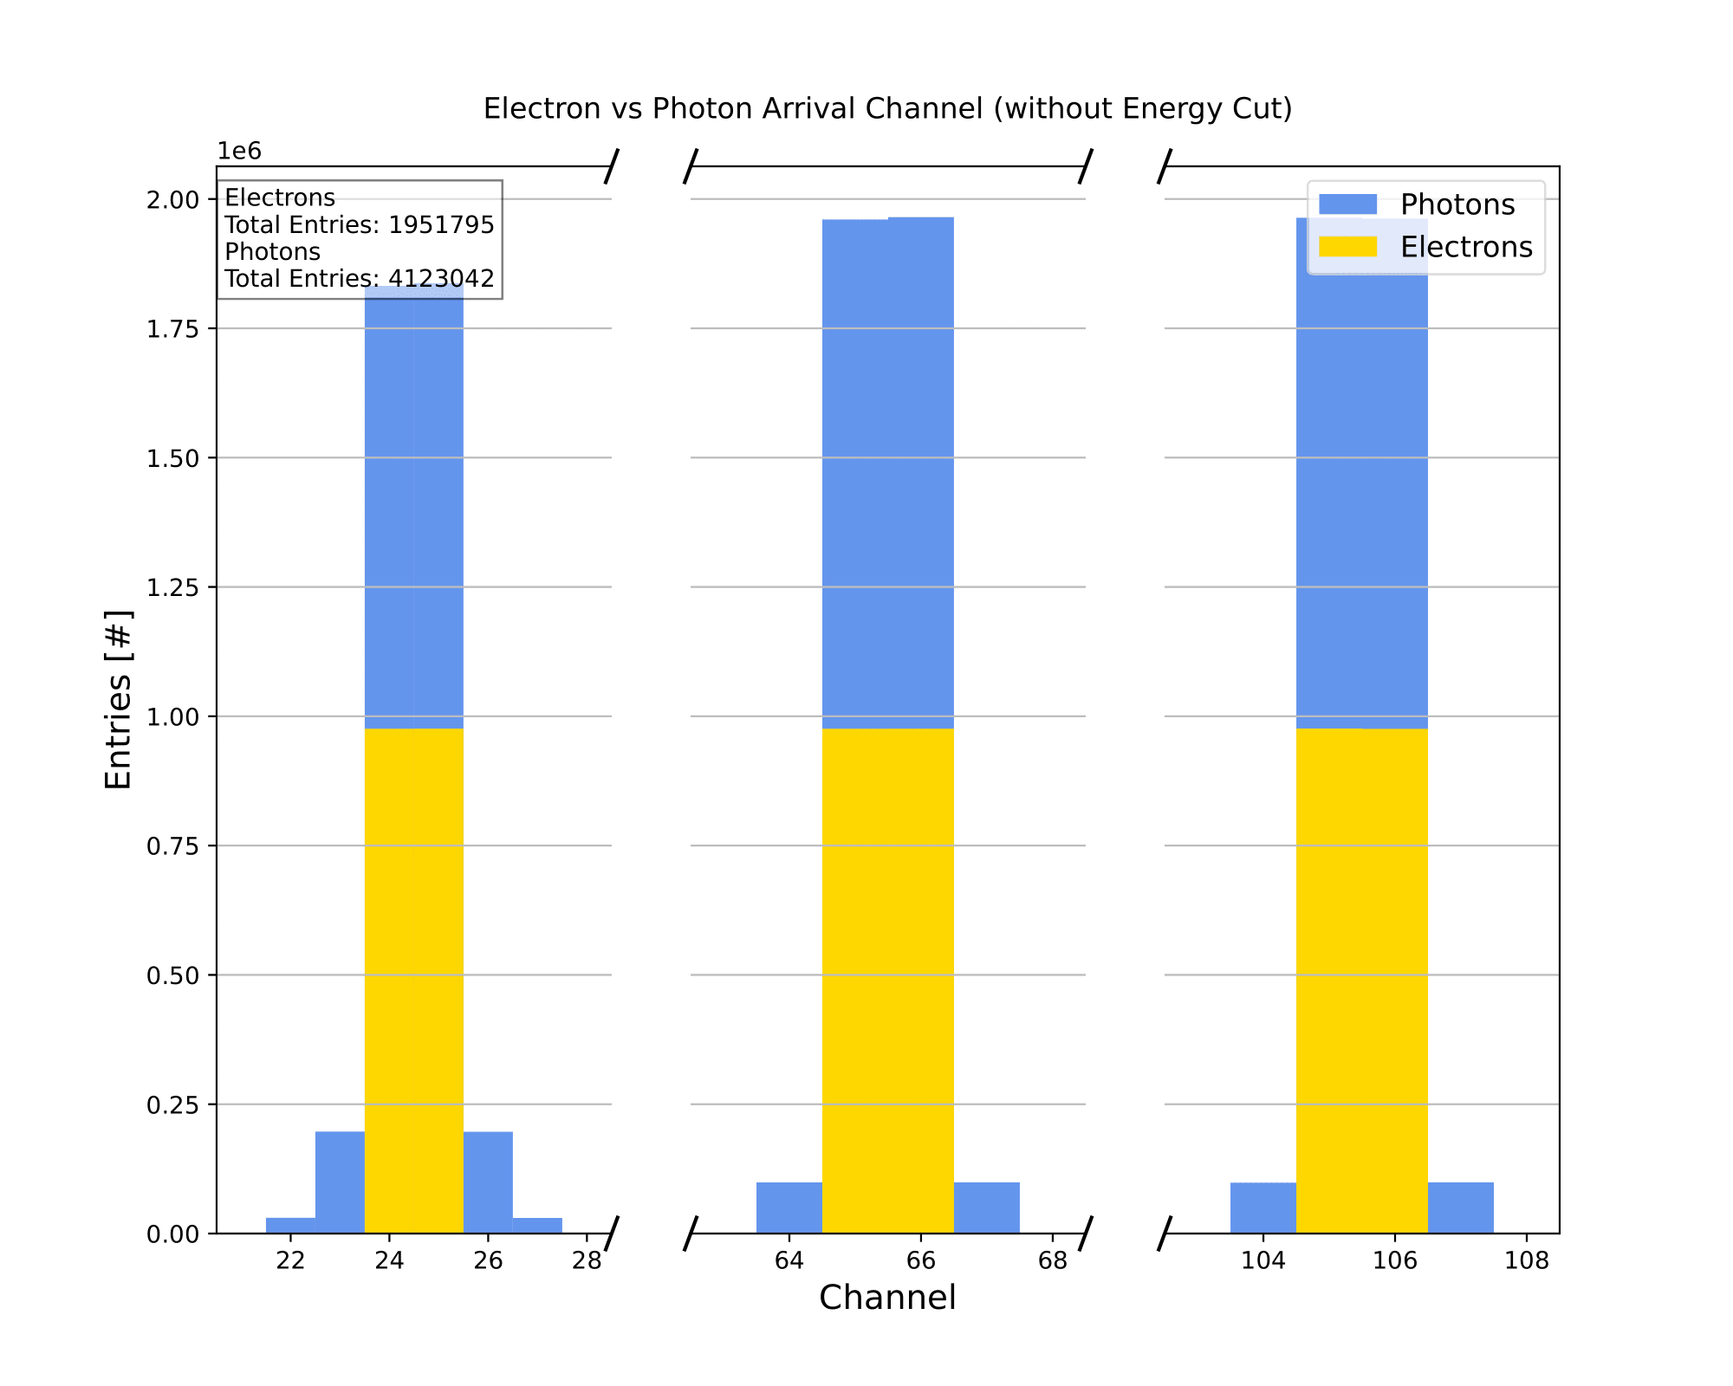
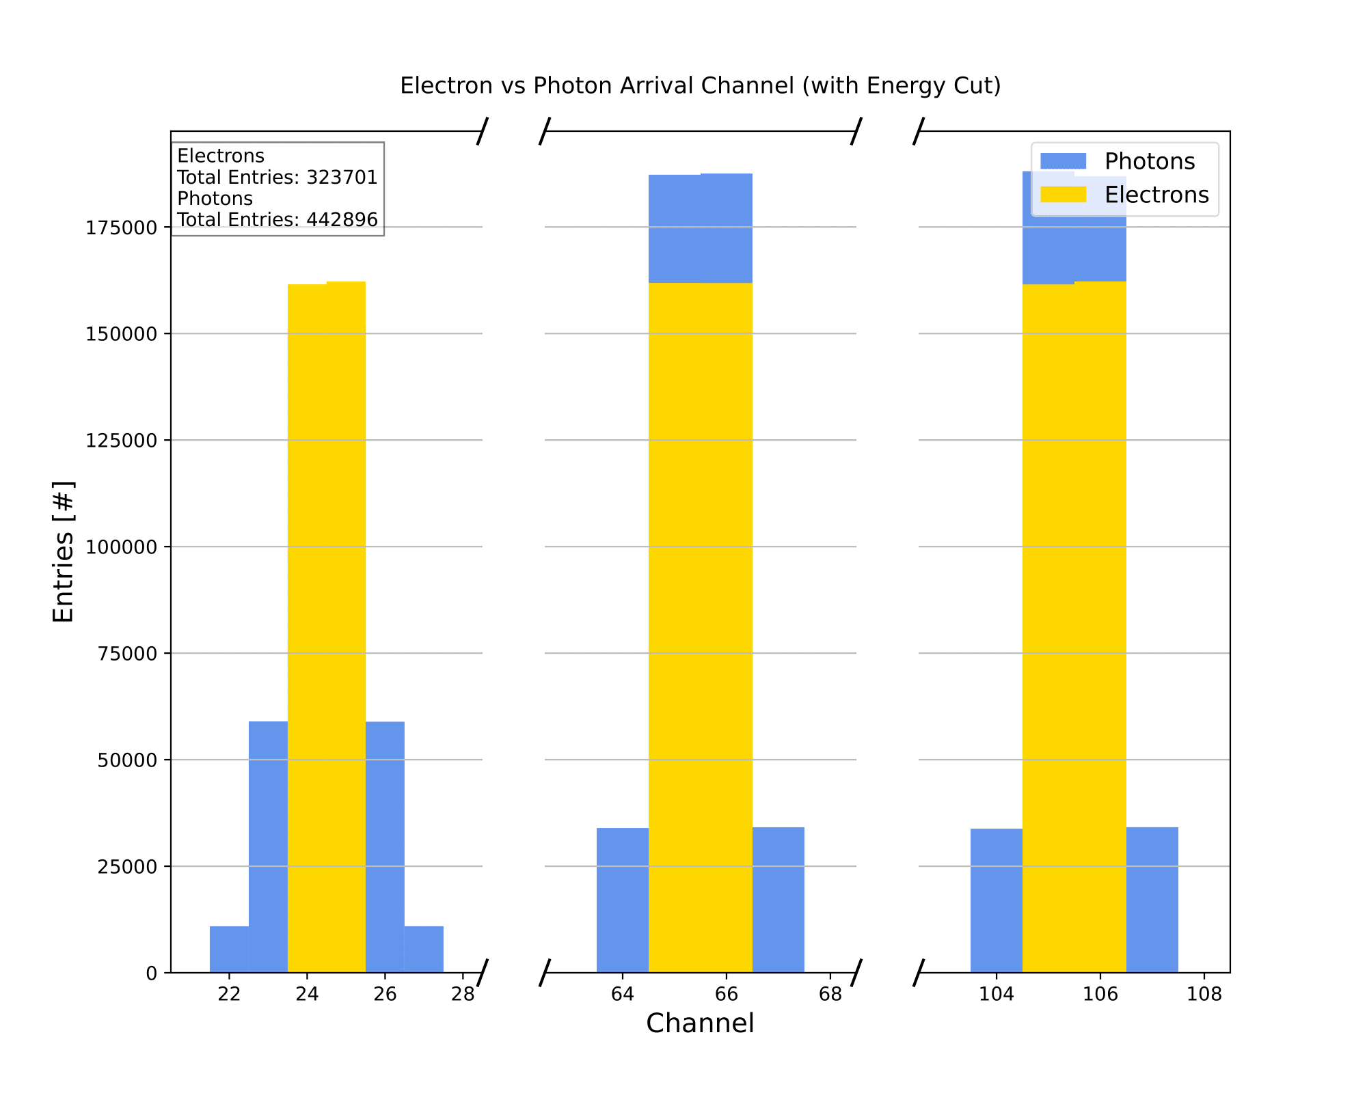
Combined Arrival Channels
Luke Saunders | Progress Report | April 20th, 2023 11

Slide 12
Electron and Photon Energy Analysis
The simulation code is currently able to analyze the energy spectrum of each collection channel pre- and post-energy cut.
  Although the pre-energy cut is unnecessary for our uses, it has been added due to it only necessitating a few additional lines of code.
As with the previous graphs, electron and photon energy spectrums are made individually for each channel; however, an additional set of plots pairs the two together.
The following analysis is generalizable to any number of collection strips with the only necessary change resulting from any modifications made to the imposed geometric cut in the initial simulation code.
Luke Saunders | Progress Report | April 20th, 2023 12

Slide 13
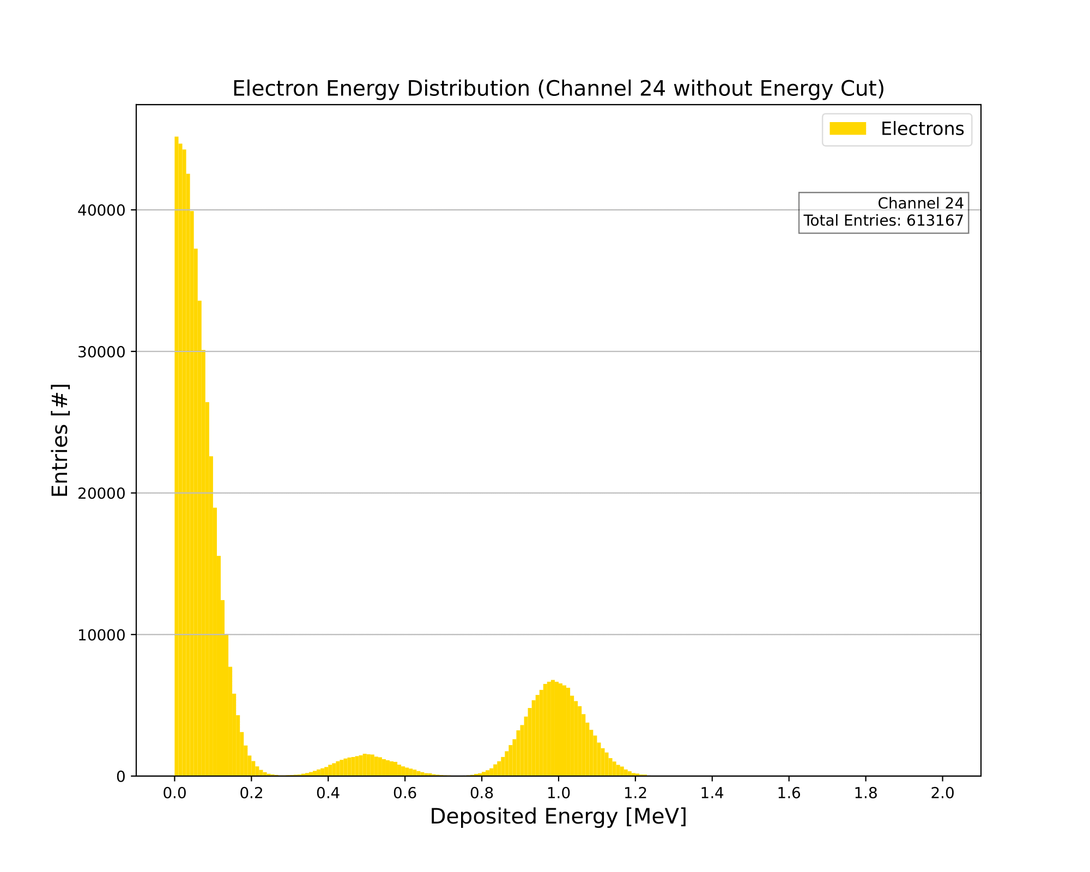
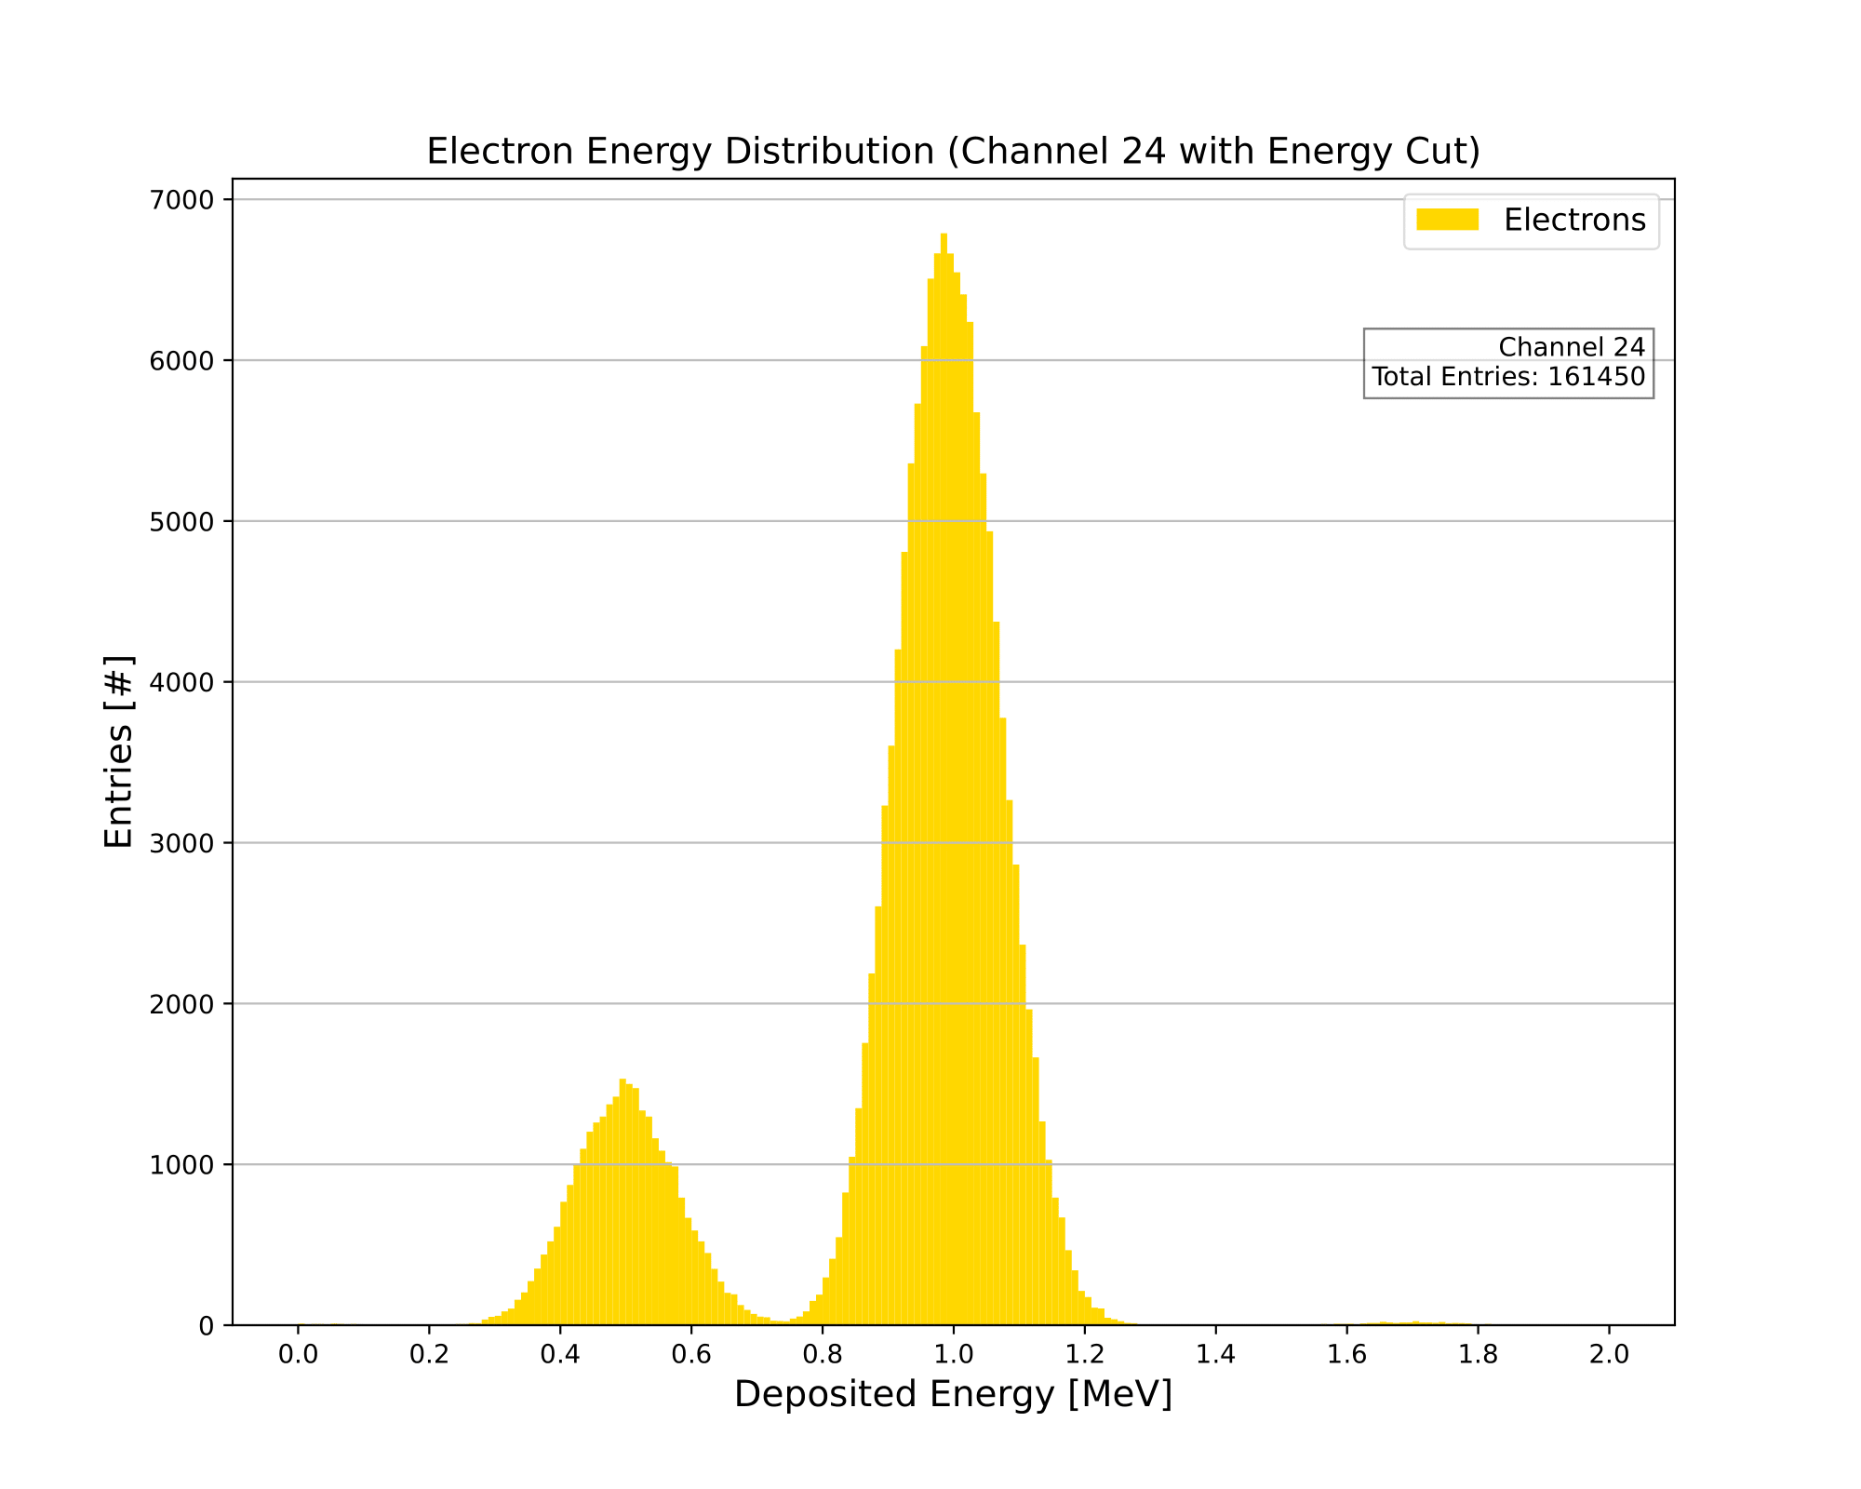
Electron Energy Distribution (Channel 24)
Luke Saunders | Progress Report | April 20th, 2023 13

Slide 14
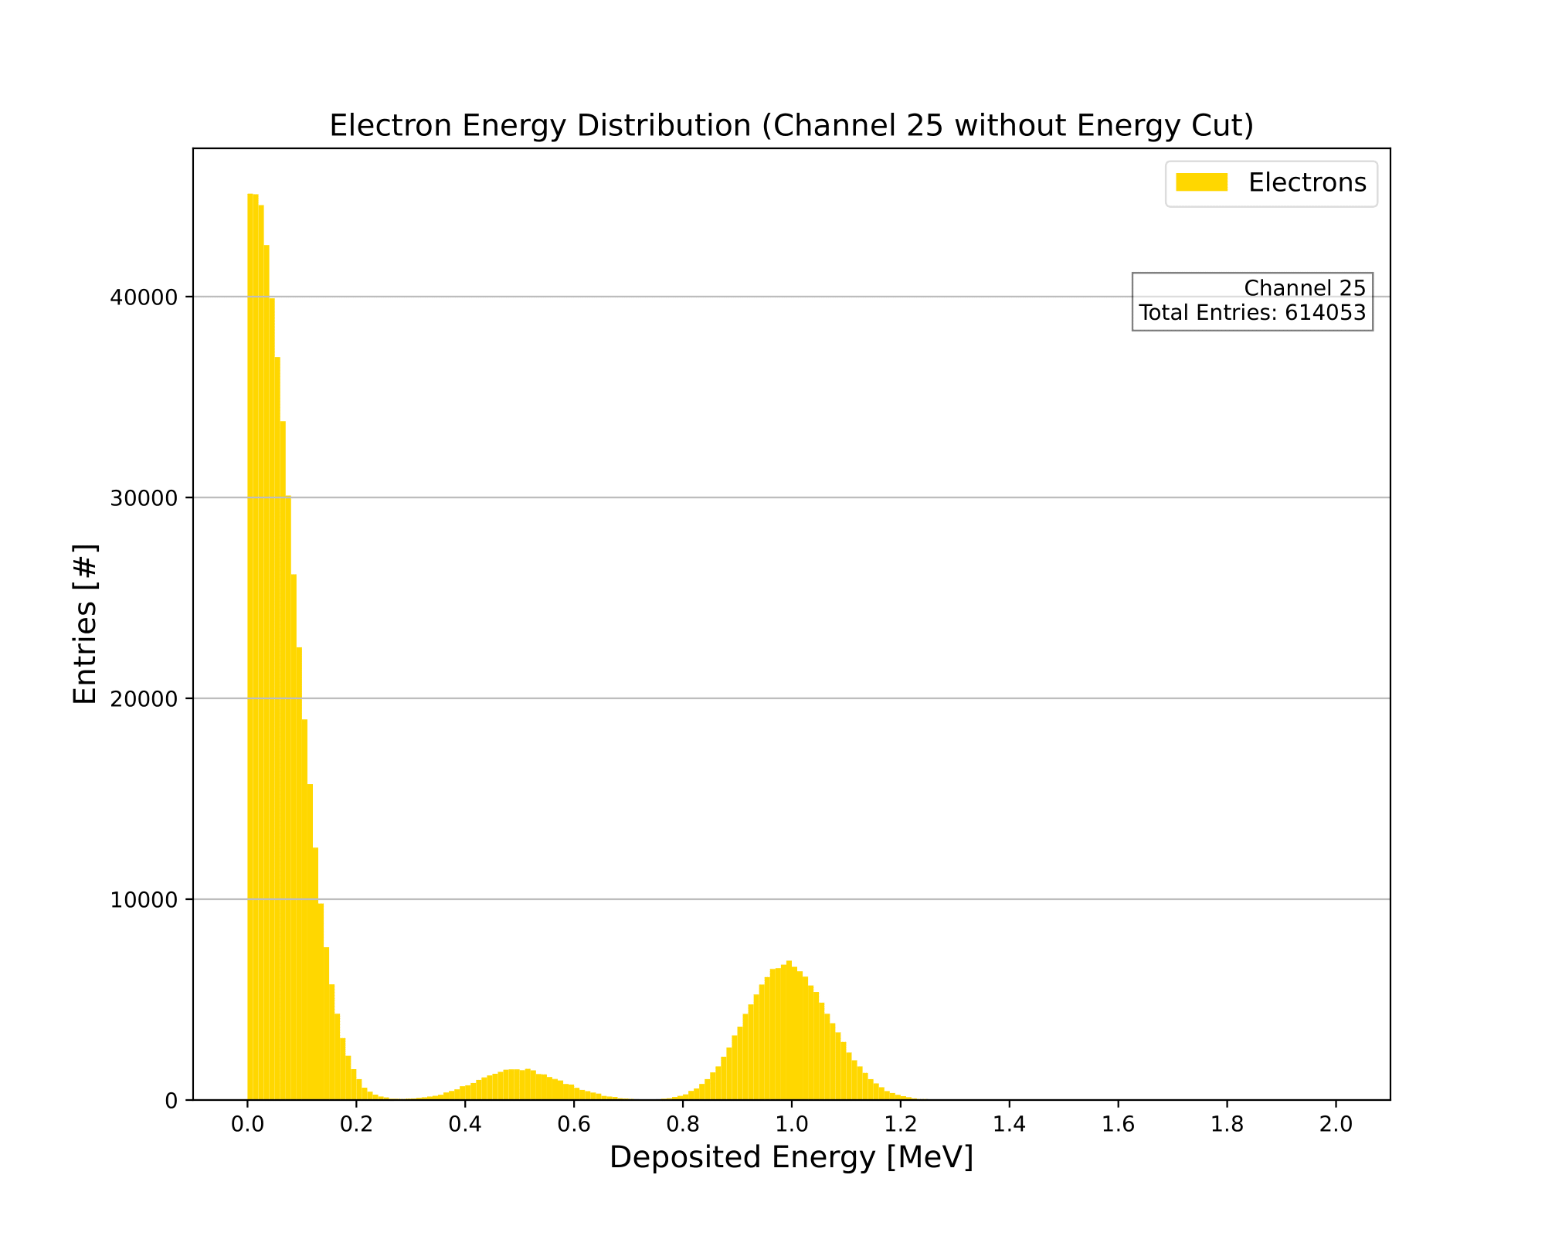

Electron Energy Distribution (Channel 25)
Luke Saunders | Progress Report | April 20th, 2023 14

Slide 15
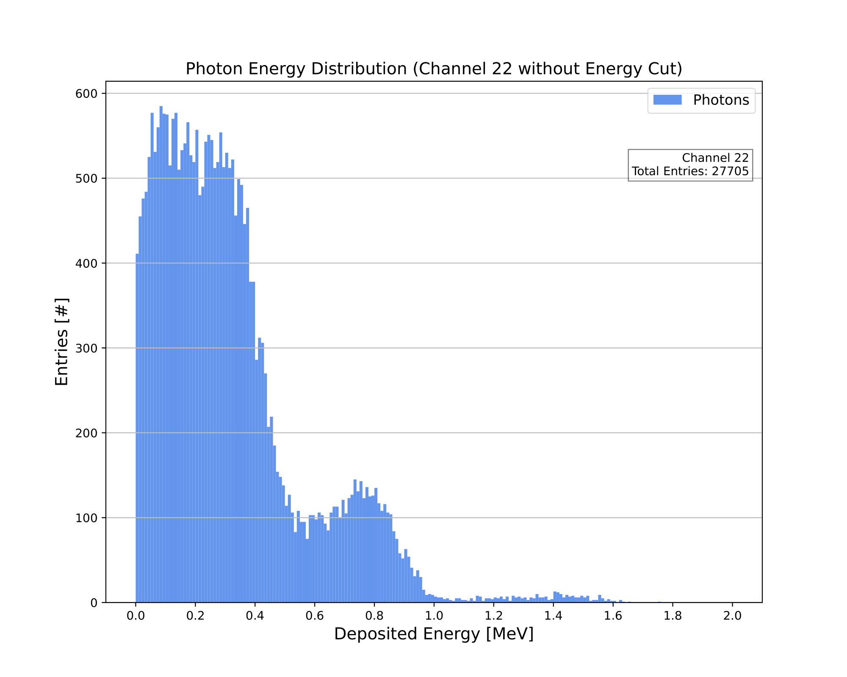
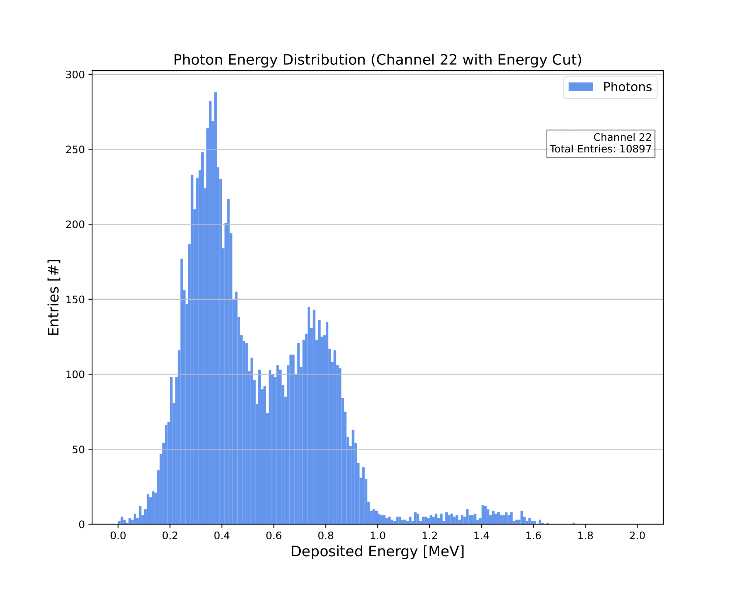
Photon Energy Distribution (Channel 22)
Luke Saunders | Progress Report | April 20th, 2023 15

Slide 16
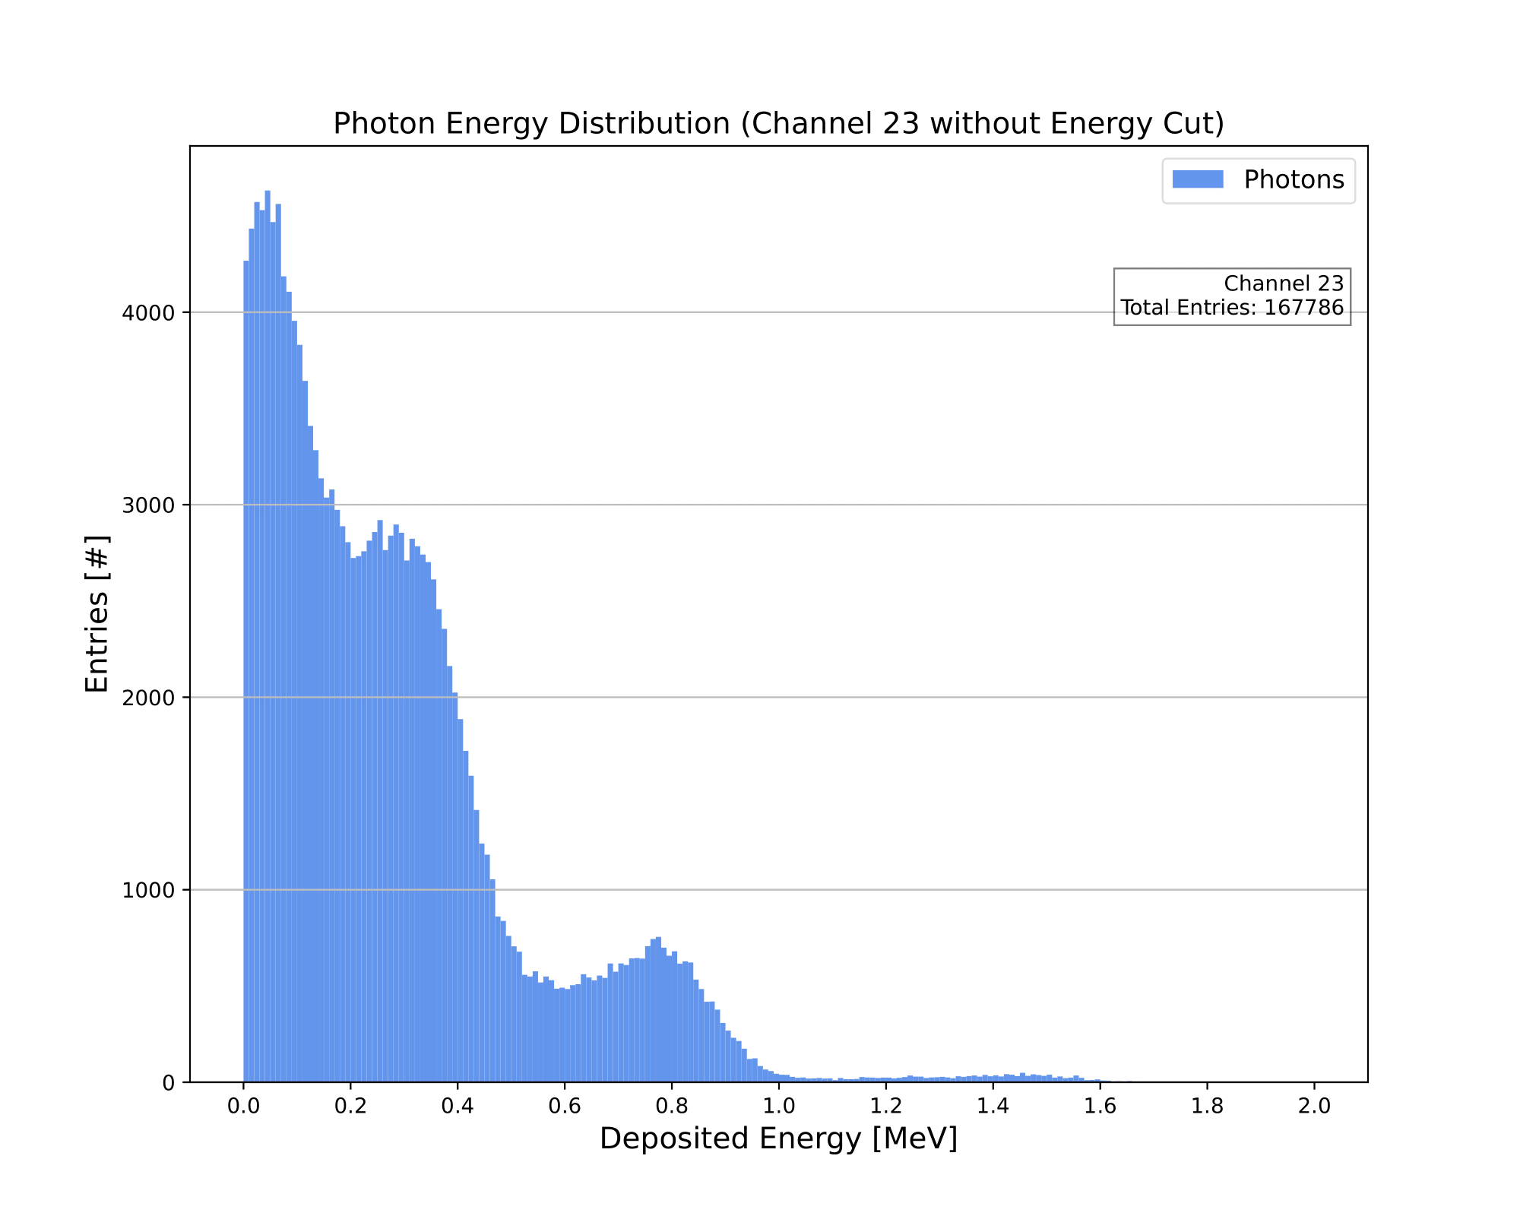
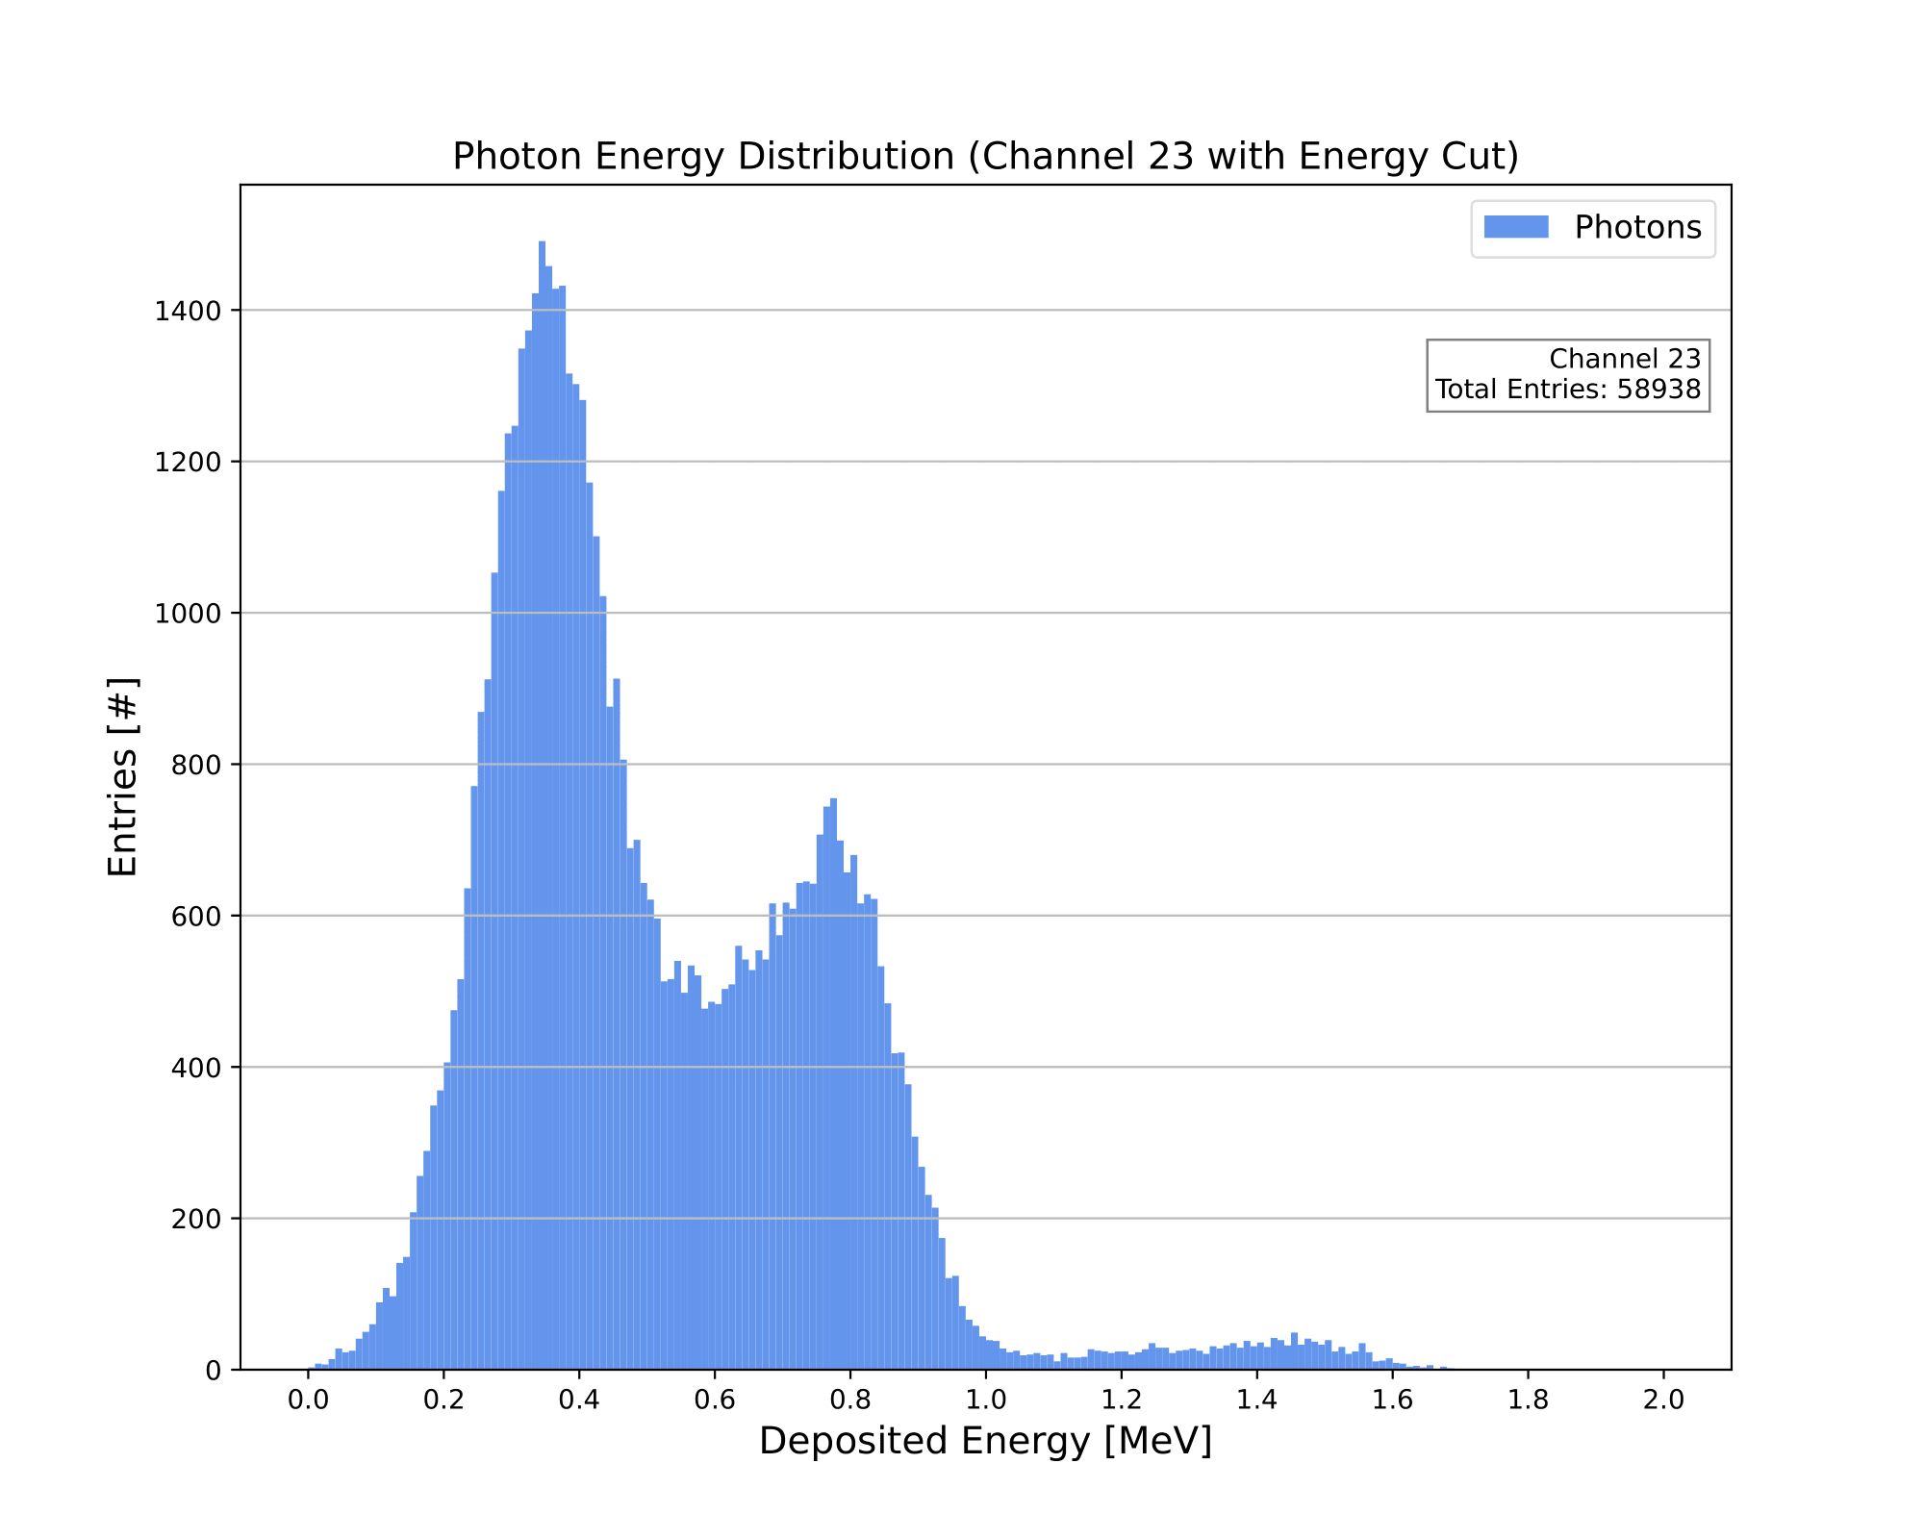
Photon Energy Distribution (Channel 23)
Luke Saunders | Progress Report | April 20th, 2023 16

Slide 17
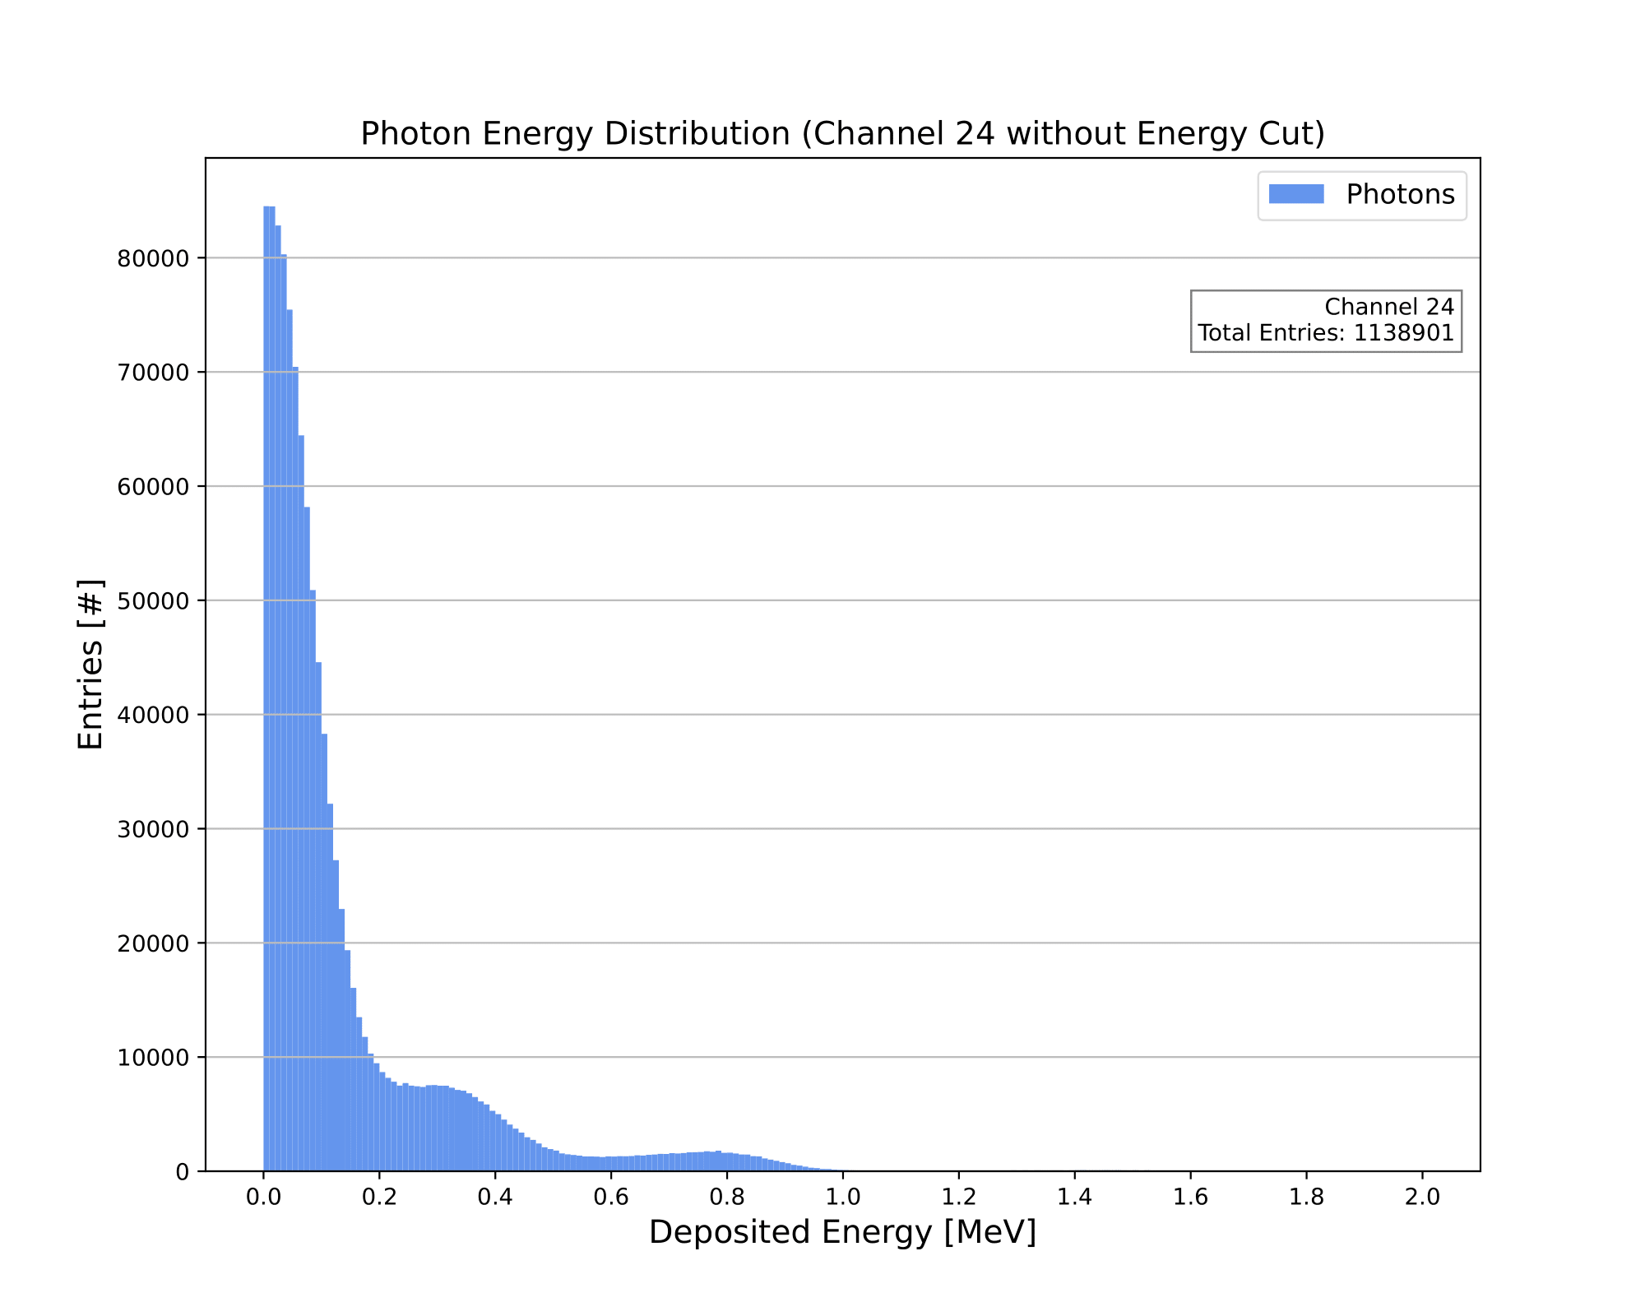
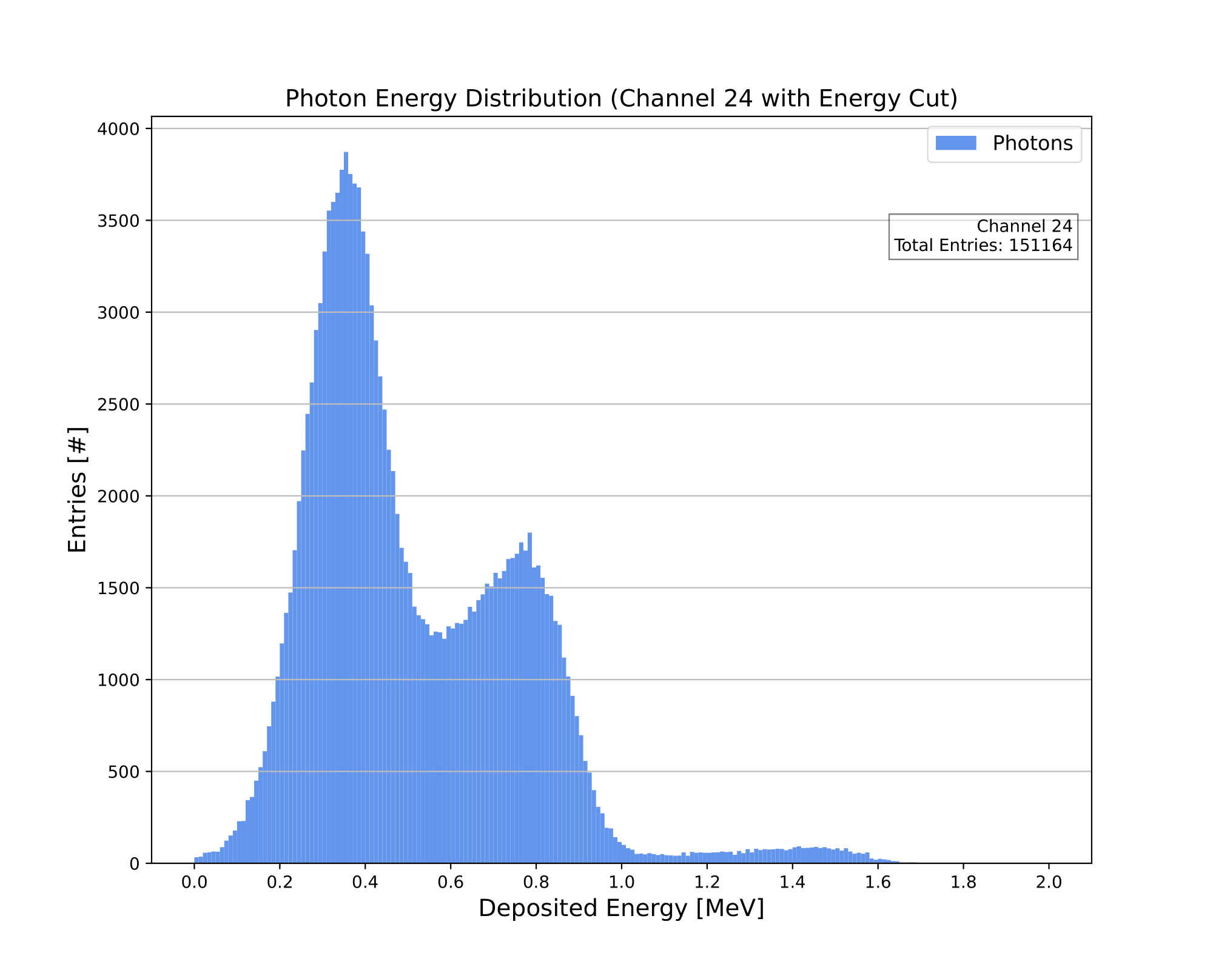
Photon Energy Distribution (Channel 24)
Luke Saunders | Progress Report | April 20th, 2023 17

Slide 18


Photon Energy Distribution (Channel 25)
Luke Saunders | Progress Report | April 20th, 2023 18

Slide 19


Photon Energy Distribution (Channel 26)
Luke Saunders | Progress Report | April 20th, 2023 19

Slide 20
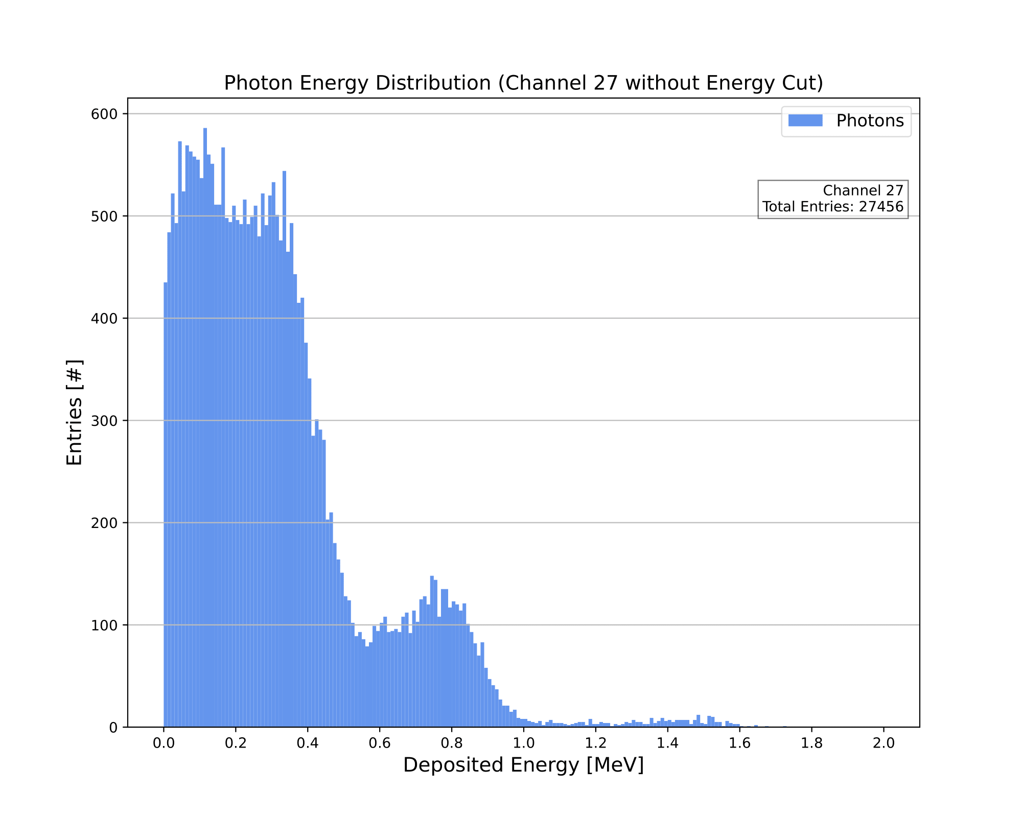

Photon Energy Distribution (Channel 27)
Luke Saunders | Progress Report | April 20th, 2023 20

Slide 21
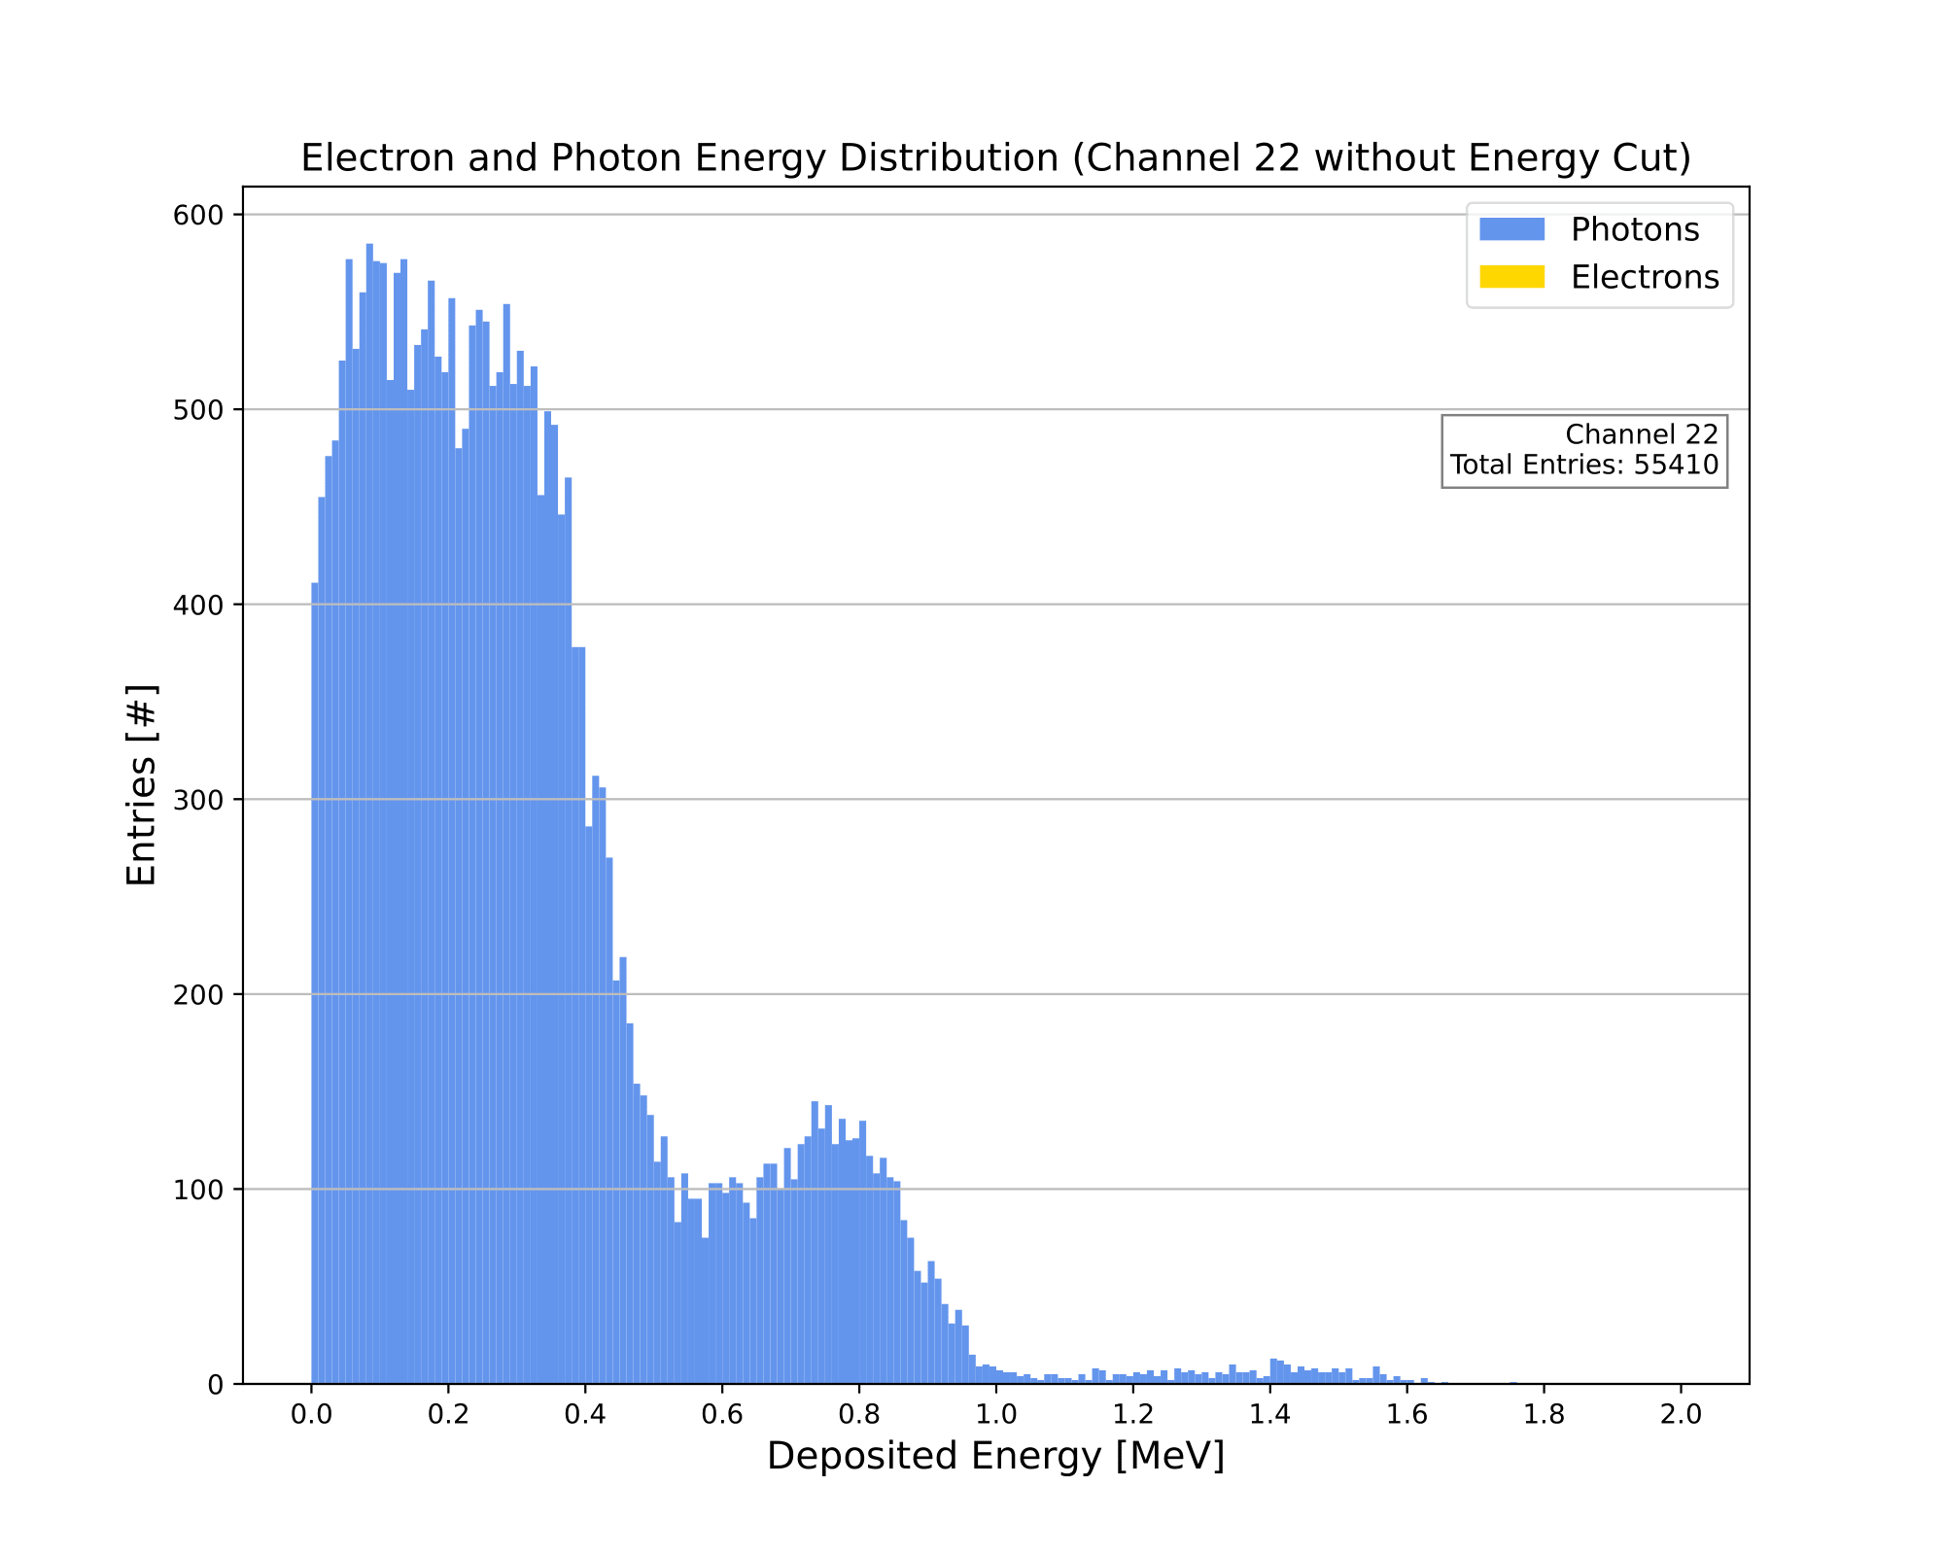

Combined Energy Distribution (Channel 22)
Luke Saunders | Progress Report | April 20th, 2023 21

Slide 22

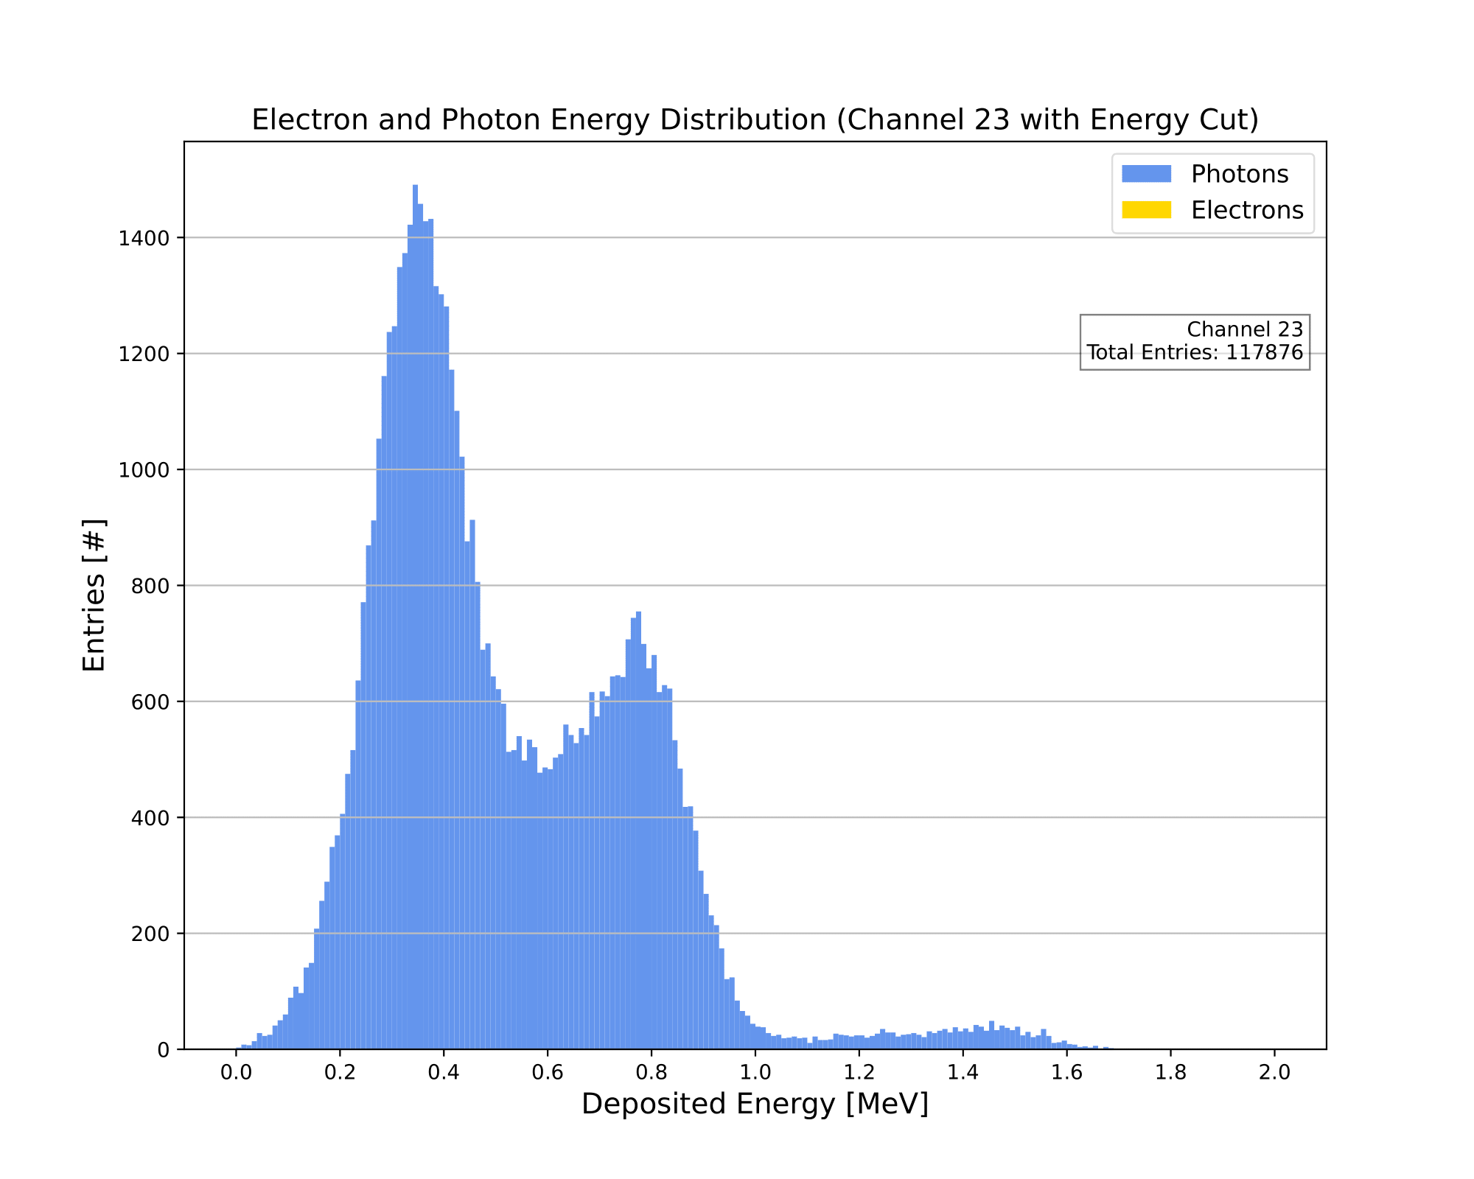
Combined Energy Distribution (Channel 23)
Luke Saunders | Progress Report | April 20th, 2023 22

Slide 23
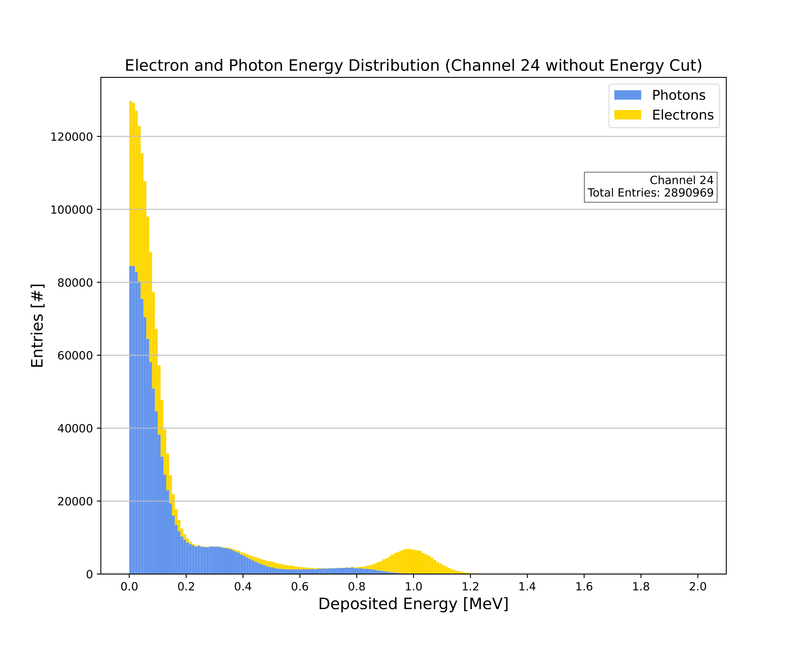
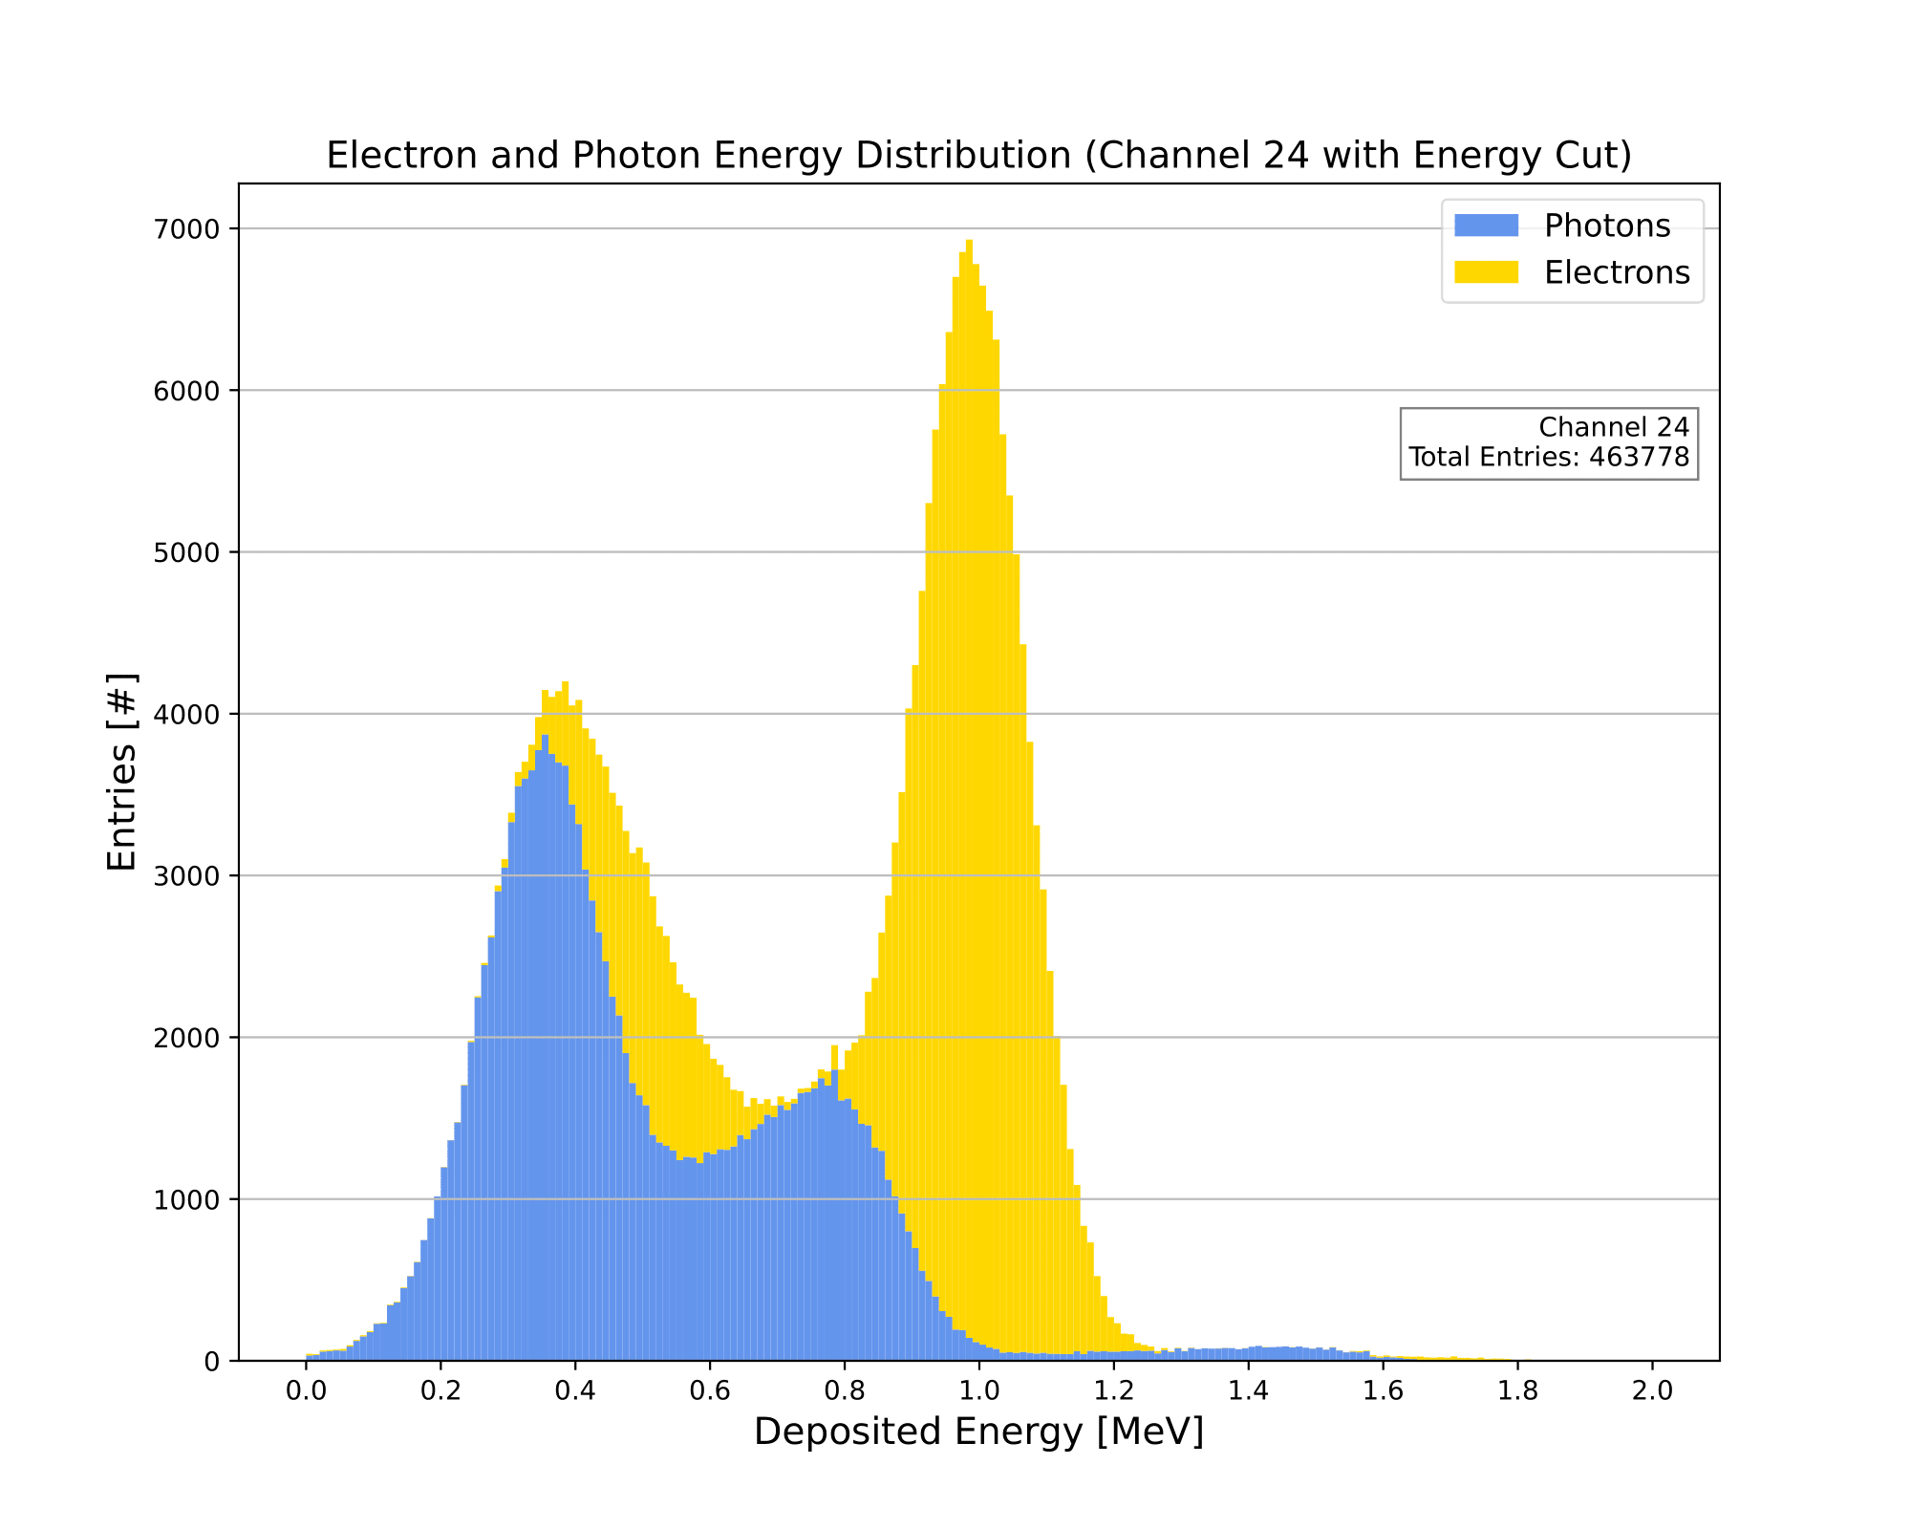
Combined Energy Distribution (Channel 24)
Luke Saunders | Progress Report | April 20th, 2023 23

Slide 24
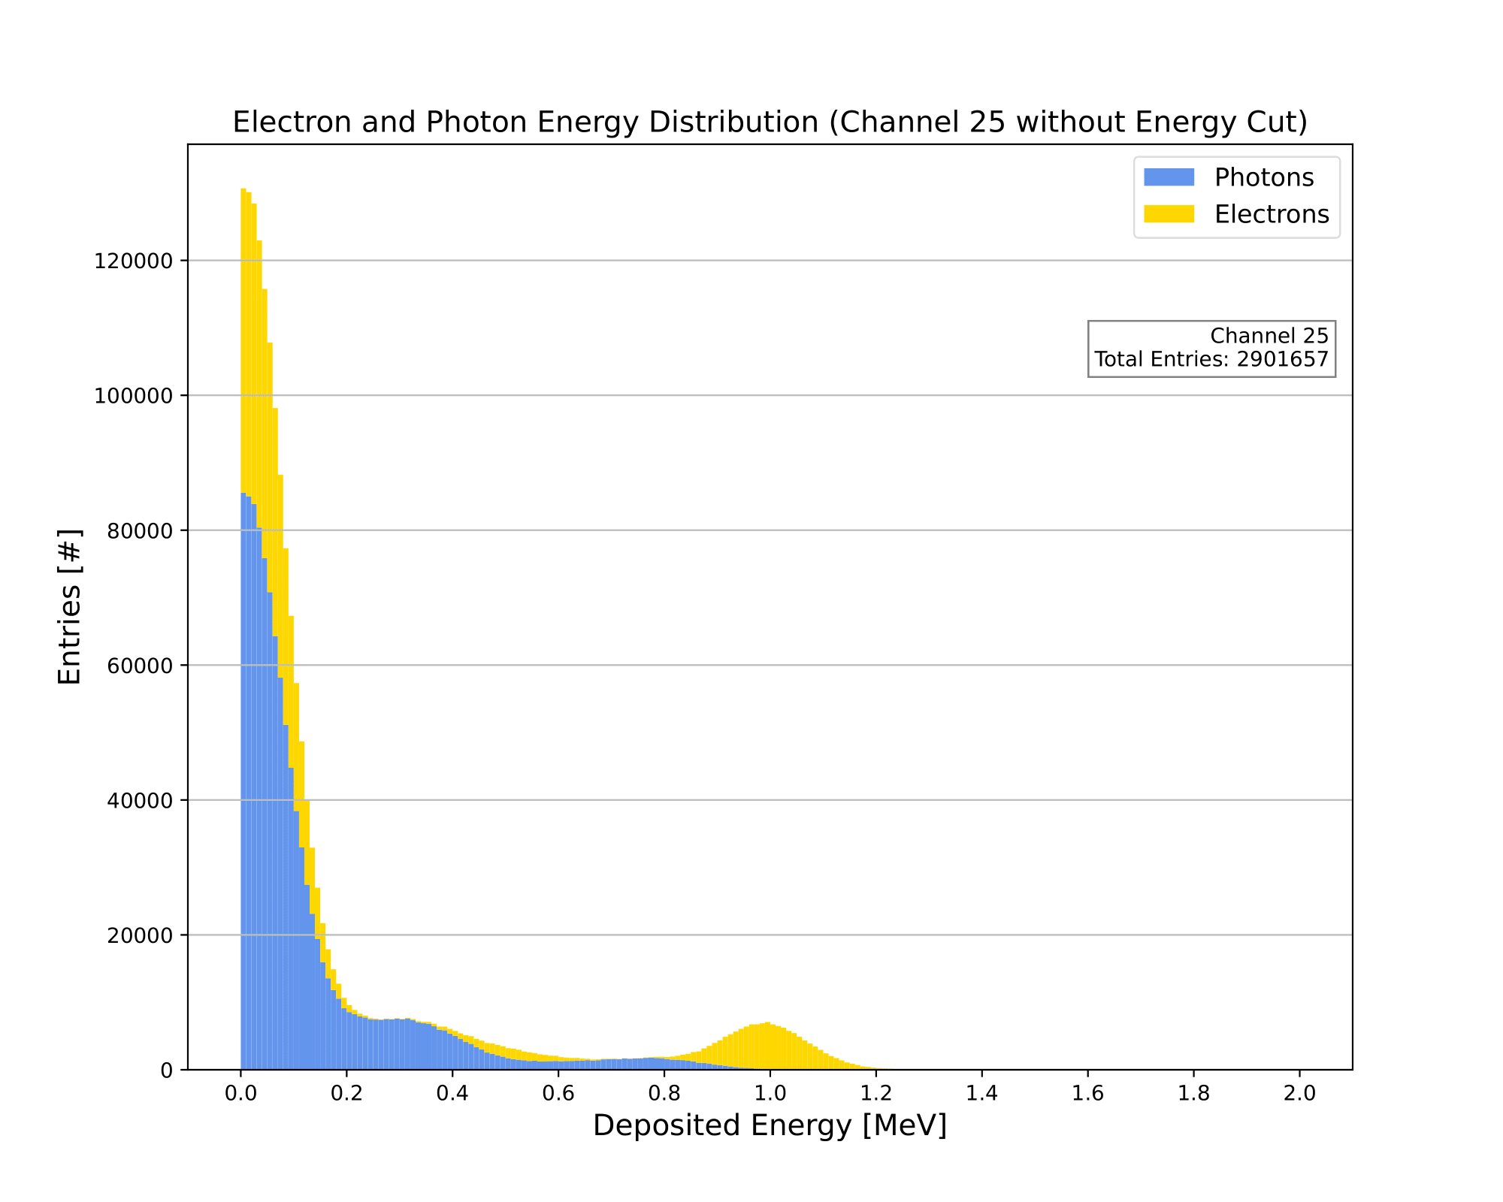
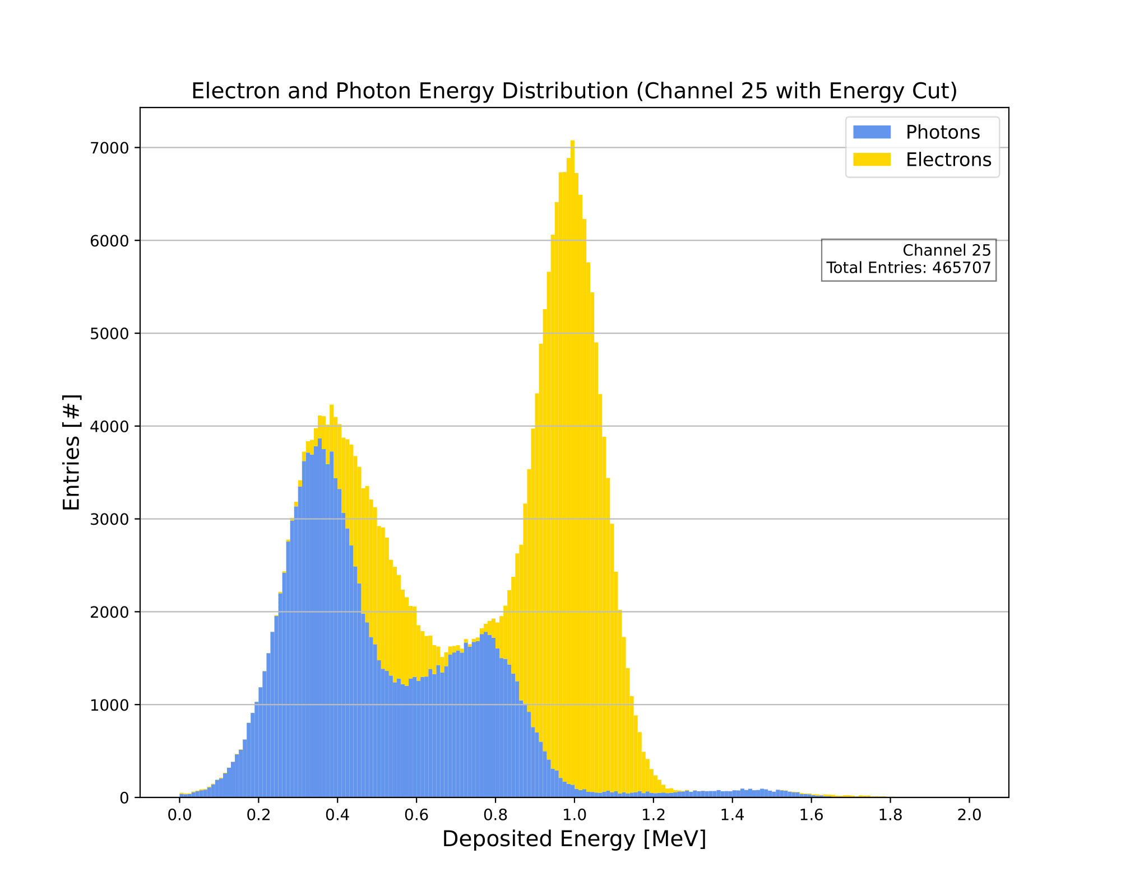
Combined Energy Distribution (Channel 25)
Luke Saunders | Progress Report | April 20th, 2023 24

Slide 25

Combined Energy Distribution (Channel 26)
Luke Saunders | Progress Report | April 20th, 2023 25

Slide 26
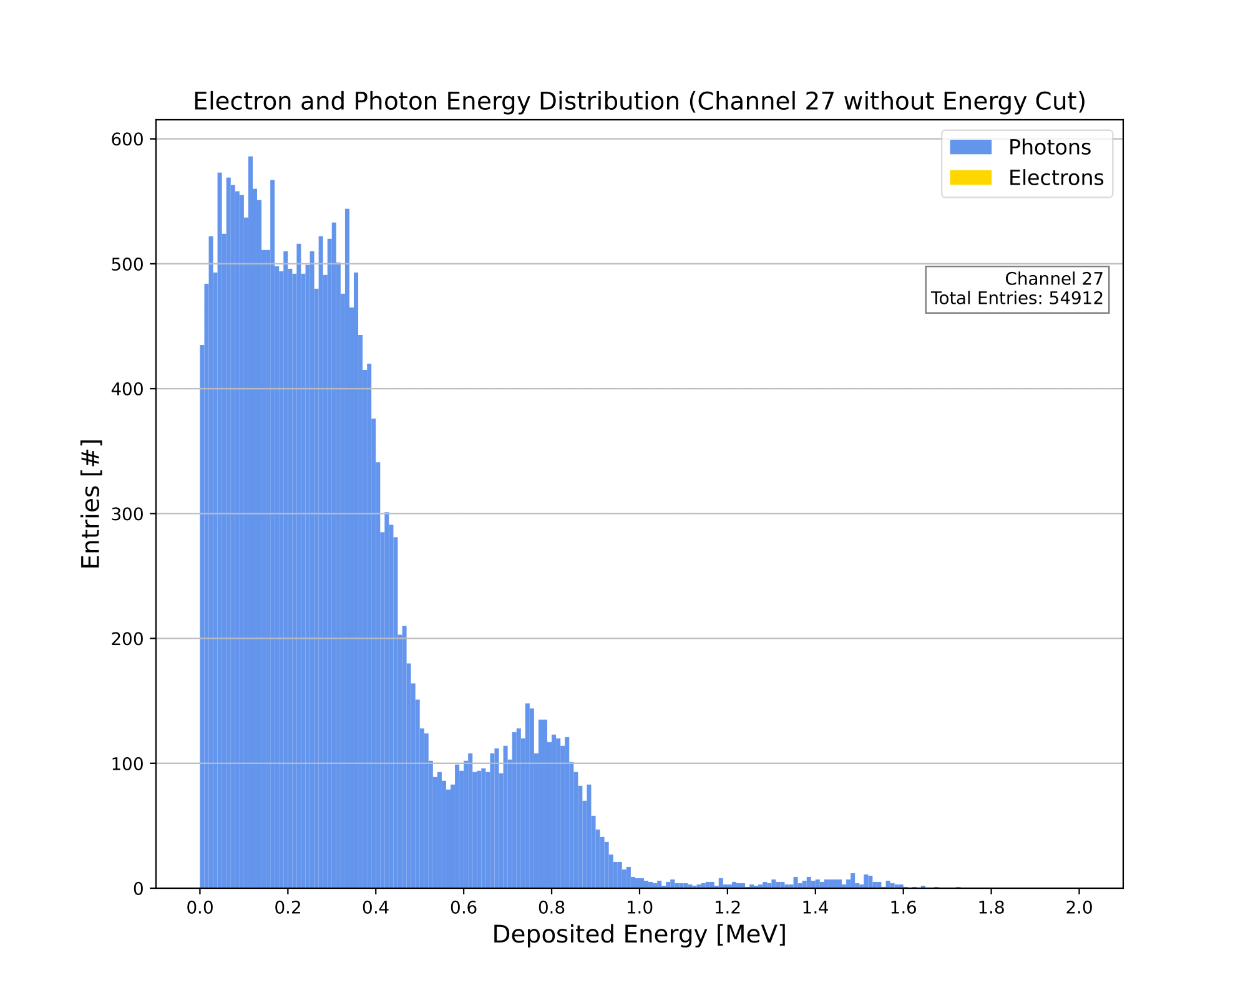
Combined Energy Distribution (Channel 27)
Luke Saunders | Progress Report | April 20th, 2023 26

Slide 27
Fake Data
When real data is taken, it will not be known immediately as to which triggers come from electrons and which are the result of photons. Due to this, the following “fake data” plots highlight the ambiguity of what will be seen when observing actual triggers.
Since we are interested in the electrons and consider the photons as background, we will sum the inner channels (those in which the source lies) and the outer channels (those in which the source doesn’t lie) in order to begin the process of finding the electron energy spectrum.
Luke Saunders | Progress Report | April 20th, 2023 27

Slide 28
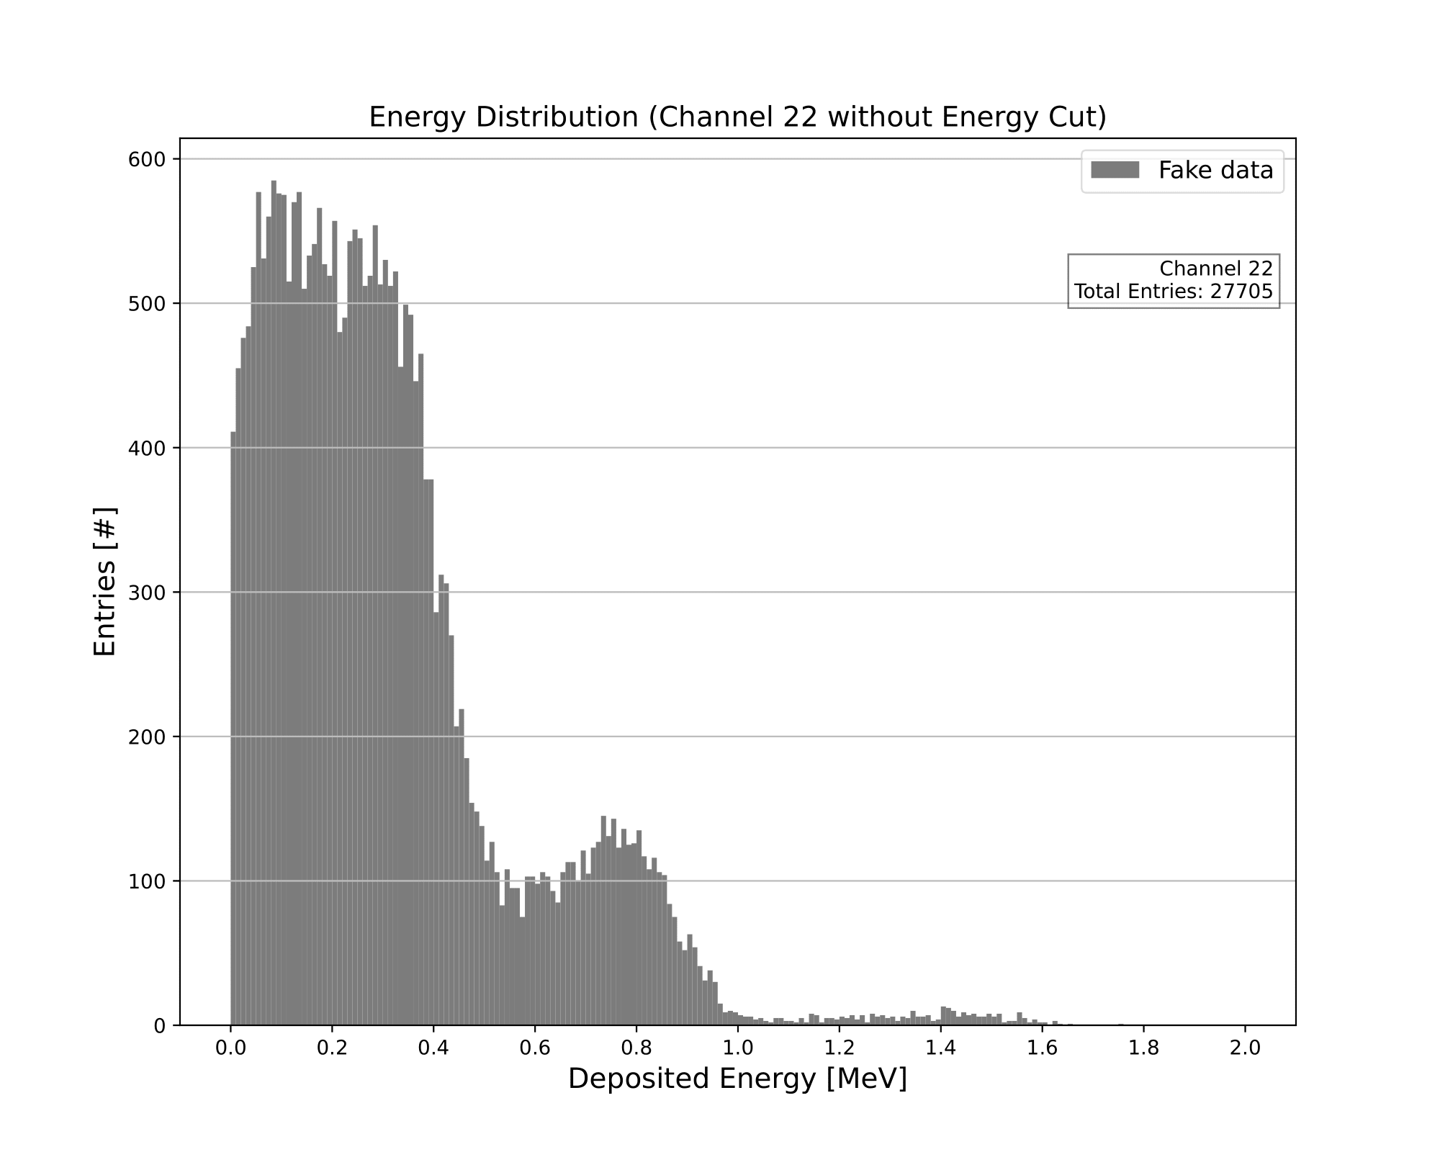
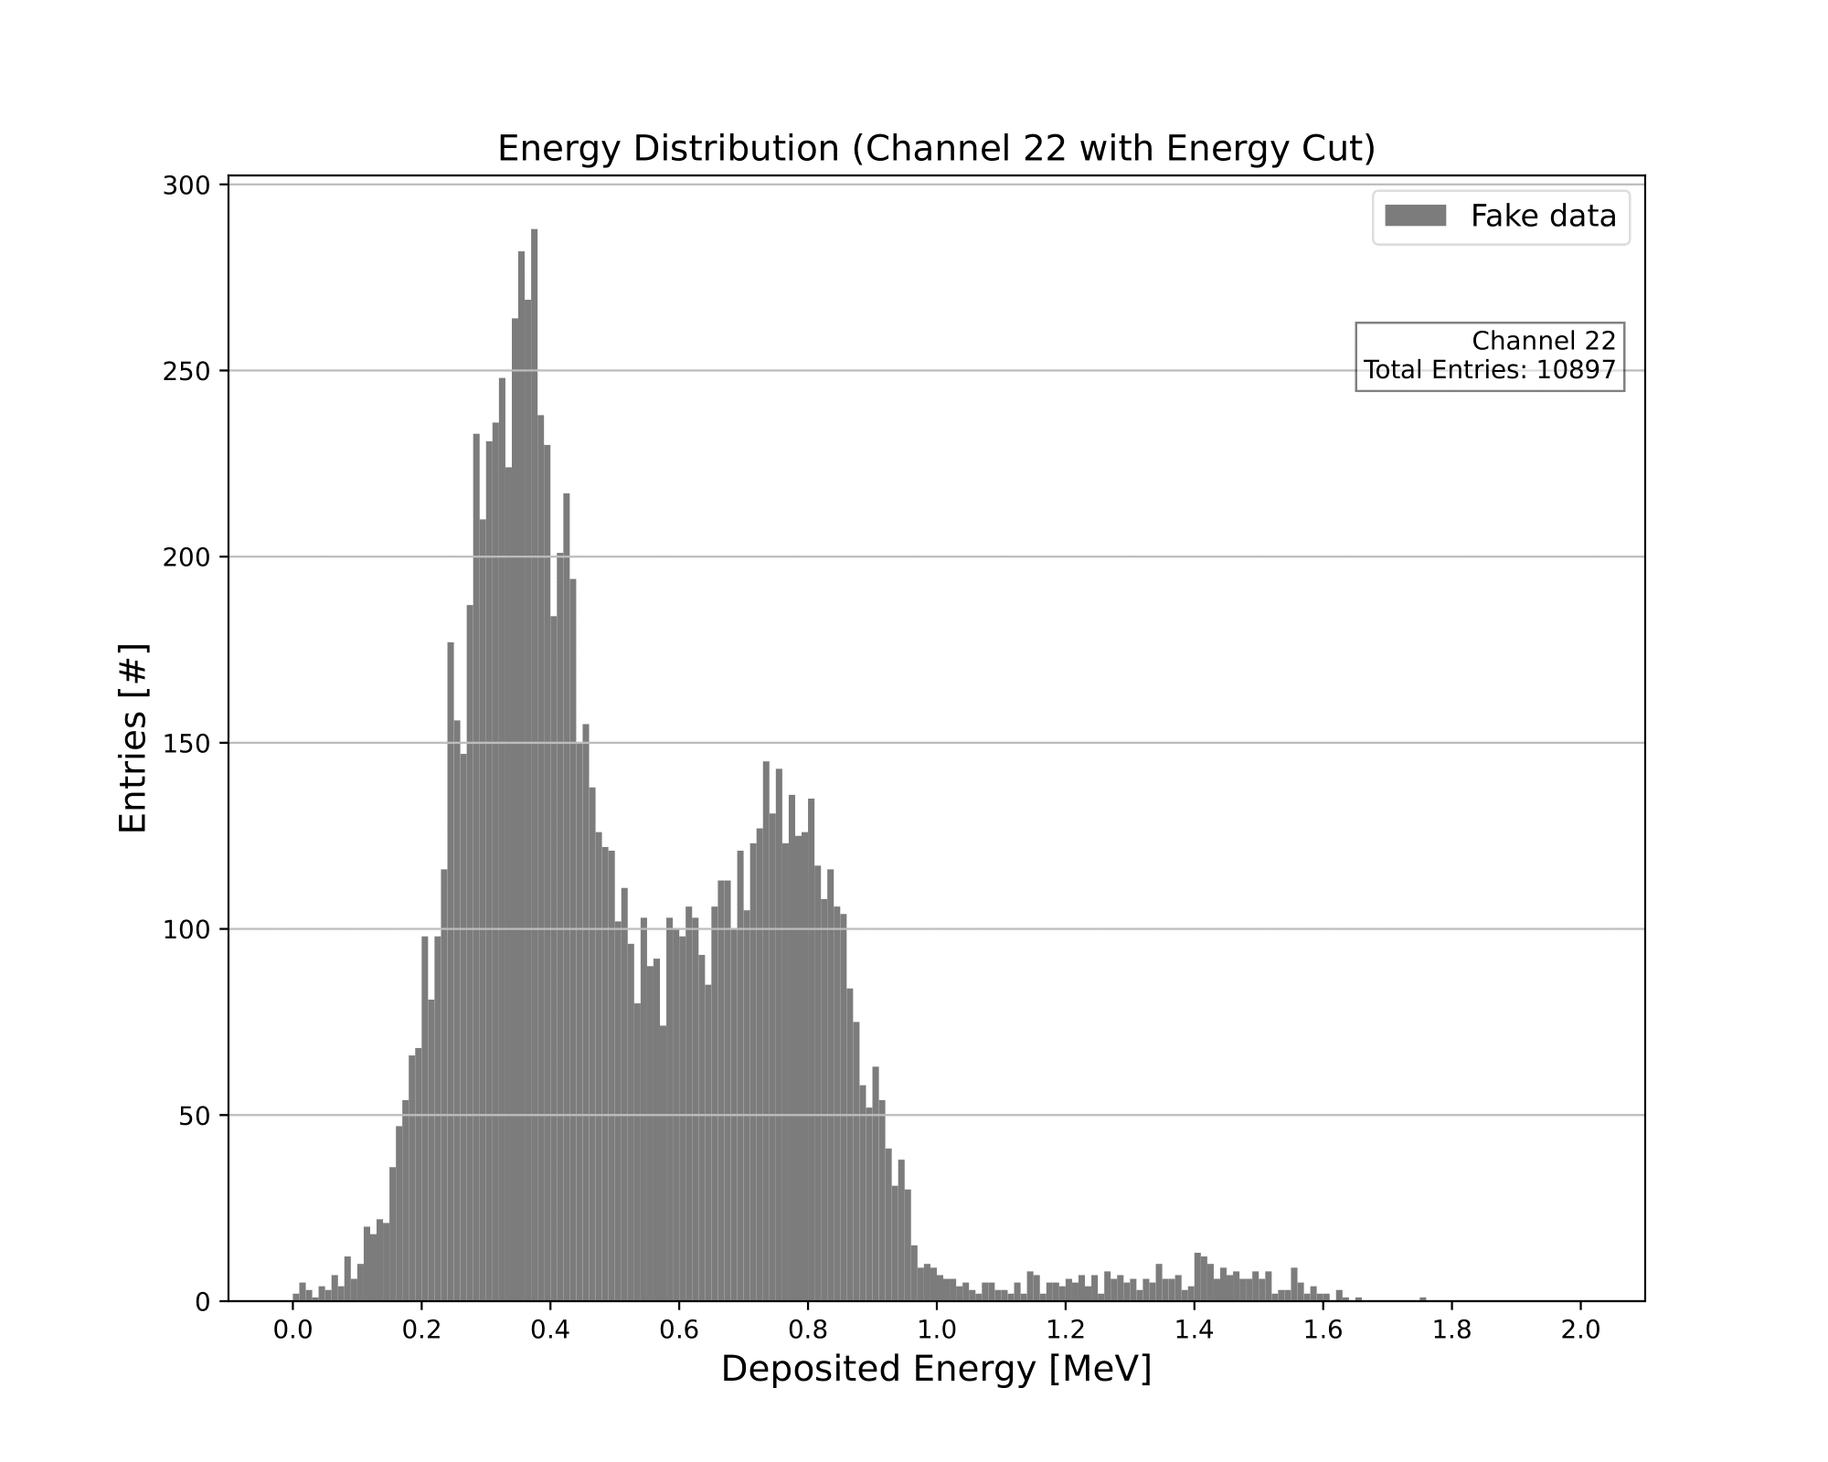
Fake Data Energy Distribution (Channel 22)
Luke Saunders | Progress Report | April 20th, 2023 28

Slide 29
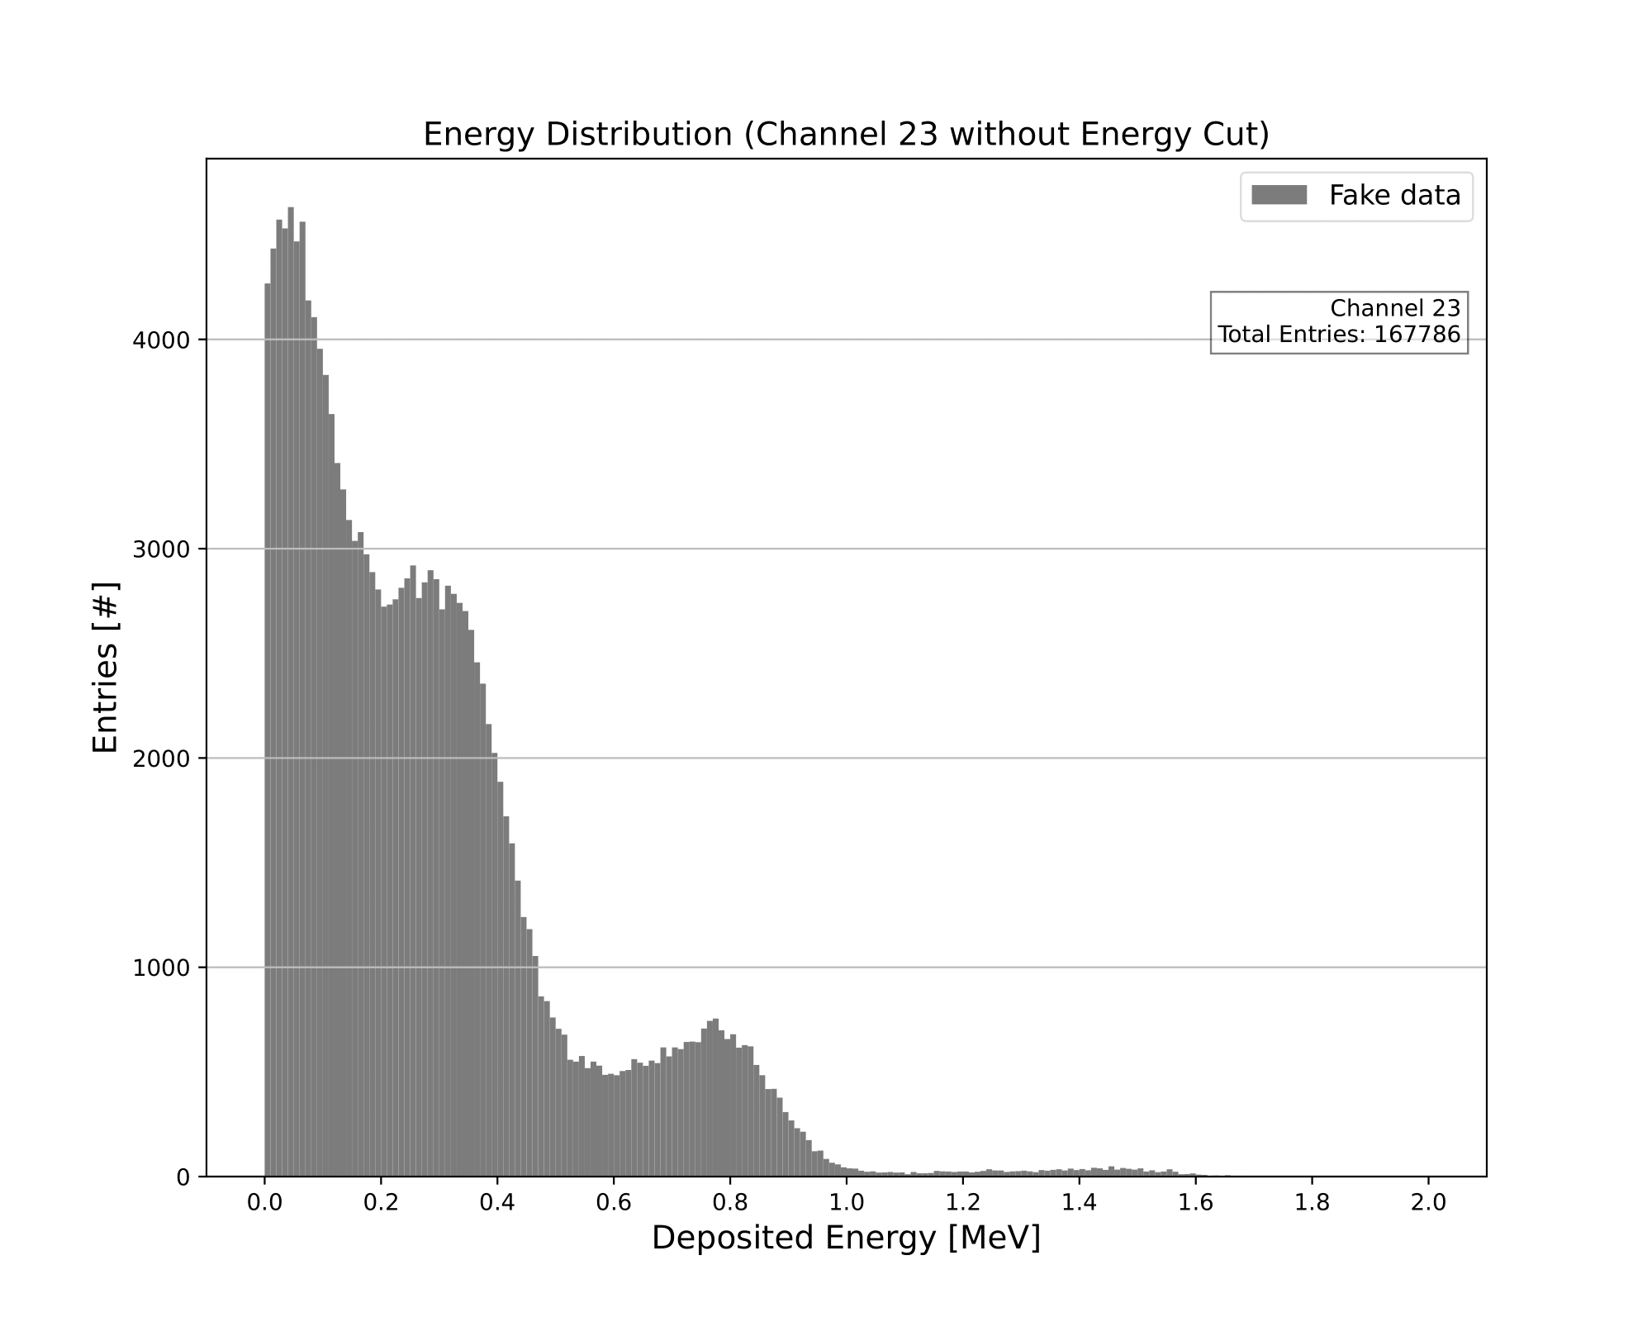

Fake Data Energy Distribution (Channel 23)
Luke Saunders | Progress Report | April 20th, 2023 29

Slide 30
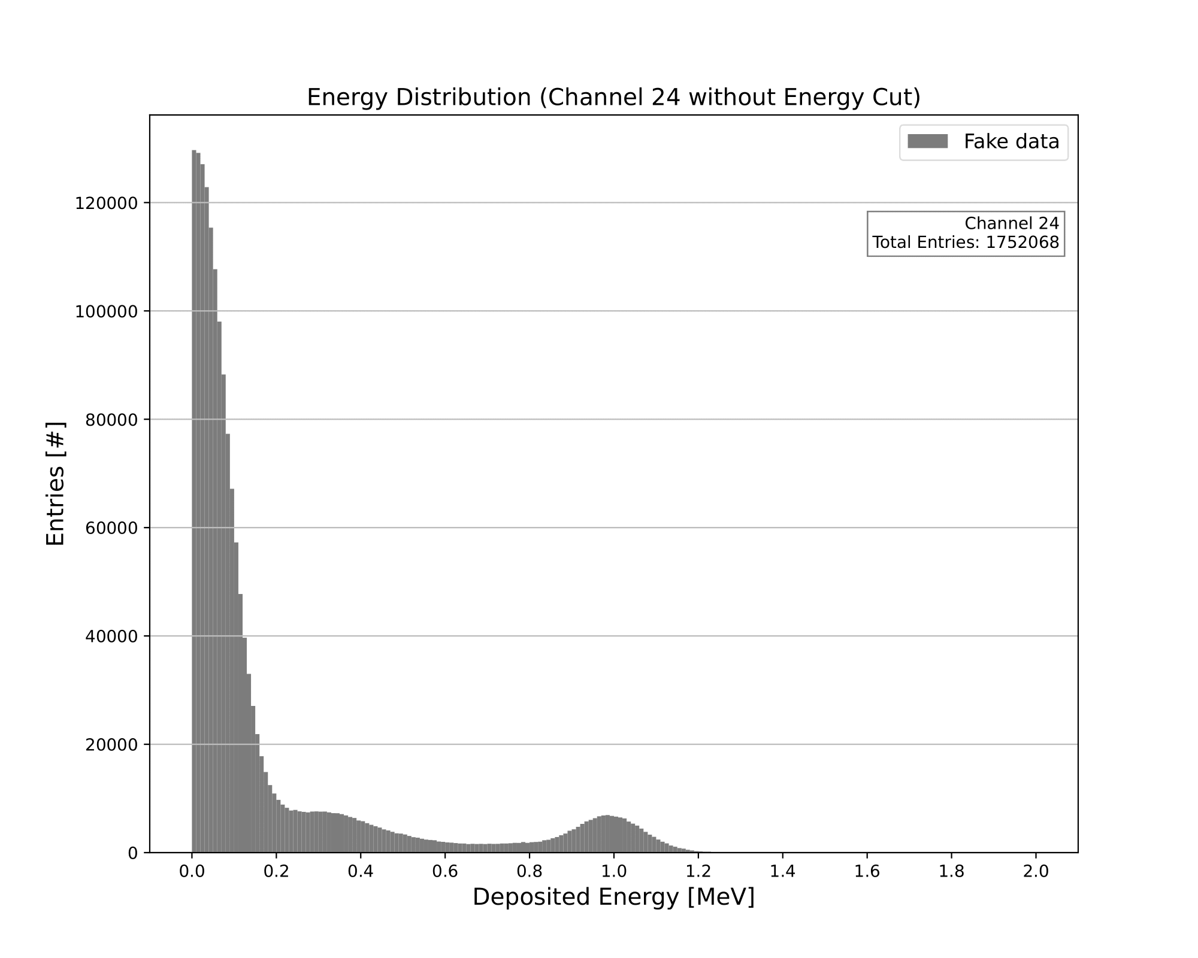
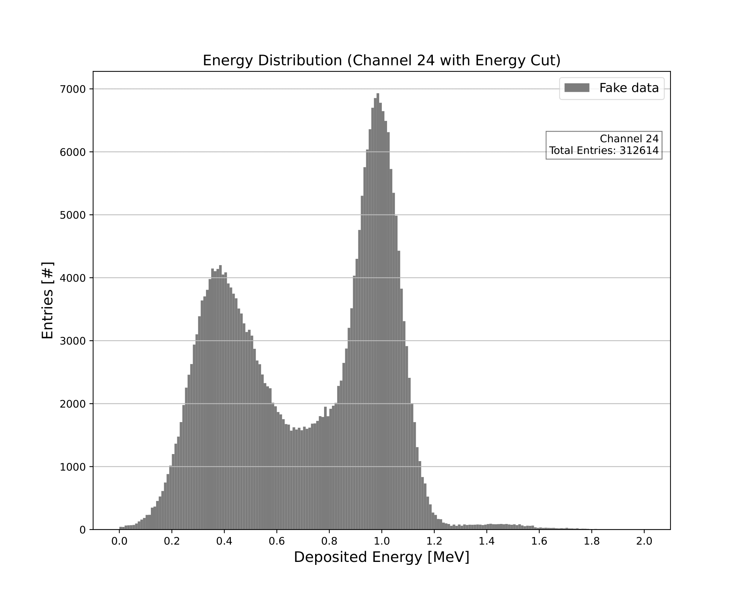
Fake Data Energy Distribution (Channel 24)
Luke Saunders | Progress Report | April 20th, 2023 30

Slide 31

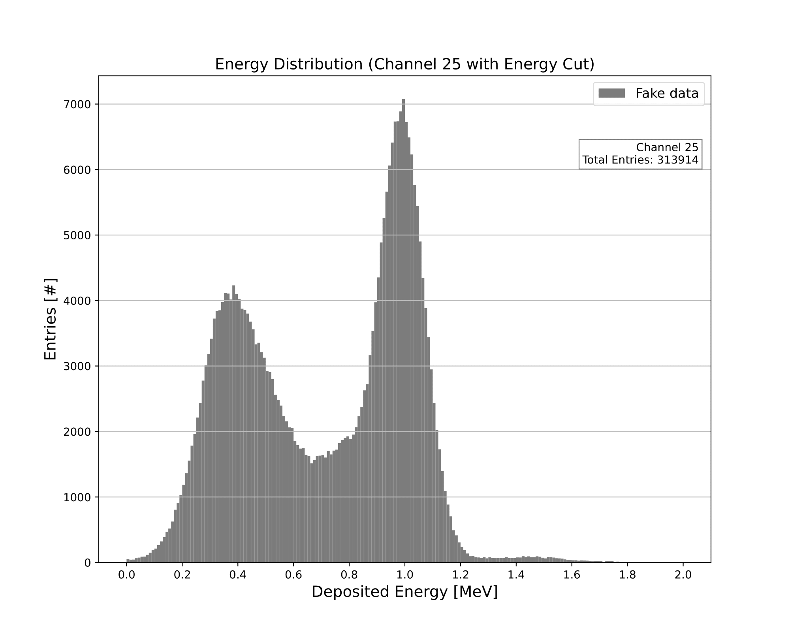
Fake Data Energy Distribution (Channel 25)
Luke Saunders | Progress Report | April 20th, 2023 31

Slide 32


Fake Data Energy Distribution (Channel 26)
Luke Saunders | Progress Report | April 20th, 2023 32

Slide 33
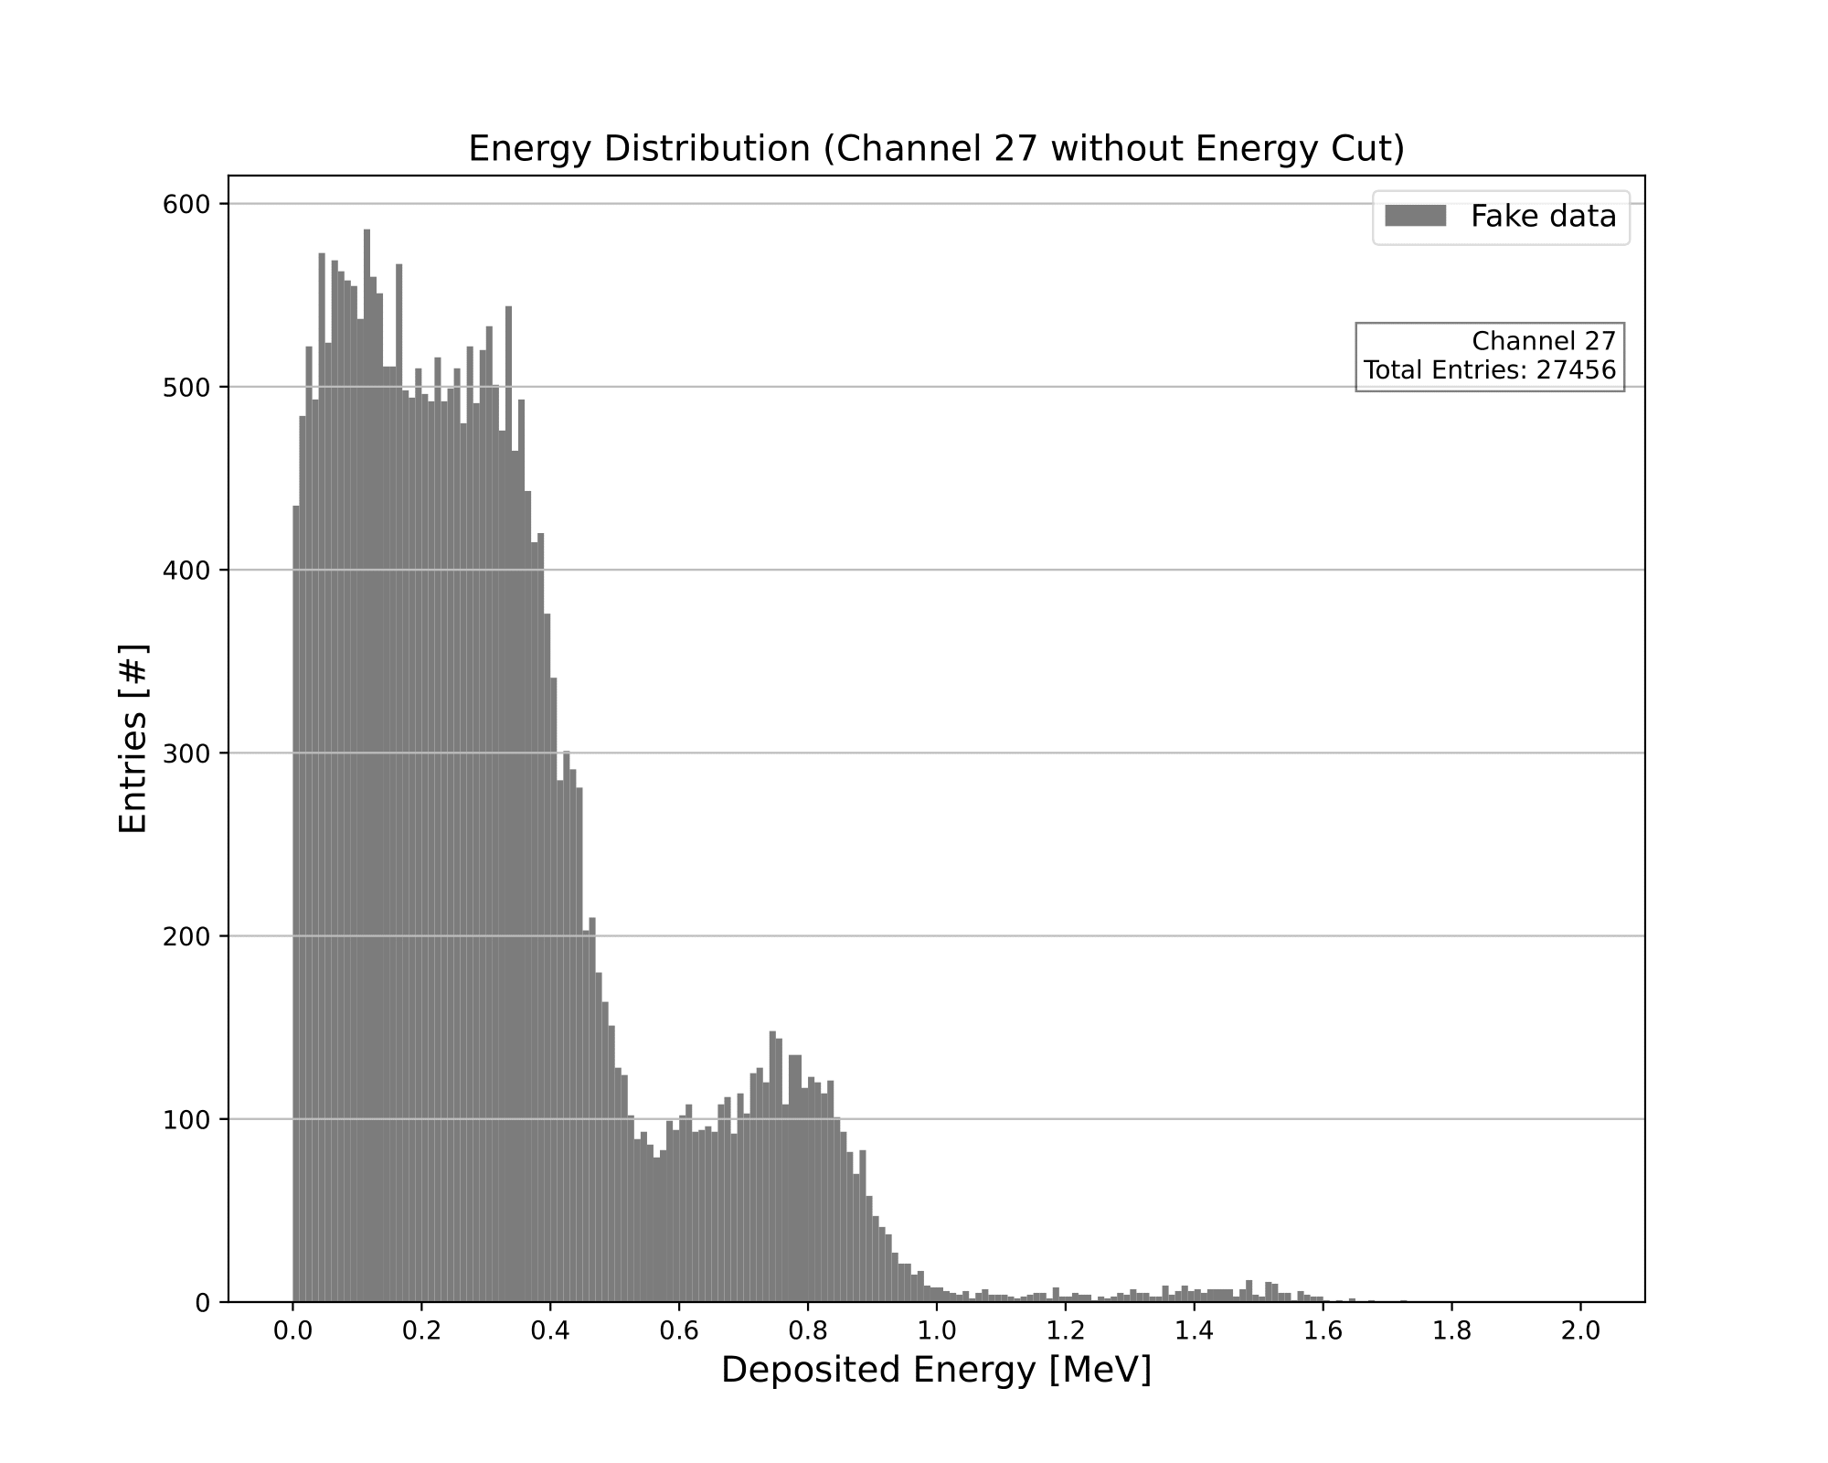

Fake Data Energy Distribution (Channel 27)
Luke Saunders | Progress Report | April 20th, 2023 33

Slide 34
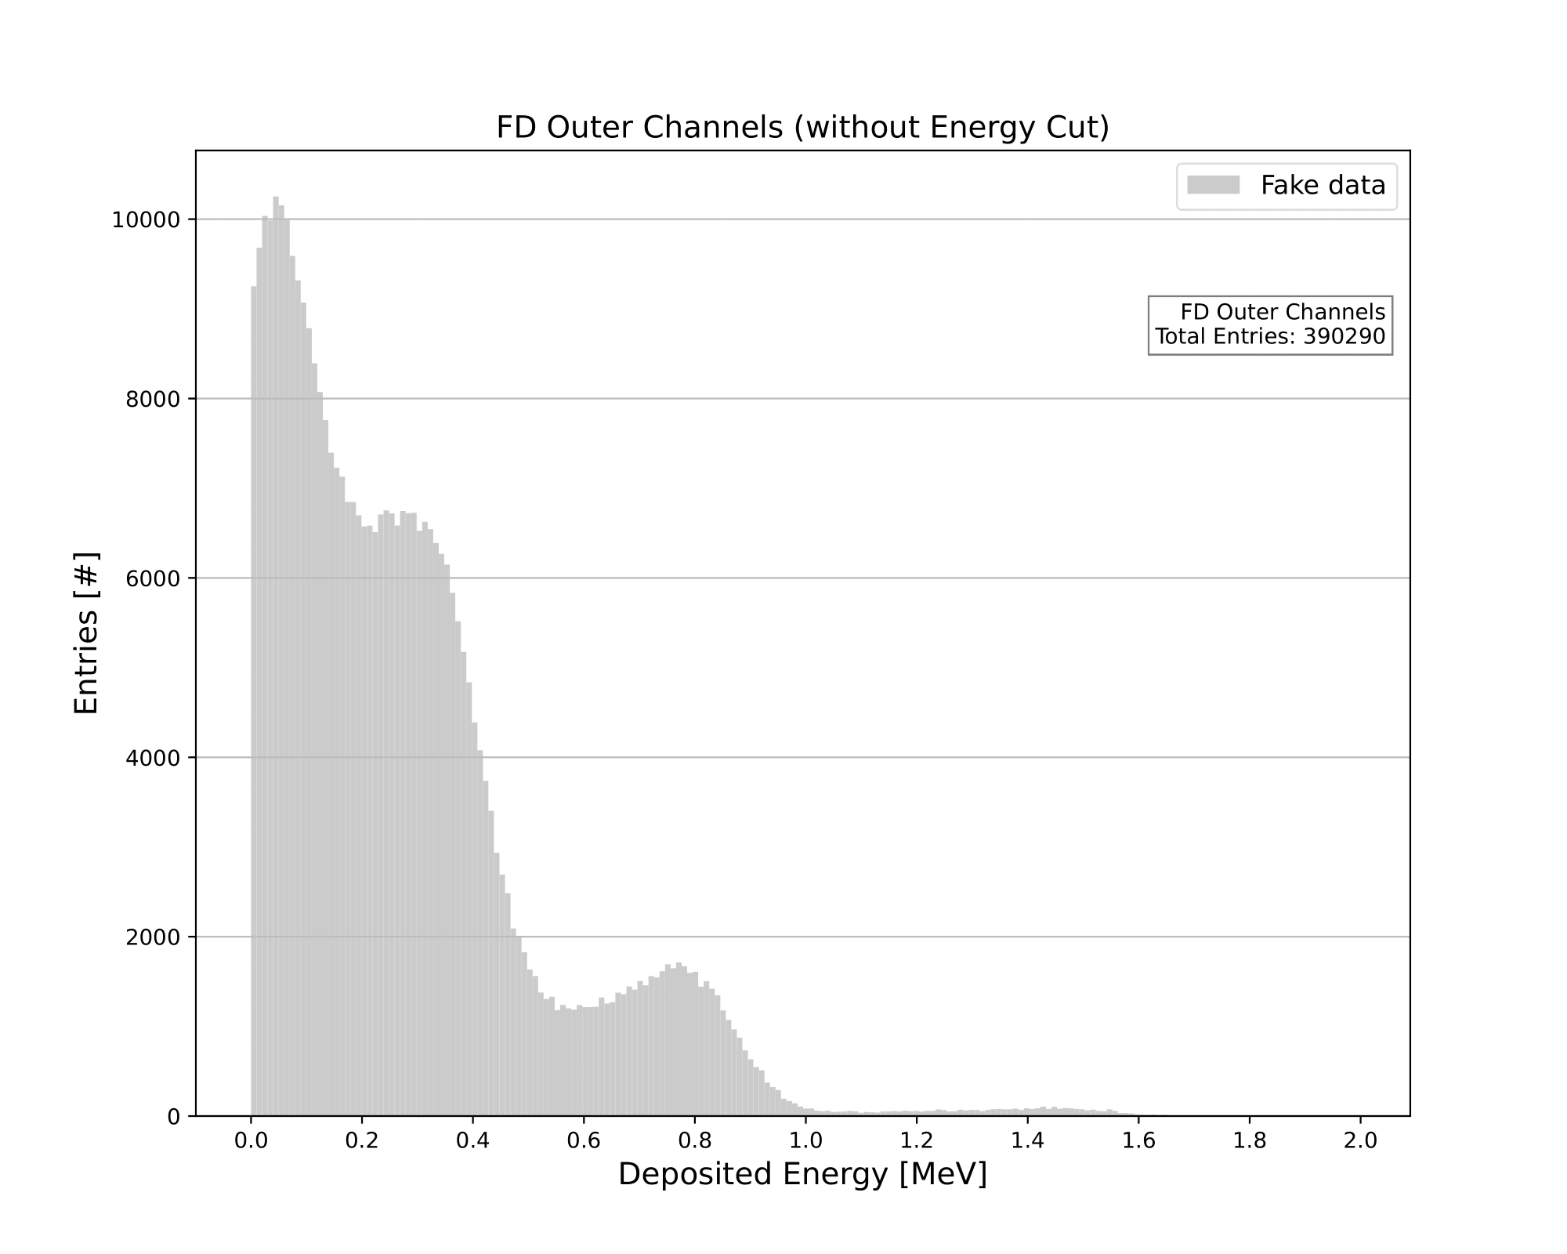
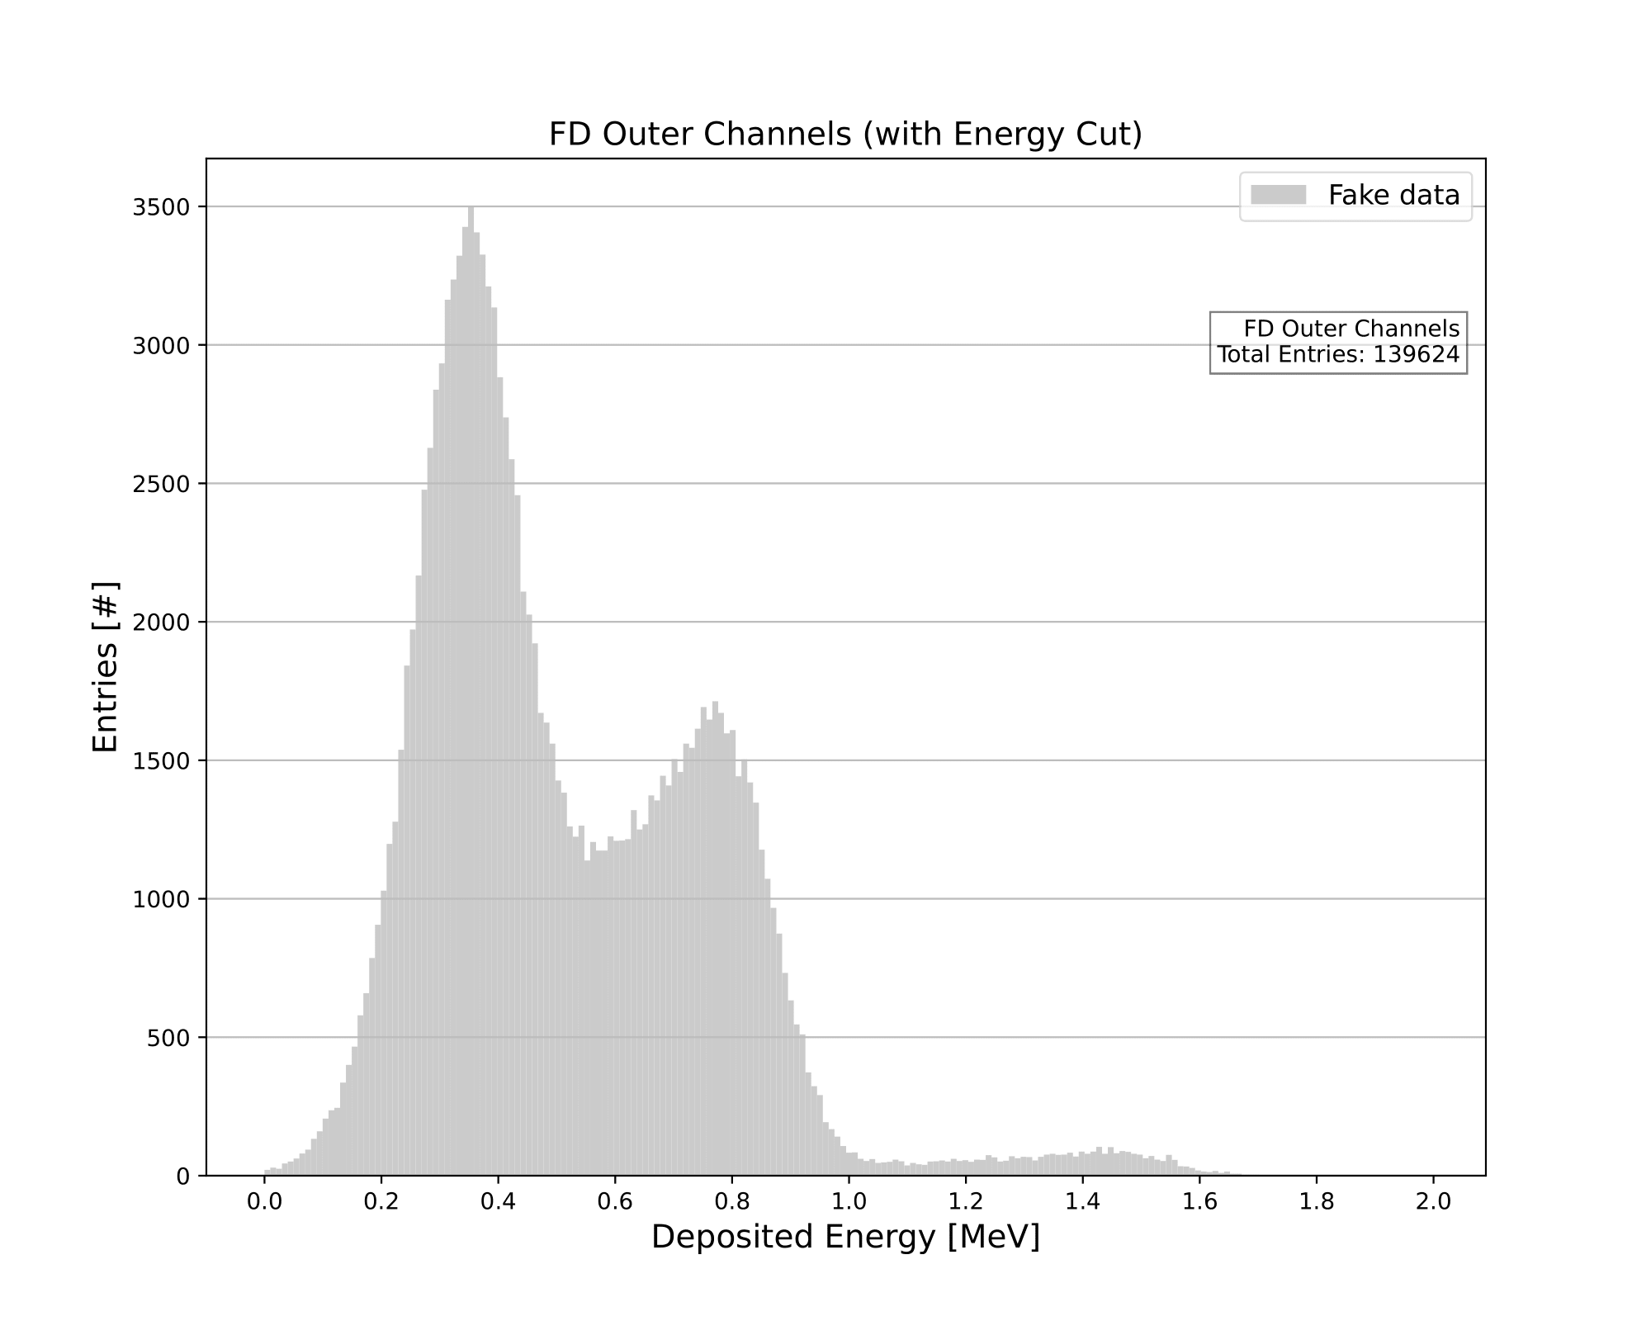
Fake Data Energy Outer Channels
Luke Saunders | Progress Report | April 20th, 2023 34

Slide 35

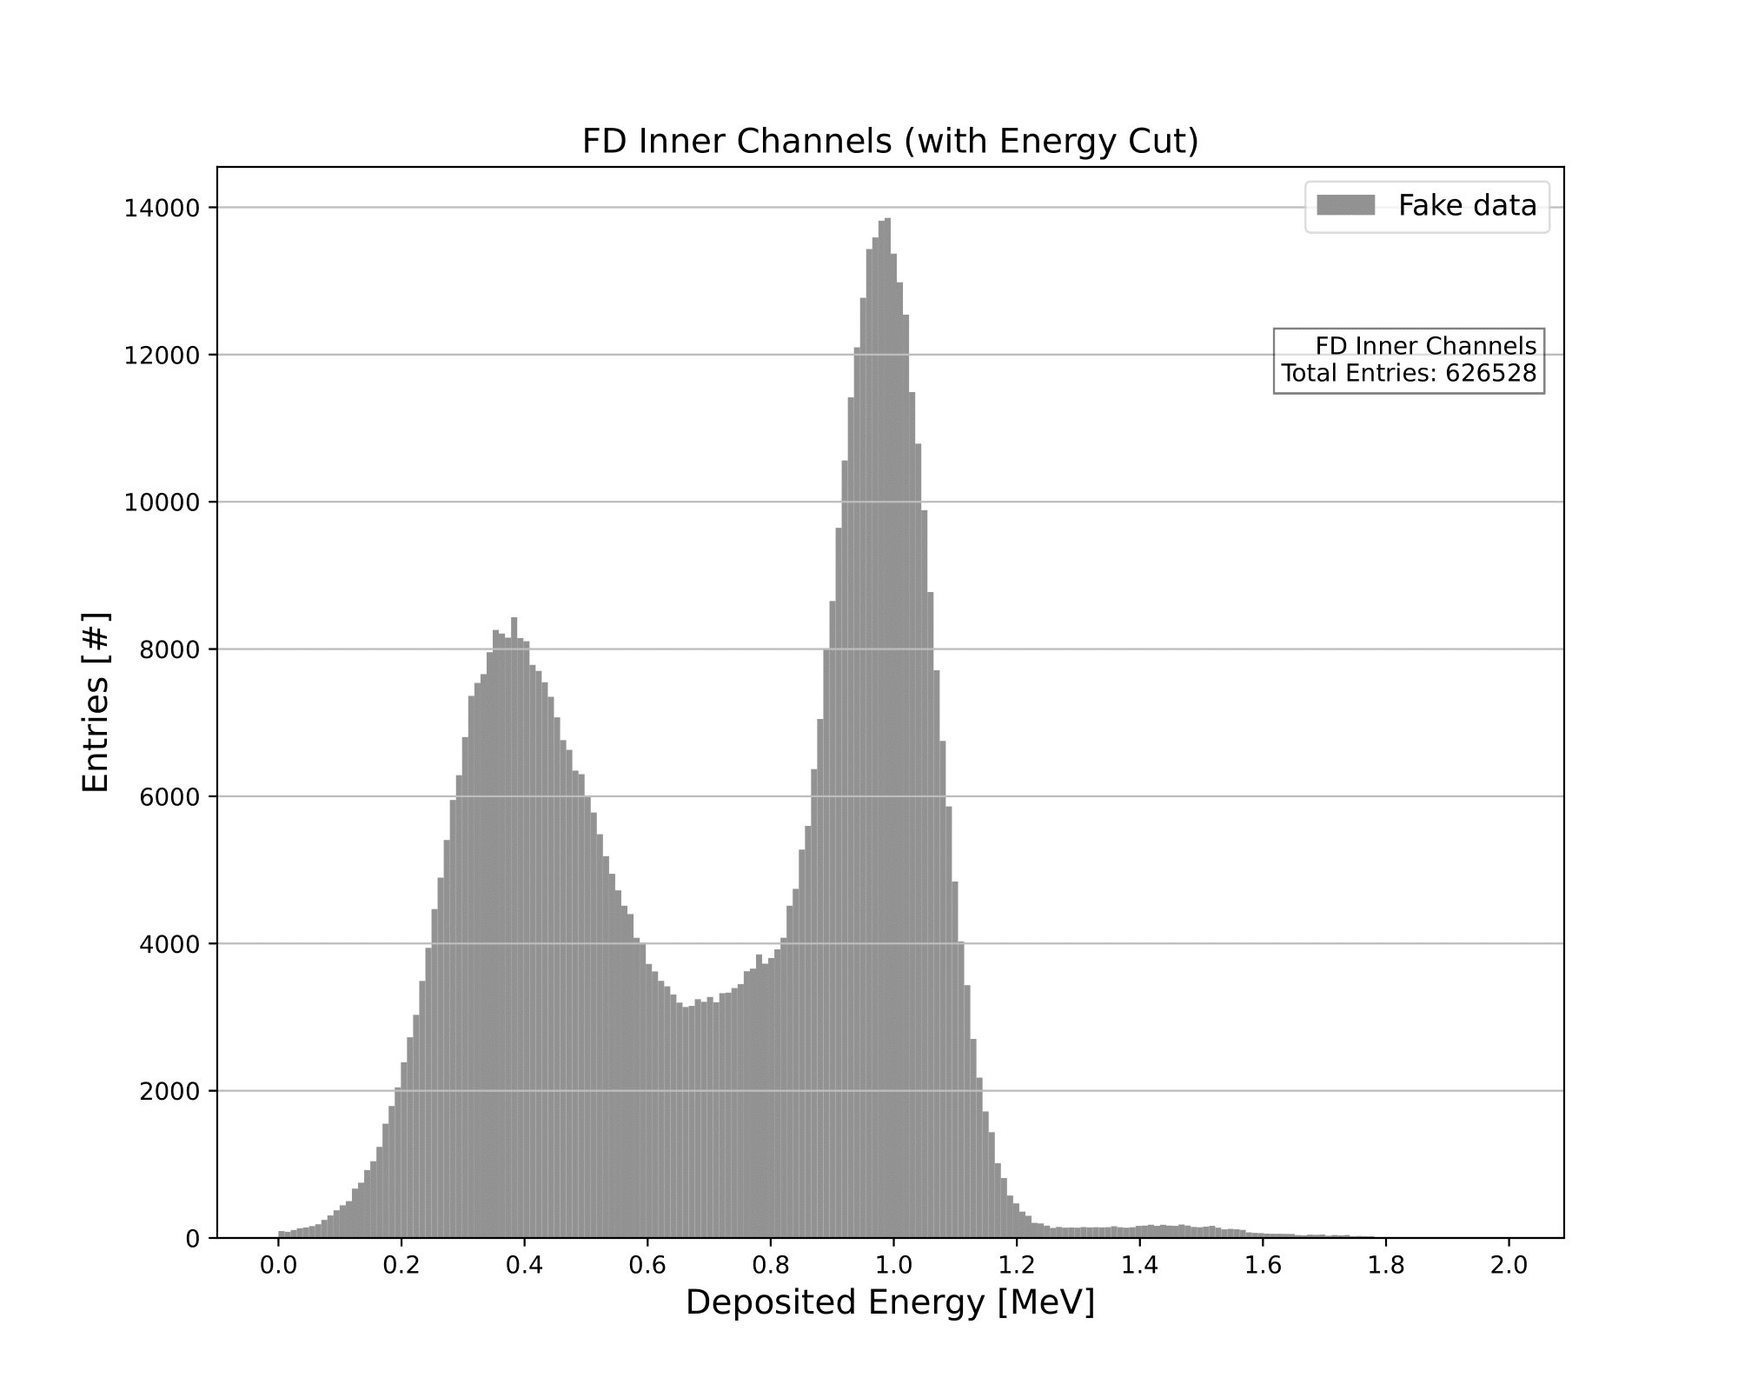
Fake Data Energy Inner Channels
Luke Saunders | Progress Report | April 20th, 2023 35

Slide 36
Photon Energy Ratios
In the following plots, the ratio between each inner and outer channel is taken.
  This process is done in order to observe the similarities between channels, as well as the differences in energy present due to the absence of electrons in the outer channels.
This same process is done later in the code in order to properly scale the outer electron channels to that of the inner channels, allowing us to disregard the photon energy spectrum.
  We will discuss and highlight later the accuracy of this process.
Luke Saunders | Progress Report | April 20th, 2023 36

Slide 37
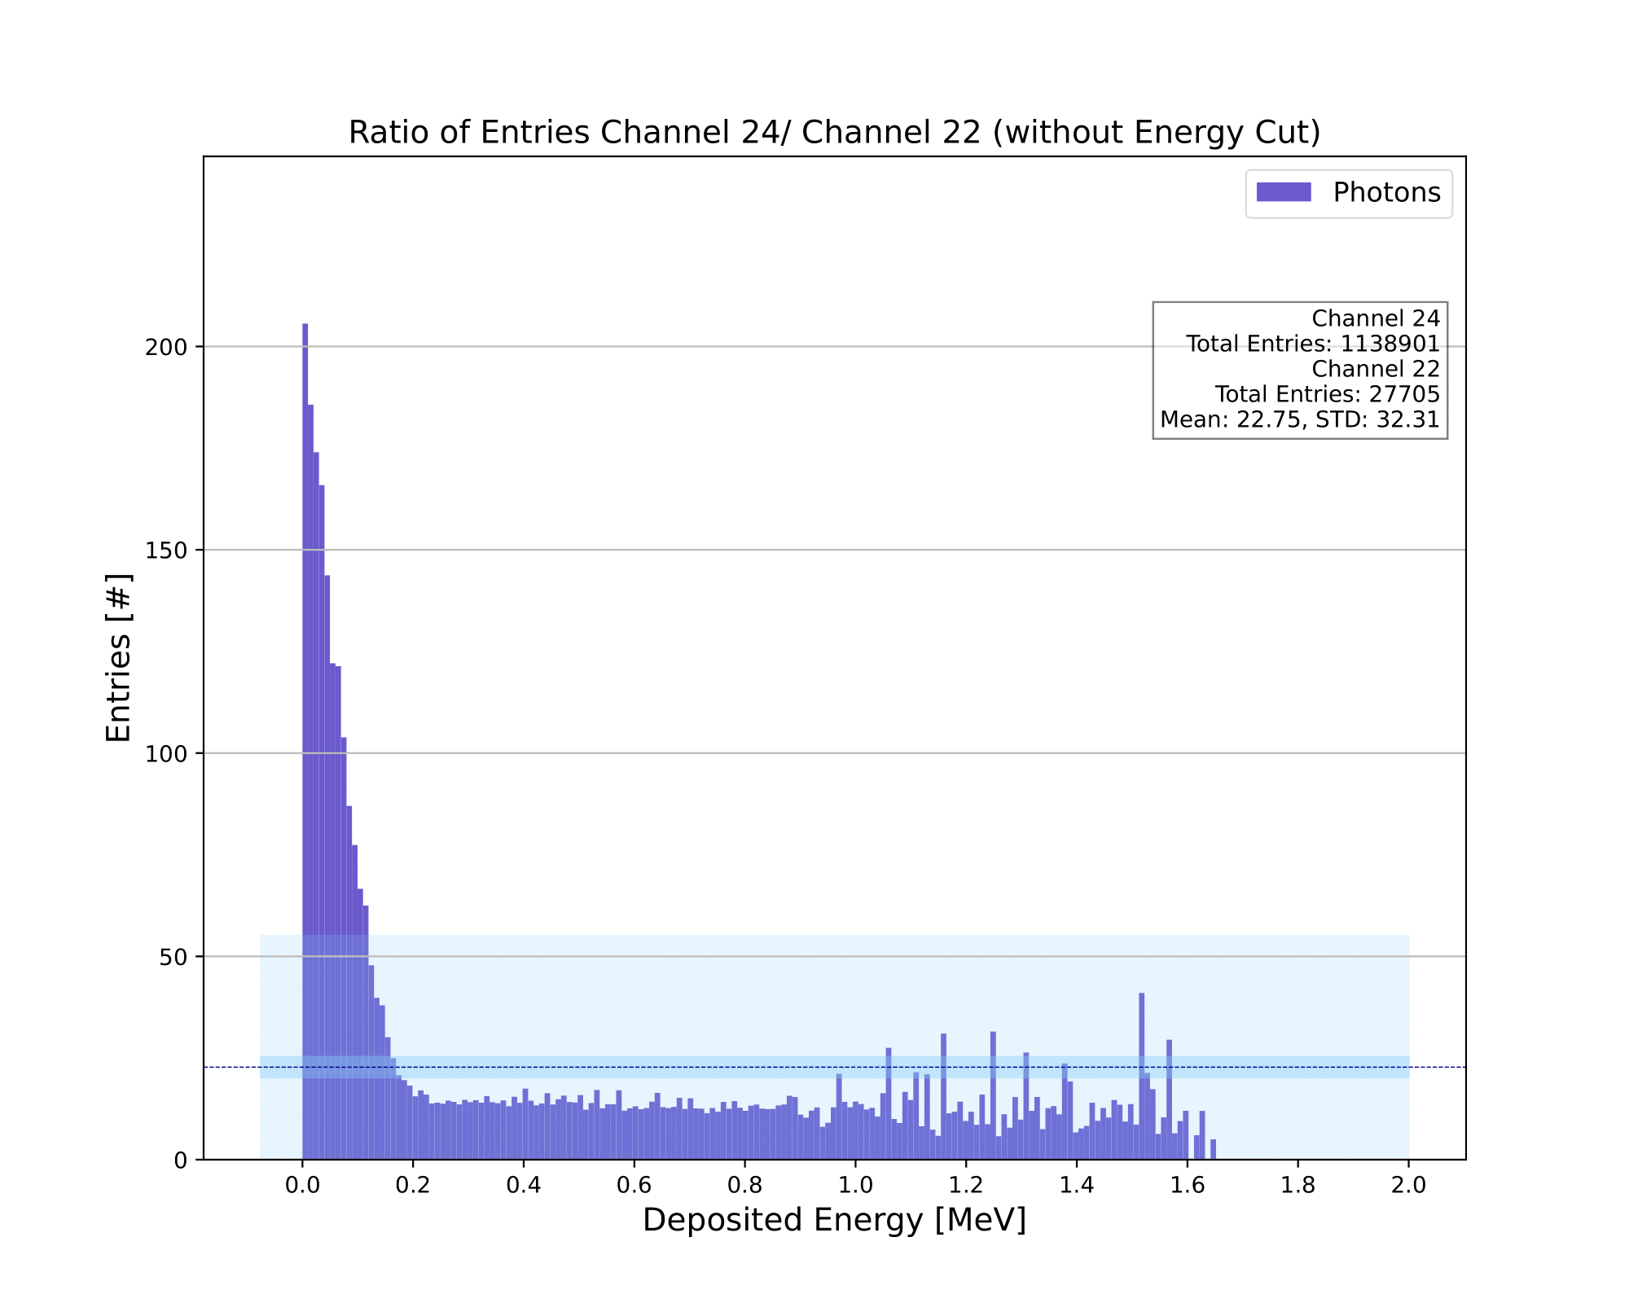
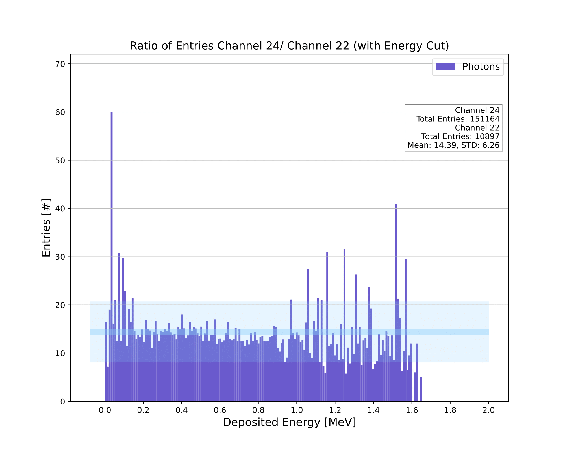
Energy Ratio (Channel 24 / Channel 22)
Luke Saunders | Progress Report | April 20th, 2023 37

Slide 38
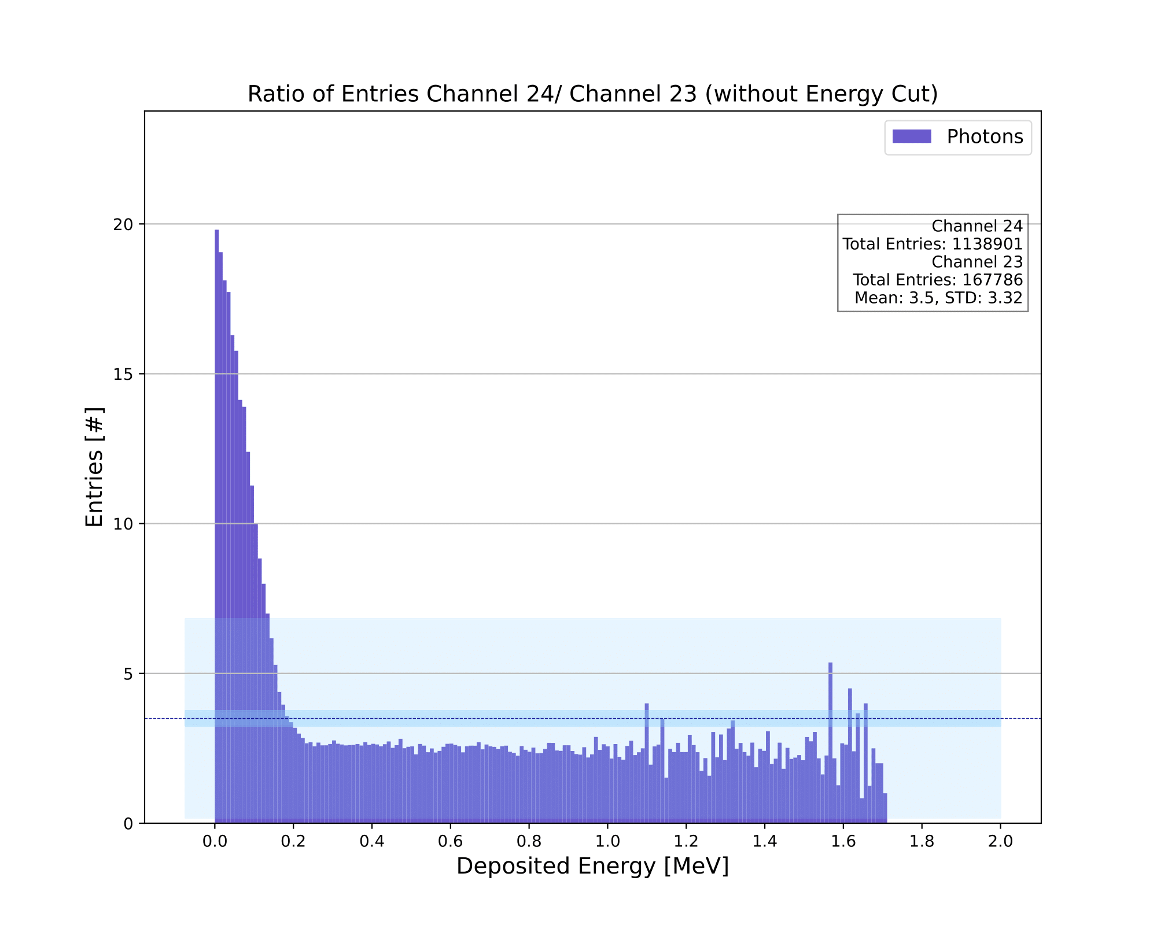
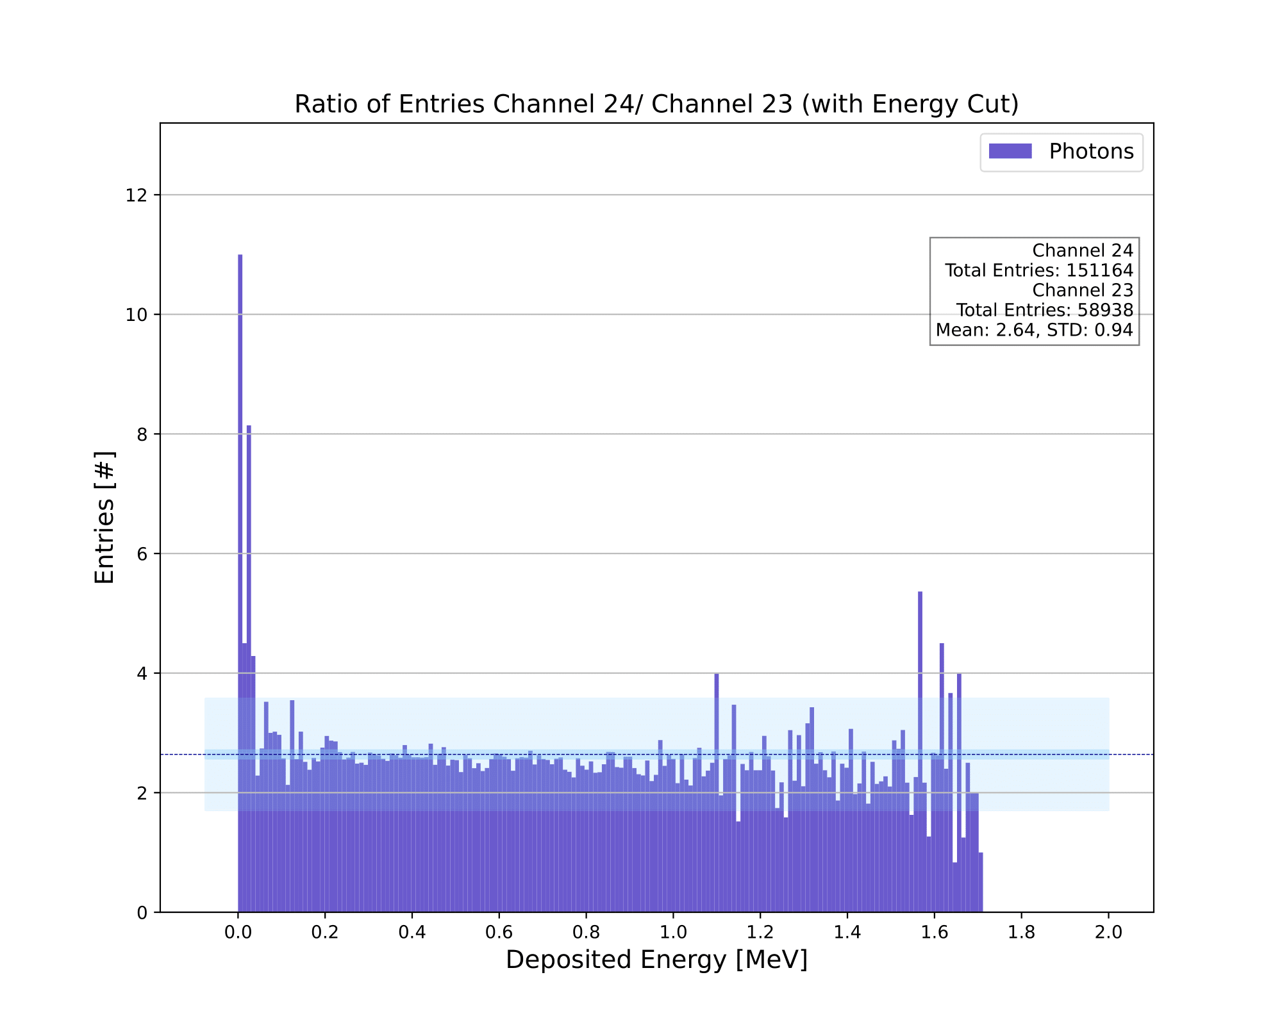
Energy Ratio (Channel 24 / Channel 23)
Luke Saunders | Progress Report | April 20th, 2023 38

Slide 39
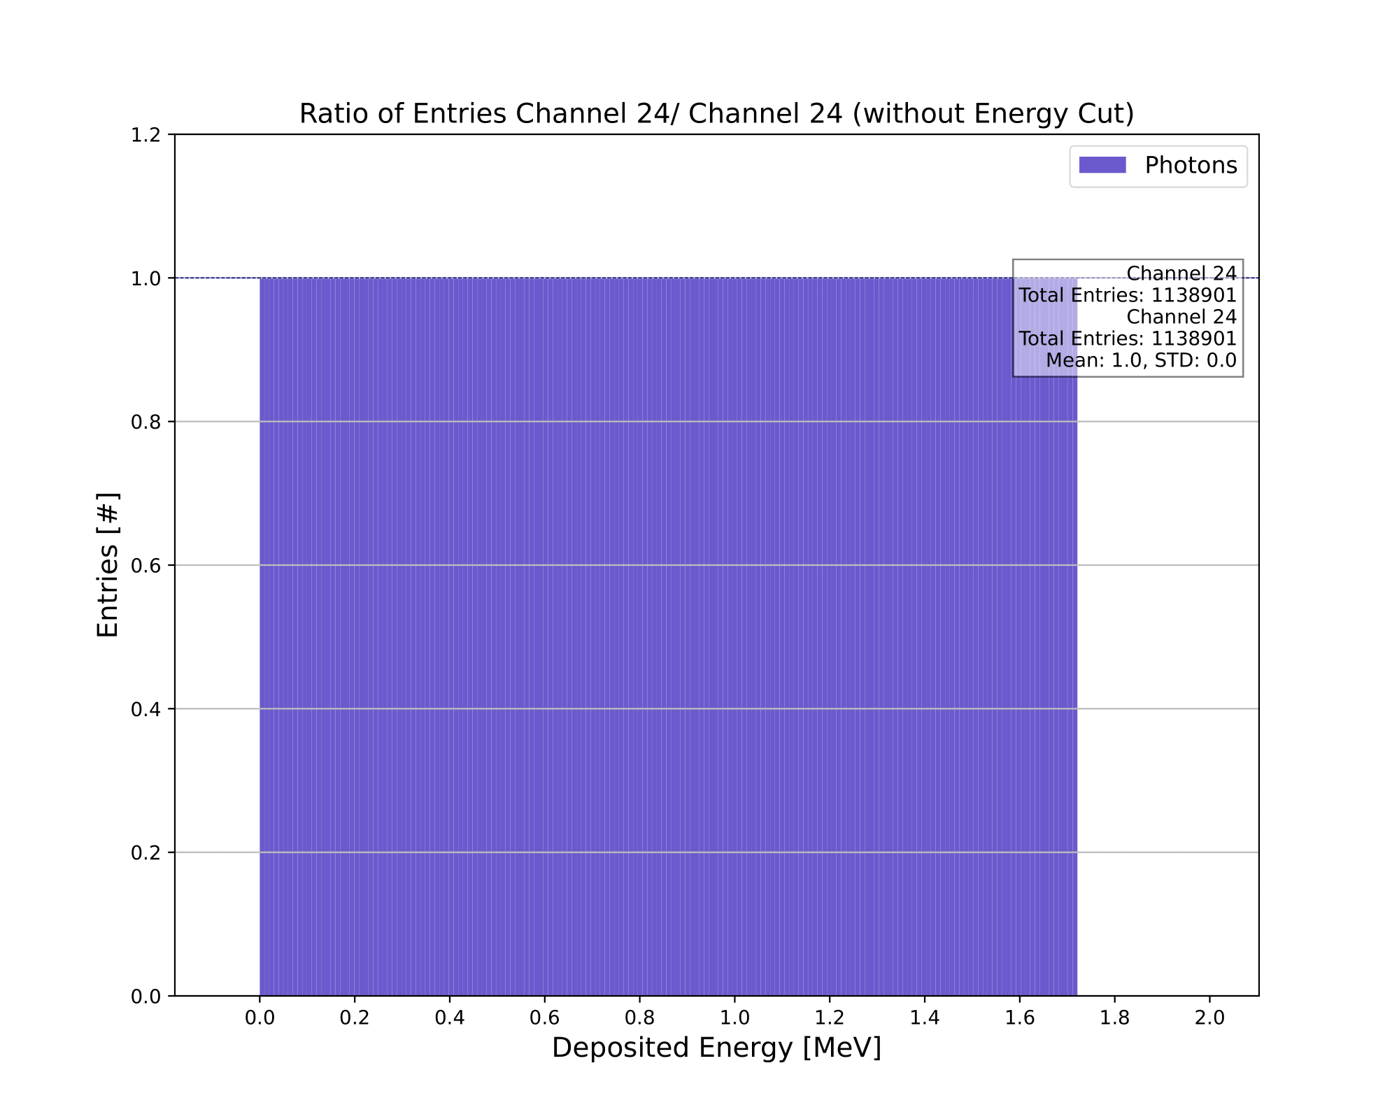

Energy Ratio (Channel 24 / Channel 24)
Luke Saunders | Progress Report | April 20th, 2023 39

Slide 40
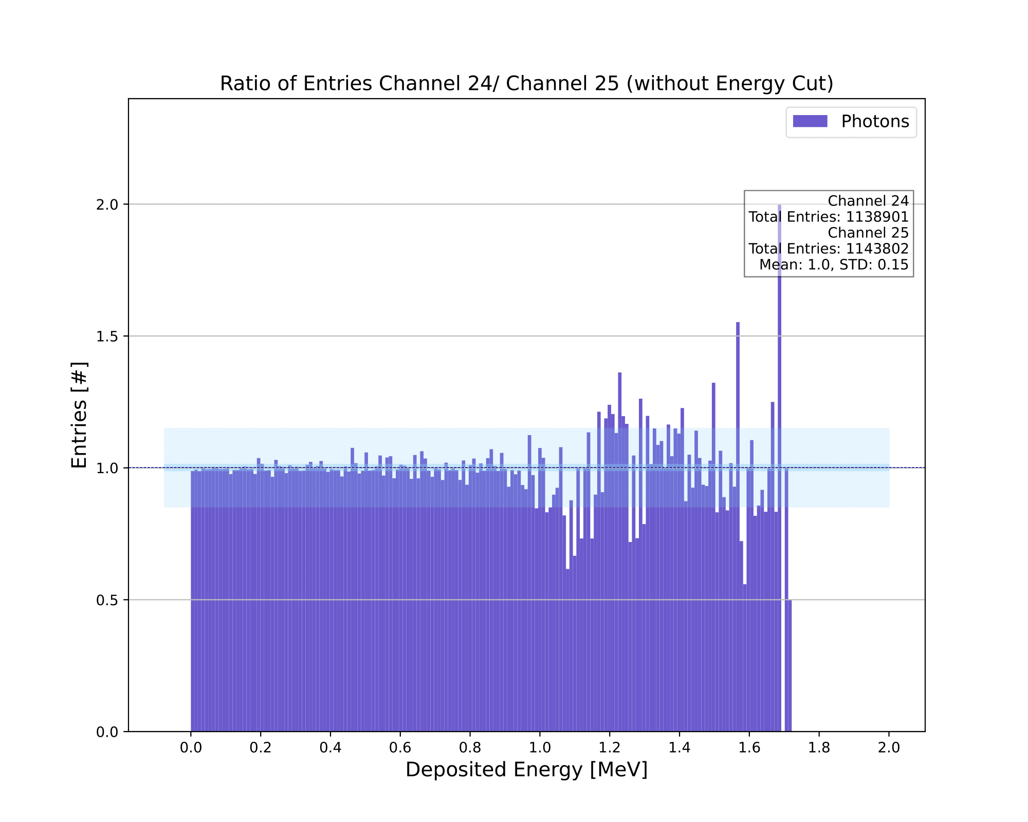
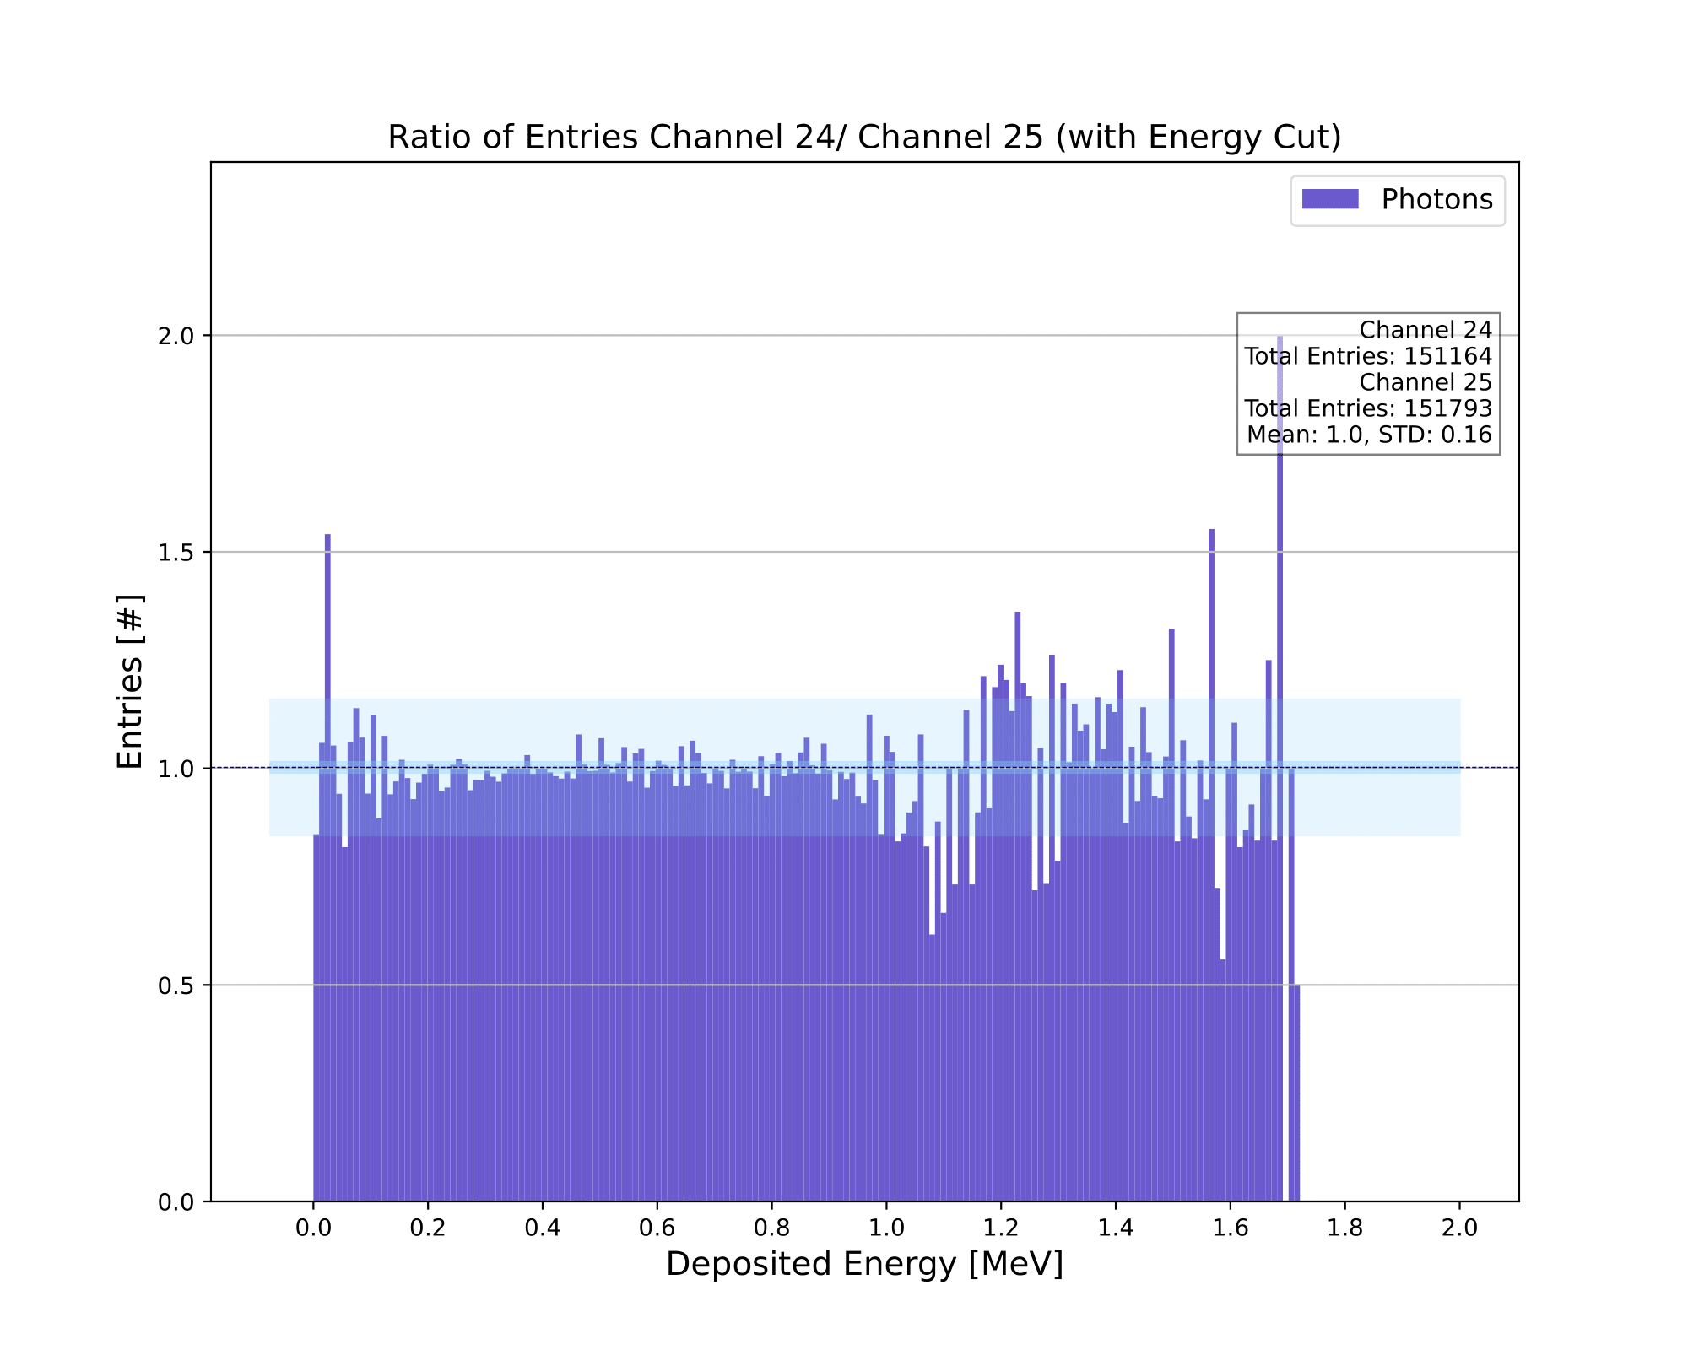
Energy Ratio (Channel 24 / Channel 25)
Luke Saunders | Progress Report | April 20th, 2023 40

Slide 41
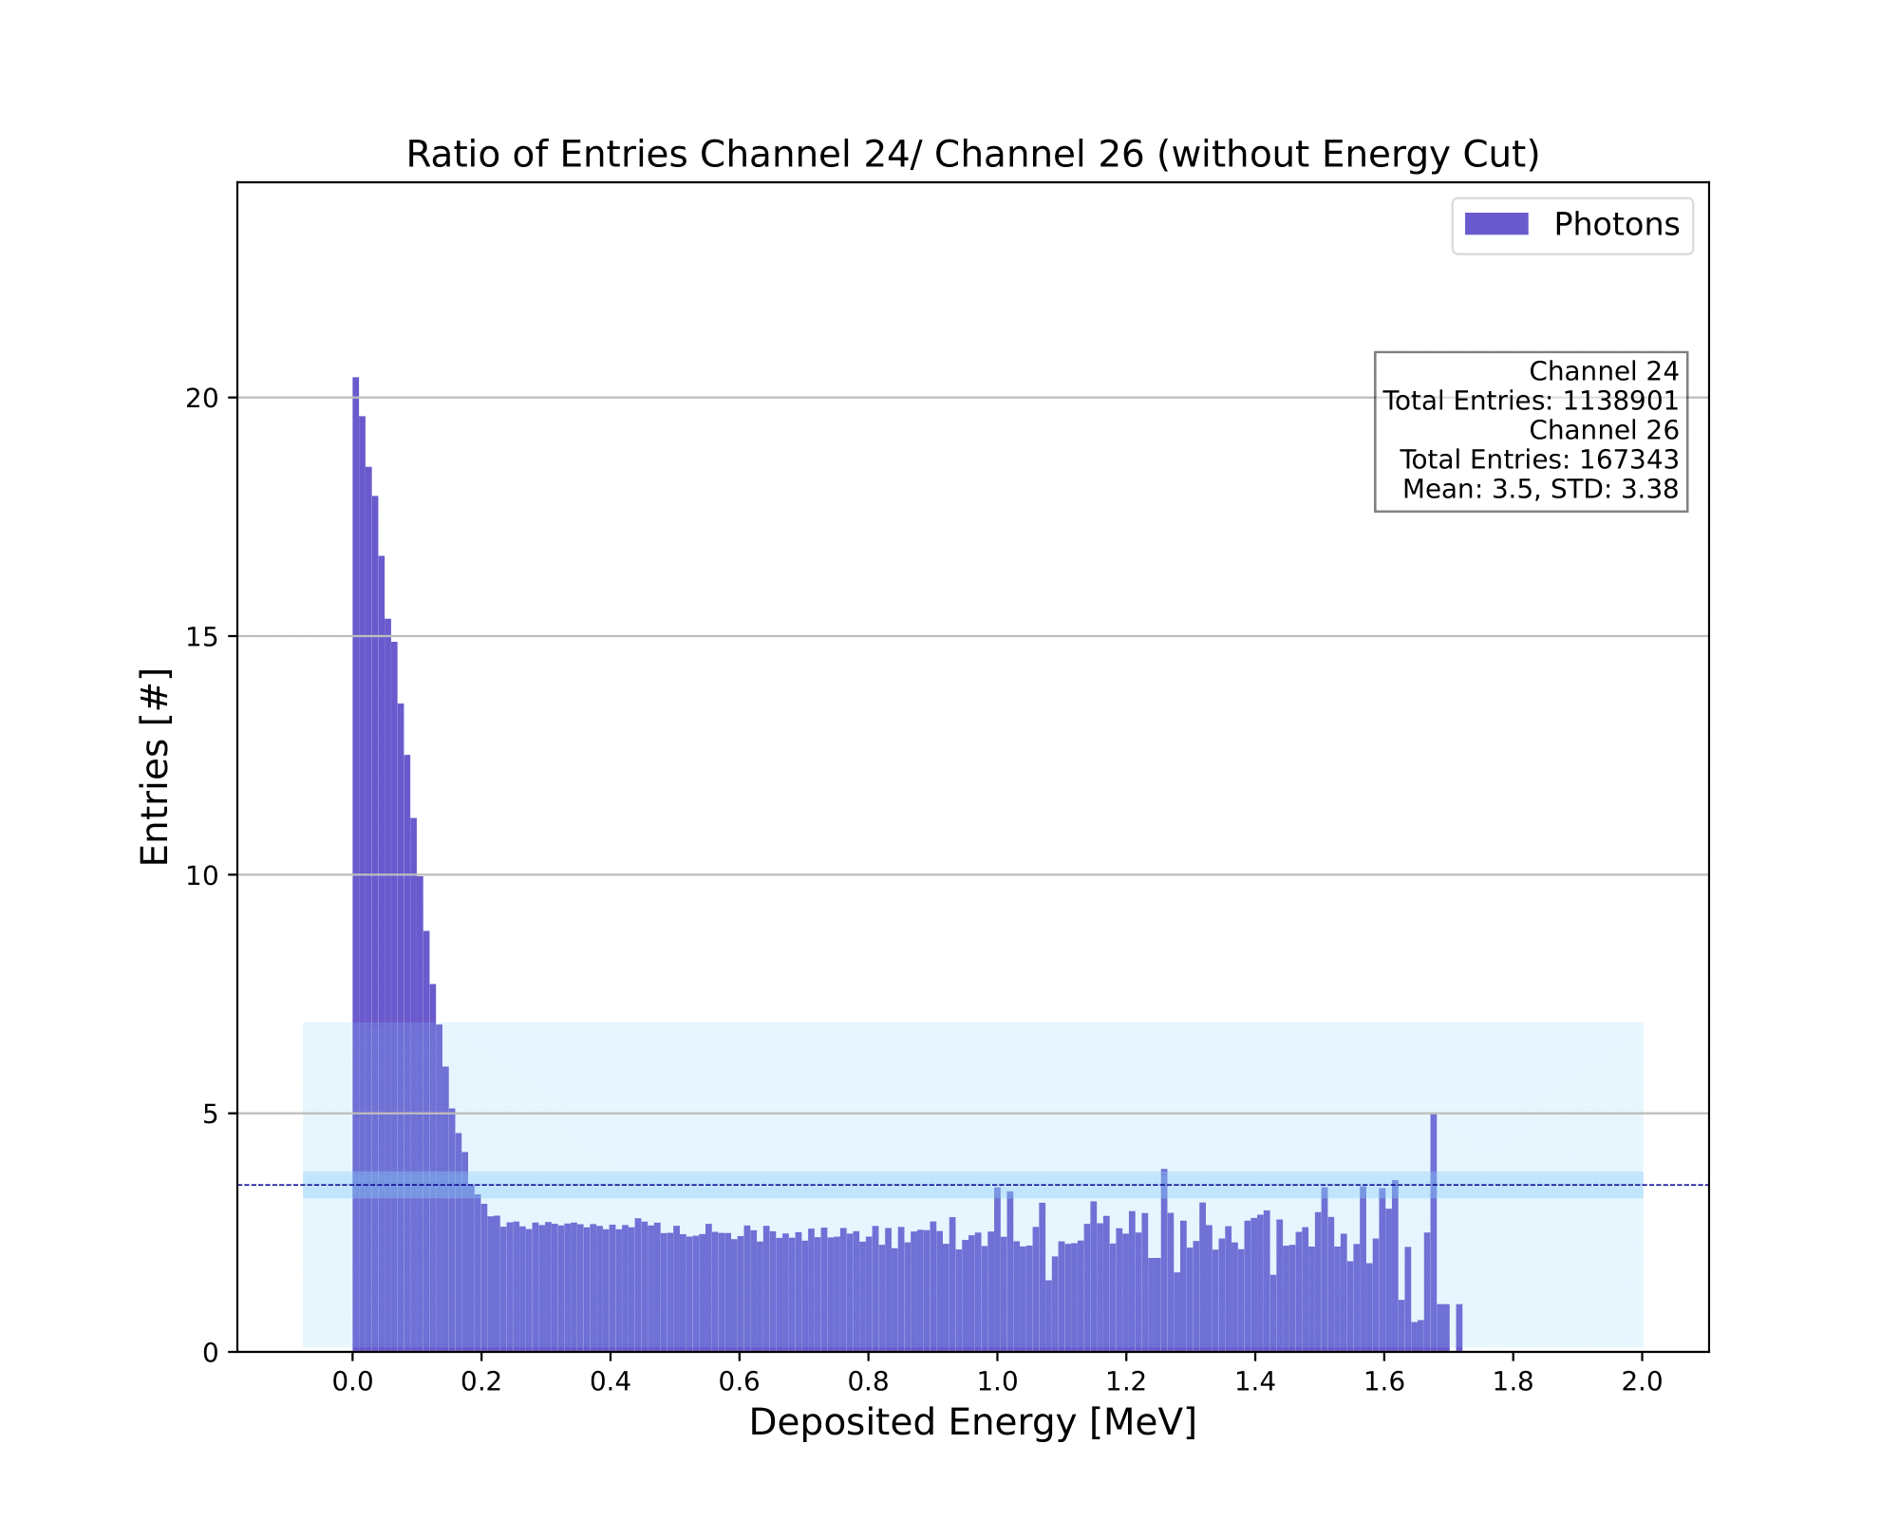
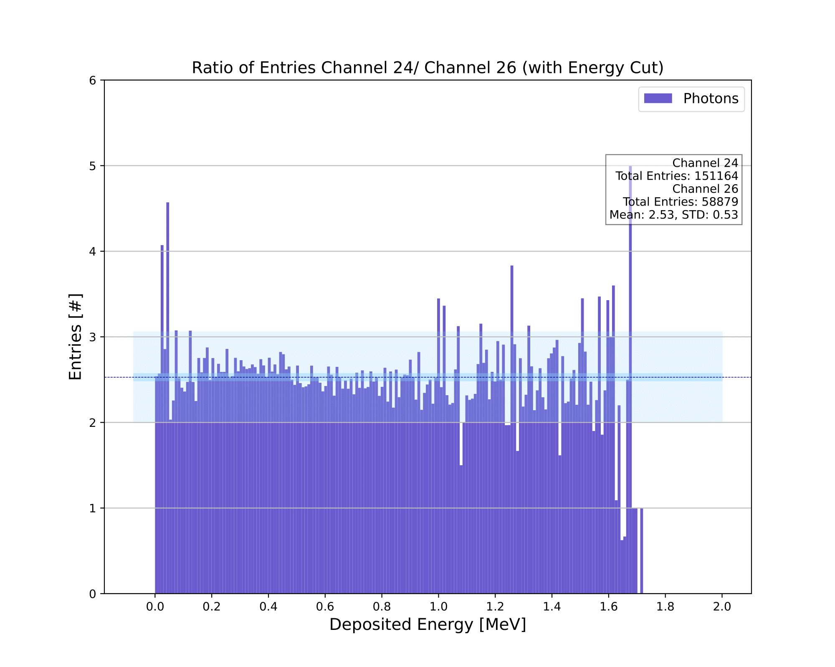
Energy Ratio (Channel 24 / Channel 26)
Luke Saunders | Progress Report | April 20th, 2023 41

Slide 42
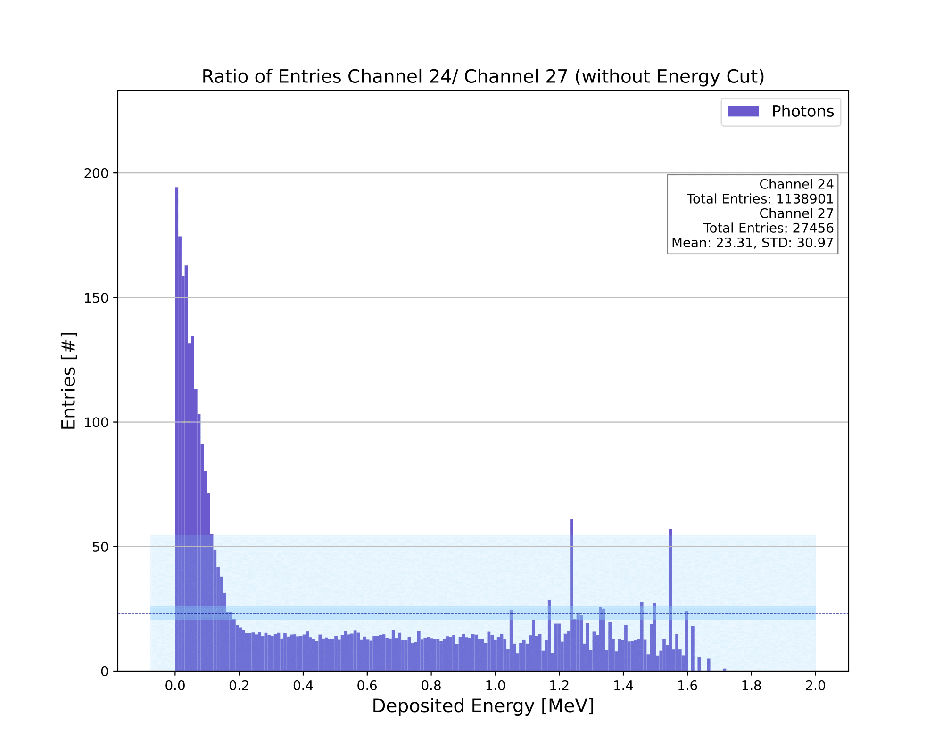
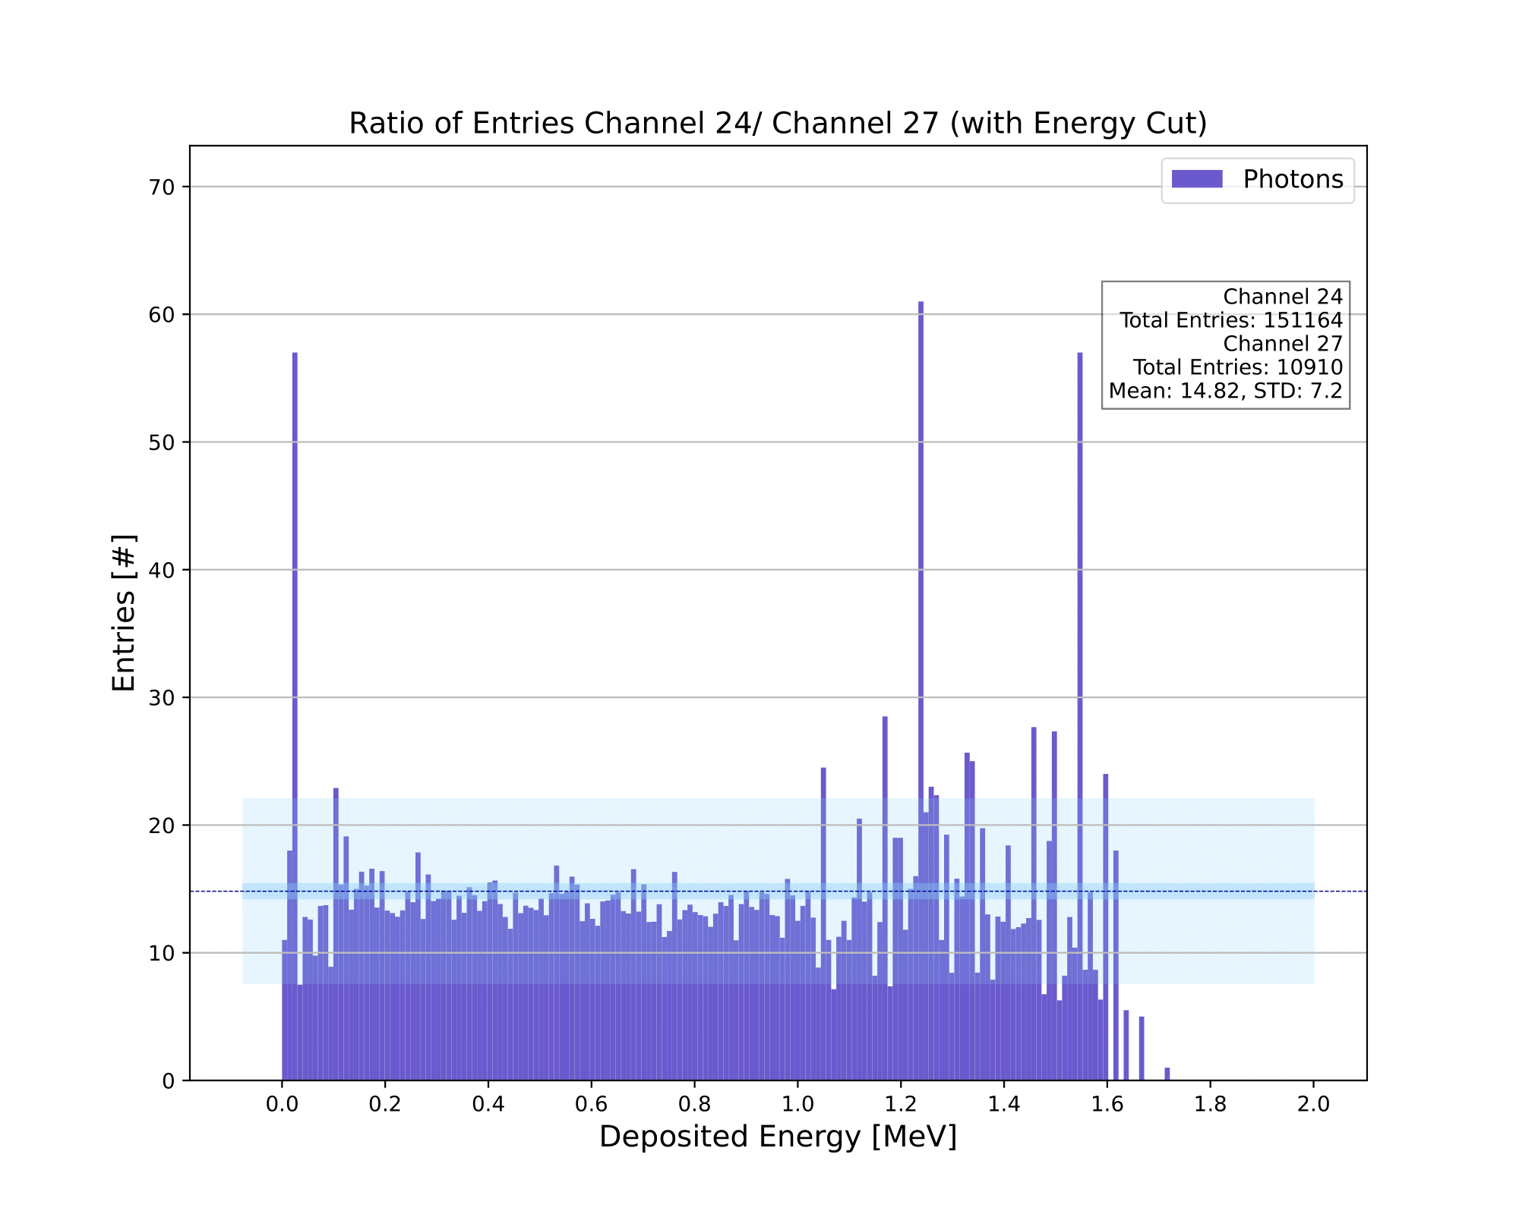
Energy Ratio (Channel 24 / Channel 27)
Luke Saunders | Progress Report | April 20th, 2023 42

Slide 43
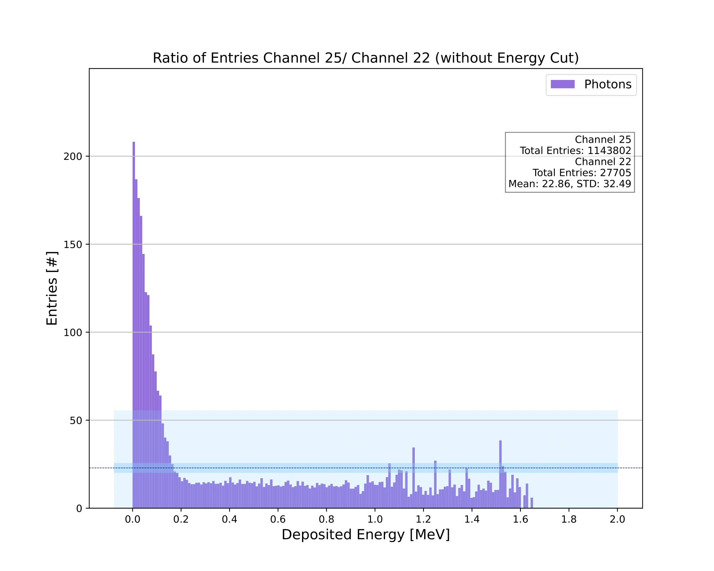
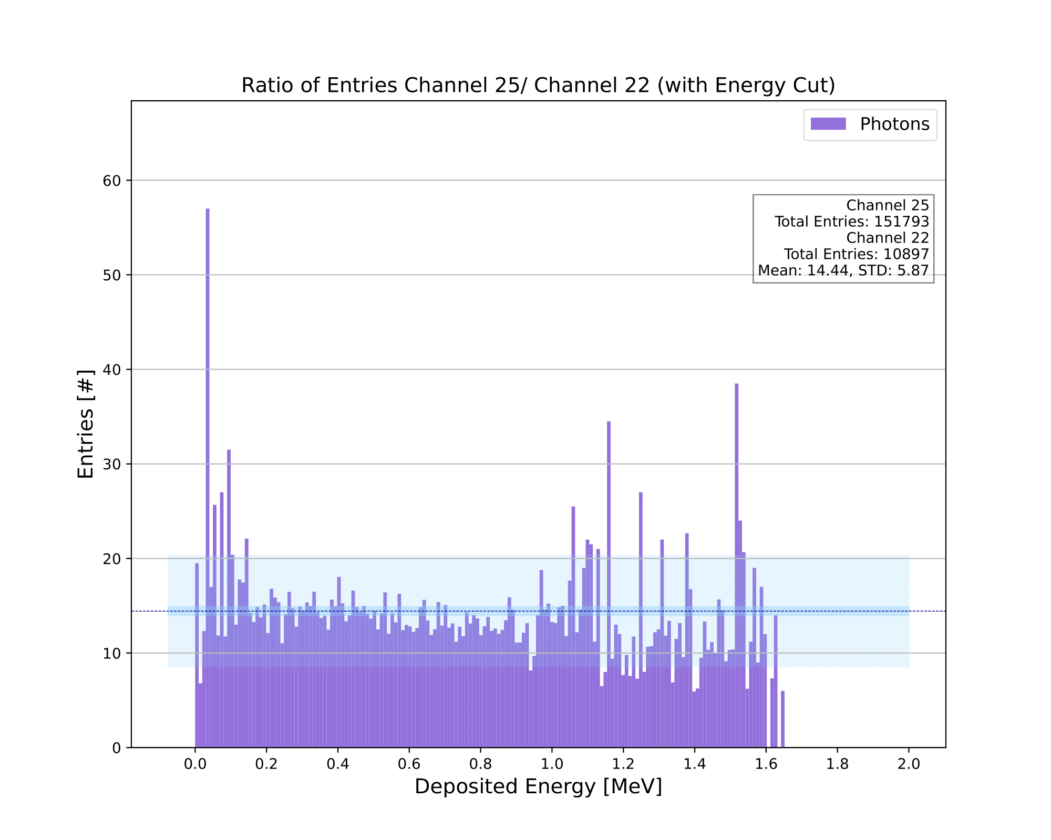
Energy Ratio (Channel 25 / Channel 22)
Luke Saunders | Progress Report | April 20th, 2023 43

Slide 44


Energy Ratio (Channel 25 / Channel 23)
Luke Saunders | Progress Report | April 20th, 2023 44

Slide 45


Energy Ratio (Channel 25 / Channel 24)
Luke Saunders | Progress Report | April 20th, 2023 45

Slide 46


Energy Ratio (Channel 25 / Channel 25)
Luke Saunders | Progress Report | April 20th, 2023 46

Slide 47


Energy Ratio (Channel 25 / Channel 26)
Luke Saunders | Progress Report | April 20th, 2023 47

Slide 48


Energy Ratio (Channel 25 / Channel 27)
Luke Saunders | Progress Report | April 20th, 2023 48

Slide 49
Photon Inner and Outer Channels
The following plots show the true inner and outer channel photon energy spectra created from the simulation code.
  The interest in these plots becomes apparent in a few slides; however, this point in the process cannot be overstated as it allows us to properly adjust for background noise once real data is being taken.
Although the simulation code does not presently account for additional background noise (such as cosmic rays), this process should still effectively eliminate a large bulk of the background present in genuine data taking.
Luke Saunders | Progress Report | April 20th, 2023 49

Slide 50


Photon Energy Outer Channels
Luke Saunders | Progress Report | April 20th, 2023 50

Slide 51


Photon Energy Inner Channels
Luke Saunders | Progress Report | April 20th, 2023 51

Slide 52
Rediscovering the Electron Energy Spectrum
From all the previous work, the electron energy spectrum is obtained from scaling the outer channel photon energy spectrum to match the inner channel distribution.
  In doing so, one can subtract this scaled spectrum from the fake data spectrum, ultimately producing the electron energies.
In the following slides, one can clearly see how closely this method matches the true electron spectrum.
  Another important note, since many of the decay products of Bi207 are probabilistically unlikely to happen, one only sees two peaks post-energy cut.
Luke Saunders | Progress Report | April 20th, 2023 52

Slide 53


Photon Energy Ratio of Inner / Outer Channel
Luke Saunders | Progress Report | April 20th, 2023 53

Slide 54


Photon Energy Outer Channels Scaled
Luke Saunders | Progress Report | April 20th, 2023 54

Slide 55


Electron Energy Subtracted Inner Channels
Luke Saunders | Progress Report | April 20th, 2023 55

Slide 56


Electron Energy Subtracted Inner Channels
Luke Saunders | Progress Report | April 20th, 2023 56

Slide 57
Difference and Accuracy of Process
The following plots focus on highlighting the accuracy of finding the electron energy spectrum by subtracting background produced on outer collection channels
Although there is a reasonably small error pertaining to certain regions of the energy spectrum, it is important to consider the rather large errors.
  At present, I am unsure of the source of some of these large errors, specifically those relating to data taken post-energy cut.
  As mentioned previously, the pre-cut energy spectrum is not necessary to our work and its error does not highlight anything particularly meaningful.
Luke Saunders | Progress Report | April 20th, 2023 57

Slide 58


True Electrons and Fake Data Difference
Luke Saunders | Progress Report | April 20th, 2023 58

Slide 59


True Electrons and Fake Data Accuracy
Luke Saunders | Progress Report | April 20th, 2023 59

Slide 60
Future Steps
Adding fits to our analysis of the energy obtained on the collection strips.
Include secondary Compton scattering interactions.
Include a timing system.
  Multifaceted and would require an understanding of the speeds at which both the gamma particles and electrons travel within the liquid argon.
Fix the minimum angle of the decay emission due to the physical boundaries of the source container.
Include a proper simulation of the image charge created across all strips (collection, induction 1, and induction 2).
  This step requires the timing system previously discussed.
Luke Saunders | Progress Report | April 20th, 2023 60

Slide 61
Acknowledgements
Dr. Francesco Pietropaolo (CERN) for his help concerning theoretical questions, as well as those having to deal with the technical makeup of the overall experiment.
Mattia Fani (LANL) for his dedication in helping me better understand certain aspects of the simulation code, alongside guiding me on how to become a more efficient and effective coder.
Luke Saunders | Progress Report | April 20th, 2023 61

