Slide 1
Spring at ISOLTRAP 2023/4/27
Roy Bualuan

Slide 2
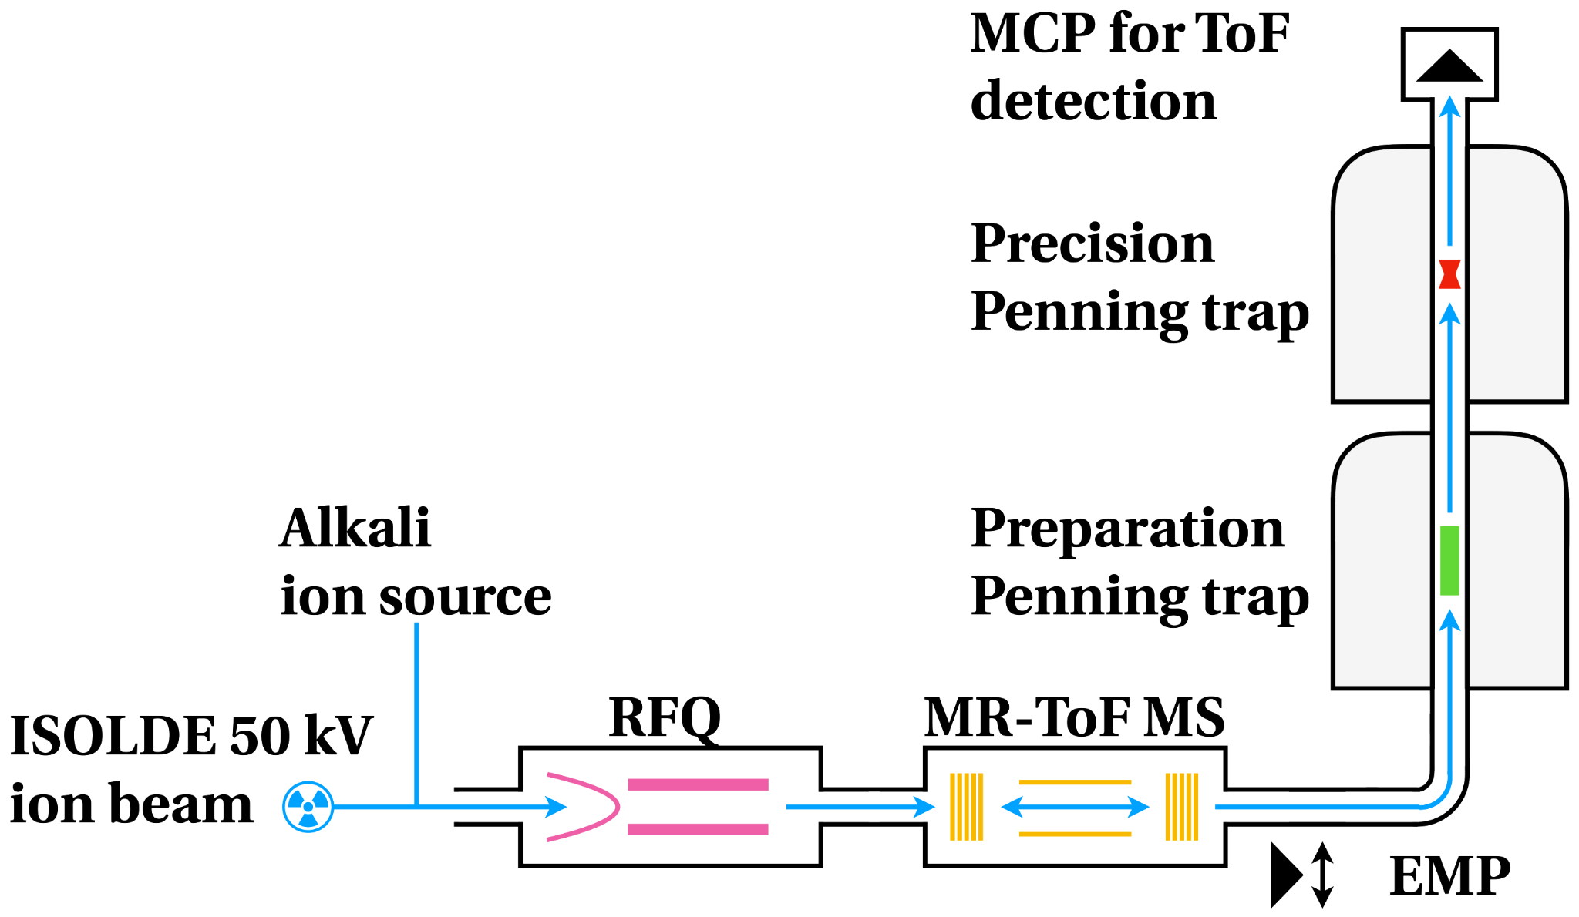
QUICK REMINDER:
Environmental Sensors
Various Odd Jobs/Help
Partial Software Transition to EPICS

Slide 3
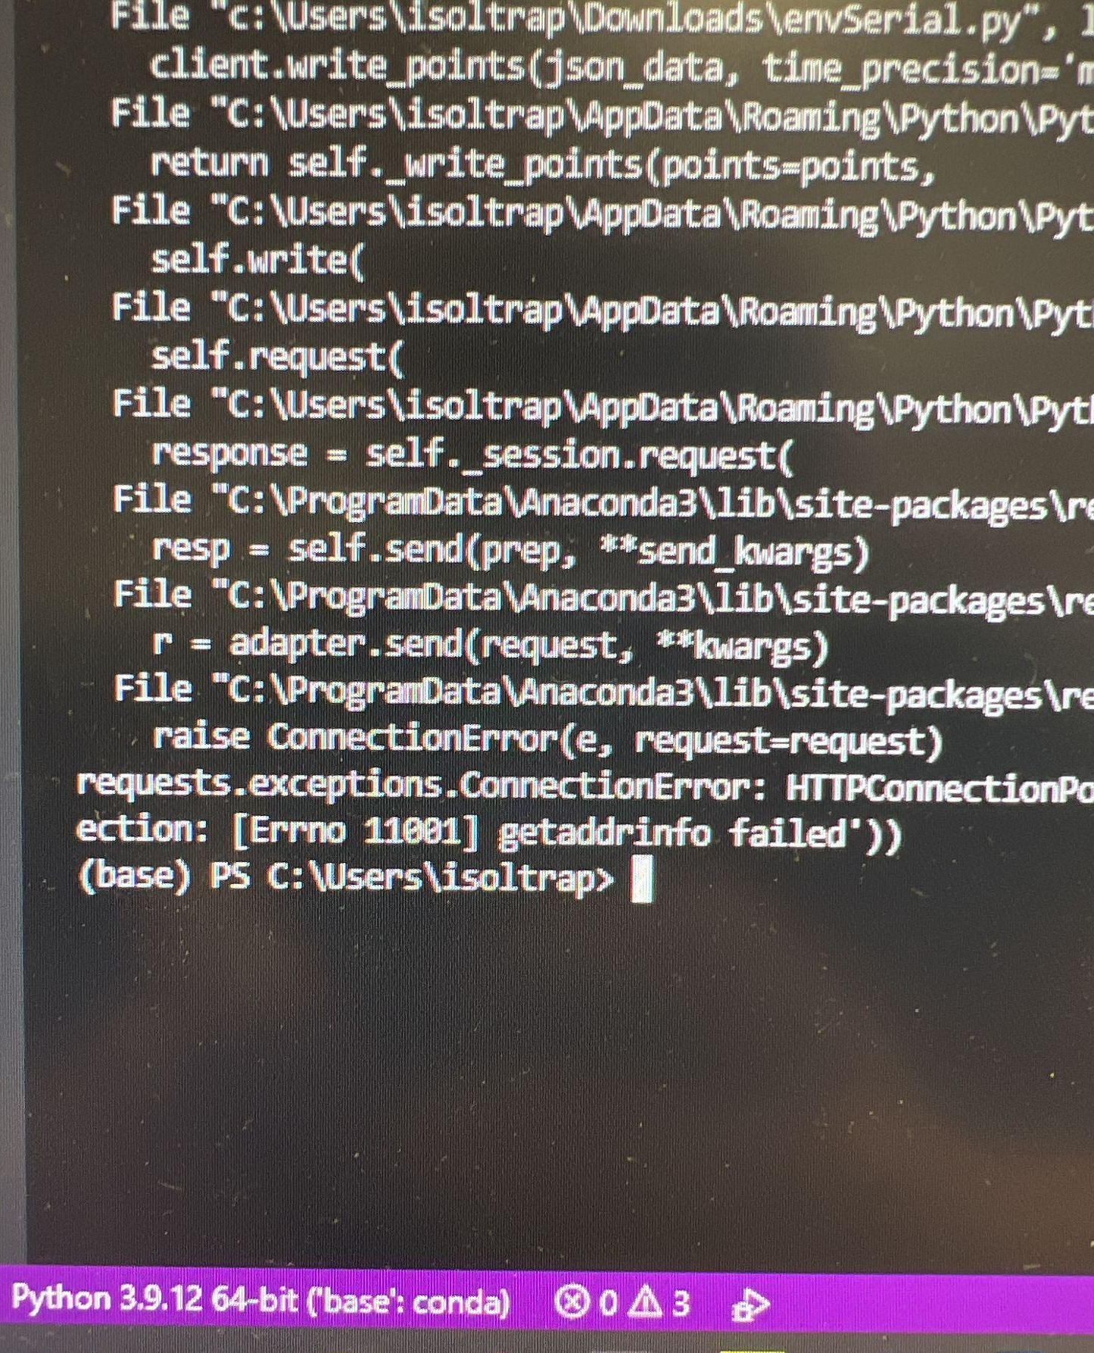
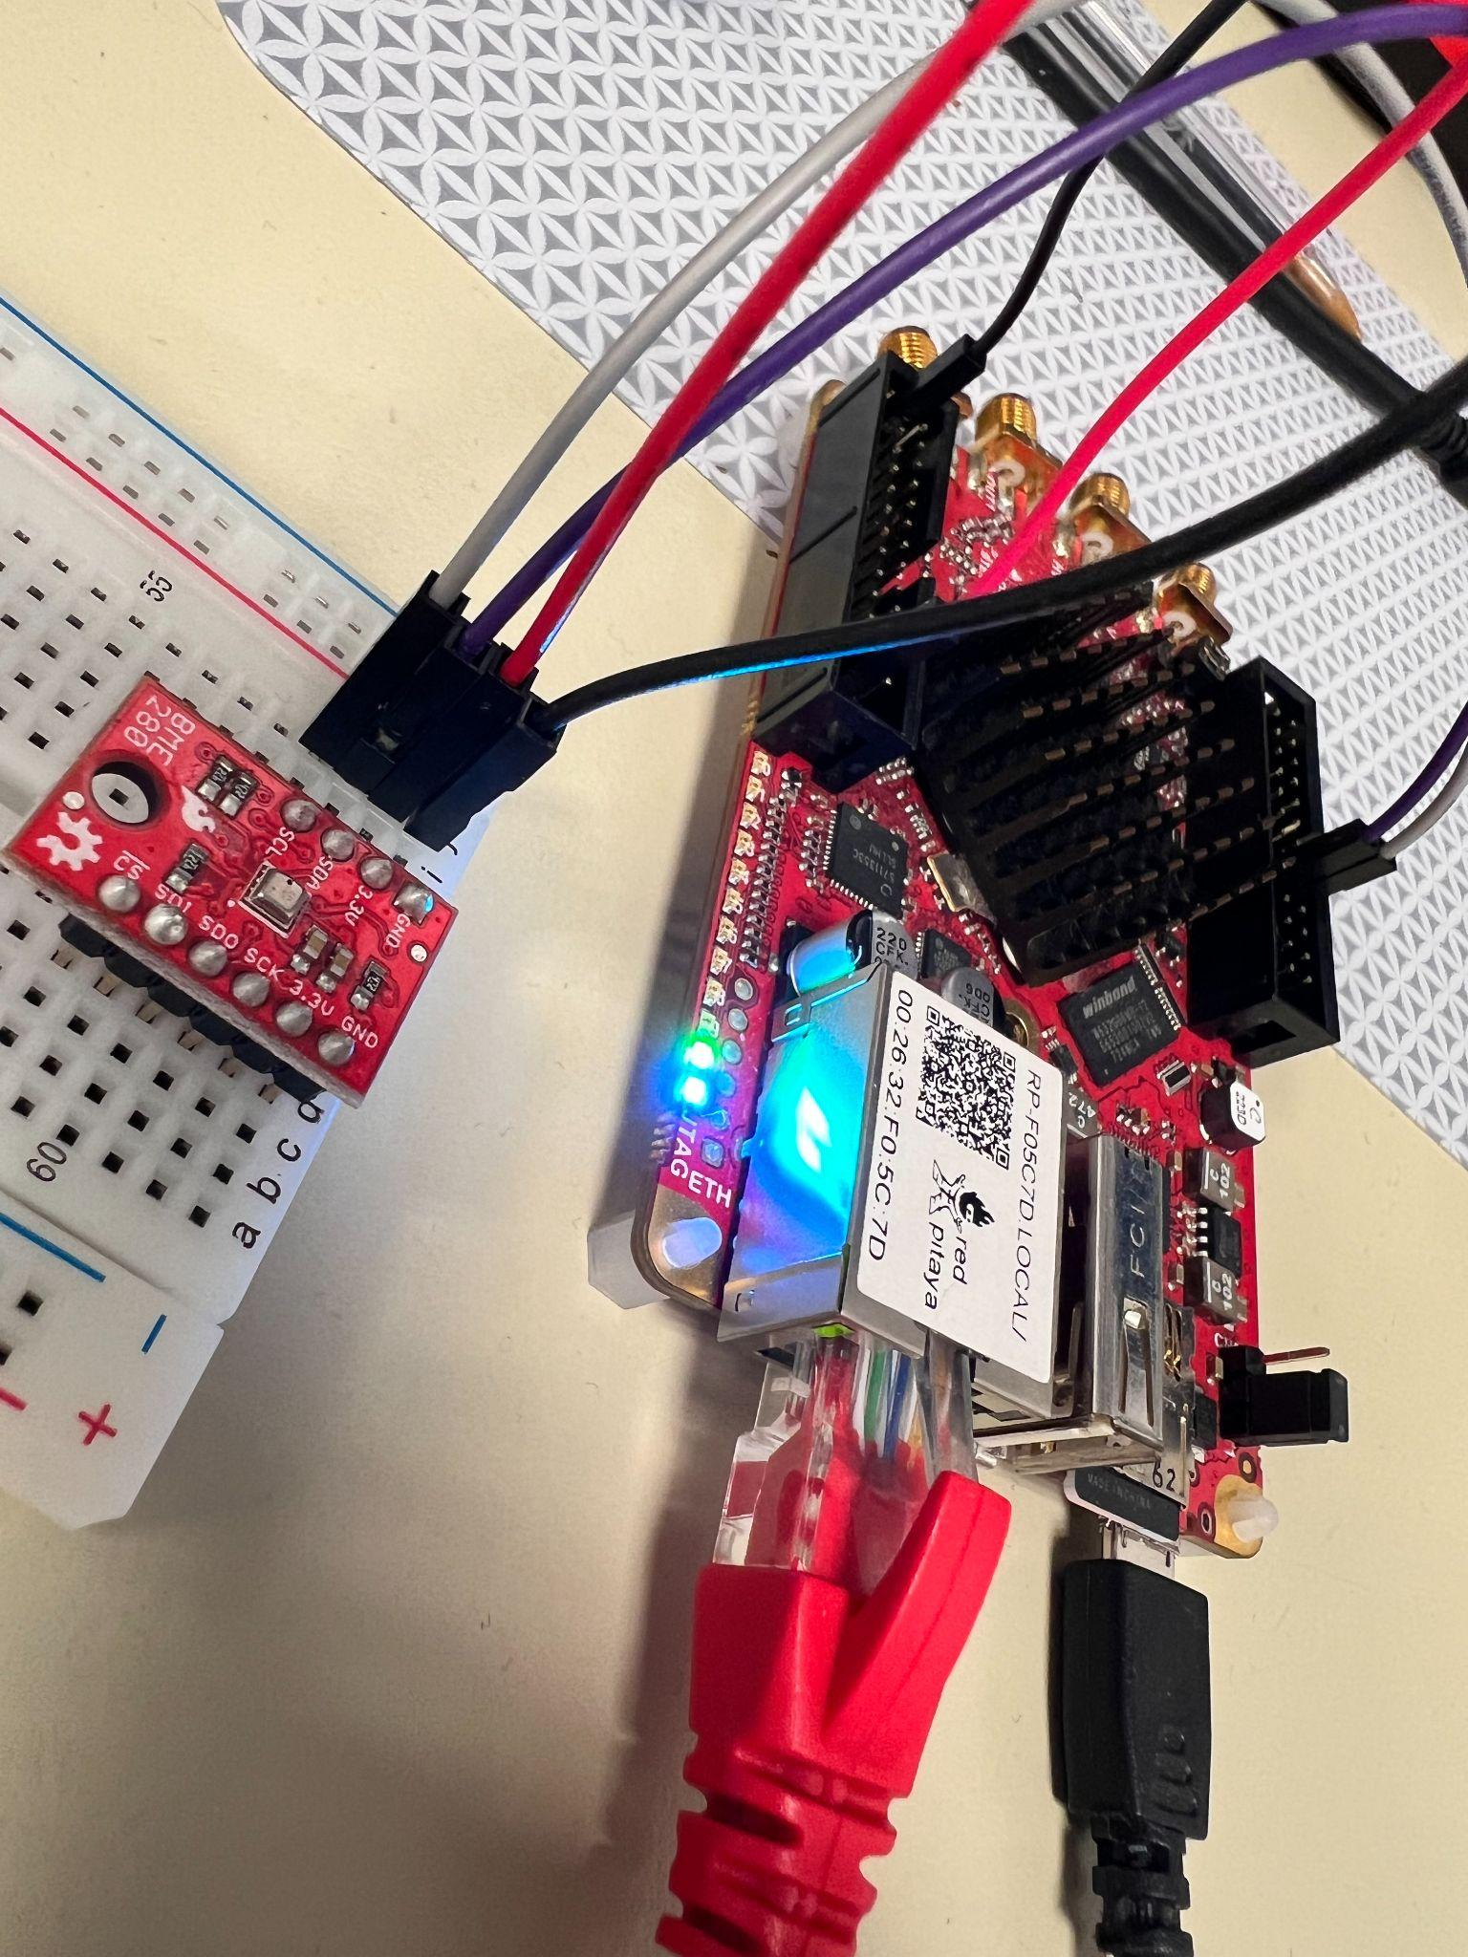
Technical Difficulties
RedPitaya issues
  Couldn’t detect BME280
  Couldn’t use BME280 and flux detector simultaneously
  Couldn’t push data to server
  Couldn’t communicate via pyVisa
  Inconsistent across different Python versions
Solution: Ditch RedPitaya!

Slide 4
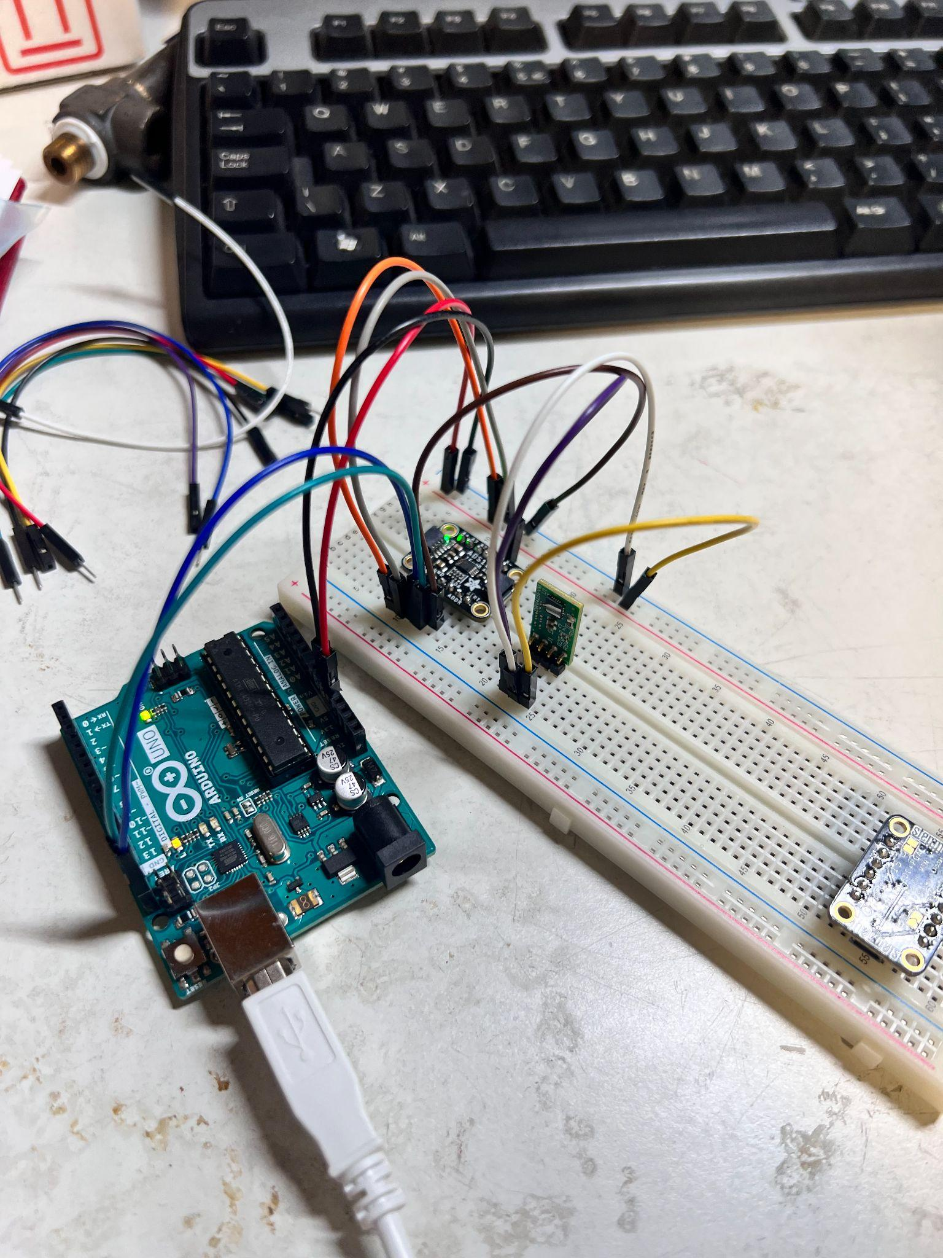
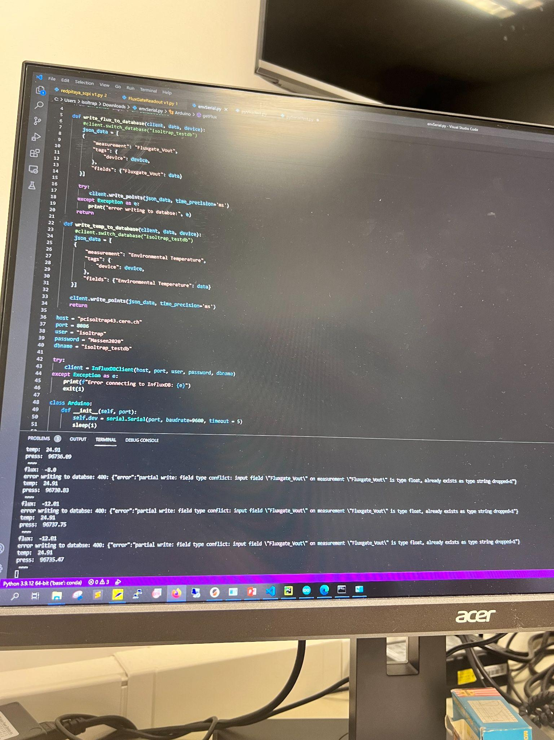
Technical Difficulties (cont.)
Arduino incompatibility
Couldn’t use BME280 and flux detector simultaneously
Couldn’t push data to PC
Inconsistent across different Python versions
Grafana breaking randomly
Low resolution
Decoding serial data

Slide 5
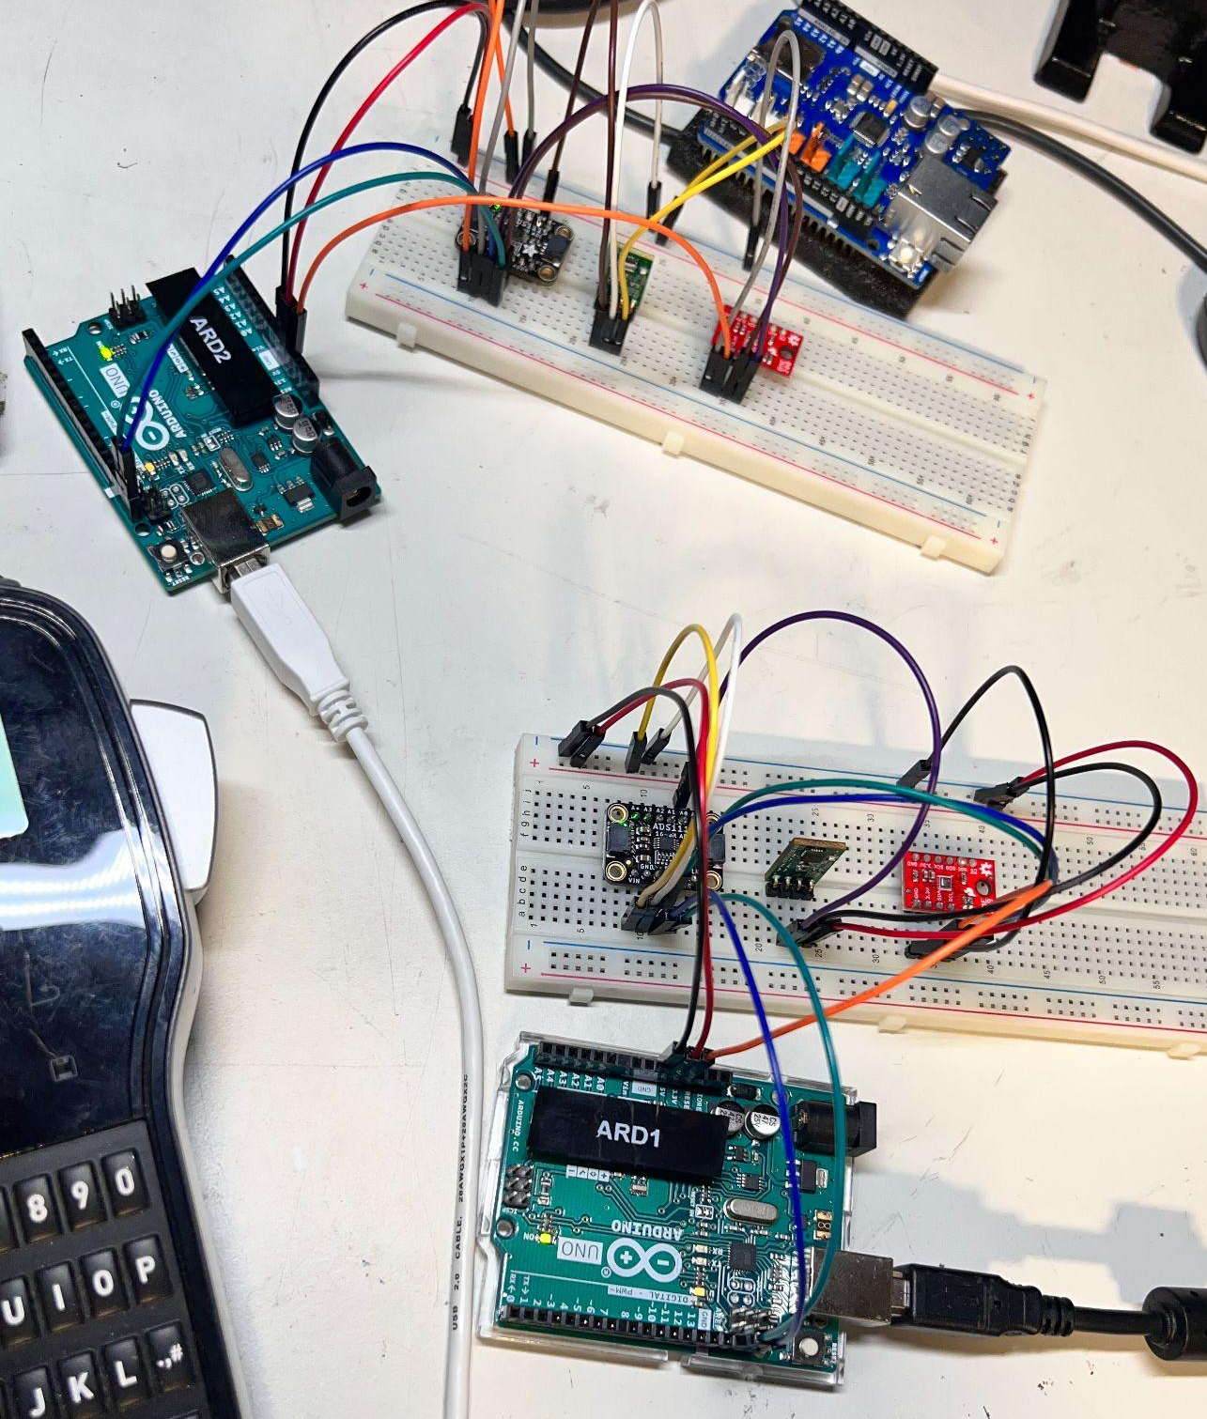
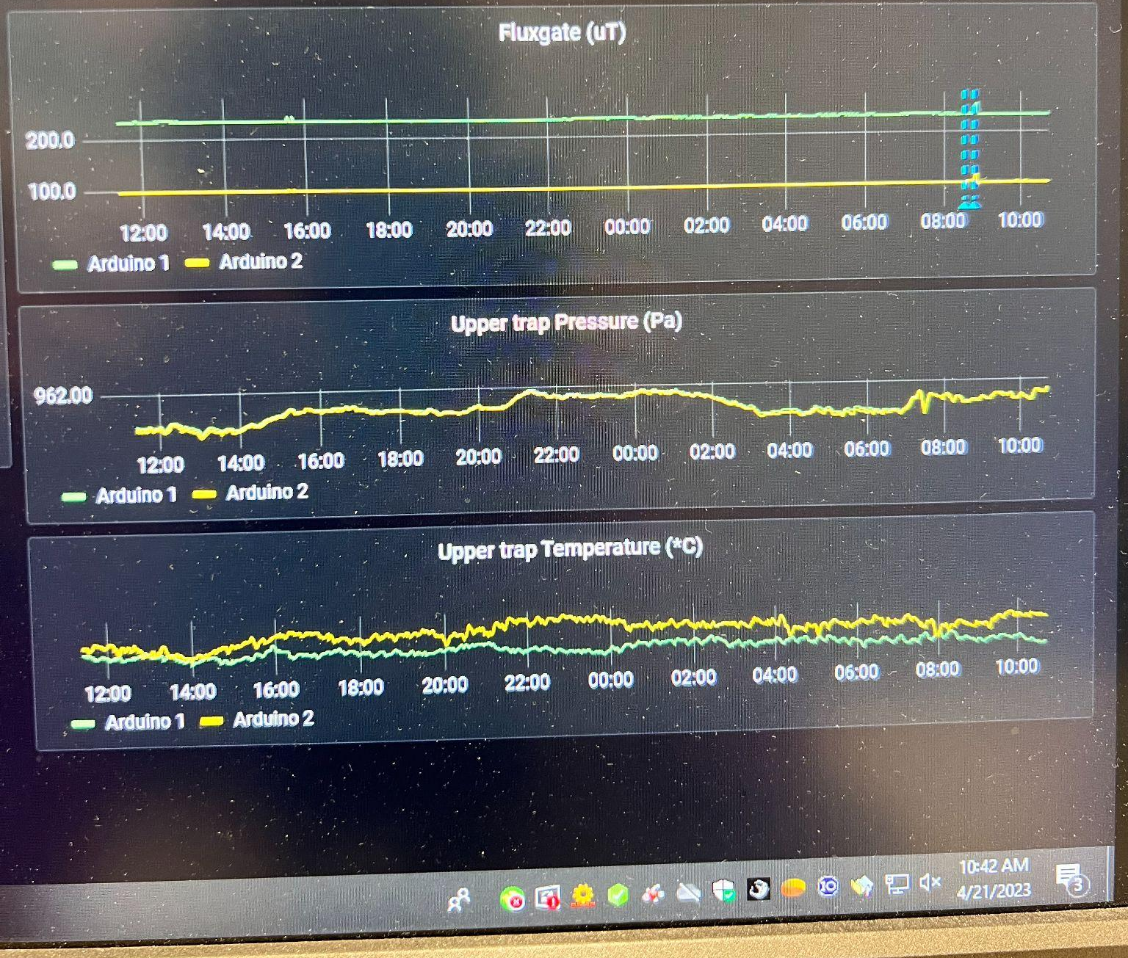
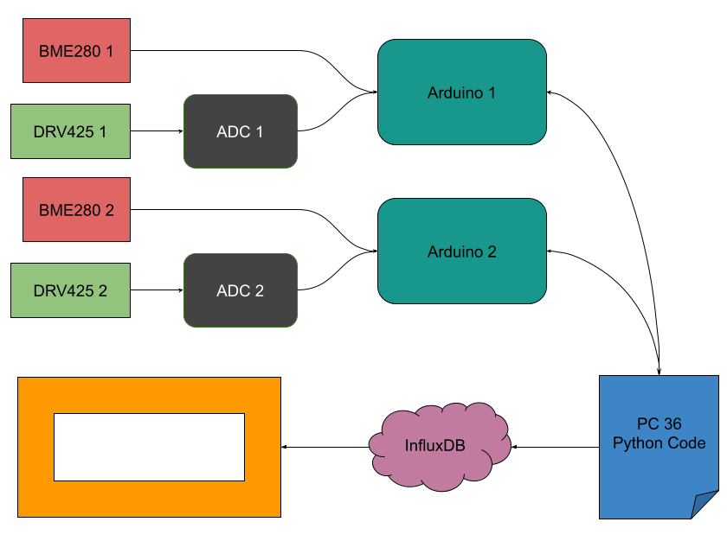
Where are we now?
Working arduino & python code
High resolution data sent to Grafana
Multiple (prototypical) detectors functional

Slide 6
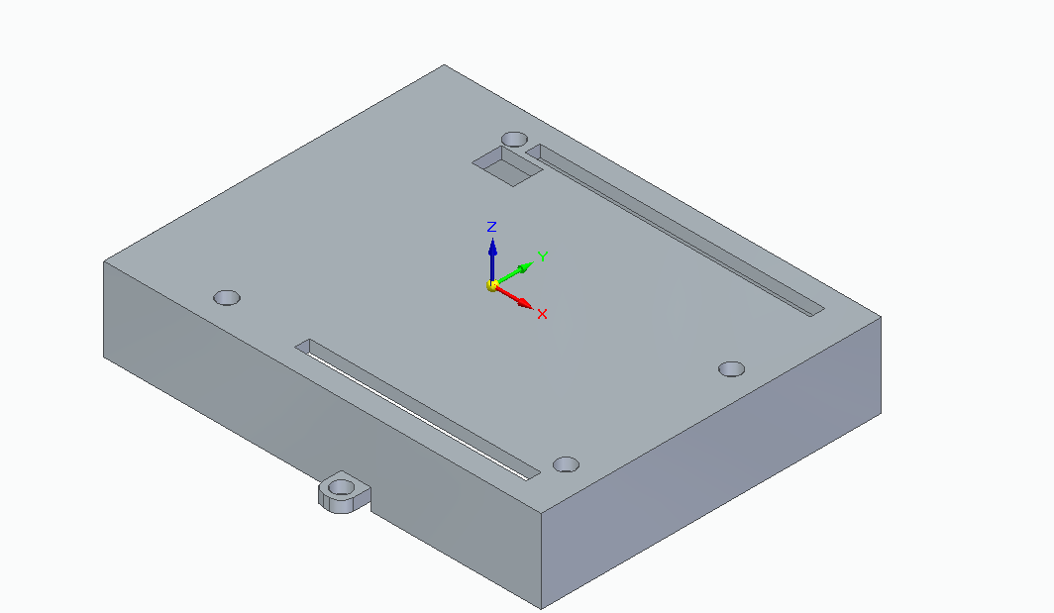
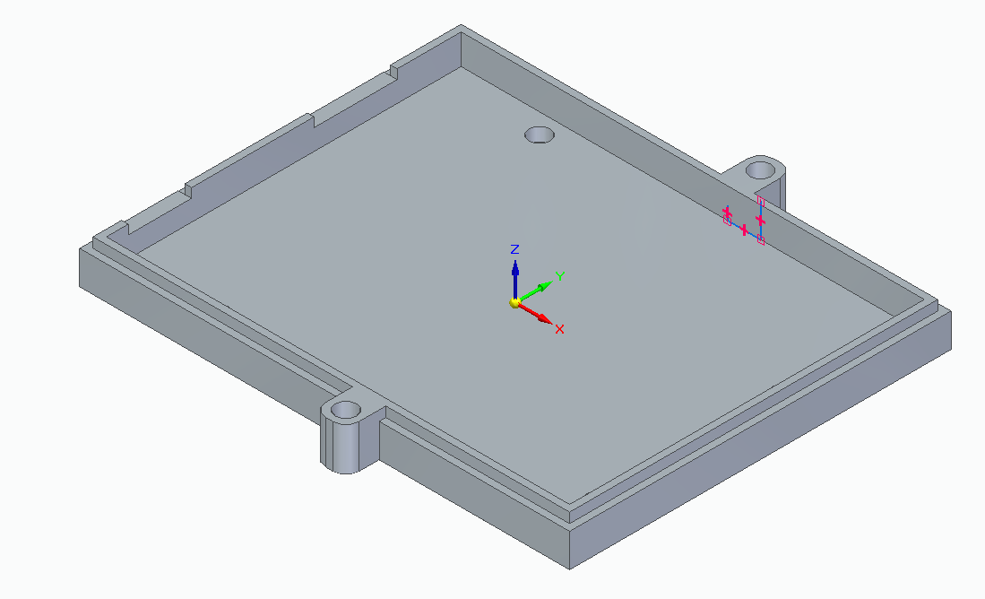
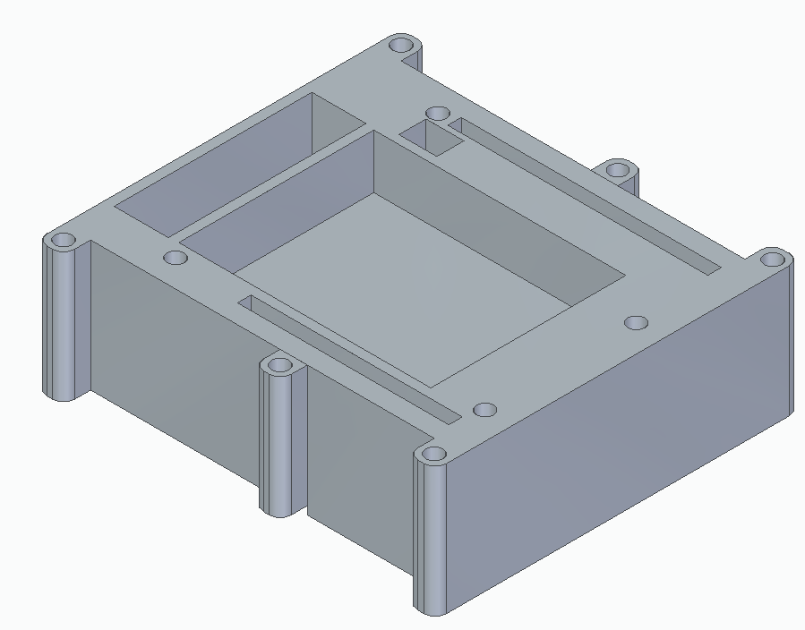
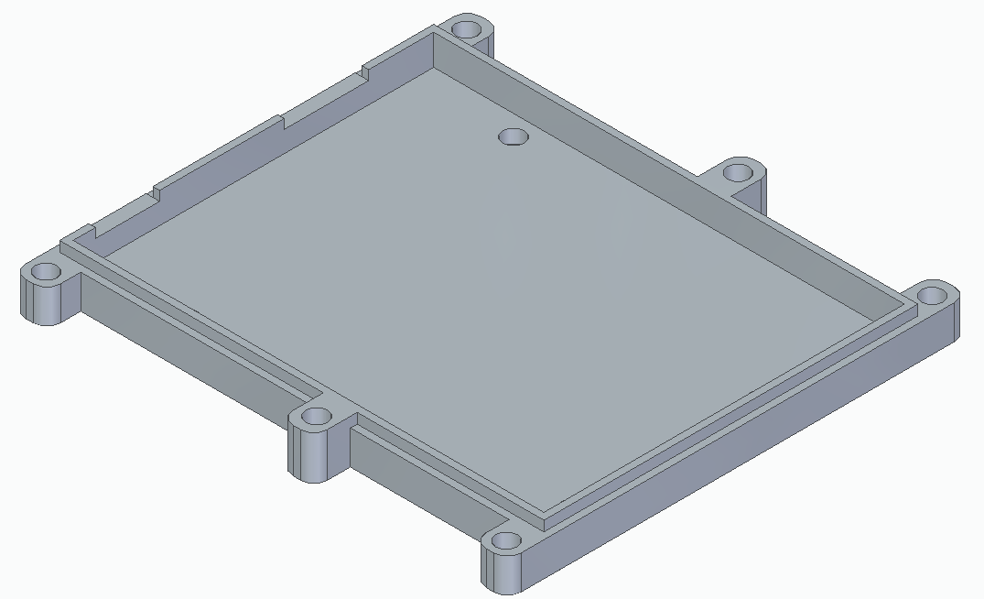
What’s next?
Environmental Sensors
  Third set of detectors & arduinos
  3D case modeling
  Properly mount detectors
  Rewire detectors and electronics
Beam time!

