Slide 1


Voltage transient simulations of the LHC main dipoles
Marvin Janitschke, TE-MPE-PE, DOCT
Acknowledgements:
Special thanks to: E. Ravaioli, C. Wiesner, M. Wozniak, M. Bednarek,
R.G. Saederup and all colleagues involved in the LHC FPA snapshot tests
Gentner scholarship

Slide 2
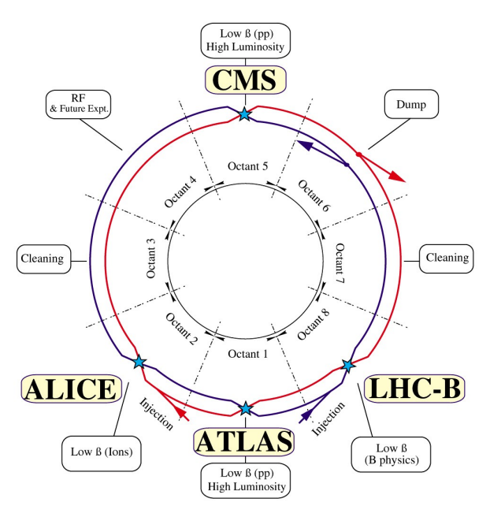
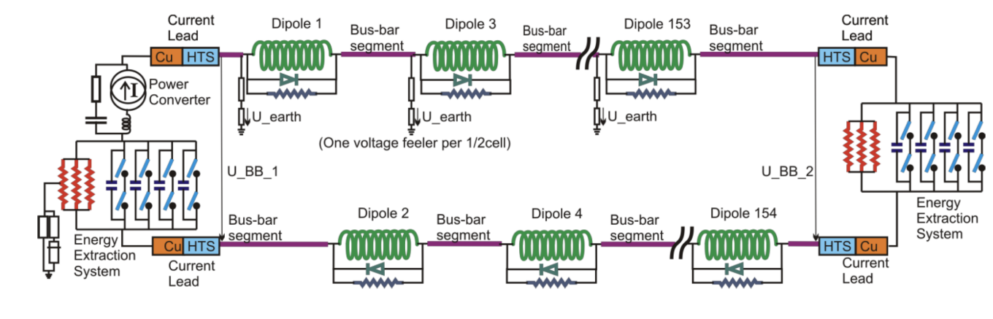
Main dipole LHC circuit
Each circuit consists of:
- 154 MB dipoles
- 13 kA power converter (PC)
- Bus-bars between magnets
- Current leads, sensing devices and earth fault systems
1
2
Each octant
3
4
4
1
3
2
5
6
4
Protection
Protection by-pass diodes
Protective parallel resistors
4x Quench heater per magnet
aperture
2x Energy extraction systems for protection (EE)
4
7
5
6
EE1
EE2
7
Marvin Janitschke | Voltage transient simulations of the LHC main dipoles

Slide 3
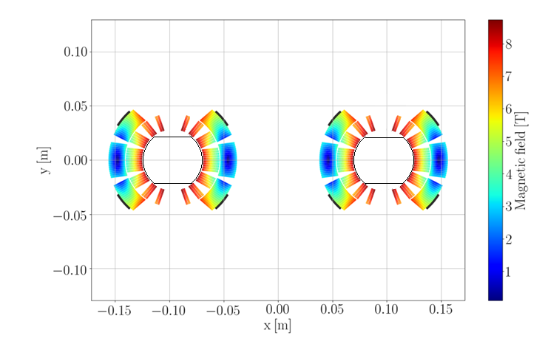
LHC main dipole magnet
Beam-screen
Parameter | Value | Unit
Length | 14.3 | m
Operating temperature | 1.9 | K
Nominal field | 8.33 | T
Current at nominal field | 11850 | A
Inductance at nominal field | 98.7 | mH
Stored energy at nominal field | 1.3 | GJ
Inner coil diameter | 56 | mm
Beam-screen and quench heaters not to scale
Marvin Janitschke | Voltage transient simulations of the LHC main dipoles

Slide 4
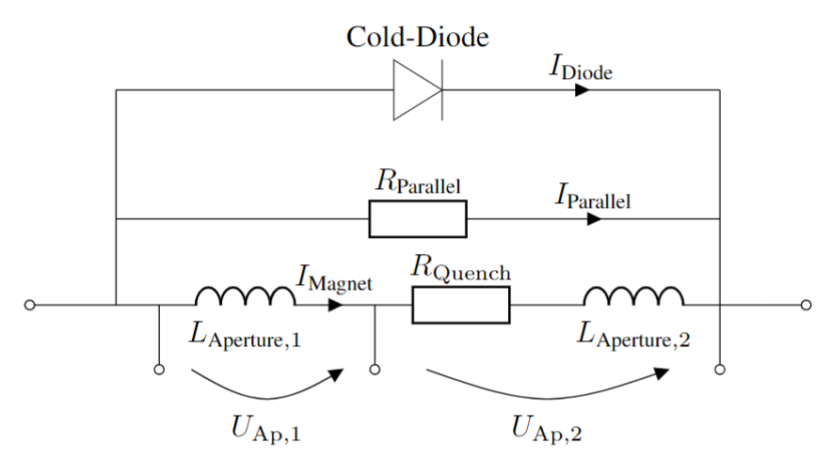
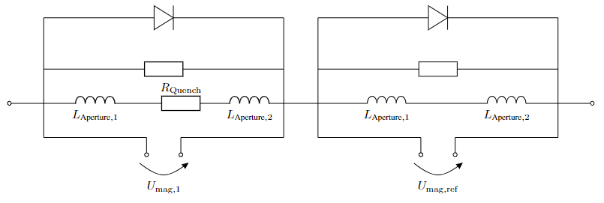


Quench detection systems
- Quenches in the main dipoles are detected in 2 ways:
1
Via voltage taps at extremes and middle point:
2
Comparing voltages across 4 adjacent magnets:
iQPS
nQPS
If voltage across a full magnet differs from its reference:
→ Quench detected
Problem: Symmetric quench!
Marvin Janitschke | Voltage transient simulations of the LHC main dipoles

Slide 5
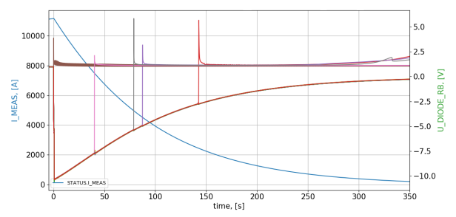
Usual transient in main dipole circuit
Subsequent quenches
Event | Name | Time
1. | Quench detection | ~ -10 ms
2. | Fast Power Abort | ~ 0 s
3. | Opening of the first energy extraction (middle of chain) | ~ 100 ms
4. | Opening of the second energy extraction (end of chain) | ~ 600 ms
5. | End of discharge | ~ 350-400 s
Initial quench
Subsequent quenches due to:
- Gaseous helium propagation
- Spurious triggering of quench protection
- …
Marvin Janitschke | Voltage transient simulations of the LHC main dipoles

Slide 6
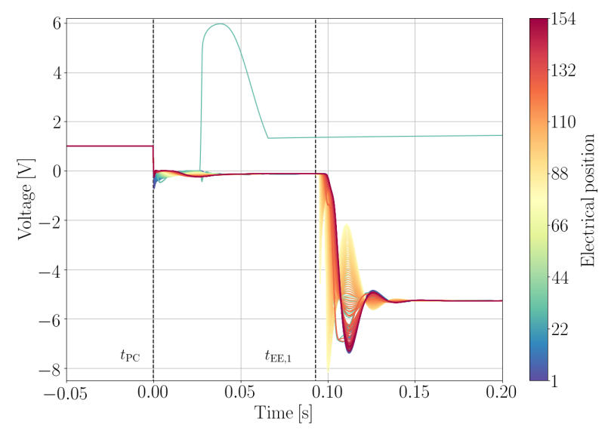
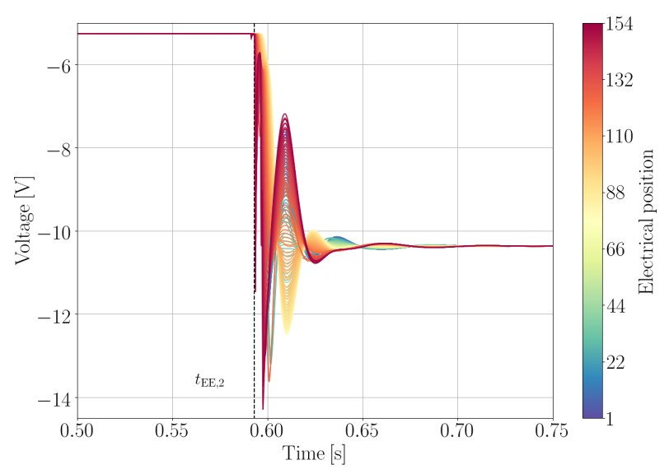
Usual transient in Main dipole circuit
Developed resistance in magnet leads to diode opening
Wave progagates from the middle towards the ends
From the beginning towards the center
After each switch opening (PC, EE1, EE2) we observe voltage waves travelling through the magnet
→ Exponentially decaying wave seeing a different phase shift at each magnet
+ Further phenomena like superposition/ reflection etc.
Marvin Janitschke | Voltage transient simulations of the LHC main dipoles

Slide 7
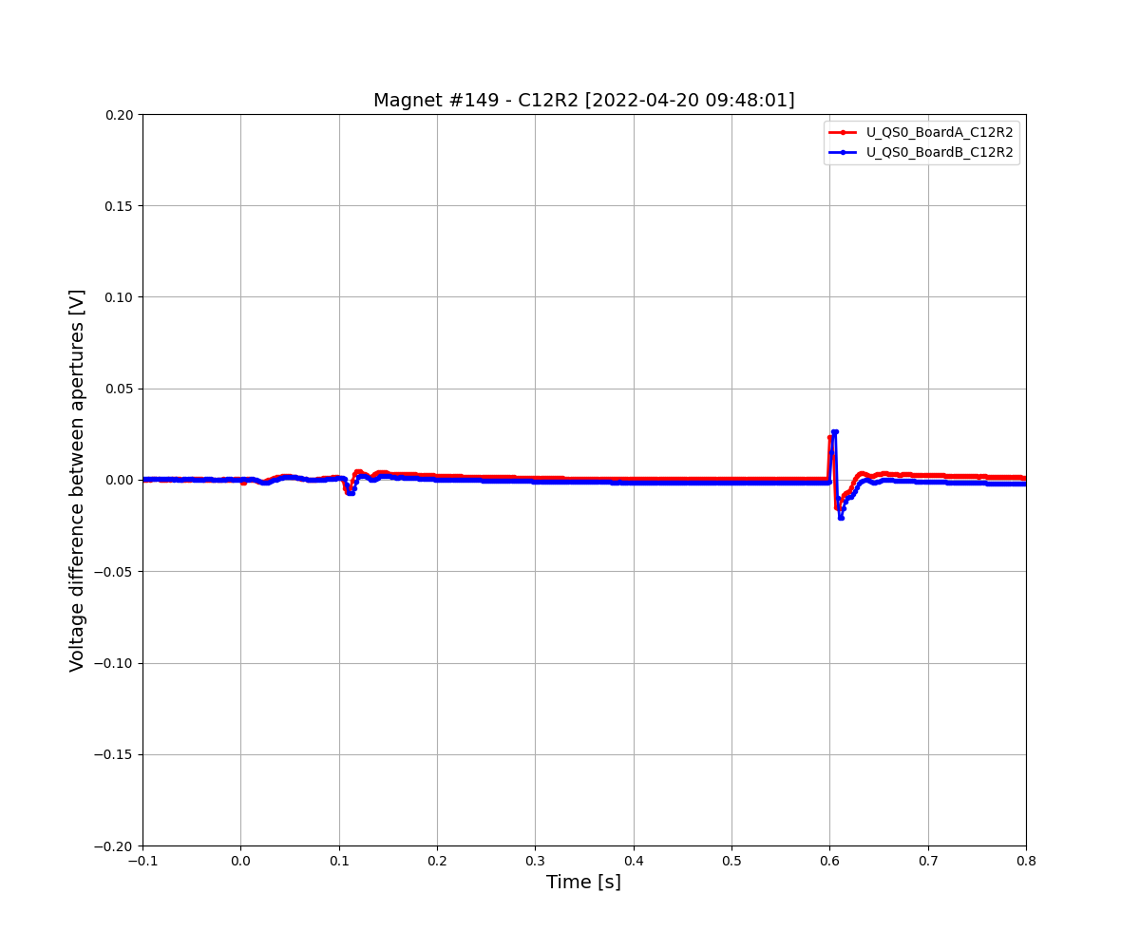
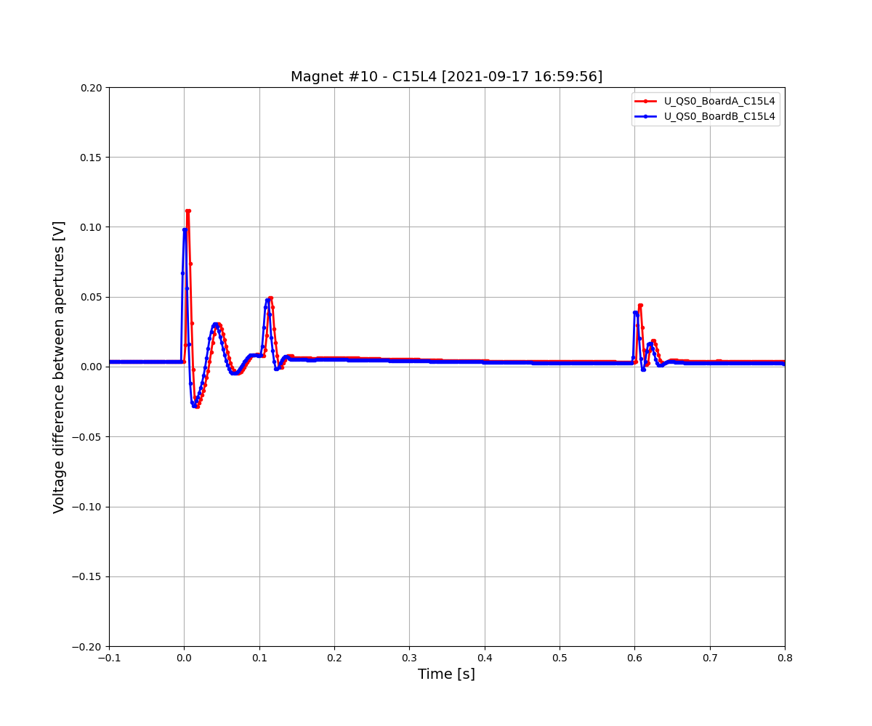


Typical examples of the $U_{QS,0}$ signal
Normal $U_{QS,0}$ signal in a transient
Other recorded $U_{QS,0}$ signals
QDS threshold
Peak-to-Peak amplitude
QDS threshold
Flat signal with only very little bumps
Expected, as magnet apertures are supposingly identical
Significant bumps, which can occur at PC, EE1 or EE2
Bumps sometimes even shortly cross QDS thresholds
→ potential spurious triggering
Indicate impedance differences between the apertures
Unbalanced dipole
impedance
More examples can be found: MP3 day 2022, 01.12.2022,
E. Ravaioli & M. Janitschke: FPA tests: Results and plans for the future
Marvin Janitschke | Voltage transient simulations of the LHC main dipoles

Slide 8
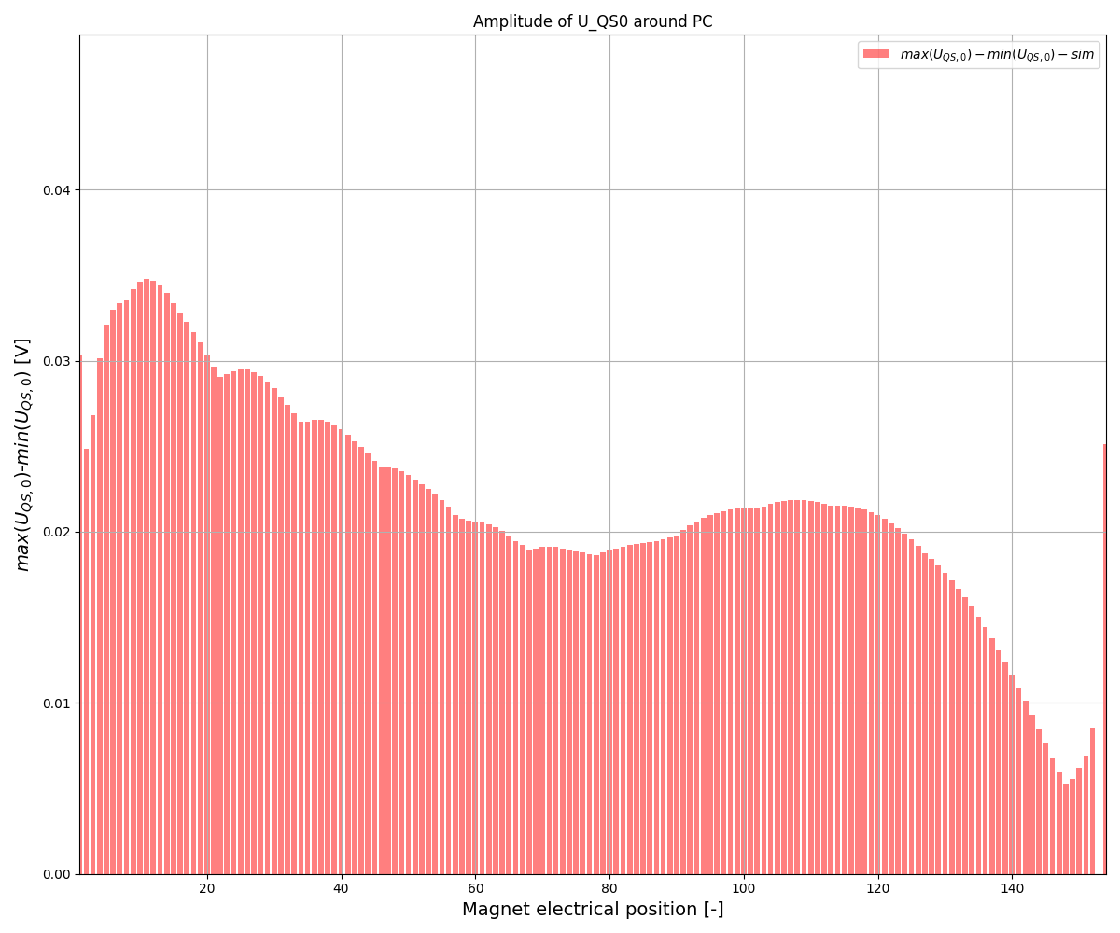
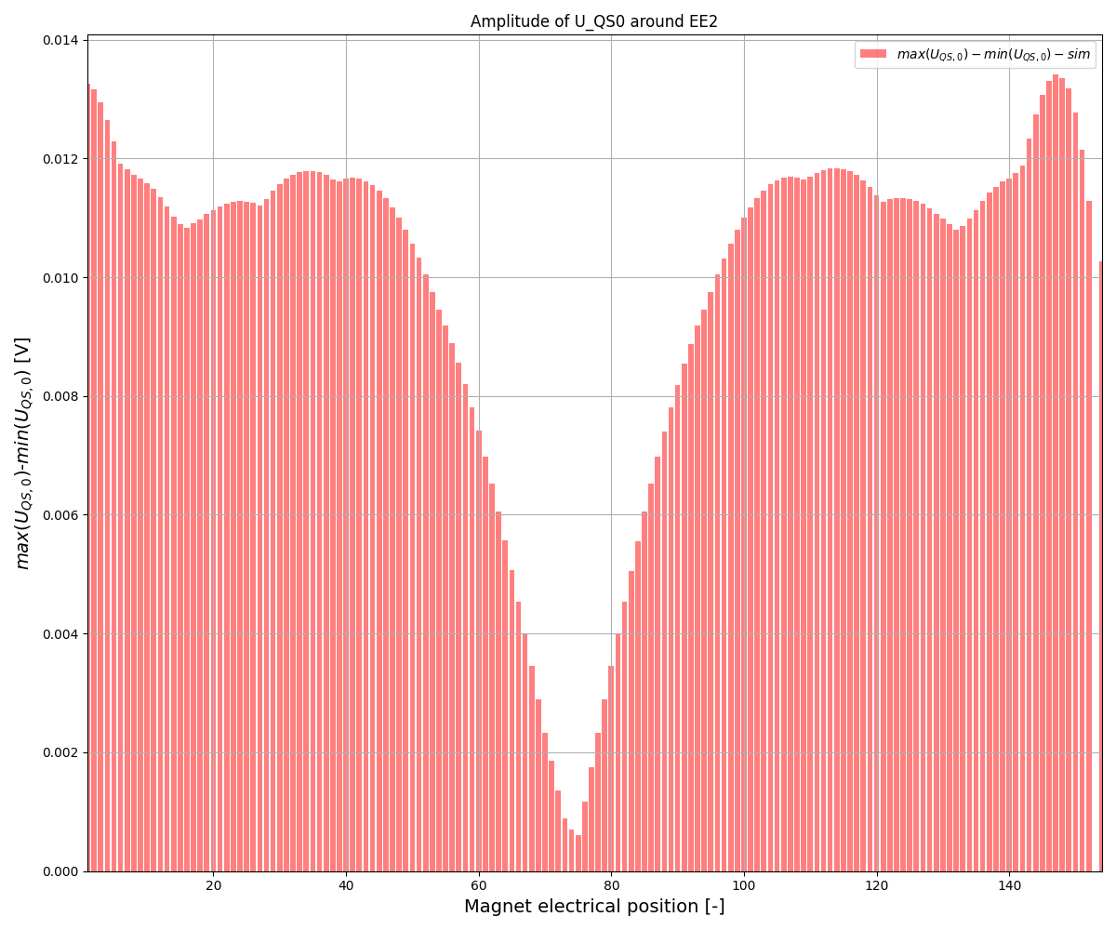
Unexplained behavior:
Unbalanced dipole impedance
Expected $U_{QS,0}$voltage signals from simulations
BUT:
Marvin Janitschke | Voltage transient simulations of the LHC main dipoles

Slide 9
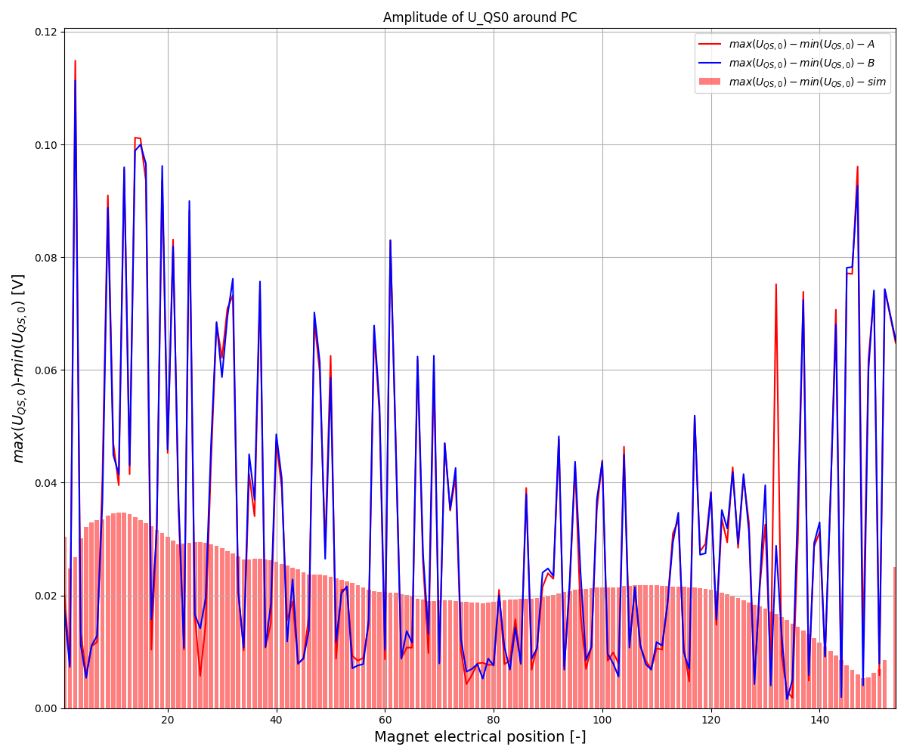
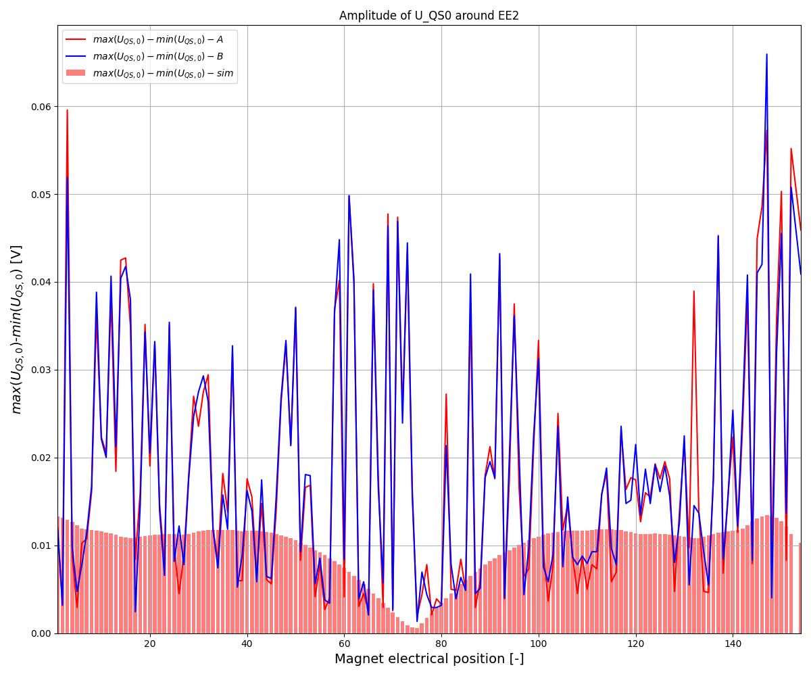

Unexplained behavior:
Unbalanced dipole impedance
Measured $U_{QS,0}$voltage signals
BUT:
Marvin Janitschke | Voltage transient simulations of the LHC main dipoles

Slide 10
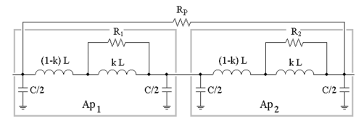
Modelling of the magnets – so far
- In case of no quench, the circuit behavior can be captured relatively precisely by a pure electrical model, utilizing ideal inductors → Simulation in SPICE
- In order to account for the unbalanced impedance, the magnet model got replaced
→ Instead of pure inductors, each aperture is split up into two inductors, one bridged by a resistor
- Values were found empirically
Aperture 1
Aperture 2
E. Ravaioli, K. Dahlerup-Petersen, F. Formenti, J. Steckert, H. Thiesen, A. Verweij, "Modeling of the Voltage Waves in the LHC Main Dipole Circuits",
IEEE Trans. Appl. SC, Vol 22, June 2012 , DOI: 10.1109/TASC.2011.2176306.
Marvin Janitschke | Voltage transient simulations of the LHC main dipoles

Slide 11
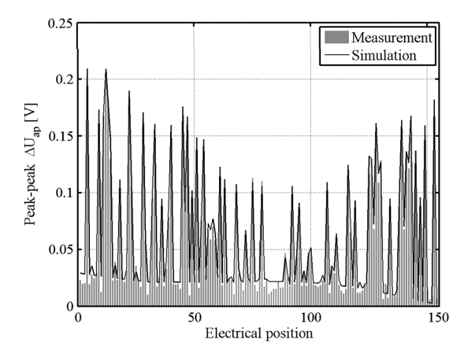
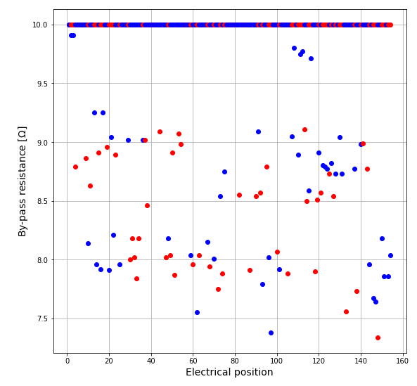
Modelling of the magnets – so far
Fitting works pretty good at low current
→ At high currents this breaks down
E. Ravaioli, K. Dahlerup-Petersen, F. Formenti, J. Steckert, H. Thiesen, A. Verweij, "Modeling of the Voltage Waves in the LHC Main Dipole Circuits",
IEEE Trans. Appl. SC, Vol 22, June 2012 , DOI: 10.1109/TASC.2011.2176306.
Marvin Janitschke | Voltage transient simulations of the LHC main dipoles

Slide 12
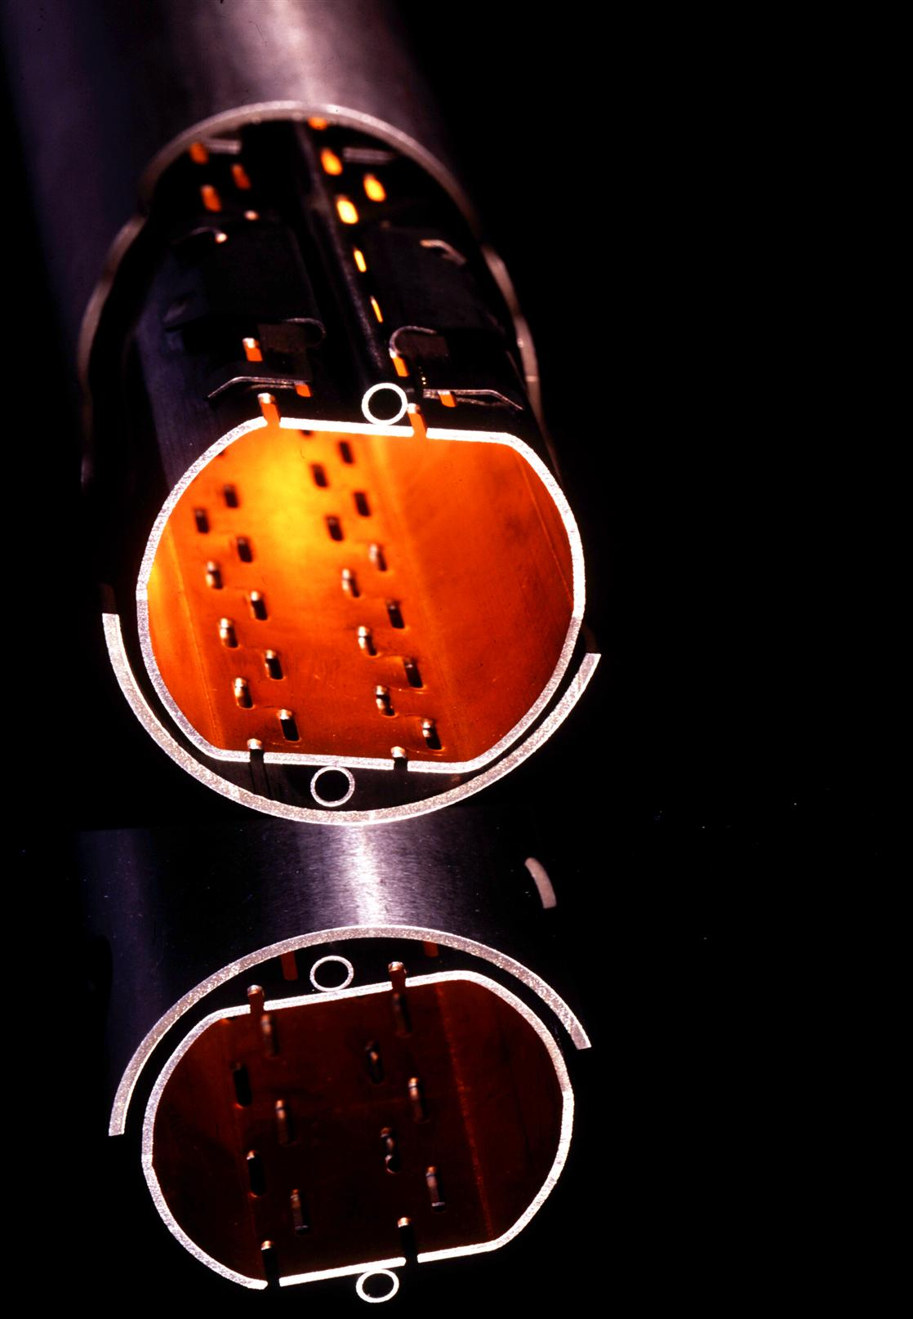
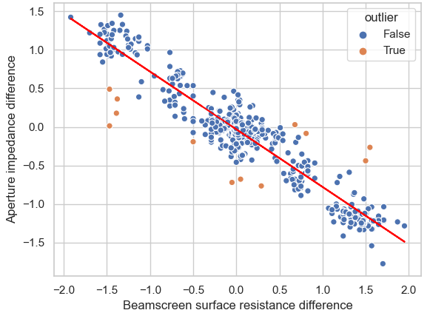
The beam-screen and its effects
Included in the magnet to protect the coils from particle
and radiation impact
1 mm of steel and ~75 µm of co-laminated copper
Previous investigations showed:
Strong correlation
between the unbalanced
impedance and beam screen
surface resistance
R.G. Saederup, "Local Transfer Function Measurement (TFM) Data Analysis", edms 2675917
Marvin Janitschke | Voltage transient simulations of the LHC main dipoles

Slide 13
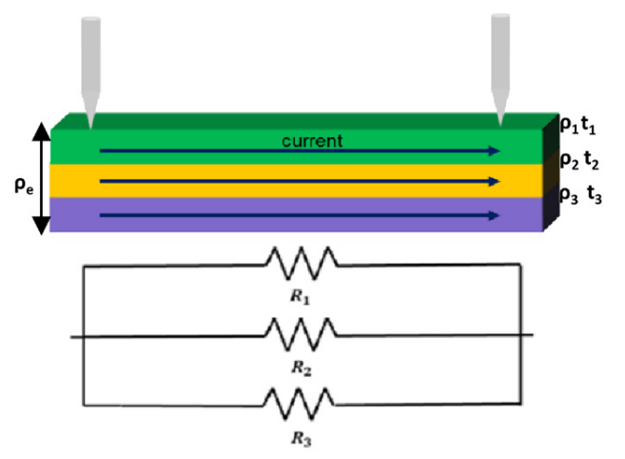
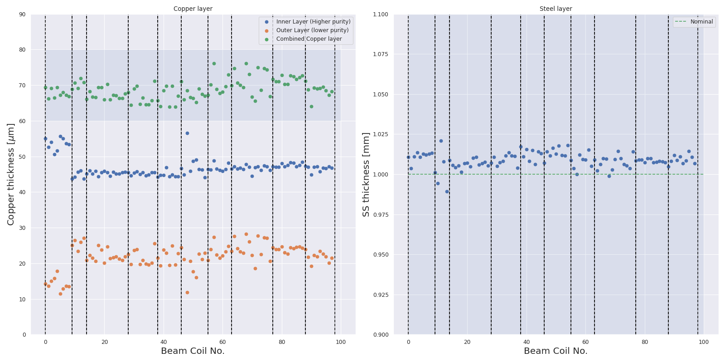
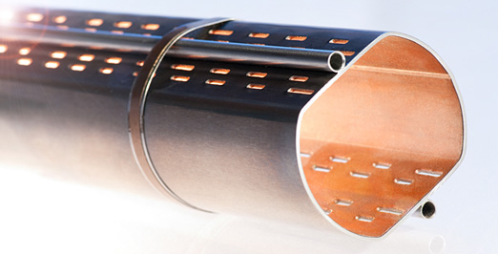
The beam-screen and its layers
1
Pure copper
Polluted copper
Steel layer
2
3
1
2
3
1
3
2
1 production
series
Marvin Janitschke | Voltage transient simulations of the LHC main dipoles

Slide 14
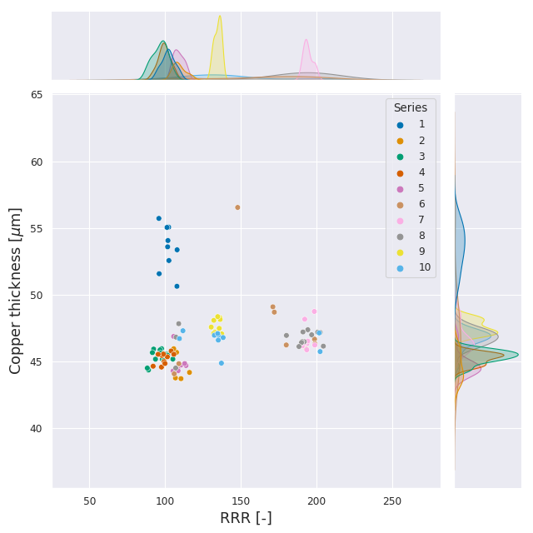
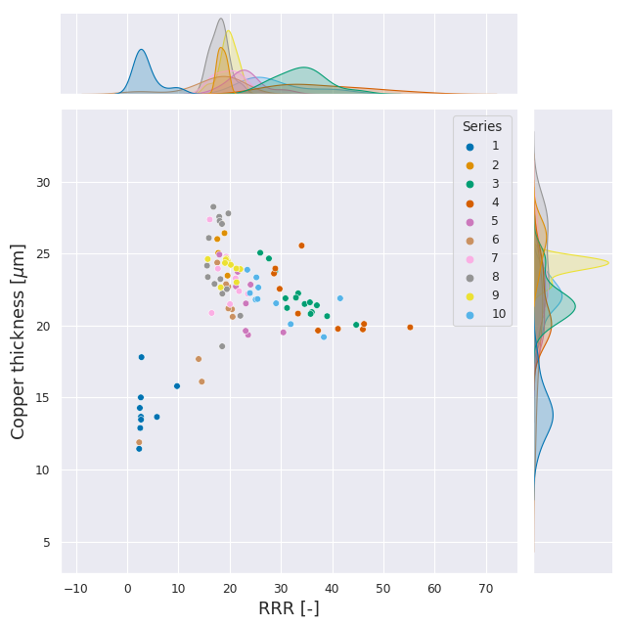
Inner layer with higher purity
Outer layer with lower purity
Marvin Janitschke | Voltage transient simulations of the LHC main dipoles

Slide 15
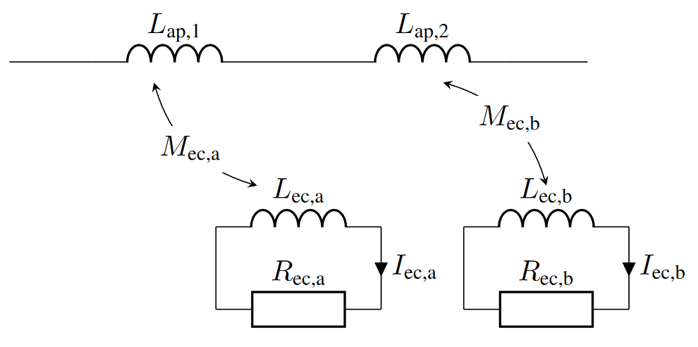
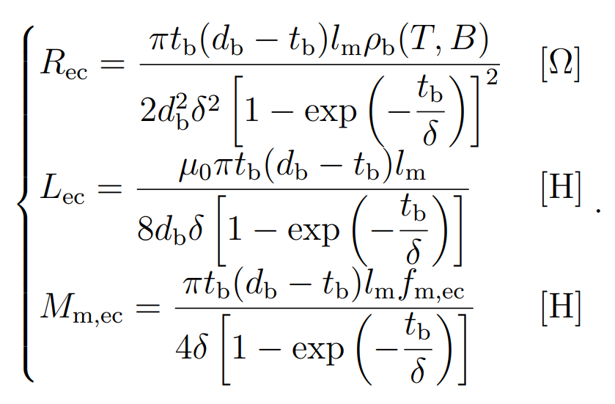
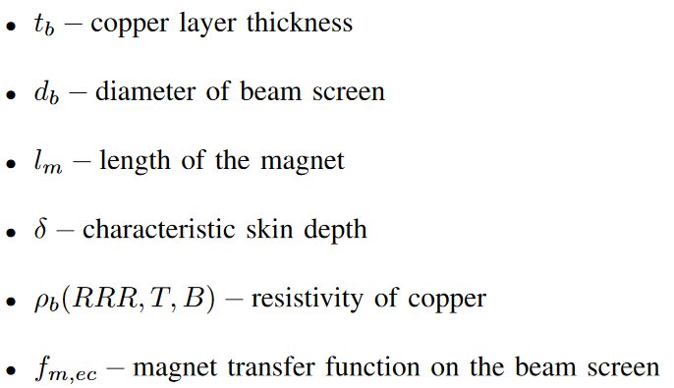
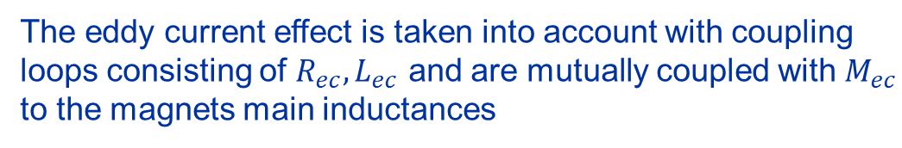
Main dipole – the new model
The eddy current effect is taken into account with coupling loops consisting of $R_{ec}, L_{ec}$ and are mutually coupled with $M_{ec}$ to the magnets main inductances
Simplified schematic, only showing
1/3 beam-screen layer
Derivation only requires measured values
Marvin Janitschke | Voltage transient simulations of the LHC main dipoles

Slide 16
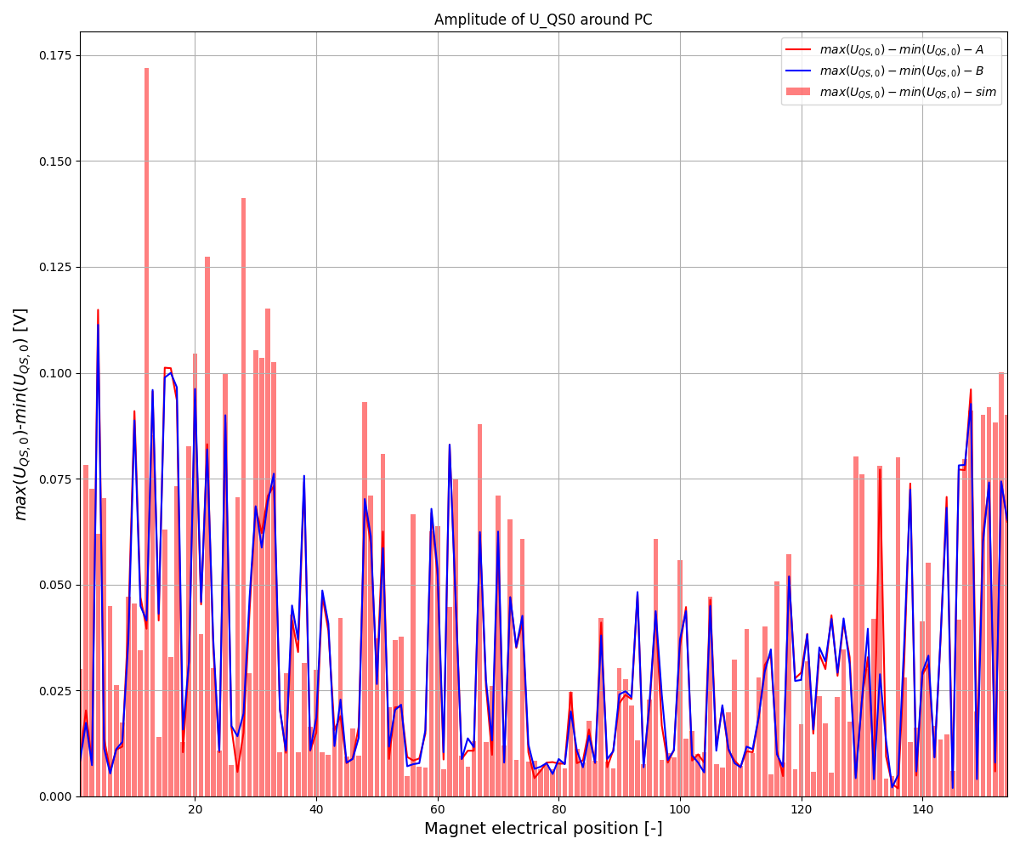
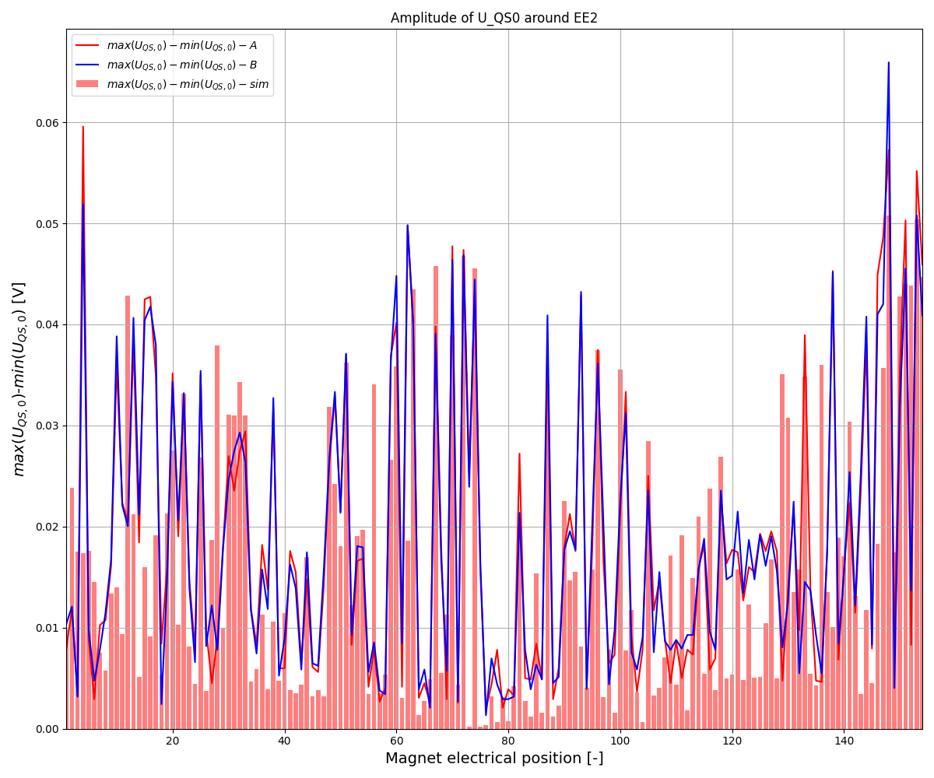

Main dipole – the new model: Results
Low current
$U_{QS,0 }$of an FPA @ 2 kA w/ 10A/s ramp
Marvin Janitschke | Voltage transient simulations of the LHC main dipoles

Slide 17
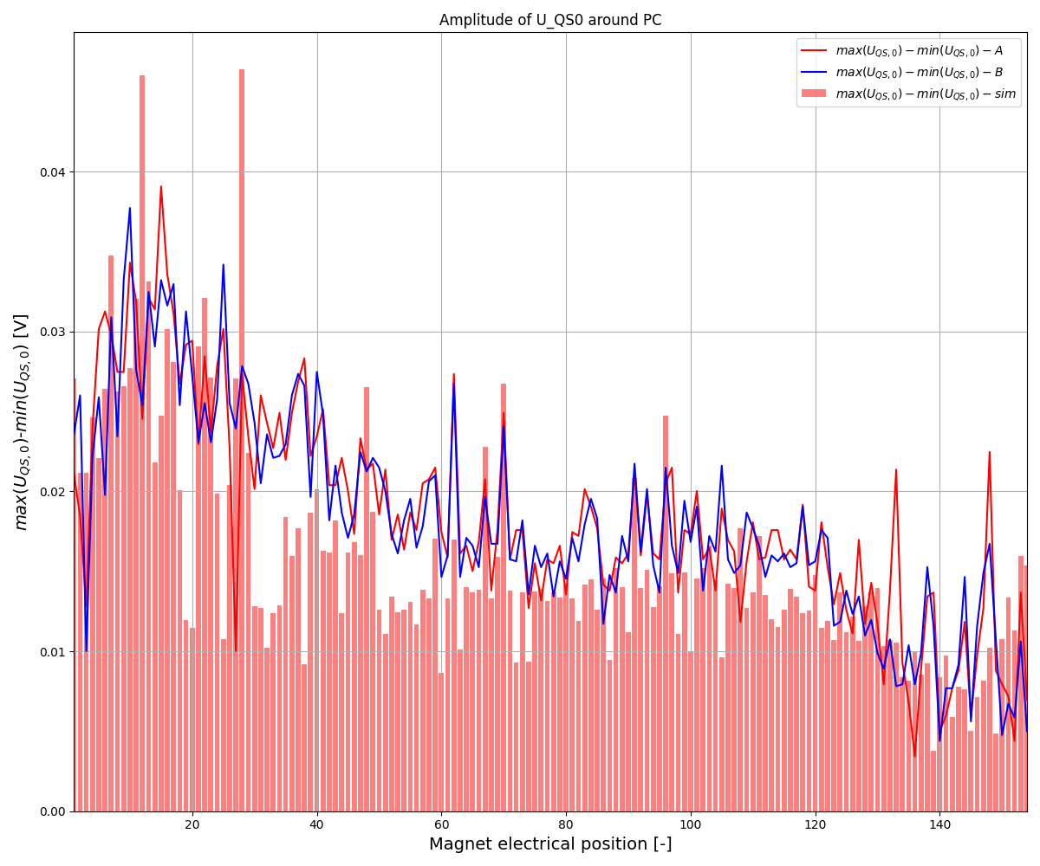
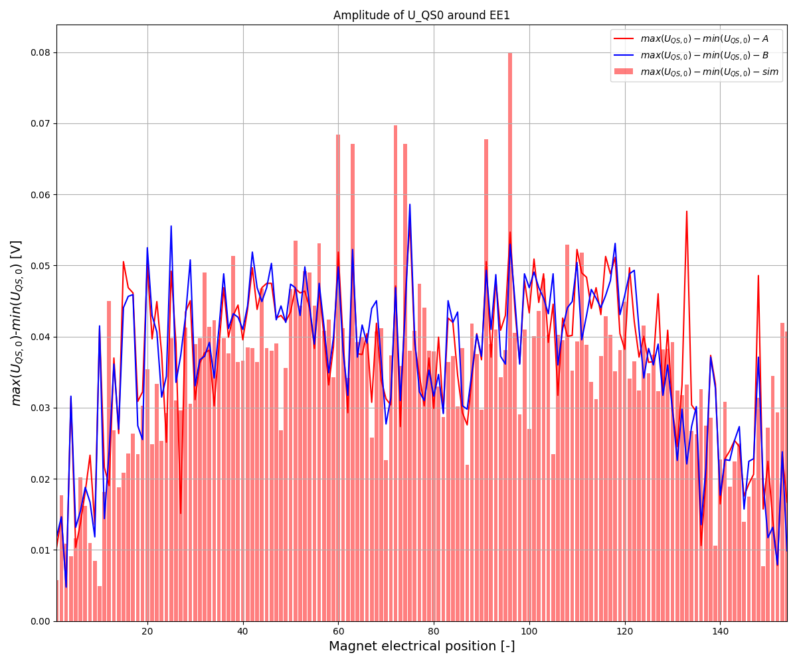

Main dipole – the new model: Results
High current
$U_{QS,0 }$of an FPA @ 11 kA w/ 10A/s ramp
Marvin Janitschke | Voltage transient simulations of the LHC main dipoles

Slide 18
Main dipole – the new model: Results
High current
$U_{QS,0 }$of an FPA @ 11 kA w/ 10A/s ramp
Fitting not perfect yet
→ Investigation of other parameters ongoing
Marvin Janitschke | Voltage transient simulations of the LHC main dipoles

Slide 19
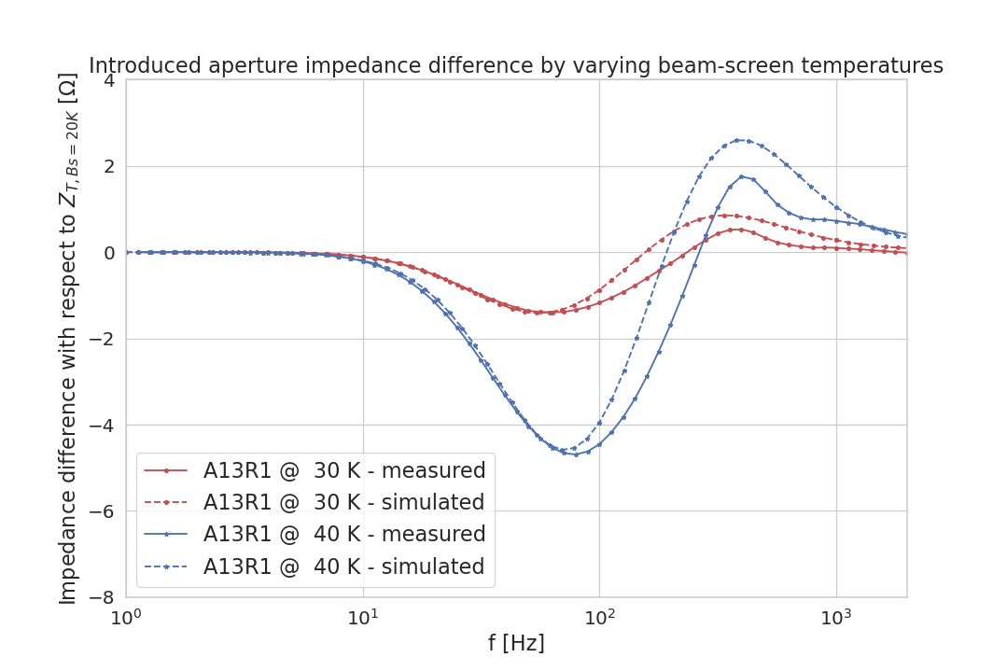

Main dipole – the new model: Results
The beam-screen effect can also be seen
and reproduced in the frequency domain
Transfer Function Measurements with the
beamscreen at:
    20 K
    30 K
    40 K
The introduced impedance differences
can be accurately reproduced
Modelling of the main dipole in the
frequency domain is work in progress
Marvin Janitschke | Voltage transient simulations of the LHC main dipoles

Slide 20
Conclusion
Further analysis of the beam-screen surface resistances showed a significant spread in purity and thickness of the different copper layers of the beam-screen
→ Novel electrical network model of the main dipole
2011 equivalent model | 2022 equivalent model
Good accuracy | Good accuracy
Empirical (not physics-driven) | Physics-driven
Predictive only for FPA | Predictive for various events
 | Able to predict new magnet’s behavior (?)
 | Possible to add a short circuit to the model
Not easily scaled | Scaled with current
Not easily expandable | Expandable with other effects
 | Expandable to frequency behaviour
Practical | Difficult to develop
Courtesy to E. Ravaioli
Marvin Janitschke | Voltage transient simulations of the LHC main dipoles

Slide 21
Thanks a lot for your attention! ☺
Marvin Janitschke | Voltage transient simulations of the LHC main dipoles

Slide 22
Appendix
Marvin Janitschke | Voltage transient simulations of the LHC main dipoles

Slide 23
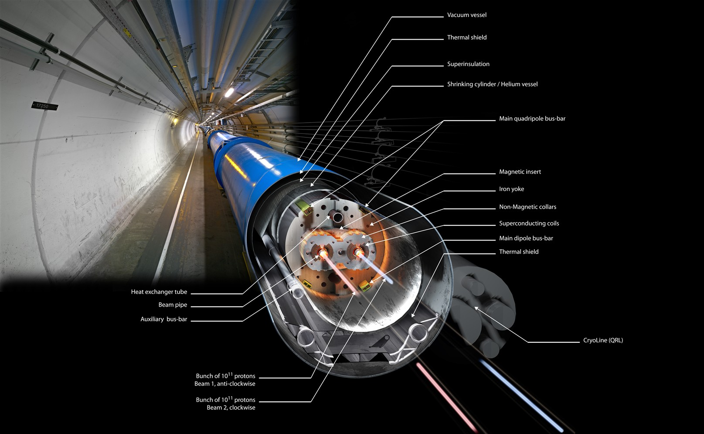
LHC main dipole magnet (MB)
We will come back
to these components
Marvin Janitschke | Voltage transient simulations of the LHC main dipoles

Slide 24
LHC main dipole magnet
Parameter | Value | Unit
Length | 14.3 | m
Operating temperature | 1.9 | K
Nominal field | 8.33 | T
Current at nominal field | 11850 | A
Inductance at nominal field | 98.7 | mH
Stored energy at nominal field | 1.3 | GJ
Inner coil diameter | 56 | mm
Beam-screen
Parameter | Value | Unit
Number of turns | 320 | -
Number of strands per turn | 28/36 | -
Number of filaments per strand | 8900/6500 | -
Critical current @ 10 T, 1.9 K | 13.75 | kA
Marvin Janitschke | Voltage transient simulations of the LHC main dipoles

Slide 25
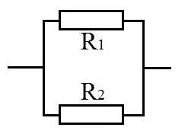


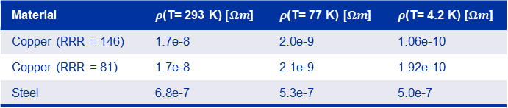

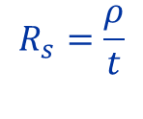



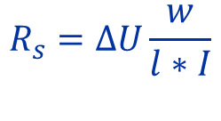

Data from Butting (2003/2004) – Random example
Series | Specimen Tube No. | Charge-No. (Bohler) | Coil No. | RRR Cu | U @293 K [V] | U @77 K [V] | U @4.2 K [V] | Length [m] | Width [m] | Thickness (total) | Thickness I (OFE-Cu) | Thickness (P506) | $R_{s}$ @ 4.2 K
10 | P. 5358 | 391324/1 | 96/1 | 145.820 | 0.00699600 | 0.00112400 | 0.00006300 | 0.07586000 | 0.00200000 | 0.00107800 | 0.00008360 | 0.00099440 | 1.66
10 | P. 5399 | 387025/2 | 95/1 | 81.218 | 0.00695900 | 0.00116000 | 0.00011200 | 0.07586000 | 0.00200000 | 0.00107500 | 0.00008280 | 0.00099220 | 2.95
CERN acceptance criteria $R_{s}<3.5 μΩ$
Material | $ρ$(T= 293 K) $[Ωm$] | $ρ$(T= 77 K) $[Ωm$] | $ρ$(T= 4.2 K) [$Ωm$]
Copper (RRR = 146) | 1.7e-8 | 2.0e-9 | 1.06e-10
Copper (RRR = 81) | 1.7e-8 | 2.1e-9 | 1.92e-10
Steel | 6.8e-7 | 5.3e-7 | 5.0e-7
$$R_{s}=ΔU\frac{w}{l∗I}$$
, I = 1 A
RRR and $t_{Cu}$were not included (?)
Now inserting all values from above (Butting) yields:
$$ΔU=R_{s}\frac{l}{w}I=\frac{ρ∗l}{t∗w}I$$
$$R_{s}=\frac{ρ}{t}$$
Correction for Stainless-Steel at 293 K:
$$I_{Cu}=\frac{R_{Cu}R_{SS}}{R_{Cu}+R_{SS}}∗\frac{1}{R_{Cu}}$$
Calculated voltages based on provided $ρ(RRR,T)$, $w, l, { t}_{Cu}$
$$R_{Cu}$$
Specimen | U @293 K [V] | U @77 K [V] | U @4.2 K [V]
P. 5358 | 0.0059 | 0.00086 | 0.0000482
P. 5399 | 0.0060 | 0.00092 | 0.0000872
$$R_{SS}$$
15%
23%
23%
Error to
Butting voltages
$$I= I_{Cu}$$
13%
20%
22%
Marvin Janitschke | Voltage transient simulations of the LHC main dipoles

Slide 26
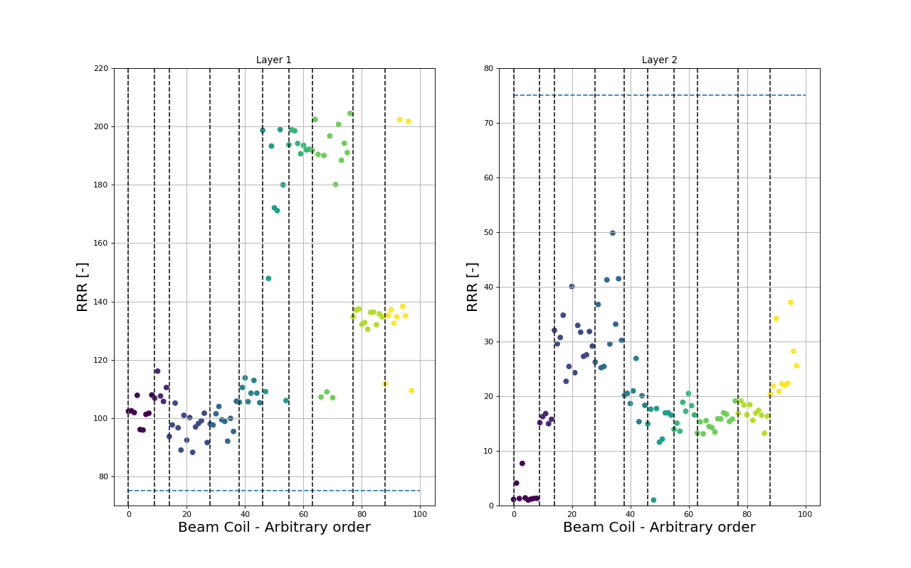
New approach – multi-layered copper
Marvin Janitschke | Voltage transient simulations of the LHC main dipoles

Slide 27
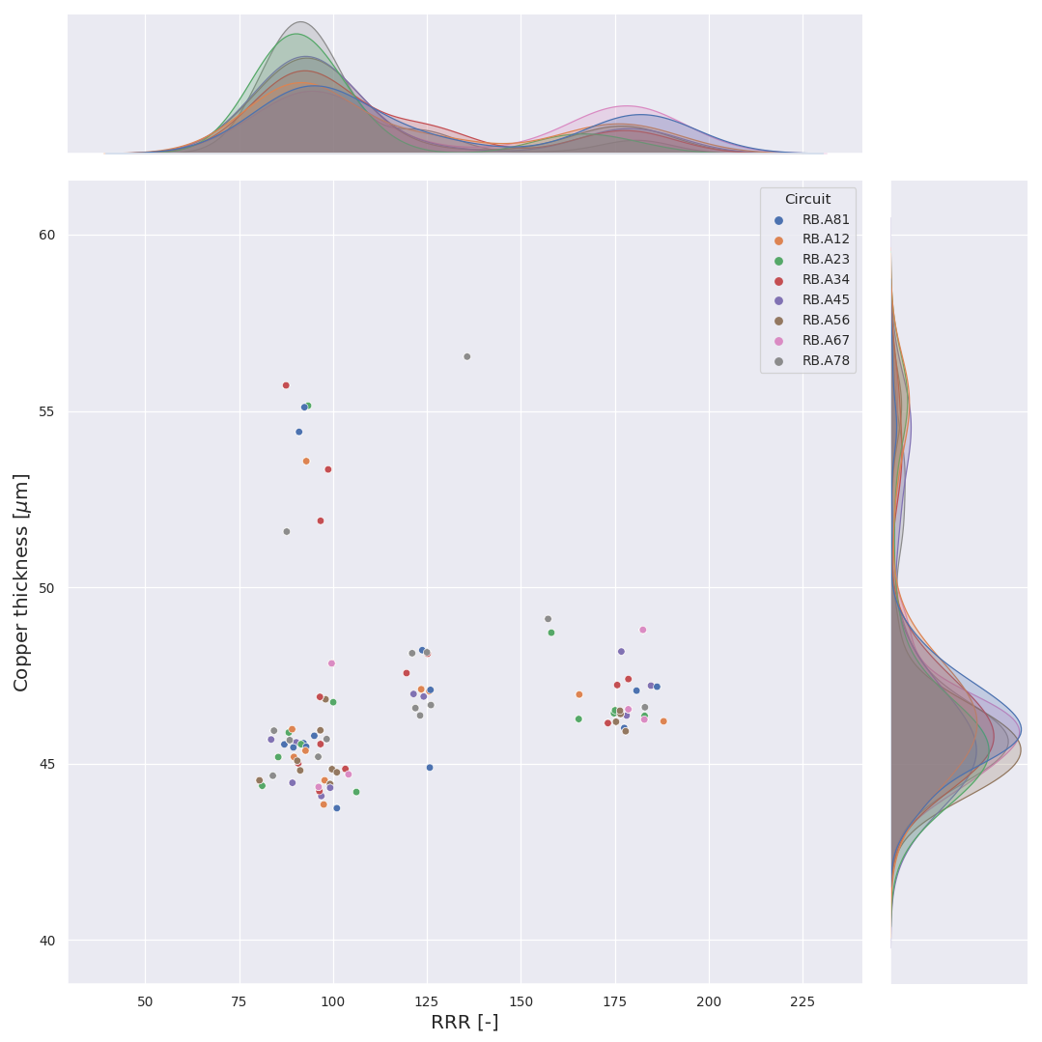
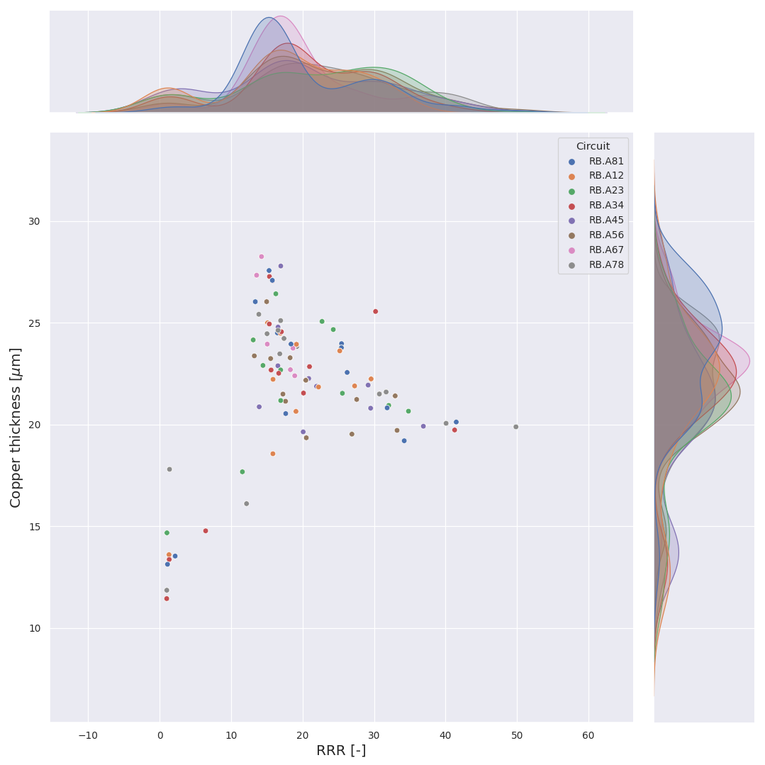
Inner layer with higher purity
Outer layer with lower purity
Marvin Janitschke | Voltage transient simulations of the LHC main dipoles

Slide 28
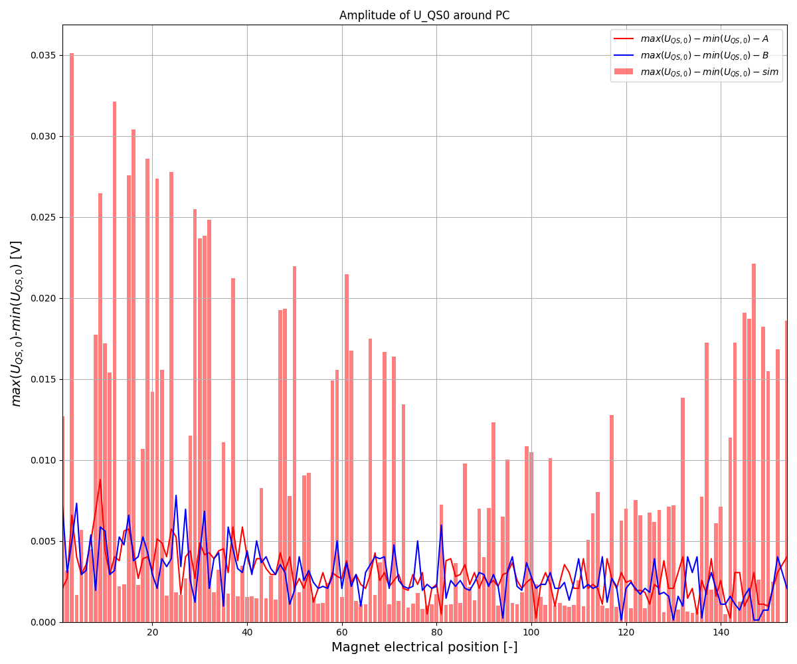
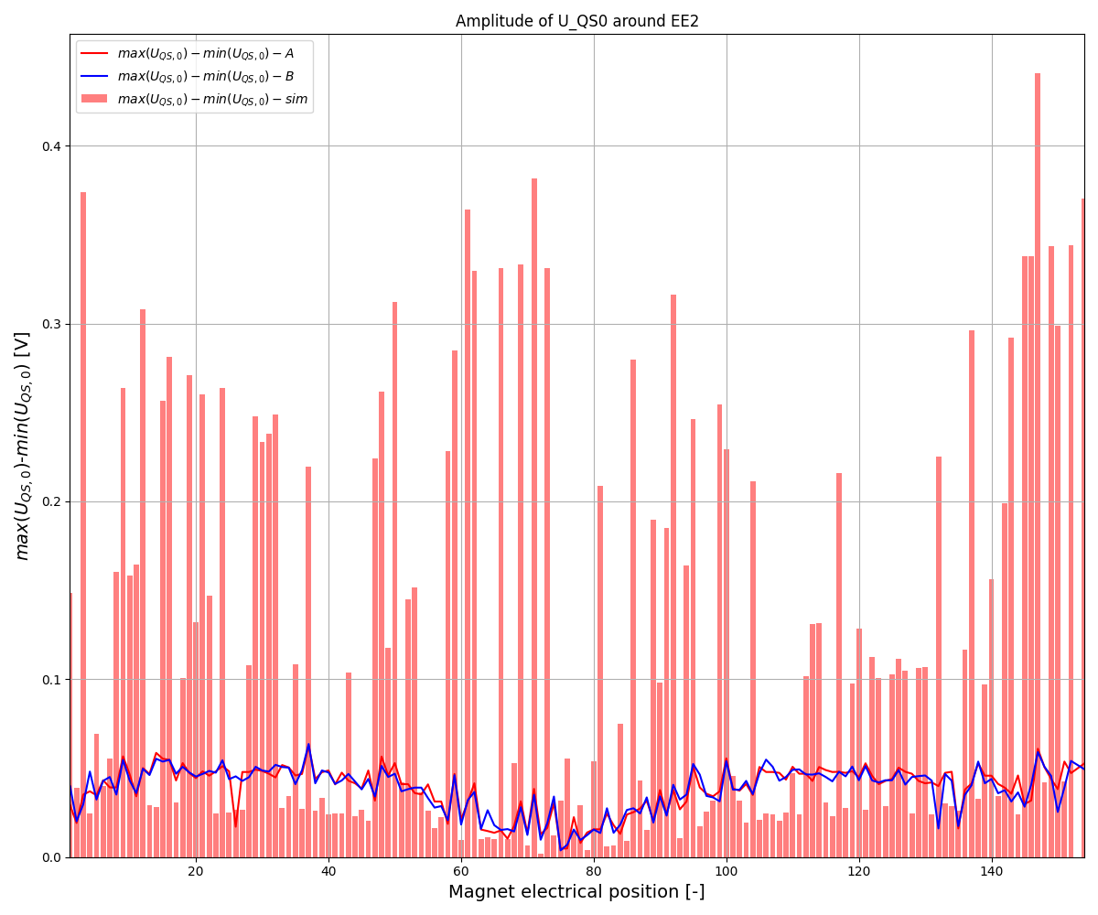
Main dipole – the new model: Results
High current
$U_{QS,0 }$of an FPA @ 11 kA w/ 10A/s ramp
Modelling results from 2011
Marvin Janitschke | Voltage transient simulations of the LHC main dipoles

Slide 29
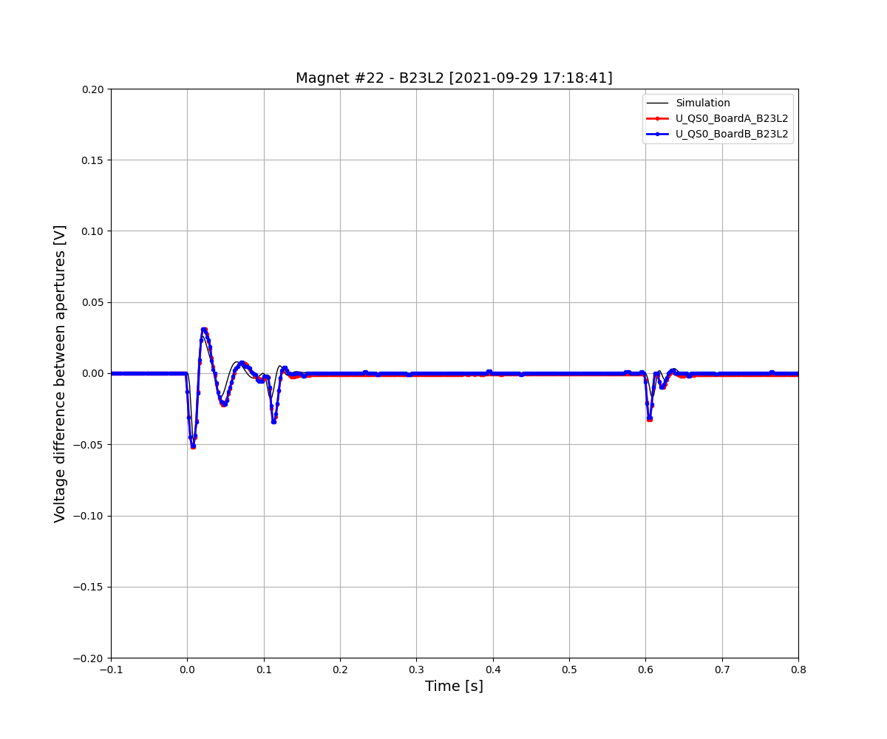
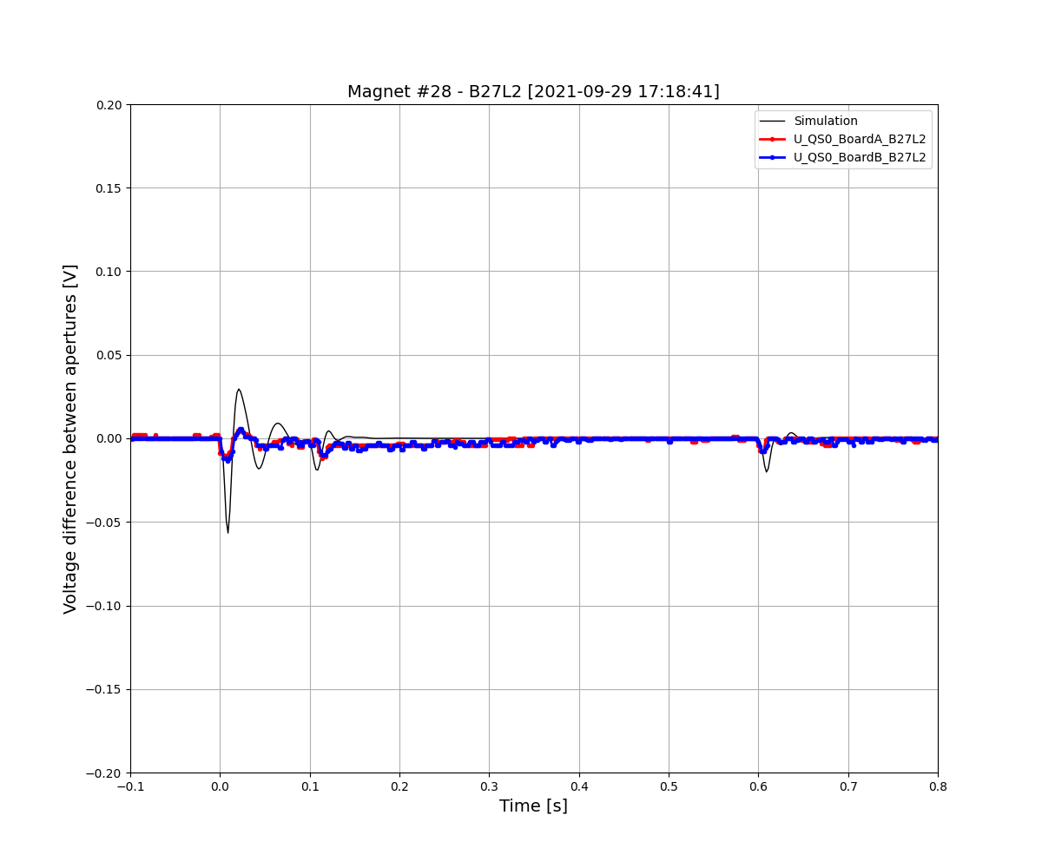
Modelling result - Examples
Marvin Janitschke | Voltage transient simulations of the LHC main dipoles

Slide 30
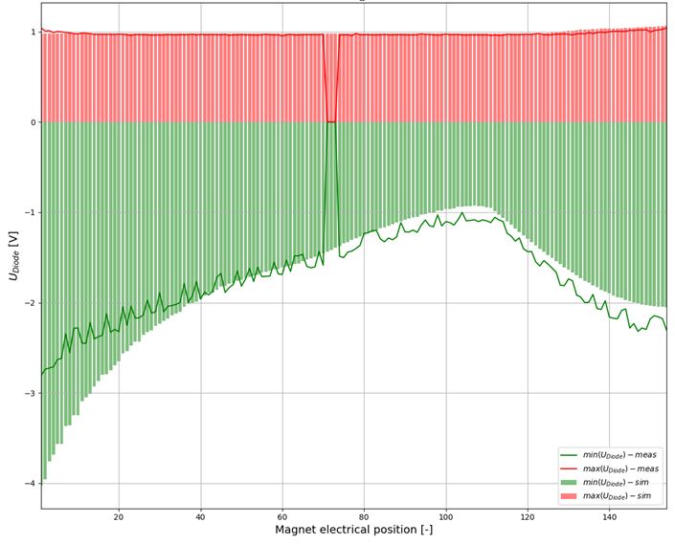
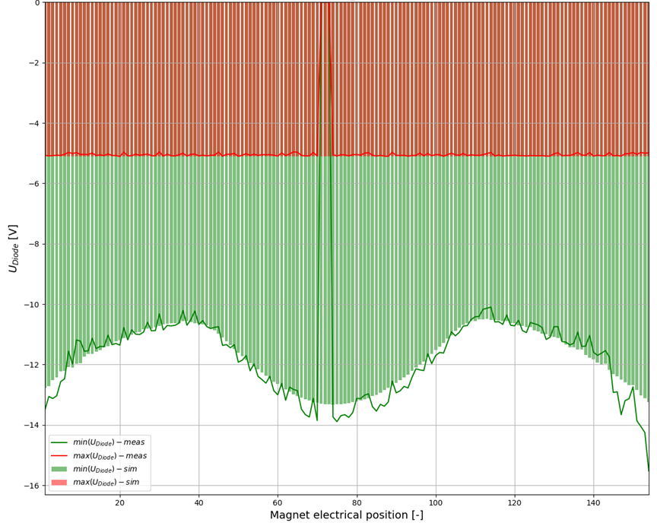
Voltages across the magnet
Marvin Janitschke | Voltage transient simulations of the LHC main dipoles

Slide 31
Conclusion
Previous modelling approaches of the main dipole were not able to reproduce the unbalanced dipole behavior at all current level
Past investigations showed a strong correlation of beam-screen surface resistances and unbalancedness
Further analysis of the surface resistances shows a significant spread in purity and thickness of the different copper layers of the beam-screen
These measured parameters were utilized in a novel model, which couples the magnet‘s main inductance to the induced eddy currents loops in the beam-screen
The results indicate to agree with measurements on low- as well as on high current levels
Still work in progress to continue analyzing other parameters in the process in order to improve the fit
The results and the model can also be used in the frequency domain, to reproduce Transfer Functions measured of the magnet → to be shown soon
Marvin Janitschke | Voltage transient simulations of the LHC main dipoles

Slide 32
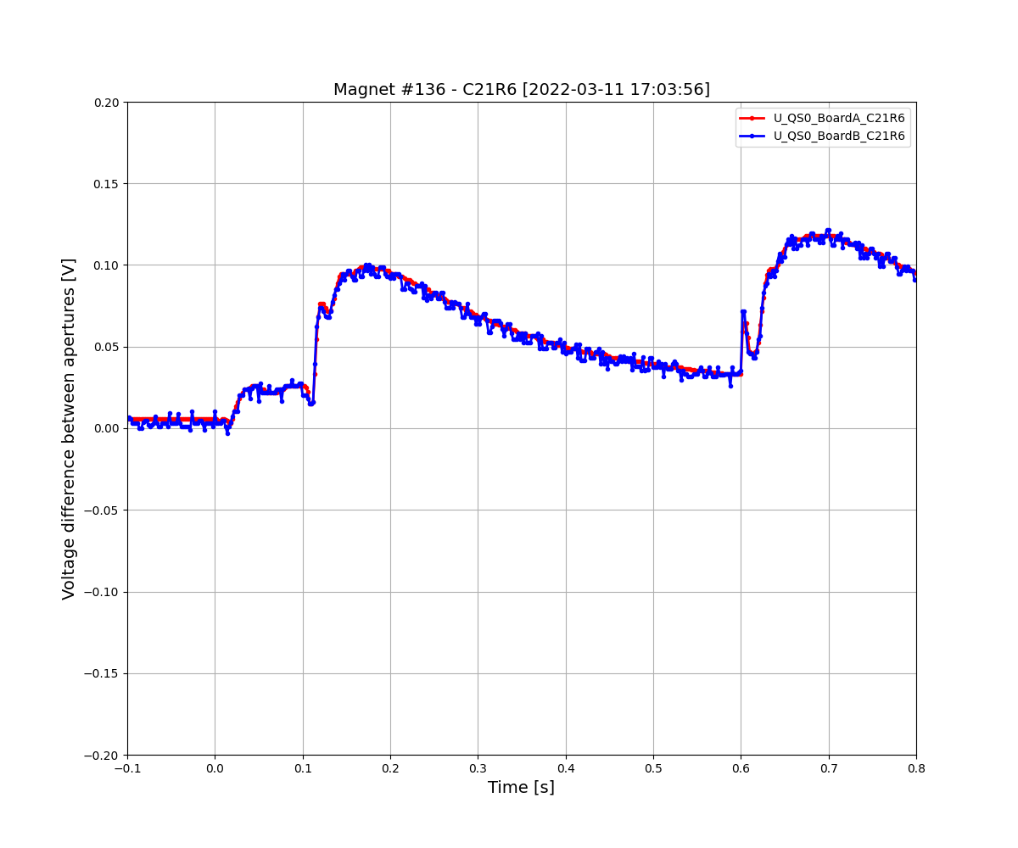
The outliers
What is going on here?
Can we model this? And if so, what could it be?
Marvin Janitschke | Voltage transient simulations of the LHC main dipoles

Slide 33
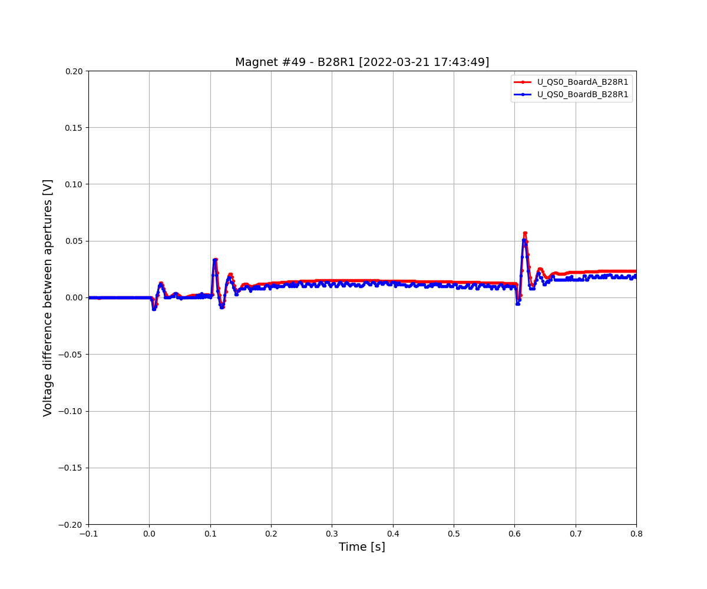
The outliers
What is going on here?
Can we model this? And if so, what could it be?
Marvin Janitschke | Voltage transient simulations of the LHC main dipoles

Slide 34

The outliers
Inter-turn short found shortly after
R.G. Saederup, "Local Transfer Function Measurement (TFM) Data Analysis", edms 2675917
Marvin Janitschke | Voltage transient simulations of the LHC main dipoles

