Slide 1

Towards complete automation of test campaign simulations using STEAM
Daniel Mayr
With special thanks to my supervisor Emmanuele Ravaioli
and also to SM18 colleagues
5th May 2023
https://espace.cern.ch/STEAM

Slide 2
OUR VISION
Full automation of transient simulations in SC magnets in a
reliable, sustainable, consistent and repeatable way
To achieve this we need 3 main ingredients:
Validated Magnet Models
A way to get magnet specific conductor parameters
A way to get event specific information
D. Mayr – Towards complete automation of test campaign simulations in STEAM – CERN – 5th May 2023
Notes:
In short: we want to press one button and run simulations for
…
Before we get into detail with those 3 points, I want to quickly talk about the why. Why do we want this? (next slide)

Slide 3
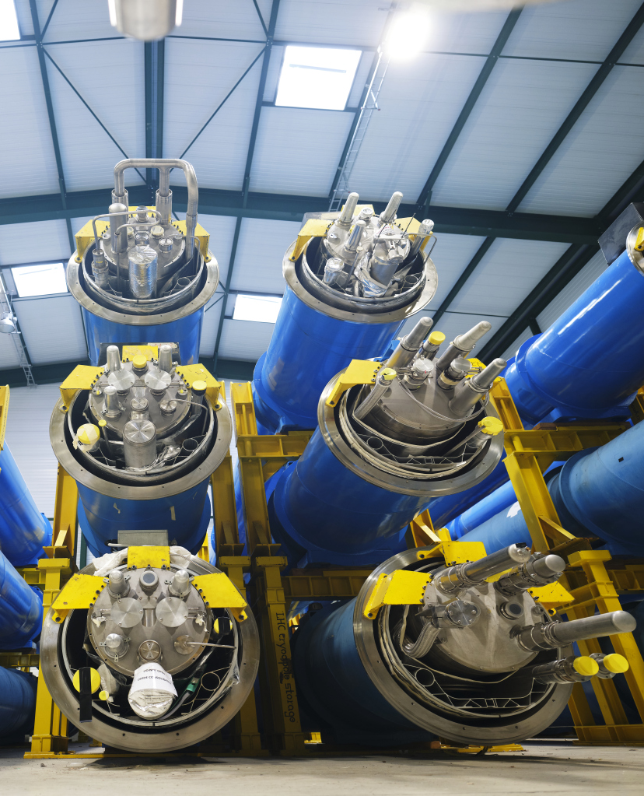
Motivation
My main use case:
Model validation (e.g. HL HOC magnets)
  100s of measurements
Many other use cases:
Comparison to measurement to identify unusual behaviour
Analyse large group of tests in a consistent manner
Provide tool for users outside of CERN
Regular tests of magnet models
D. Mayr – Towards complete automation of test campaign simulations in STEAM – CERN – 5th May 2023
Notes:
Manufactured by INFN in Italy and then
Ad 1: (e.g. quenches during operation)
Ad 2: (e.g. all quenches in one go)
Ad 3: (e.g. magnet manufacturers)

Slide 4
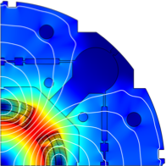
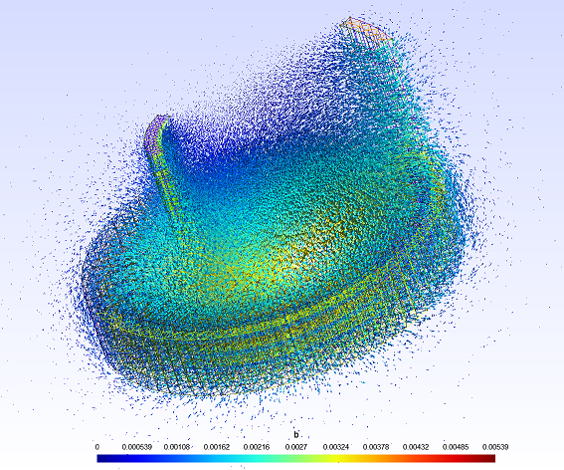
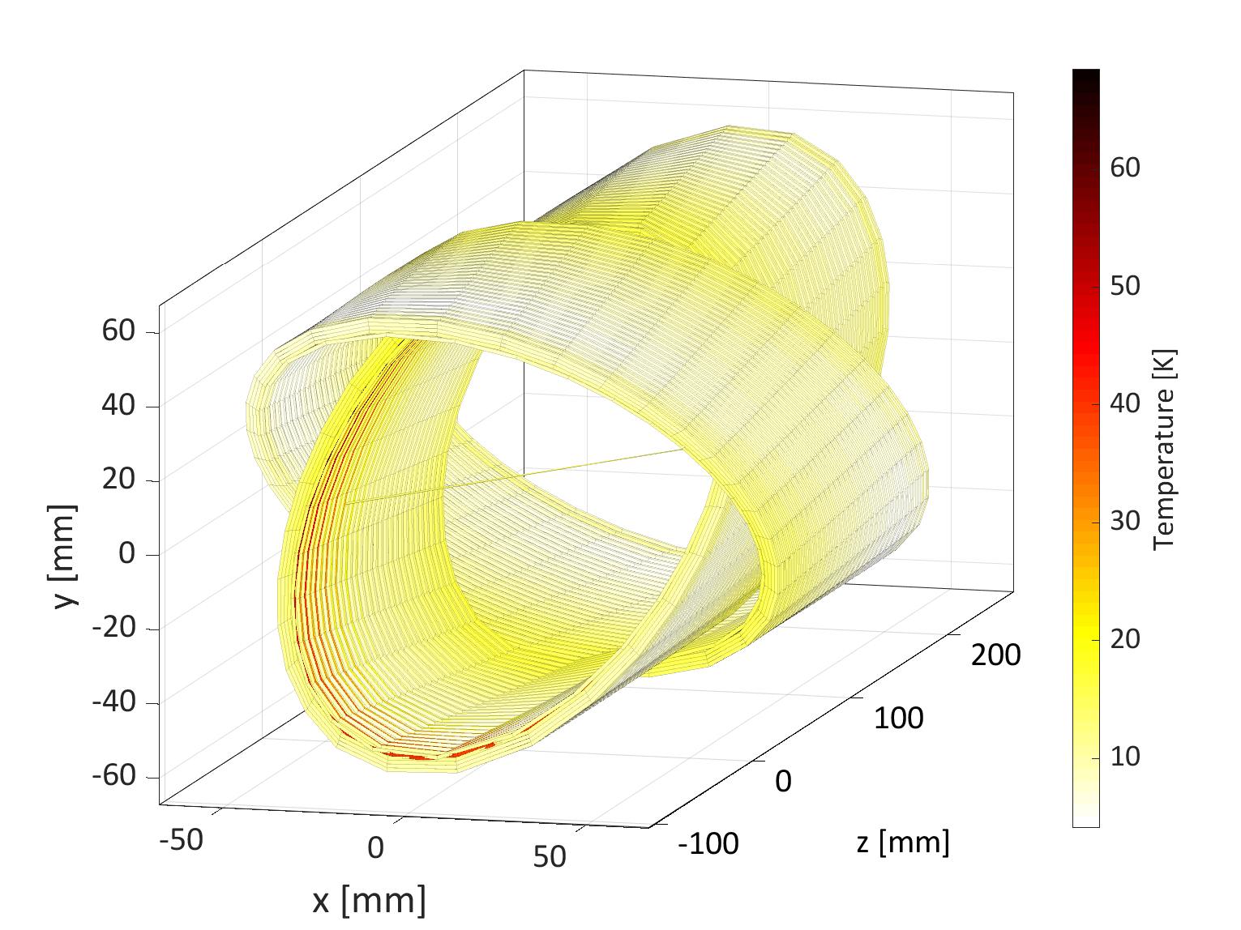
Short overview of STEAM Framework
Simulation of Transient Effects in Accelerator superconducting Magnet circuits
Goal: perform diverse transient simulations across all levels of detail, involving circuits, magnets, conductors, wires and filaments.
→ No single tool can do it all: STEAM connects different tools
*COMSOL license needed. **Commercial circuit solver from Cadence Design Systems. ***Free tools from Sandia Labs
D. Mayr – Towards complete automation of test campaign simulations in STEAM – CERN – 5th May 2023
Notes:
Transients include: EE, quench back, QH or CLIQ induced quenches, electrical arcs, non insulation coils, short circuit, powering, frequency transfer measurements
Magnets: solenoid & pancake, cos-theta, CCT (=canted-cosine-theta), block coil, common coil
Circuit: nested, stand alone, magnets in series, different combinations
Conductors: NbTi, Nb3Sn, BI-2212, YBCO
FiQus → Gmsh for geometry and meshing and on GetDP for solving and postprocessing
LEDET → electro-magnetic & thermal transients in 2D & 3D using finite difference
proteCCT → electro-magnetic & thermal transients in CCT magnets using finite-difference
SIGMA → electro-magnetic & thermal transients in 2D using a COMSOL finite-elements model
Underlying Conductors are simulated in LEDET or BBQ/PyBBQ

Slide 5
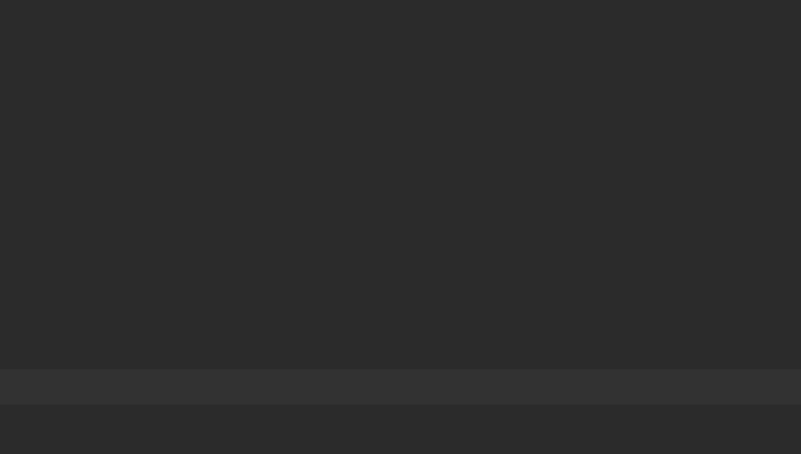
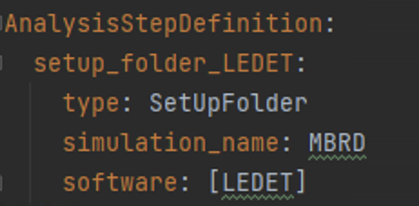
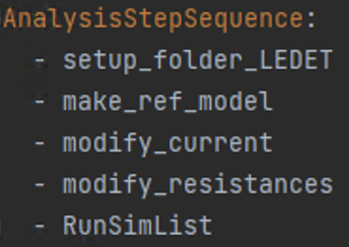
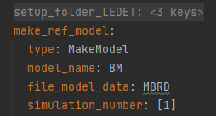
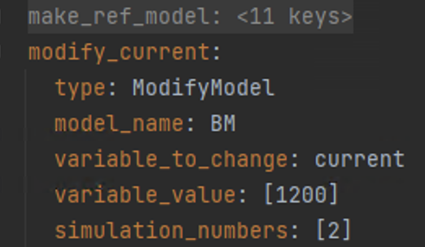
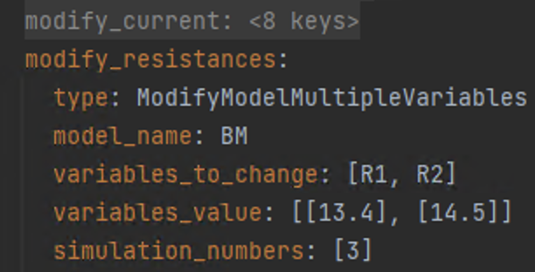
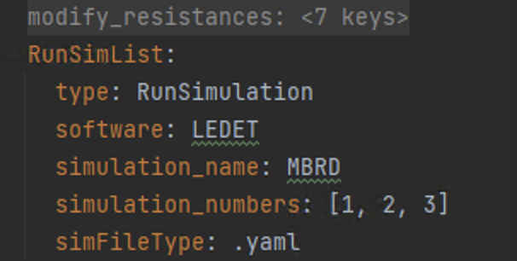


How to use STEAM: a simplified simulation setup
SetUpFolder
MakeModel
ModifyModel
ModifyModelMultipleVariables
RunSimulation
...
STEAM is organized in steps:
The user first defines the steps
Then their order
Let’s try to setup a test campaign to validate a magnet model →
100s of measurements
For every measurement we need to change:
  Bath temperature
  Conductor: RRR, length, …
  Initial current
  Quench Heater: time, …
  EE, CLIQ, …
In total: 100s variables
100s*100s = 10.000s variables
10.000s of hand crafted lines
D. Mayr – Towards complete automation of test campaign simulations in STEAM – CERN – 5th May 2023
Notes:
What looks very complicated in the background is very easy to use for the user in the foreground:
Just imagine changing hundreds of variables for tousends of simulations

Slide 6
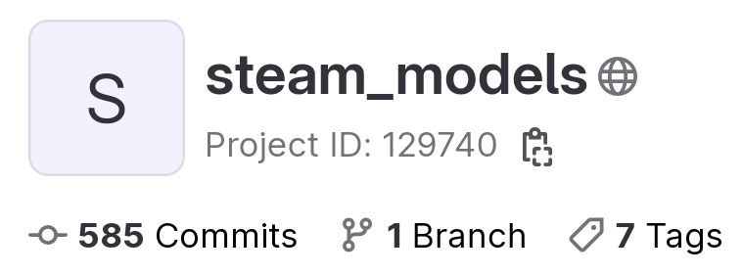
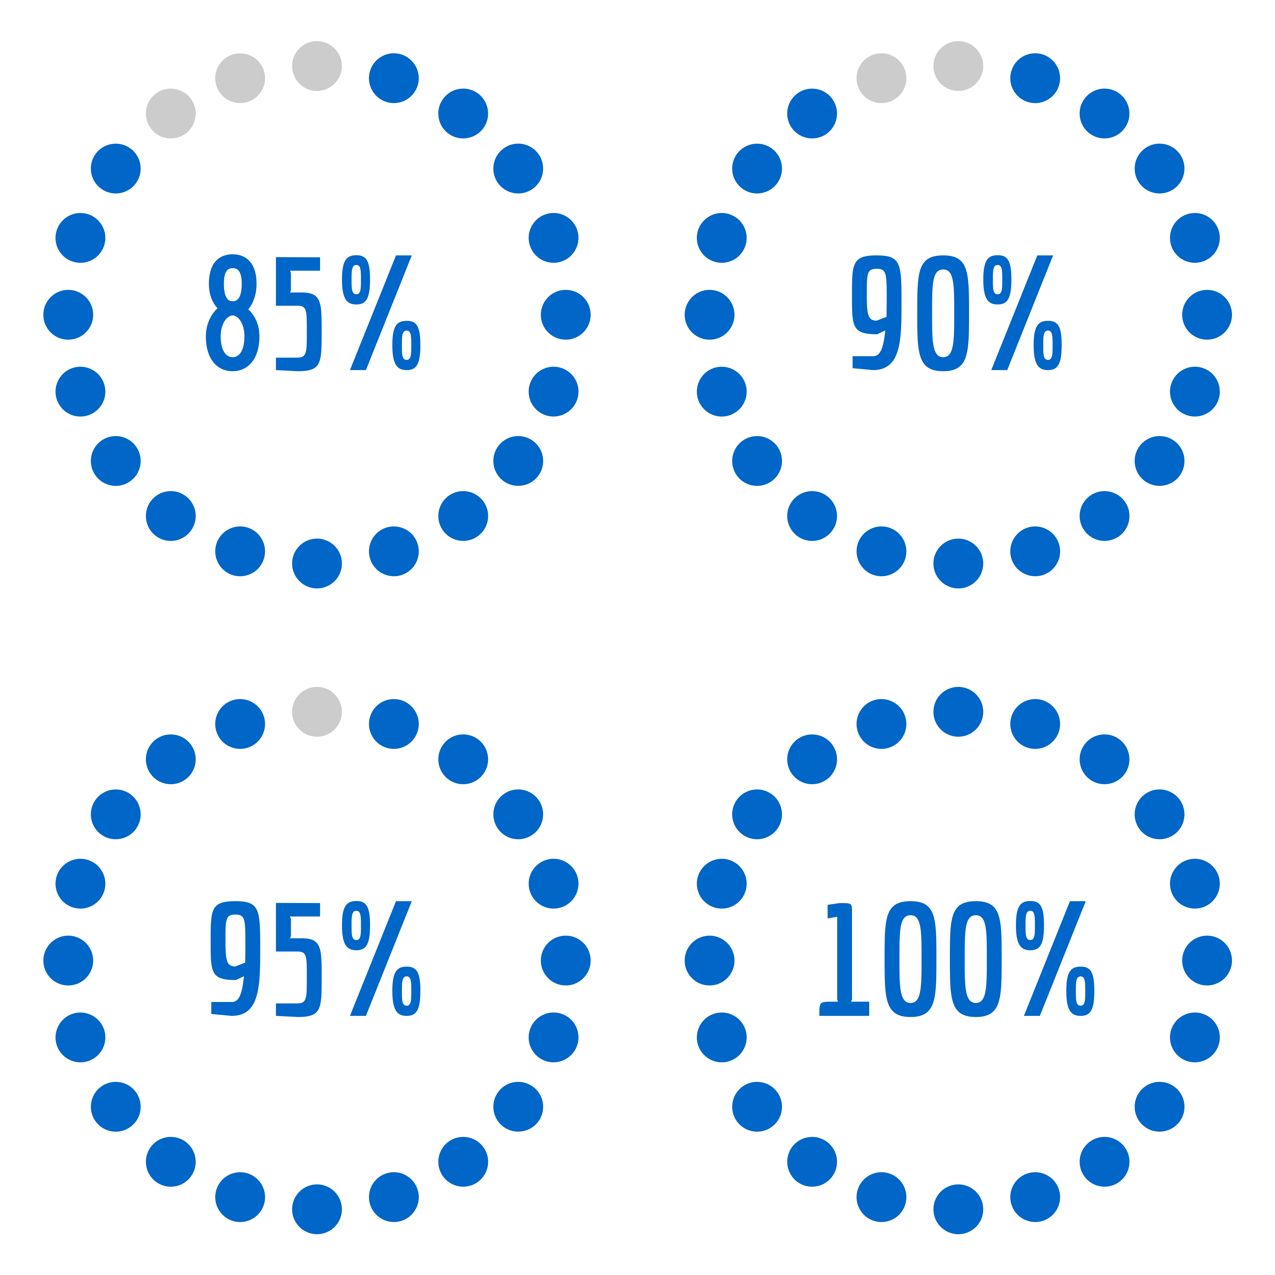
Back to our problem…
We need 3 main ingredients to run automated test campaigns:
Validated Magnet Models
A way to get magnet specific conductor parameters
A way to get event specific information
Ad 1) Validated Magnet Models
PyBBQ
XYCE
LEDET
…
FiQuS
SIGMA
LHC
HL-LHC
D. Mayr – Towards complete automation of test campaign simulations in STEAM – CERN – 5th May 2023
Notes:
Lets come back to the 3 things we needed
Ad 2.
several people contributed to make magnet (&circuit) models
Version controlled STEAM_models repository
Containing unified models (used by every tool in the framework)
currently in validation phase with large number of measurements
95% of LHC magnets, 50% of HL-LHC done / split icon

Slide 7
Ad 2) A way to get magnet specific conductor parameters
Introduction of new step: ParsimConductor
1. Reads conductor database
…
2. Calculates conductor parameters for all coils
Critical current measurements → Jc fit parameters (CUDI1, Summers, Bordini)
RT resistance measurement → Optimization of Variables with some uncertainty
3. Assigns parameters to all the correct conductors in the model → new Step: ParsimSweeper
D. Mayr – Towards complete automation of test campaign simulations in STEAM – CERN – 5th May 2023
Notes:
1.
Conductor database = large csv file containing parameters and measurements for all coils of all the magnets
Created manually from all the past manufacturing reports → for future tests we want to directly parse it from database
2.
Calculates Jc fit parameters for variable number of critical current measurements
Currently working for Summers, CUDI1, Bordini (Bottura & CUDI3 missing)
Optimization with room temperature resistance measurement
Either of the coil length (if it is not known) or the Cu/nCu ratio (when coil length is known)
Weights parameters when more then one conductor measurement is present for the coil

Slide 8
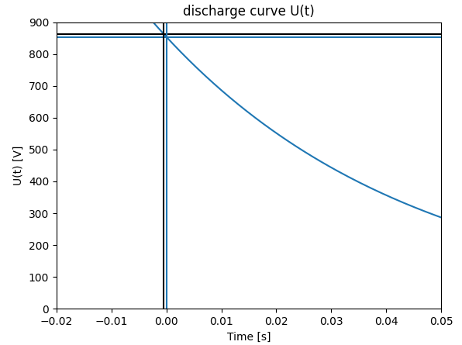
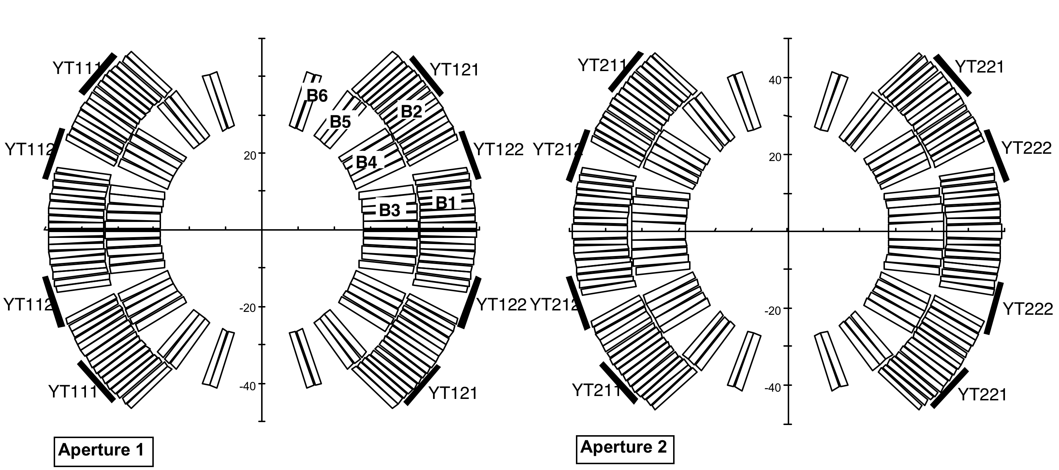
Ad 3) A way to get event specific information
Introduction of new step: ParsimEvent
1. Reads quench dictionary
…
CLIQ
Quench Heaters
Energy Extraction
warm resistance
Initial current
Bath temperature
…
2. Calculates various simulation parameters
[1]
3. Setup initialization files for Viewer (mark data for conversion, find paths and timestamps)
4. Assigns parameters to the model → new Step: ParsimSweeper
D. Mayr – Towards complete automation of test campaign simulations in STEAM – CERN – 5th May 2023
Notes:
1. Quench Dictionary: Automatically generated csv file containing all parameters for conducted measurement events (>60 parameters)
Colleagues from SM18 automatically generate it – implementation is very flexible so that it is easy to use for other formats (e.g. KEK)
In close contact with the colleagues to optimize the quench dict
This dict has hundrets or thousends of lines – this shows how crucial automation is here
2. We have to deal with quite many different cases.
Quench Heaters: trigger at different times or can be switched off
QH are connected to different parts of the magnets, therefore influencing different
“QH Start time” is time where current dropped by 1%: interpolate discharge curve backwards
Adjusts simulation times automatically to QH
Currently final preparations are being made to include Energy Extraction
Many smaller calculations for get desired values. E.g. cold resistance, …
3. This is crucial. Otherwise one would have to make the setup file for the viewer by hand. With this file the viewer knows what to plot and where to find the data.
So all the paths to measurements and simulation results
4. Reuse code to change many parameters multiple ways, ParsimSweeper internally also reuses as much code that we already have

Slide 9


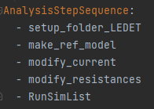
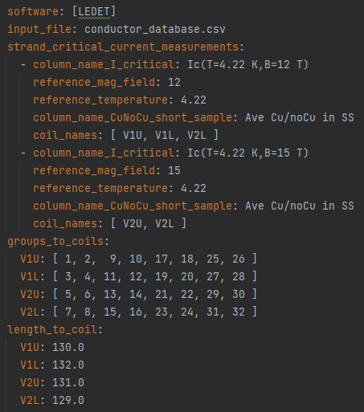
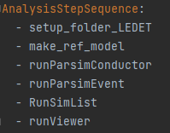


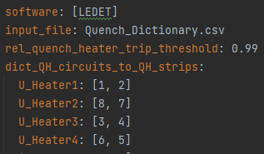

Workflow: campaign setup
Input files
How to use STEAM campaigns:
ParsimConductor definition:
guaranteed reproducibility
Simulation results
result
ParsimEvent definition:
result files & reports
Viewer
compared meas & sim
D. Mayr – Towards complete automation of test campaign simulations in STEAM – CERN – 5th May 2023
Notes:
after this setup: one click and
all simulations for a given test campaign are performed with all parameters up to date (in this case mat because LEDET is used – in future one could use many different tools and evaluate them, then different solutions)
The Viewer will compare all measured and simulated variables and outputs
Small limitation because manually – impossible to automate

Slide 10
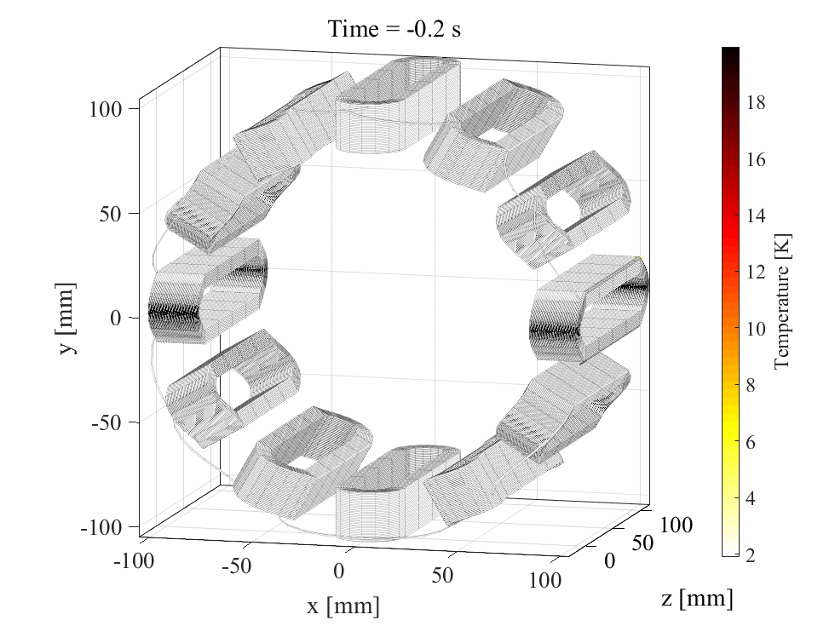
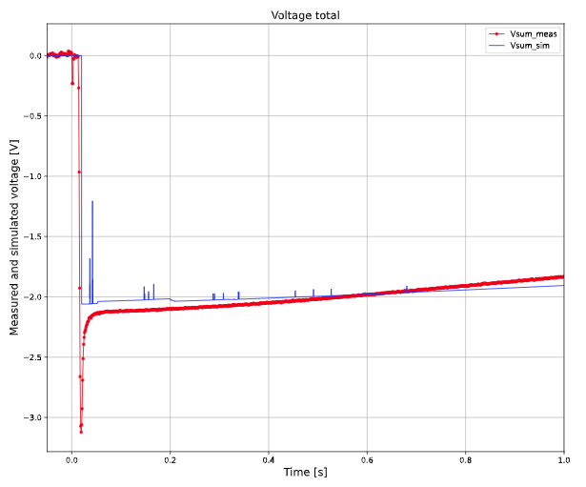
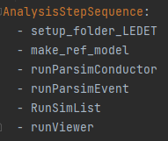
Example Application: validation of HL HOC magnets
my main project and Master’s thesis
One simulation per measurement
Comparison plots for all variables
and for each simulation-measurement pair
x100s
…..
…..
x100s
…..
…..
x100s
x100s
This would be impossible by manually crafting input files!
D. Mayr – Towards complete automation of test campaign simulations in STEAM – CERN – 5th May 2023
Notes:
Emph: This yaml list is all the user needs to understand

Slide 11
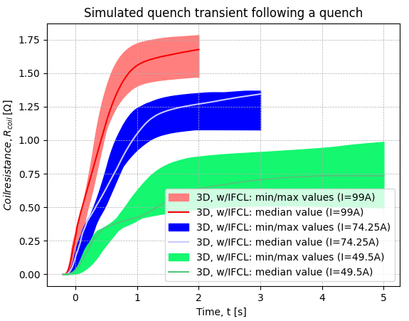
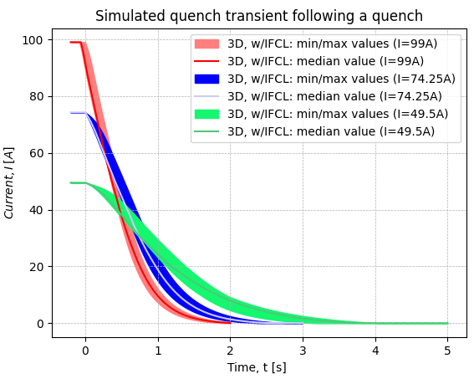
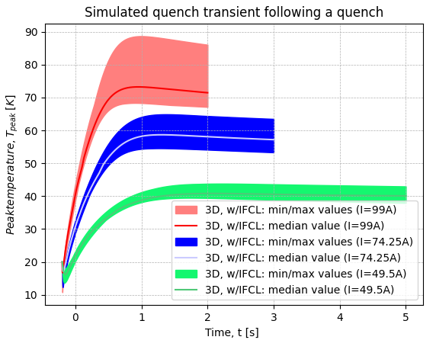
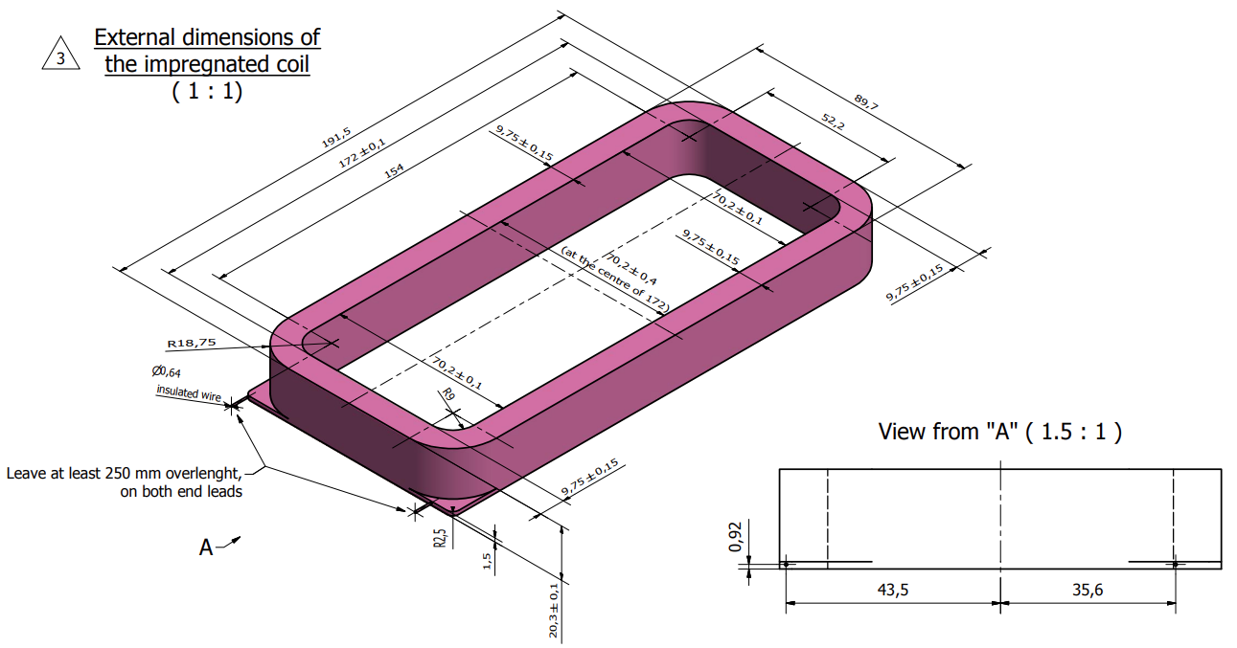
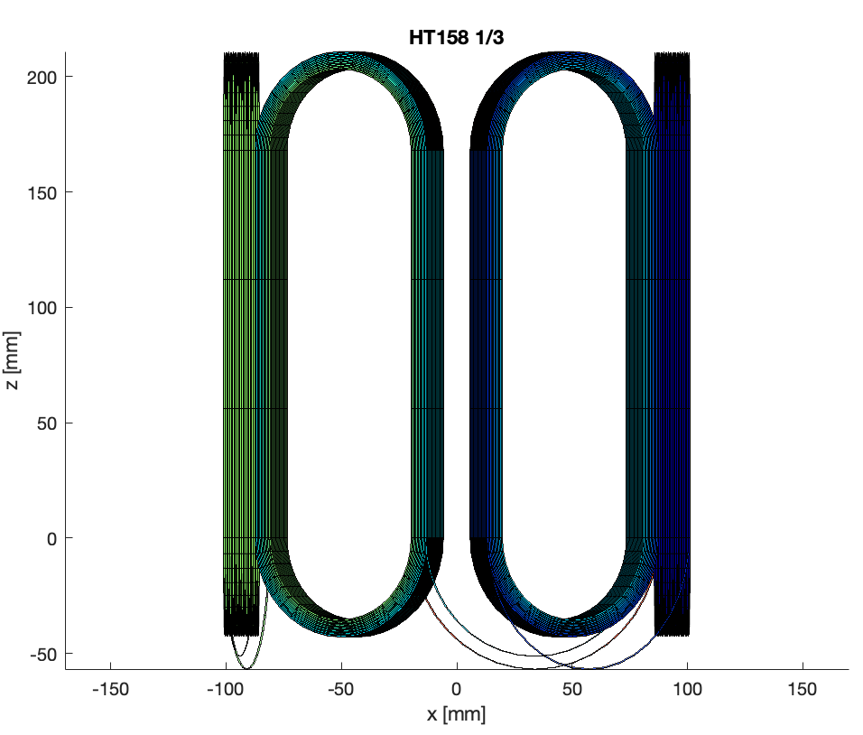
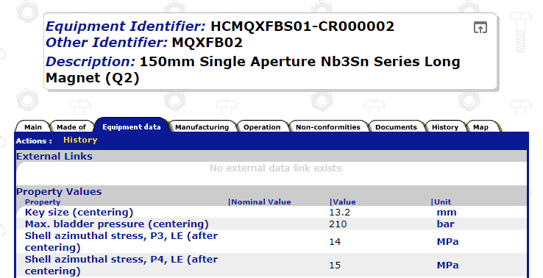
Outlook
Improve the Viewer:
More flexible
Allow 2D plots
Allow multiple tools in one plot
More efficient way to deal with different quench locations
Guide on Gitlab how to use ParsimConductor and ParsimEvent
[2]
[3]
correct 2D-to-3D geometry parser
retrieve conductor data automatically from MTF
D. Mayr – Towards complete automation of test campaign simulations in STEAM – CERN – 5th May 2023
Notes:
Some other things I will do in the near future

Slide 12
Conclusion
We are in the process of solving the problems needed for a fully automated campaign analysis:
  Validated Magnet Models
  A way to get magnet specific conductor parameters
  A way to get event specific information
LHC
HL-LHC
We are much closer to reliably automate transient simulations for accelerator magnets, ensuring consistency and repeatability.
D. Mayr – Towards complete automation of test campaign simulations in STEAM – CERN – 5th May 2023

Slide 13
Image Sources
[1]https://indico.cern.ch/event/311824/contribution/10/attachments/597262/821989/QuenchHeaters_FRM.pptx
[2]https://edms.cern.ch/ui/file/2317707/AC/lhcmcsxfc0003-vAC.pdf
[3]https://edms5.cern.ch/pls/asbuilt/mtf_equip.eqp_main_top?p_rec_type=A&p_rec_id=HCMQXFBS01-CR000002
Last accessed: 04.05.2023
D. Mayr – Towards complete automation of test campaign simulations in STEAM – CERN – 5th May 2023

