Slide 1
Towards complete automation of circuit event simulations
VIJAY CHAKRAVARTY, (Technical Student) TE-MPE-PE
Supervisor: Dr. Emmanuele Ravaioli
5th May, 2023
Notes:
Good morning, thanks for joining. I am Vijay Chakravarty, a technical student with the STEAM team and the topic of my presentation is “Towards complete automation of circuit event simulations.”

Slide 2



Motivation
Simulate any LHC event on the fly
Automate the analysis of diverse circuit families
Perform periodic tests of validated circuit models
Notes:
There are fundamentally three separate but interlinked motivations for complete automation:
We begin with a rather grand motivation of simulating any LHC event on the go. So, if an event of interest happens anywhere in our circuits, we wish to see exactly where it happened, predict how it might have happened and check if it is something we expect or is it something out of the blue.
This brings us to our second motivation of ‘diversity’ and this is also a challenge, because the LHC is huge, it has 8 major different types of circuit families. Each circuit family has various types of circuits and each circuit may have different types of magnets, PCs, different quench protection systems and so on. So, our second motivation is not to be intimidated by this diversity and complexity and try to find a cohesive solution for the entire LHC.
Finally, we want to ensure a legacy for posterity, for the future. We want that once the events are simulated, there should be some mechanism to check if the event is something unusual or not.
For each of these motivations, keep in mind the corresponding icon. Eagle for on the fly simulation of any circuit event, a person confounded with complexity for the diversity of circuit families and a checklist for periodic tests. You will see these icons throughout the presentation and would know what we are trying to achieve here.

Slide 3
Outline of my talk
Introduction to STEAM and softwares used
ABCD Analysis Strategy
Three Improvements
Where does automation begin?
Why is it a challenge: Complexity and diversity of LHC circuit families
Synergy between analysis techniques of magnets and circuits
An example of simulation plots generated
Periodic tests and sanity checks
Automation Flow
Notes:
Having answered the question of “Why automation?”, we get into a basic outline of this presentation:
I’d briefly touch upon the scope within the STEAM team that I am working on.
What strategy we started with, my supervisor Emmanuele calls it the ABCD strategy.
Three major improvements that we did and that form the foundation stones of the analysis and automation.
We’d discuss where we begin, why it’s a challenge and how circuits and magnets benefit from an integrated approach.
Subsequently, we will see how one such circuit event is plotted and checked.
Finally, we will try to understand this automation through one simple flowchart.
Sounds good? Alright, let’s begin!

Slide 4

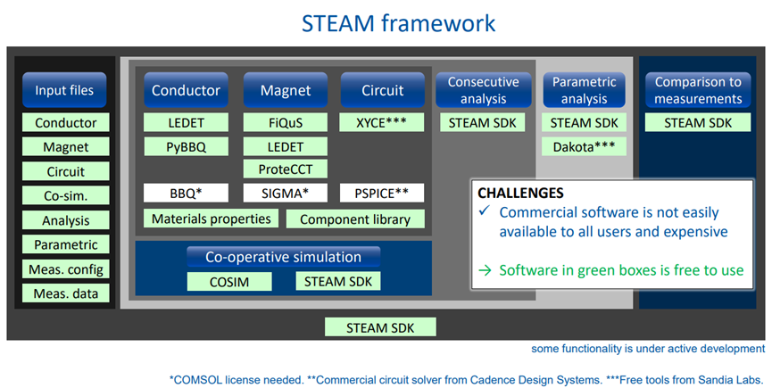
What is STEAM? ?
Simulation of Transient Effects in Accelerator Magnets
Achieve specialized, trusted, consistent, repeatable and sustainable software tools and models
Designed to model electrical, electromagnetic, and thermal transients in superconducting magnets and circuits
Notes:
To the members of the STEAM team present, if I start explaining the framework, it will be the ignominious equivalent of preaching to the choir. But to others in the section, I’d say that the STEAM framework acts as a versatile, useful and computationally efficient software package to model electrical, electromagnetic and thermal transients in superconducting magnets and circuits. Daniel, in his presentation, showed you this portion. My focus is on the third pillar of the image he showed: “Circuit”, as you can see. Under circuits, you can see the names of two softwares, PSPICe and XYCE and they form the subject matter of the next slide.

Slide 5



XYCE PSPICE
Xyce (zīs, rhymes with “spice”)
Open source, SPICE-compatible, high-performance analog circuit simulator
Developed by Sandia National Laboratories, USA
Fully functional analog circuit simulator
Supports digital components
Integrates system-level interfaces with electrical designs
Notes:
As you saw in the last slide, XYCE was in green, indicating that it is open-source and free to use and that is the motivation for doing more and more circuit simulations in XYCE instead of PSPICE. However, currently most of the simulations that we run are on PSPICE. We wish to have the option to run simulations on both softwares and we were able to successfully run some of the circuit families on XYCE. The rest will be included in due time.

Slide 6

ABCD analysis strategy for all circuit families
Validation of existing circuits
Making models of all remaining circuit types
Verifying circuit-specific models
Improving model (A continuing process…)
All these steps have been successfully applied for all circuit types of all the 8 circuit families.
Notes:
That concludes our introduction portion. And we come to the board game of strategy invented in my country. It’s the strategy with which we started the endeavour. Simply put, our ABCD strategy:
In the beginning, we had existing circuit models for some of the circuit families. They were validated, made sure they had all the components connected properly and that they made sense.
Secondly, on the same blueprint, circuit models were made for the remaining circuit types. Now, we have a repository of circuit models in the steam_models circuit library that covers the expanse of different circuit types in the LHC.
Again, these were verified, that they were able to represent all the variations that were possible…for example, some circuit types had different number of magnets, they had to have separate models. Similarly, circuits with nested magnet models had to be created.
Finally, we began improvement of the models which will be discussed as we progress.

Slide 7

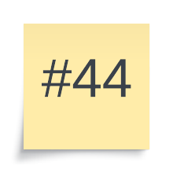
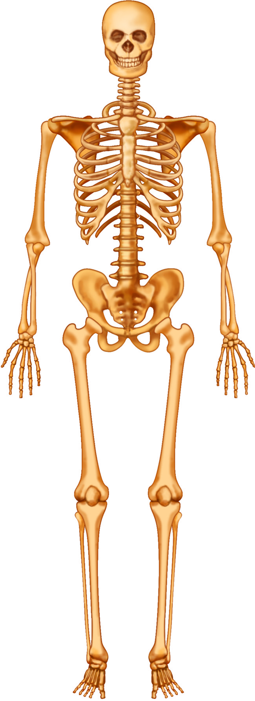
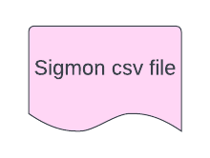
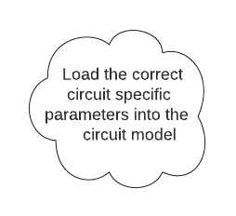
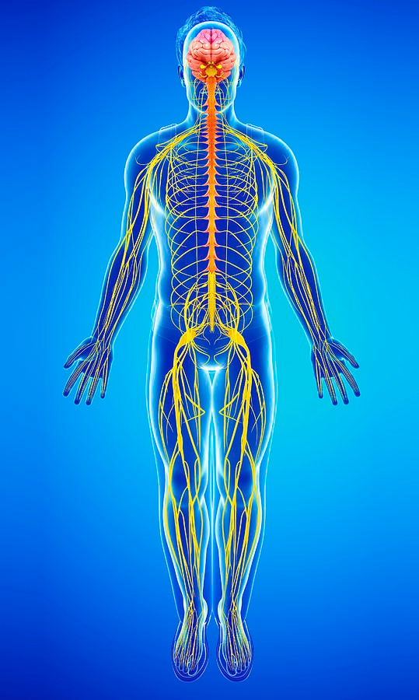
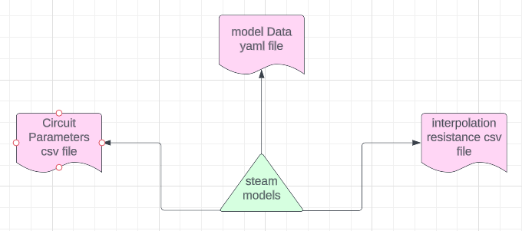
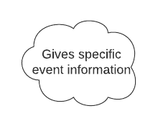

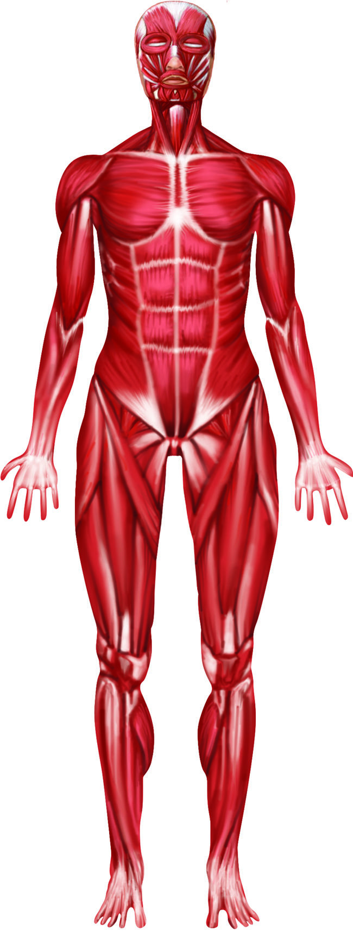


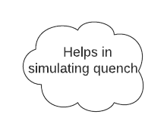
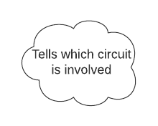
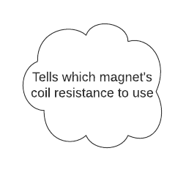
Snapshot
Steps A, B and C
Notes:
And we encounter our first icons. Remember from the motivation? This snapshot at the outset provides a bird’s eye view of what we mean by the first three steps and how it connects to simulation of any circuit event. The SigMon csv file provides us information of a specific circuit event. We use Python programming to parse all the information present in that event file and then rely on our validated circuit models in the steam_models repository to simulate the event. Many internal files and steps make the feat possible. Three main such files are shown. The numbers of these files required to cover the expanse of all different kinds of LHC circuits are also shown in corresponding sticky notes. It is noteworthy that we use simple readable YAML files to store most information and this makes it easier for even the uninitiated to understand what circuit parameters are being used. The netlist for circuit models, keys to configure Viewer plots, sanity checks and tests all of them can be tweaked with the help of simple different yaml files. The interpolation csv files are generated for each magnet type. There are about 40 magnet types. We can see that we have about 44 circuit models, each of whose parameters are changeable based on what circuit specific information is read from one of the 8 circuit parameters csv file. Each of these 8 files correspond to the 8 circuit families.
To understand it simply, follow the pink arrows. The event file tells us what circuit is involved, we read this information and get to know which of the 8 circuit families we should be looking into for circuit specific information that we will then load as parameters into the circuit model. Additionally, through the circuit name, we also deduce what magnets should be used and in what configuration and we call on the interpolation csv file of that magnet to get magnet specific coil resistances. Hence, model data yaml file serves as a skeleton upon which the muscles and nerves of circuit parameters and magnet coil resistance are respectively superimposed to make a functioning body. And in case you like the metaphor of biology, we will see later that all this can be neatly packed into the skin of ParsimEvent step, as mentioned by Daniel and hence we create a functioning human body. In essence, we can use the Steps A,B and C with a myriad of other things instead of just SIgmon FPA circuit event files and use this for various different purposes. All we need to know from the outside is which circuit is triggered and the rest will be figured out for whatever purpose people in the future see fit. The crux is as soon as you have the body of circuit simulation ready, you are only bound by your imagination in what that body can achieve if given appropriate inputs. SigMon csv file is nothing but nutrition for the body in that regard. A very delicious Bengali thali indeed.

Slide 8
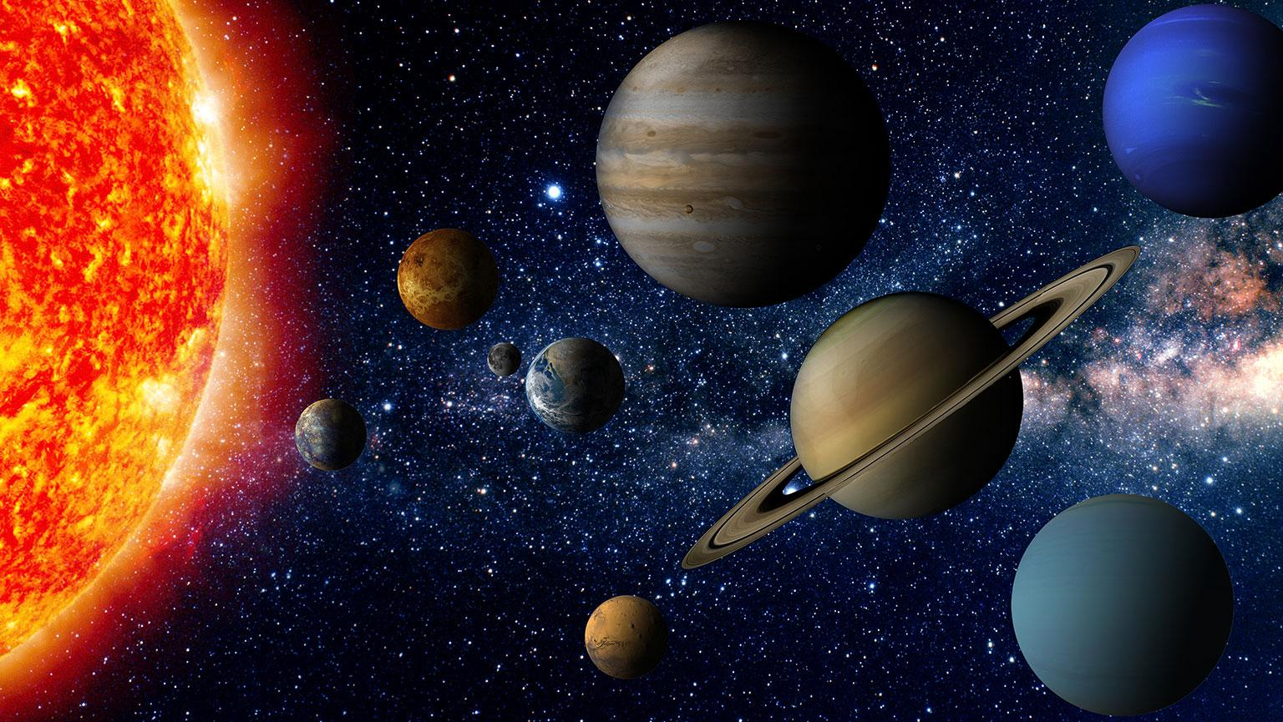
LHC Circuit Families : The Eight Planets
RB
600 A
RQX
RQ
IPQ
80-120 A
60 A
IPD
Notes:
In case it was an overdose of biology metaphors in the last slide, let me take you to astronomy. This is how I see the 8 circuit families: as 8 planets in our Solar System. The eight circuit families are of various sizes, they have different features and above all, they all form part of the LHC or the solar system.
Let’s start with Mercury or IPQ: There are 78 individually powered quadrupole circuits that make up the LHC matching sections or dispersion suppressor quadrupole. They have one of the three nominal currents, and one of the four magnet types. Some of them function at 4.5K and some at 1.9 K.
Venus or inner triplet RQX circuits focus the proton beams before collision at 4 locations. They have 4 magnets, 3 PCs and the magnets can be of two types. We shall look at some plots for RQX later.
Earth or RQ consists of 16 main quadrupole circuits. They can be focusing or defocusing , and have 47 or 51 magnets.
Mars or IPD is a rather simple circuit family with just one magnet which can be of 4 types however. These are responsible for bringing the two beams of the LHC into collision and then separating beyond the collision point.
Jupiter or RB are the main bending dipole circuits that have 154 magnets per circuit. Since it has the highest number of magnets, it is Jupiter.
The final three planets represent the circuit families named after their typical current levels.

Slide 9

Challenge: Complex diversity of the eight planets
RQX has three PCs each with different ramp rate, acceleration and current
IPQ has 2 different magnet configurations (2 apertures and 4 apertures)
Although IPD circuits have just one magnet, they employ four different circuit types and corresponding different magnets.
RQ family has defocusing and focusing circuits and employs a hierarchical sub-modular structure for the PC.
600 A circuits may have EE and/or parallel resistors or may be self-protected.
RB and RQ must include diodes with heating modeling across the magnets that quench.
Nested magnets pose another challenge.
Notes:
The different circuit families we just saw have very unique characteristics that make the challenge of automating their simulations interesting. Some of the salient features of these circuit families that had us thinking how best to accommodate them in a common automation.scheme are shown.
The corresponding picture is taken from the chapter of understanding diversity in my political science textbook of class 6th. So, all we needed to figure out was how to make these ostensibly different people hold hands in the shared strength and unity of automation.

Slide 10
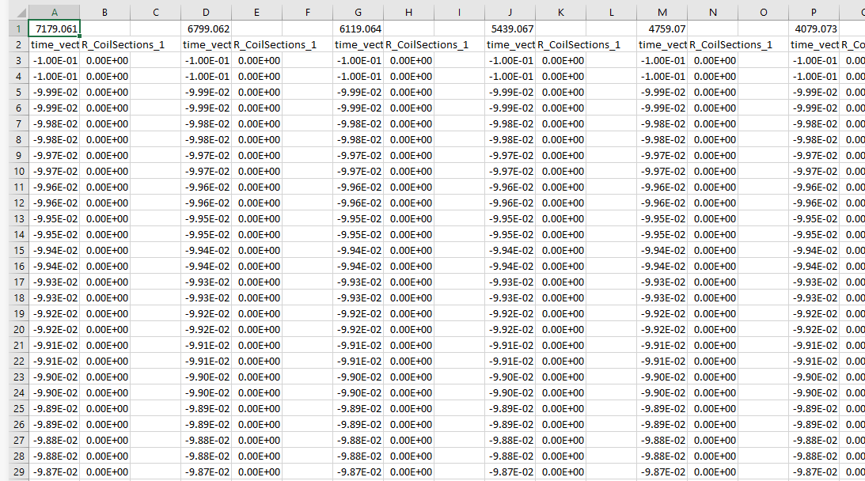
Improvement 1: Coil Resistance Interpolation
The Coil resistances used for interpolation are derived from earlier work of PSPICE-LEDET co-simulation by the STEAM team. (Thanks Marvin!)
Lumped-Element Dynamic Electro-Thermal (LEDET) model includes non-linear dynamic effects such as the dependence of the magnet’s differential self-inductance on the presence of inter-filament and inter-strand coupling currents in the conductor.
Notes:
For that unity and strength, we go back to step D mentioned before in our strategy: Improvement in circuit models. It is an ongoing process. Even after my project is complete, there will be scope for improving the modeling. It is only through our improved humanity that we can hope to accept and hold hands with people different from ourselves. And we will be discussing which three improvements in the humanity/ modeling of our circuits helped us achieve the automation.
It is said that progress is possible only by standing on the shoulders of giants. Marvin had done a lot of these PSPICE-LEDET co-simulations in the past, which produced coil resistance files for different types of magnets that we are currently using. These files are magnet specific and an example can be seen above. This is an interpolation_resistance csv file for the magnet MQXA which is used for the inner triplet (RQX) circuits. As you can see, the numbers on top are the current levels. For each current level, we have a list of columns: time_vector and the coil resistances calculated by the cosimulation for those current levels at the corresponding times.
(P.S. if asked, these files were generated with the understanding that the PC off occurs at time 0, that’s why the time vector can be negative. However, when we deal with pspice, we use an appropriate offset to avoid negative times)

Slide 11
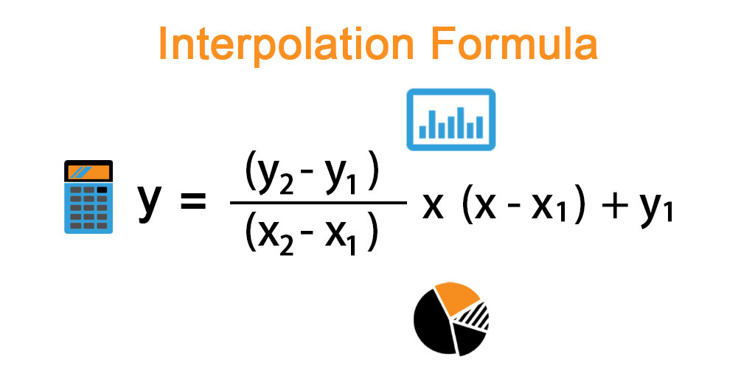
Coil Resistance Interpolation
Once the coil resistances are taken from the LEDET output, we can use them to interpolate coil resistances for current levels in the range.
PSPICE
For interpolation, we use the good old formula
Other options can be fine tuned, like how many magnets and apertures are there, what time offset should be used, etc.
LEDET
Co-simulation
Notes:
So, the current levels in the previous file were fixed as you saw. But it is most likely that a circuit event will not have the same fixed current at which the cosimulation with PSPICE and LEDET was run. In order to simulate any current between these current levels we use the simple interpolation formula we all learnt in high school as shown. So, we have different levels in the file from 0 to the maximum current possible for that magnet. Having many intermediate current levels between these extremes improves the accuracy of the interpolated resistance.
Using LEDET, the electro-magnetic and thermal domains can be modeled with three sub-networks of lumped-elements:
reproducing the electrical transient in the main magnet circuit,
the thermal transient in the coil cross-section,
and the electro-magnetic transient of the inter-filament and inter-strand coupling currents in the superconductor.
Simultaneously model macroscopic electrical transients and phenomena at the level of superconducting strands.

Slide 12
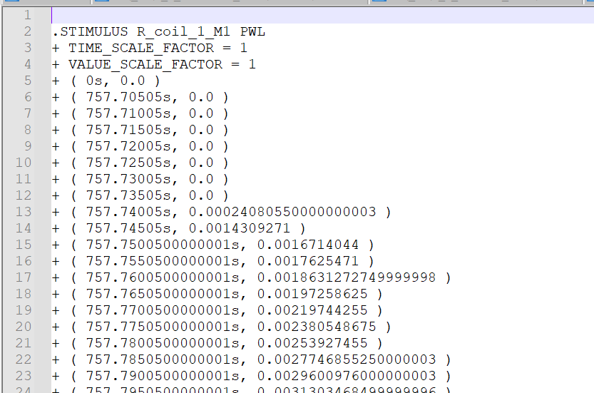
Improvement 2 :Stimulus File Generation
Once we have the interpolated coil resistances, we can feed that into our next step of stimulus (.stl) file generation.
R_coil_1_M1 in the adjacent image acts as an external stimulus to the parametrized magnet component in the magnets library file.
This way of using interpolated coil resistances to determine exact stimulus for the parametrized magnet helps us with automation of simulations of very different magnet types.
Thus, we replace the magnet component to include coil resistances.
Notes:
Our second improvement feeds on the previous improvement thereby compounding the shared goodness. We feed the interpolated coil resistances into the quenching magnets for each time in the time-vector added with an offset to determine the correct time to turn off the PC. The coil resistance becomes non-0 and starts increasing at some time before the Power converter is switched off. As is shown in the image above.

Slide 13
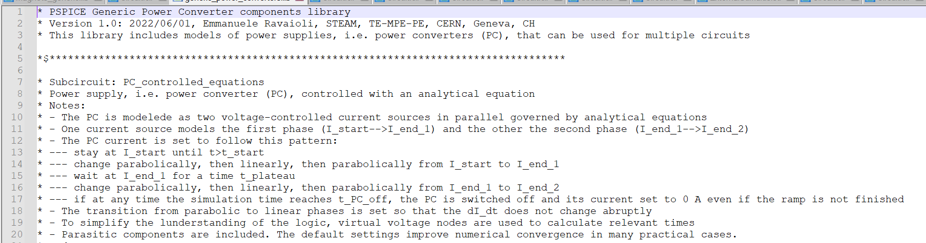
Improvement 3: Change of Power Converter Model
Inclusion of global parameters like ramp rate, acceleration to control the power converter with an analytical equation, as described below
Notes:
The last improvement for the humanity of our circuit simulations comes from changing the model of power converter. We use an analytical equation of a parabola, line and another parabola in succession to reach a plateau and again a parabola, line and parabola to reach the final current. It is noteworthy that should the circuit event signify that the fast power abort happens before the final current can be reached, then those cases are handled too, depending on whether the powering current was in the linear or the first or second parabolic regions of a ramp.

Slide 14


Where do we begin? What do we begin with?
LHC Magnet circuits,
Powering and
Performance Panel (MP3)
Repository
Fast Power Abort (FPA)
Circuit Events
Produced by SigMon- Signal Monitoring project
Simple csv file
All relevant information about that particular FPA event for a particular circuit
Including ramp rate, acceleration, plateau duration, type of quench, position in the magnet, date, time etc.
Notes:
Now that we have understood, the human body of circuit simulation as well as improved its humanity through the three improvements We start discussing what this human body is consuming. Simply put, it is a csv file produced by the SigMon team that serves us all the information about circuit events. As mentioned earlier, we are using FPA event circuit events right now. But any type of csv file that has information about a particular circuit event can be used to perform different functions in the future.

Slide 15
Synergy between analysis of magnets and circuits
Integration of the analysis of circuit events into the ParsimEvent step (the skin of our human body analogy)
Just change case_model from ‘magnet’ to ‘circuit’
For example, reading FPA circuit event files instead of quench dictionaries as done for magnets
Notes:
Now we come to what enables this seamless integration of all the muscles of circuit parameters, nerves of magnet coil resistance and skeleton of model data into one unit: the largest organ skin. All the steps ABCD are all bundled into the parsim event step. Parsim Event was covered in detail by Daniel. We use a similar not identical process, For the uninitiated, suffice it to say that it is as simple as changing case_model from magnet to circuit while implementing. Just as in the previous ppt, quench dictionaries were being read for magnets, in the case of circuits we are reading FPA circuit event files.

Slide 16
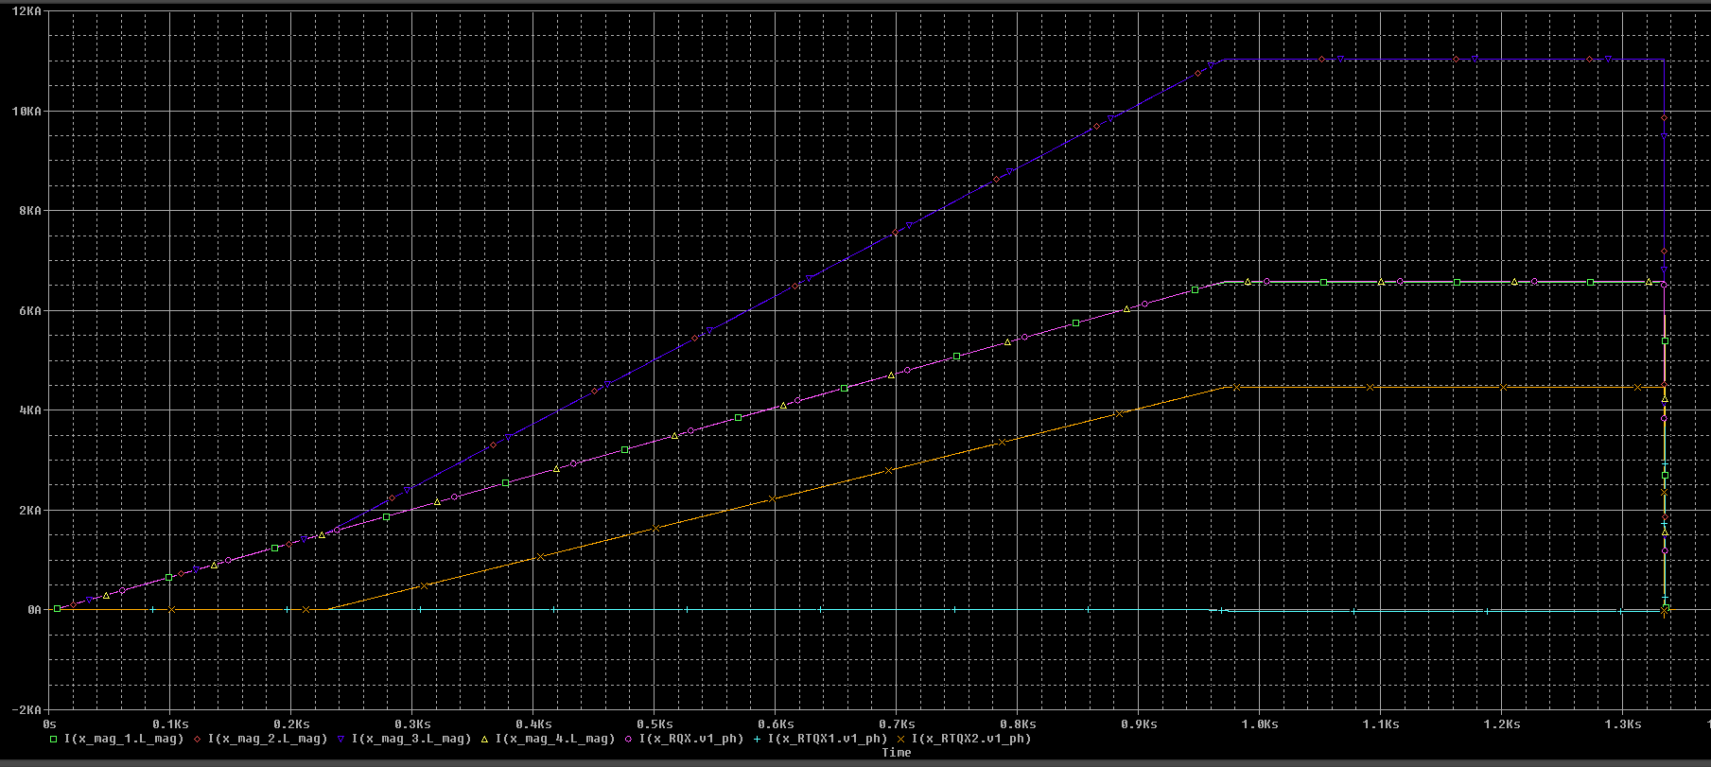
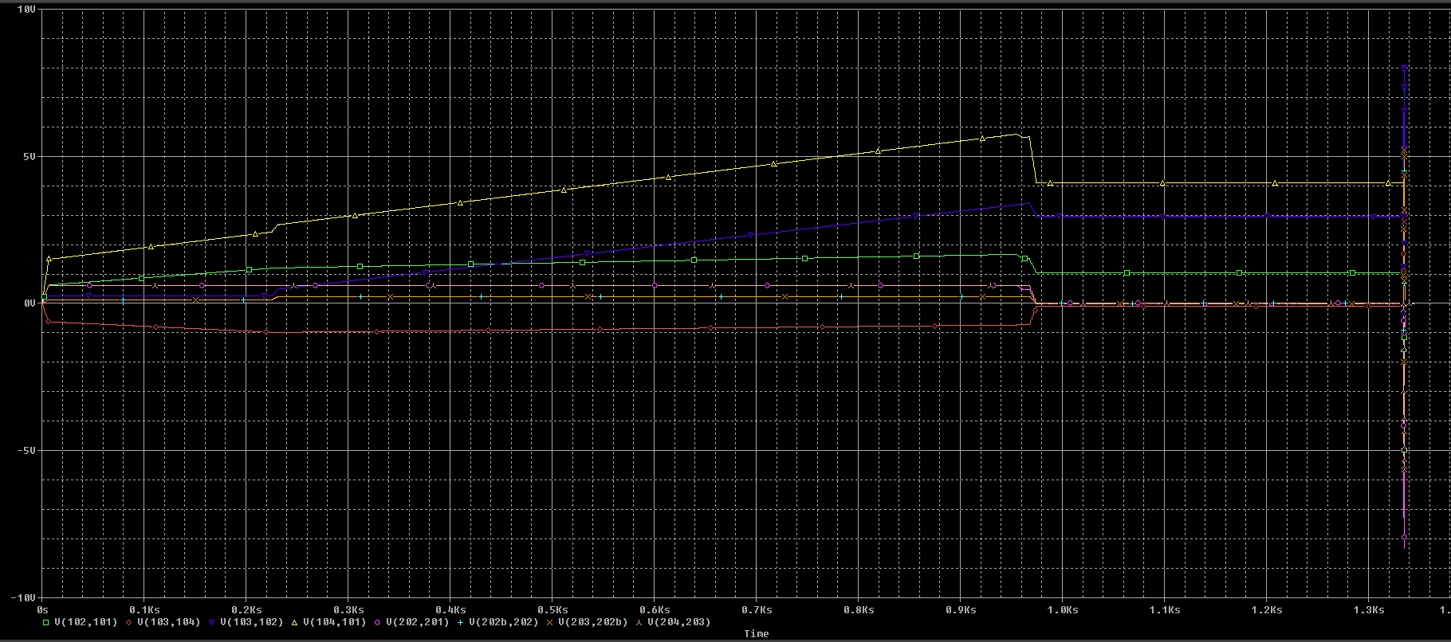
Simulation Plots: RQX
Notes:
Thus, we move on to the results section of our ppt. At the top, you can see what a typical FPA circuit event file looks like: it has all that information. For our purposes currently, circuit name, ramp rates, plateau durations, current at discharge are the entries of interest. If some circuit has an EE (not for RQX but some in say 600A) then we also have to see data entries corresponding to EE.. Coming back to the plots, on your left you see the major currents of interest: the currents through the 4 magnets and 3 PCs. On your right, you see the voltages of interest. They are all within -1V to 6V range, which is good. To see that the event file has directly been used, you can see the length of plateau in the current plot. It’s 359.96 s long as you might see in columns L,M,N of event file.

Slide 17
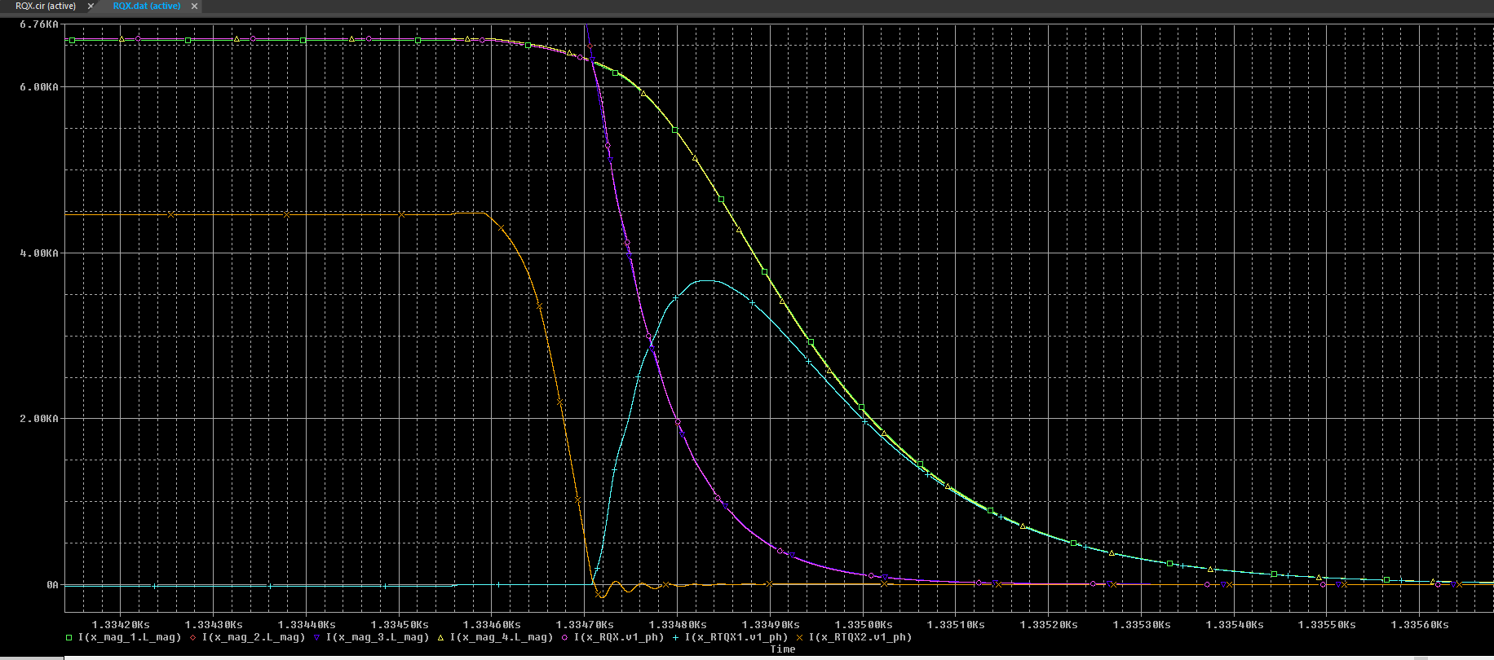
A closer look…
Notes:
When you zoom in the area near the point of switching off the power supply, you get the beautiful characteristic RQX plots.Although discussing specific details of this specific plot is not the point of the presentation, I couldn’t resist including it for it is very pretty.

Slide 18
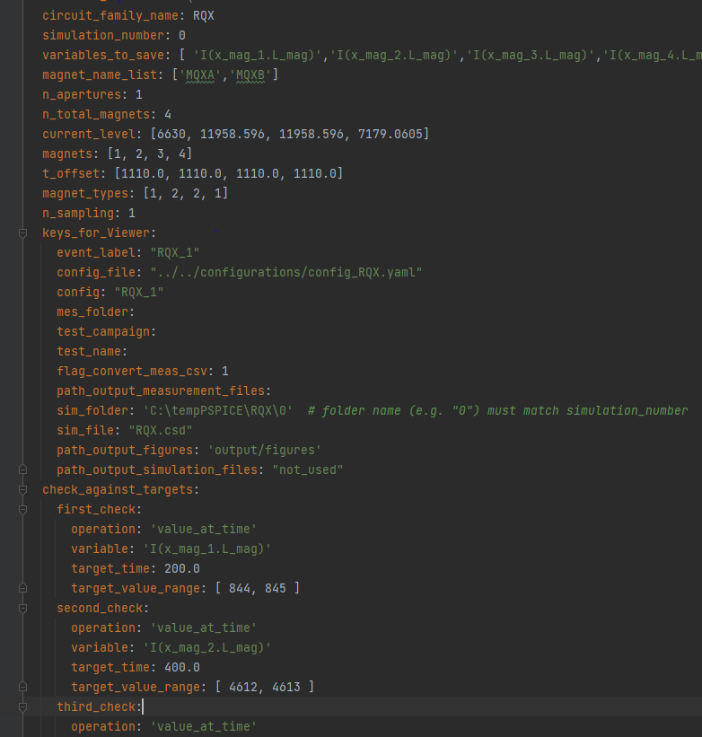
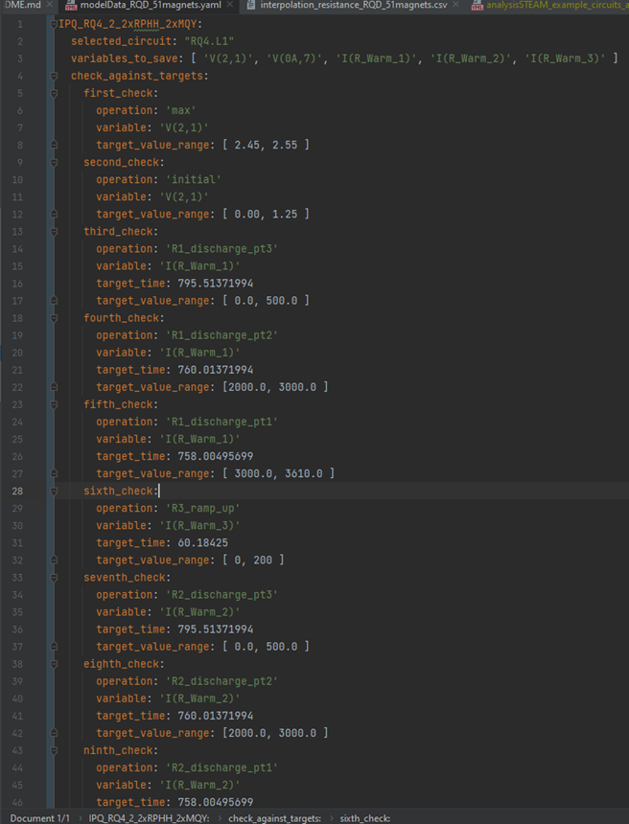
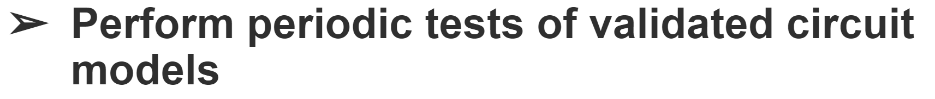
Periodic Tests and Sanity Checks
Sanity checks are exercised upon the
signal values at points of interest. For example:
currents during discharge and ramp up
voltages across power converters
minimum/maximum values
checking at certain points of time
Notes:
Having produced our plots, we come back to our last motivation of periodic tests. For tested validated circuits, we can institute sanity checks for different signals at various times, we can check minimum maximum values of currents and voltages. These checks too are instituted with the help of simple yaml files.This is done periodically. having such tests is important to detect any unusual activity in the future. If one of the tests fail, we’d know that something has change and further enquiry can be done. It also serves as a ready reference for further development. And thus our human of automated circuit simulation has left something for the future as well. I don’t know about you, but I quite like this human we created through the course of this presentation. They sound like a decent human being, they are able bodied, they eat well and care about the future.

Slide 19
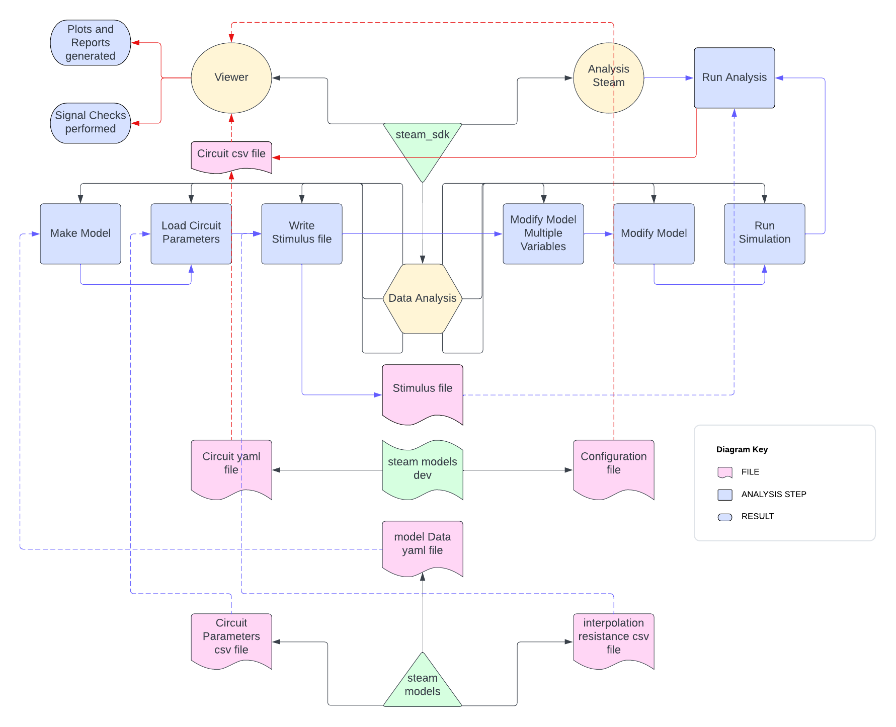
Automation Flow
Notes:
This brings us to our concluding slides. Earlier, we saw the zoomed in bottom portion of this graph. As I said, there are various repositories of the STEAM framework that make the automation possible. In the middle of the graph emanating from DataAnalysis you can see many of the steps that Daniel mentioned in his ppt. The Viewer creates the plots you saw and subsequently checks are performed.

Slide 20


Conclusion
Simulate any LHC event on the fly
Automate the analysis of diverse circuit families
Perform periodic tests of validated circuit models
50%
95%
50%
Notes:
We return to our motivations and see the amount of progress.
Our grandest ambition is about 50% done. It still needs a little tinkering to enable it to cover all types of events. But we are confident that is well within our reach as only nitty gritties need to be fixed and the scope expanded. The larger scheme works as seen by tests representative of each circuit family.
We have made most progress on the second motivation as it is also the title of the ppt and the central pillar of other motivations.
Finally, the third motivation is actually kept at 50 as a caution. Because we are constantly improving our models, the tests run the risk of becoming outdated with every improvement. I will give you an example. Yesterday, we made changes in the PC analytical equation itself to enable negative ramp rates. So, we can make such foundational fundamental changes and it is through the power of automation that it is seamlessly propagated to the simulation of each circuit model and event. Without automation, it would have been a nightmare to find that months of your work now fails the tests because you found out something was wrong in the core of the simulation. Once, we are satisfied with the level of improvements, increasing the progress of the third motivation to 100% is just a matter of a week.

Slide 21
Notes:
So that brings me to the end of this presentation. Thank you for bearing with my metaphors and the privilege of your time. If someone has questions, I’d be happy to take them.

