Slide 1

Technology options for the final cooling solenoids
B. Bordini, C. Accettura, A. Bertarelli, L. Bottura,
Dudarev, A. Kolehmainen, T. Mulder,
A. Verweij, M. Wozniak

Slide 2
1st Question to Review Panel
Are all critical magnet systems identified, including the true performance drivers, with no missing area ?

Slide 3
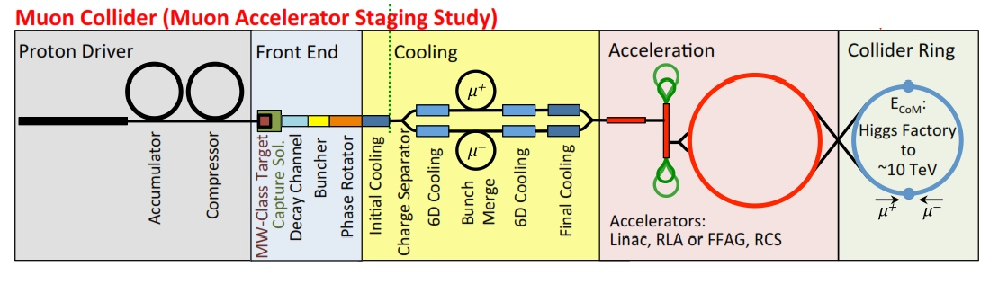
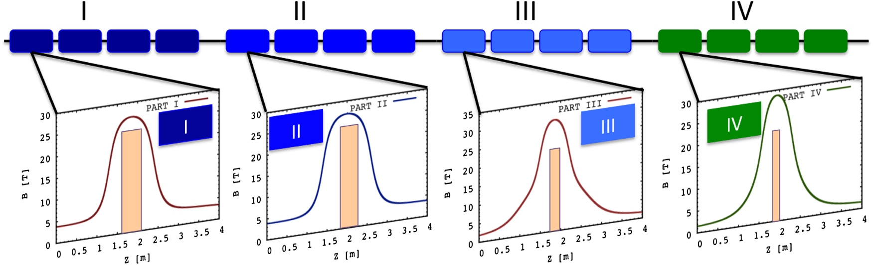
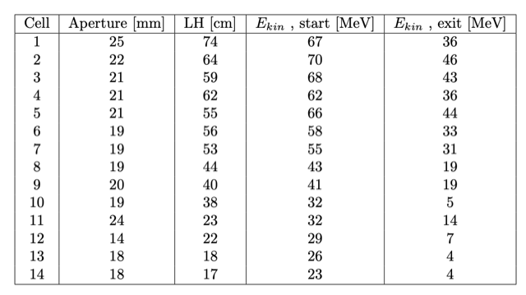
The Final Cooling Channel
The final cooling solenoids are part of the the final cooling channel, which is constituted by several cells
  16 were proposed by the MAP study
  14 are presently considered by IMCC
4 𝞼 beam dimensions and kinetic energies Courtesy of Elena Fol
A layout schematic of 16 cells of the final cooling channel defined by the MAP study (Sayed et al. Phys. Rev. ST Accel. Beams 18, 091001). The coloured boxes in the top represent the cooling cells. The bottom figures show a sample of the on-axis field of the strong focusing solenoid; the shaded areas show the corresponding absorbers lengths.

Slide 4
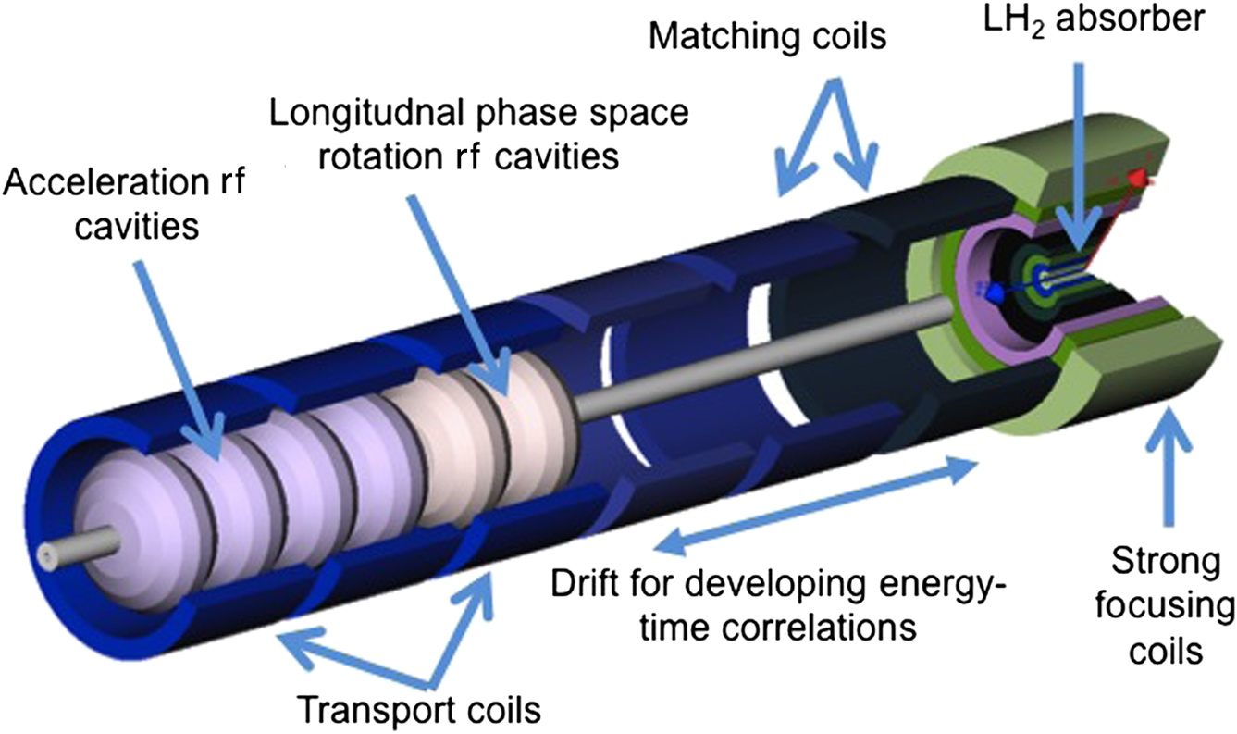
The Ionizing Cooling Cell
Each cell starts with a strong focusing final cooling solenoid enclosing the LH2 absorber
The final cooling solenoid is followed by matching coils, energy-phase rotation rf cavities, and acceleration rf cavities
The final cooling solenoids have been identified as the critical components the final cooling section
Schematic of the elements of one ionization cooling cell, Sayed et al. Phys. Rev. ST Accel. Beams 18, 091001

Slide 5
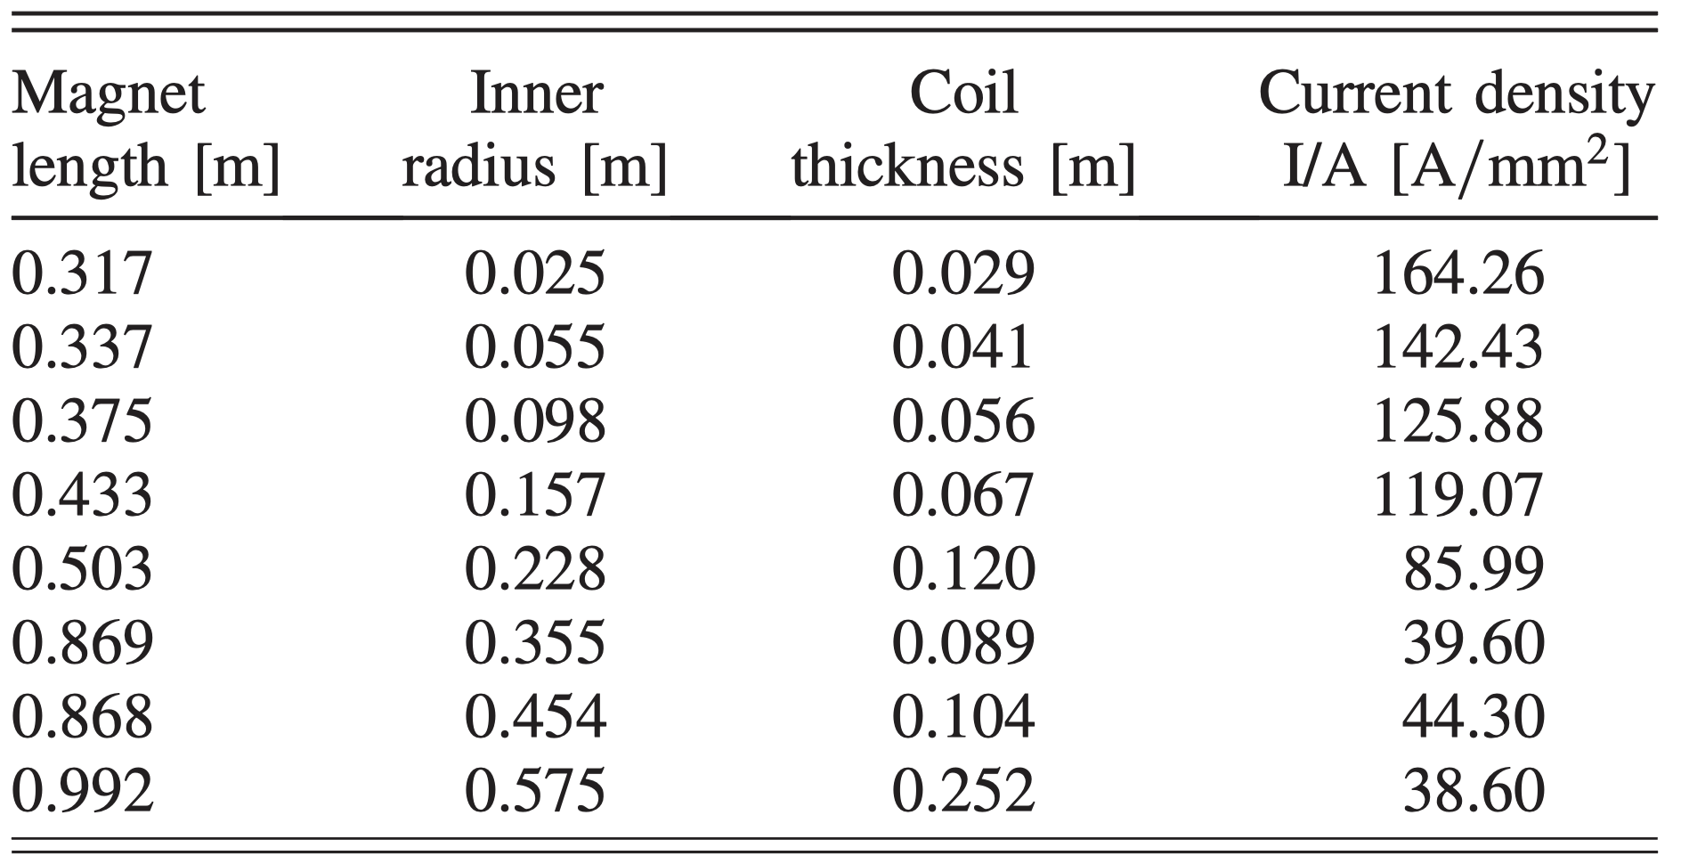
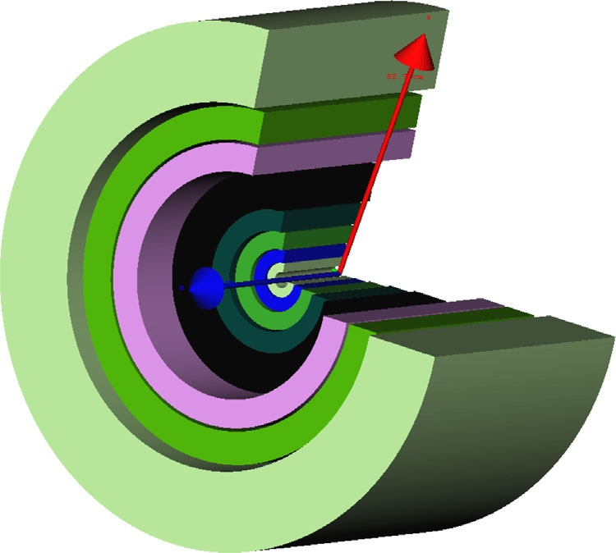
The Final Cooling Solenoid
Design proposed by MAP
Outermost radius R_{Out}= 83 cm
A set of eight superconducting coaxial coils providing a peak field of 50 T. The inner radius of the smallest coils is 0.025 m. Sayed et al. Phys. Rev. ST Accel. Beams 18, 091001
Main specs used for the CERN conceptual design
  B ≥ 40 T, aperture 𝝓 ≥ 50 mm, field homogeneity 1 % over ˜ 0.5 m
  Energizing time 6 hrs and persistency 0.1 Units/s

Slide 6
2nd Question to to Review Panel
Is the evaluation of technology options complete and appropriate ?
Specifically, are there viable options that have not been considered, or not evaluated correctly ?

Slide 7
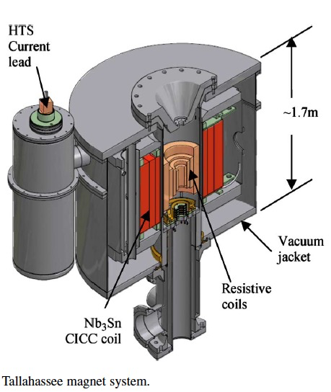
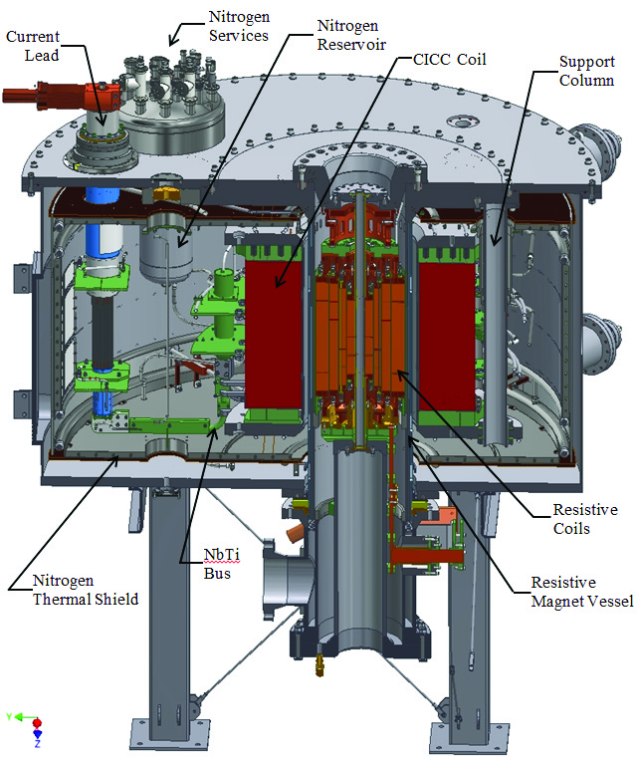
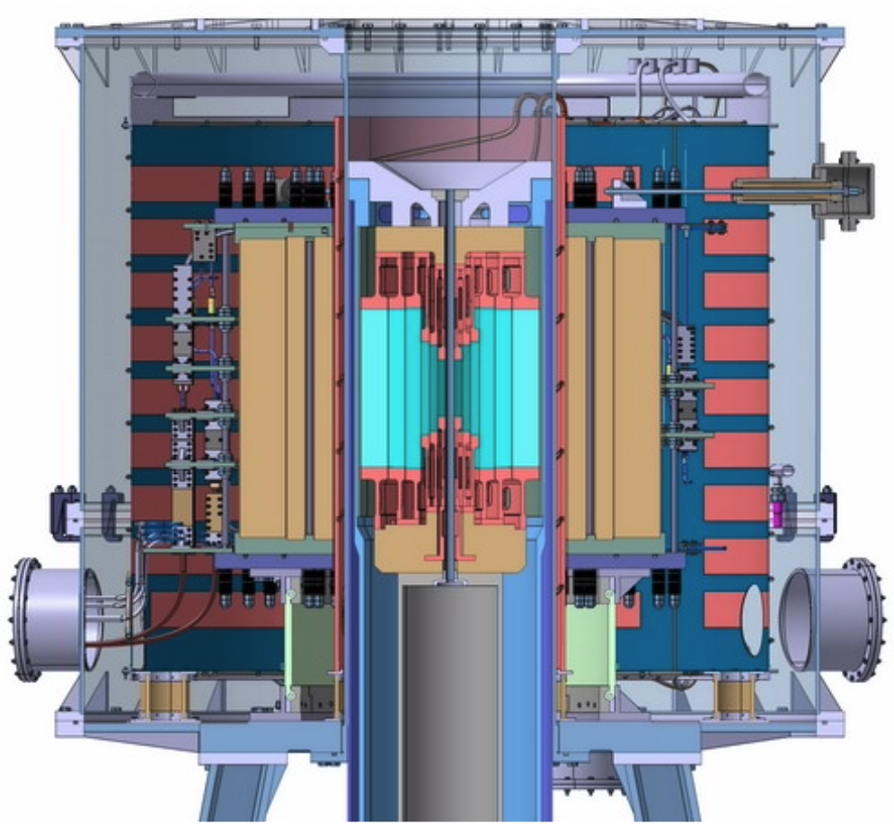
State of the Art Ultra High Field Hybrid Solenoid Superconducting + Resistive
https://nationalmaglab.org/user-facilities/dc-field/magnets-instruments/
http://english.hmfl.cas.cn/uf/ms/202202/t20220224_301451.html
Cross section of 45 T, 32 mm NHFML user facility solenoid
Hybrid Magnet 33.5 T from resistive insert, 11.5 T by superconducting outsert
30 MW power comsumption
Cross section of 36 T, 48 mm NHFML user facility (NMR) solenoid
Hybrid Magnet 23 T from resistive insert, 13 T by superconducting Nb3Sn CICC outsert
14 MW power comsumption
Cross section of 40*/37 T, 32/50 mm CHMFL user facility solenoid
Hybrid Magnet 29/26 T from resistive insert, 11 T by superconducting Nb3Sn CICC outsert
20 MW power comsumption

Slide 8
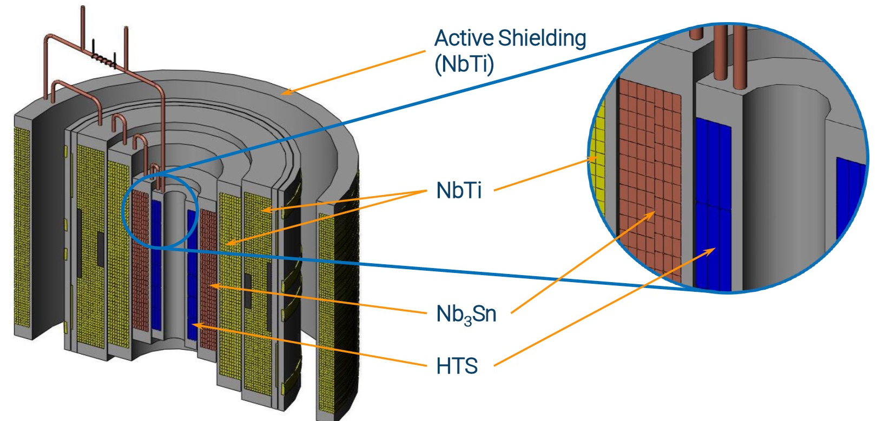
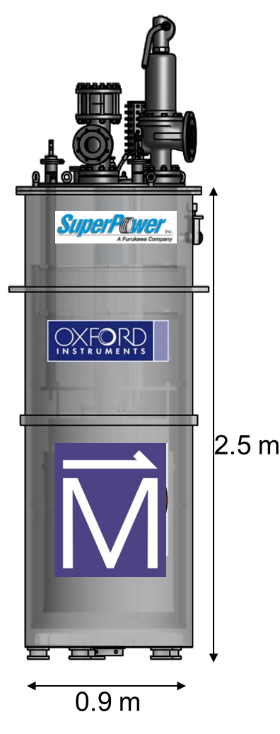
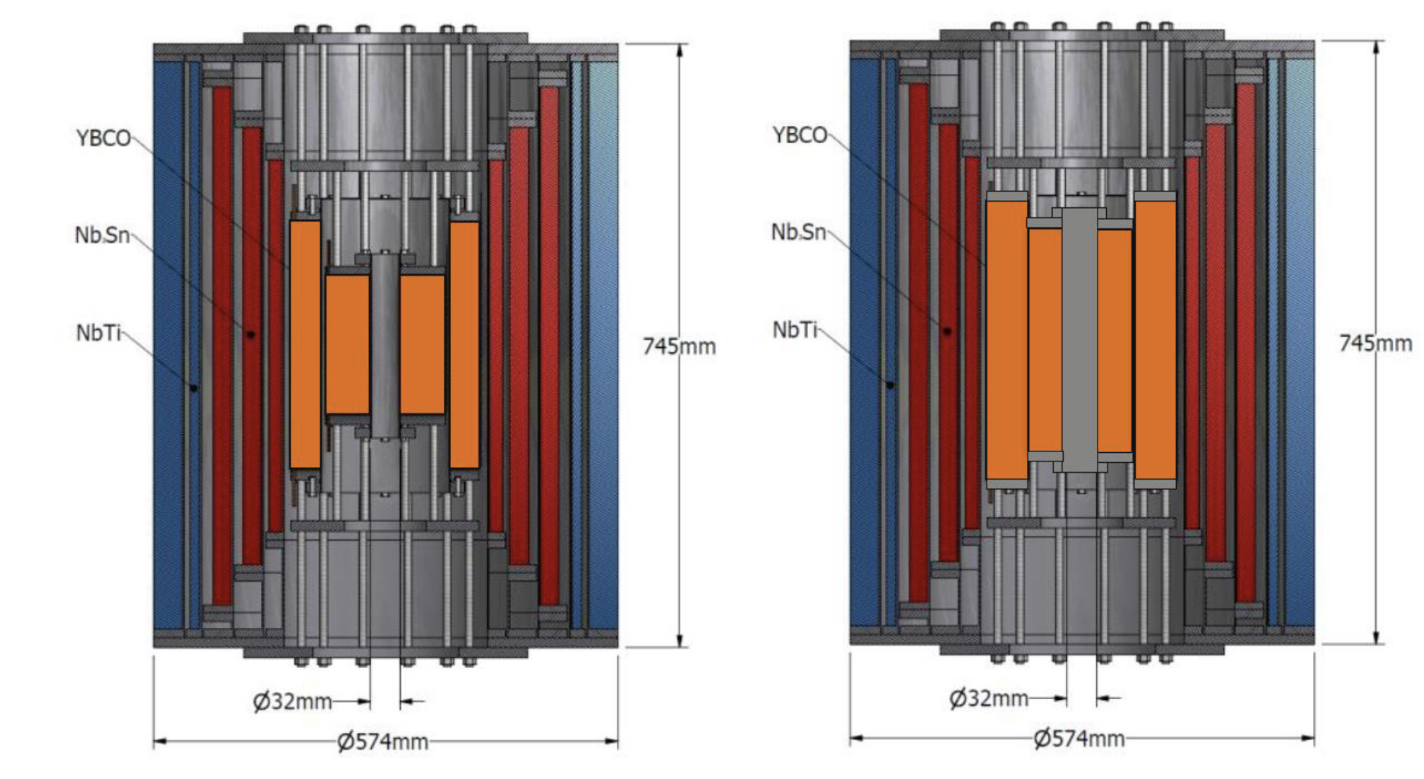
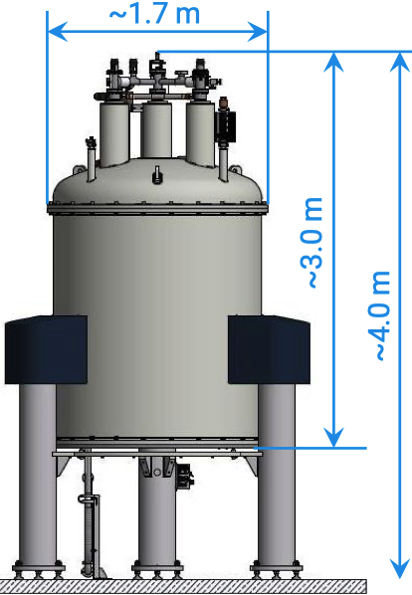
State of the Art Ultra High Field Hybrid Superconducting Solenoids
Cross section of 32 T (15 T LTS, 17 T two ReBCO double pancake coils), 32 mm user facility solenoid https://nationalmaglab.org/user-facilities/dc-field/magnets-instruments/
Artistic impression of a UHF NMR magnet by Bruker:
1.2 GHz-NMR (Bruker) 28.19 T – 54 mm RT https://snf.ieeecsc.org/sites/ieeecsc.org/files/documents/snf/abstracts/MT27%20PL1%20Bruker%20High%20Field%20NMR.pdf

Slide 9
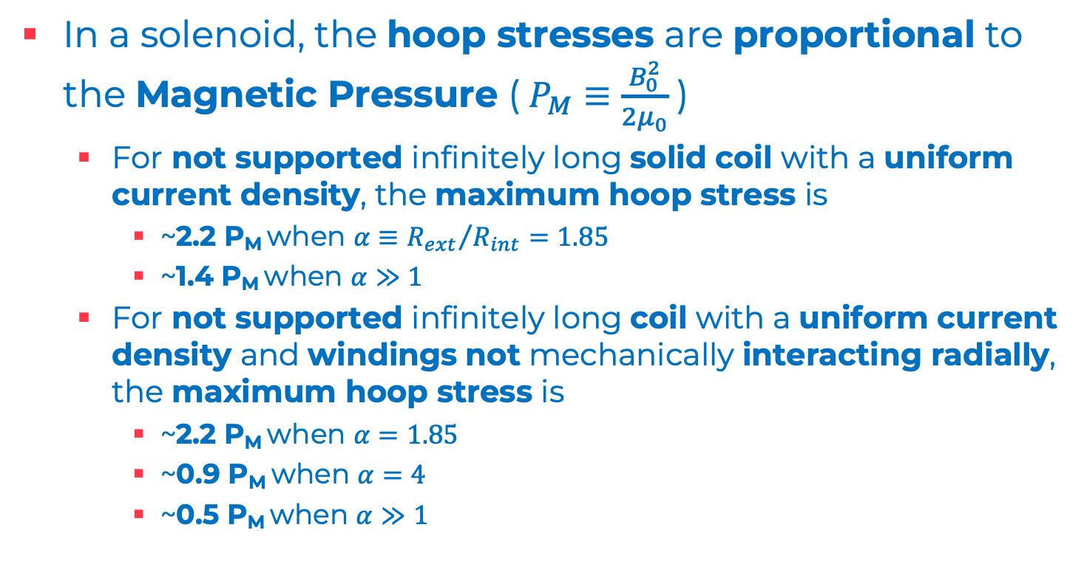
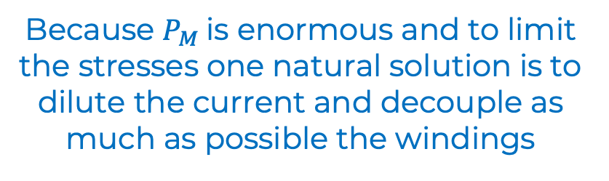
Why state of the art Ultra High Field UHF Hybrid solenoids are so big?
In a solenoid, the hoop stresses are proportional to the Magnetic Pressure ($P_{M}≡\frac{B_{0}^{2}}{2μ_{0}}$)
  For not supported infinitely long solid coil with a uniform current density, the maximum hoop stress is
    ~2.2 P_{M} when $α≡{R_{ext}}/{R_{int}=1.85}$
    ~1.4 P_{M} when $α≫1$
  For not supported infinitely long coil with a uniform current density and windings not mechanically interacting radially, the maximum hoop stress is
    ~2.2 P_{M} when $α=1.85$
    ~0.9 P_{M} when $α=4$
    ~0.5 P_{M} when $α≫1$
  Yield strength of
  annealed oxygen free copper: 30-80 MPa (grain size 50-3 μm)
  austenitic steel 316LN SS: 270 MPa at RT (830 MPa at 4 K)
Because $P_{M}$is enormous and to limit the stresses one natural solution is to dilute the current and decouple as much as possible the windings

Slide 10
UHF Superconducting Solenoids
Next step for nested coils
Cartoon design of 40 T, 32 mm user facility solenoid (planned) – Courtesy of Ian Dixon NHMFL
The design of superconducting solenoid by using nested insulated coils proved to be successful in producing ~30 T magnets with apertures up to 5 cm
  This concept will be further investigated and perfected by ongoing projects that try to optimize it and to reach larger field values
While this design is suitable for user facilities, it is not clear it could satisfy the needs of the final cooling solenoids

Slide 11
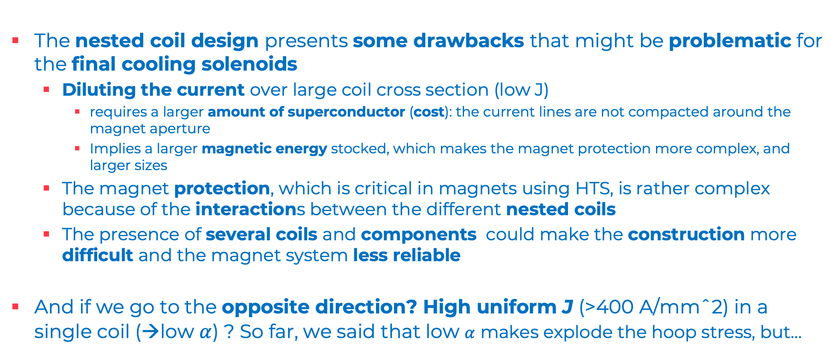
UHF Superconducting Solenoids
Nested Coils & Final Cooling Solenoid
The nested coil design presents some drawbacks that might be problematic for the final cooling solenoids
  Diluting the current over large coil cross section (low J)
    requires a larger amount of superconductor (cost): the current lines are not compacted around the magnet aperture
    Implies a larger magnetic energy stocked, which makes the magnet protection more complex, and larger sizes
  The magnet protection, which is critical in magnets using HTS, is rather complex because of the interactions between the different nested coils
  The presence of several coils and components could make the construction more difficult and the magnet system less reliable
And if we go to the opposite direction? High uniform J (>400 A/mmˆ2) in a single coil (→low $α$) ? So far, we said that low $α$ makes explode the hoop stress, but…

Slide 12
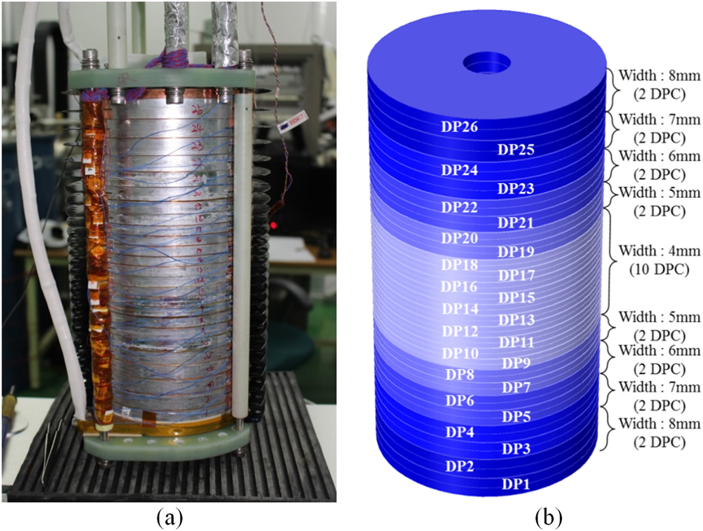
UHF Superconducting Solenoids
Single coil, High-J_{e}
This concept was proved successful for a Not Insulated ReBCO winding that reached 26.4 T with a maximum hoop stress of 286 MPa
But we need much larger fields (>40 T) and the hoop stress is proportional to B₀ˆ2
Plus, at larger fields, tensile radial stress appears, which is not acceptable for ReBCO tapes, what can we do?
  Support externally the coil with stiff rings that also apply a precompression to the coil
Sunam NI one-body ReBCO magnet
26.4 T in 35 mm, J central pancake 404 A mm⁻² (26.4 T HTS multi-width)
overall diameter and height: 172 and 327 mm
S. Yoon et al. Supercond. Sci. Technol. 29 (2016) 04LT04

Slide 13
Technologies
We chose the all-HTS NI/MI Single Coil (pre-compressed) option because of its very high potential (for future particle accelerator and other societal applications, see slides 24-25) and because nobody is pursuing it (as far as we know)

Slide 14
3rd Question to to Review Panel
Are the selection of options to be studied in detail, and the ranking of priorities, justified and appropriate for the objectives of a pre-conceptual report, due by end 2025 ?

Slide 15
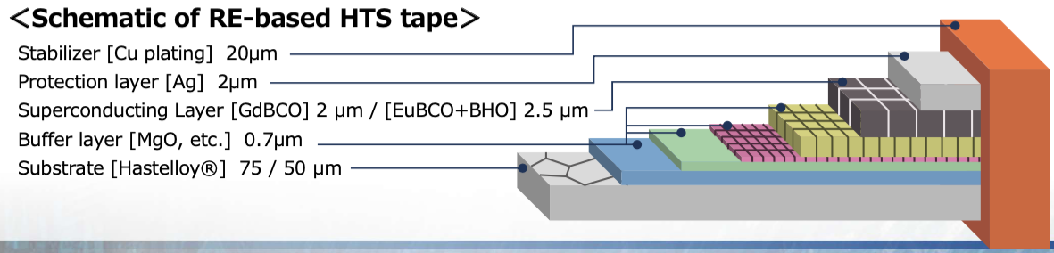
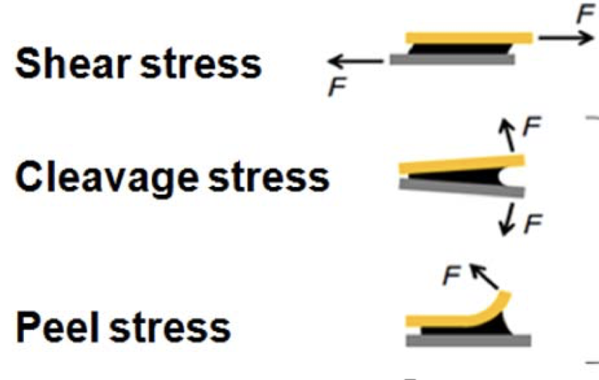
Electro-mechanical Properties of the ReBCO tape*
For a 12 mm wide tape, we can assume critical current I_{c} values of this level
  Measured² at 4.2 K: I_{c} (B⟘=15 T) ~ 1.8 kA; I_{c} (B⫽ =15 T) ~ 5.4 kA
  Estimated at 4.2 K: I_{c} (B⟘=50 T) ~ 300 A; I_{c} (B⫽ =50 T) > 1000 A
Mechanical stresses producing irreversible I_{c} reduction
  Tensile longitudinal strain > 0.4 %¹ (600-800 MPa depending on the Hastelloy fraction)
  Compressive stress in thickness direction > 400 MPa¹
  Compressive stress in width direction > 100 MPa¹
  Tensile stress in thickness direction: 10-100 MPa³
  Shear stress > 19 MPa³
  Cleavage/Peel stress³ (tensile at tape extremities)<1 MPa³
Sketch taken from ref. 1
¹https://www.fujikura.co.jp/eng/products/newbusiness/superconductors/01/superconductor.pdf
² Shinji Fujita, Satoshi Awaji et al. IEEE TAS, VOL. 29, NO. 5, AUGUST 2019
³ Hideaki Maeda and Yoshinori Yanagisawa IEEE TAS, VOL. 24, NO. 3, JUNE 2014
Picture taken from ref. 3
*In appendix the conductor specifications produced for the Muon Collider Project

Slide 16
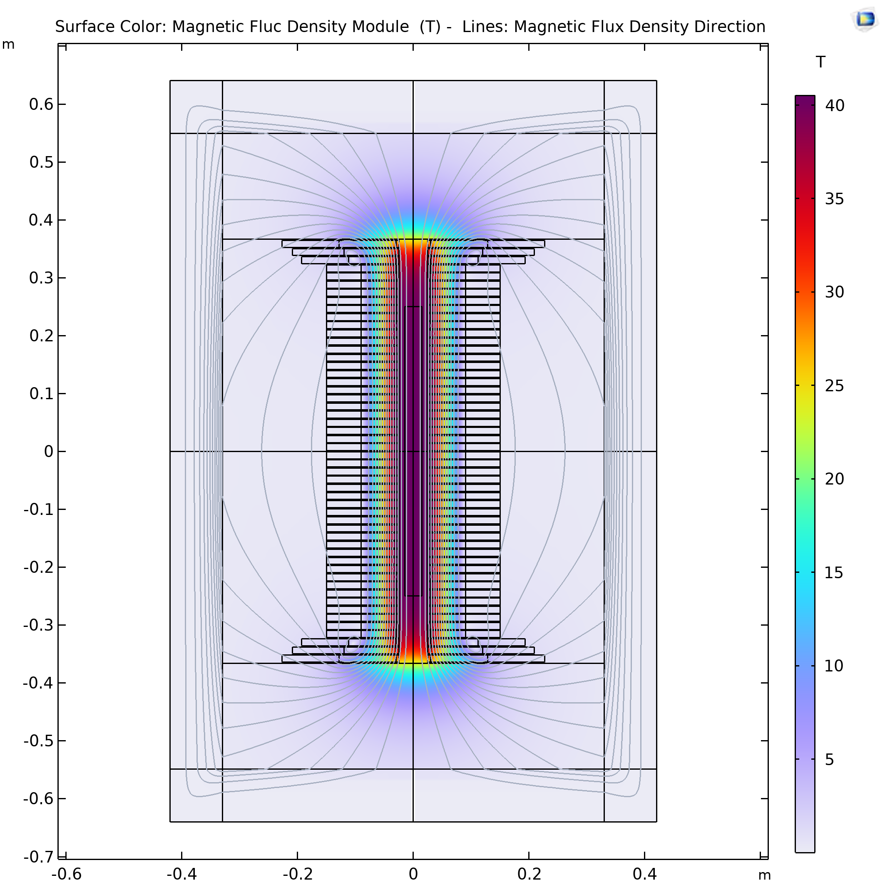
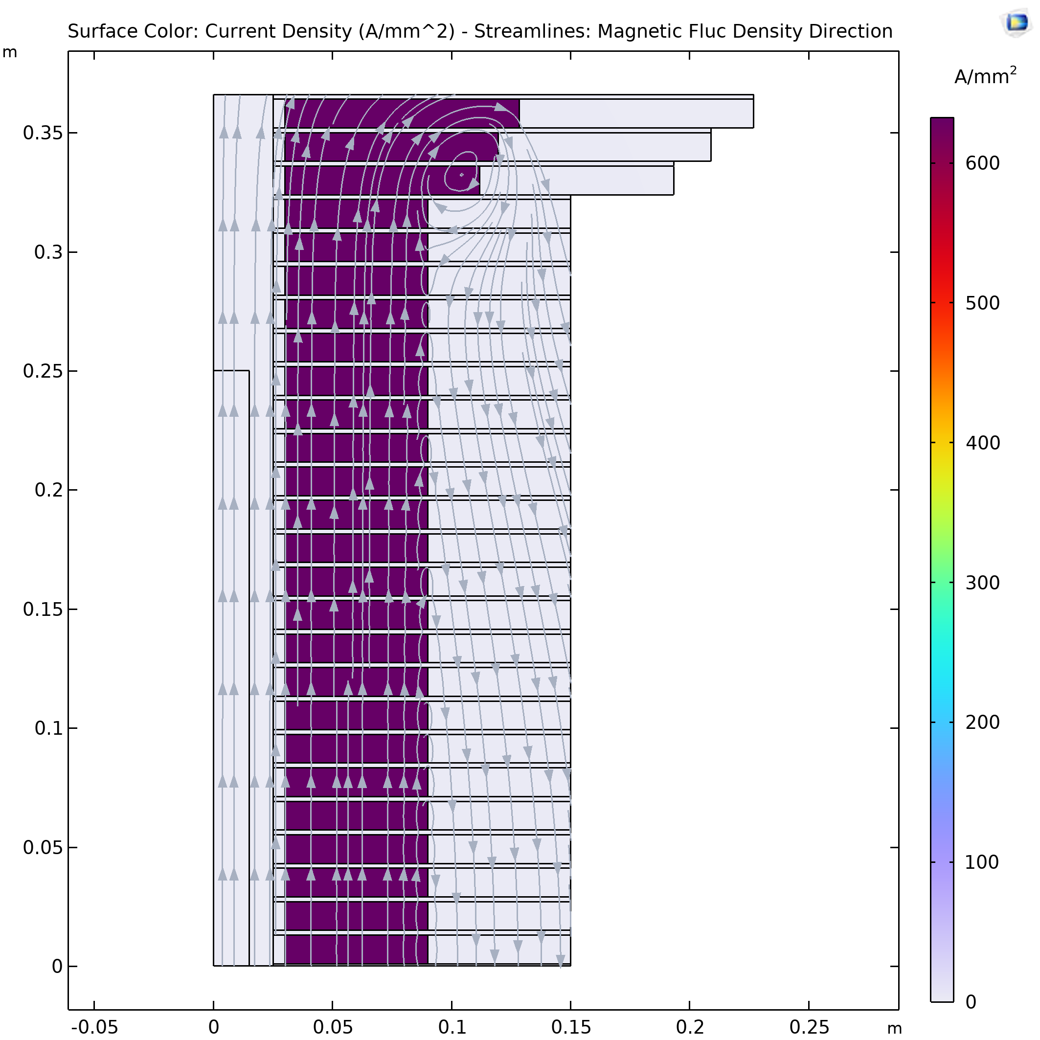
40+ T Conceptual design
  46 identical ‘modular’ and 6 ‘correction’ pancakes
  ‘modular’ pancake:
    6 cm (6-8) thick coil
    J_{e} 632 A mm⁻² (>500)
    12 mm wide tape
    Outer ring thickness x times (>1) coil thickness
    Inner ring 5 mm thick
    Support Plate 2 mm (less?) thick
    Bore aperture 50 mm
    Bore Field = 40 T
Inner Ring
‘Correction’ Coil
Infinite Elements
Outer Ring
Bore
Vacuum
‘Modular’ Coil
1 % Field Homogeneity
Support Plate

Slide 17
Principles Guiding the study 1/2
J_{e} > 500 A mm⁻²
  limit costs and dimensions
Modular Single coil pancakes (not nested coils)
  simplify the design, the magnet system and the protection
Non/metal insulated coils
  protection, mechanical robustness, high J_{e}
Avoid tensile radial stresses and limit the hoop strain to values lower than 0.4 %
  minimize the risk of I_{c} degradation
Figure rapresenting ¼ of the solenoid
Radially support each pancake via a stiff outer ring that also applies a radial precompression on the coils
  limit the hoop strain and avoid tensile radial stresses

Slide 18
Principles Guiding the study 2/2
Maintain the magnetic field lines practically parallel to the tapes in the ‘modular’ coils
  minimize axial Lorentz forces and maximize I_{c}
Intercept axial Lorentz forces between pancakes via support plates
  minimize the pancakes mechanical interactions, avoid the accumulation of axial forces
Use as wide as possible tapes, 12 mm
  to limit the number of pancakes
Figure rapresenting ¼ of the solenoid
Robust design for the ‘correction’ coils, to account for the not negligible axial forces experience (significant radial fields) and the conductor magnetization (tape striations ?)
  protection, mechanical robustness

Slide 19
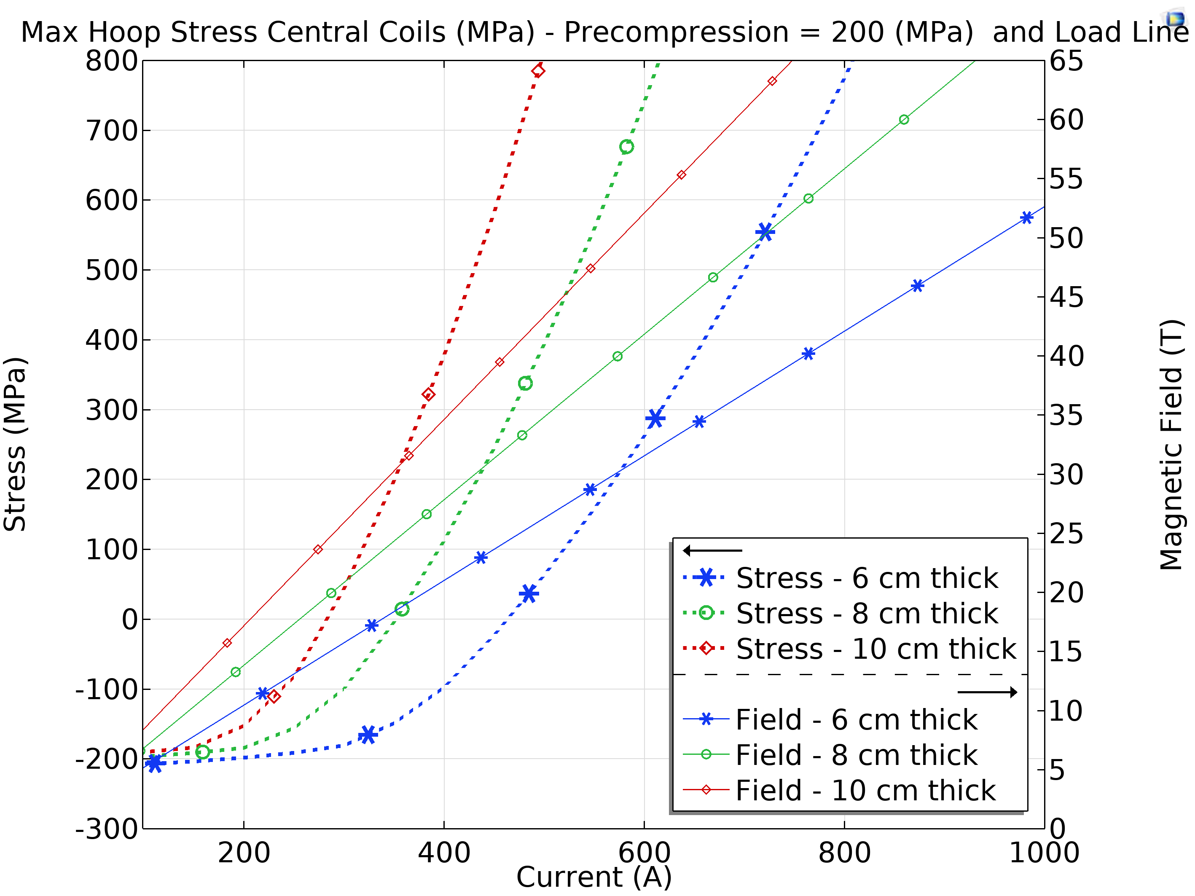
Mechanical Analysis I *
main findings
A precompression of about 200 MPa is essential to limit the conductor hoop stress to acceptable values
Max Hoop stress and load line for different thickness of the modular coil winding (pre-compressed at 200 MPa)
Even with a 200 MPa precompression, the coil thickness must be smaller than ~8 cm to avoid radial tensile stress
The maximum field achievable with this design (based on pancakes made of a single coil) is about 40 T
Most of the axial Lorentz forces act on the last 2 pancakes of each extremity
  about 3 and 1.5 MN → on average ~30 and 15 MPa applied on the respective support plates
  the axial force acting on the 4th coil is more than one order of magnitude lower
*Assumption in appendix

Slide 20
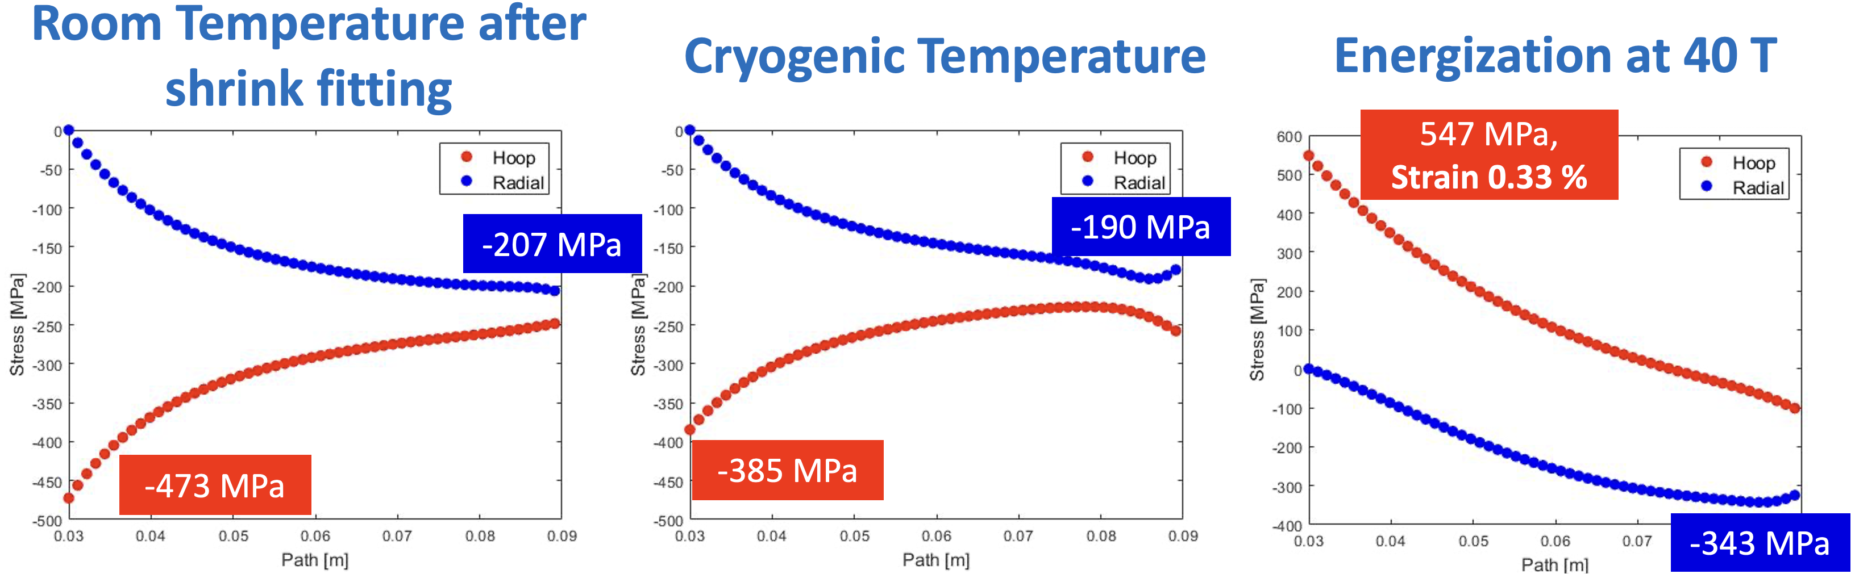
Mechanical Analysis II *
Case studies and main findings
200 MPa precompression feasible via shrink fitting**
Calculated stresses and strains are well below the limits of the superconductor
The max hoop strain strongly depends on the thickness of the plates between modular coils
Plots refer to Case 1
The tape Copper fraction does not significantly impact the results of the linear analysis
  Cu yielding needs to be assessed (work in progress)
Courtesy of C. Accettura see her talk on Thursday!
* Analysis Assumptions and **Alternative design to shrink fitting in Appendix
Stress and strain in the ‘modular coils’ after shrink fitting at Room Temperature, after cooldown at 4.2 K and; at full energization (40 T)
 |  |  |  | Stress (MPa) at RT |  | Stress (MPa) at 4.2 K |  | Stress (MPa) and Strain (%) at 40 T
Case | Copper in the tape, (%) | Distance between 'modular' coils (mm) | J_{e} (A/mm²) | Min Hoop | Min Radial | Min Hoop | Min Radial | Max Hoop Stress | Min Radial Stress | Max Hoop Strain
1 | 40 | 2 | 632 | -473 | -207 | -385 | -190 | 547 | -343 | 0.33
2 | 20 |  |  | -484 | -211 | -413 | -193 | 529 | -352 | 0.3
3 | 40 | 0 | 542 | -473 | -207 | -385 | -190 | 412 | -320 | 0.25
4 | 20 |  |  | -484 | -211 | -413 | -193 | 393 | -330 | 0.22

Slide 21
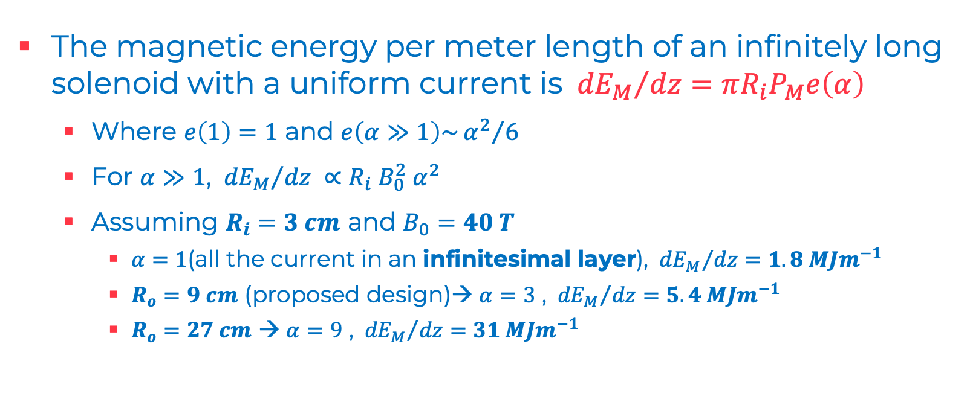
Protection Studies
Magnetic Energy
The magnetic energy per meter length of an infinitely long solenoid with a uniform current is ${{{ dE}_{M}}/{dz}=πR_{i}P}_{M}e\left(α\right)$
  Where $e\left(1\right)=1$ and $e\left(α≫1\right)\sim {α^{2}}/6$
  For $α≫1$, ${{ dE}_{M}}/{dz} ∝R_{i} B_{0}^{2} α^{2}$
  Assuming $R_{i}=3 cm$ and $B_{0}=40 T$
    $α=1$(all the current in an infinitesimal layer), ${{ dE}_{M}}/{dz}=1.8 MJm^{−1}$
    $R_{o}=9 cm$ (proposed design)→ $α=3$ , ${{ dE}_{M}}/{dz}=5.4 MJm^{−1}$
    $R_{o}=27 cm$ → $α=9$ , ${{ dE}_{M}}/{dz}=31 MJm^{−1}$
6 cm thick ‘modular’ pancakes (600 turns)
12 mm wide tape
60 mm winding inner diameter (50 mm bore aperture)
2 mm distance between modular pancakes
Parameters in modular pancakes

Slide 22
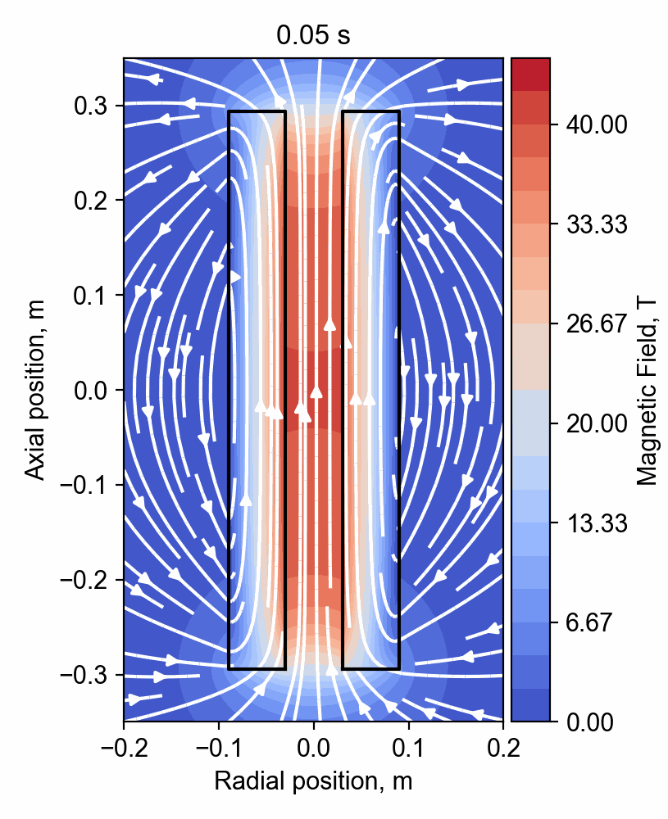
Protection Studies
Fast Transients
Detailed analysis of fast transients in Not/Metal Insulated coils are essential for their protection ( and operation)
CERN started to work on it
  Several experts on quench dynamics and SC magnets protection
  In house software (STEAM) validated on numerous LTS magnet tests/experiments
  Development of new tools dedicated to the transient analysis on ReBCO not/metal insulated coils
  Availability of and competences on FEM software (Comsol Multiphysics and GetDP) running on CERN clusters
Simulation and Animation courtesy of Tim Mulder

Slide 23
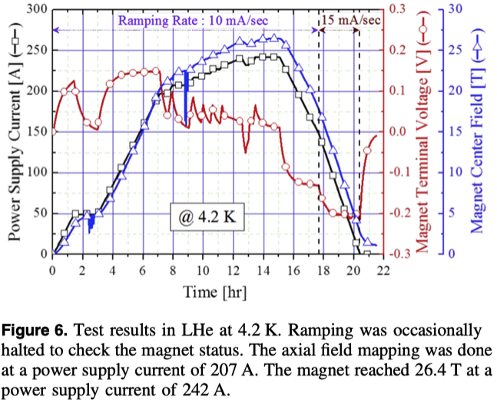
Operation
¹ S. Yoon et al. Supercond. Sci. Technol. 29 (2016) 04LT04
The required energization time, 6 hrs, seems achievable for Not/Metal Insulated coils
  the 26.4 T Sunam NI coil was energized in about 14 hrs¹, despite the very low surface contact resistance, 9.6 μΩ cm²
  In previous smaller small-scale REBCO NI test coils, the same group found a surface contact resistance about 7 times larger¹
The surface contact resistance can be increased by reducing the Cu content in the conductor, especially on the tape edges, and/or interposing a resistive metal tape in between the turns, or …
Studies for defining the proper surface contact resistance and how to achieve it consistently, also considering the magnet protection and the required field persistency, are on going
  To meet operation requirements, other solutions, as correction coils or a power supply with active feed-back, are also considered

Slide 24
Main Conclusions on the design work
The conductor critical current seems not to be a limiting factor for a all ReBCO 40-50 T solenoid with a 50 mm bore
The proposed conceptual design shows the potential for developing a compact 40 T final cooling solenoid
Two main criticalities have been identified:
  The electro-mechanical design → stresses on the conductor are very large
  The electrodynamics and protection of the magnet → complex transients to control
CERN INFN, CEA, CNRS, PSI,UniGE, SOTON, UniTwente started to tackle these criticalities via modeling and experimental activities*
*More on experimental activities in appendix

Slide 25
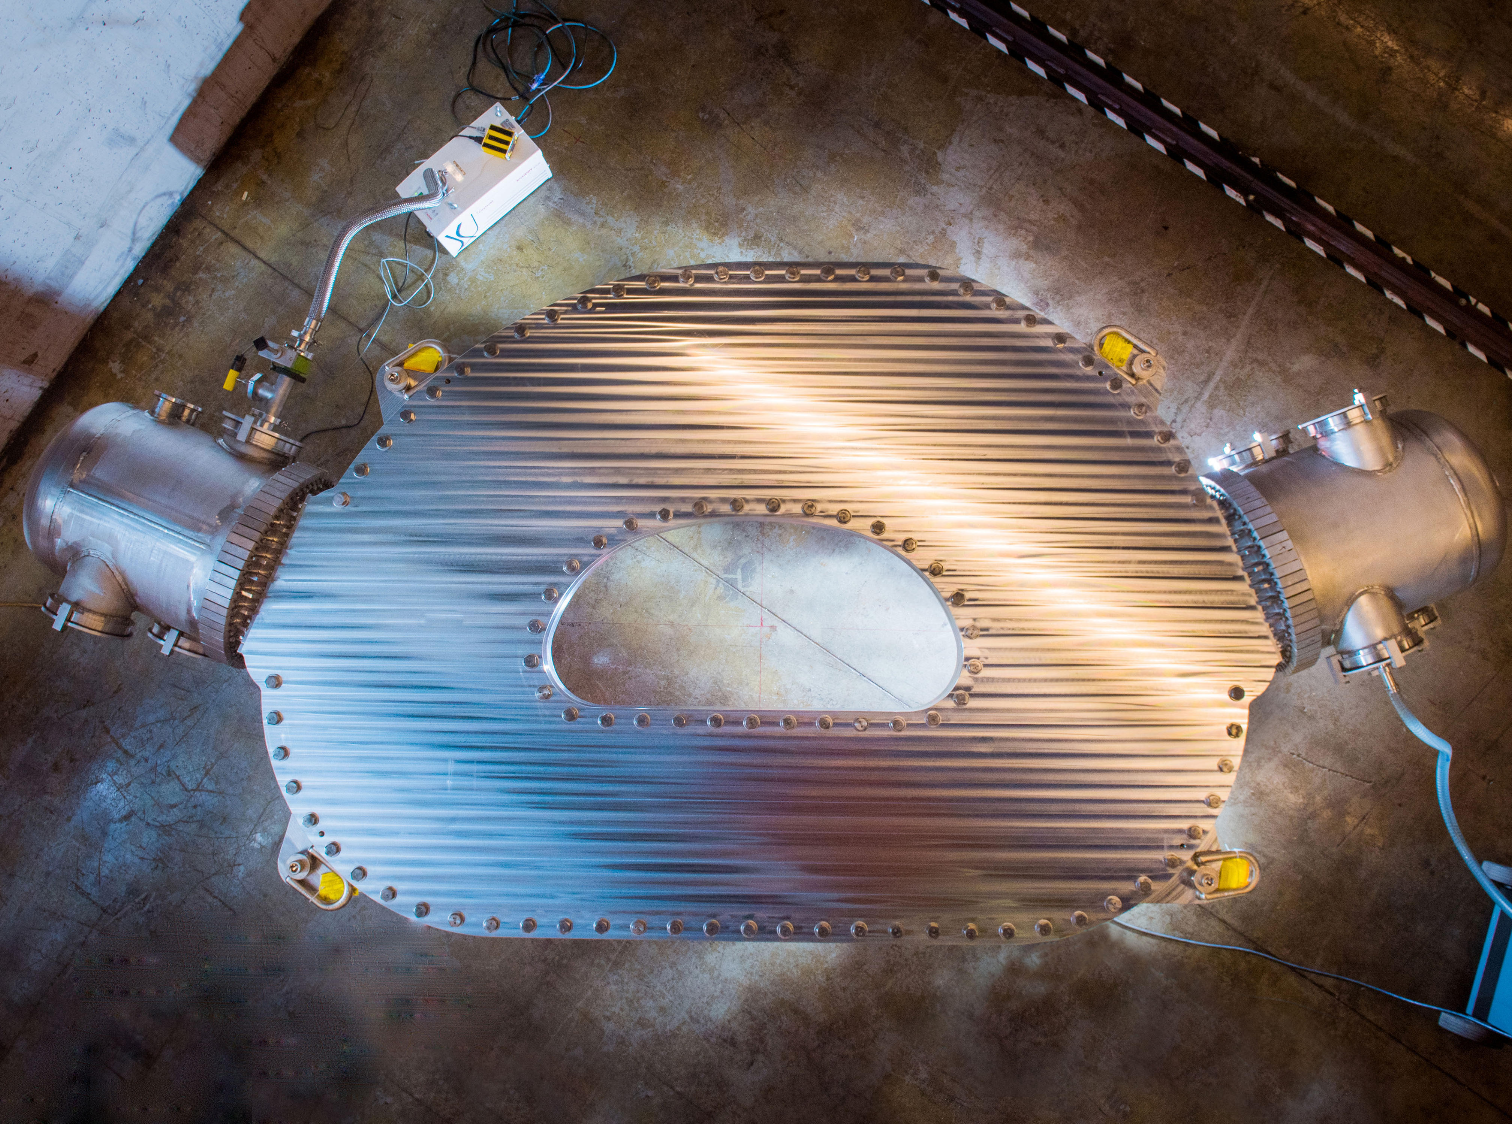
Relevance to Science and Society of not/metal insulated ReBCO coils 1/2
The potential of a large coils’ cost/mass/volume reduction and of operating at 20 K, makes this technology extremely attractable for:
MIT/CFS SPARC TF Coil prototype
20 T at 20 K (HTS)
  The Sustainability of medium/large particle accelerators
  Compact/Modular Fusion Reactor based on magnetic confinement
  High Field Science (see previous slides)

Slide 26
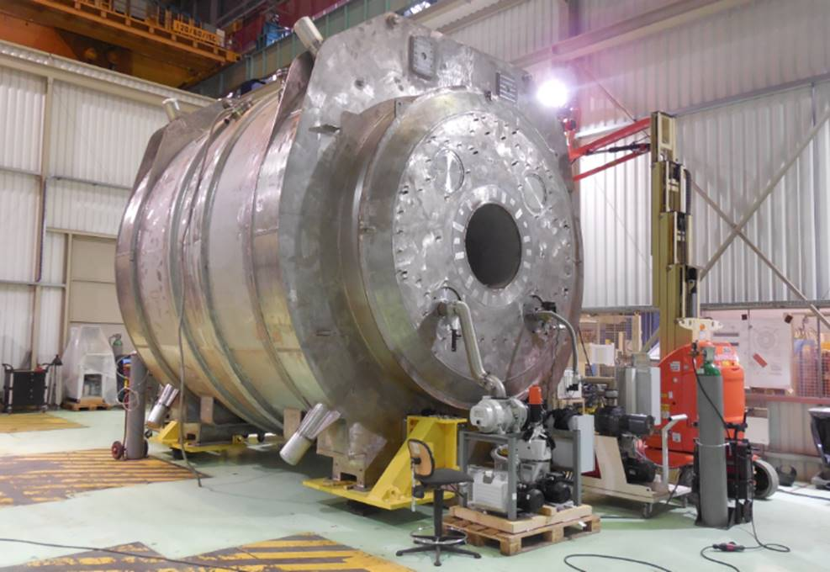
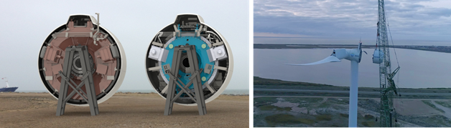
Relevance to Science and Society of not/metal insulated ReBCO coils 2/2
The development of this technology could also strongly impact
  Nuclear Magnetic Resonance (see previous slides)
    higher fields to improve resolution of the resonance spectra and the acquisition speed
  Magnetic Resonance Imaging
    Large bore (900 mm), high-field (11.7 T) and high-homogeneity solenoids, in persistent- or quasi-persistent mode. Nb-Ti technology is dominant but there is strong interest for HTS, especially for cryo-free operation.
  Wind turbine generators
    Compact generator essential ingredient for large turbines, the trend is now for >> 1 MW turbines
UHF MRI magnet (11.7 T, 900 mm bore, full body) developed by CEA/Alstom
Courtesy of L. Quettier
(left) The 3.6 MW EcoSwing HTS generator (blue, 4 m diameter) next to its conventional counterpart with the same power rating (red, 5.4 m diameter), prior to (right) its lift onto the turbine https://www.utwente.nl/en/tnw/ems/research/sust/EcoSwing/

Slide 27
4th Question to to Review Panel
Is the work program proposed matching the above ambitions ?

Slide 28
Overall Work Plan & Resources
A draft version of the overall work plan for the mmWG and EU MuCol WP7 has been written (see document by LB/LQ/SF)
  For the final cooling solenoid, a preliminary Risk and mitigation plan has been defined (see appendix)
The final cooling solenoid effort can count on a large collaboration including well established institutes and universities
  Institutes: CERN, INFN, CEA, CNRS, PSI
  Universities: Geneva, Twente, Southampton
A large number of enthusiastic young researcher strongly push the fast progresses of the project

Slide 29
Scheduling
A preliminary Gantt chart has been defined

Slide 30
Thank You For the Attention

Slide 31
APPENDIX

Slide 32
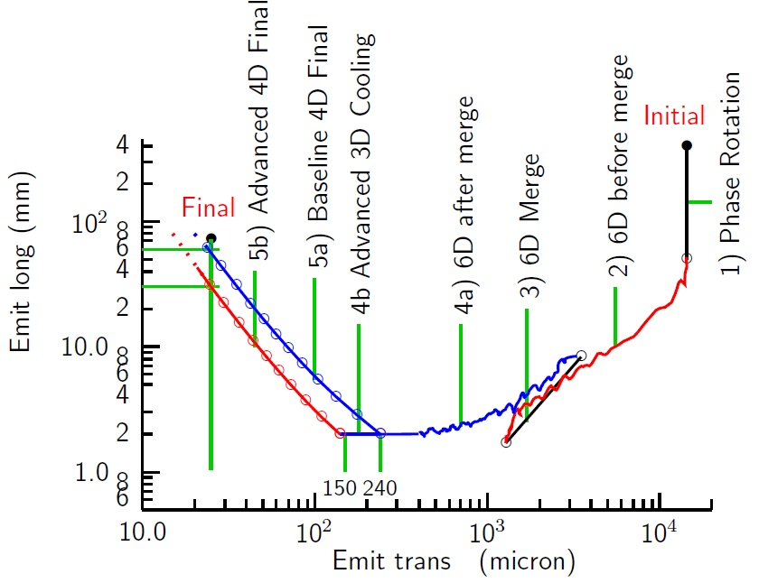
The Cooling System
The final cooling solenoid is part of the cooling system
The cooling system is designed to reduce the transversal emittance while preserving the longitudinal emittance
D. Neuffer et al 2017 JINST 12 T07003

Slide 33
The Final Cooling Channel
4 𝞼 beam dimensions and kinetic energies Courtesy of Elena Fol
In particular, the final cooling solenoids are part of the the final cooling channel, which is constituted by several cells; 16 were proposed by the MAP study (see figure below) and 14 are presently considered by IMCC
A layout schematic of 16 cells of the final cooling channel defined by the MAP study (Sayed et al. Phys. Rev. ST Accel. Beams 18, 091001). The coloured boxes in the top represent the cooling stages. The bottom figures show a sample of the on-axis field of the strong focusing solenoid; the shaded areas show the corresponding absorbers lengths.

Slide 34
Technologies
Technology | Pro’s | Con’s
Hybrid SC (LTS) + resistive Insulated Nested Coils | Known technology (TRL 9) | Large dimension and mass Electric power consumption
All SC, LTS + HTS Insulated Nested Coils | Known design principles Synergy with other fields of science application Can profit from development by others (e.g. NHMFL) | Large dimension and mass Developmental technology (TRL 6/7)
All SC, HTS Insulated Nested Coils | More compact than LTS/HTS Allows for operation at higher temperature | R&D at low readiness (TRL 4/5)
All SC, HTS Non/Metal-insulated Nested Coils | Same as previous case (row) + even more compact, with an increased magnet stability and reduced risk of burning the magnet. Potential of reaching even larger fields with respect to the single coil solution (next row). Synergies with other fields of science and societal applications. Can profit from development by others (e.g. NHMFL) | R&D at low readiness (TRL 3/4/5) Ramping time, field stability need, and electro-mechanical behavior during fast transients to be demonstrated
All SC, HTS Non/Metal-insulated Single Coil (No Nested) | Same as previous case (but the max. field potential) + even more compact, with a lower risk of burning the magnet, simpler to protect, reduced number of coils (one per pancake) and joints. Significant cost/volume/weight reduction for 20-40 T solenoids. | Same as previous option (row) including TRLs + mechanical precompression (B>30 T) need to be demonstrated

Slide 35
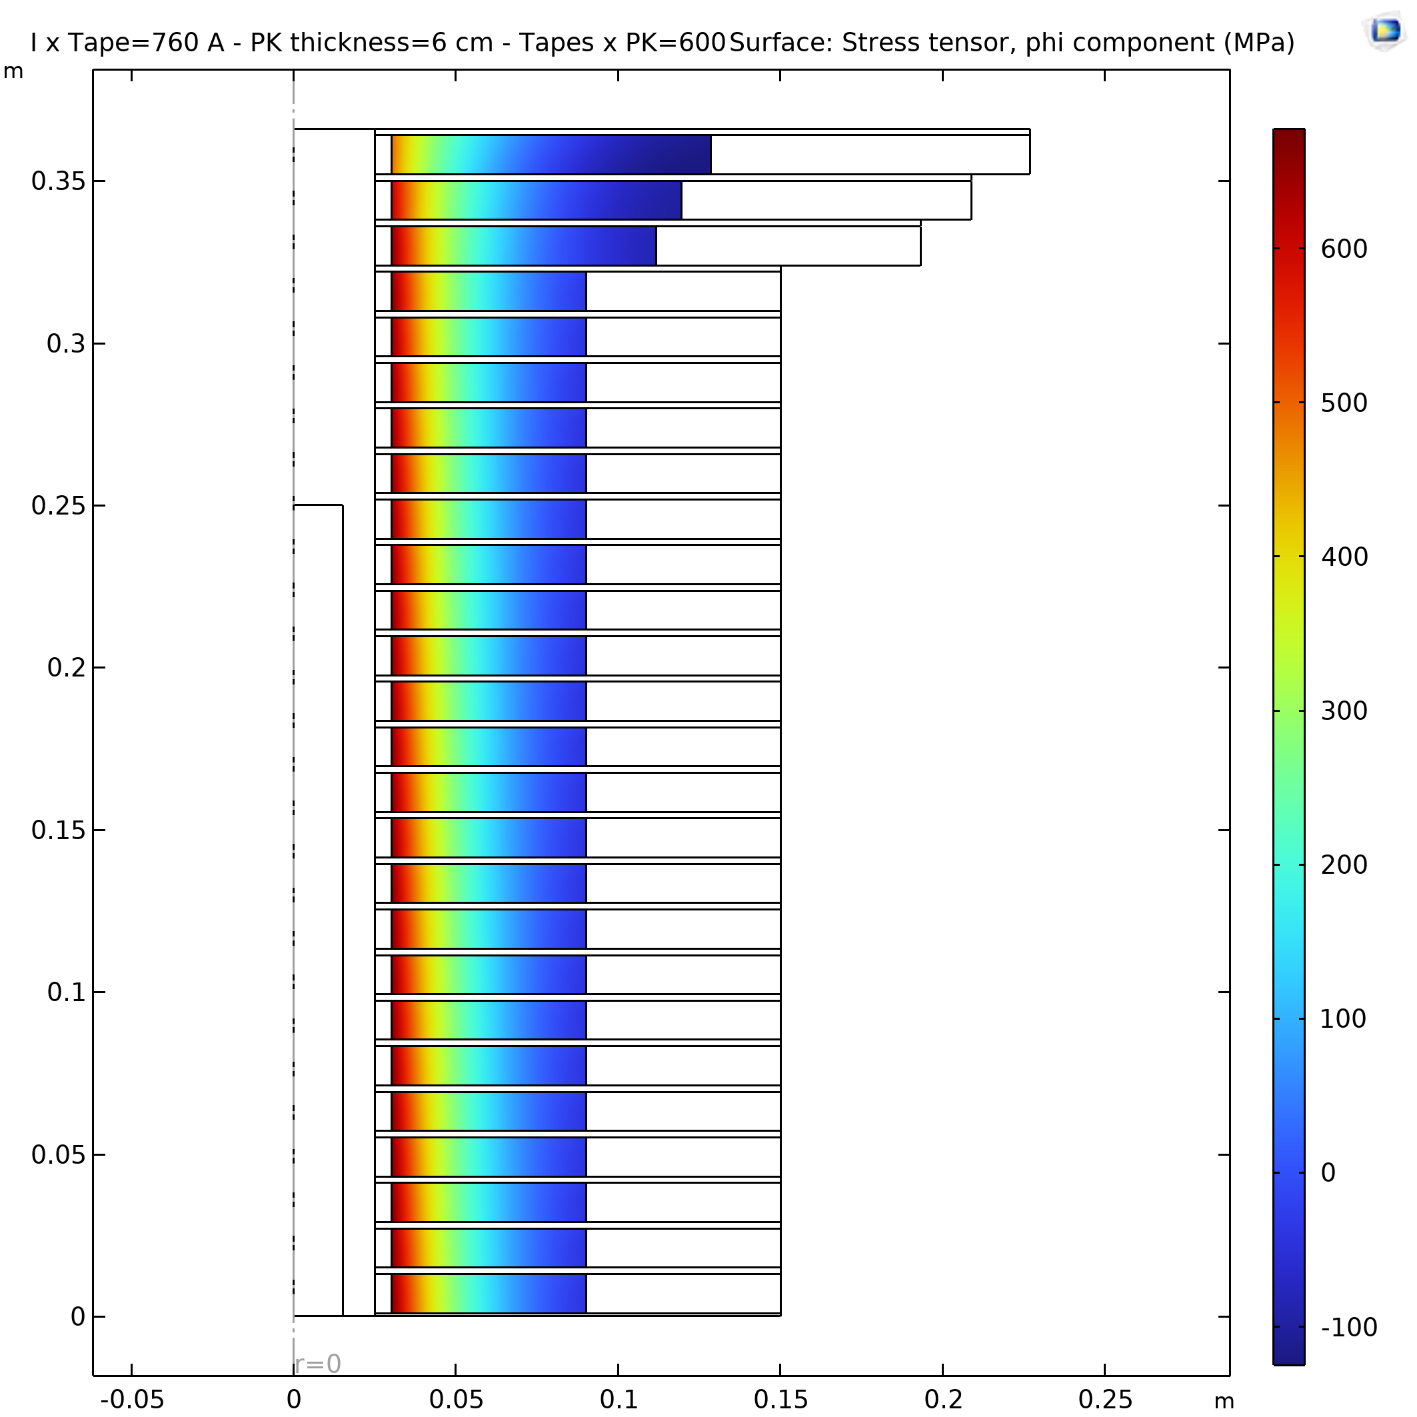
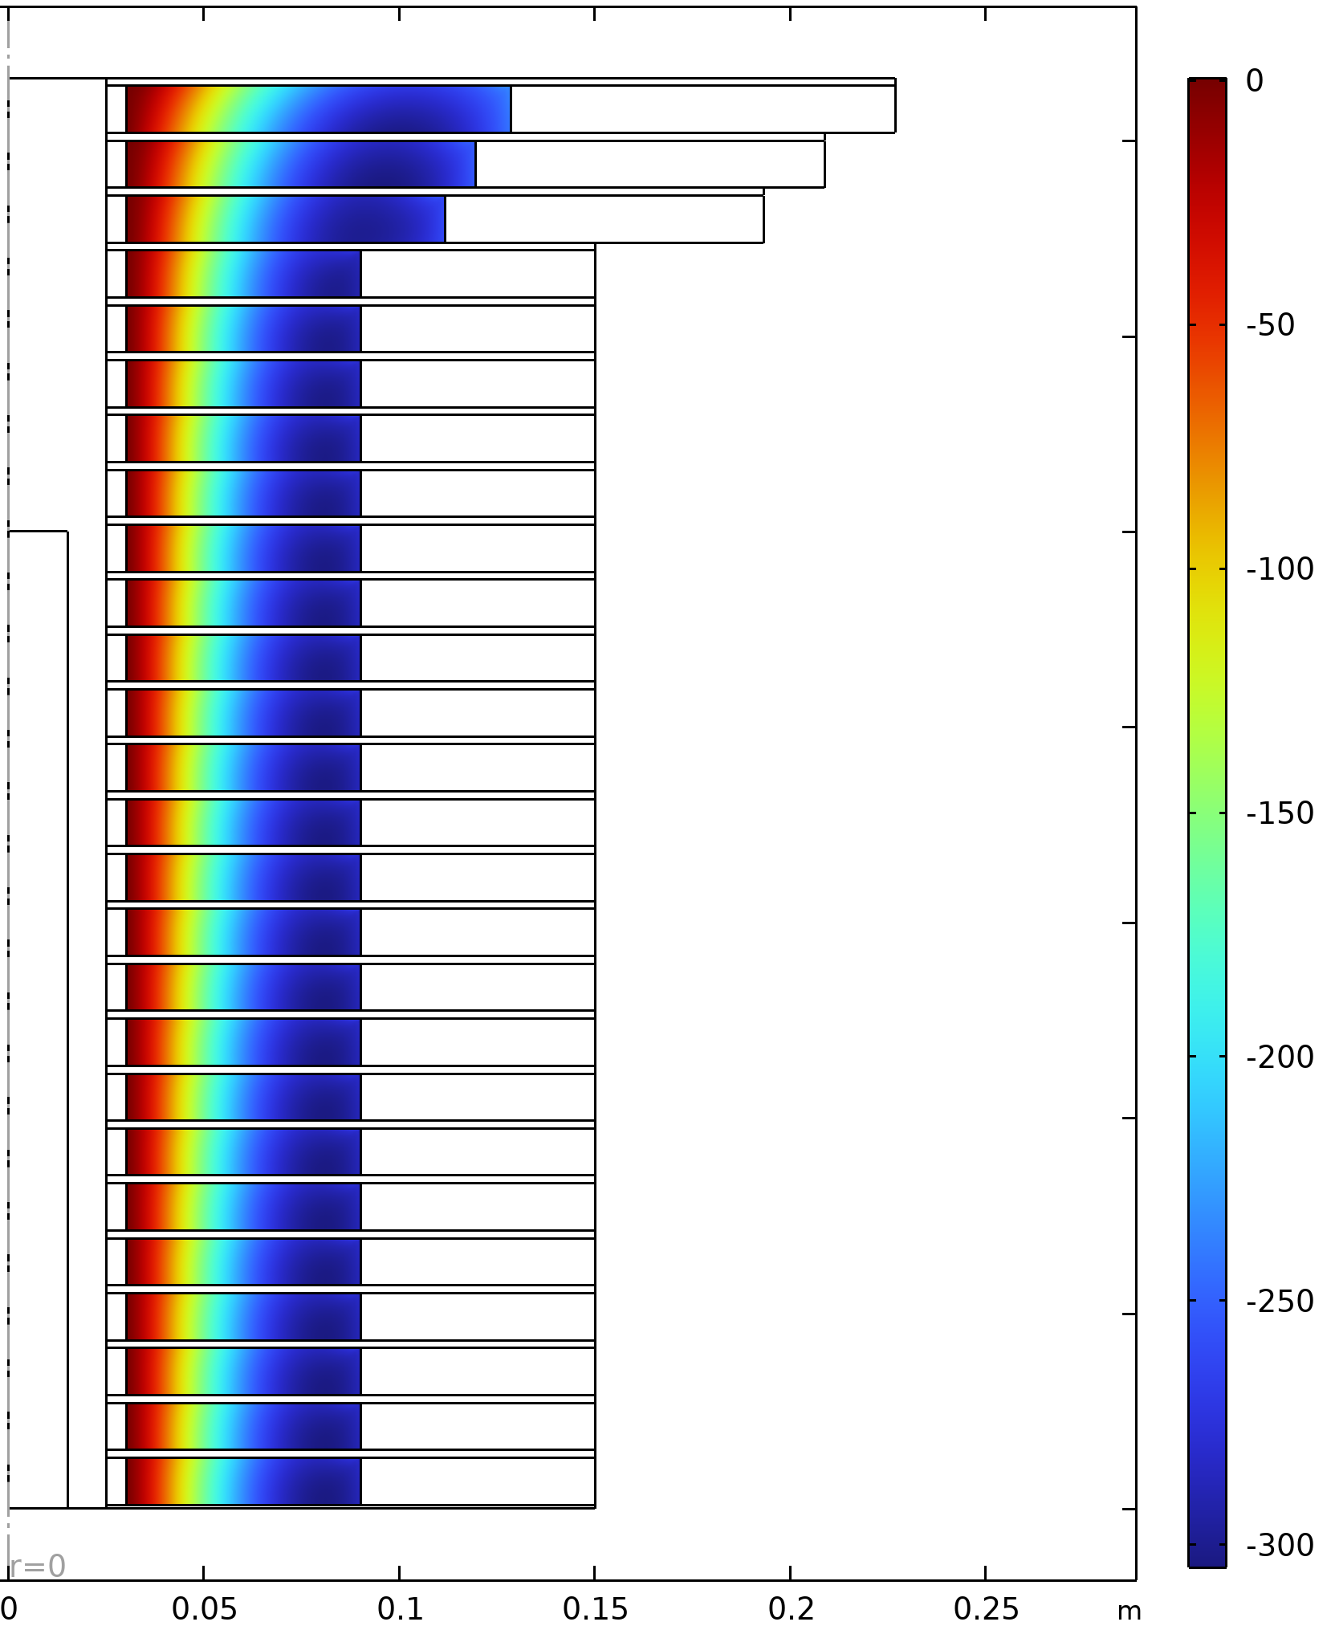


Mechanical Analysis I
assumptions and analysis
Main assumptions: fully elastic, Isotropic approximated Young Modulus (150 MPa); no thermal contraction; 200 MPa coil precompression; 100 𝜇m thick ReBCO tape with 50 𝜇m of Hastelloy and 40 𝜇m Cu
‘Correction’ Coil
Hoop Stress $σ_{θθ }$, MPa
Radial Stress $σ_{rr}$, MPa
‘Modular’ Coil

Slide 36
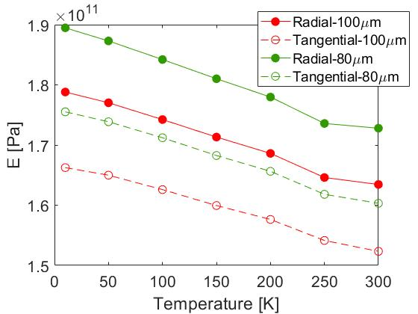
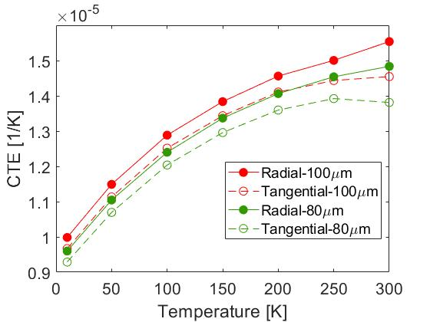
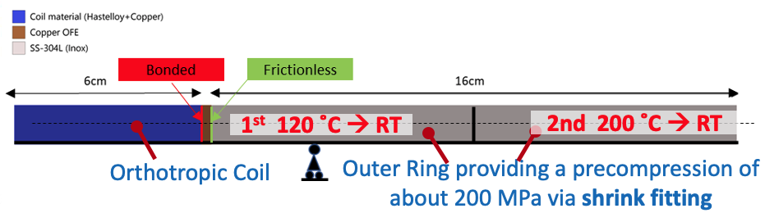
Mechanical Analysis II
assumptions and type of simulations
Main electromagnetic assumptions: uniform current density, infinite solenoid field distribution
  representative of a ‘modular’ coil sufficiently far from the solenoid extremities in stationary conditions
Main mechanical assumptions: fully elastic, orthotropic mechanical material properties
  homogenized with different rule of mixtures depending on the considered property and direction
Plots and Sketches
Courtesy of C. Accettura
Performed analysis
  Mechanical ANSYS simulation to calculate the stress in a modular coil during
    The 200 MPa precompression applied on the coil at room temperature via shrink fitting by two preheated concentrical rings
    The cool down of the assemble from RT to 4.2 K
    The energization at 4.2 K of the pre-compressed coil

Slide 37
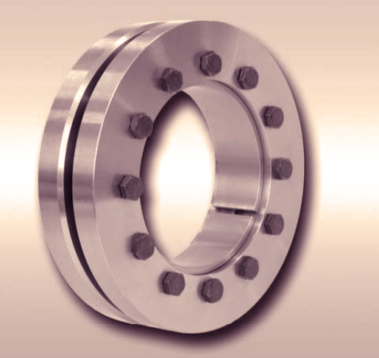
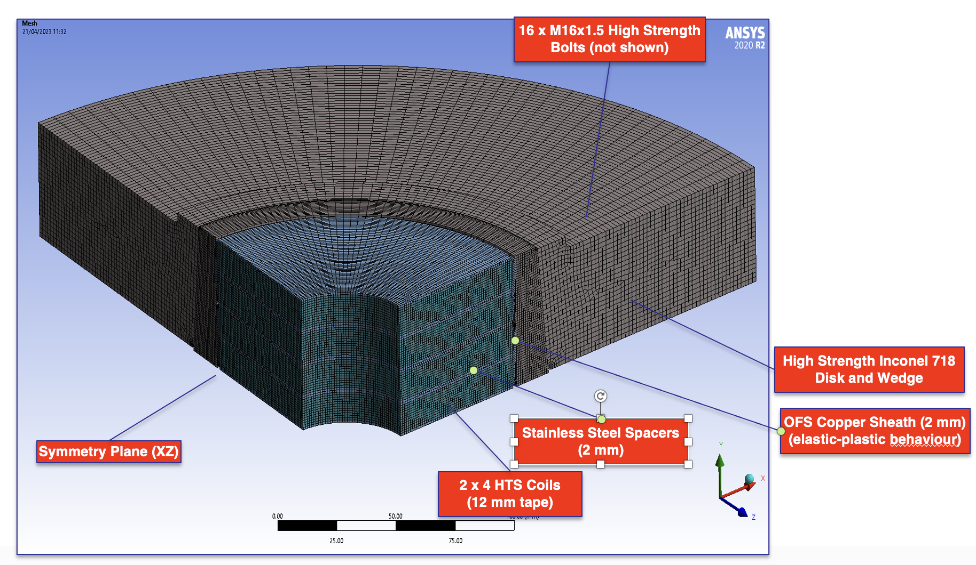
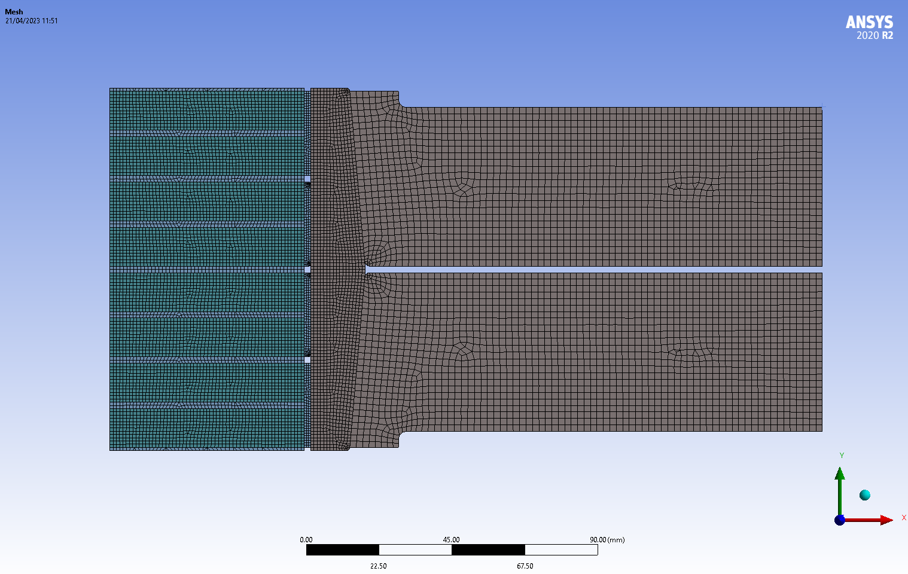
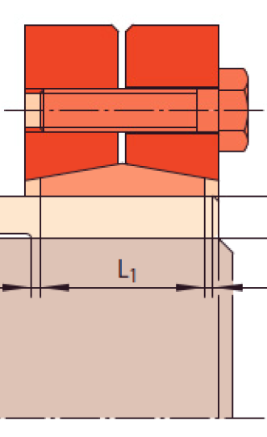
Precompression
alternative design to shrink fitting
A Alternative concept is based on a pair of adjustable shrink-discs with conical surfaces
Thicker coils packs can be assembled (up to 8 x 12 mm coils)
Main Dimensions
Coil ID 60 mm
Coil OD 180 mm
Disc OD 500 mm
Coil Pack Height 112 mm
Courtesy of Alessandro Bertarelli

Slide 38
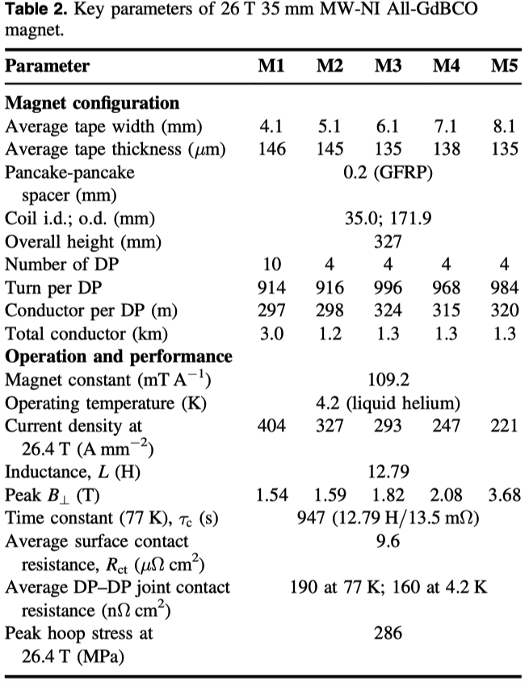
HF Superconducting Solenoids
High-Jc - Single coil
Sunam NI one-body
ReBCO magnet
26.4 T in 35 mm, J central pancake 404 A mm⁻²
(26.4 T HTS multi-width)
overall diameter and height: 172 and 327 mm
S. Yoon et al. Supercond. Sci. Technol. 29 (2016) 04LT04

Slide 39
HTS tape specifications
 |  | Specification | Target
Minimum J_{non-Cu} (4.2 K, 20 T) | (A/mm²) | 1500 | 3000
Minimum J_{non-Cu} (20 K, 20 T) | (A/mm²) | 600 | 1250
σ(I_{C}) | (%) | 10 | 5
Minimum copper RRR | (-) |  | 20
Minimum Unit Length (UL) | (m) | 200 | 500
Minimum bending radius | (mm) | 15 | 10
Allowable σ_{longitudinal non-Cu} | (MPa) | 800 | 1000
Allowable compressive σ_{transverse} | (MPa) |  | 400
Allowable tensile σ_{transverse} | (MPa) |  | 25
Allowable shear τ_{transverse} | (MPa) |  | 20
Range of allowable ε_{longitudinal} | (%) | -0.1…0.4 | -0.1…+0.5
Internal specific resistance ρ_{transverse} | (nΩ/cm²) |  | 20
Width: 4 or 12 mm
Substrate (non-magnetic alloy): 40…60 μm
Copper stabilizer (total): 20…40 μm
Total tape thickness: 60…100 μm
Entries in red are for information to the manufacturers

Slide 40
Some info on the experimental work
The design work is complemented by a focused testing activity on short samples and coils, devoted to measuring directly performance and technology limits
Electro-mechanical characterization relevant to UHF conditions, at University of Geneva (new experiment on single tape) and university of Twente
Small pancakes manufactured and tested by CERN EP-ADO, possibly INFN-LASA and other beneficiaries. This activity profits from ongoing developments, and extends it
Courtesy of L. Bottura

Slide 41
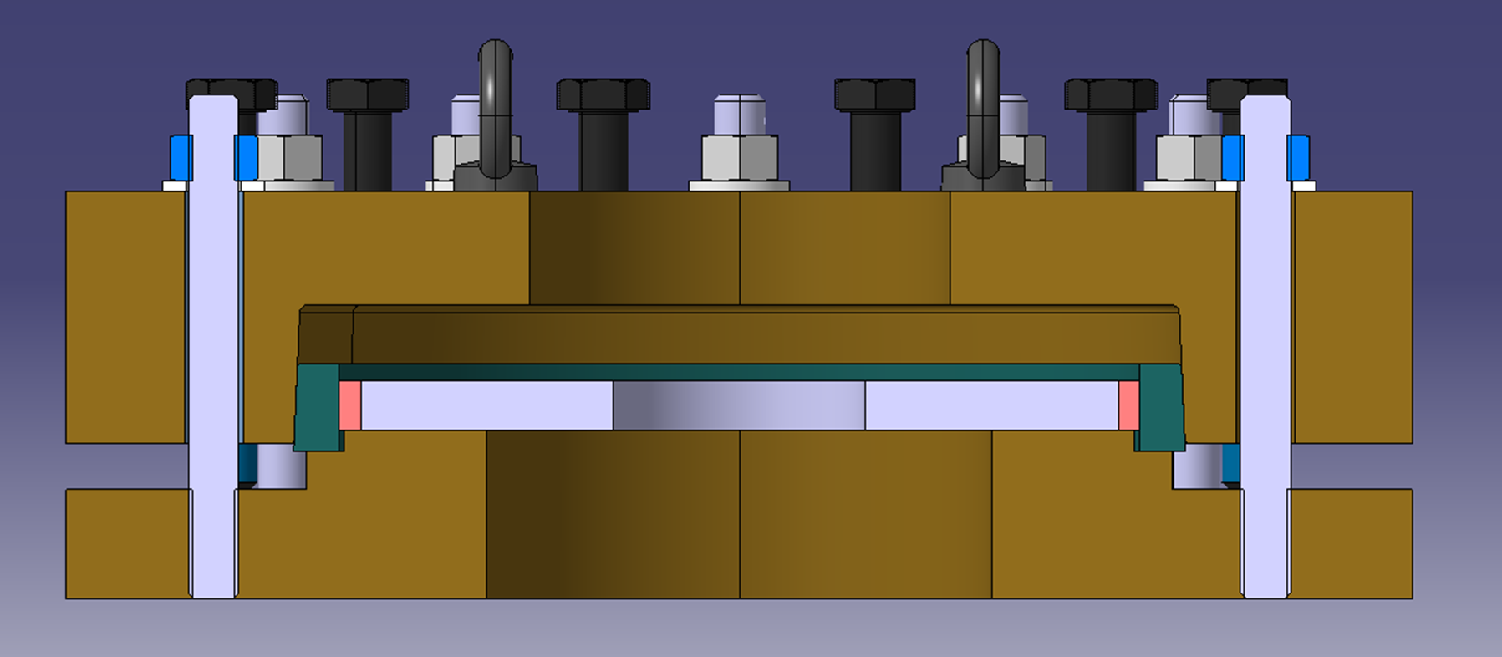
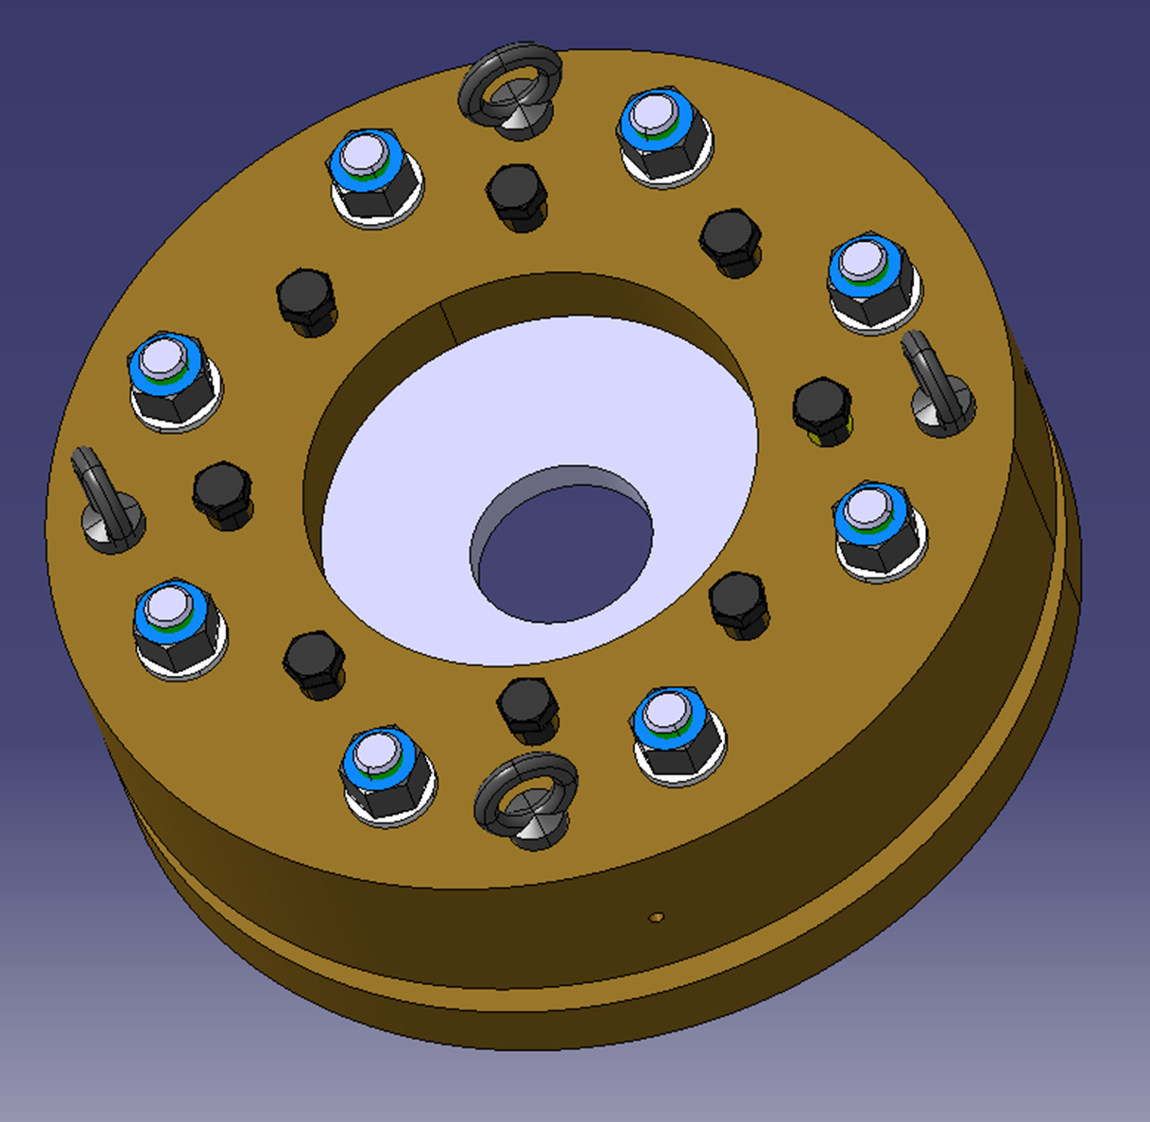
Some info on the experimental work
Precompression studies
Necessary to characterize mechanical properties of representative coil samples to validate this concept → a compressive jig with controlled compressive force is proposed to test pancake coil (customized design based on Shrink Disc concept) at CERN Mechanical Measurement Lab
Courtesy of A. Bertarelli, F. Sanda A. Kolehmainen

Slide 42
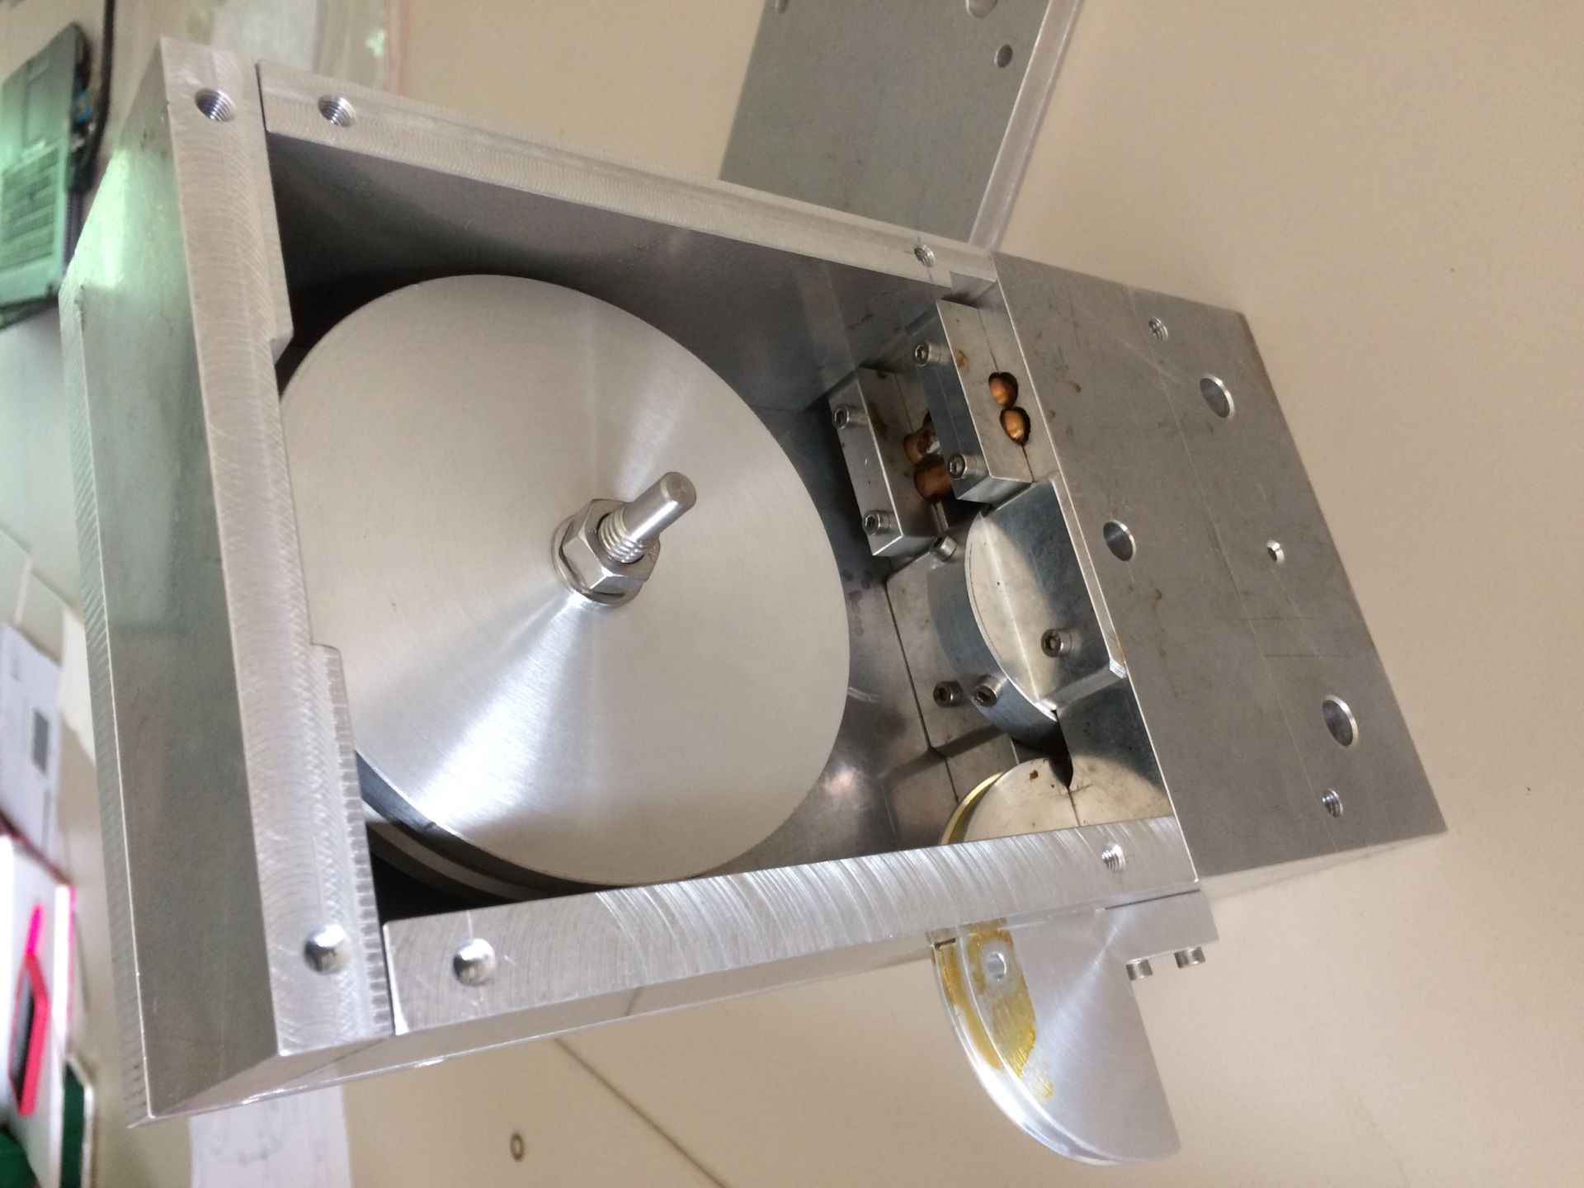
Some info on the experimental work
Winding & Plating Studies
A small winding machine, also allowing tin coating has been built at CERN to start winding and plating studies
A Pancake is wound on Hastelloy solder coated 1-2 mm ring at 190<T<200 degree at certain tension
Courtesy of A. Dudarev

Slide 43
Some info on the experimental work
Why a small-size single pancake or a stack of pancakes ?
It is the natural intermediate step between the tape critical current, and other tests, and the final solenoid configuration
It is easy to wind and test
It reproduces relevant conditions of field, force and energy density (can be tested in a background field)
It is small and does not waste material
Parametrical studies can be performed to test fabrication parameters and manufacturing technique (winding tension, insulation method…)
With properly chosen geometry it can be used to test some of the technology of a final solenoid (joints, resistance control, reinforcements)
Courtesy of L. Bottura

Slide 44
Some info on the experimental work
Reference pancake configurations
Geometrical Parameters
  60 mm inner diameter
  20 mm and 60 mm thickness
  4 mm and 12 mm tape width
  Single and double pancakes winding
  One- and two-in-hand winding
  Pancakes can be stacked in mini-coils
Identical/similar configurations used at CERN, INFN, PSI
Courtesy of L. Bottura

Slide 45
Some info on the experimental work
Test of pancakes as inserts
Testing at LNCMI of a selected number of coils/stacks is foreseen as part of MuCol Task 7.2
20 T, 170 mm warm bore, 120 mm cold bore
Could host the 20 mm thick stacks, total field reach approximately 40 T
Two sessions per year are planned, each testing session is one week long
Testing time in 2024 should be declared at the next call (November 2023)
LNCMI is eager to collaborate, to advance their R&D, and prepare the upcoming INFRA-TECH-24-01 proposal (due Spring 2024)
Courtesy of L. Bottura

Slide 46
Risk and mitigation plan
Courtesy of L. Bottura
Risk | Mitigation action (program) | Tests (tape length)
Reaching field/sub-optimal performance | Use pancakes to test performance (force and thermal cycles) and compare to expected performance from characterized tapes (NOTE: need of complete Ic(B,T,angle) scaling) | 10 sub-size (500) 5 full-size (1250)
Tape degradation during coil manufacturing | Test performance before/after winding at 77 K, partly covered by previous item. Dedicated tests to be performed for: soldering or potting, double pancakes and transitions, joints | 10 sub-size (500)
Coil internal mechanics and mechanical properties | Instrumented stacks and dummy pancakes to verify stress components and distributions. Reinforcements and bonding of turns | 20 stacks (200) 10 dummy (500) 10 sub-size loading (500)
Coil external mechanics and pre-load | Pre-loading structure development and tests | 5 dummy (250) 5 sub-size loading (250) 5 full-size loading (1250)
Inter-turn resistance control and variants | Produce baseline windings (e.g. soldered, no insulation control) and variants introducing intrinsic and extrinsic resistance control | 15 sub-size (750)
Joints resistance and stability | Produce test configuration for pancake joints and unit electrical/mechanical test. Integrate joints in pancakes and test resistance and stability (force and thermal cycles) | 20 single joints (200) 10 sub-size (500) 2 full-size (500)
Quench detection | Introduce and test diagnostics in above tests. Select baseline (voltage ?) for comparison | Use above pancakes for dedicated tests
Quench protection | Test energy release and temperature increase in provoked and spontaneous quenches | Use above pancakes for dedicated tests
Coil dynamic forces | Test mini-coil stacks of pancakes | 12 full-size (3000)

