Slide 1


Cryogenic Cooling and the Physics of Superfluid Helium
Andrea Vitrano
Machine Protection and Electrical Integrity Group (TE-MPE-PE)
24th August 2023 – PE Section Meeting
cern.ch/steam

Slide 2
Outline
1
Cryogenics
2
Cooling Techniques
3
Superfluid Helium (He II)
4
Cooling the LHC main dipole
5
Recent He II Studies
6
Conclusions

Slide 3
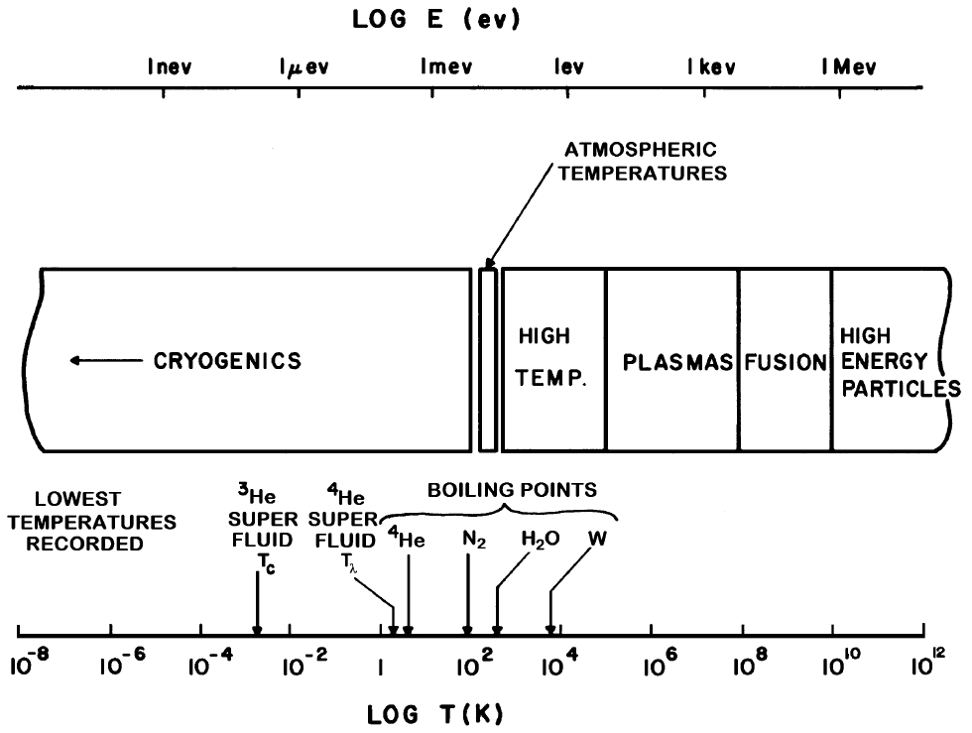
Cryogenics
Cryogenics
1
2
Cooling Techniques
Superfluid Helium (He II)
3
4
Cooling the LHC MB
Recent He II Studies
5
6
Conclusions
Van Sciver, S.W., 2012. Springer New York.

Slide 4
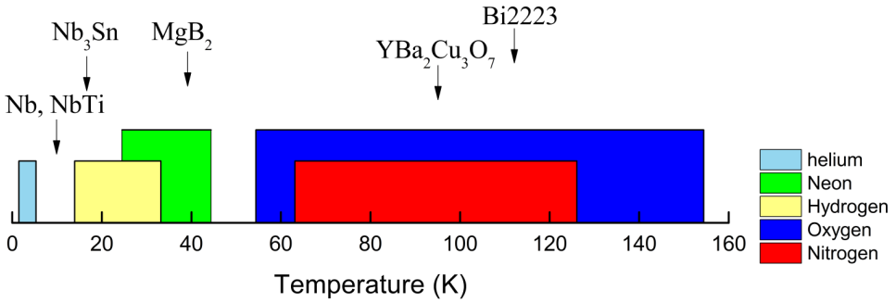
Cooling below 120 K
Cryogenics
Coolant type: cryogens
1
2
Cooling Techniques
Superfluid Helium (He II)
3
4
Cooling the LHC MB
Recent He II Studies
5
6
Conclusions
Baudouy, B., 2015. arXiv:1501.07153.

Slide 5
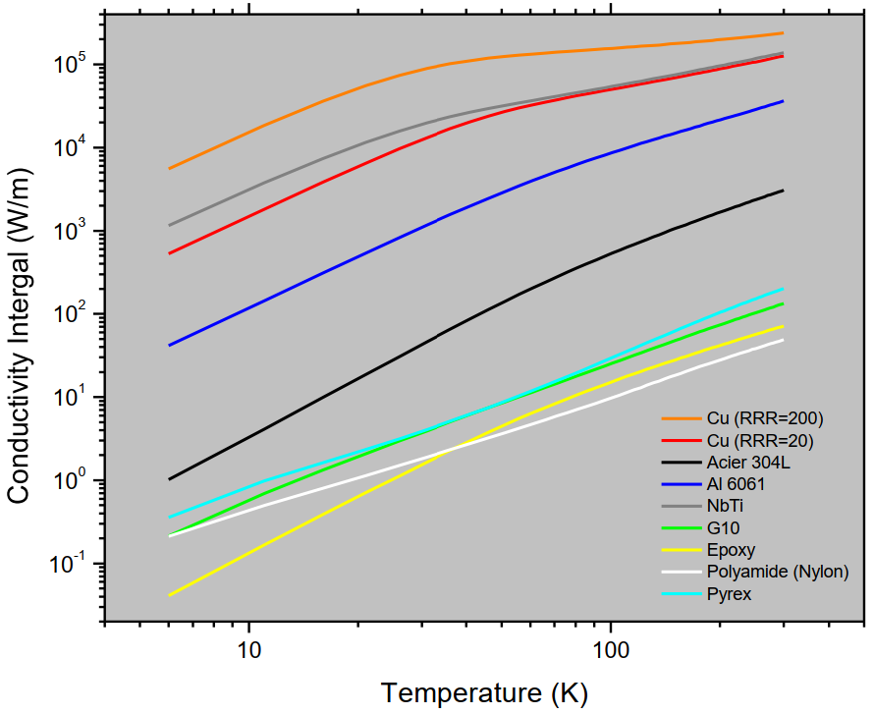
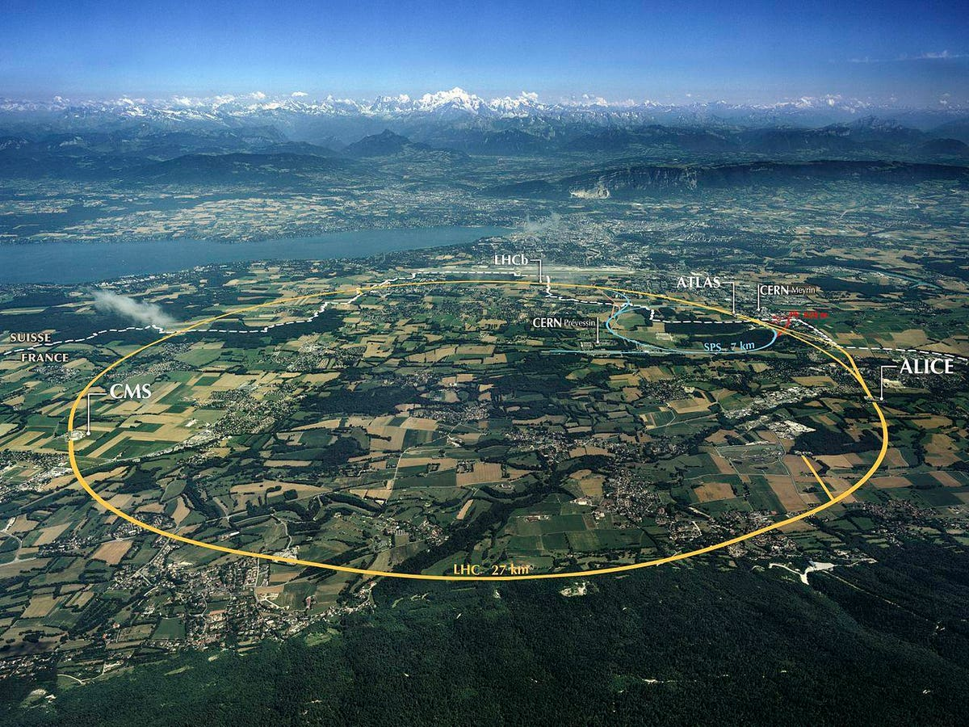
Cooling below 120 K
Cryogenics
Coolant type: cryogens
Material properties: contraction, embrittlement, etc..
1
2
Cooling Techniques
Superfluid Helium (He II)
3
4
Cooling the LHC MB
Recent He II Studies
5
6
Conclusions
L = 27 km
dL = 81 m !
T (K)
Baudouy, B., 2015. arXiv:1501.07153.

Slide 6
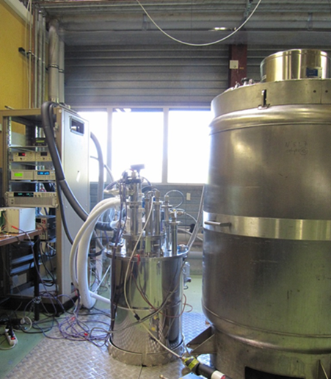
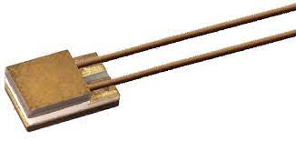

Cooling below 120 K
Cryogenics
Coolant type: cryogens
Material properties: contraction, embrittlement, etc..
Equipment: insulated systems, measuring devices
1
2
Cooling Techniques
Superfluid Helium (He II)
3
4
Cooling the LHC MB
Recent He II Studies
5
6
Conclusions
Cernox® CX

Slide 7
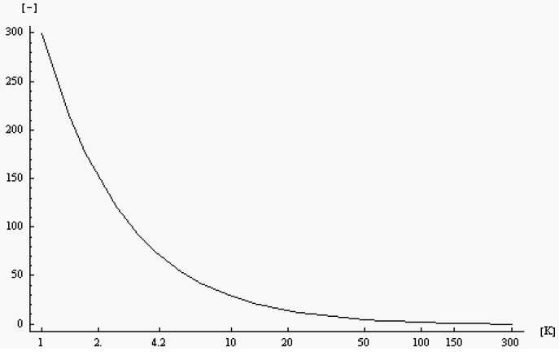

Cooling below 120 K
Cryogenics
Coolant type: cryogens
Material properties: contraction, embrittlement, etc..
Equipment: insulated systems, measuring devices
Consumption: energy-intensive processes
1
2
Cooling Techniques
Superfluid Helium (He II)
3
Carnot Factor
4
Cooling the LHC MB
Recent He II Studies
5
6
Conclusions
Wagner, U., 2004. CAS

Slide 8




Cooling below 120 K
Cryogenics
Coolant type: cryogens
Material properties: contraction, embrittlement, etc..
Equipment: insulated systems, measuring devices
Consumption: energy-intensive processes
Safety: personnel and environmental hazards
1
2
Cooling Techniques
Frostbites
Asphyxiation
Superfluid Helium (He II)
3
4
Cooling the LHC MB
Flammable gas
Oxidizing gas
Recent He II Studies
5
Gas/liquid volume ratio: ~ 700-800 !
Pressure build-up
6
Conclusions
Koettig, T., 2014. (No. CERN-HSE-PHO-2014-007).

Slide 9
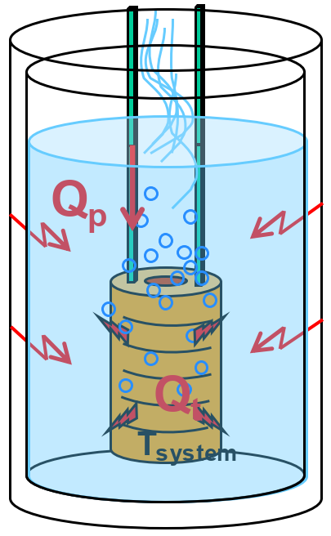
Cryogenic cooling
Cryogenics
System subjected to:
Thermal radiation (outer vessel)
Conduction (current leads, structural supports)
Internal dissipation (AC losses, Joule effect)
Maintain T_{system} ~ constant:
Shield incoming heat loads
Extract internal heat loads
1
2
Cooling Techniques
Superfluid Helium (He II)
3
T∞
4
Cooling the LHC MB
Recent He II Studies
5
6
Conclusions
Baudouy, B., 2015. arXiv:1501.07153.

Slide 10
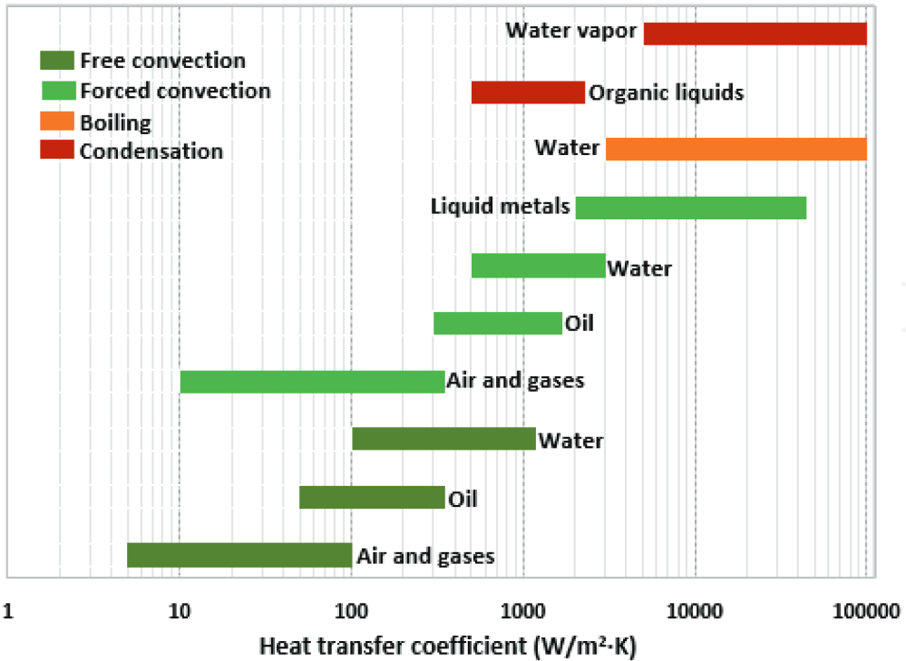
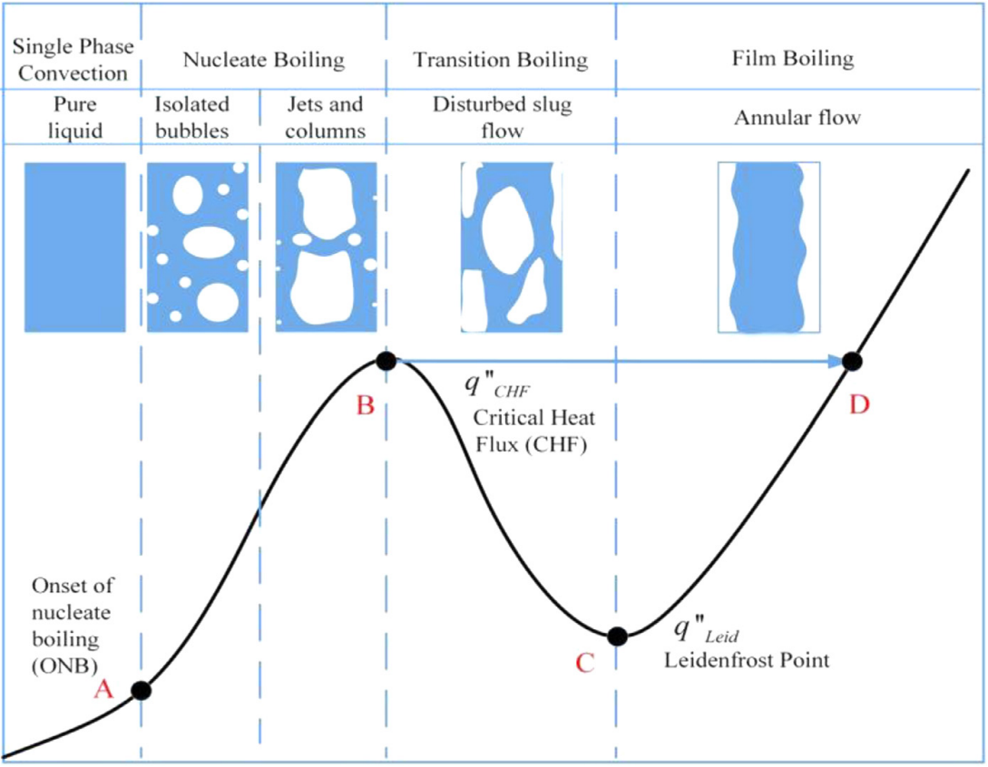


Heat transfer regimes
Cryogenics
1
Flow boiling
2
Cooling Techniques
Superfluid Helium (He II)
3
4
Cooling the LHC MB
Recent He II Studies
5
6
Conclusions
Murshed, S., 2016. DOI: 10.5772/63321
Singh, S.K., 2021. DOI: 10.1016/j.ijheatmasstransfer.2021.122020

Slide 11
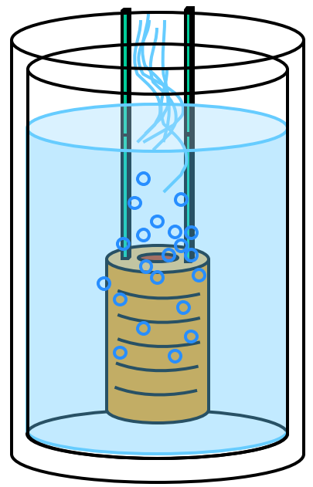
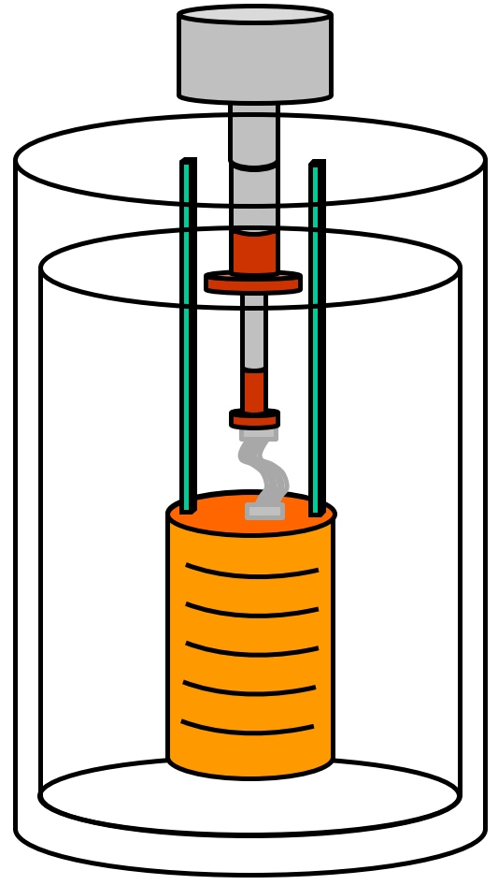
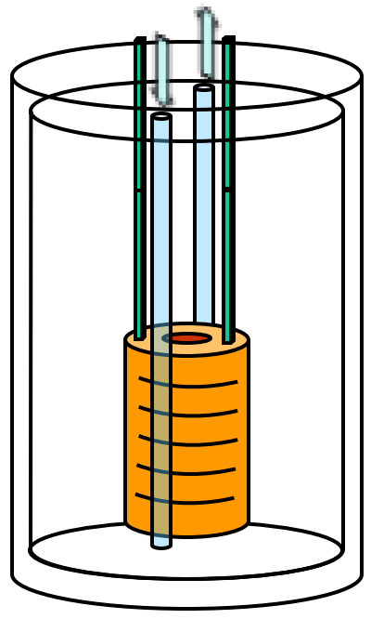
Cryogenic cooling
Cryogenics
Direct cooling:
Cryogen in direct contact
Large heat transfer rate
Uniform temperature
Indirect cooling:
No direct contact with cryogen (a)
Dry systems (b)
Moderate heat loads
1
2
Cooling Techniques
Superfluid Helium (He II)
3
4
Cooling the LHC MB
Recent He II Studies
5
Conclusions
(a)
(b)
6
Baudouy, B., 2015. arXiv:1501.07153.

Slide 12
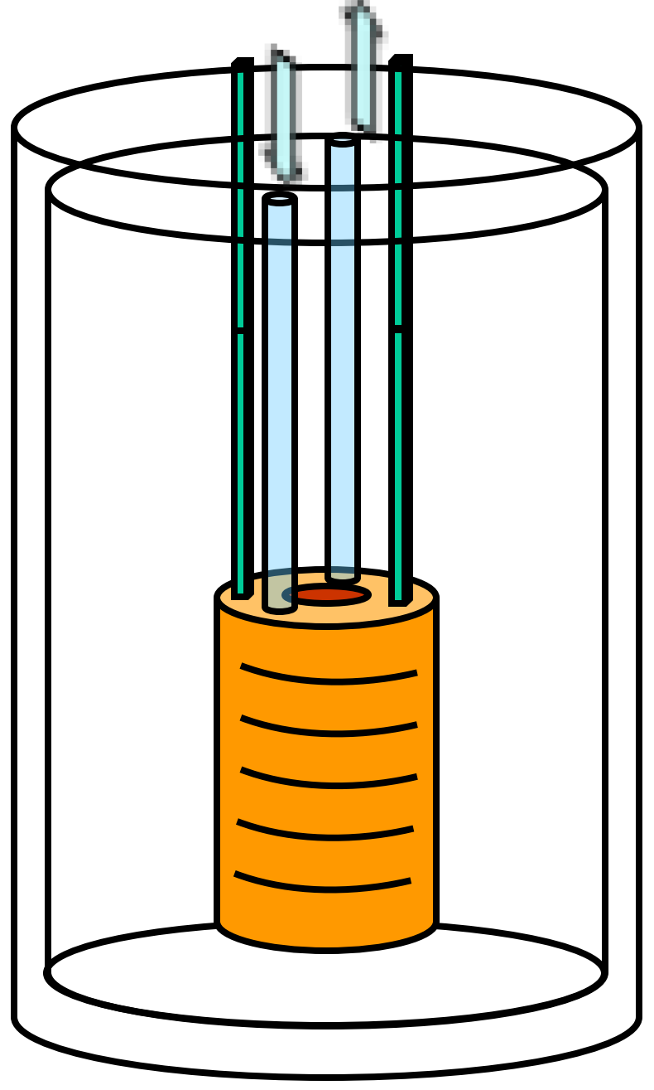
Forced flow
Cryogenics
Advantages:
Reduced amount of cryogen
Adjustable heat transfer rate
Nearly constant temperature (TP)
Higher heat transfer coeff (SC, TP)
Disadvantages:
Circulation system
Pressurization system (SC)
Sub-cooling system (SP)
Orientation matters (TP)
1
2
Cooling Techniques
Superfluid Helium (He II)
3
4
Cooling the LHC MB
Indirect
Direct
Recent He II Studies
5
SP: single-phase
TP: two-phase
SC: supercritical
6
Conclusions
Baudouy, B., 2015. arXiv:1501.07153.

Slide 13
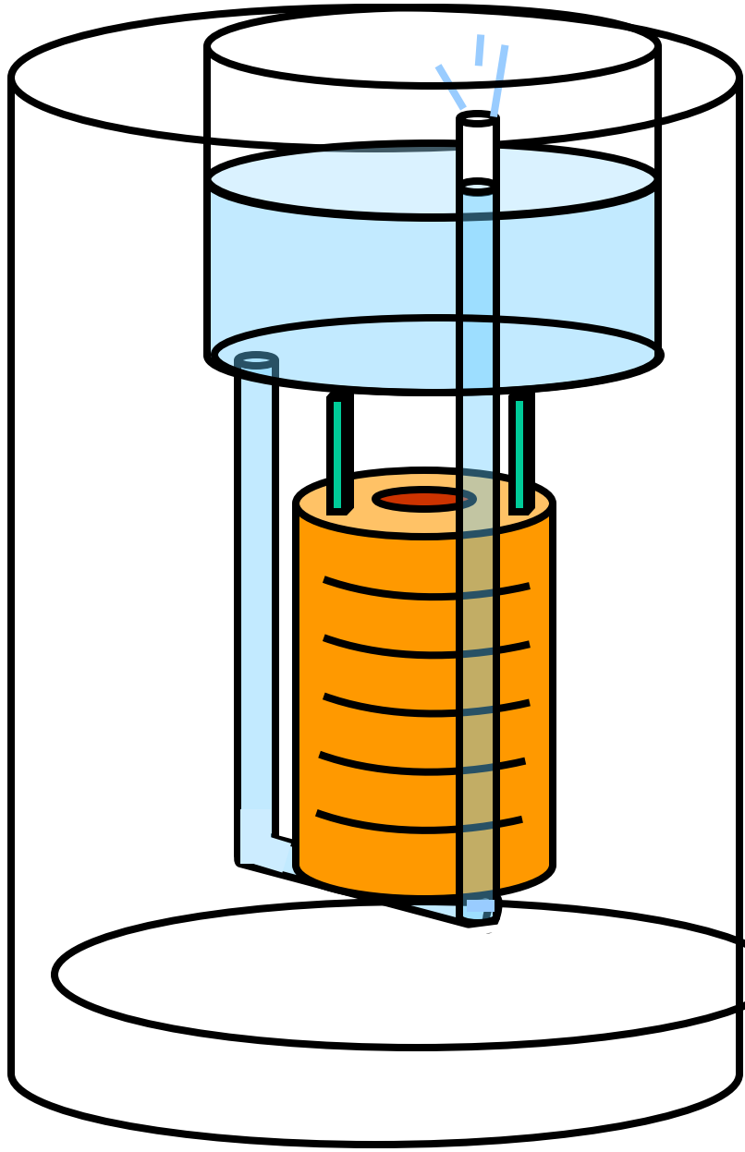
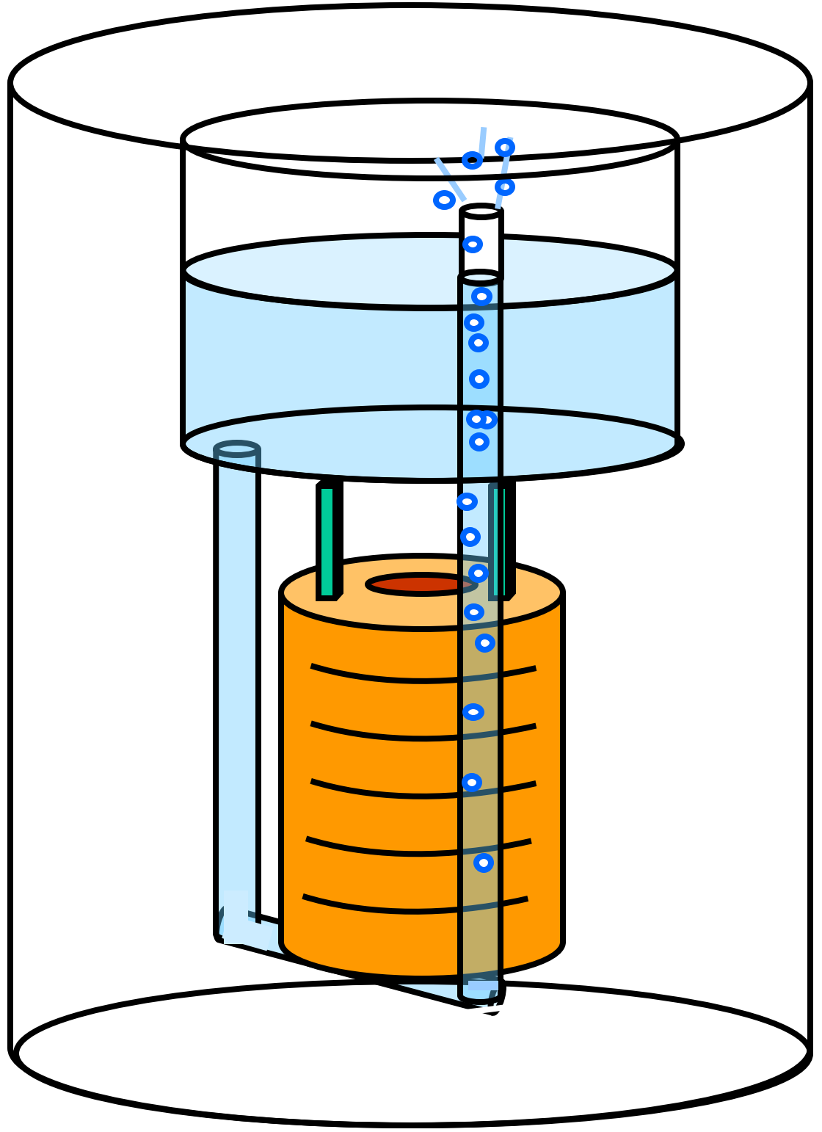
Circulation loops
Cryogenics
Advantages:
No pumping system
Auto-tuned mass flow
Higher heat transfer (TP)
Disadvantages:
Gravity dependent
Flow instabilities
Mixed convection
(Ri = Gr / Re²)
1
2
Cooling Techniques
Superfluid Helium (He II)
3
4
Cooling the LHC MB
Recent He II Studies
5
SP: single-phase
TP: two-phase
6
Conclusions
Baudouy, B., 2015. arXiv:1501.07153.

Slide 14
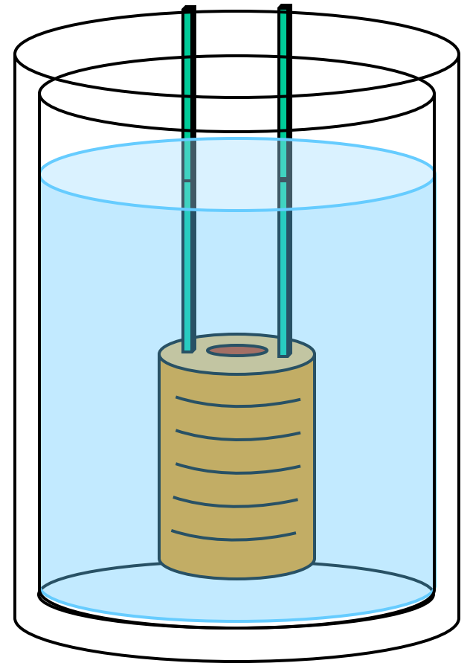
Bath cooling
Cryogenics
Advantages:
No mass flow
High heat transfer (SB)
Nearly constant temperature (SB)
Disadvantages:
Large amount of cryogen
Limited temperature range
Risk of film boiling (SB)
Risk of leaks (SB)
Limited heat transfer (PB)
Temperature stratification (PB)
1
2
Cooling Techniques
Superfluid Helium (He II)
3
4
Cooling the LHC MB
SB: saturated
PB: pressurized
Recent He II Studies
5
Superfluid Helium
6
Conclusions
Baudouy, B., 2015. arXiv:1501.07153.

Slide 15
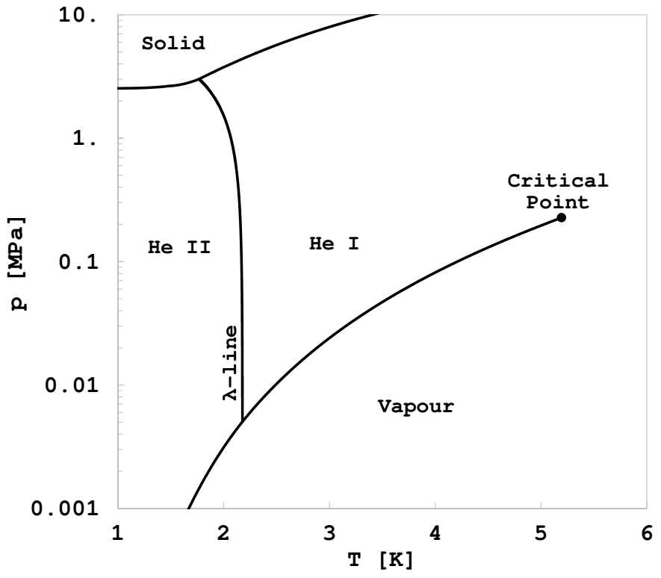
Helium (⁴He)
⁴He phase diagram
Cryogenics
No triple point
Solid under external p only
Lambda point:
T_{λ} = 2.17 K
p_{λ} = 5.04 kPa
at atmospheric pressure:
T_{λ} = 2.168 K
T_{sat} = 4.2 K
1
2
Cooling Techniques
Superfluid Helium (He II)
3
4
Cooling the LHC MB
Recent He II Studies
5
6
Conclusions

Slide 16
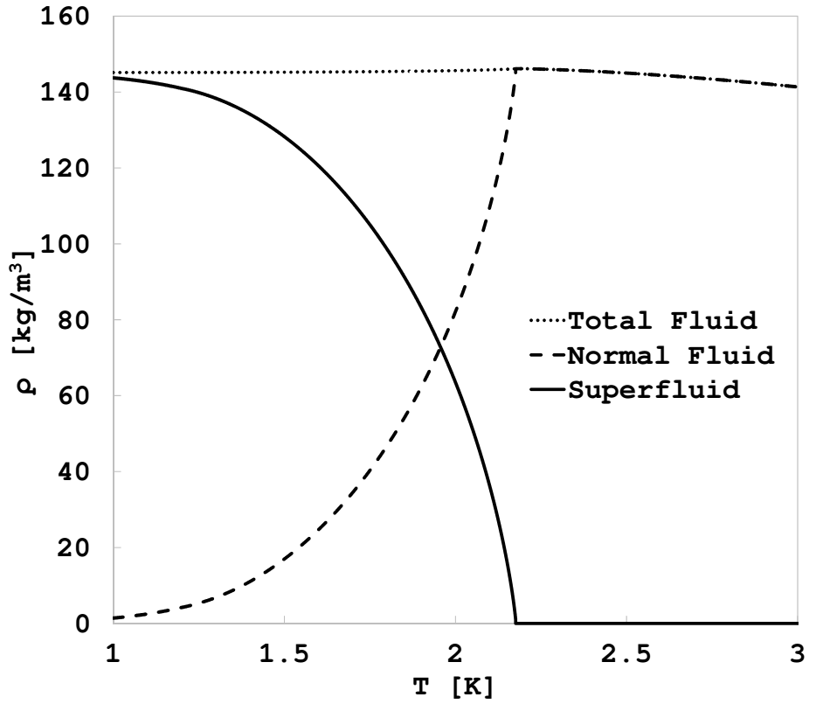


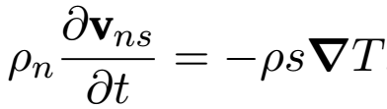


Two-fluid model
Two-fluid model:
Entropy: s_{s} = 0, ρ_{n}s_{n} = ρs
Viscosity: µ_{s} = 0, µ_{n} = µ
v = 0 → counterflow:
Liquid helium density
Cryogenics
1
2
Cooling Techniques
Superfluid Helium (He II)
3
4
Cooling the LHC MB
Recent He II Studies
5
6
Conclusions
T _{λ}

Slide 17
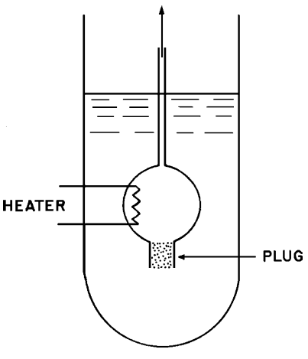


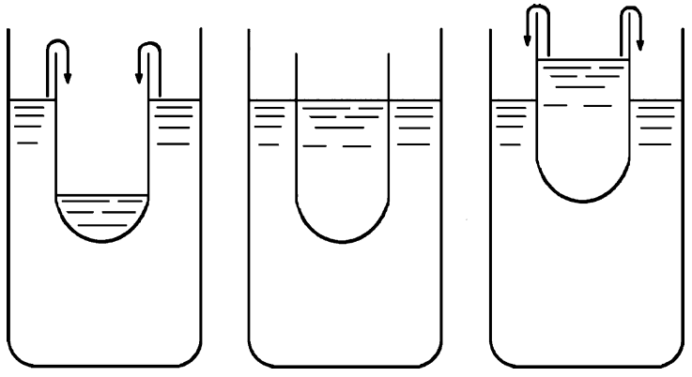
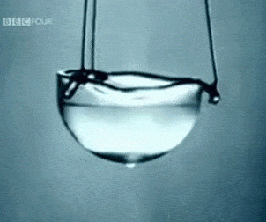
Thermo-mechanical effect
Cryogenics
Fountain effect:
London’s eq:
Mechano-caloric effect
Rollin film:
Van der Waals forces
Frictionless film
Heat flow in film
1
2
Cooling Techniques
Superfluid Helium (He II)
3
4
Cooling the LHC MB
Recent He II Studies
5
6
Conclusions
Van Sciver, S.W., 2012. Springer New York.
BBC

Slide 18
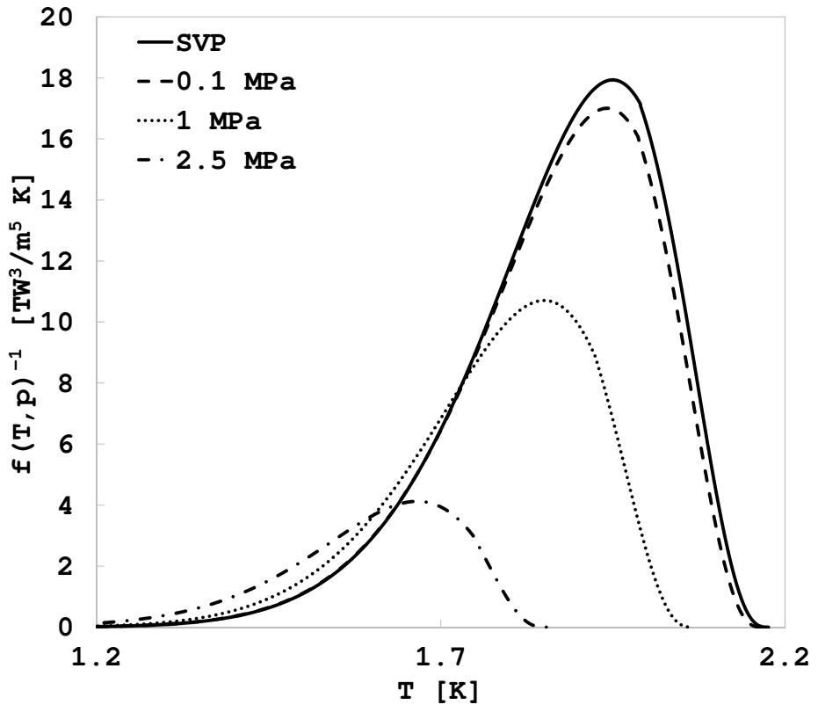
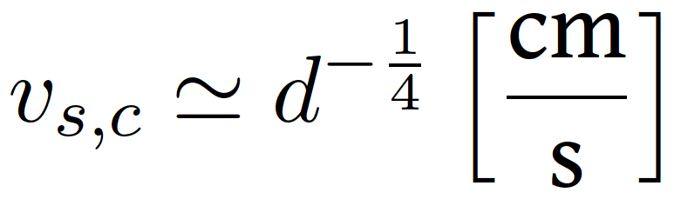
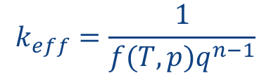

Landau and Gorter-Mellink regimes
Landau regime:
Frictionless superfluid
Critical velocity
Gorter-Mellink regime:
Quantum turbulence
Mutual friction force
He II heat transport:
Heat conductivity function
Cryogenics
1
2
Cooling Techniques
$$k_{eff}=\frac{1}{f(T,p)q^{n−1}}$$
Superfluid Helium (He II)
3
at q = 10 kW/m² →100 kW/m K !
4
Cooling the LHC MB
Recent He II Studies
$$−\frac{dT}{dx}=g\left(T, p\right)q+f(T, p)q^{n}$$
5
Conclusions
Landau regime
G.-M. regime
6
n ~ 3
1.95

Slide 19
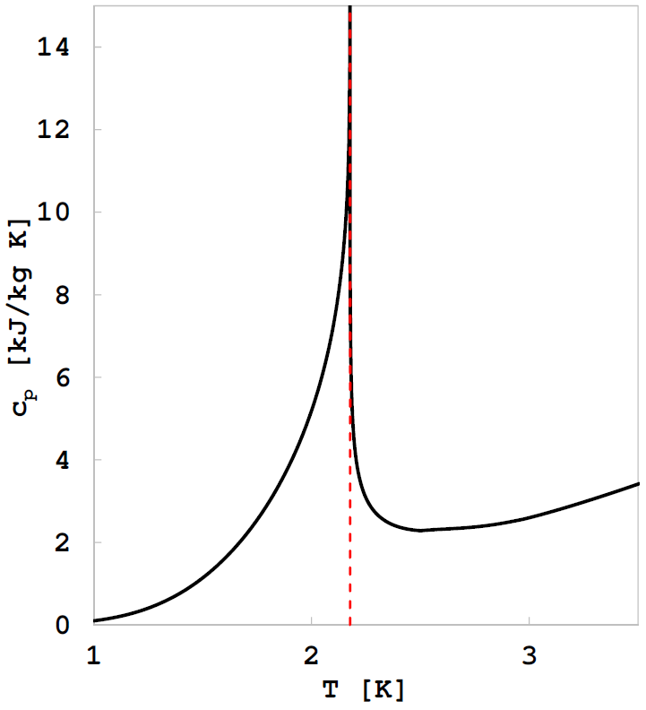
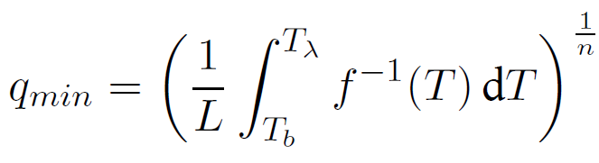

Helium phase transitions
Specific heat capacity
Cryogenics
Ehrenfest classification of phase transitions:
Derivatives of the Gibbs free energy
First-order → discontinuous entropy
Second-order → discontinuous c_{p}
1
2
Cooling Techniques
Superfluid Helium (He II)
3
Critical heat flux in channels:
Minimum value for λ-transition:
Peak nucleate boiling << q_{min}
4
Cooling the LHC MB
Recent He II Studies
5
λ-point
6
Conclusions
Van Sciver, S.W., 2012. Springer New York.

Slide 20
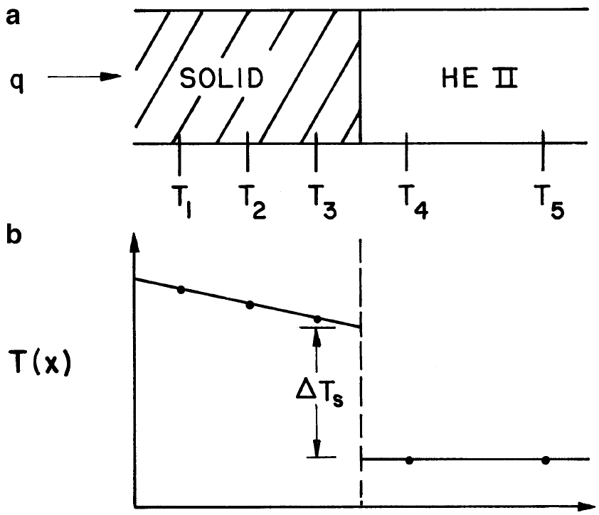
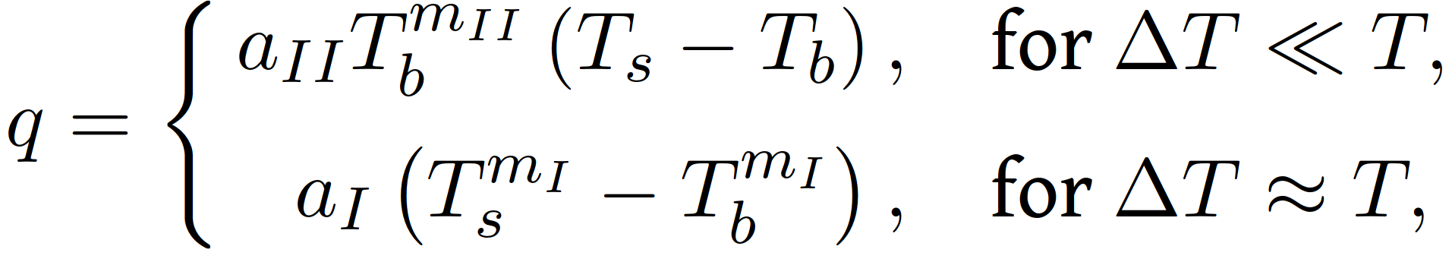
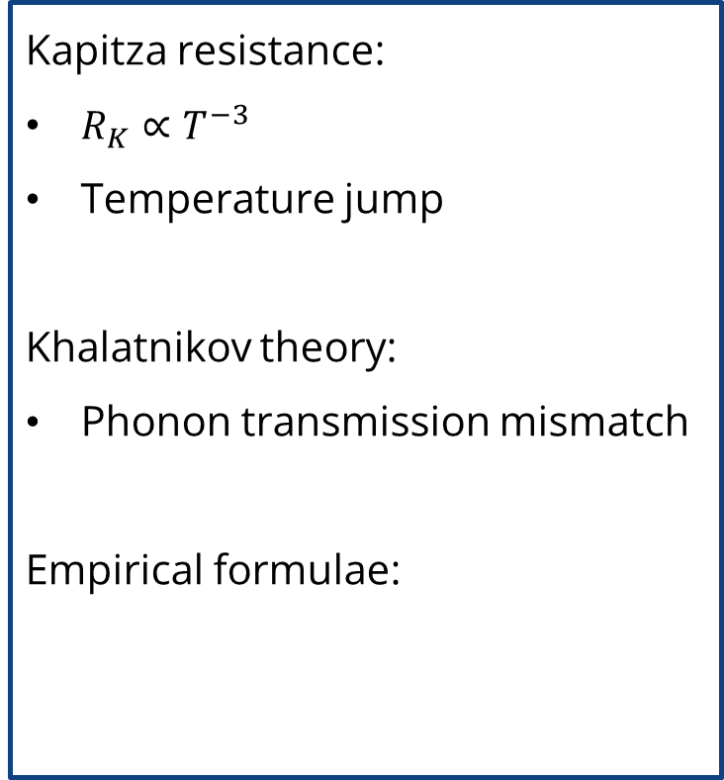
Thermal boundary resistance
Cryogenics
Kapitza resistance:
$R_{K}∝T^{−3}$
Temperature jump
Khalatnikov theory:
Phonon transmission mismatch
Empirical formulae:
1
2
Cooling Techniques
Superfluid Helium (He II)
3
4
Cooling the LHC MB
Recent He II Studies
5
6
Conclusions
Van Sciver, S.W., 2012. Springer New York.

Slide 21
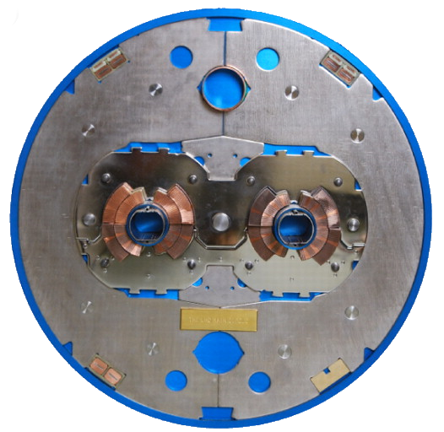
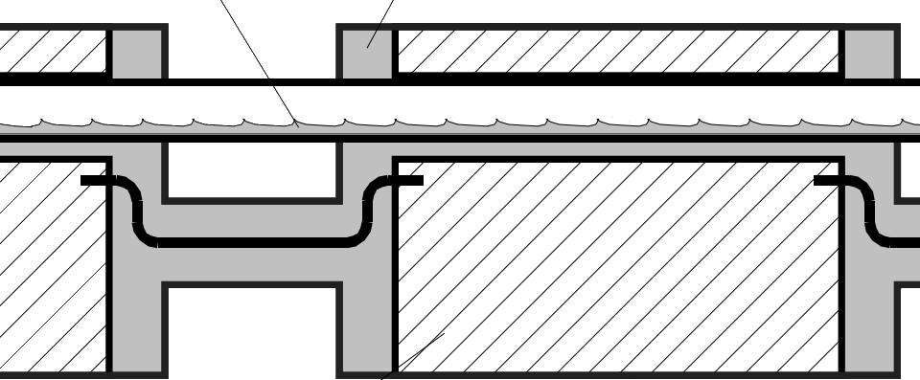
LHC main dipole cooling
Cryogenics
1
Heat exchanger pipe in saturated He II
Steel collars
Cooling Techniques
Pressurized He II
2
Superfluid Helium (He II)
3
Cooling the LHC MB
Cross section
4
Recent He II Studies
5
Beam pipe
Superconducting coil
6
Conclusions
L. Evans. 2012. Philosophical Transactions of the Royal Society A
P. Lebrun, L. Tavian. 2014. CAS

Slide 22
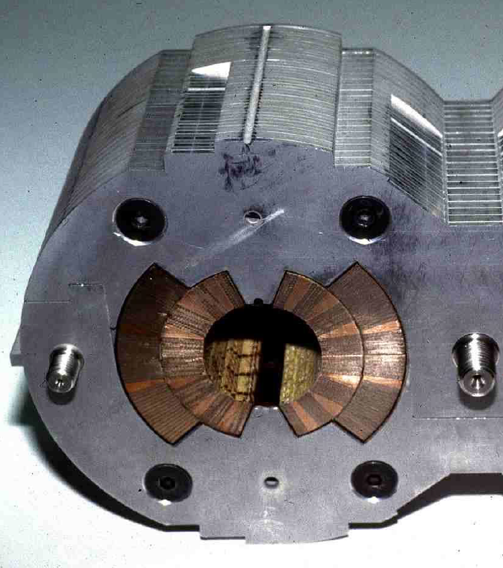
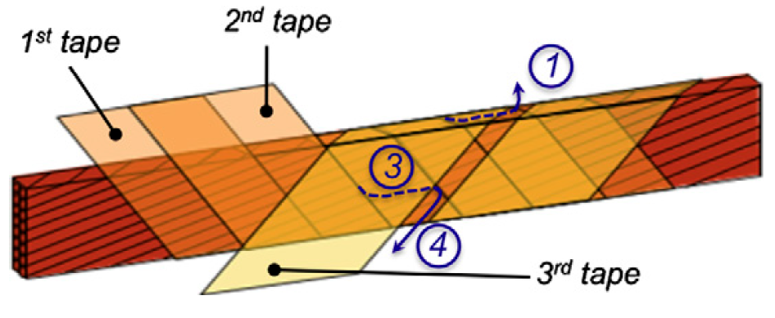
Cooling process obstacles
Cryogenics
1
200 micron thick spacing
2
Cooling Techniques
Steel collars
Superfluid Helium (He II)
3
4
Cooling the LHC MB
Recent He II Studies
10 micron thick spacing
5
6
Conclusions
Conductor
Insulating tape
L. Evans. 2012. Philosophical Transactions of the Royal Society A
P.P. Granieri. 2013. Cryogenics
M. Wilson. 2015. Joint Universities Accelerator School

Slide 23
Recent heat and mass transfer studies
Cryogenics
How does He II behave during phase transitions in confined geometries?
How to simulate it via numerical modeling?
1
2
Cooling Techniques
Superfluid Helium (He II)
Research work:
Experimental: test campaigns in He II cryostat in high-aspect ratio channels
Analytical: dimensional study and generalization of the He II equations
Numerical: CFD modelling of He II and its phase transitions with OpenFOAM
3
4
Cooling the LHC MB
Recent He II Studies
5
6
Conclusions

Slide 24
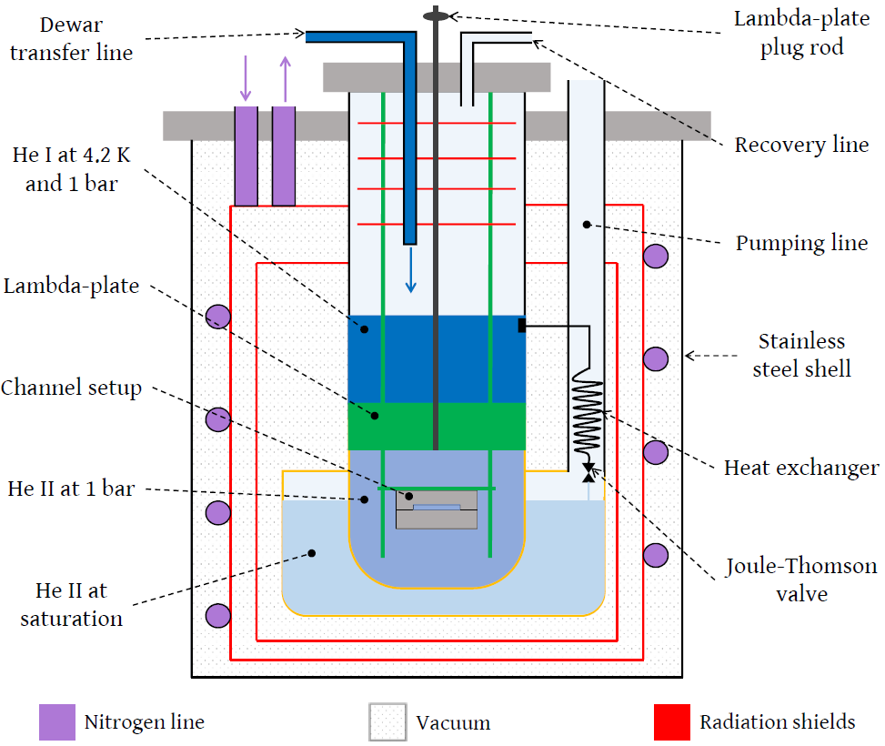
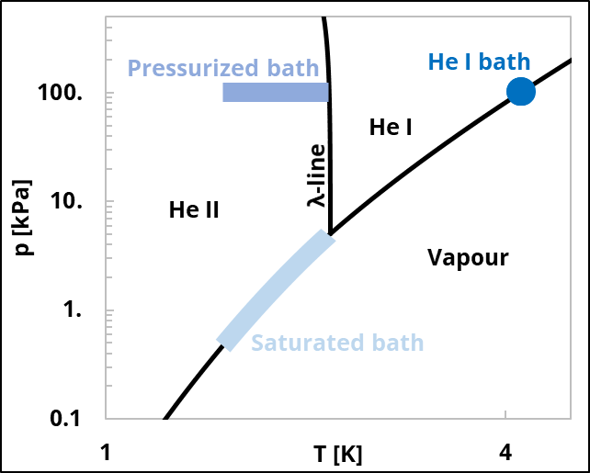
Experimental rig and operations
Claudet-type cryostat:
Double bath system
Pressurized He II
Pressure-regulated temperature
Cryogenics
1
2
Cooling Techniques
Superfluid Helium (He II)
Helium phase diagram
3
4
Cooling the LHC MB
Recent He II Studies
5
6
Conclusions

Slide 25
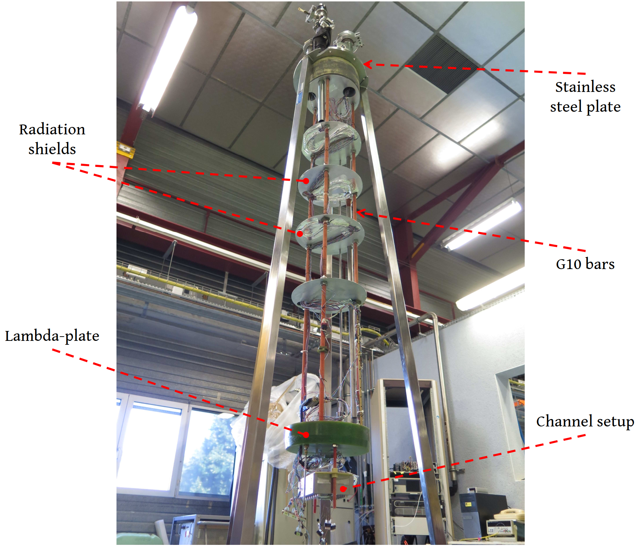
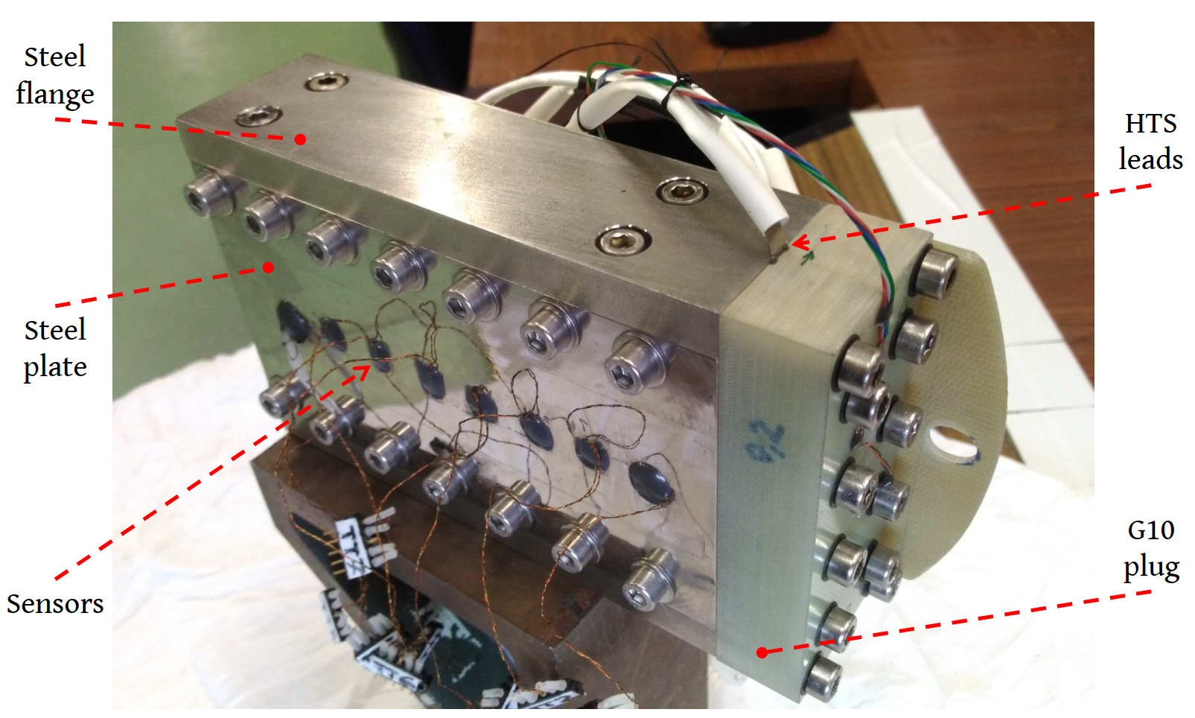
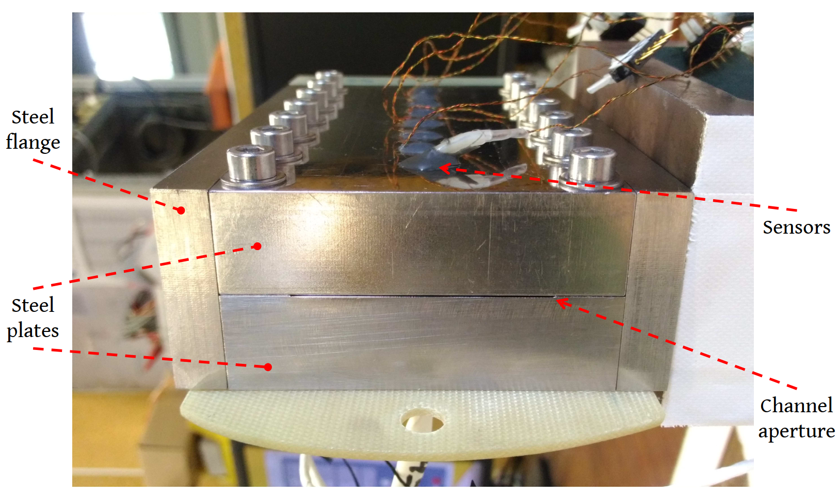
Insert and channel setup
Cryogenics
1
2
Cooling Techniques
0.2-0.5 mm thick
14 cm long
5 cm wide
Superfluid Helium (He II)
3
4
Cooling the LHC MB
Recent He II Studies
5
6
Conclusions

Slide 26
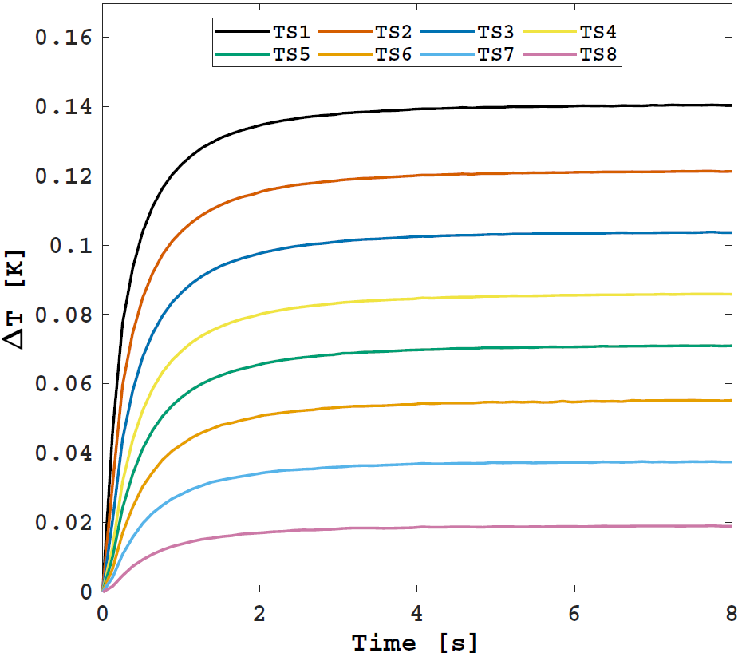
Clamped flux tests
Cryogenics
Constant heat flux applied since time 0
Fixed bath temperature
Measurements at the sensors’ location: TS1 (close to heater) → TS8 (close to bath)
1
2
Cooling Techniques
Superfluid Helium (He II)
3
q
g
TS1
TS8
4
Cooling the LHC MB
Temperature difference with respect to the bath (1.8 K)
0.2 mm thick channel
horizontal orientation
q = 22.5 kW/m²
Recent He II Studies
5
6
Conclusions

Slide 27
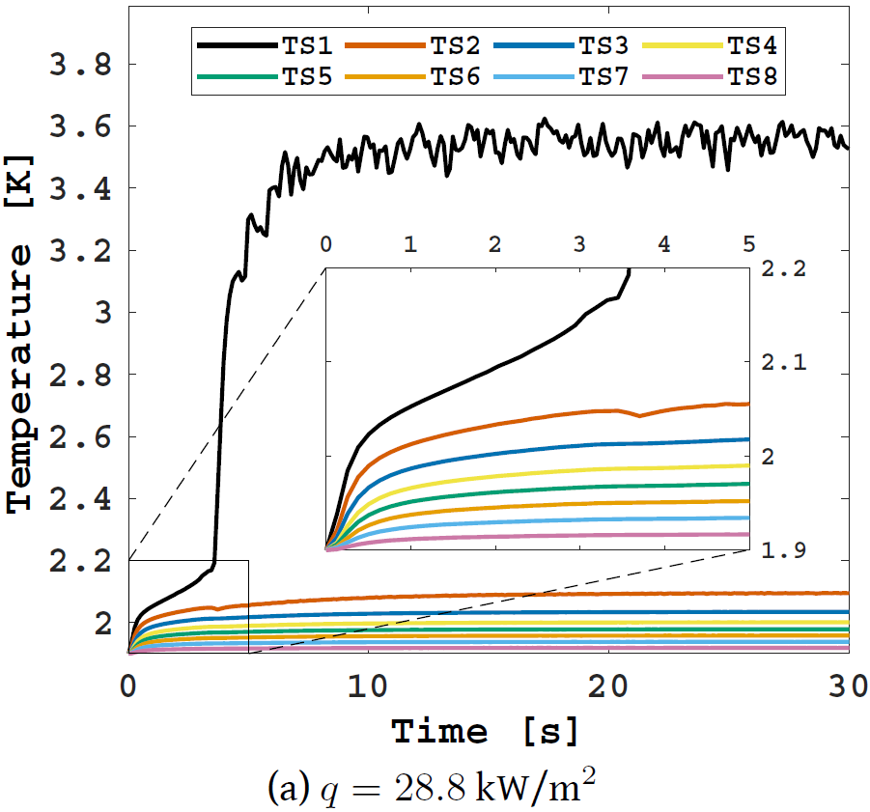
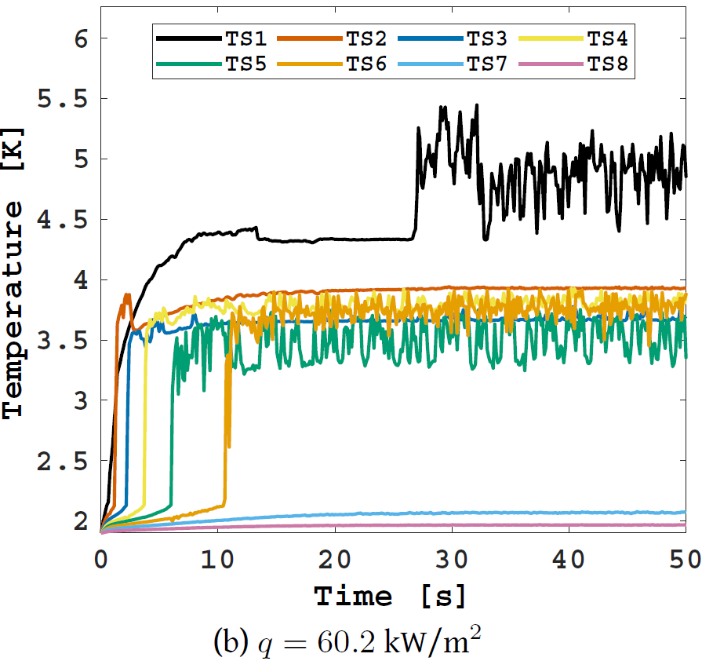
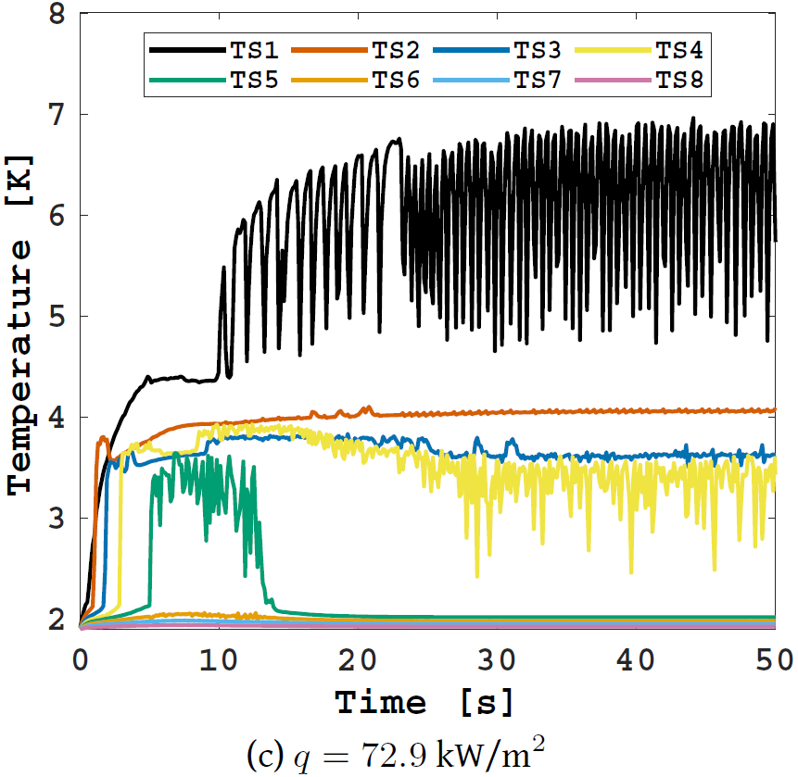
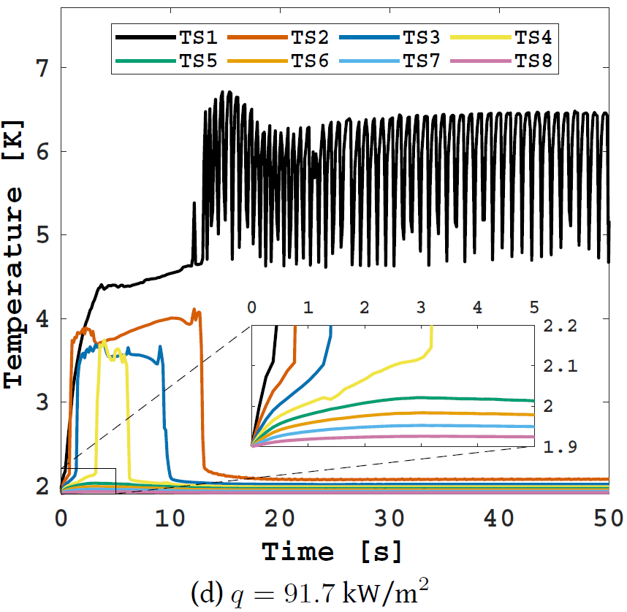
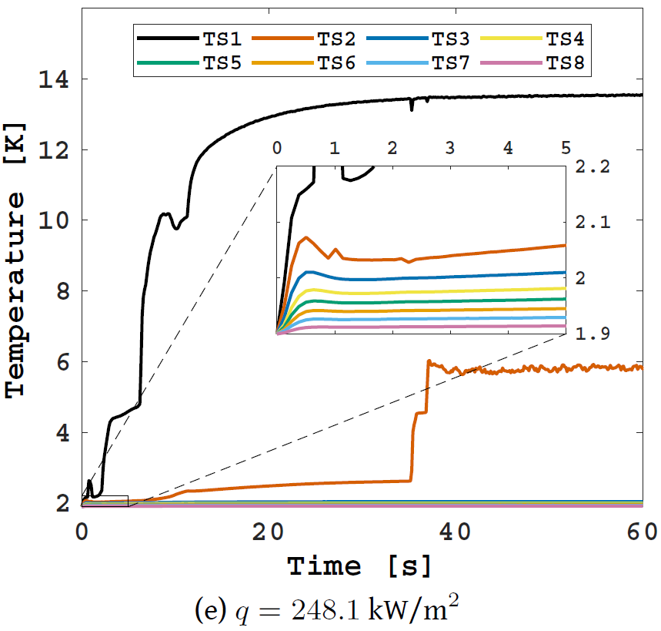
Temperature evolution above q_{c}
Cryogenics
1
2
Cooling Techniques
Superfluid Helium (He II)
3
4
Cooling the LHC MB
Temperature evolutions at T_{b} = 1.9 K for different heat fluxes in the horizontal 0.2 mm thick channel
Recent He II Studies
5
6
Conclusions

Slide 28
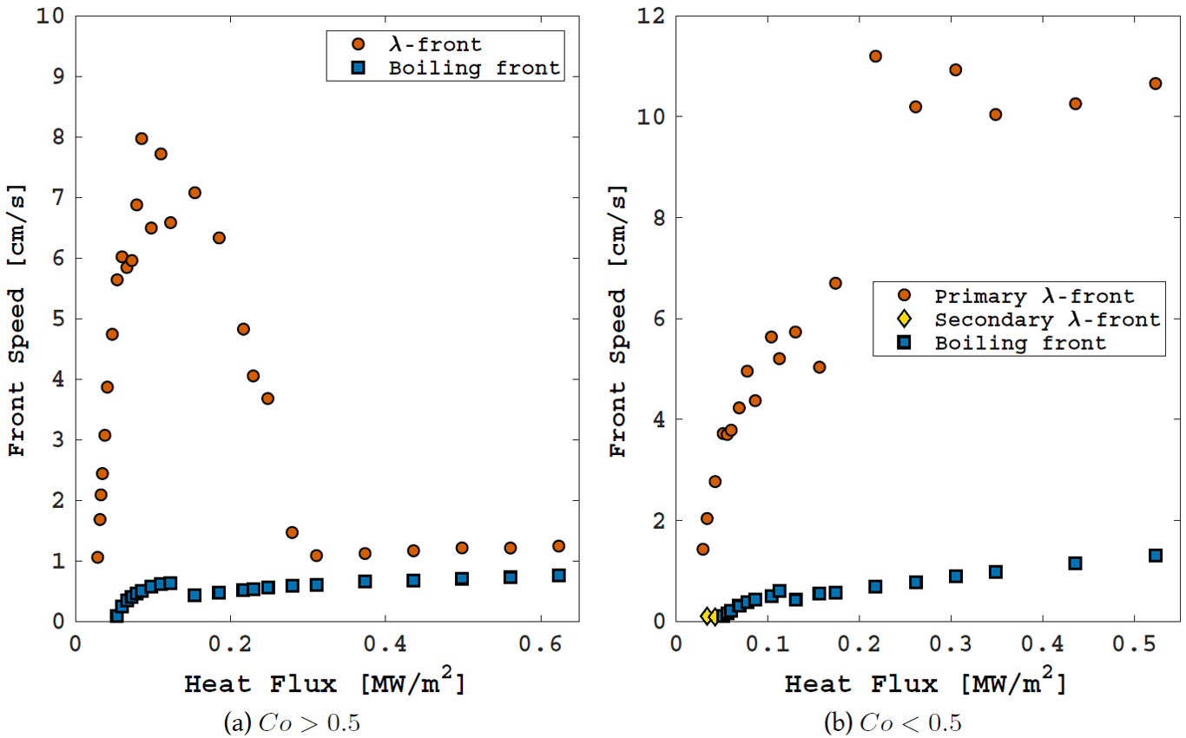
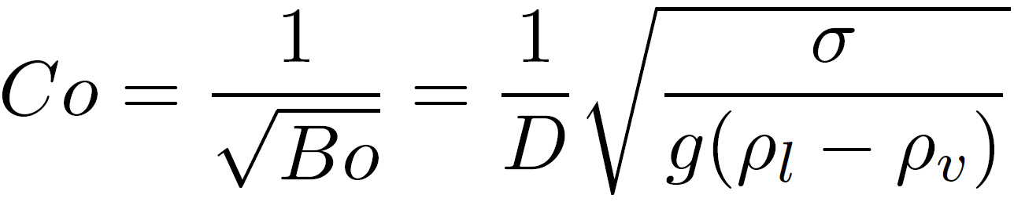
Double-front propagation
Cryogenics
1
2
Cooling Techniques
Confinement number:
Threshold: Co = 0.5
Superfluid Helium (He II)
3
4
Cooling the LHC MB
at TS1 in the 0.2 mm thick channel
at TS1 in the 0.5 mm thick channel
Recent He II Studies
5
6
Conclusions

Slide 29
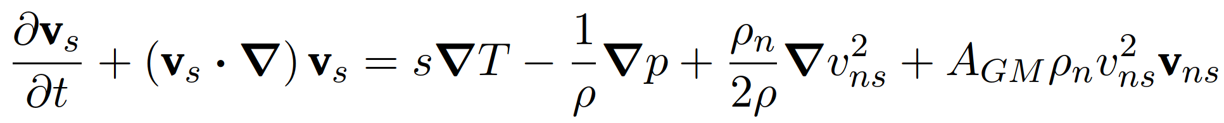


Hall-Vinen–Bekharevich–Khalatnikov equations
Cryogenics
Incompressible He II Navier-Stokes equations in the Gorter-Mellink regime
1
2
Cooling Techniques
Superfluid Helium (He II)
3
inertial forces
viscous forces
thermo-mechanical force
pressure drop
diffusive term
mutual friction force
4
Cooling the LHC MB
Recent He II Studies
5
Kitamura’s single fluid model assumption:
6
Conclusions
T. Kitamura. 1997. Cryogenics

Slide 30
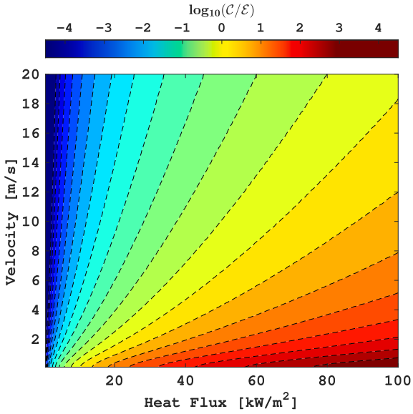

HVBK equations dimensional study
Cryogenics
1
2
Cooling Techniques
Superfluid Helium (He II)
3
4
Cooling the LHC MB
Recent He II Studies
5
6
Conclusions
A. Vitrano. 2023. Cryogenics

Slide 31







Second-order transition problem
Cryogenics
1
Cooling Techniques
Representation of two non-uniform adjacent control volumes
2
Superfluid Helium (He II)
3
Correction algorithm:
Identify front location:
Correct face temperature:
Re-compute temperature gradient
Correct He II fields
4
Cooling the LHC MB
Recent He II Studies
5
6
Conclusions
A. Vitrano. 2022. Computer Physics Communications

Slide 32


He II numerical modelling
Cryogenics
R. Srinivasan and A. Hofmann. 1985. Cryogenics
1
2
Cooling Techniques
q
g
Superfluid Helium (He II)
3
TS1
TS8
4
Cooling the LHC MB
Recent He II Studies
5
Y. S. Ng. 1989. Journal of Thermophysics and Heat Transfer
L. Bottura. 1999. International Journal for Numerical Methods in Fluids
6
Conclusions
A. Vitrano. 2022. Computer Physics Communications

Slide 33



Phase transitions numerical modelling
Cryogenics
1
q
g
Cooling Techniques
TS1
TS8
T_{b} = 2.15 K
T_{heater} = 22.7 K
2
Superfluid Helium (He II)
3
4
Cooling the LHC MB
Recent He II Studies
5
6
Conclusions
A. Vitrano. 2022. Computer Physics Communications

Slide 34
Conclusions
Cryogenics
1
Superfluid helium: difficult to model and handle, costly to maintain, but it ensures:
High contact surface (very low viscosity)
Great thermal stability (very high specific heat)
Great heat transfer capabilities (very high effective thermal conductivity)
→ Effective cooling (two-phase forced flow & subcooled bath)
2
Cooling Techniques
Superfluid Helium (He II)
3
4
Cooling the LHC MB
Recent He II Studies
5
6
Conclusions

Slide 35
Thank you for your attention
Questions?
cern.ch/steam
steam-team@cern.ch

