Slide 1
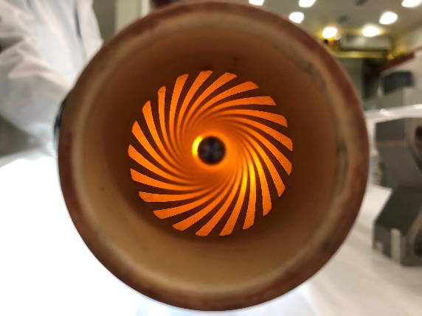
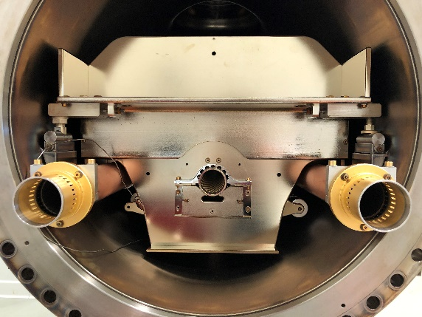
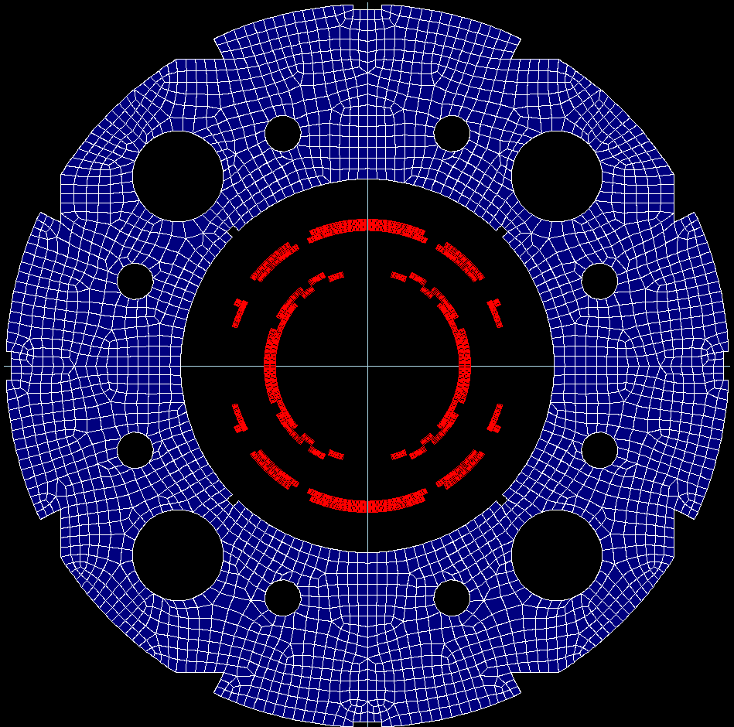
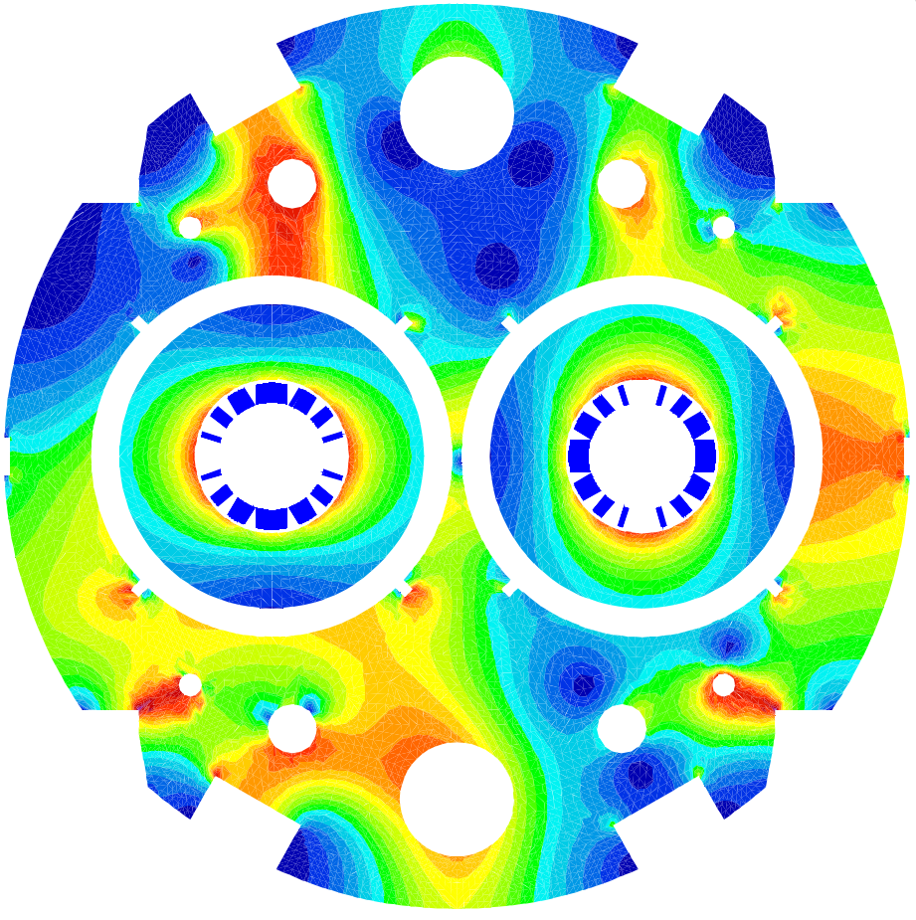
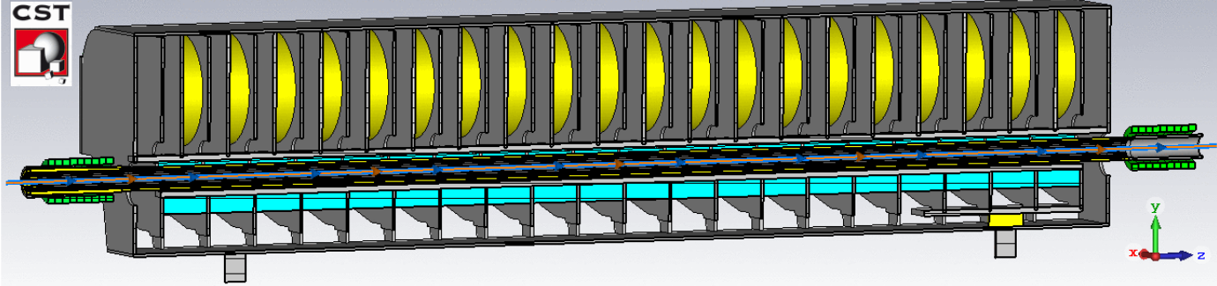
Analysis, simulations and measurements for the operation of accelerator magnets
Agnieszka Chmielińska
09.11.2023
PE Section Meeting

Slide 2




Career history
Oct. 2010 – Feb. 2014
Mar. 2014 – Apr. 2016
B.Sc. in Applied Physics
AGH-UST & TE-VSC Trainee Student
Simulations and tests of the ion
pump controller electronic system
M.Sc. in Applied Physics
AGH-UST & TE-VSC Technical Student
Secondary-electron yield measurements
at cryogenic temperatures
Analysis of surface conditioning to better understand the electron-cloud effect
Aug. 2016 – Dec. 2019
Sept. 2020 – Aug. 2023
Ph.D. in Physics
EPFL & TE-ABT Doctoral Student
Development of a novel beam screen for kicker magnets, involving EM simulations, electric-circuit simulations and RF measurements
Senior Fellow
CERN, TE-MSC
EM simulations of superconducting magnets and design of experiments
Software design and implementation for data-processing in automated workflows
Magnetic field prediction for operation

Slide 3
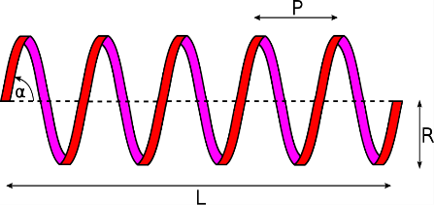
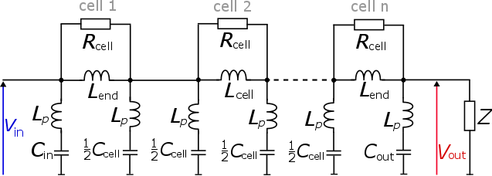
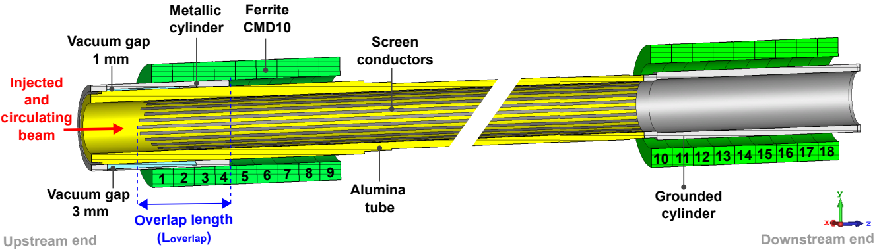
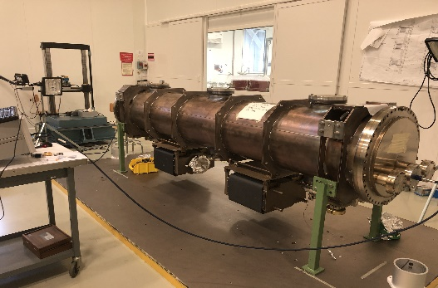

Doctoral Student in TE-ABT-PPE (2016-2019)
Conceptual design
Electric-circuit simulations
(Cadence PSpice)
Optimization of the beam screen for the FCC
injection kicker magnets, Ph.D. at EPFL (2019)
Contribution to the upgrade and commissioning of the LHC Injection Kicker Magnet (LHC MKI)
Development of the novel concept
of a helical beam screen
  Improved high-voltage performance
  Reduced beam-coupling impedance
EM simulations (CST Studio Suite, Opera-2D)
RF measurements (LHC MKI) and signal processing
Prototype validation

Slide 4
Beam screen for the kicker magnets

Slide 5
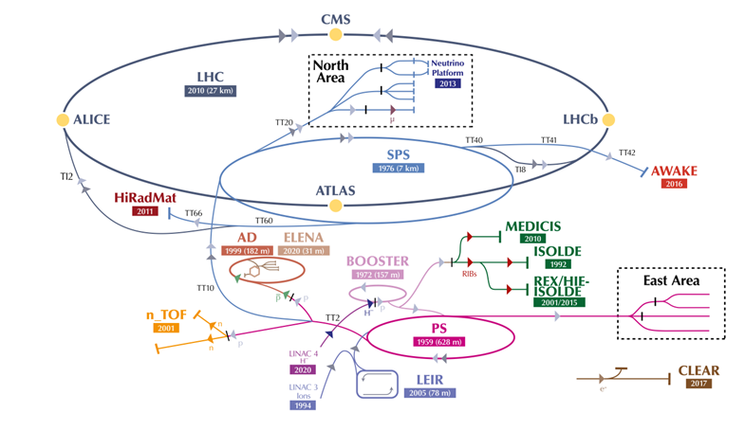
Introduction
CERN accelerator complex:
What do we mean by injection?
A particle beam must be injected into a circular accelerator or accumulator at the right time while:
placing the newly injected particles onto the
correct trajectory,
minimizing beam loss.
Machine protection related issues:
high beam energy (up to 2.4 MJ for each LHC injection and twice more for FCC-hh).
Technological challenges:
fast, high voltage pulse generators,
special types of magnets (kickers and septa).

Slide 6
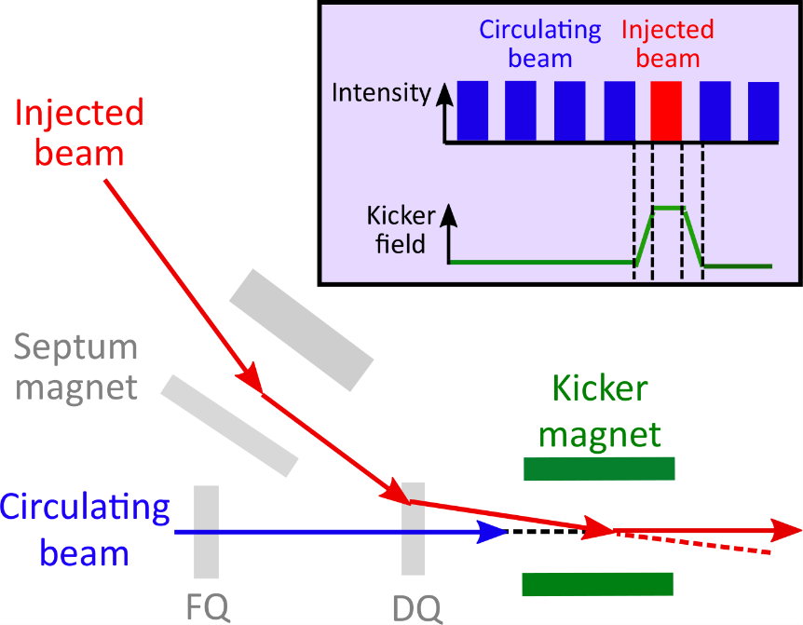
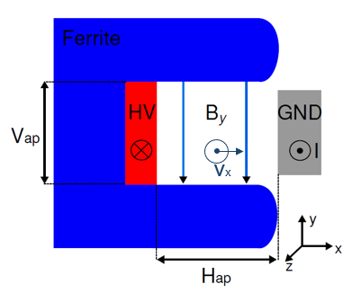
Injection kicker magnet (I)
Single-turn injection:
C-core ferrite:
Kicker magnet is a pulsed dipole magnet with very fast rise and/or fall time (from tens to hundreds of nanoseconds)
It “sees” the circulating beam!
Ni-Zn ferrite yoke is always used for fast applications (e.g. 8C11, CMD5005)

Slide 7
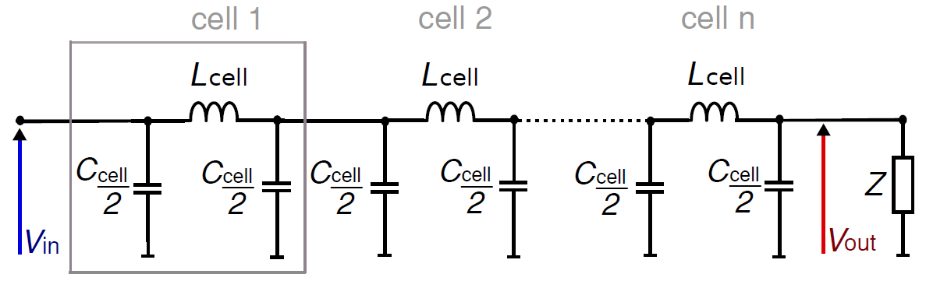
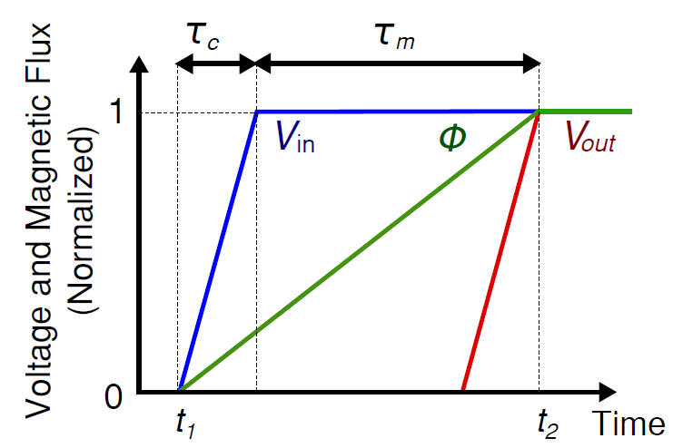
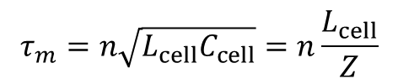



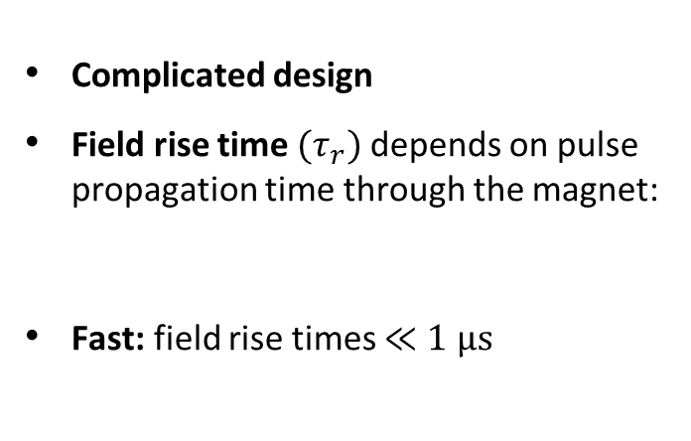
Injection kicker magnet (II)
Transmission line ferrite-loaded kicker magnet is the best option to achieve fast field rise and fall times with low pulse ripple.
Transmission line topology:
Field rise time:
Complicated design
Field rise time ${(τ}_{r})$depends on pulse propagation time through the magnet:
Fast: field rise times $≪1 μs$
Magnetic flux:
Field rise time:
$$Φ=\int{{(V}_{in}−V_{out})dt}$$
$$τ_{m}=n\sqrt{L_{cell}C_{cell}}=n\frac{L_{cell}}{Z}$$
$$τ_{r} \sim { τ}_{m}+τ_{c}$$
${ τ}_{c}$ $\text{–}$ rise time of the voltage pulse

Slide 8
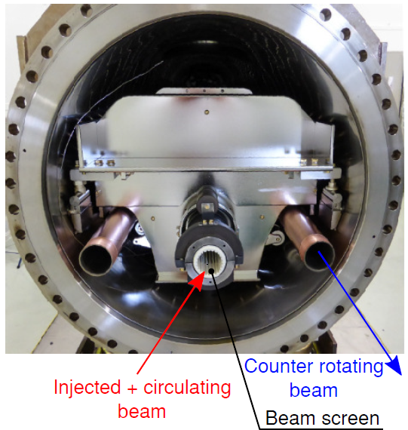
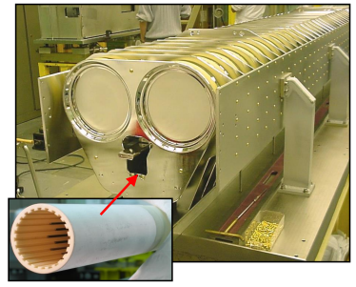
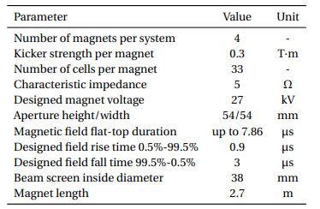
Example: LHC injection kicker magnet (MKI)
Major problem: beam-induced heating due to the real component of the longitudinal beam-coupling impedance $→$ a beam screen is placed in the aperture of each LHC MKI.

Slide 9
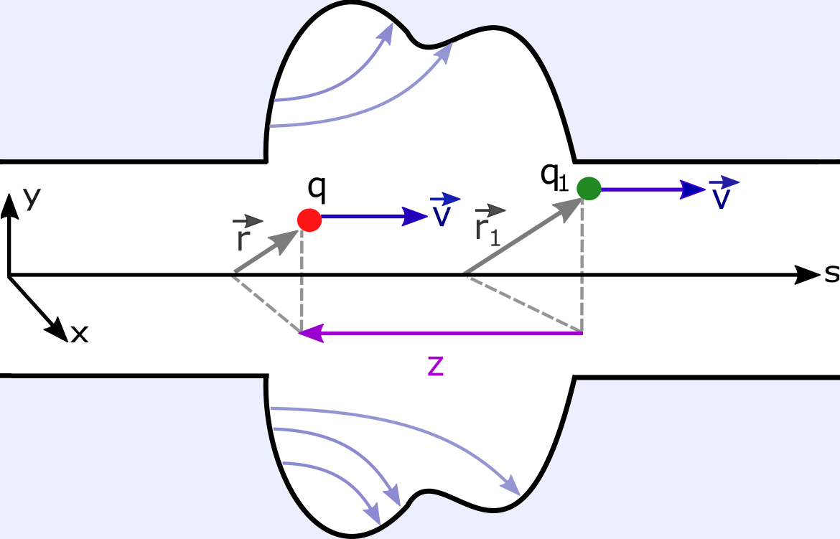
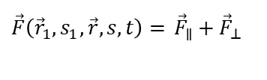
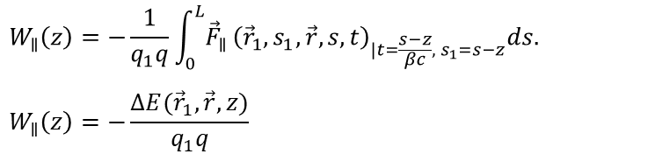
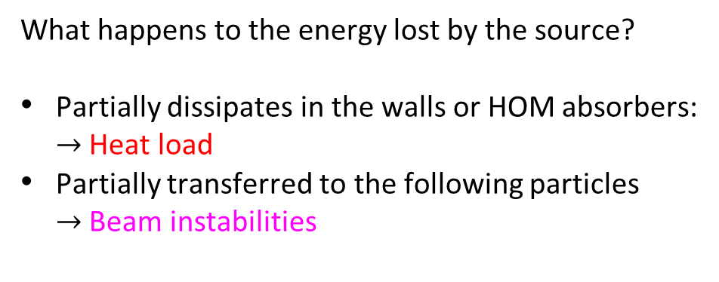
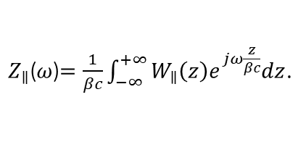
Beam coupling impedance
Reference system:
Longitudinal wake function:
$$W_{∥}\left(z\right)=−\frac{1}{q_{1}q}\int_{0}^{L}{{\vec{F}}_{∥}}{\left({\vec{r}}_{1}, s_{1},\vec{r},s,t\right)}_{|t=\frac{s−z}{βc}, s_{1}=s−z}ds.$$
$$W_{∥}\left(z\right)=−\frac{ΔE({\vec{r}}_{1}, \vec{r},z)}{q_{1}q}$$
The wake field generated by the source particle
affects the witness particle.
.
source
Longitudinal beam coupling impedance:
witness
$Z_{∥}$($ω$)$=\frac{1}{βc}\int_{−∞}^{+∞}{W_{∥}\left(z\right)e^{jω\frac{z}{βc}}dz}$.
What happens to the energy lost by the source?
Partially dissipates in the walls or HOM absorbers:
$→$ Heat load
Partially transferred to the following particles
$→$ Beam instabilities
The net force acting on the witness charge:
$$\vec{F}\left({\vec{r}}_{1}, s_{1},\vec{r,}s,t\right)=q\left[\vec{E}\left({\vec{r}}_{1}, s_{1},\vec{r},s, t\right)+\vec{v}×\vec{B}\left({\vec{r}}_{1}, s_{1},\vec{r},s,t\right)\right]$$
$\vec{F}\left({\vec{r}}_{1}, s_{1},\vec{r},s, t\right)=$ ${\vec{F}}_{∥}+{\vec{F}}_{⊥}$

Slide 10
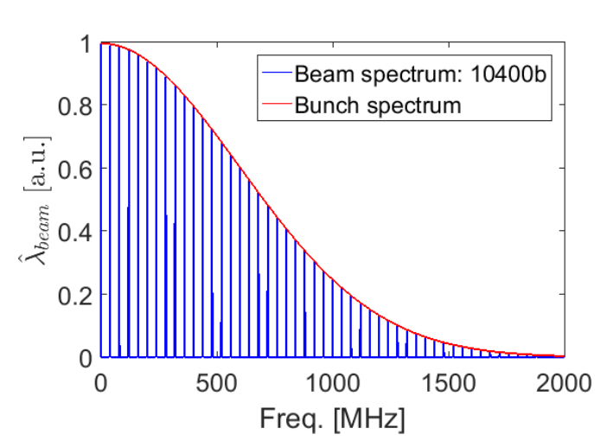
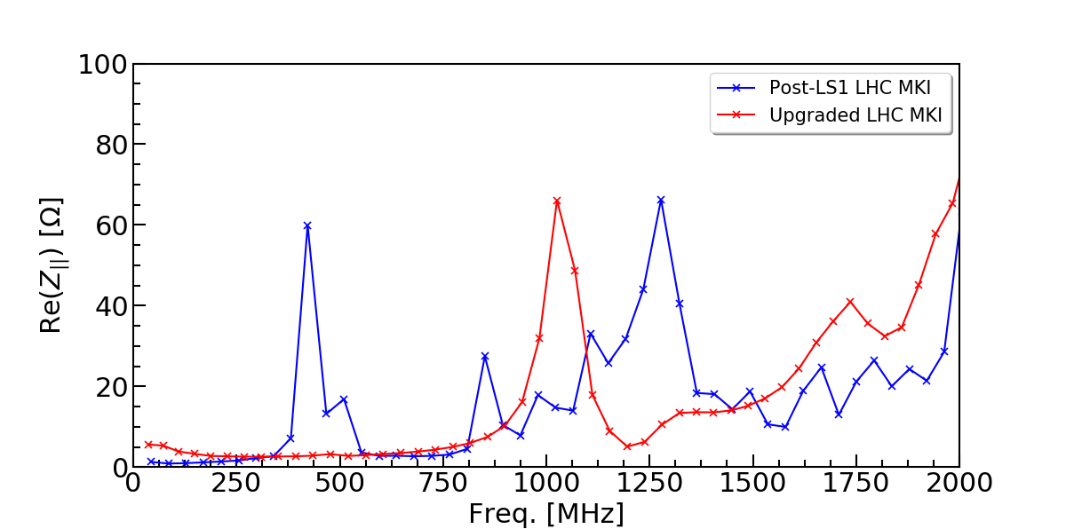
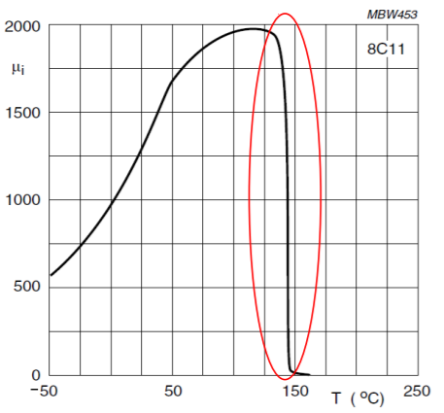
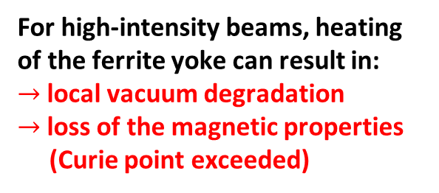
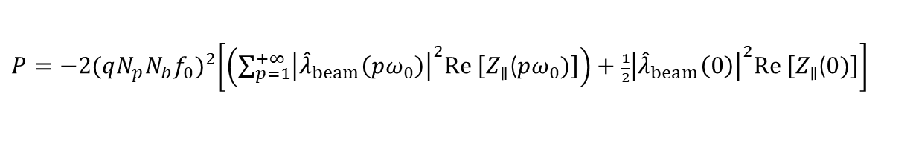
Beam-induced heating
Power loss (multipole pass):
Consequences:
$P=−2{(qN_{p}N_{b}f_{0})}^{2}\left[\left(\sum_{p=1}^{+∞}{{\left|{\hat{λ}}_{beam}\left(pω_{0}\right)\right|}^{2}Re \left[Z_{∥}\text{(}pω_{0})\right]}\right)+\frac{1}{2}{\left|{\hat{λ}}_{beam}\left(0\right)\right|}^{2}Re \left[Z_{∥}\text{(}0)\right]\right]$
For high-intensity beams, heating of the ferrite yoke can result in:
$→$local vacuum degradation
$→$loss of the magnetic properties
(Curie point exceeded)
$N_{b}$ – number of bunches, $N_{p}$– bunch intensity, $f_{0}$ – revolution frequency, ${\hat{λ}}_{beam}$ – beam spectrum.
Beam spectrum
Impedance spectrum
25 ns bunch spacing $→$ 40 MHz beam harmonics
Shift the peaks towards higher frequencies!

Slide 11
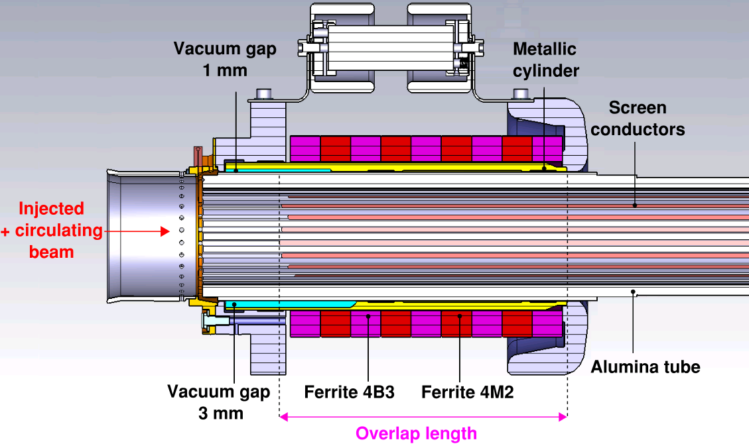


Beam screening: Conventional design (I)
General features:
24 (NiCr) straight screen conductors
$→$reduced beam coupling impedance
Capacitive coupling to the beam pipe at the upstream end and connection to the beam pipe at the downstream end
$→$ fast magnetic field rise time
Overlap length determines resonances
in the longitudinal impedance spectrum
$→$possibility to shift resonant modes
to higher frequencies:
Ferrite rings at both ends of the beam screen
$→$ power loss reduction in the ferrite yoke
LHC MKI post-LS1 beam screen:
Upstream
end
$$f_{conv}^{(n)}=\frac{nc}{2\sqrt{ε_{r,eff}}+(L_{overlap}+δ_{fringe})}$$
More than 15 years of development…

Slide 12
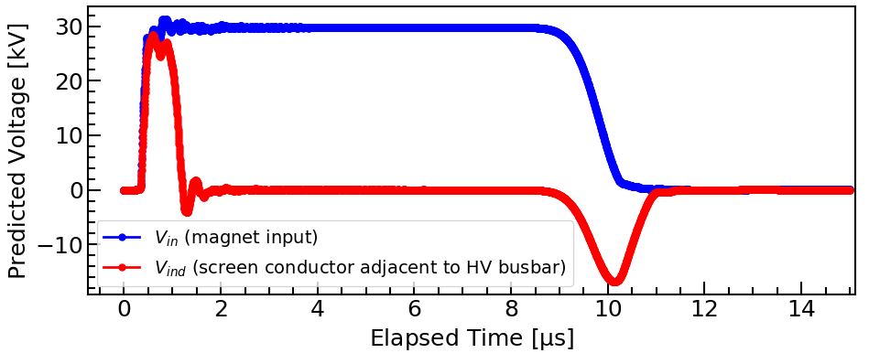
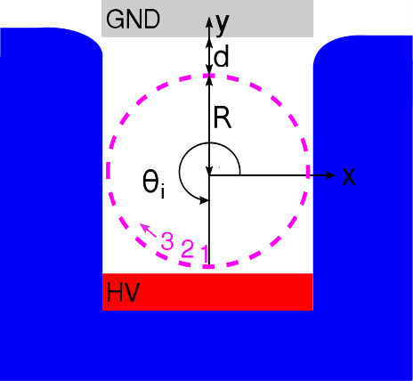
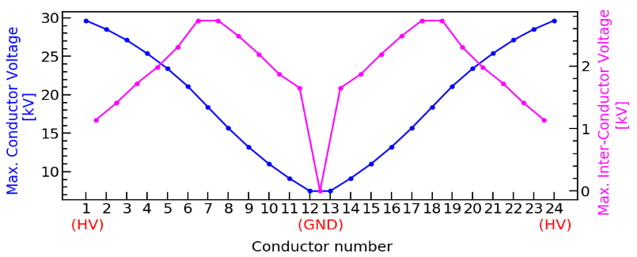

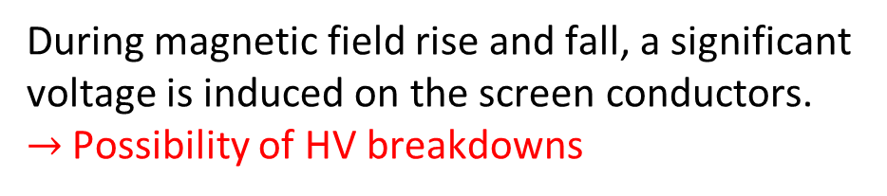
Beam screening: Conventional design (II)
During magnetic field rise and fall, a significant voltage is induced on the screen conductors.
$→$Possibility of HV breakdowns
Magnet voltage and voltage of screen conductor:
Maximum conductor and inter-conductor voltages (for 60 kV PFN voltage):
Induced voltage:
$$V_{i}=\frac{dΦ}{dt}=\frac{dB}{dt}\left(d+R−y_{i}\right)L$$

Slide 13
Design of a beam screen for FCC-hh
Analysis of the LHC MKI beam screen (not discussed here)
Design of the conventional beam screen for FCC-hh (not discussed here)
Development of a novel helical beam screen for FCC-hh (next slides)

Slide 14
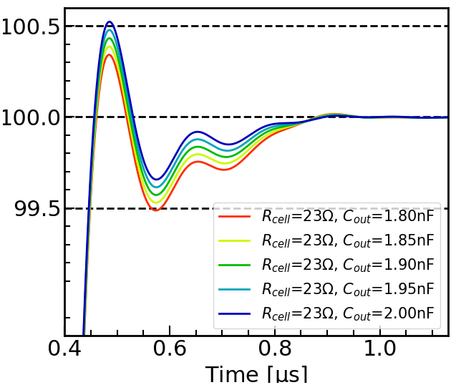
Design of a kicker magnet module for FCC-hh
Specification of baseline parameters
Analysed kicker waveform:
Baseline parameters:
Injecton energy [TeV]
Angle [mrad]
Pulse duration [µs]
Current [kA]
Voltage [kV]
System impedance [Ω]
System length [m]
Field rise time [µs]
Aperture dimensions [mm]
Magnet fill time [µs]
Good field region (h/v) [mm]
Flat-top tolerance [%]
3.3
0.18
2
2.4
15
6.25
40
0.43
48/48
0.355
8/8
±0.5
PSpice model
18 magnets per
injection system
Normalized magnetic flux [%]
Analysis of field rise time and field flat-top quality
CST model
New PSpice model and CST model
14

Slide 15
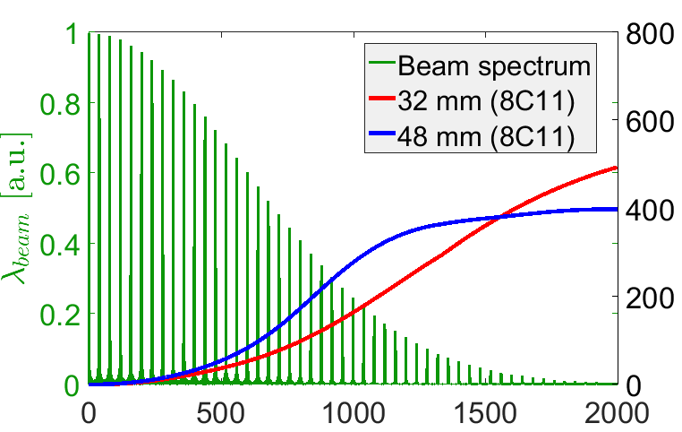
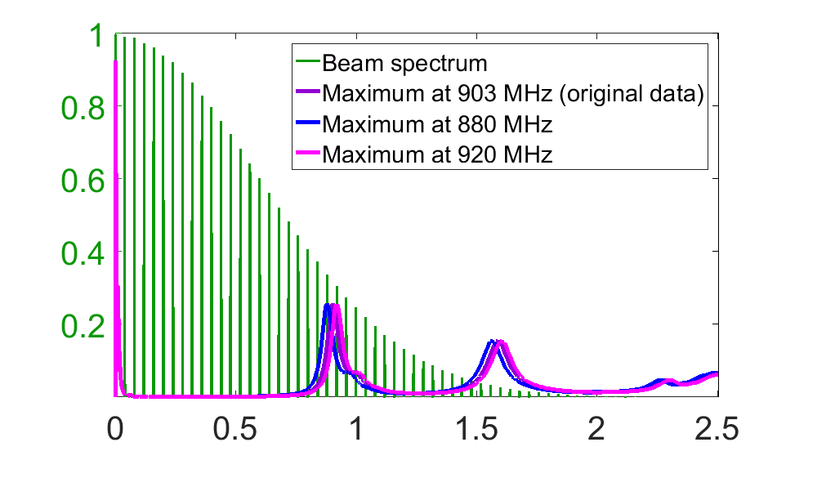


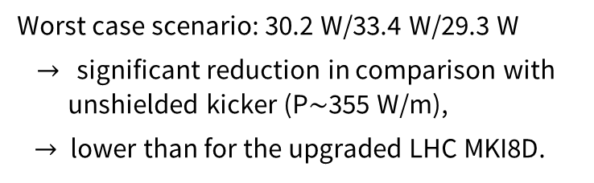





Power deposition estimates
Unshielded kicker magnet:
Kicker magnet with the conventional beam screen:
Induced voltage:
400
$${\hat{λ}}_{beam} [a.u.]$$
300
$${\hat{λ}}_{beam} [a.u.]$$
${Re Z}_{||}$/L [W/m]
2.8 MHz, 462 $Ω$
${Re Z}_{||}$[$Ω$]
903 MHz, 128 $Ω$
1590 MHz, 94 $Ω$
200
100
Freq. [MHz]
Freq. [GHz]
Aperture
dimensions
[mm x mm]
P [W/m]
Ideal beam
spectrum
P [W/m]
Nominal beam
spectrum
Worst case scenario: 30.2 W/33.4 W/29.3 W
$→$ significant reduction in comparison with
unshielded kicker (P$\sim$355 W/m),
$→$ lower than for the upgraded LHC MKI8D.
32 x 32
48 x 48
228.1
355.4
227.1
353.9
LHC MKI limit: 160 W/m.
Power loss is at unacceptable level.
15

Slide 16
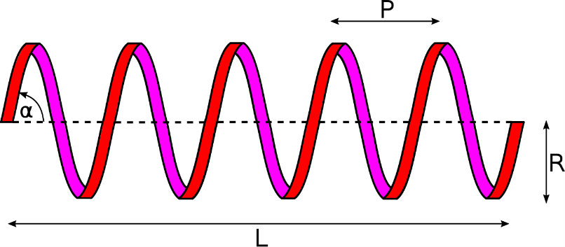
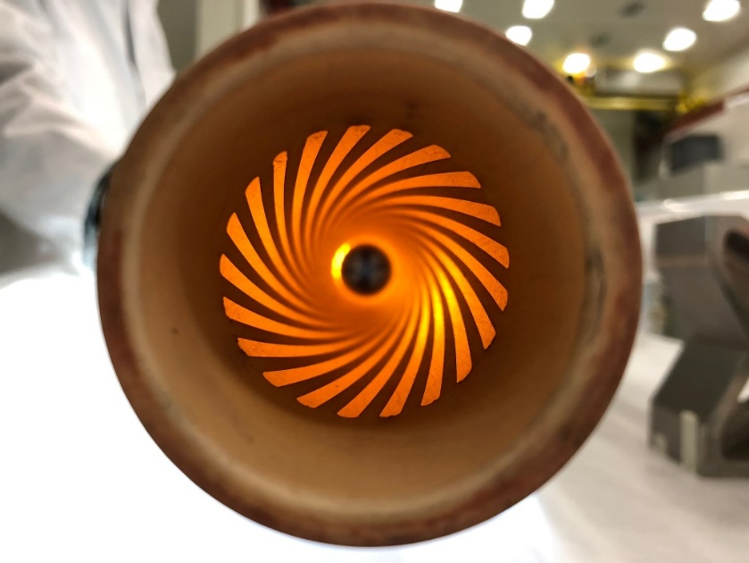

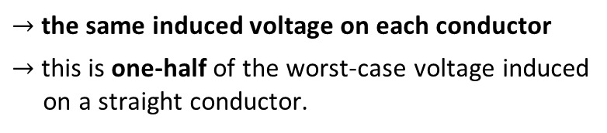
New concept of a helical beam screen
Each screen conductor has a form of a helix:
Induced voltage:
Photograph of the alumina tube with 21 screen conductors applied using Ag paint
For an integer number of turns:
$$V_{i}=\frac{dB}{dt} \left(d+R\right)L$$
$→$the same induced voltage on each conductor
$→$this is one-half of the worst-case voltage induced
on a straight conductor.
Significantly improved HV performance

Slide 17
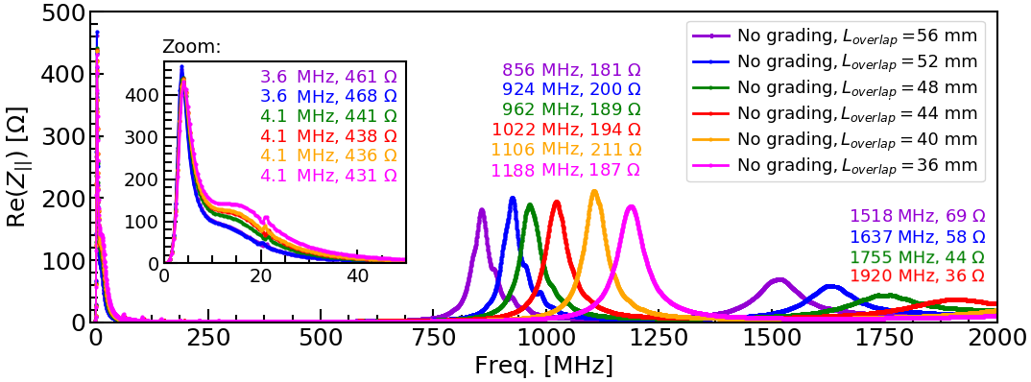
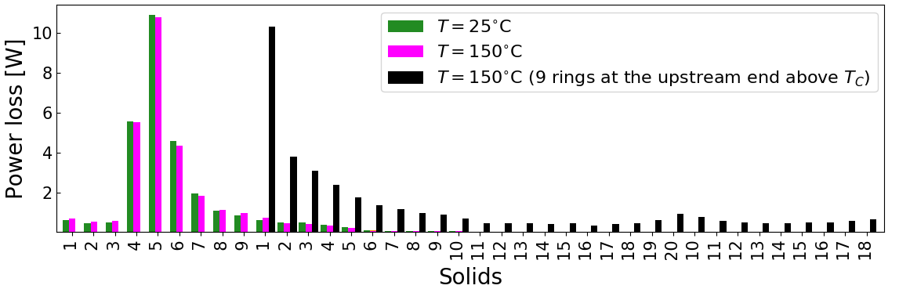
Beam coupling impedance simulations
Longitudinal impedance optimization
Beam coupling impedance modelling
(CST Studio Suite) to optimize:
  Beam-induced heating
  Power distribution
  Impact on beam stability
Power deposition distribution
No heating issues are expected for the FCC-hh kicker magnets for nominal beam parameters.

Slide 18
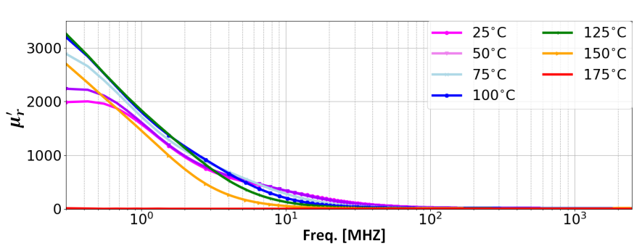
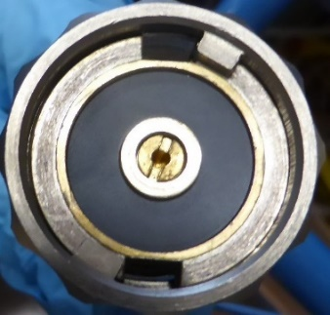
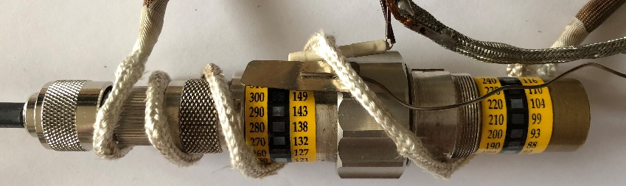
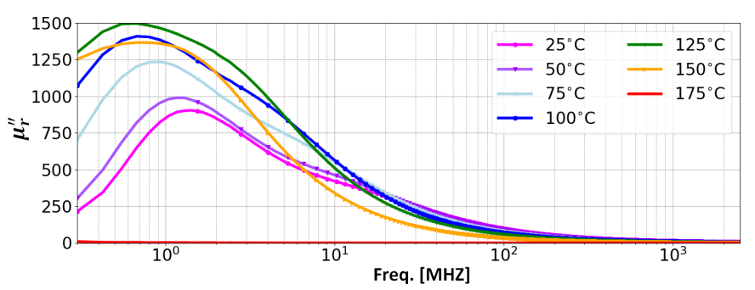
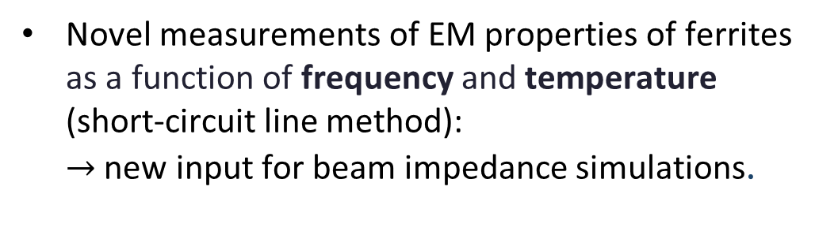
Characterization of EM properties of ferrites
Novel measurements of EM properties of ferrites as a function of frequency and temperature (short-circuit line method):
$→$ new input for beam impedance simulations.
Measured temperature dependence complex permeability for CMD5005.
Chmielińska, A. et al. "Measurements of electromagnetic properties of ferrites as a function of frequency and temperature", In Journal of Physics: Conference Series, vol. 1067. No. 8, p. 082018. IOP Publishing.

Slide 19


Field response of the kicker magnet simulations
Field response modelling (coupling Opera-2D with Cadence PSpice) to achieve required:
  Field rise time
  Field flat-top quality
Central cell inductance vs. frequency (Opera-2D)
Impact of a beam screen upon kicker waveform (PSpice)
Selected baseline: Cu or Ag,
30 µm x 1.3 mm
Proposed beam screen design satisfies the field rise time and the field flat-top quality requirements

Slide 20


Experimental benchmark
  Coaxial-wire measurements performed on the LHC MKI to validate numerical models (classical and resonant method)
Experimental setup
LHC MKI with a helical beam screen
Longitudinal impedance
First demonstrated feasibility of this concept
Chmielińska, A. and Barnes, M. J. "Helical beam screen for the Future Circular Collider for hadrons injection kicker magnets." Physical Review Accelerators and Beams 23.4 (2020): 041002.

Slide 21
Measurements of beam coupling impedance
  Coaxial-wire measurements performed on the LHC MKI to validate numerical models (classical and resonant method)
Experimental setup
LHC MKI with a helical beam screen
Longitudinal impedance
Complete picture of the optimization of the beam screen design.
Consistent results in theoretical, numerical and experimental studies.
First demonstrated feasibility of this concept
Chmielińska, A. and Barnes, M. J. "Helical beam screen for the Future Circular Collider for hadrons injection kicker magnets." Physical Review Accelerators and Beams 23.4 (2020): 041002.

Slide 22







Fellow in TE-MSC-TM (2020-2023)
Integration of numerical models with magnetic measurement data to model and characterize the
magnetic field of superconducting magnets
Design of experiments (test plan, specification of cycles)
Data-driven updates of numerical models
Magnetic-field prediction for machine operation (FiDeL)
  Semi-empirical model decomposition
Software design and implementation for data-analysis
PyMagAnalysis
Operational cycle
of MCBC (vdM scans)
Cross-talk
simulations in ROXIE
Rotating-coil measurements in SM18
https://gitlab.cern.ch/te-msc-mm/pymaganalysis

Slide 23
Analysis of simulations and measurements to predict the magnetic field for the operation of superconducting magnets

Slide 24
FiDeL model for machine operation (I)
The Field Description of the LHC (FiDeL) is the magnetic field prediction system that provides a model of the transfer function of magnetic circuits installed in the machine in order to retrieve the current level given the required field:
→ indispensable for LHC operation
  → uses parametric equations to fit magnetic measurements
  → based on physical decomposition of effects that contribute to the total ﬁeld in the
  aperture of the magnet
  → uses several levels of approximations, starting from a linear dependance on the
  current and adding correction terms (depending on the magnet type and function).

Slide 25

FiDeL model for machine operation (II)
1. Geometric: $B_{m}^{geo }= γ_{m}^{ }I.$
2. Magnetization: $B_{m}^{mag }= μ_{m}^{ }\left|I\right|{\left(\frac{I_{inj }}{\left|I\right|}\right)}^{2−p_{m}}{\left(\frac{I_{c }−\left|I\right|}{I_{c }−I_{inj }}\right)}^{q_{m}}$ ${\left(\frac{{T_{c0 }}^{1.7}−{T_{ }}^{1.7}}{{T_{c0 }}^{1.7}−{T_{meas }}^{1.7}}\right)}^{h_{m}}.$
3. Saturation: $B_{m}^{sat }= \sum_{i=1}^{N}{σ_{m}^{i}}IΣ\left(I, S_{m}^{i},I_{0m}^{i},I_{nom}\right),$
where$Σ\left(I, S_{ }^{ },I_{0}^{ },I_{nom}\right)=−\frac{1}{2}\left[1+\operatorname{erf}\left(S\left(\frac{\left|I\right|−I_{0}}{I_{nom}}\right)\right)\right], \operatorname{erf}\left(x\right)=\frac{2}{\sqrt{π}}\int_{0}^{x}{e^{−t^{2}}dt.}$
  The fitting parameters are implemented in the LHC control system.

Slide 26
PyMagAnalysis
Filtering:
- Time,
- Current,
- Ramp-rate.
FiDeL Fit
Modelling fit
Analyzer
Data input
Multipole inputs:
- ROXIE input,
- Measurement input,
- FiDeL input.
Advanced analysis:
- current vs. time,
- multipole vs. time,
- multipole vs. current,
- linear fit,
- residuals vs. current,
- and many more…
Plotter
Presenting results:
- custom labels,
- zoom,
- plot types,
- and many more…
ROXIE files
FiDeL reports (EDMS)
Magnetic
Measurement DB
https://gitlab.cern.ch/te-msc-mm/pymaganalysis

Slide 27

Analysis of nonlinear effects during luminosity calibration (I)
MCBC/MCBY magnets are used to provide beam separation during van der Meer (vdM) scans.
MCBC
MCBY
Operational cycles
Nonlinearities and lack of repeatability during vdM scans triggered the necessity to review the hysteretic behaviour of MCBC/MCBY magnets.

Slide 28




Measurements in SM18
vdM scans: 1,2,4,5
other scans: 3,6,7
Extensive program of standard and operational test cycles launched to characterize the magnetic field and its reproducibility from scan to scan using the rotating-coil technique.

Slide 29



Analysis of measurements and simulations (I)
Analysis of nonlinear effects due to persistent currents
Update of the
ROXIE models
FiDeL model + beyond
FiDeL Model & beyond
+ impact on the beam
Developed numerical model to account for transitions between major magnetization branches

Slide 30


Benchmark of the proposed model
Comparison of the measured magnetization-branch transitions (markers) and the proposed extended FiDeL model for the MCBC magnet (dashed lines).
Predicted and measured impact of magnetic hysteresis on the transverse displacement
Courtesy of M. Hostettler
Chmielińska, A., et al. "Magnetization in superconducting corrector magnets and impact on luminosity–calibration scans in the Large Hadron Collider." Eur. Phys. J. Plus (2023) 138: 796.

Slide 31


Magnetic model for the MCBXF (I)
MCBXF
Powering cycles
  Inner coil provides vertical field
  (main field B1, normal)
  Outer coil provides horizontal field
  (main field A1, skew).

Slide 32

Identifying the problem
  The development of FiDeL model is particularly challenging due to angular dependence of saturation (and persistent current magnetization).

Slide 33




Proposed model (I)
Original definition:
$B_{m}^{sat }(I_{1})= \sum_{i=1}^{N}{σ_{m}^{i}}I_{1}Σ\left(I_{1}, S_{m}^{i},I_{0m}^{i},I_{nom}\right),$ where: $Σ\left(I, S,I_{0}^{ },I_{nom}\right)=−\frac{1}{2}\left[1+\operatorname{erf}\left(S_{ }^{ }\left(\frac{\left|I_{ }\right|−I_{0}^{ }}{I_{nom}}\right)\right)\right]$,
$m$ – multipole, ${σ_{m}^{ },S}_{m}^{ },I_{0m}^{ },I_{nom}$ – fitting parameters.
Proposal:
$$B_{m}^{sat }\left(I_{1}\right) ↦ B_{m}^{sat }(I_{1},I_{2})$$
$$A_{m}^{sat }\left(I_{2}\right) ↦ A_{m}^{sat }(I_{1},I_{2})$$
$I_{1}$ - inner current
$I_{2}$ - outer current
$B_{m}^{sat }\left(I_{1},I_{2}\right)= \sum_{i=1}^{N}{σ_{m}^{i}}I_{1}G_{m}^{B}(I_{1},I_{2})Σ\left(I_{1}G_{m}^{B}\left(I_{1},I_{2}\right), S_{m}^{i},I_{0m}^{i},I_{nom_1}\right)$,
$A_{m}^{sat }\left(I_{1},I_{2}\right)= \sum_{i=1}^{N}{σ_{m}^{i}}I_{2}G_{m}^{A}(I_{1},I_{2})Σ\left(I_{2}G_{m}^{A}\left(I_{1},I_{2}\right), S_{m}^{i},I_{0m}^{i},I_{nom_2}\right)$,
where${ G}_{m}^{ }\left(I_{1,}I_{2}\right)$ is a function of inner and outer current (determined experimentally).

Slide 34






Proposed model (II)
$$Input:I_{1},I_{2}$$
$$G_{m}^{B}\left(I_{1,}I_{2}\right)$$
$$G_{m}^{B}\left(I_{1,}I_{2}\right)$$
$$B_{m}^{sat }\left(I_{1},I_{2}\right)= \sum_{i=1}^{N}{σ_{m}^{i}}I_{1}\left(\frac{a}{α\left(I_{1},I_{2}\right)+∆}+b\right)Σ\left(I_{1}\left(\frac{a}{α\left(I_{1},I_{2}\right)+∆}+b\right), S_{m}^{i},I_{0m}^{i},I_{nom1}\right),$$
$$G_{m}^{A}\left(I_{1,}I_{2}\right)$$
$$G_{m}^{A}\left(I_{1,}I_{2}\right)$$
$$A_{m}^{sat }\left(I_{1},I_{2}\right)= \sum_{i=1}^{N}{σ_{m}^{i}}I_{2}\left(\frac{a}{\frac{π}{2} − α\left(I_{1},I_{2}\right)+∆}+b\right)Σ\left(I_{2}\left(\frac{a}{\frac{π}{2} − α\left(I_{1},I_{2}\right)+∆}+b\right), S_{m}^{i},I_{0m}^{i},I_{nom2}\right)$$
$$,$$
$where: α\left(I_{1},I_{2}\right)= \tan_{ }^{−1}\left(\frac{|I_{1}|/I_{nom1}}{{|I}_{2}|/I_{nom2}}\right)$

Slide 35


Modelling error
New model with angular dependence of saturation
The error is within required specification (±30 units for B1/A1)
Baseline for HL-LHC

Slide 36
Modelling error
New model with angular dependence of saturation
With PyMagAnalysis framework we brought the best available knowledge from simulations and measurements to understand the magnet behavior itself and to provide precise field predictions for operation.
The error is within required specification (±30 units for B1/A1)
Baseline for HL-LHC

Slide 37
Thank you for your attention!

