Slide 1
APPEC 2017-2026 Strategy midterm update
SAC final proposal
Sijbrand de Jong (APPEC SAC chair)

Slide 2

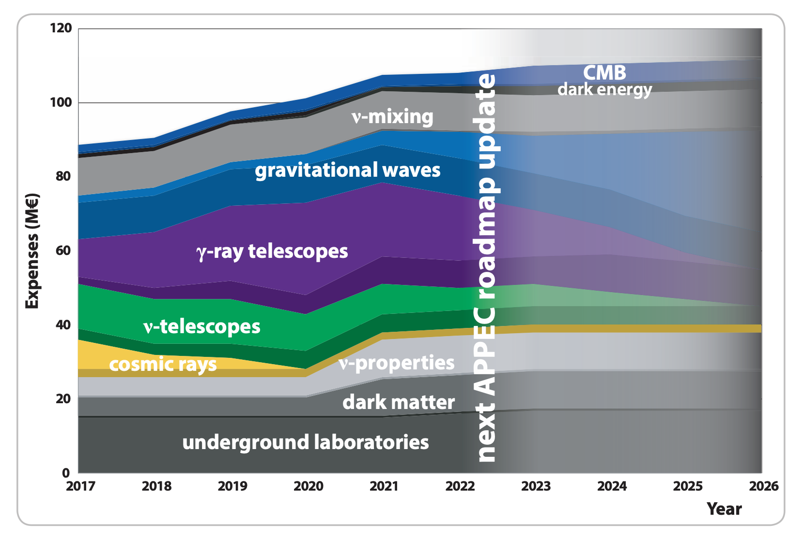
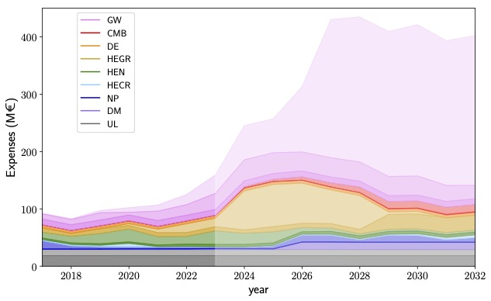
Expenses projection
Census has been sent out
To: - experiments’ spokes
- lab directors
Thanks to Maria Haupt, Katharina Henjes-Kunst, Tim Heinl, Julie Epas, Andreas Haungs, Job de Kleuver
A lot of work !!!

Slide 3
Old expenses projection

Slide 4
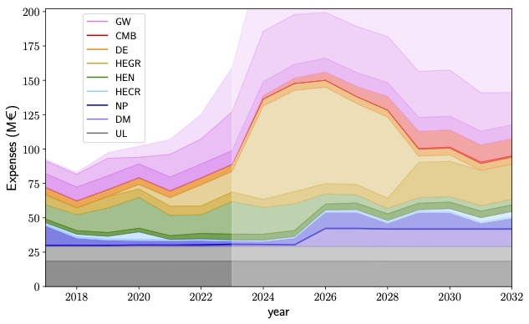
New expenses projection

Slide 5
Comparison of UL expenses projection
UL Extra: investment

Slide 6
Comparison of DM expenses projection
DM investment delay

Slide 7
Comparison of ν properties expenses projection
No more DUNE
0νββ delay

Slide 8
Comparison of HECR expenses projection
GRAND/GCOS
Auger upgrade delay

Slide 9
Comparison of HEN expenses projection
KM3NeT more secured + IceCube NextGen

Slide 10
Comparison of HEGR expenses projection
CTA exploitation
CTA investment delay

Slide 11
Comparison of DE+CMB expenses projection
LiteBird & Gen4

Slide 12
Comparison of GW expenses projection
ET investment from regular funding agencies
ET exploitation
ET pathfinder

Slide 13
GW expenses projection
ET investment from
exceptional sources
ET investment from regular funding agencies
ET exploitation

Slide 14
Next steps
We now go through the midterm update text (again)
The GA adopts the APPEC European Astroparticle Physics Strategy 2017-2026 – mid-term update text and expenses plot
A presentable version with pictures is prepared by the Joint Secretariat and sent for your approval (by email?)
Proper communication around the public launch of the midterm is organised by the joint secretariat (and executed after your approval)

