Slide 1

OAQ training
Including a little bit of Carpenter training
F. J. Mangiarotti, 2023.03.27

Slide 2
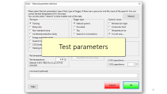
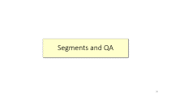
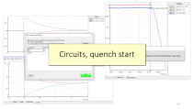
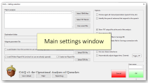
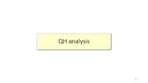
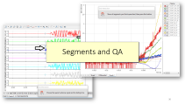
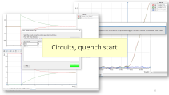
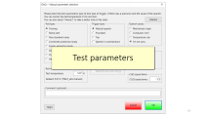
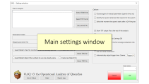
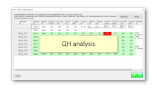
Topics
What is OAQ?
How to use OAQ?
  Main settings
  Circuits, quench start, and QH induced quench start
  Test parameters and precursor
  Quenching segments and quench antenna
  QH analysis
OAQ output and relationship with Carpenter

Slide 3
What is OAQ?

Slide 4
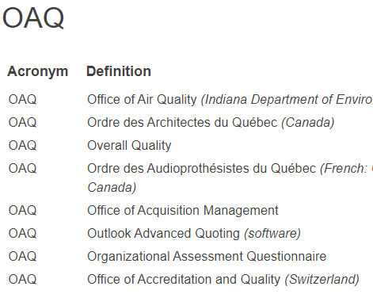
What is OAQ?
OAQ stands for Operational Analyzer of Quenches.
It is the software we use after every quench or quench-like event to process data in a uniform manner.
Its purpose is to be fast and easy to use. It is not meant to be the only or last analysis of the quench data.
https://acronyms.thefreedictionary.com/OAQ

Slide 5

Why are we even doing this training?
Since OAQ is the entry point for quench data into Carpenter, we need to make sure we all use the same conventions to have consistent processed data
We can fix the data once it is in Carpenter but it’s more difficult :/

Slide 6
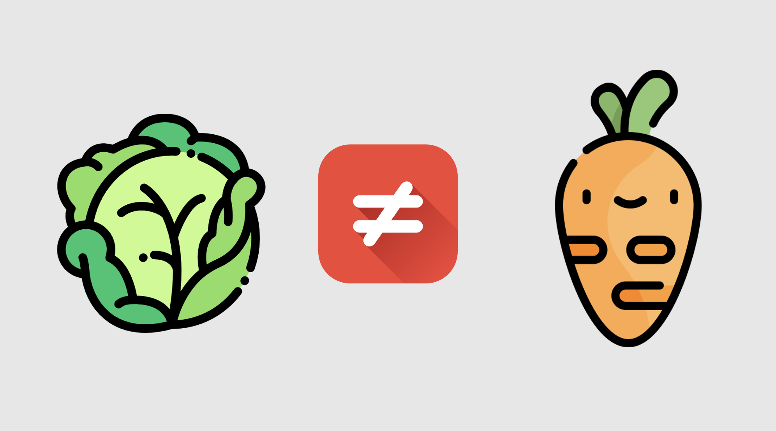
Why are we even doing this training?
Since OAQ is the entry point for quench data into Carpenter, we need to make sure we all use the same conventions to have consistent processed data
We can fix the data once it is in Carpenter but it’s more difficult :/
https://fr.wiktionary.org/wiki/comparer_des_choux_et_des_carottes

Slide 7

For which files do we do OAQ → Carpenter?
Any file that matches one of the following criteria:
  There was a quench
  Energy extraction was used with current in the magnet
  Magnet QH were used
  CLIQ was used in the magnet
Don’t put:
  Zero current “noise” checks
  QH firing into dummy QH

Slide 8
How to use OAQ?

Slide 9
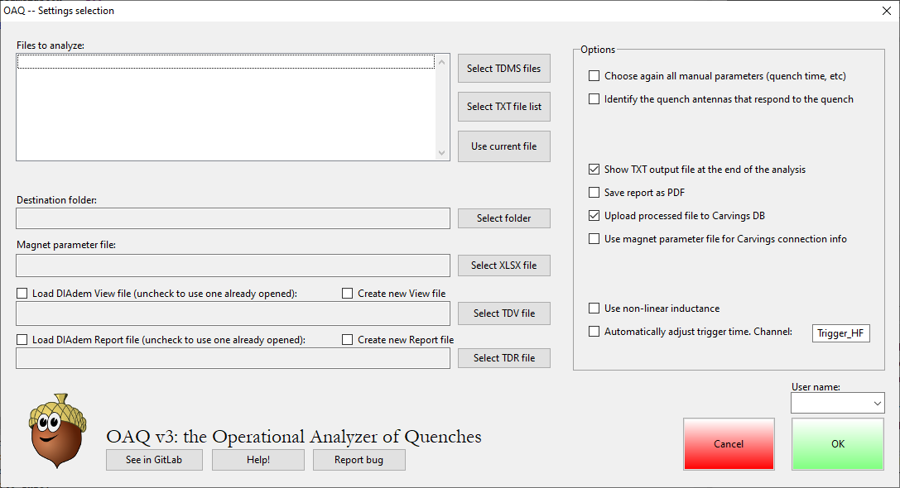
Main settings window

Slide 10
Here you can select the files to analyze.
Options:
Select one or more TDMS files, all in the same folder
Select a text file with a list of files (including file path). The files must be for the same magnet because OAQ will use only one parameter file, but they can be in different folders
The currently open file

Slide 11
After selecting the files, OAQ will automatically propose a destination folder and a parameter file. If you want a different you can change it.
You can also load or create a DIAdem view or report, and OAQ will automatically propose (but not automatically load) views or reports if it finds them in the proper folder.

Slide 12
You can select some analysis options as well:
Choose again all manual parameters: OAQ will always try to find an OAQ file from a previous analysis, to re-load the manual parameters such as quench time, segments, test parameters etc. If you want to update them, select this option.
Identify the quench antennas that respond to the quench: if you check this option, you will be asked to select which quench antennas react to the quench. It is not selected by default because there is no automatic way of detecting that quench antennas are present. Example later.

Slide 13
These are output options:
Show TXT output file at the end of the analysis: it does what it says. It can be a good idea to disable if you are running many files.
Save report as PDF: if you have a report template (either that you created or automatically generated by OAQ) you can ask OAQ to update it and save it as PDF at the end of the process.
Upload processed file to Carvings DB: this is used to automatically try to upload the output TXT file to the database behind Carpenter. It works if (a) the magnet name in the DAQ file is the MTF name, and (b) the Carpenter test plan is ready to input a quench or protection study. If these are not true, you can use the next option.
Use magnet parameter file for Carvings connection info: this is to upload the output file to the database behind Carpenter using the information (testplan ID, magnet name, thermal cycle, etc) from the parameter file.

Slide 14
Special options:
Use non-linear inductance: OAQ calculates stored energy and magnet resistance, based on the measured current and voltage, and the inductance provided as input in the parameter file. If you want to use non-linear inductance (as opposed to a constant value) check this – and make sure to specify the non-linear inductance formula in the parameter file!
Automatically adjust trigger time: this was useful when the trigger signal was corrupted. It calculates a “normal” band from the data start until t=-10 ms and determines the trigger moment as the moment when the signal deviates 1 % above the maximum or below the minimum of the band. Hopefully, this is not needed anymore…

Slide 15
Bottom buttons:
See in GitLab: to see OAQ’s GitLab page.
Help!: it will bring you to the “readme” in GitLab. This file has (or should have) the same information as this presentation. I try to update it whenever there is a major change.
Report bug: this will let you report a bug in the GitLab page. It’s useful because that way I remember if I don’t do it right away. I recommend that you also tell me directly ☺
Username: here you must select your name to continue the analysis. If your name does not appear here, please let me know and I’ll fix it.
OK: start the analysis
Cancel: abort the analysis

Slide 16
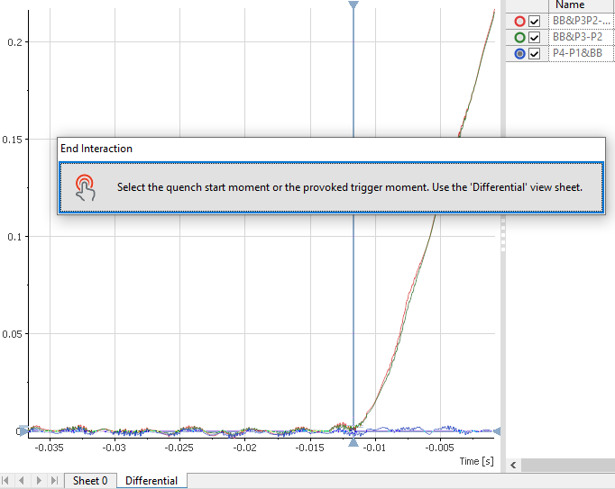
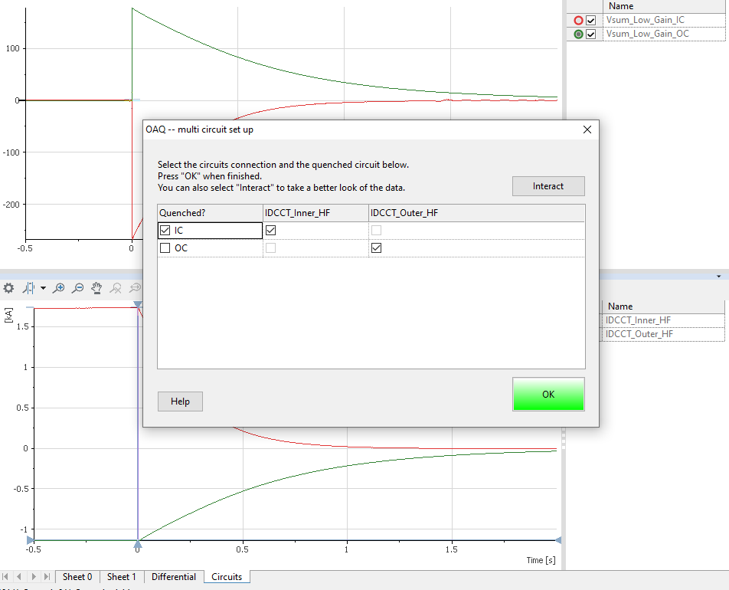
Circuits, quench start

Slide 17
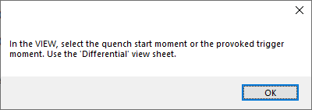
Here you select the quench start moment.
If in doubt, take the conservative approach (i.e., more to the left)
This time is afterwards used to calculate the quench integral from quench, and the time from quench start to detection.

Slide 18
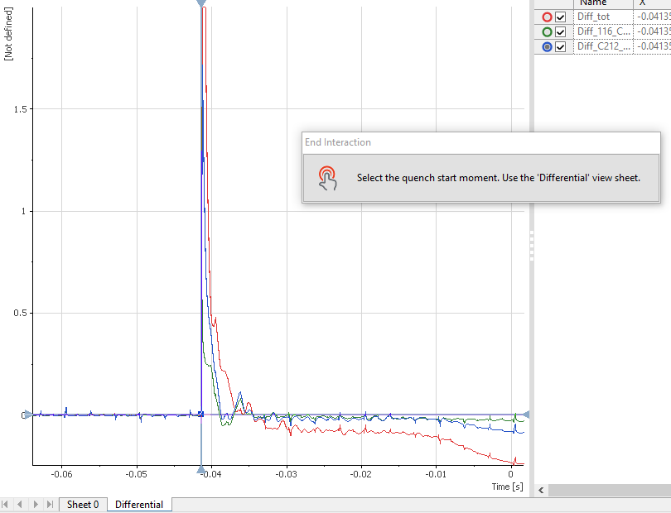
For a QH induced quench, select the QH firing moment as the most conservative option.

Slide 19
If you have more than one circuit, you can select which one quenched. You can Interact to check if your choice is correct.
Also, if changing the power converter is allowed, here is where you need to define it properly (example: D2 cryomagnet)

Slide 20
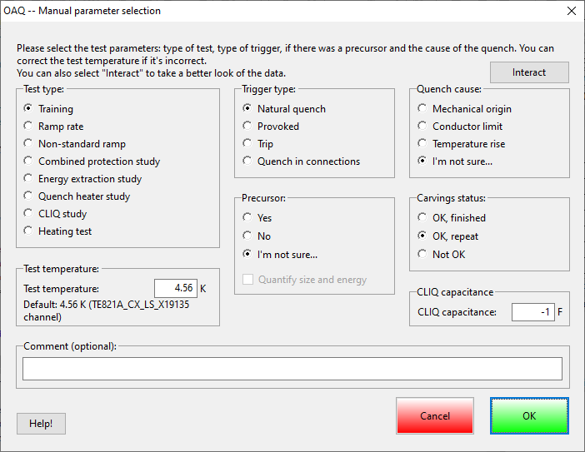
Test parameters

Slide 21
By pressing “Interact”, the dialog closes and you can look at the data directly, using the DIAdem view or other tools.
Afterwards you will return here

Slide 22
Test type gives an idea of what was the purpose of the test
Training: this was a standard ramp to quench at nominal ramp rate.
  This includes quenches which are not technically training, for example if a limit is reached
Ramp rate: same as above but at different ramp rate
Non-standard ramp: this is for ramps that are not straight. For example: VI measurements, quenches during holding current, etc.
Combined protection study: a protection study using more than one protection mechanism
EE, QH and CLIQ study: tests performed to study a single protection mechanism.
  Tests that include more than one mechanism but only focus on one should be here (example: QH delay test using QH and EE for protection after the quench is detected)
Heating test: a quench that was provoked by for example AC losses, DC heating, spot heaters…

Slide 23
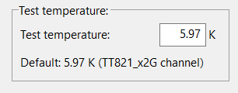
Test temperature:
OAQ will try to automatically find, with the following rules:
OAQ will look for the last channel in LF_f1 called “TT821” without the word “range” in them.
Otherwise OAQ will look for the last channel in LF_f1 with analysis property “Cold_mass_temperature”
If all that failed, OAQ will try to guess from the extension: “na”, “pa” is 4.5. “a”, “b”, “c”, “d” is 1.9
The user can then change the value. I highly recommend you check because many times there are mistakes (such as the example below!)

Slide 24
Trigger type tells you what happened
Natural quench: there was a spontaneous quench in the magnet
Provoked: a person went and pressed a button to provoke a quench
Trip: there was no quench, just a protection system trip (examples: flux jump, water loss, LHe level loss, wrong thresholds)
Quench in connections: there was a spontaneous quench in the connections (including for example busbars and current leads)

Slide 25
Here you can select if there was a precursor. If you select “I’m not sure”, nothing will be recorded.
If you select “Yes” you can choose to quantify the precursor. This will open a new window after you click OK here.

Slide 26
Quench cause:
Mechanical origin: typically, a movement or vibration
Conductor limit: typically, when many quenches are at the same level, with the same signature, etc
Temperature rise: something caused the magnet to heat up (heaters, AC loss, the magnet temperature went up because pumping stopped…)
I’m not sure: nothing will be recorded. Best option if you are not sure – we can always go back and fill out the empty ones

Slide 27
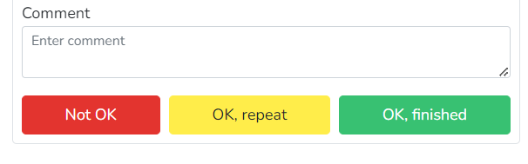
Carving status: equivalent to pressing the red, yellow or green buttons in Carpenter:
Remember to use “Not OK” if there were big problems!
Examples: short circuit, broken QH.
CLIQ capacitance: only enabled for quenches where CLIQ is automatically detected. Remember to put the value in Farads!

Slide 28
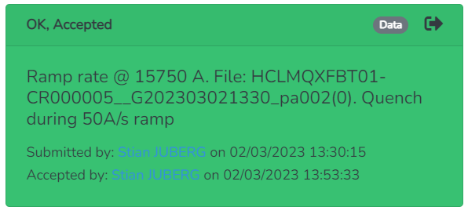
The comment (if any) will appear in Carpenter right after the automatic comment. It’s best to put it here than in Carpenter to make everything smoother.
The Help button will bring you to the GitLab readme page, to the section dedicated to this part.
OK to continue, Cancel will leave all these fields empty

Slide 29
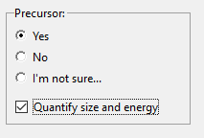
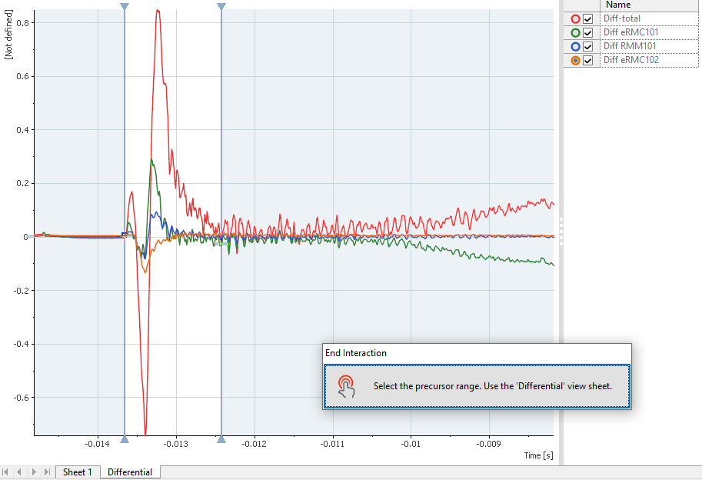
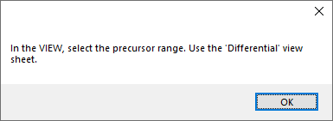
If you chose to quantify the precursor, OAQ will ask you to select the precursor range.
OAQ then calculates the peak voltage and the precursor energy (integral of V*I).

Slide 30
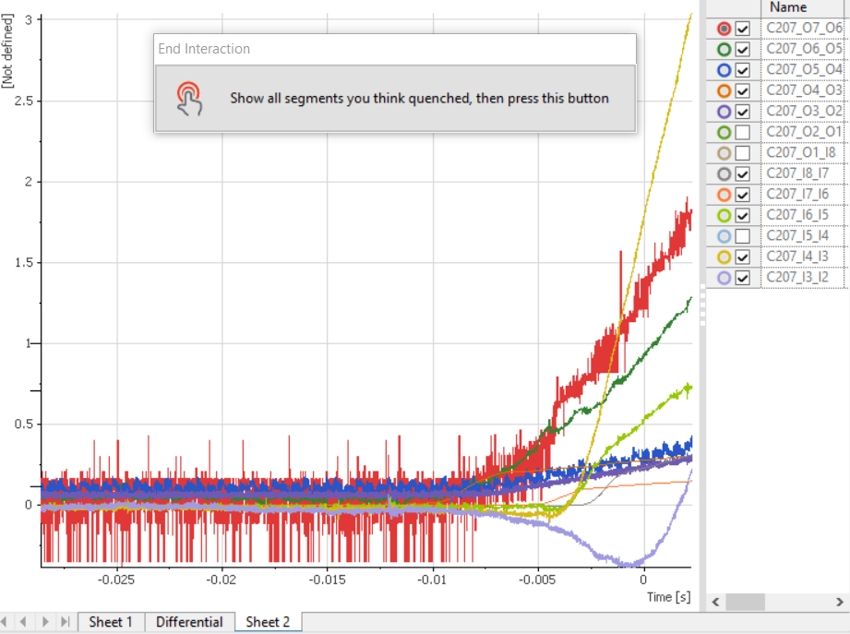
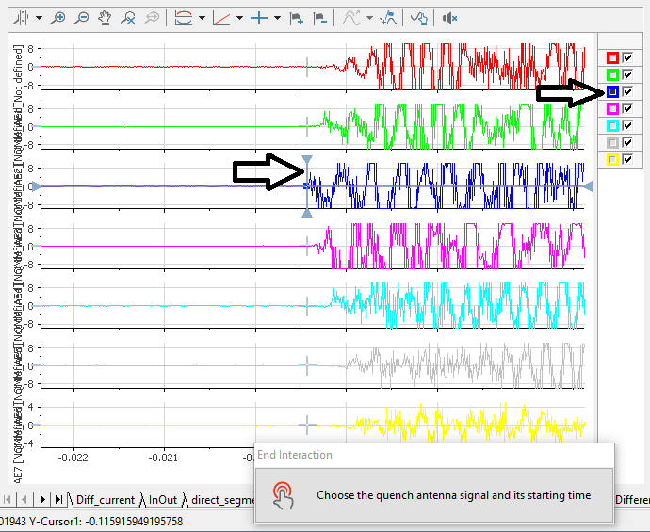
Segments and QA

Slide 31
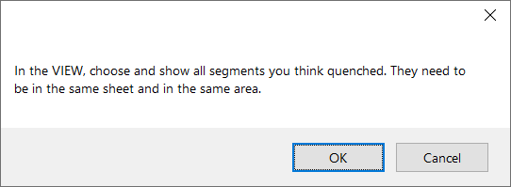
Now you need to select the segments you think quenched.
OK to continue
Cancel to skip, nothing will be recorded, and the analysis continues
This step is skipped if you choose the trigger type “provoked” or “trip”

Slide 32
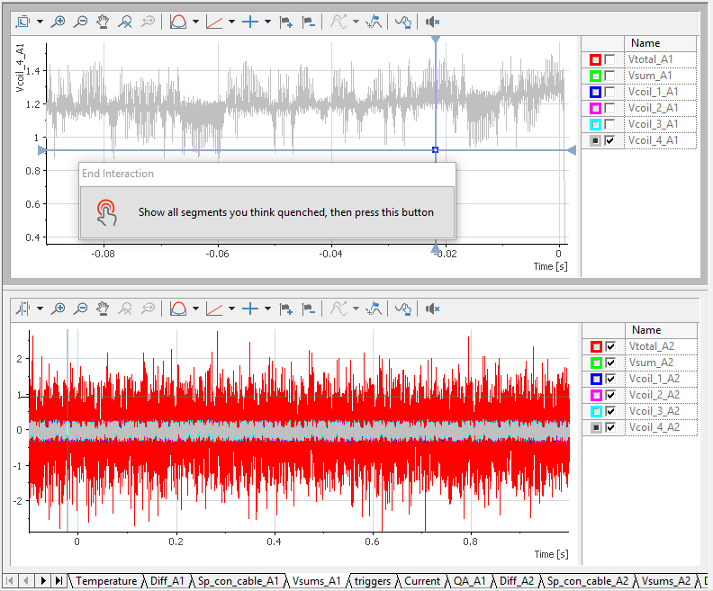
In this example the quench was in Vcoil_4_A1. See that the top area is selected (gray rectangle, cursor highlighted) and only one signal is visible.
OAQ will not use the bottom area because it’s not selected.

Slide 33
In this example many segments quenched, and we leave them all selected.
Note that we don’t include the coil voltage because we have the small segments

Slide 34
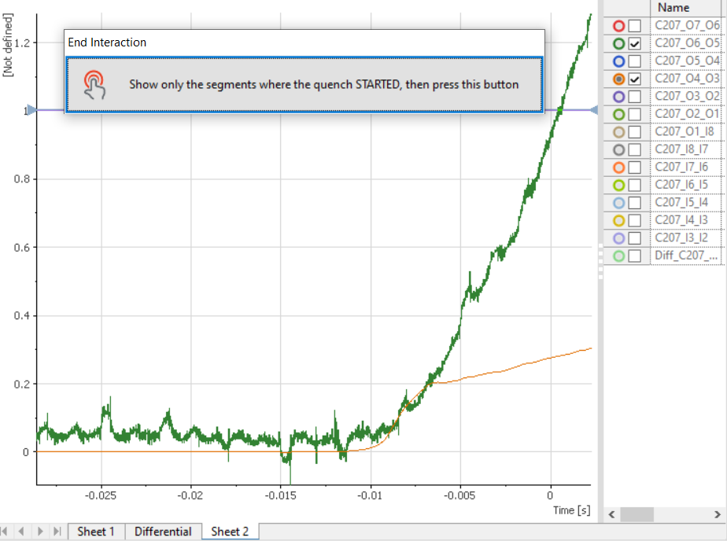
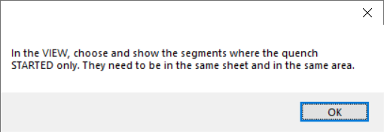
This is the same example as previous slide.
If you select more than one segment, OAQ will then ask you where the quench started. This can still be more than one segment (but typically fewer than before)

Slide 35
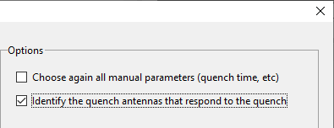
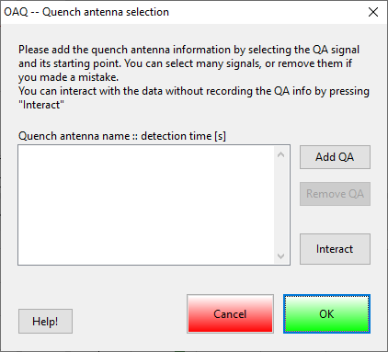
For the quench antenna selection: you get this dialog to select as many QAs as you want.
Add QA lets you add a new quench antenna (see next slide)
You can remove a QA that you added mistakenly by Remove QA
Interact lets you look at the data without changing the selected QAs
Help will bring you to the GitLab readme page
Cancel to abort (nothing gets saved)
OK to save and continue

Slide 36
When you press Add QA, you go to the View. You need to select here the signal and position the cursor at the start time.
Only select the first QA(s) to react. If there are two segments that react at the same time, you need to Add QA twice.
If many signals in the same segment react simultaneously, choosing the largest is enough.
The objective is to have the longitudinal localization of the quench.

Slide 37
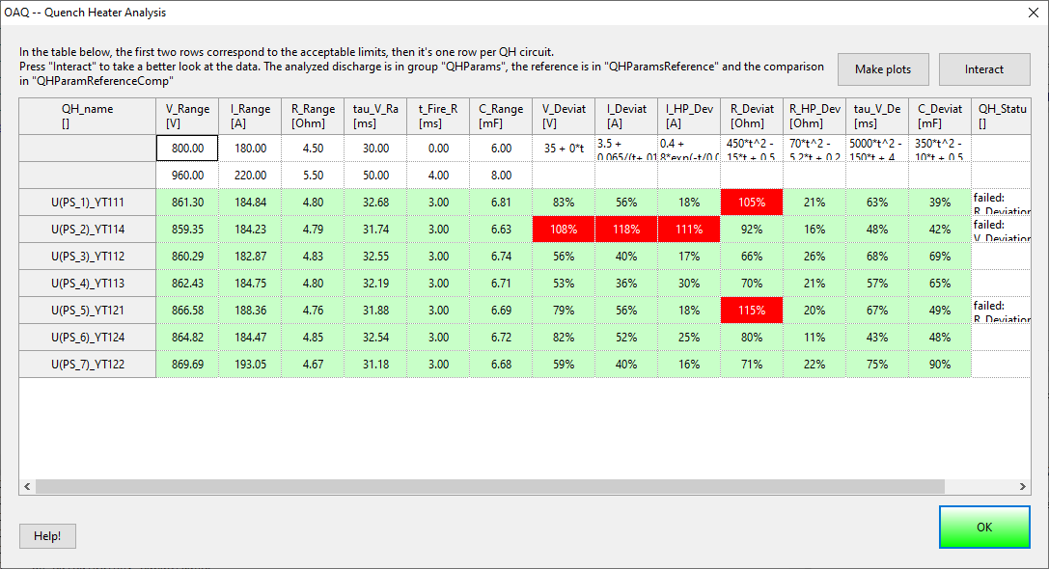
QH analysis

Slide 38
This table is for information, no action required. You can interact as normally or make automatic plots (see next two slides).

Slide 39
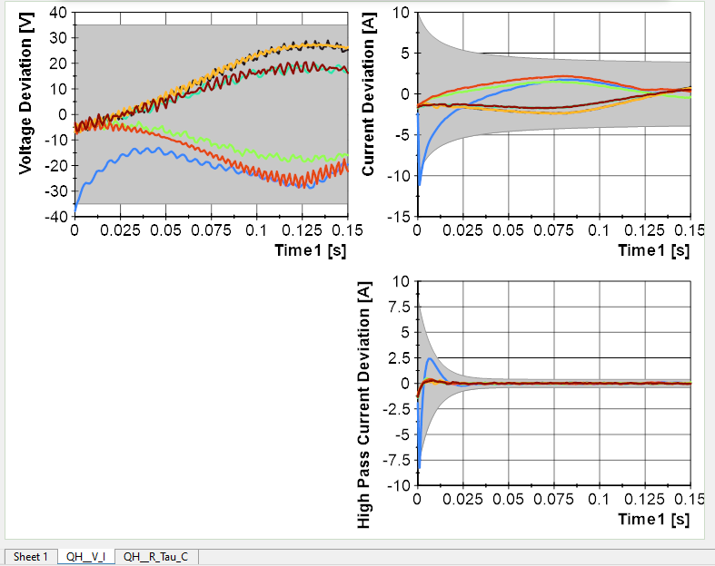
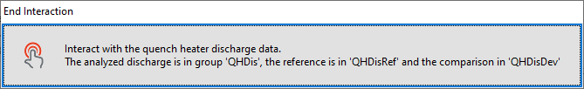
Deviation means voltage/current/etc in this test minus the reference voltage/current/etc.
High pass plots let you see if there are spikes – these could indicate some problem like QH breakdown.
Here, the blue is slightly outside the bounds at the start probably because it was not fully charged.
Current deviation is useful to detect problems at the end of the decay.

Slide 40
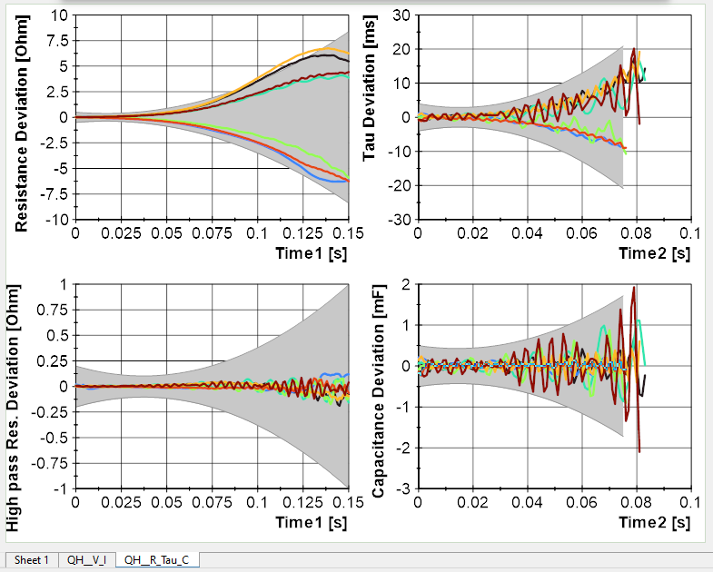
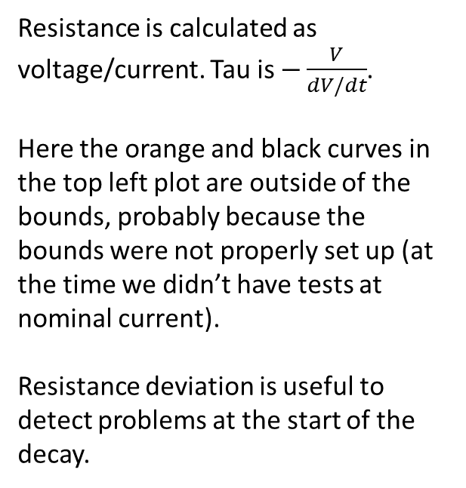
Resistance is calculated as voltage/current. Tau is $−\frac{V}{dV/dt}$.
Here the orange and black curves in the top left plot are outside of the bounds, probably because the bounds were not properly set up (at the time we didn’t have tests at nominal current).
Resistance deviation is useful to detect problems at the start of the decay.

Slide 41

OAQ and Carpenter

Slide 42
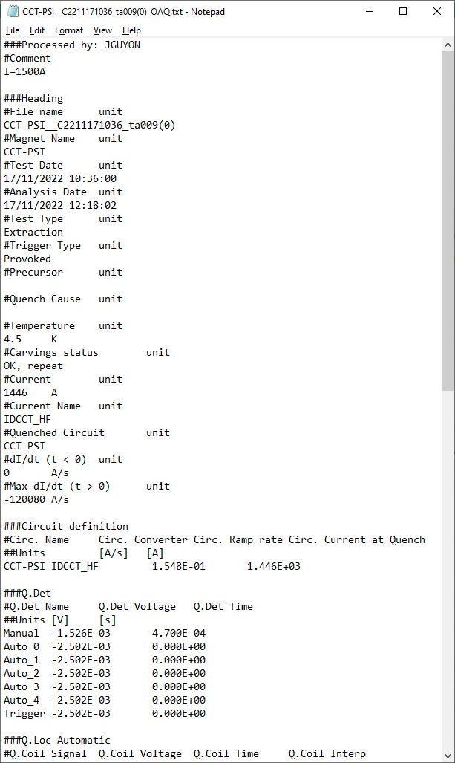
OAQ output
OAQ outputs a text file, typically saved in:
MTB_meas\ANALYSIS\[magnet name]\OAQ\
After an OAQ analysis, all the calculations are kept in DIAdem, so for example you can go back and look at the magnet resistance vs time, or the QH capacitance, etc.
The OAQ text file is the input for Carpenter

Slide 43
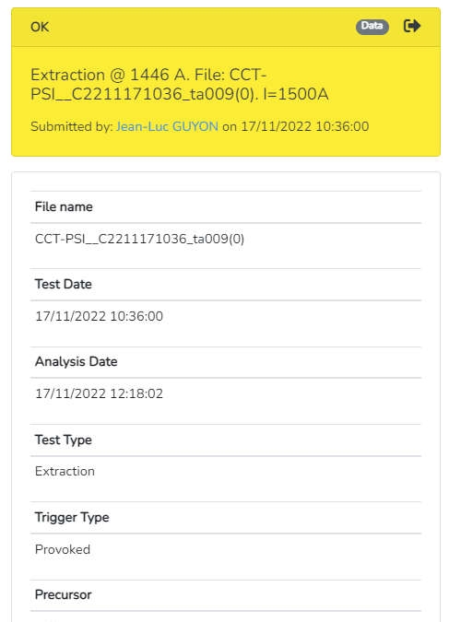
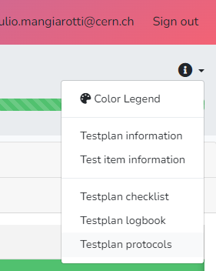
OAQ data in Carpenter
You can see the data for each testplan by clicking the result.
All the files are used for automatic plotting via the Protocols, filtering by:
  Temperature (user input)
  Trigger type (user input)
  Quench location (user input)
  Ramp rate (calculated)

Slide 44
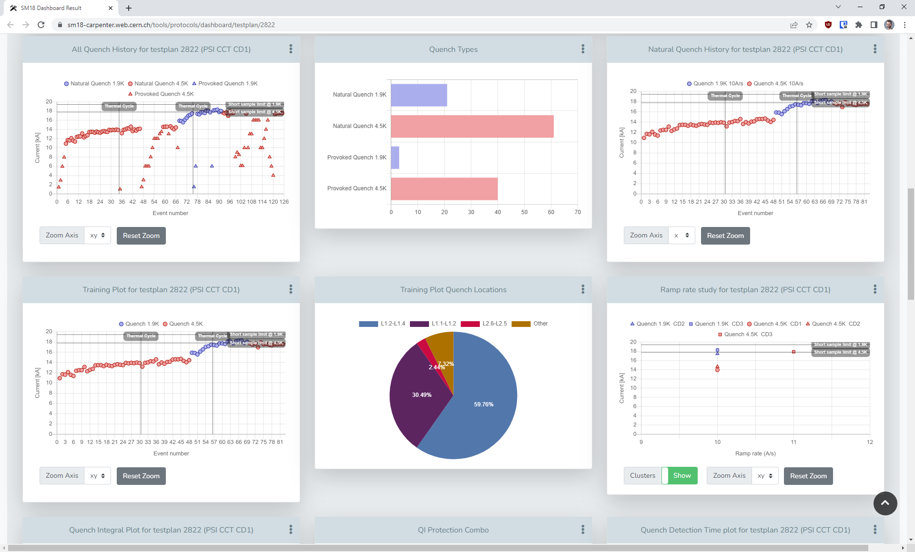
Protocols

Slide 45
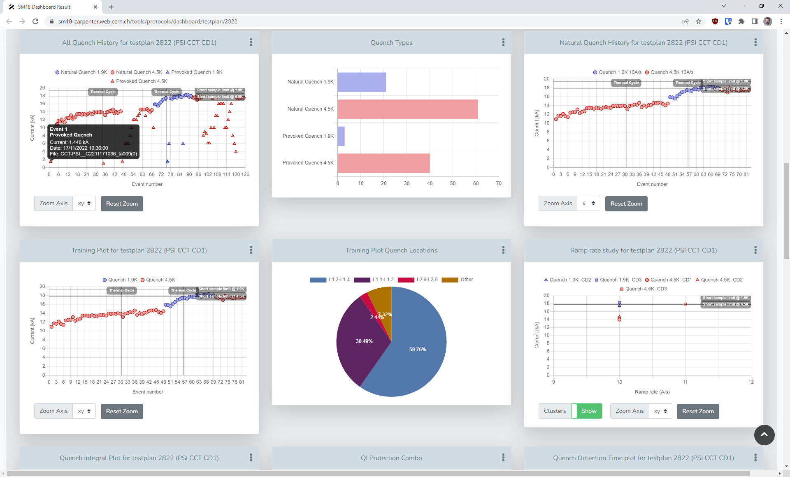

Slide 46
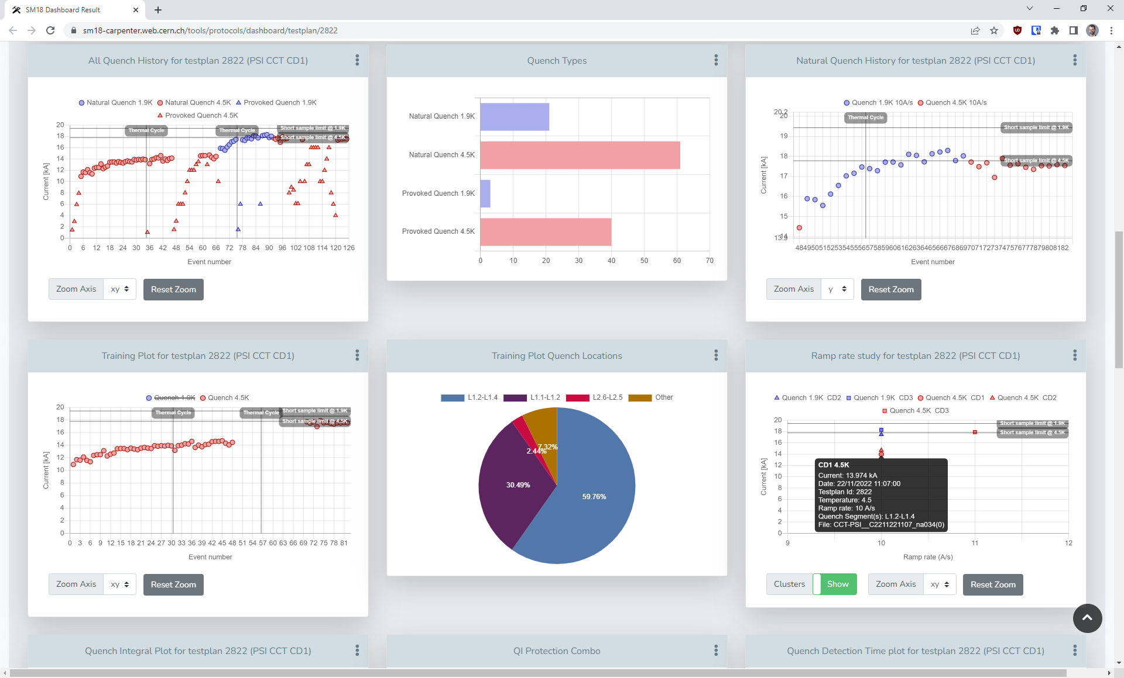

Slide 47
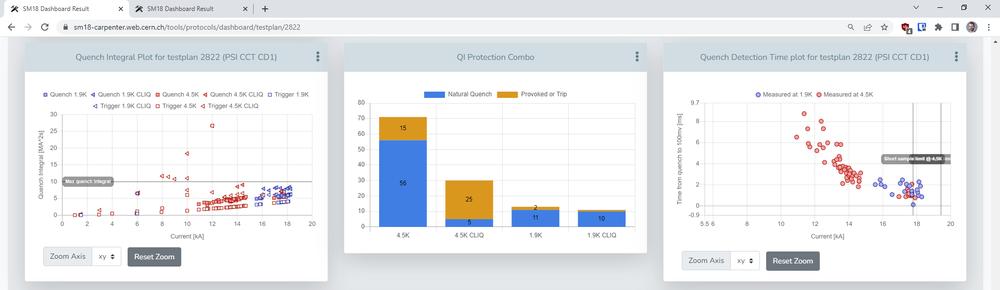
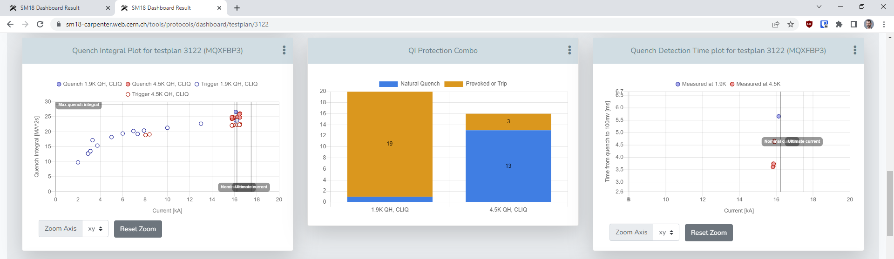

Slide 48

End

Slide 49
Appendix: files used as examples
Multi circuits:
HCMCBXFB012-E5000001__G202210111058_a007(0)
Precursor quantification:
CRMHRMM_M001-CR000011__C2112061409_a009(0)
Many quench segments:
HCMQXFM001-CR000078__C2302280941_a001(0)
QH analysis:
HCLMQXFBT01-CR000004__G202209071633_na040(0)

