Slide 1
RENOVATION OF THE B60 - PRESENTATION OF THE PROJECT TO NEIGHBOURS
Z. Arenas & V. Ricodeau
04/04/2023 EDMS- 2874893

Slide 2
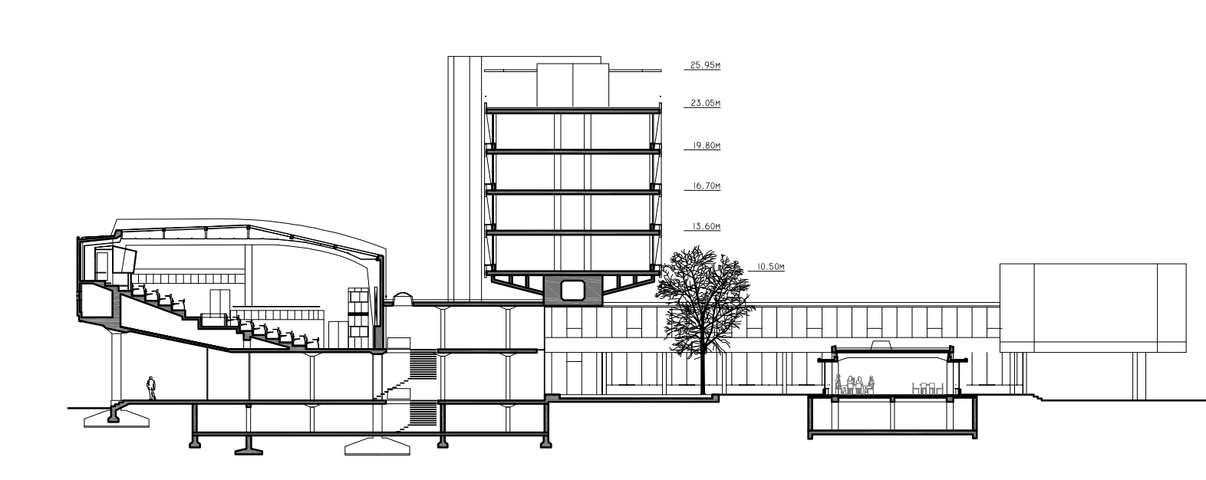

Global Picture
SCHERRER ROAD
BUILDING B60
MAIN BUILDING

Slide 3
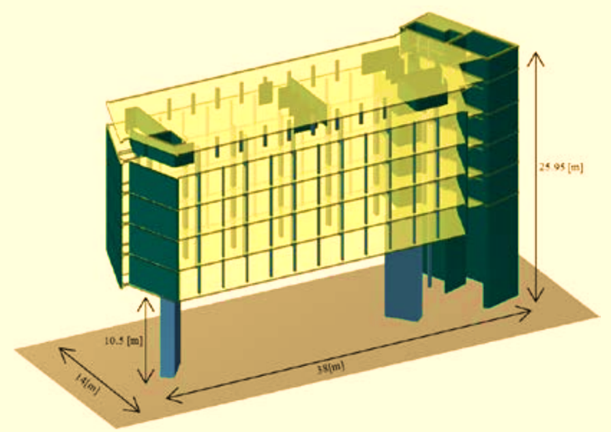
Key
Facts
CHARPAK ROOM
Built in 1959 (Charpak room added in 1975)
Exceptional architectural value (Swiss Architect Steiger)
Unusual structure bridge-like
Asbestos is the major hazard
Fire safety non-compliance hazard
No thermal insulation
BRIDGE

Slide 4
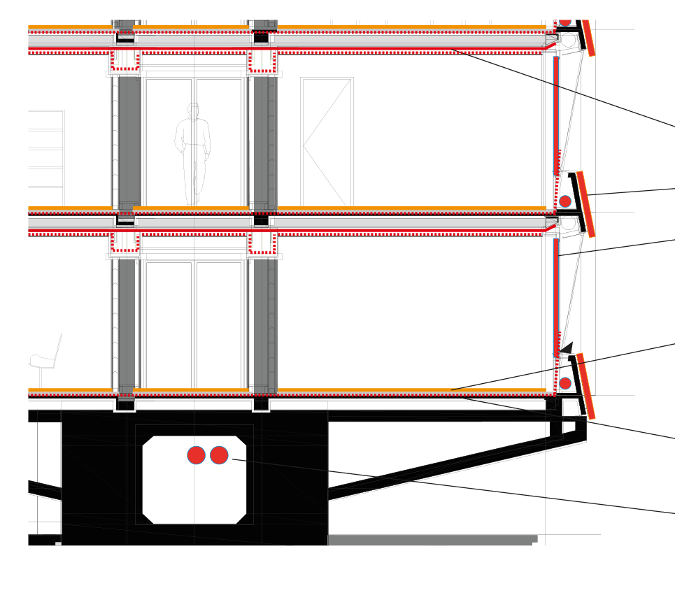
Environmental remediation Strategy
Constraints due to asbestos contamination
  Impossible to renovate with operation of offices
  Full asbestos cleaning calls for full interior demolition
  Keep only the structural elements
Asbestos
4

Slide 5
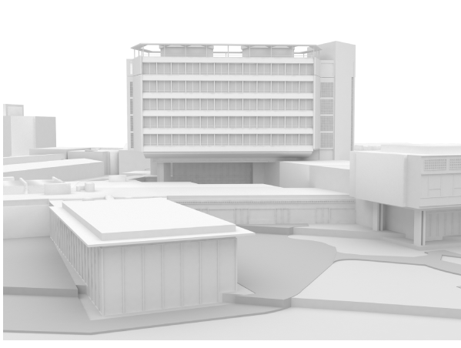
Rehabilitation Strategy
Rehabilitation Specs
  Consideration of original architectural features
  Adding an additional level (Charpak room enlargement)
  Reconstitution of the original Attic (Sun breaker)
  Technical rooms on the roof
Project: Restore the original image of the building’s
5

Slide 6
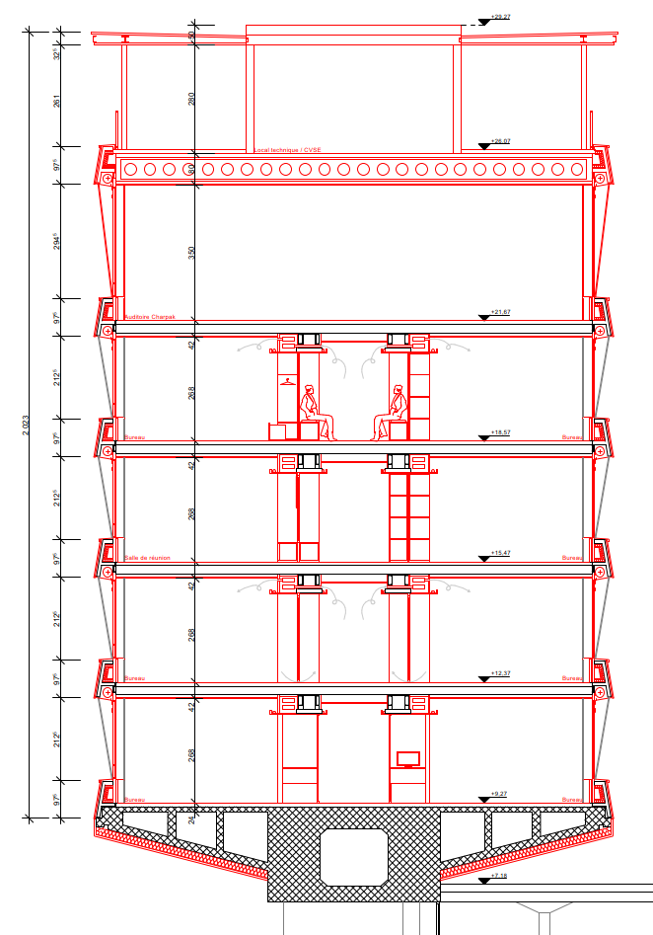
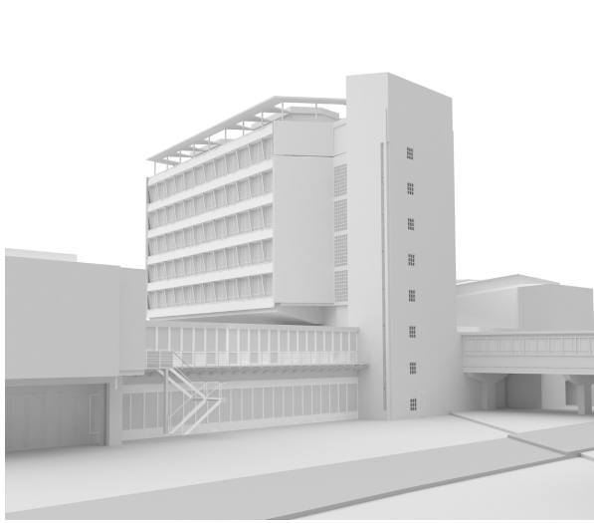
Project: 4 levels + Charpak + Technical rooms
Project: Restore the original image of the building’s

Slide 7
Nominal
Schedule
2023
2024
2025
Project:
  Works in building B60 : 2,5 y
  Asbestos intervention: 10 m : April – November 2023
  Design and tender: 11 m : April – December 2023
  Rehabilitation: 18 m : 2024 – mid-2025
S1 | S2 | S1 | S2 | S1 | S2
 |  |  |  |  | Available

Slide 8
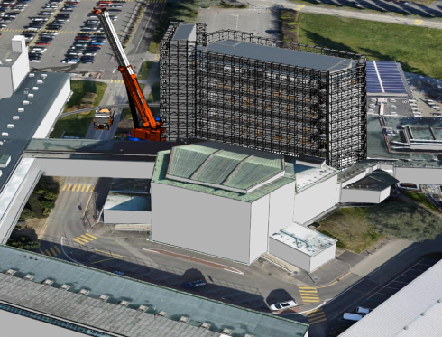
Methodological Strategy
  Next presentations :
  Information:
  Asbestos topic – O. Prouteau
  Works-related nuisances:
  Circulation inside and outside the main building – VR
  Building containment (Asbestos related) – V. Ricodeau
  Work-related noise – V. Ricodeau
R+1
8

