Slide 1
RENOVATION OF THE B60 - PRESENTATION OF WORKS-RELATED NUISANCES TO NEIGHBOURS
Z. Arenas & V. Ricodeau
04/04/2023 EDMS- 2874893

Slide 2
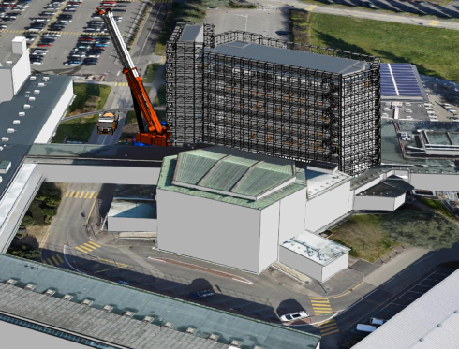

Methodological Strategy
Maintain operational the campus services and offices in the ground floor: UBS bank, kiosk, CAGI cultural kiosk, UNIQA, CWT travel agency, Users’ Office, Staff Association and restaurant, etc.
Disruption to the Main Building complex and its surroundings will be kept to a minimum:
  Circulation inside and outside
  Works-related noise
R+1
2

Slide 3
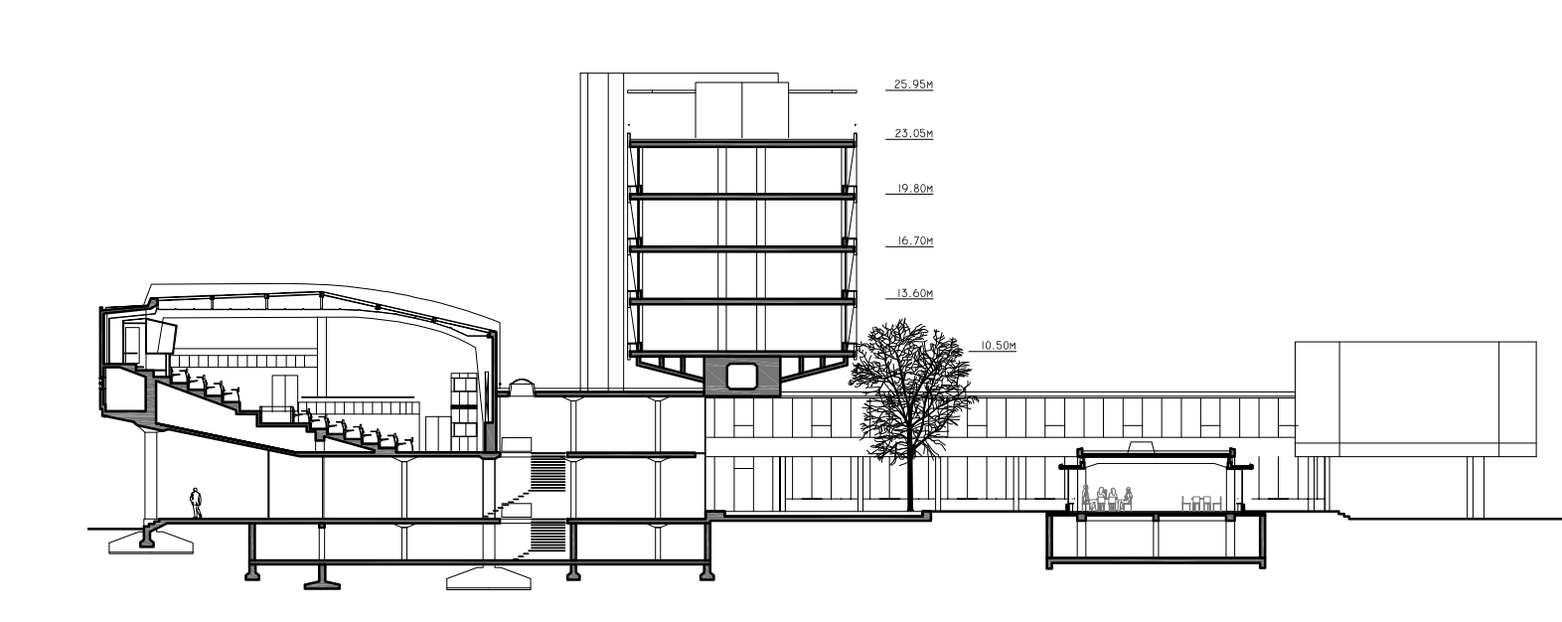
  Presentation of the modifications for the whole duration of the works (Next slide)
3

Slide 4
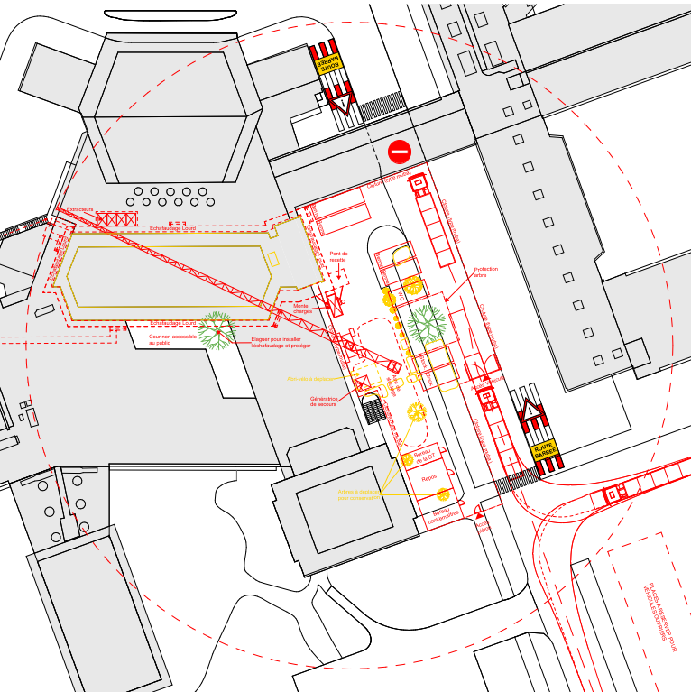
Circulation outside
The main building
  Modifications for the whole duration of the works:
  Route Scherrer will be closed
  Traffic will be diverted onto the Routes Curie and Bohr
  Drop-off by car and parking limited to 30 minutes
  U-turn in front of the former post office
  CERN shuttle will not stop at Building 500, substituted by the B39 stop (then walk to the Main Building)
  North bike shelter (user office) closed and replaced by the bike bicycle garage
4

Slide 5
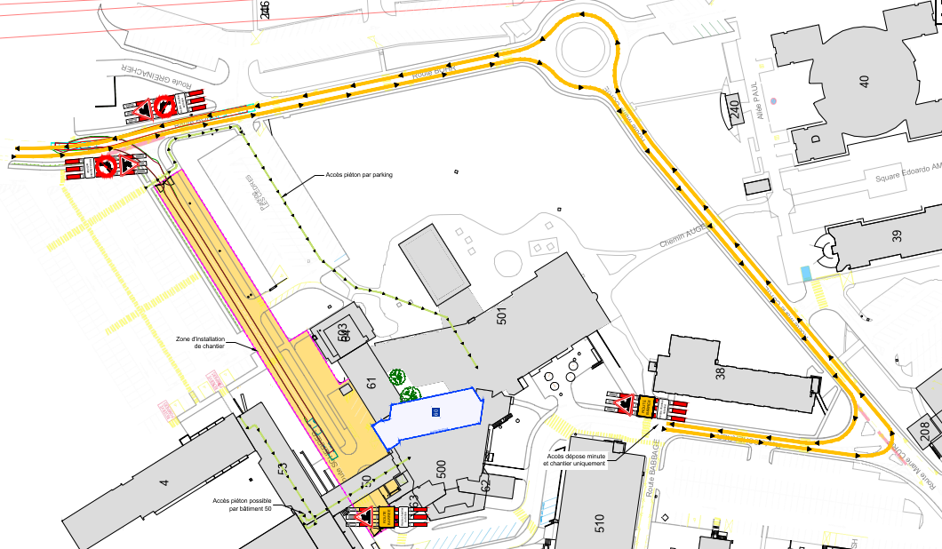
Traffic diversion
Including shuttles
shuttle
5

Slide 6
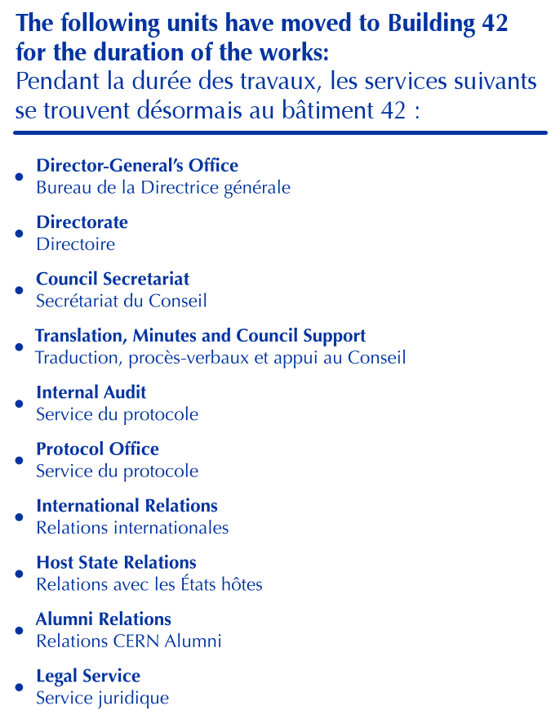
Circulation inside the Main building
  Modifications for the whole duration of the works:
  The DG unit and staff have moved to the B42
  The B60 will be closed, including chapak room, the stairwell and lifts
  The lifts in Buildings 3, 52 and 53 will replace the B60 lifts
  Connection to the others buildings via the building B50 bridge
  Disabled people will use the existing wheelchair ramps and the toilets in the basement
6

Slide 7
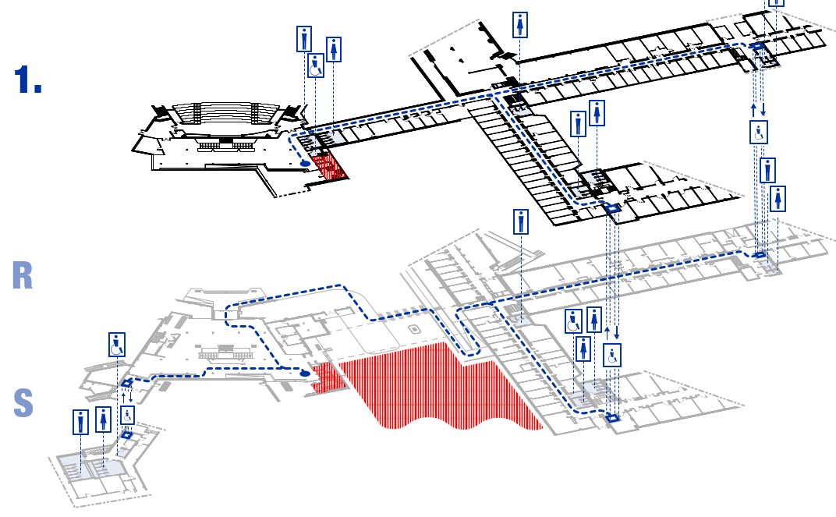
B50 bridge
7

Slide 8
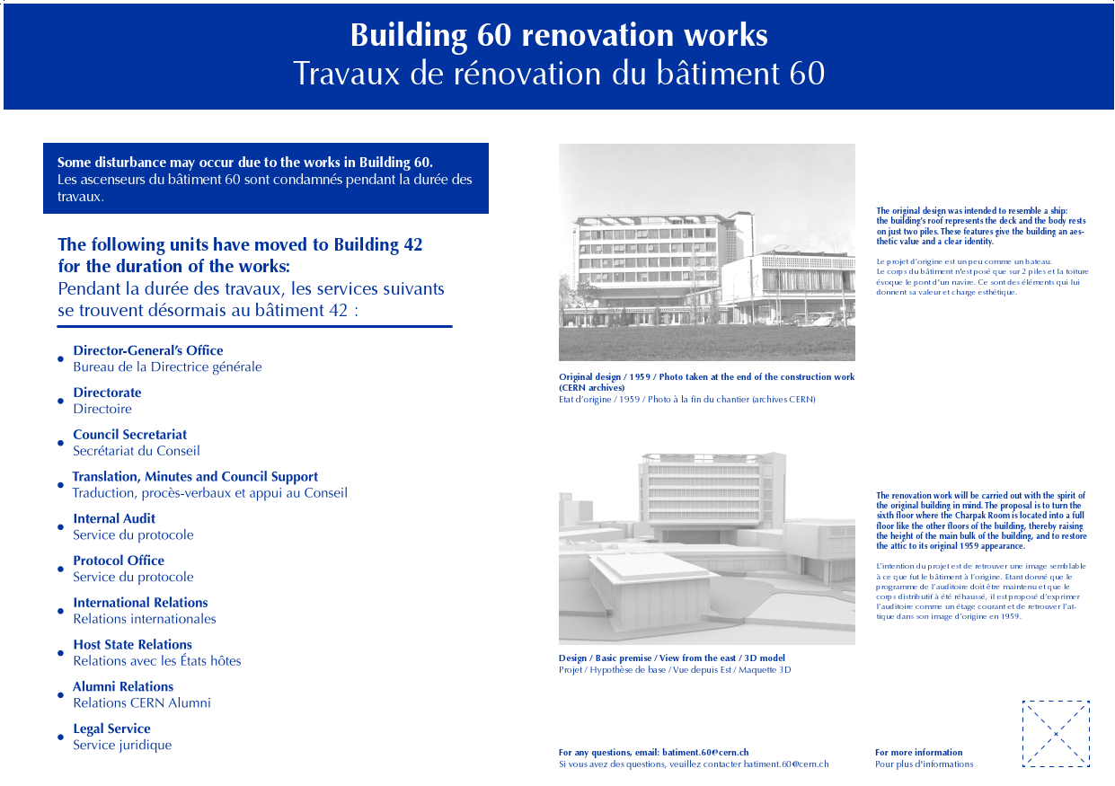
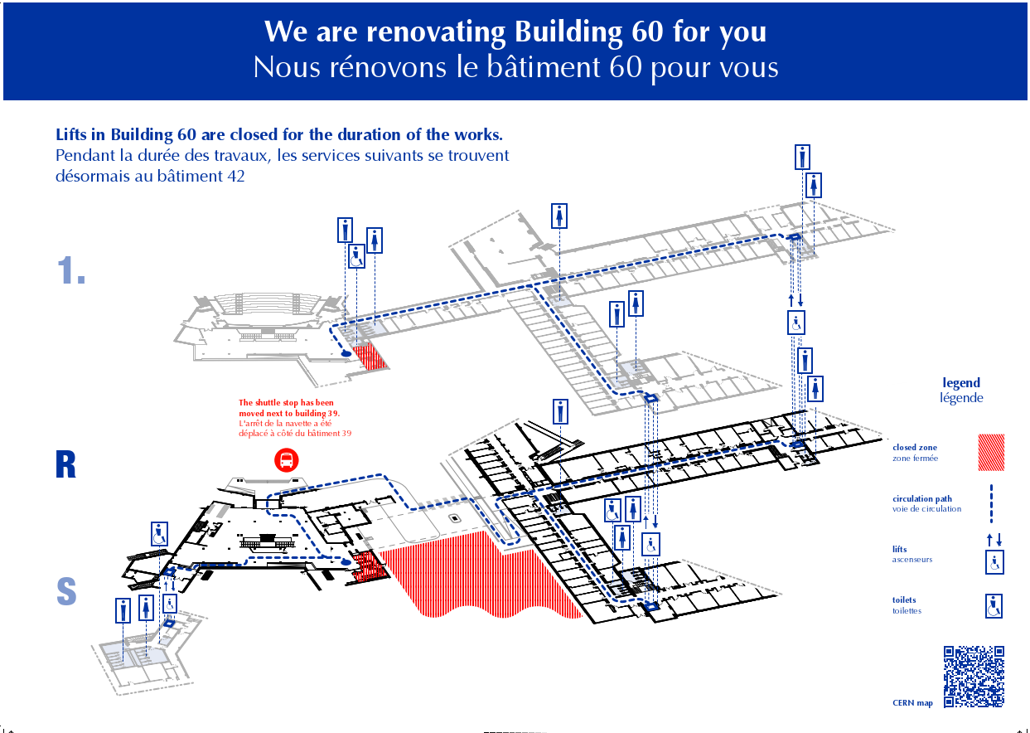
  Example of communication panels that will be display in the main builidng:
  Informational panel
  Circulation panels
8

Slide 9
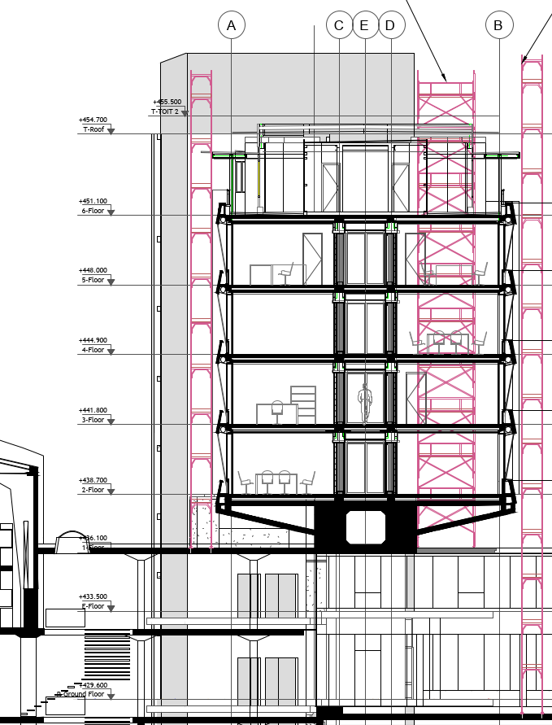
Work-related Noise
V
Noise from extractors for the building containment working H 24/24 from may to September 2023 (Cf. blue “V”)
Noise from remediation and demolition works (concrete demolition noise in the light blue zone)
V
V
V
The area will be noisier than usual during the first demolition phase (May to September 2023): Measures are being taken to limit disruptions around B60
The noise level is very difficult to estimate, so the neighbourhood will be informed regularly
An email contact will be available for any demands

Slide 10
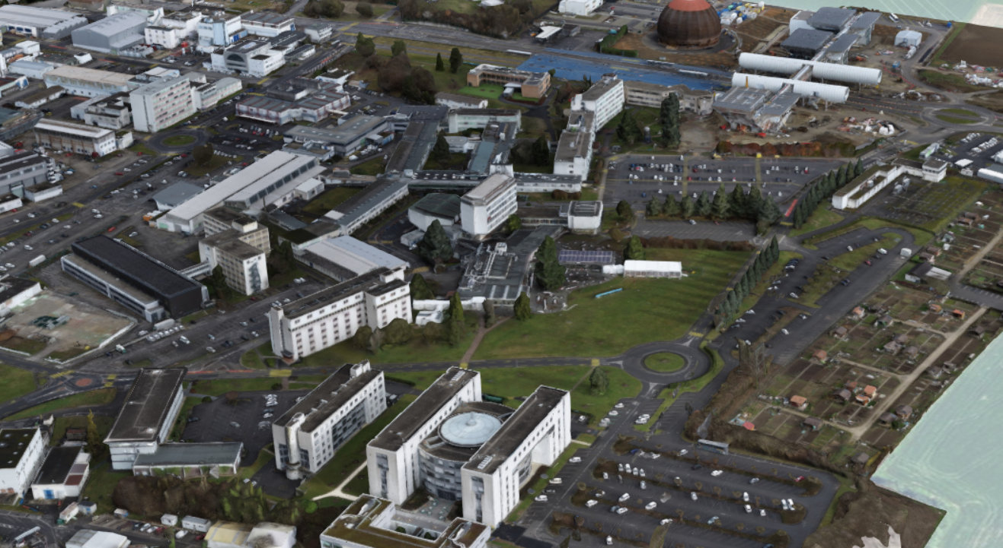
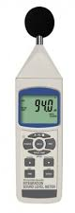

  Measurement of noise levels by HSE-ENV

Slide 11
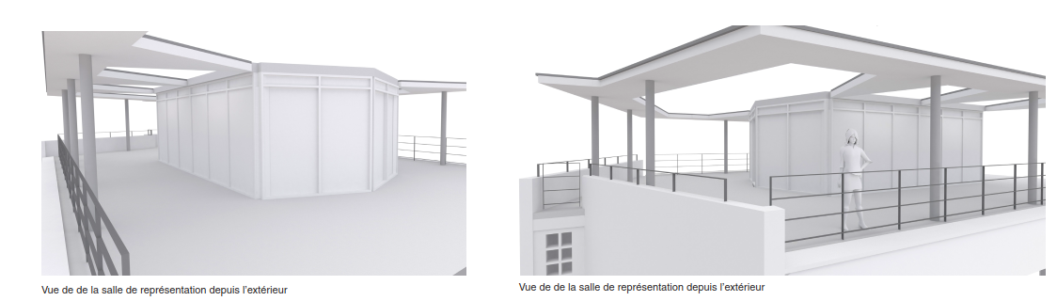
Questions
Answers ?

