Slide 1
LHCONE saturation analysis
Katy, 26/04/23

Slide 2
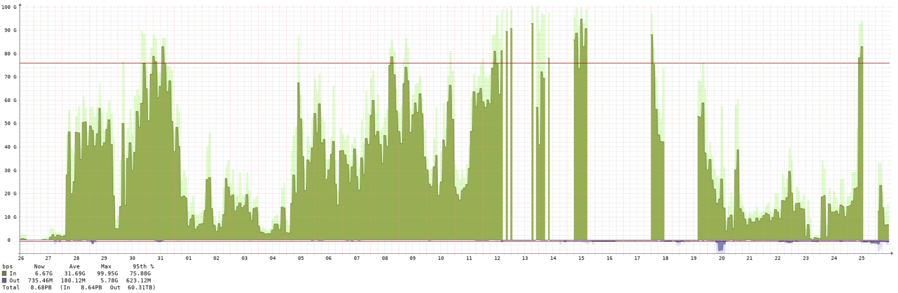
LHCONE now in production for WNs for 1M
Near saturation
Gaps in monitoring?

Slide 3
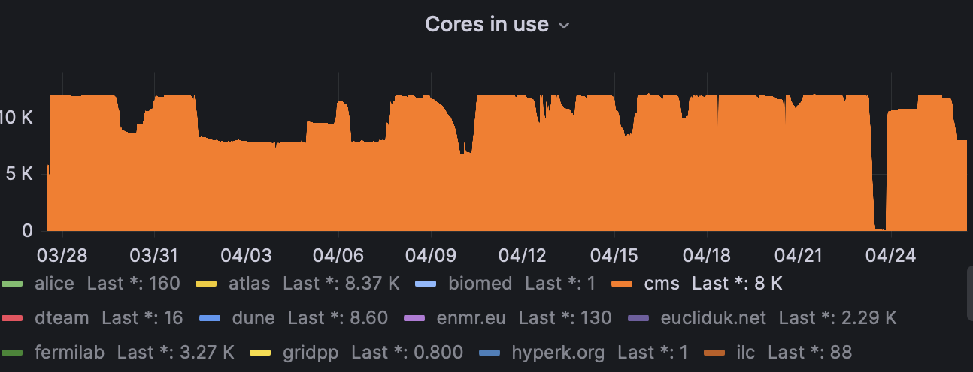
CMS jobs?
Katy theory:
CMS comes back from drain and picks up mostly Production jobs starting at the same time.
Hence they get to the step doing the remote reads at almost the same time (>10k cores)
Expect a network spike a day or two after coming back from drain
CMS in drain; usage drops
??

Slide 4
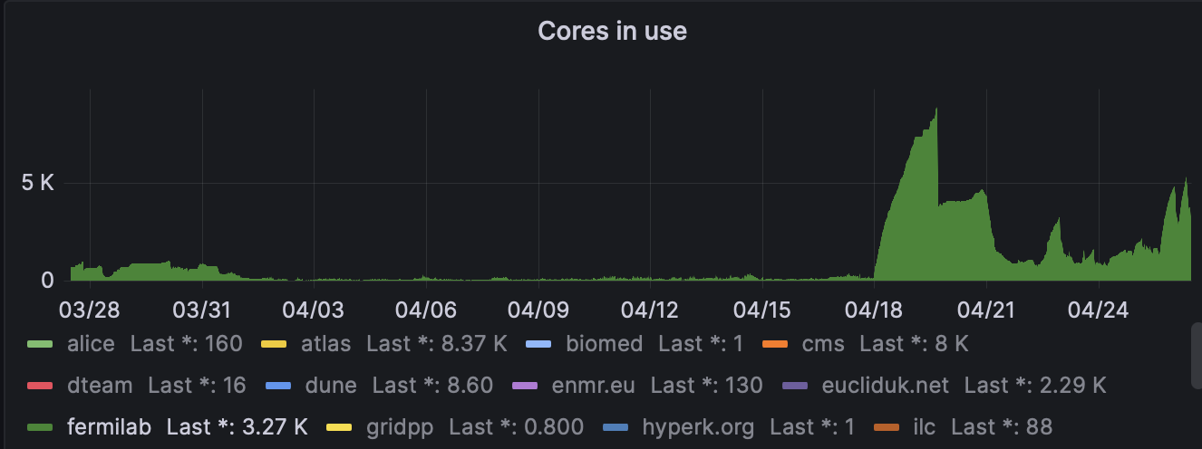
Fermilab VO jobs?
From my Fermilab contact:
“The Fermilab VO jobs will be doing mostly remote (not just remote, but transatlantic) reads, yes, with a few exceptions. One experiment was having a lot of failures last week when they got a few thousand jobs running. I was wondering if they might have been saturating the inbound to RAL side of things, actually. Were you seeing some issues of that sort?”

Slide 5
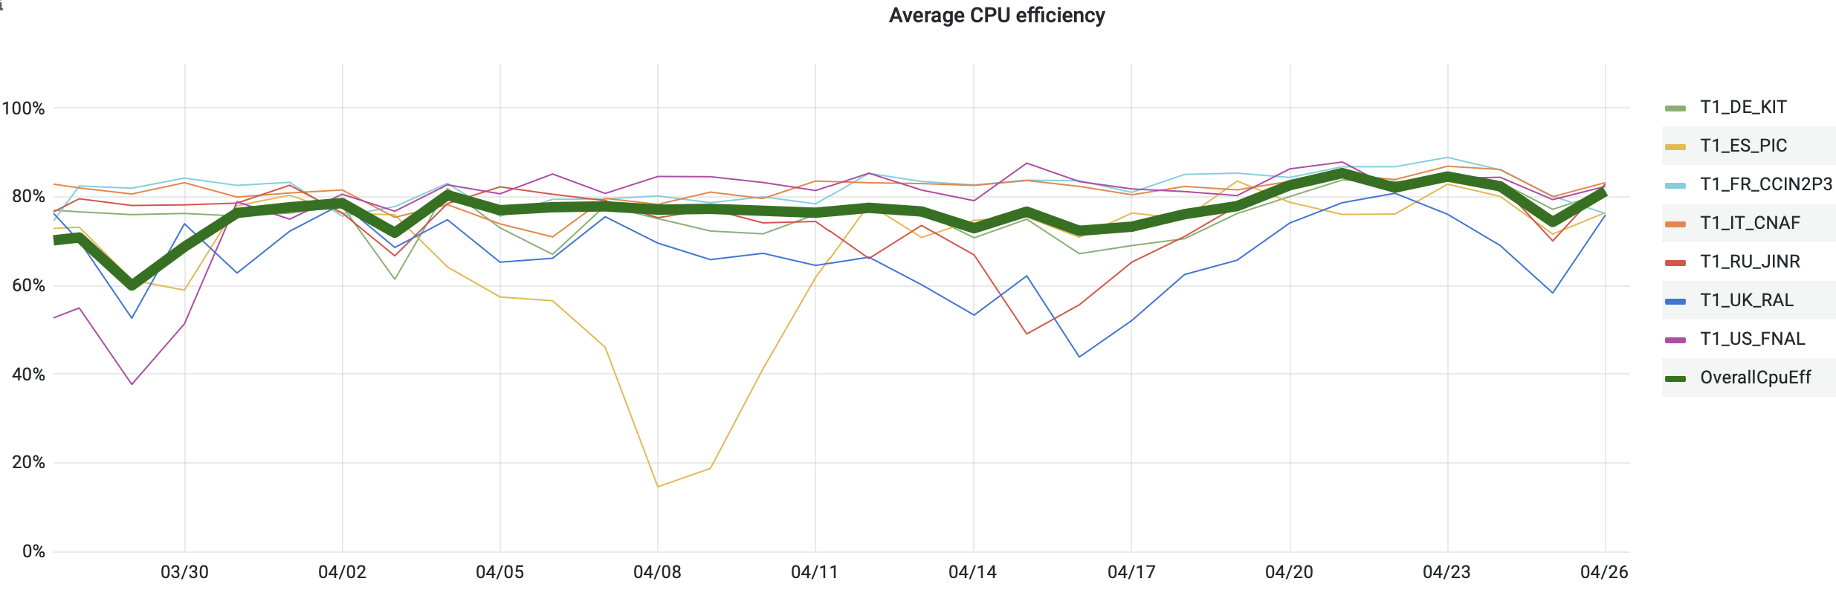
CMS efficiency is ‘below average’ for this month

Slide 6
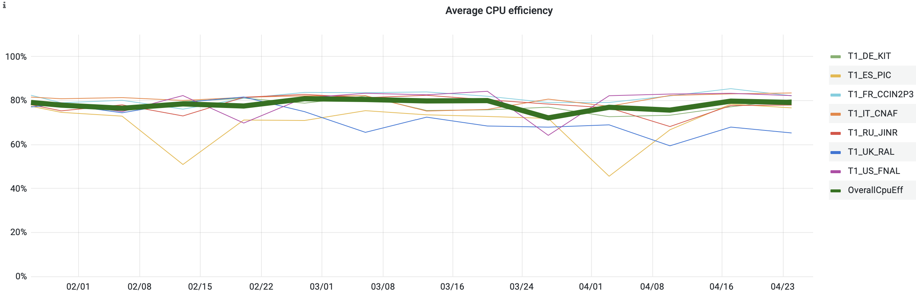
Already fell before the move to LHCONE?
WNs on LHCONE?

Slide 7
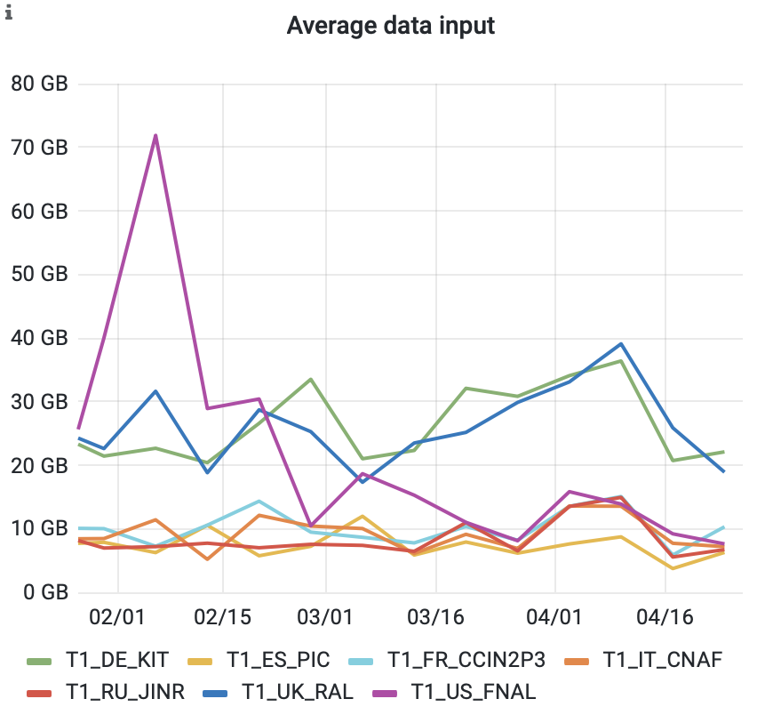
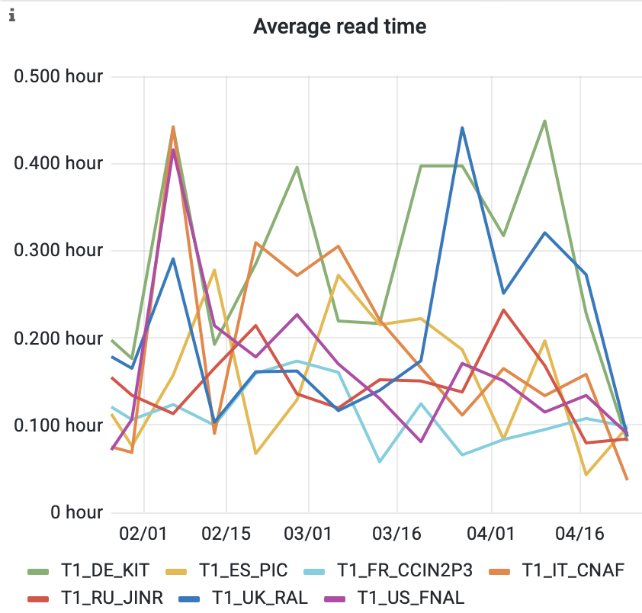
CMS jobs – all reads (local and remote) 90d

Slide 8
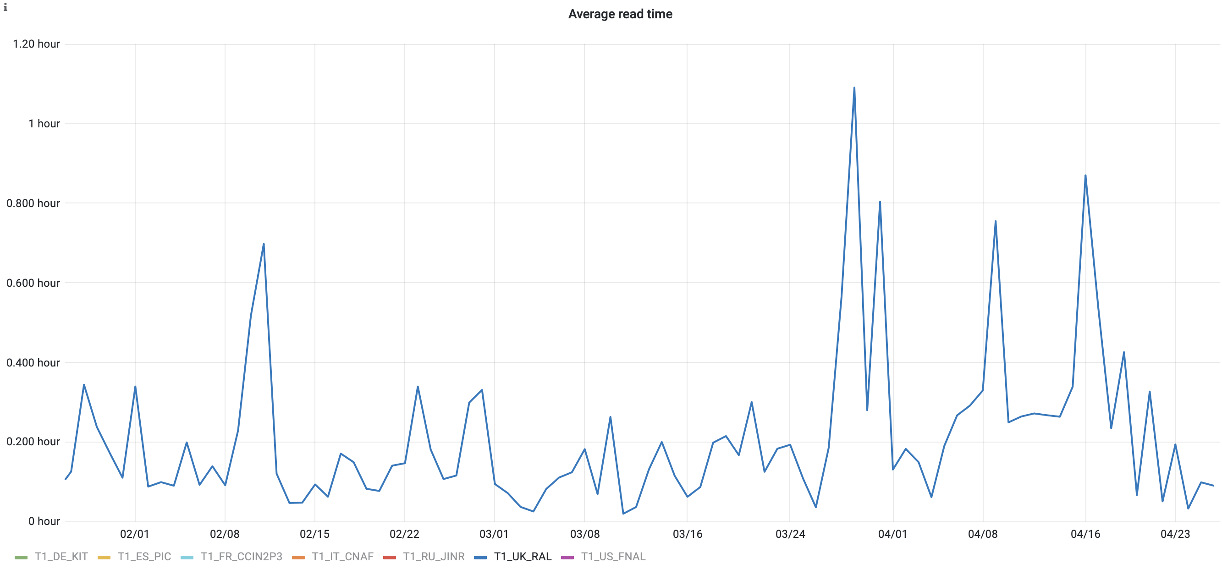
Read time – all reads (local and remote)

Slide 9
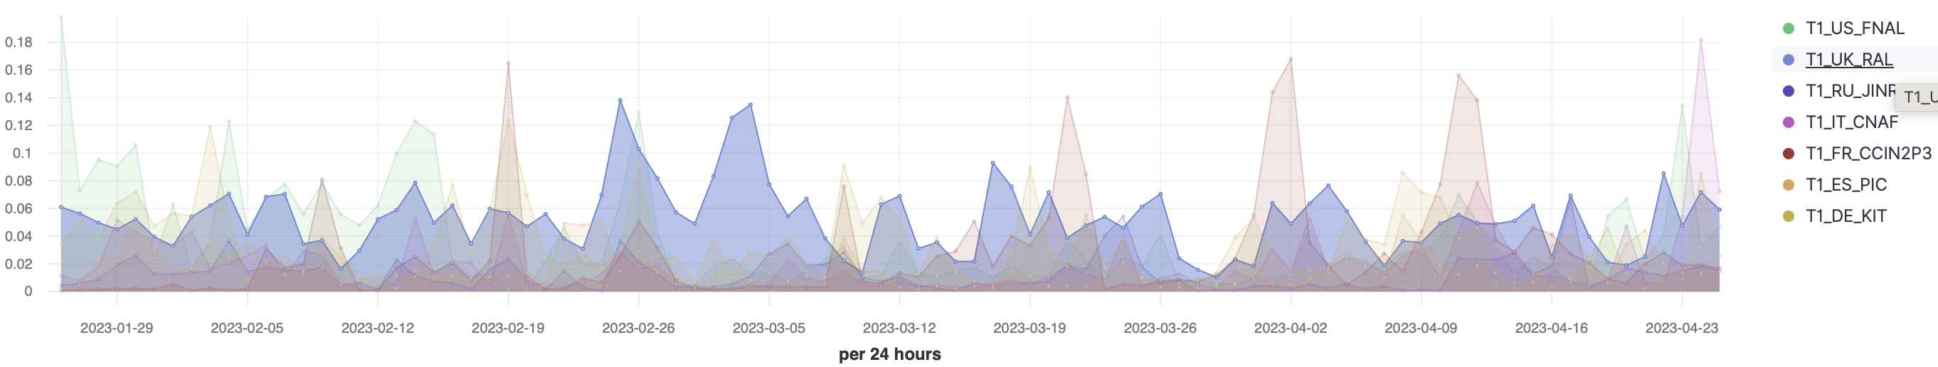
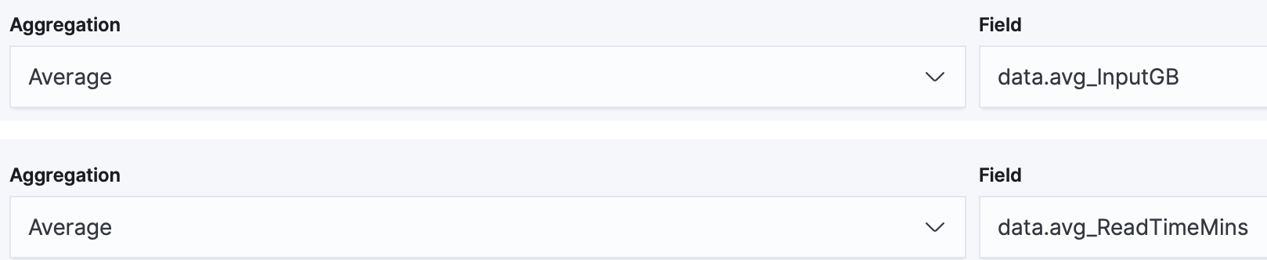
Read rates – 90d (remote read jobs?)
data.Status:"Running" AND data.Site:T1* AND data.DESIRED_CMSPileups:exists
I think this part of the query is not working
params.var_inputgb / (params.var_readtimemin * 60)

