Slide 1
Mechanical characterization of
Nb₃Sn coils
G. Vernassa - kick-off meeting in SMT - 22/03/2023

Slide 2
Previous discussions
Mechanical Characterization of Nb₃Sn
Collared vs B&K structures
Behavior at interfaces
Instrumentation form design phase
Nb₃Sn magnets design
Modelling techniques in FEA
Geometrical interferences
Insulations & Epoxy resins
Stress Limits & Degradation
Indico links:
https://indico.cern.ch/event/1184319/
https://indico.cern.ch/event/1184315/

Slide 3

Thesis perspective: Reliability analyses
Established methodologies to assess the impact of
uncertainties.
Probability theory for modelling:
    Materials
    Geometrical parameters and tolerances
    Operational parameters (boundary
    conditions, rare random events, …)
    Accuracy of the physical modelling (gap
    with reality)

Slide 4
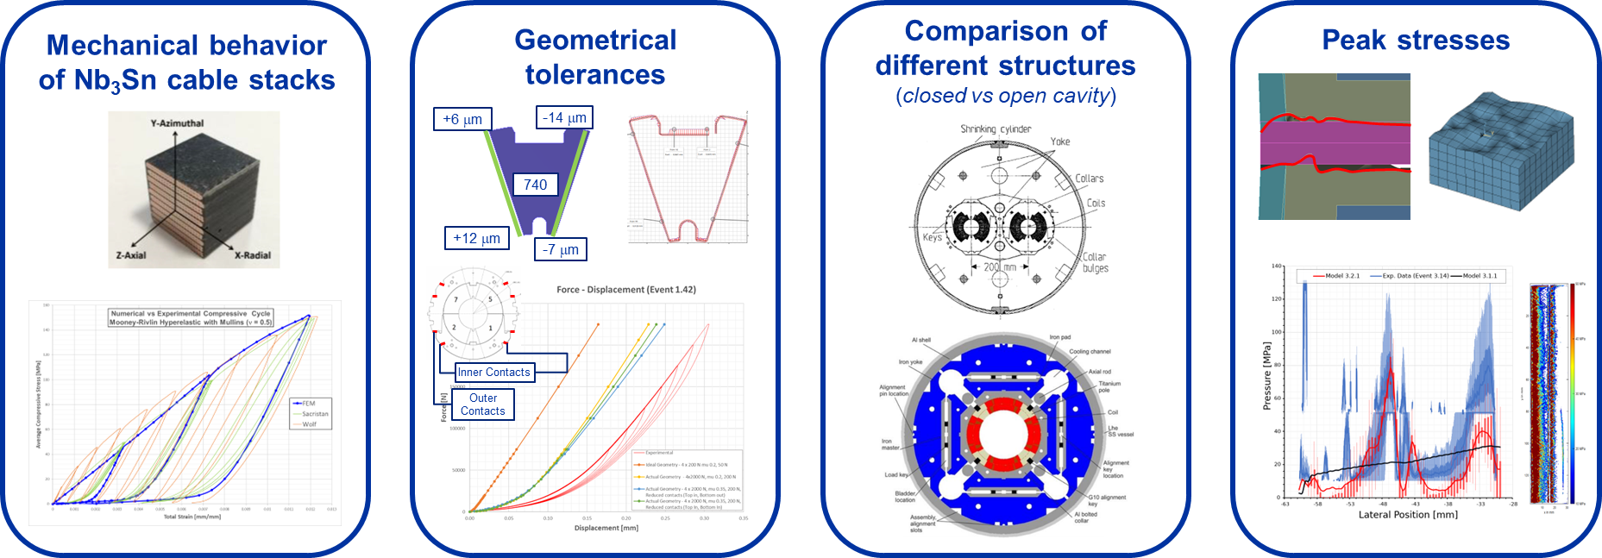
Probabilistic design of Nb₃Sn accelerator magnets

Slide 5
Subjects of interest
Mechanical Characterization of Nb₃Sn
Collared vs B&K structures
Behavior at interfaces
Instrumentation form design phase
Nb₃Sn magnets design
Modeling techniques in FEA
Geometrical interferences
Insulations & Epoxy resins
Stress Limits & Degradation

Slide 6
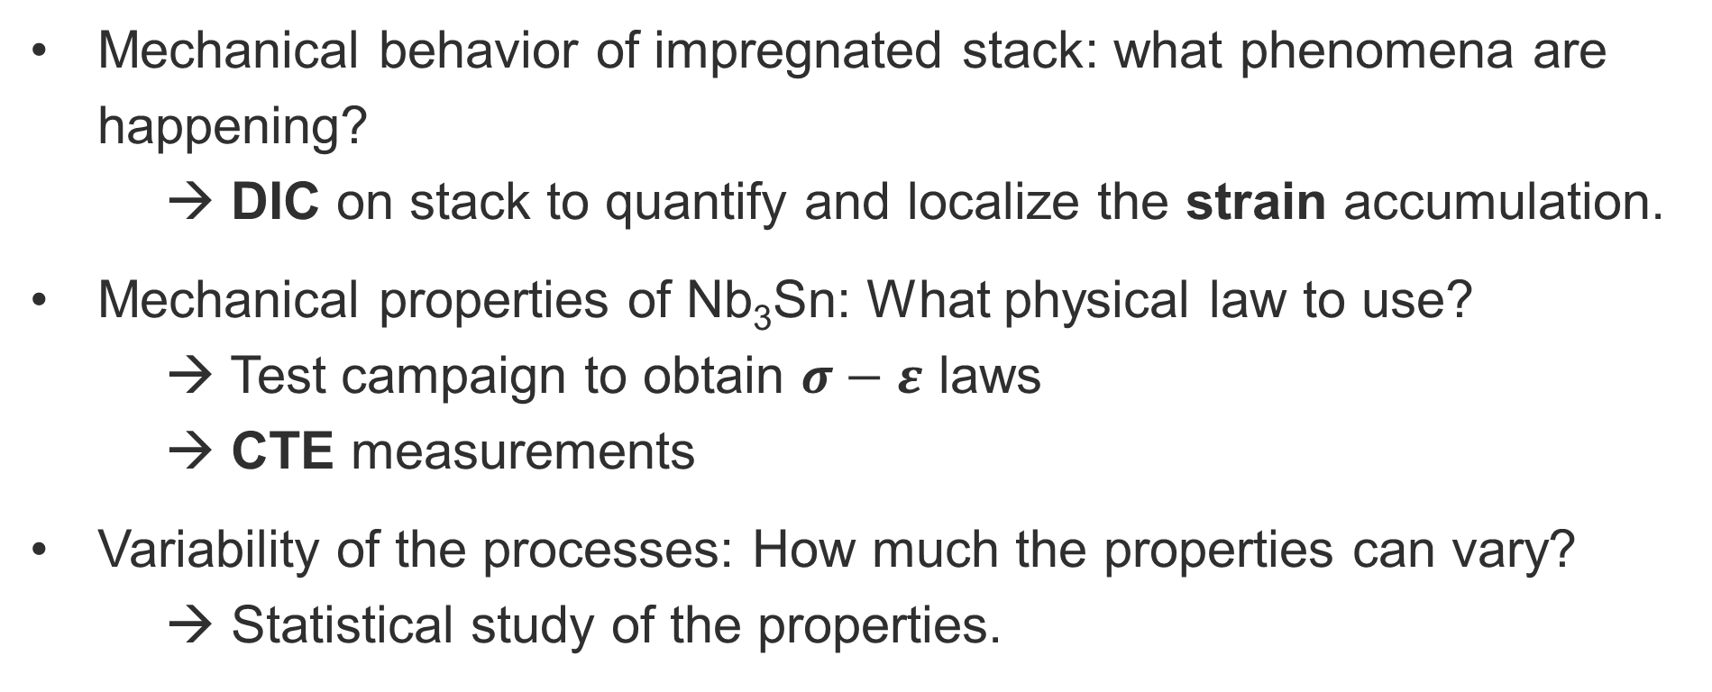
Relevant tests
Mechanical behavior of impregnated stack: what phenomena are happening?
→ DIC on stack to quantify and localize the strain accumulation.
Mechanical properties of Nb₃Sn: What physical law to use?
→ Test campaign to obtain $σ−ε$ laws
→ CTE measurements
Variability of the processes: How much the properties can vary?
→ Statistical study of the properties.

Slide 7
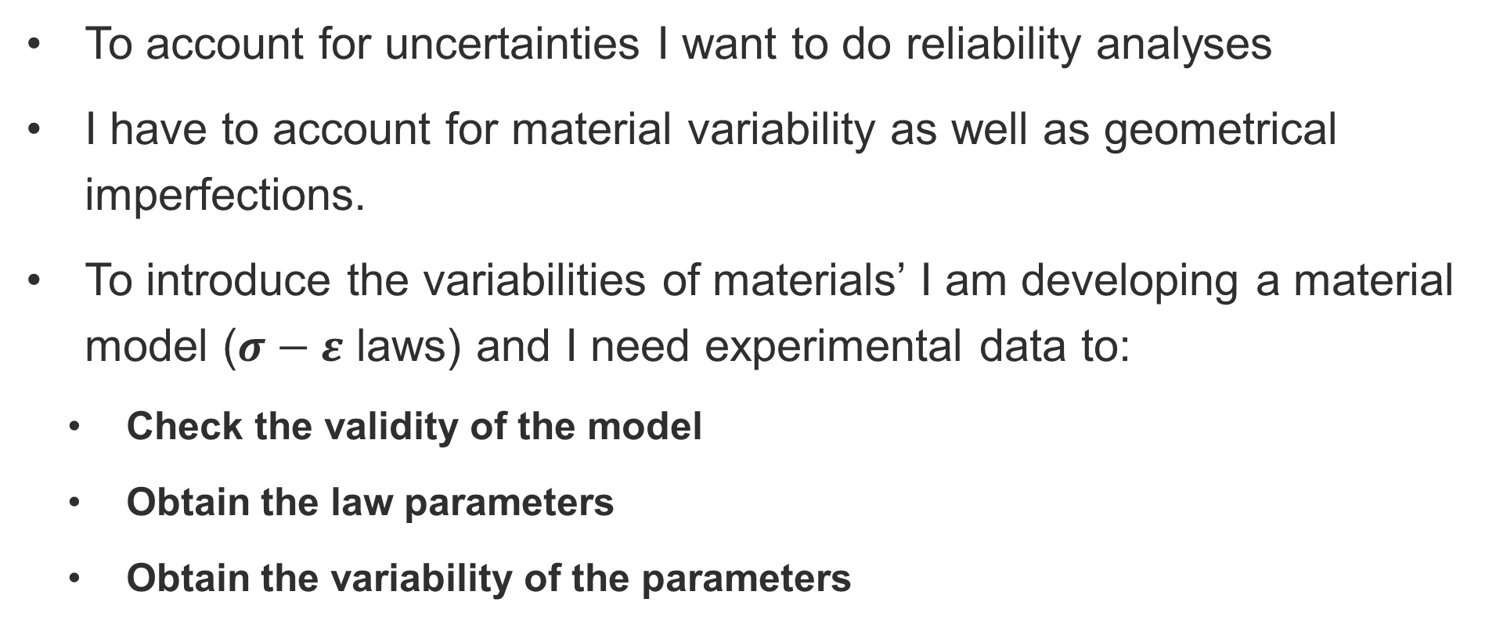
In summary
To account for uncertainties I want to do reliability analyses
I have to account for material variability as well as geometrical imperfections.
To introduce the variabilities of materials’ I am developing a material model ($σ−ε$ laws) and I need experimental data to:
  Check the validity of the model
  Obtain the law parameters
  Obtain the variability of the parameters

Slide 8
Support slides

Slide 9
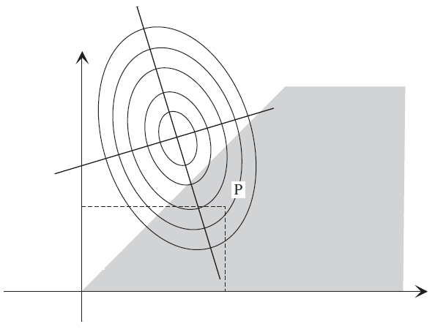
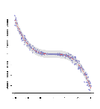
The probabilistic paradigm
Acceptance: nothing is certain in real world
Loads, geometry, and parameters are assumed to be random
The result we control is the probability of failure
output
stress
failure
strain
design

Slide 10
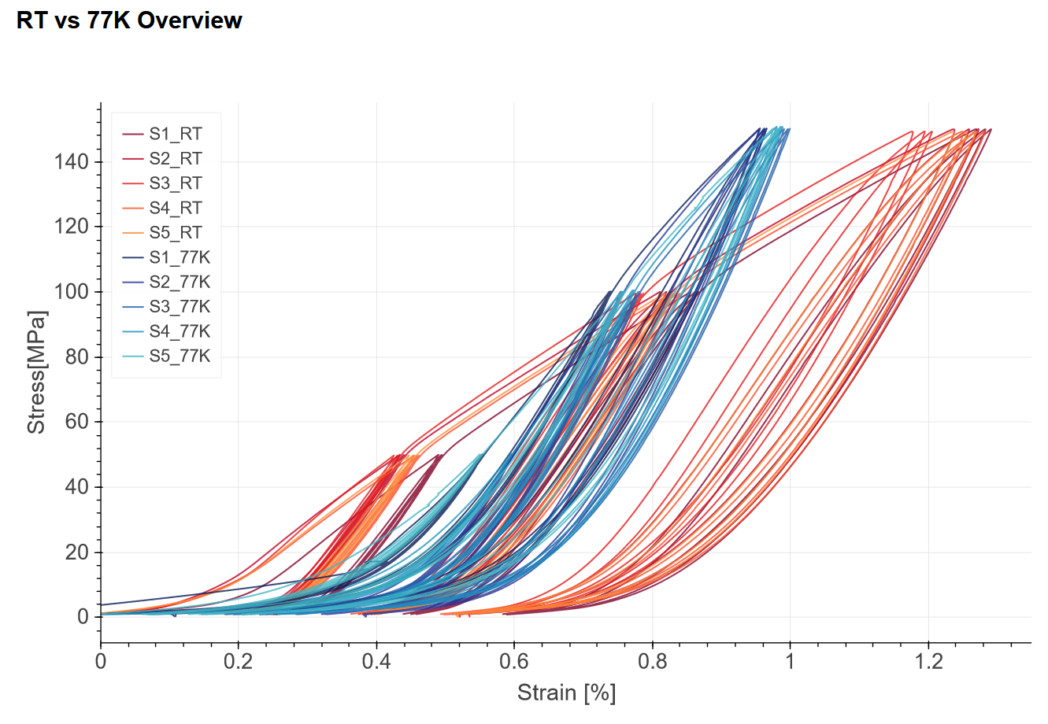
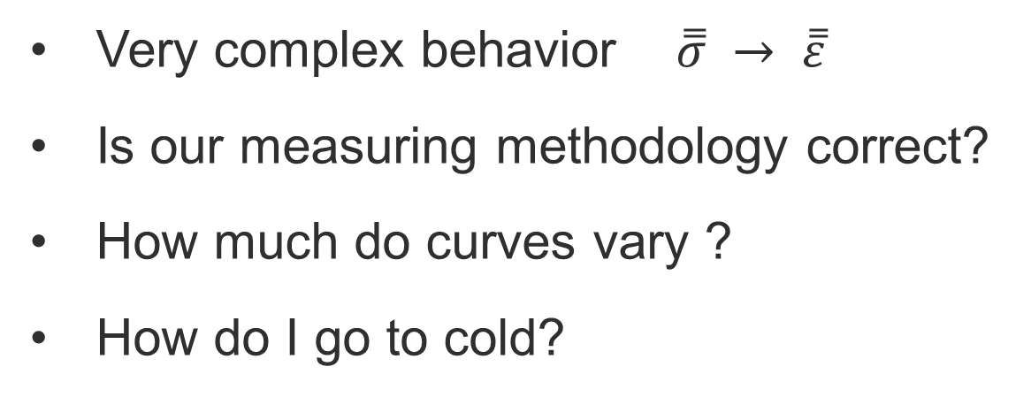
1. Modeling technique in FEA
QUESTION:
What physical laws I employ to model this behavior?
Very complex behavior $\overset{̿}{σ} → \overset{̿}{ε}$
Is our measuring methodology correct?
How much do curves vary ?
How do I go to cold?

Slide 11
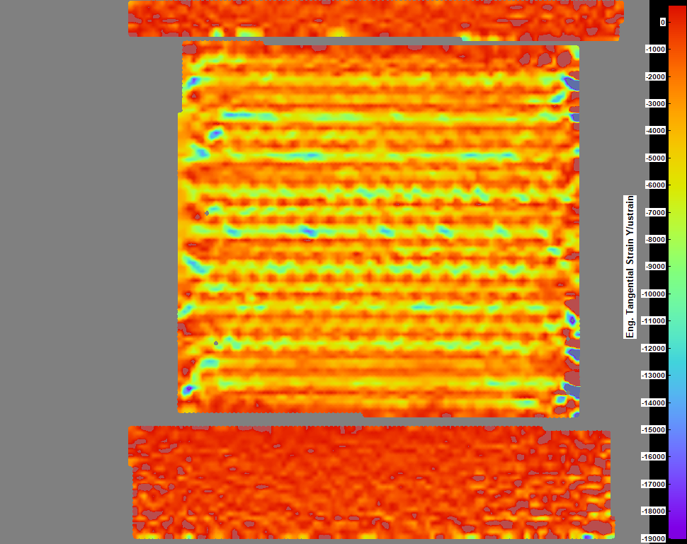
2. Mechanical characterization of a stack
QUESTION:
Am I making the correct assumptions in my physical laws ?
Where, How, How much it deforms.
What happens with compensation of keystone?
Do I see microstructural changes in Copper?

Slide 12
3. Interfaces
QUESTION:
What law should I use to account for this behavior?
Surface irregularities lead to flat start?
Effects at impregnated locations?

Slide 13
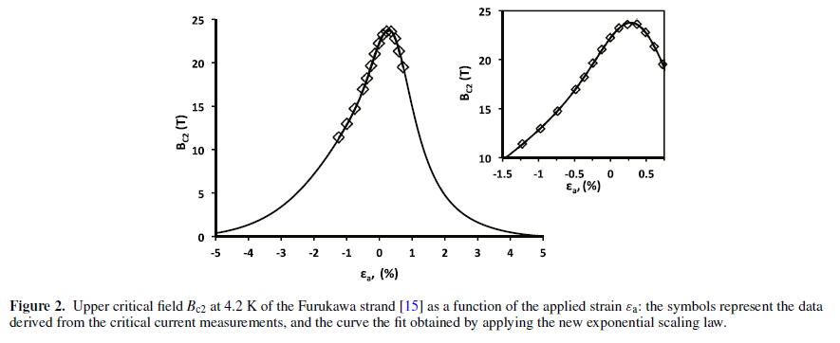
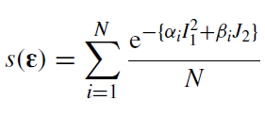
4. Extension to smaller scales
QUESTION:
What is the link between the strain values we compute at the macro / meso -scale and those happening at the microscale?
e.g.
Scaling laws for reversible
critical current reduction.
B. Bordini - An exponential scaling law for the strain dependence of the Nb3Sn critical current density

Slide 14




Cable configurations in samples
Let’s discuss about it
keystone compensated:
attempts to be cable-representative
It is not simply a matter of stress decomposition; we also have varying stiffness across the width.
$$σ_{n}$$
p
$$τ_{n}$$
width
keystone
angle
mid-thickness
keystone not compensated:
attempts to be coil-representative
[1]
Thin edge:
high compaction
Thick edge:
lower compaction
[1] Ten Kate HHJ et al (1991) Development of an experimental 10 T Nb3Sn dipole magnet for the CERN LHC. IEEE Trans Magn 27(2):1996–1999

Slide 15
First sample campaign
The first samples should address this issue.
We are looking for a cable both in keystoned and non-keystoned version.
First goal is to understand which version of keystoned cable is more representative of the rectangular one*.
vs.
Assumed reference
* We are in fact assuming that the rectangular configuration should be the reference.

Slide 16
Study approach
The first tests will address the issue of the keystone, laying the bases for the real test campaign.
A second important step would be to look at local effects at the interfaces:
  Cable stack to universal testing machine tooling
  Cable stack to cable stack
  Intermediary polymide sheets (Kapton) and other medium materials
  Cable stack to impregnated wedge
Then, we can investigate the impact of the resin volume fraction (stack compaction).
Across this study we will consider the reproducibility of the results with material models combinations in FEA. Hence, CMM measurement and surface characterization should be carried throughout.
22 March 2023
G. Vernassa | Mechanical characterization of Nb₃Sn coils
16

Slide 17
