Slide 1
CERN CMS TIER2 Baltic project
Jānis Irbe
Riga Technical University, 2023

Slide 2


«CMS needs and interest in a joint Tier2
computing grid in the Baltic Region»
Danilo Piparo, CERN CMS Offline and Computing Co-Coordinator
Jānis Irbe janis.irbe@rtu.lv

Slide 3
The goal
Unite high-performance computing resources from Baltic academic institutions in a federated HPC resource pool for efficient processing of CERN CMS TIER2 workloads.
Jānis Irbe janis.irbe@rtu.lv

Slide 4
Objectives
HPC Resource consolidation
Collaboration partners
Unite the High Performance computing (HPC) resources and competencies of academic institutions
Leading partner - RTU High Energy and Accelerator Technology Center.
Expand the Latvian CERN CMS Tier2 federated cloud infrastructure created in the pilot project, connecting with partner infrastructure and CERN through GEANT.
Latvian partners: University of Latvia, National Library of Latvia, Rēzekne Technology Academy and Ventspils Radio Astronomy Center.
Involving possible Baltic group partners from Estonia and Lithuania: Kaunas Technical University, University of Tartu, Vilnius University, KBFI, TALTECH.
Industry partners
Jānis Irbe janis.irbe@rtu.lv

Slide 5
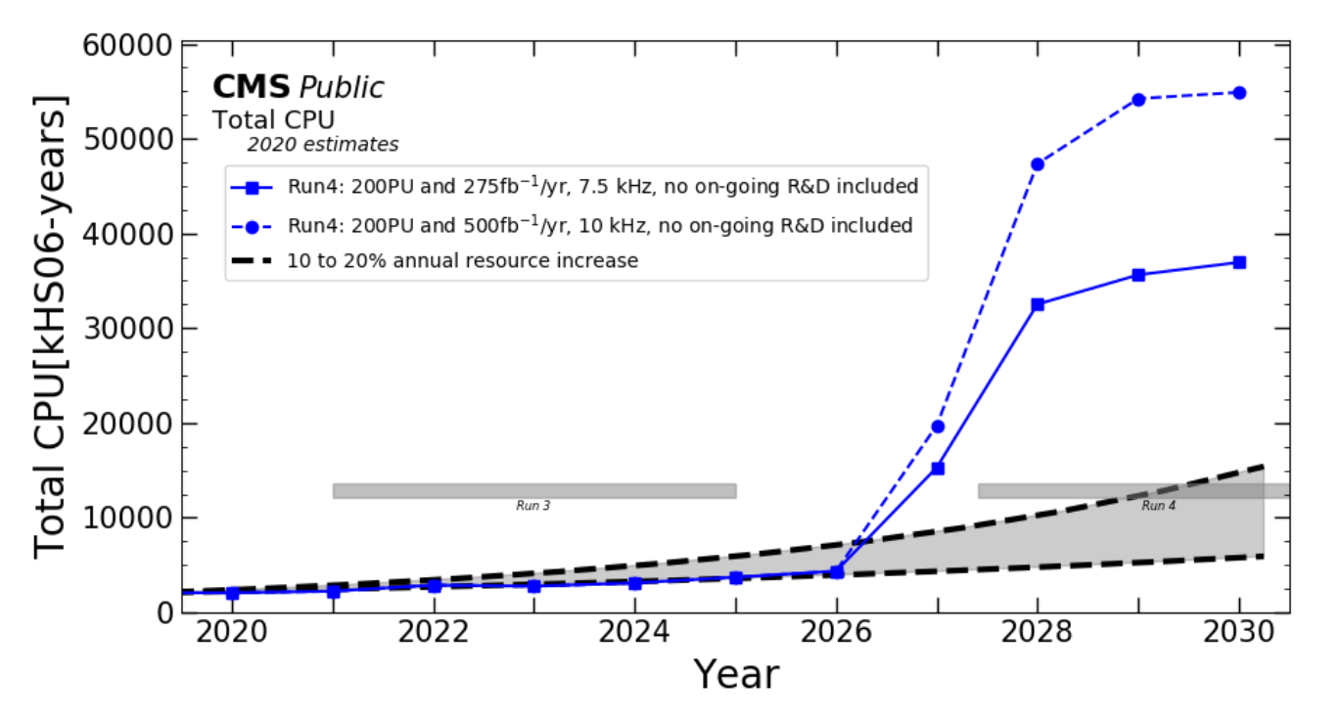
CMS compute requirements
High Luminosity LHC (HL-LHC) will start with Run 4 in 2029.

Slide 6
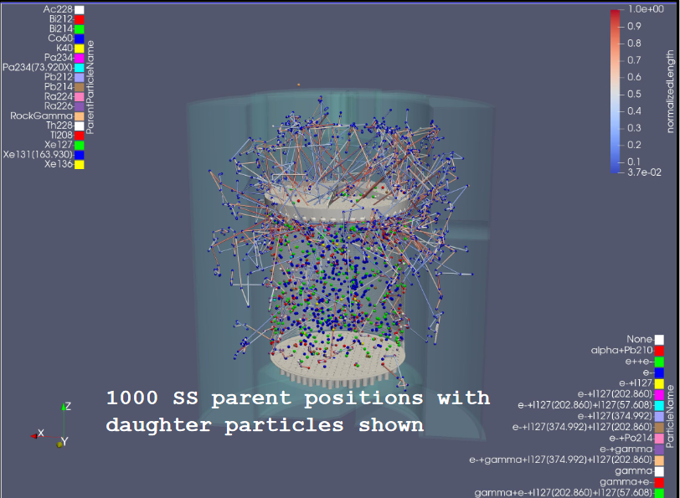

Changes in CMS TIER2 software
GridFTP is being replaced by WebDAV, no need for GRID type certificates - tokens are used for authentification instead
Offline Compute software includes Machine-Learning elements
Portability libraries like Alpaka are used that are CPU/GPU cross-compatible with autodetection
Workloads can be distributed on Linux VMs or «thin» singularity containers with cvmfs
10G data bandwidth is recommended
PATATRACK Pixel Track Reconstruction with Alpaka

Slide 7


Current partner involvement
A technical feasibility study was carried out on the possibilities of combining HPC resources;
Resource allocation and SLA contracts concluded with Latvian partners – LU, VA, LNB, RTA;
Cooperation agreement for feasibility study concluded with Kaunas Technical University, agreement with Estonia partners regarding consultancy;
Purchases and delivery of TIER2 HPC nodes and networking equipment have been made, some including GPU processors;
Planned participation of RTU and partners in activities at CERN, Estonia, Lithuania and Latvia;
Doctorate students working for CERN are involved in federated TIER2 site building and further operations management;
Rebuilding the HPC platform and preparing the environment for HPC workflows is in progress and is expected to be finished in May 2023.
Jānis Irbe janis.irbe@rtu.lv

Slide 8
Thank you!
Jānis Irbe
CERN CMS TIER2 Latvia project manager
Riga Technical University
High Energy Particle Physics and Accelerator Technology Center
janis.irbe@rtu.lv
https://www.rtu.lv/lv/aef
Jānis Irbe janis.irbe@rtu.lv

