Slide 1
LSMU – CERN
Activities from Lithuanian University of Health Sciences
Prof. dr. Rasa Ugenskienė;
Prof. dr. Elona Juozaitytė
2022-10-24

Slide 2

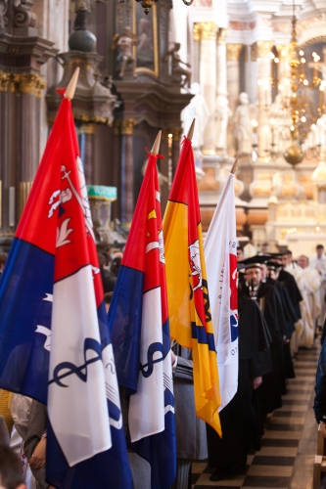
About Lithuanian University of Health Sciences
The largest institution of higher education for biomedical sciences in Lithuania;
Integration of studies, research and clinical practice.
Consists of two main academies: Medical Academy and Veterinary Academy.
Includes 7 faculties, 6 research institutes, two animal clinics and the Hospital of LUHS.
Has more than 7,000 students enrolled.

Slide 3
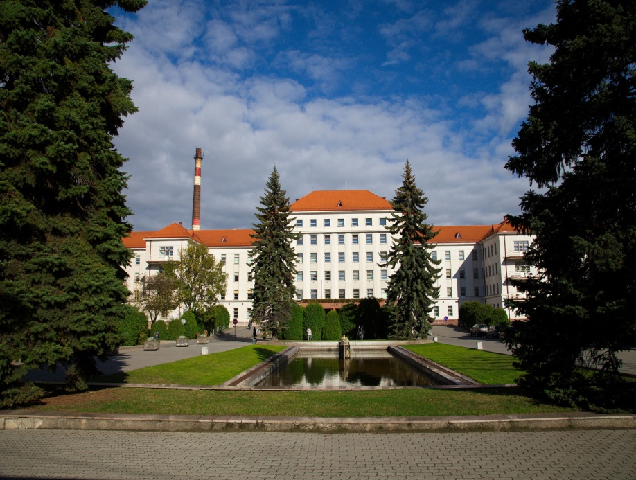
Hospital of Lithuanian University of Health Sciences Kauno Klinikos
The largest healthcare institution in Lithuania which aims to:
improve the health and life quality of of population
develop ambitious and advanced health specialists
create and implement innovations based on scientific research.
uses state-of-the-art technologies in radiotherapy.

Slide 4
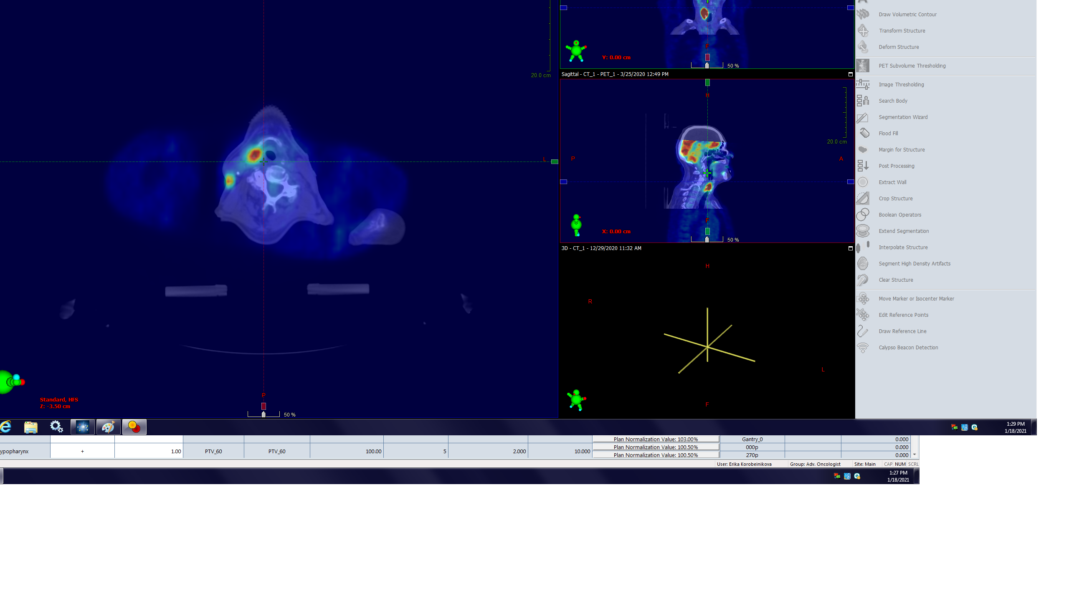
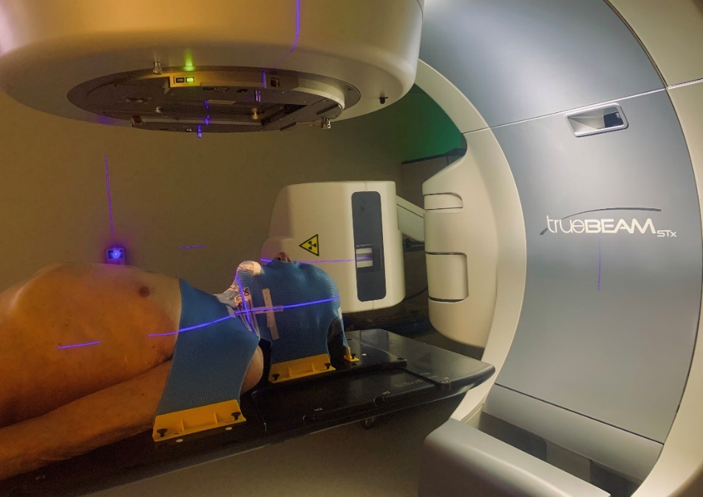
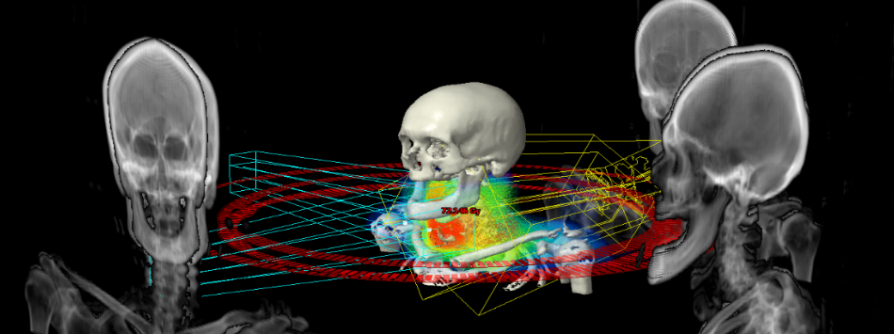
LSMU research areas in radiotherapy and radiobiology
Prognostic and predictive molecular markers of solid tumors;
Molecular mechanisms of sensitivity and resistance to radiotherapy in breast cancer or other cell lines;
Association between common genetic variations with individual patient variability in normal tissue late radiation toxicities;
Radiotherapy optimisation using ¹⁸F-FDG-PET/CT images;
Linac-based fractionated stereotactic radiotherapy vs. intensity modulated radiotherapy;
New brachytherapy techniques.

Slide 5
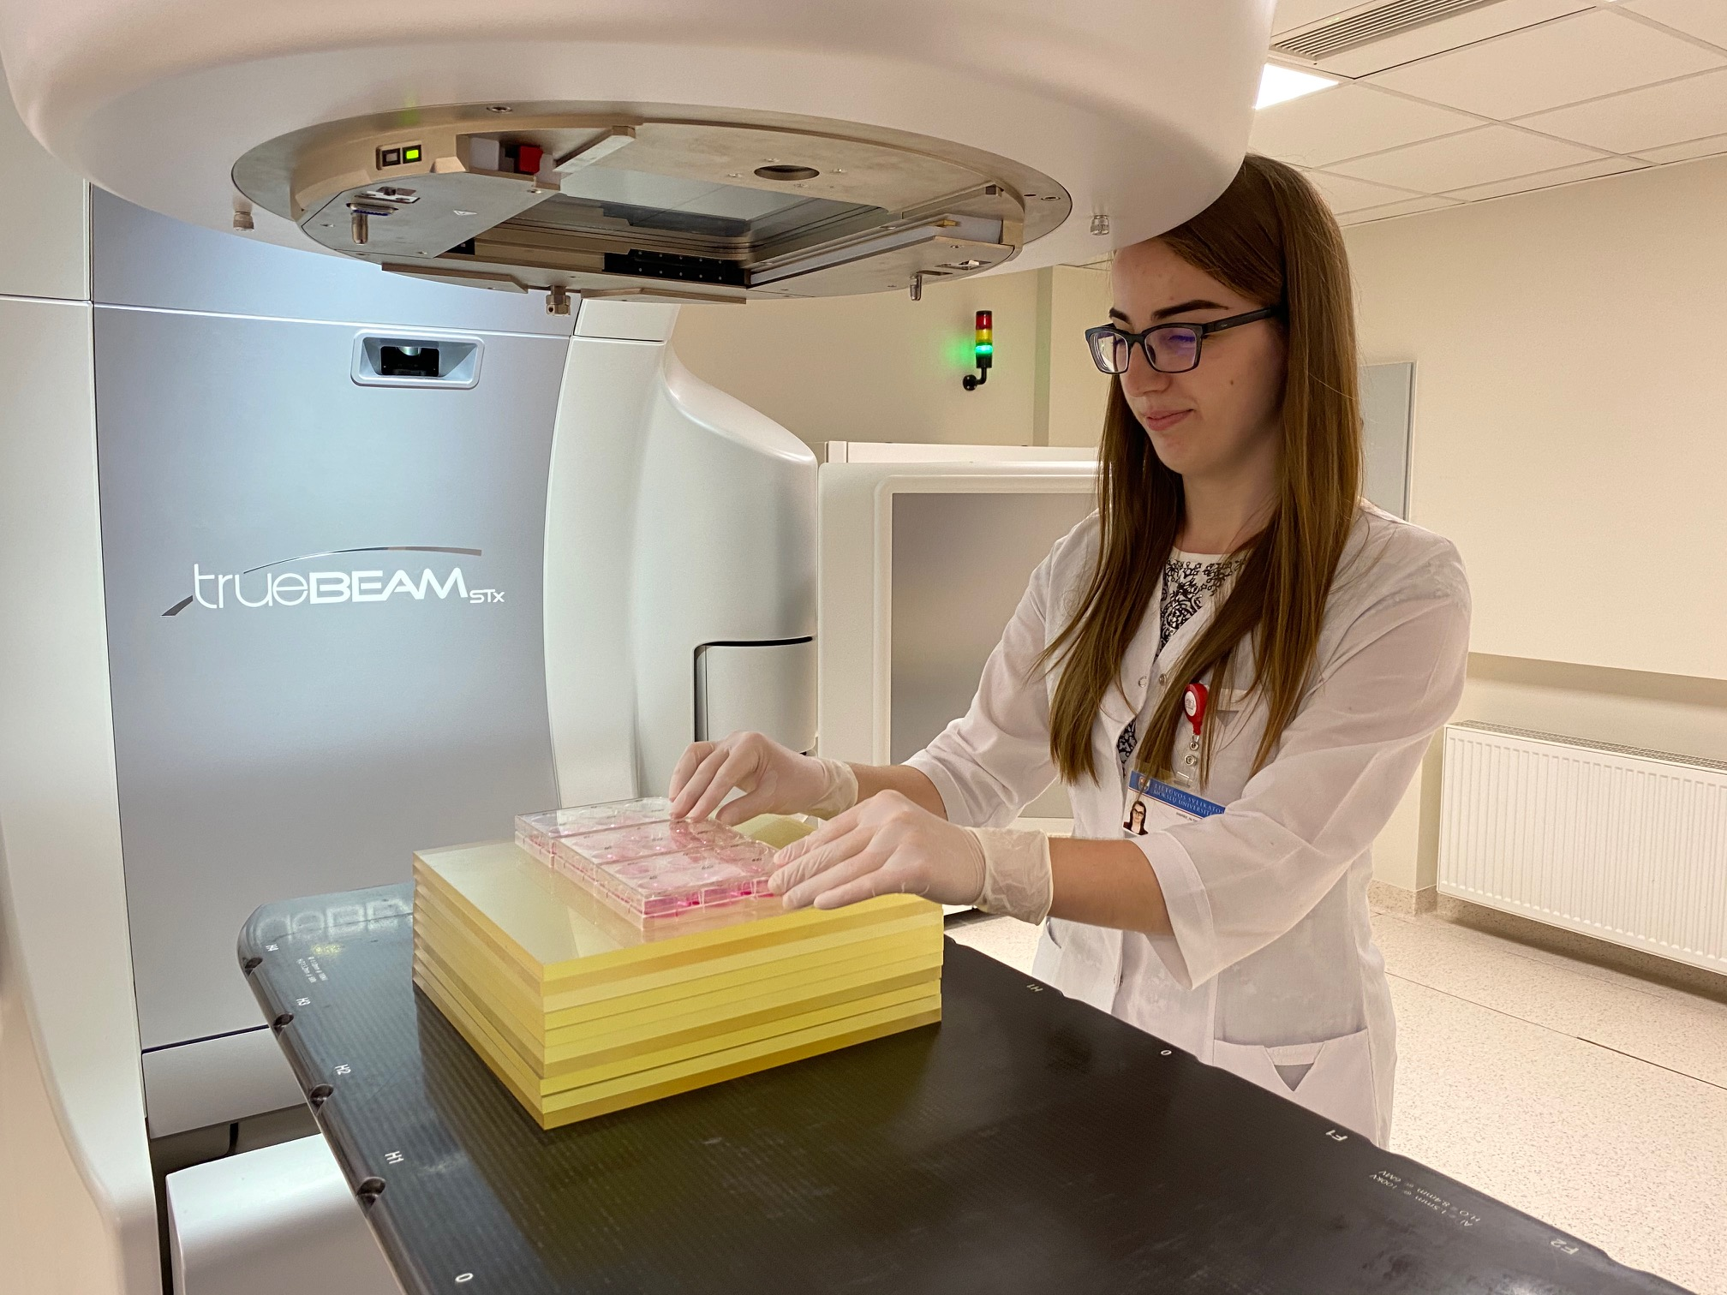
LSMU-CERN collaboration
During the last years training of medical physicists and radiation oncologists was organized in collaboration with CERN.
Development of nuclear medicine is closely related to the deployment of cyclotron at LUHS University Hospital.
Oncology institute: CERN- activities related to 4 projects in Radiobiology.

Slide 6
LSMU-CERN PROJECT No.1
2017.07.01 – 2017.12.31
“Molecular mechanisms determining breast cancer cells resistance to radiotherapy”
(lt. ,,Molekuliniai mechanizmai lemiantys krūties vėžio ląstelių atsparumą radioterapijai”)
The aim: to compare the response of breast cancer cells to radiotherapy.
Cell survival, intensity of apoptosis, and cell cycle changes were analyzed on MCF-7 and MDA-MB-231 breast cancer cells.

Slide 7
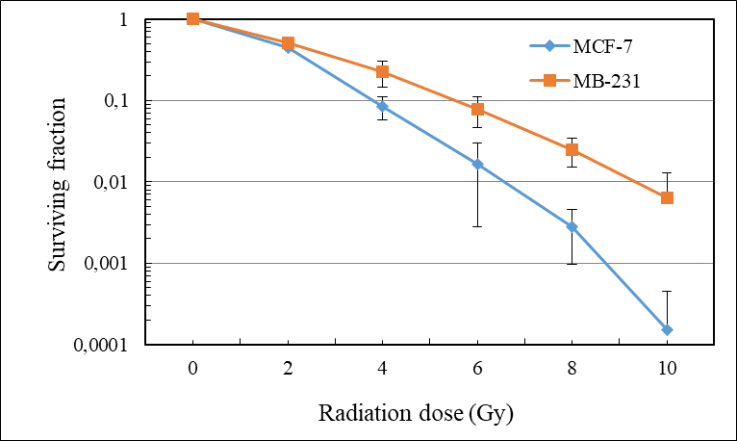
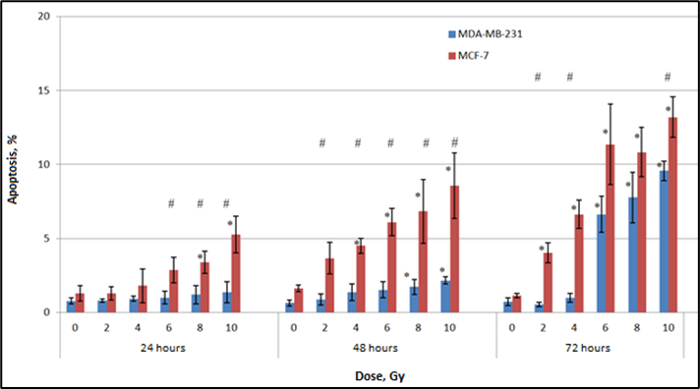
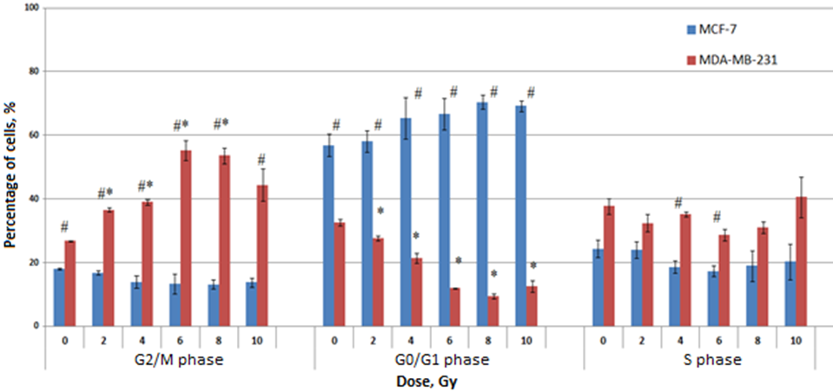
Project No.1 results
The effect of ionizing radiation (IR) on cell survival, apoptosis and cell cycle delay
Cell survival following the exposure to ionizing radiation (IR).
The apoptosis following the exposure to IR.
The cell-cycle phase distributions following IR.

Slide 8
LSMU-CERN PROJECTS No.2
2018.07.01 – 2018.12.31
“The identification of biomarkers responsible for head and neck cancer radioresistance“
(lt. ,,Galvos ir kaklo navikų rezistentiškumą sąlygojančių biožymenų analizė“)
The aim: to determine YAP1 gene copy number and several miRNA (miRNA-200a, miRNA-141, miRNA-375) expression in head-neck tumors relative to normal adjective tissue.
The cohort consisted of 50 head-neck cancer patients.

Slide 9
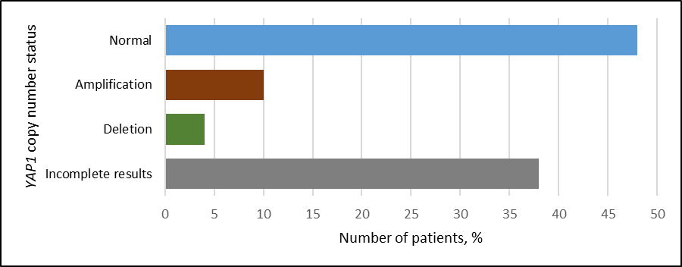
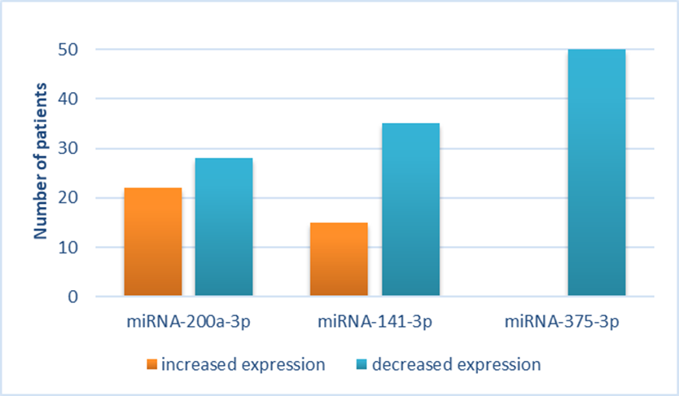
Project No.2 results
YAP1 copy number status and miRNA expression profiles
YAP1 gene copy number status in the studied head-neck cancer group (n=50)
Distribution of studied miRNA expression profiles among patients

Slide 10
CERN-LSMU PROJECT No.3
2019.07.01 – 2020.12.31
“Molecular mechanisms of resistance to radiotherapy in breast cancer cells and the effect of radio-sensitizing agents“
(lt. ,,Molekuliniai mechanizmai lemiantys krūties vėžio atsparumą radioterapijai ir radiojautrumą didinančių medžiagų poveikio analizė“)
The aim: to analyze the substances which could decrease radioresistance in breast cancer cell lines (MDA-MB-231 and MCF-7).
Two phytochemicals were selected as potential radiosensitizing agents: resveratrol (RSV) and kaempferol (KMF).

Slide 11
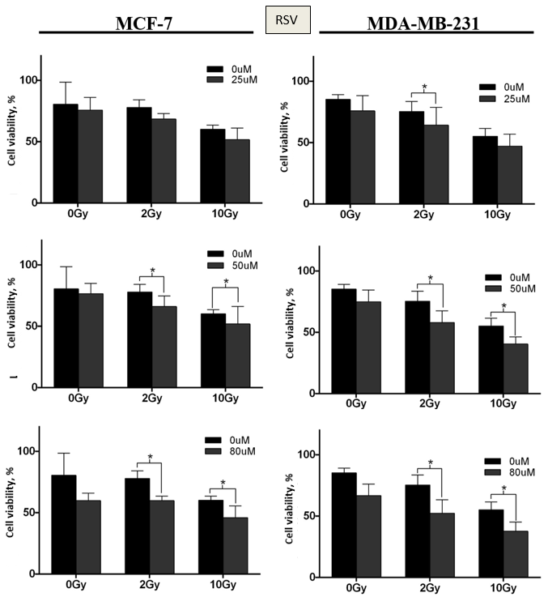
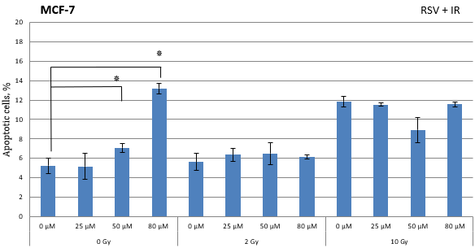
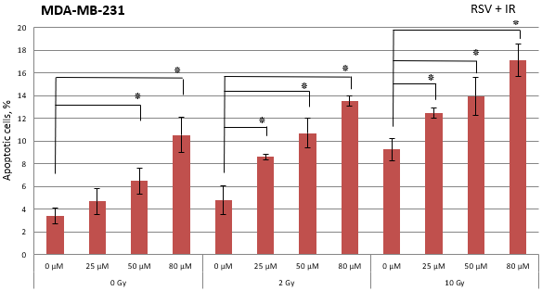
Project No.3 results I
The effect of restveratrol (RSV) and RSV+IR on cell survival and apoptosis
RSV and RSV+IR significantly reduced the viability of cell lines.
In MCF-7 apoptosis was induced by RSV, but RSV + IR combination had no effect.
In MDA-MB-231 cells, both RSV and RSV+IR combination increased apoptosis.
Effect of RSV and ionizing radiation on the apoptosis
Cell viability following exposure to 25, 50, 80 µM of RSV and IR (2 and 10 Gy)

Slide 12
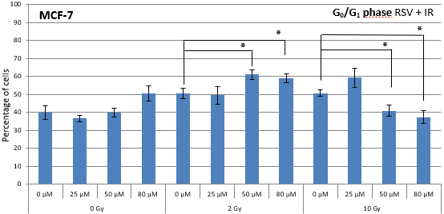
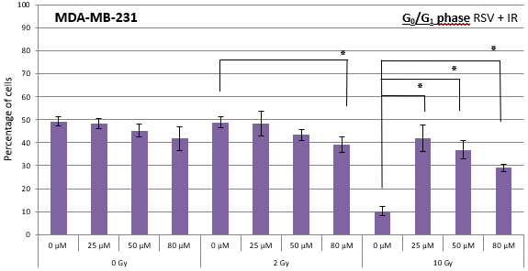
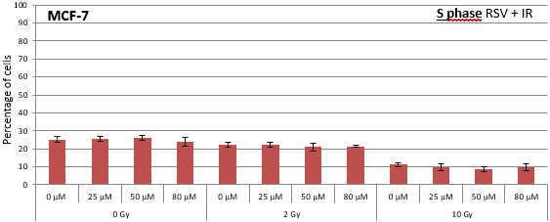
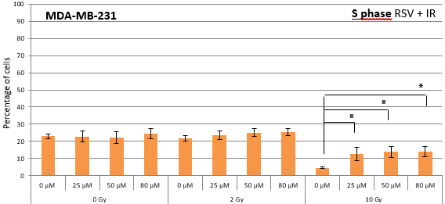
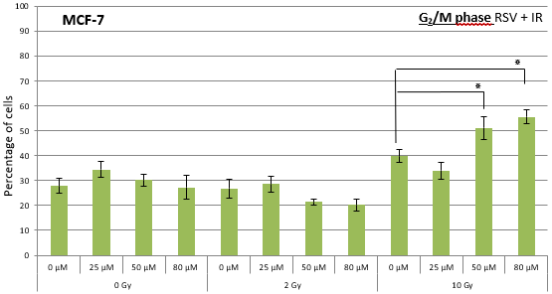
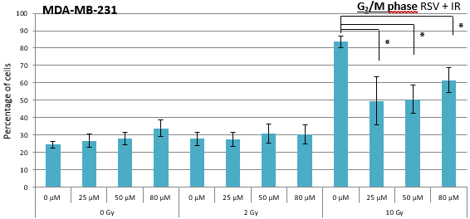
Project No.3 results II
The effect of restveratrol (RSV) and RSV+IR effect on cell cycle delay
RSV in combination with IR caused cell cycle arrest depending on cell line, IR dose, and RSV concentration.
Effect of RSV and ionizing radiation on the cell cycle

Slide 13
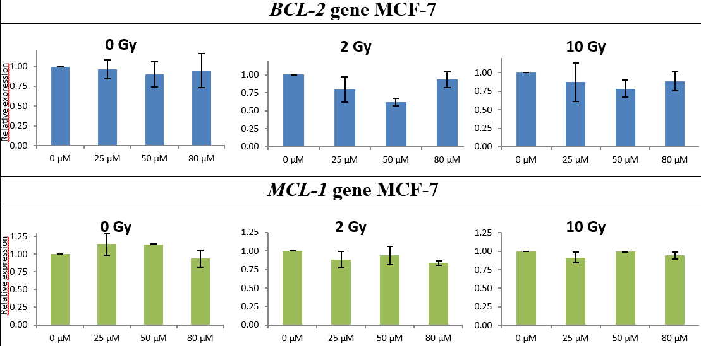
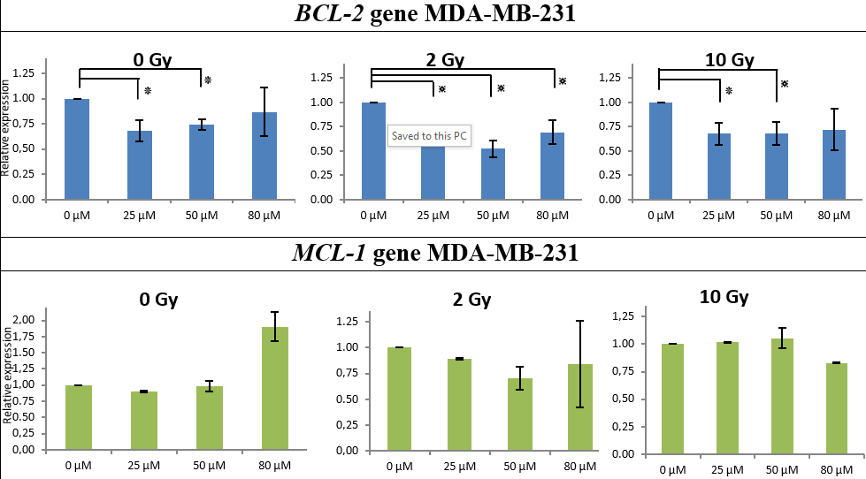
Project No.3 results III
The effect of Restveratrol (RSV) and RSV+IR effect on gene expression
RSV did not cause changes in the expression of either BCL-2 or MCL-1 genes on MCF-7 cells.
RSV downregulated BCL-2 gene expression on MDA-MB-231 cells.
Effect of RSV and ionizing radiation on BCL-2 and MCL-1 expression
Effect of RSV and ionizing radiation on BCL-2 and MCL-1 expression

Slide 14
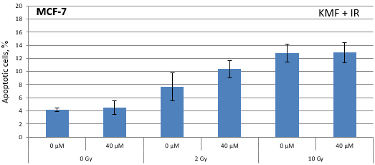
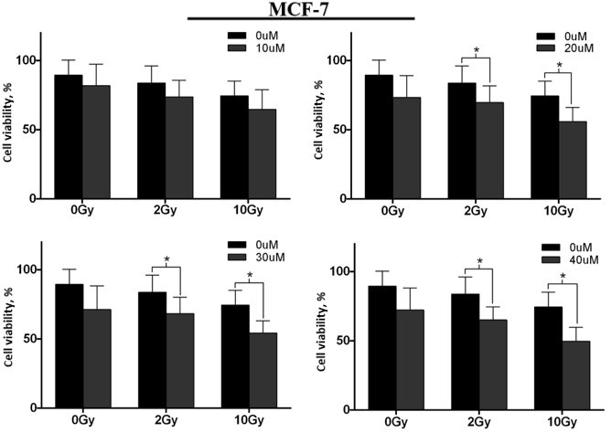
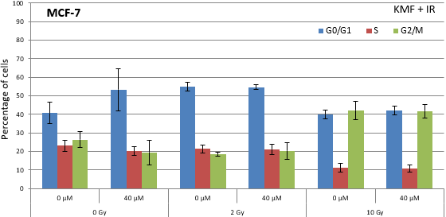
Project No.3 results
The effect of kaempferol (KMF) and KMF+IR effect on cell survival, apoptosis and cell cycle delay
KMF was effective only on MCF-7 cells.
MDA-MB-231 cell line showed the resistance to KMF.
KMF did not induce significant apoptosis of MCF-7 cells either alone or in combination with IR.
Effect of KMF and ionizing radiation on the apoptosis of MCF-7 cells
KMF did not induce cell cycle changes in MCF-7 either alone or in combination with IR.
Cell viability following exposure to 10, 20, 30, 40 µM of KMF and IR (2 and 10 Gy)
Effect of KMF and ionizing radiation on the cell cycle

Slide 15
LSMU-CERN PROJECT No.4
2021.07.01 – 2022.12.31
“The search for radiosensitizing phytochemicals and the analysis of their effect on apoptosis mechanism in breast cancer cells in vitro“
(lt. ,,Radiojautrumą didinančių fitocheminių medžiagų paieška ir jų poveikio apoptozės mechanizmui analizė krūties vėžio ląstelėms in vitro)
The purpose: to continue the search for radiosensitizing phytochemicals and their analysis on breast cancer cells.
Sulforaphane (SFN), which is one of the strongest natural antioxidants, was chosen for this study.
Cell viability, the intensity of apoptosis, apoptosis-related gene expression at RNA and protein levels following the combined effect of SFN and ionizing radiation are currently under investigation on MDA-MB-231 and MCF-7 breast cancer cells.

Slide 16
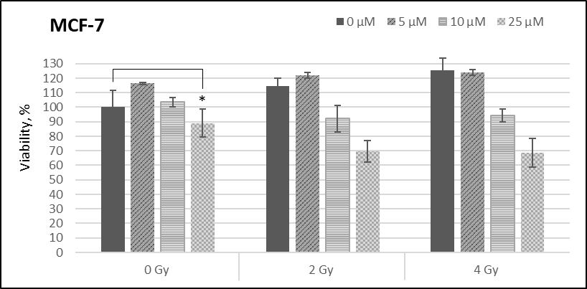
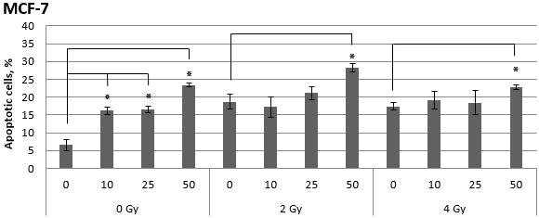
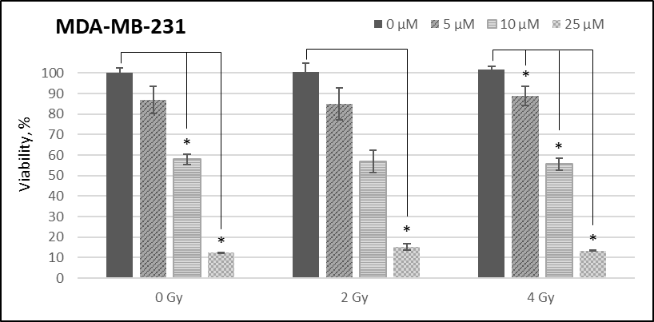
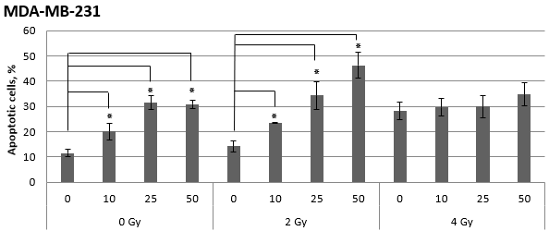
Project No.4 results I
The effect of sulforaphane (SFN) and SFN + IR on cell survival and apoptosis
SNF and SNF + IR increases apoptosis.
The combination of 50 µM SFN and 2 Gy IR was the most effective.
SNF and SNF + IR decreased cell viability in MDA-MB-231 cells
Cell viability following exposure to SFN and ionizing radiation
Effect of SFN and ionizing radiation on apoptosis

Slide 17
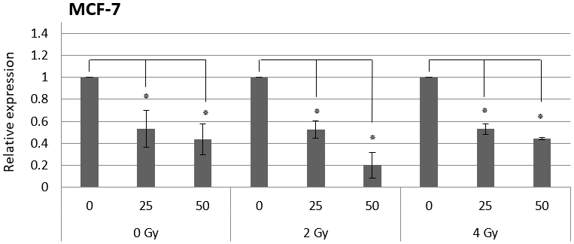
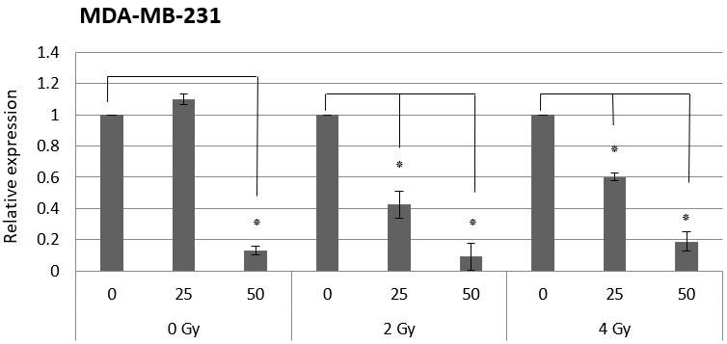
Project No.4 results II
The effect of sulforaphane (SFN) and SFN+IR on BCL-2 gene expression
SFN and SFN+IR decreased the expression of BCL-2 gene in both cell lines.
Effect of SFN and IR on BCL-2 gene expression

Slide 18
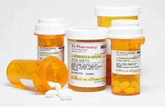
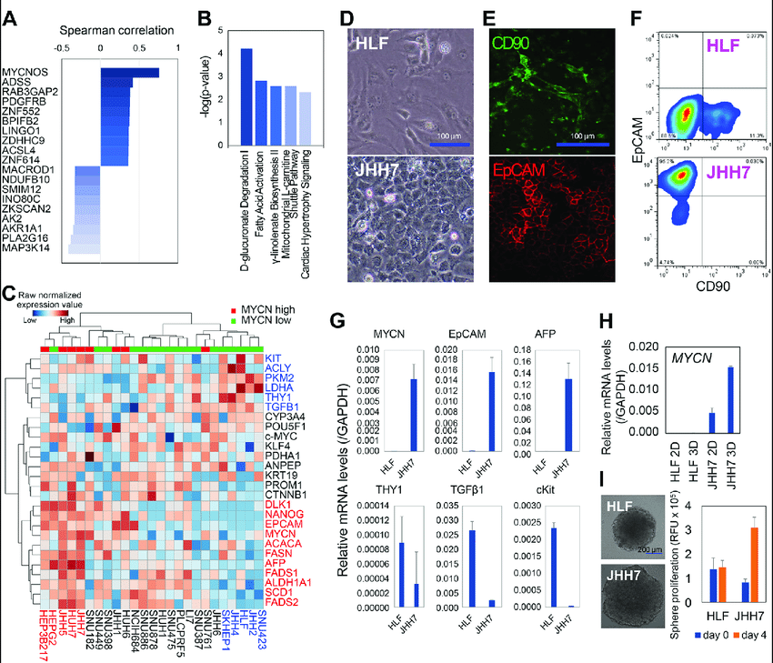
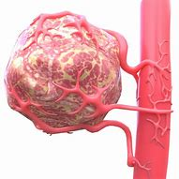
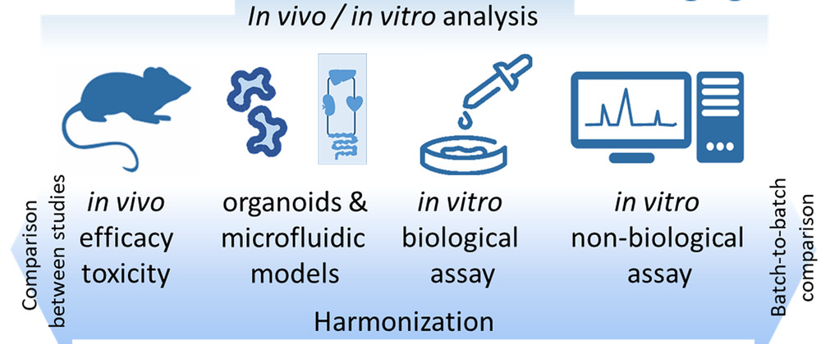

FUTURE DIRECTIONS
Combined radiosensitizing agent effect analyses
Multiple gene expression analysis at RNA and protein level
3D cell models
Aditional functional cell assays
Precision radiotherapy biomarkers analyses

Slide 19
PUBLICATIONS
Laukaitienė, Danguolė; Ugenskienė, Rasa; Inčiūra, Arturas; Juozaitytė, Elona. The Radiosensitizer Potential of Sulforaphane on Breast Cancer Cells // 7th Kaunas / Lithuania International Hematology / Oncology Colloquium : 26 May 2022, Kaunas, Lithuania : Online Poster Abstract Book / Editor Elona Juozaitytė ; Abstracts' Reviewers Rolandas Gerbutavičius, Arturas Inčiūra, Dietger Niederwieser, Domas Vaitiekus ; Kaunas Region Society of Oncologists, Hematologists and Transfusiologists. Kaunas : Eventas, 2022. ISBN 9786099616759, p. 9-9.
Laukaitienė, Danguolė; Vaitkus, Antanas; Savukaitytė, Aistė; Vadeikienė, Roberta; Inčiūra, Arturas; Ugenskienė, Rasa; Juozaitytė, Elona. Skirtingų krūties vėžio ląstelių linijų atsparumo radioterapijai tyrimas // Sveikatos mokslai = Health sciences in Eastern Europe. Vilnius : Sveikatos mokslai. ISSN 1392-6373, 2021, t. 31, Nr. 3, p. 81-87. doi:10.35988/sm-hs.2021.085. Prieiga per internetą: <https://doi.org/10.35988/sm-hs.2021.085>.
Laukaitienė, Danguolė; Bartnykaitė, Agnė; Ugenskienė, Rasa; Inčiūra, Arturas; Juozaitytė, Elona. Radiosensitization Effect of Resveratrol on Breast Cancer Cell // 6th Kaunas / Lithuania International Hematology / Oncology Colloquium : 28 May 2021, Kaunas / Lithuania : Online Poster Abstract Book / Editor Elona Juozaitytė ; Abstracts' Reviewers Arturas Inčiūra, Viktoras Rudžianskas, Milda Rudžianskienė, Aistė Savukaitytė ; Kaunas Region Society of Oncologists, Hematologists and Transfusiologists. Kaunas : Eventas, 2021. ISBN 9786099616728, p. 10-11.
Gudoitytė, Greta; Ugenskienė, Rasa; Savukaitytė, Aistė; Bartnykaitė, Agnė; Vaitkus, Antanas; Juozaitytė, Elona. The Effect of Kaempferol on the Change in Vitality of Breast Cancer Cells in Combination with Ionizing Radiation // 5th International Hematology / Oncology Colloquium : 26 June 2020, Kaunas / Lithuania : Online Poster Abstract Book / Editor Elona Juozaitytė ; Abstracts' Reviewers Arturas Inčiūra, Rolandas Gerbutavičius, Sigita Liutkauskienė ; Kaunas Region Society of Oncologists, Hematologists and Transfusiologists. Kaunas : Eventas, 2020. ISBN 9786099616704, p. 7-8, no. 7.
Gudoitytė, Greta; Ugenskienė, Rasa; Savukaitytė, Aistė; Bartnykaitė, Agnė; Vaitkus, Antanas; Juozaitytė, Elona. The Effect of Resveratrol on the change in vitality of breast cancer cells in combination with ionizing radiation // Eighth International Conference on Radiation in Various Fields of Research, Virtual Conference, 2020 : (RAD 2020) : Book of Abstracts : [July 20-24, 2020, Herceg Novi, Montenegro] / [editor Goran Ristić]. Niš : RAD Centre, 2020. ISBN 9788690115013, p. 127-127.
Laukaitienė, Danguolė; Savukaitytė, Aistė; Vadeikienė, Roberta; Vaitkus, Antanas; Ugenskienė, Rasa; Juozaitytė, Elona; Inčiūra, Arturas. Evaluation of resistance of different breast cancer cell lines to radiotherapy // 1st International doctoral students’ conference “Science for Health” : book of abstracts : April 13, 2018, Kaunas, Lithuania / Lithuanian university of health sciences. LSMU Department of Research Affairs. Council of LSMU Doctoral Students ; [Edited by Indrė Šveikauskaitė]. Kaunas : Lietuvos sveikatos mokslų universiteto Leidybos namai, 2018. ISBN 9789955155300, p. 59-60.

Slide 20
Thank You For Your Attention

