Slide 1
Coating the Wide-Open Waveguide Crab Cavity
- set-up, planning and implementation
Fabian Manke, Alban Sublet, Thibaut Richard, Mauro Taborelli, Lucie Baudin, Ana Teresa Perez Fontenla, Stephan Pfeiffer
30/03/2022
FCC RnD Meeting

Slide 2
Outline
Principal coating set-up
Coating recipe and test bench results
Simulations and process planning
Current state: Going full-scale
Perspectives for the year

Slide 3
Outline
Principal coating set-up
Coating recipe and test bench results
Simulations and process planning
Current state: Going full-scale
Perspectives for the year

Slide 4
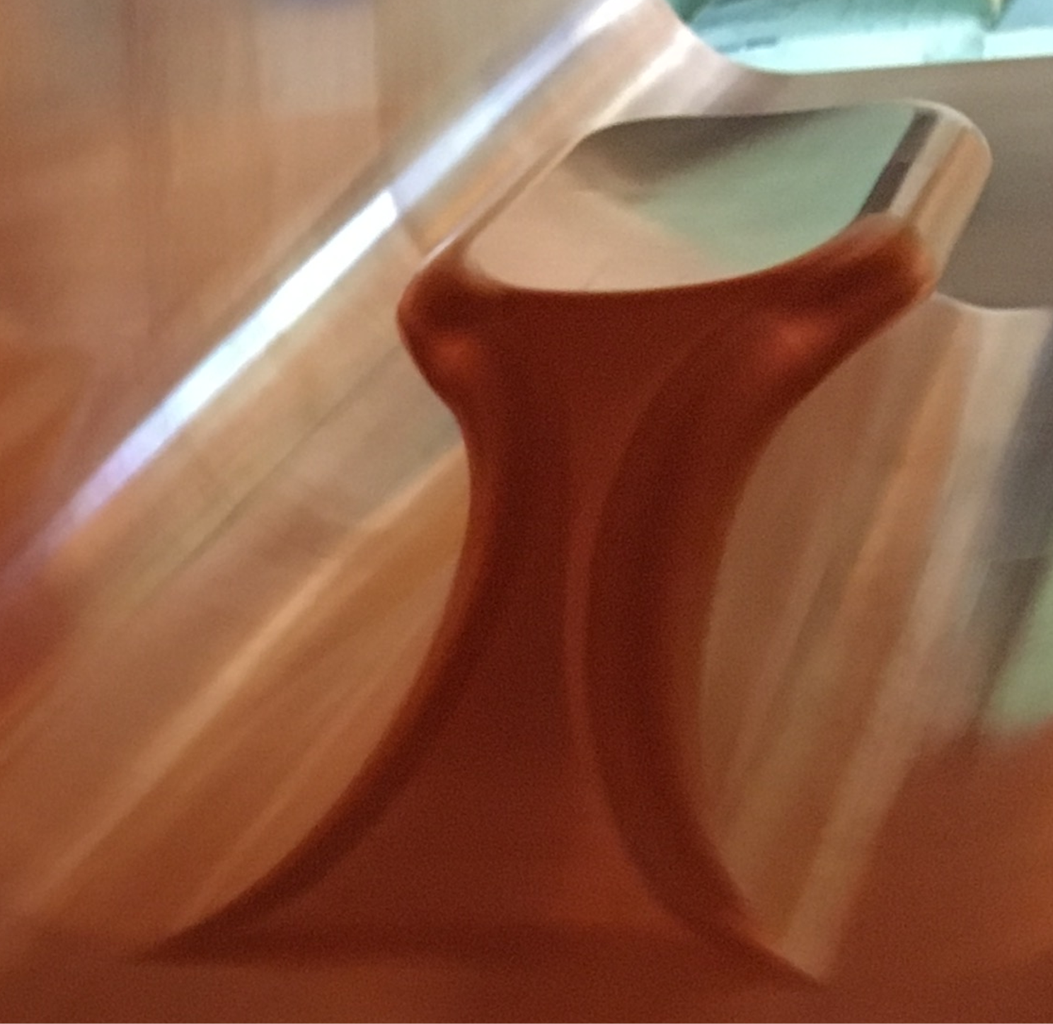
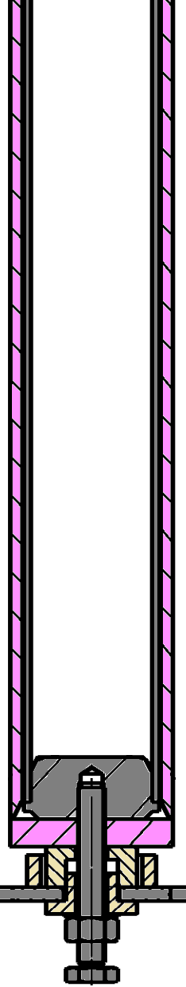
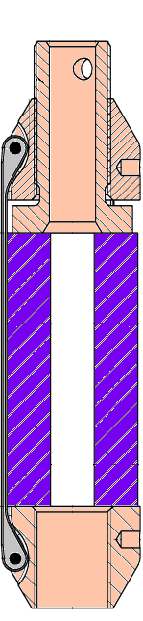
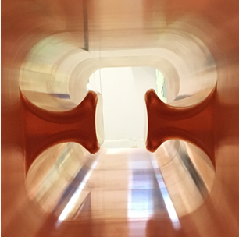
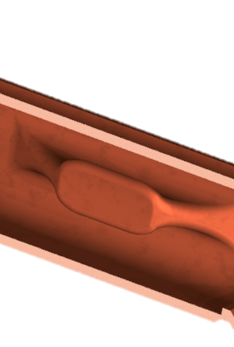
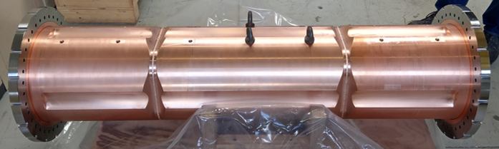
1. Multi-cathode coating set-up
Challenging internal geometry
Assembly of six independent, alignable cathode cylinders
Air-cooled movable magnets
Bipolar HiPIMS technique in Ar
Stainless
steel tube
Air flow
Nb cylinders
“Mushroom” ridge
Nb sputtering flux
Moving
magnet
FWHM
≈2cm
25 cm
140 cm, 290 kg
F. Avino et al, TTC, 05.02.2020, Geneva

Slide 5
Outline
Principal coating set-up
Coating recipe and test bench results
Simulations and process planning
Current state: Going full-scale
Perspectives for the year

Slide 6
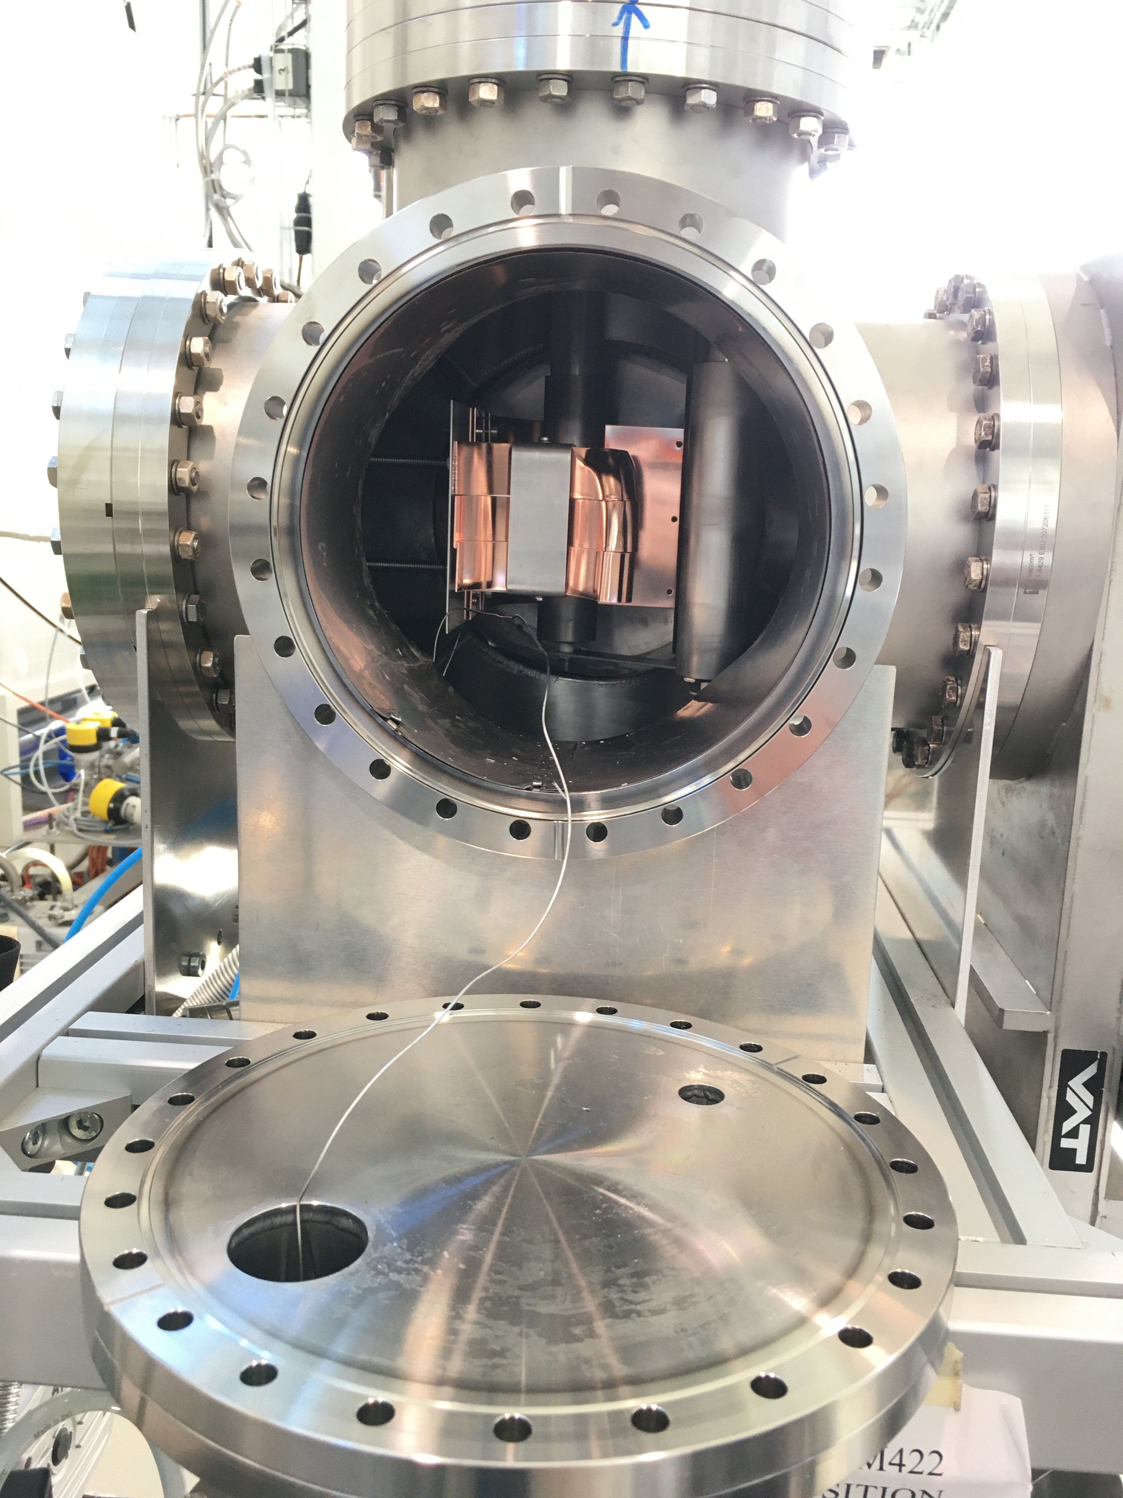
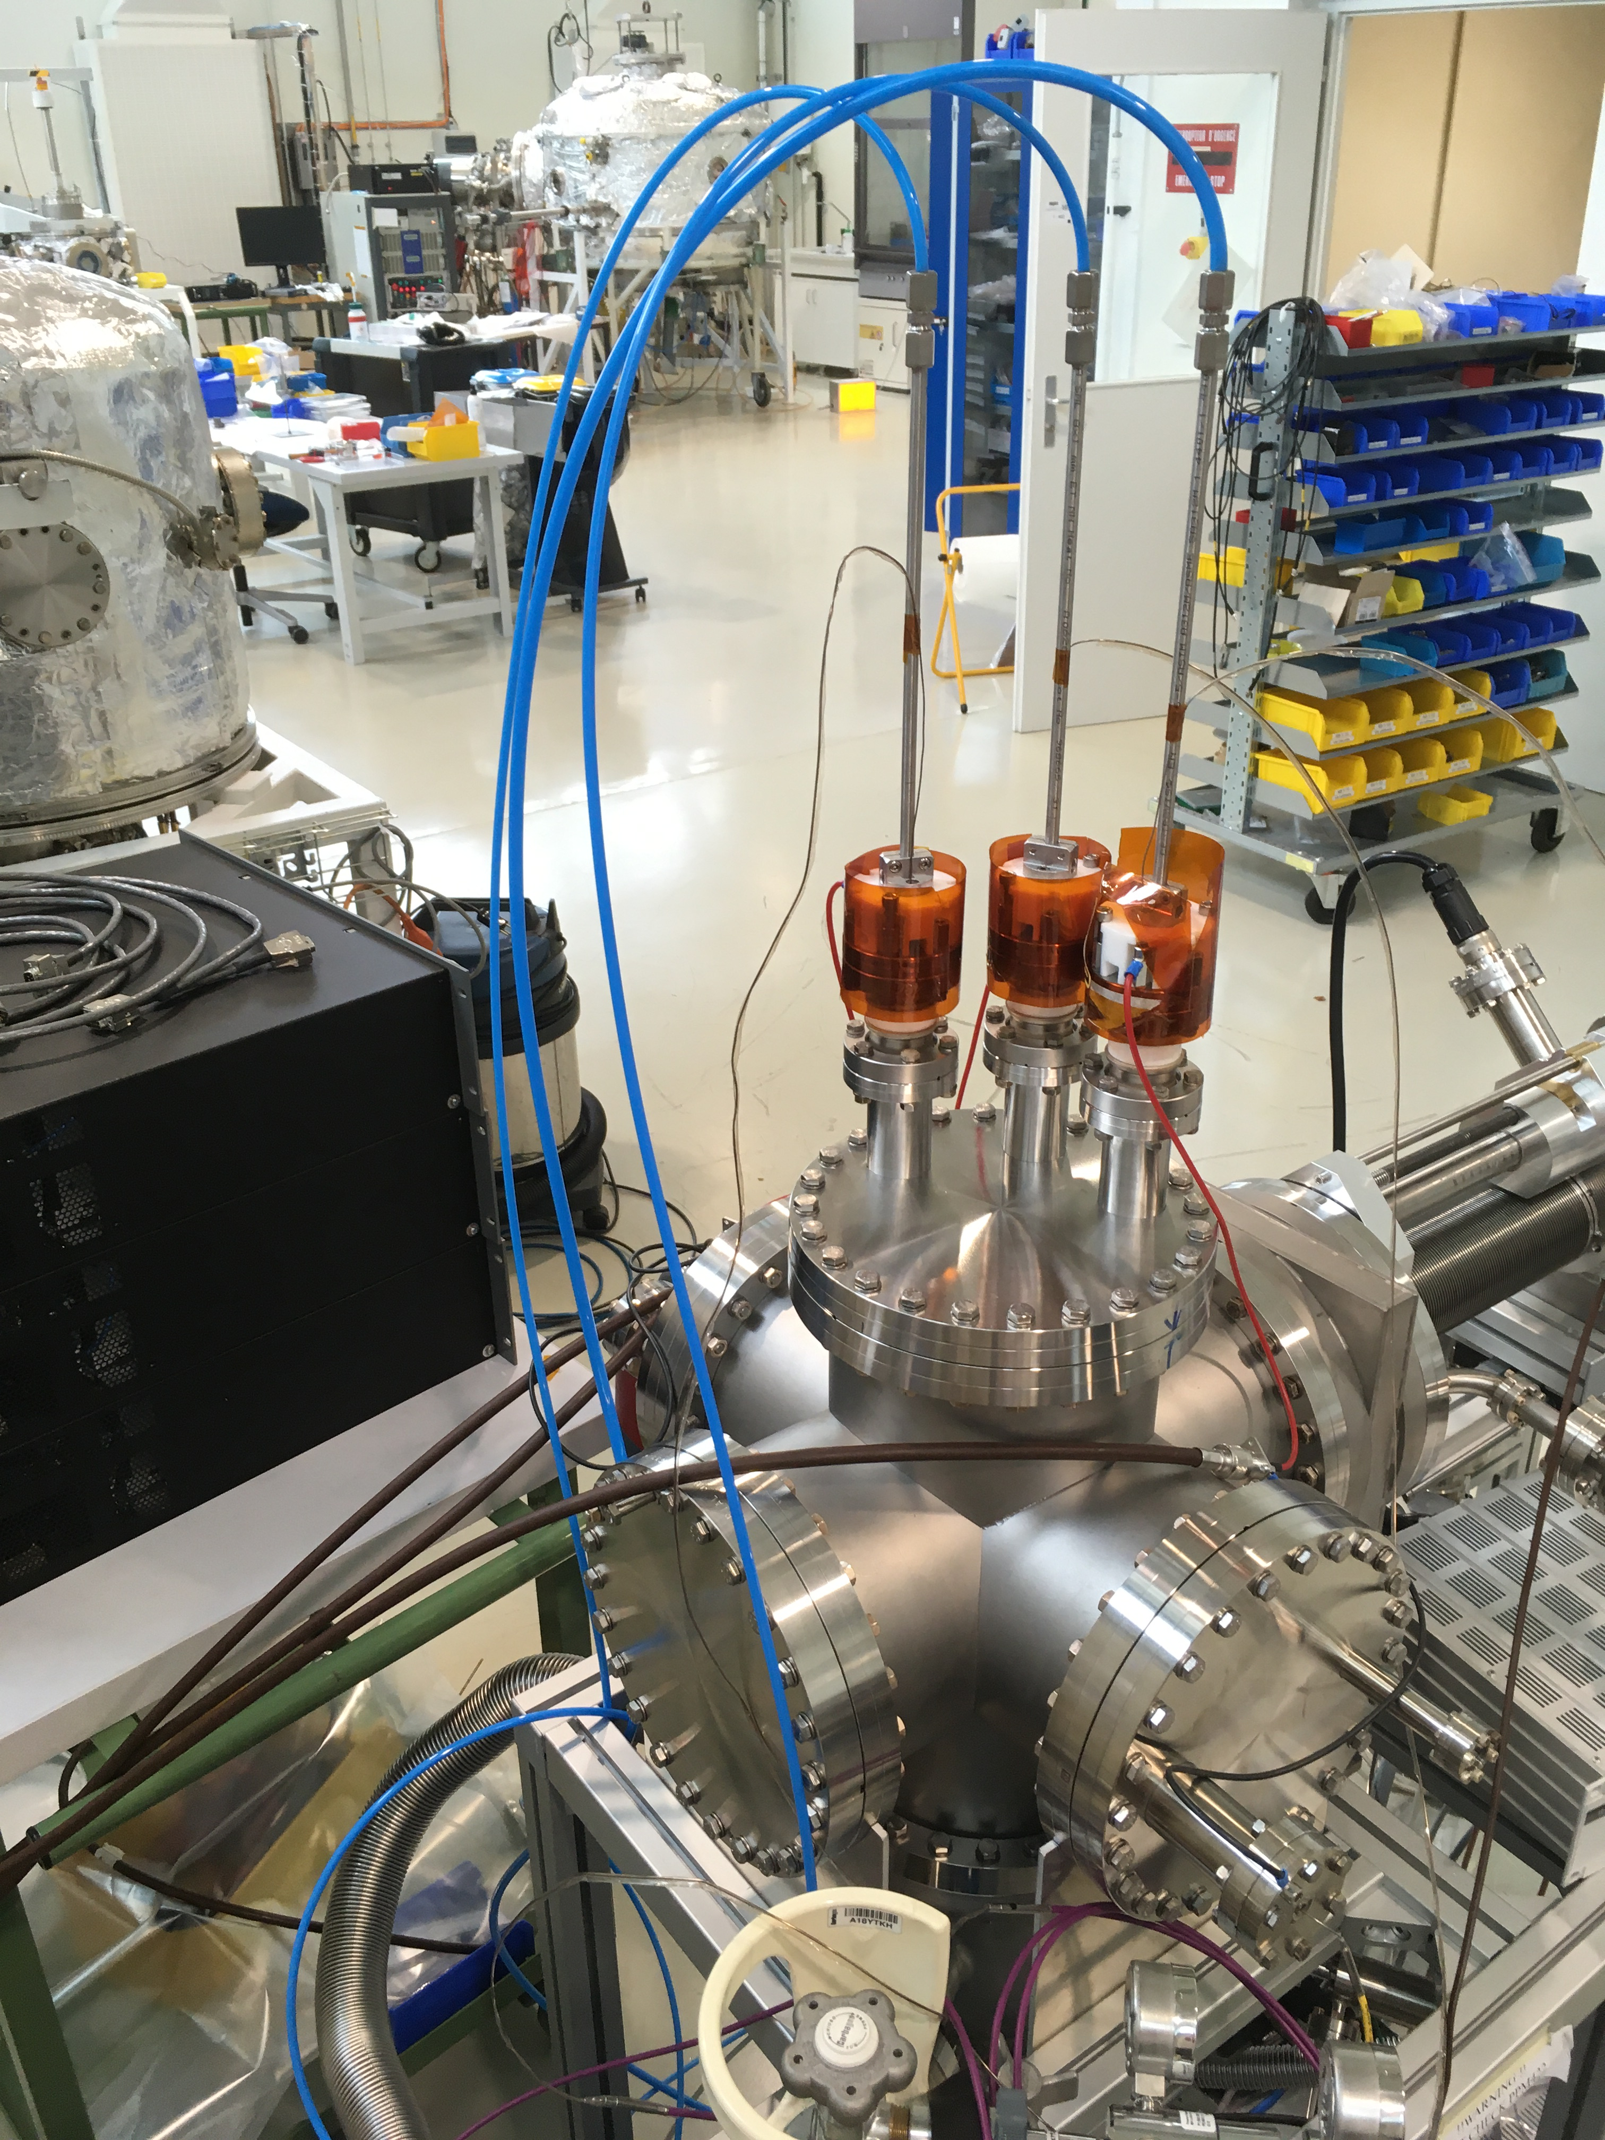
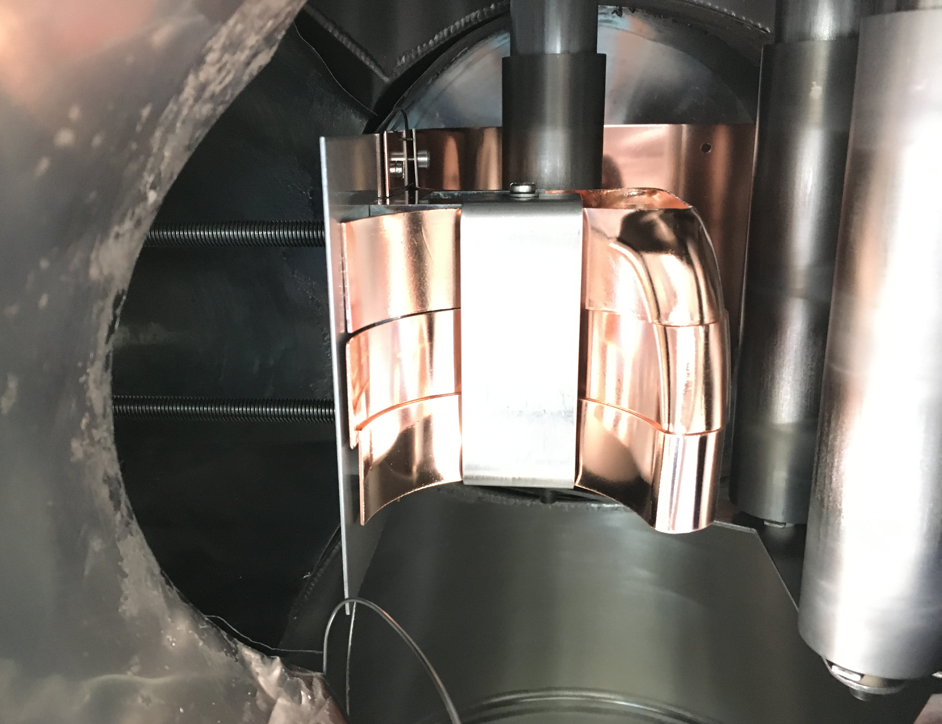
2. Coating testbench
Validate recipe, power, magnets for desired film uniformity and morphology
Three cathode coating testbench
The six-way cross
Side view
Bottom view
Stainless
steel tube
Air flow
Nb cylinders
Nb flux
Moving
magnet
Longitudinal cathode view
Before coating
After coating

Slide 7
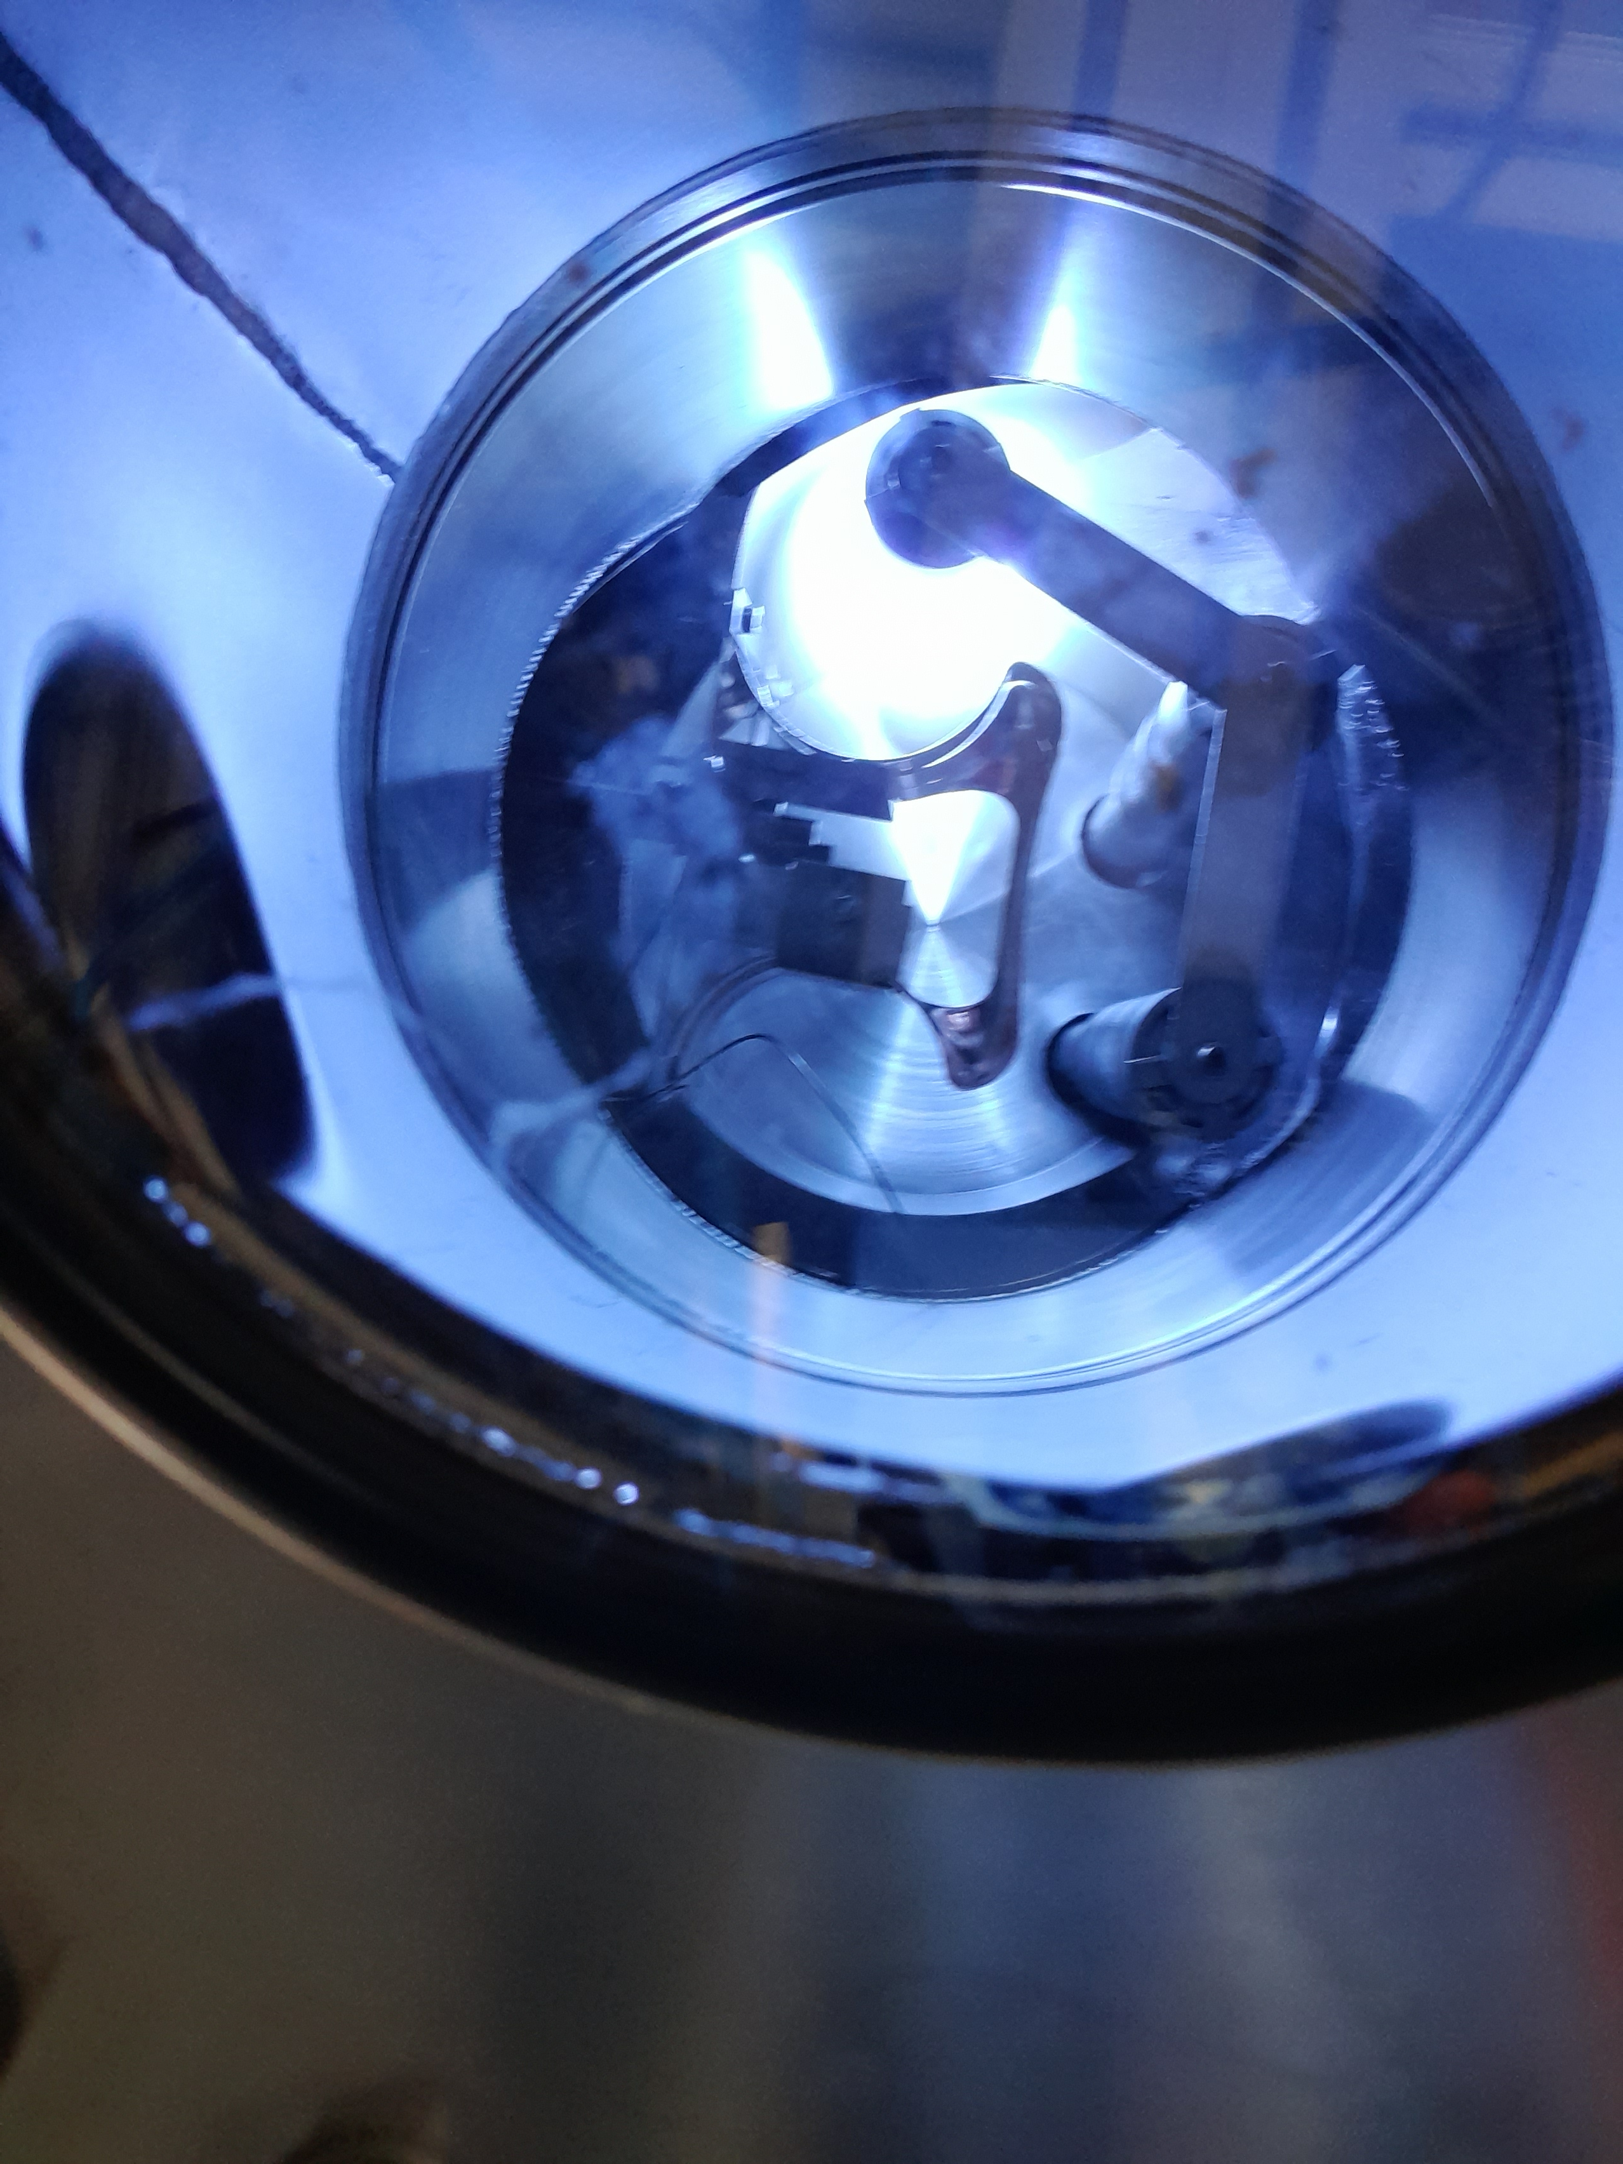
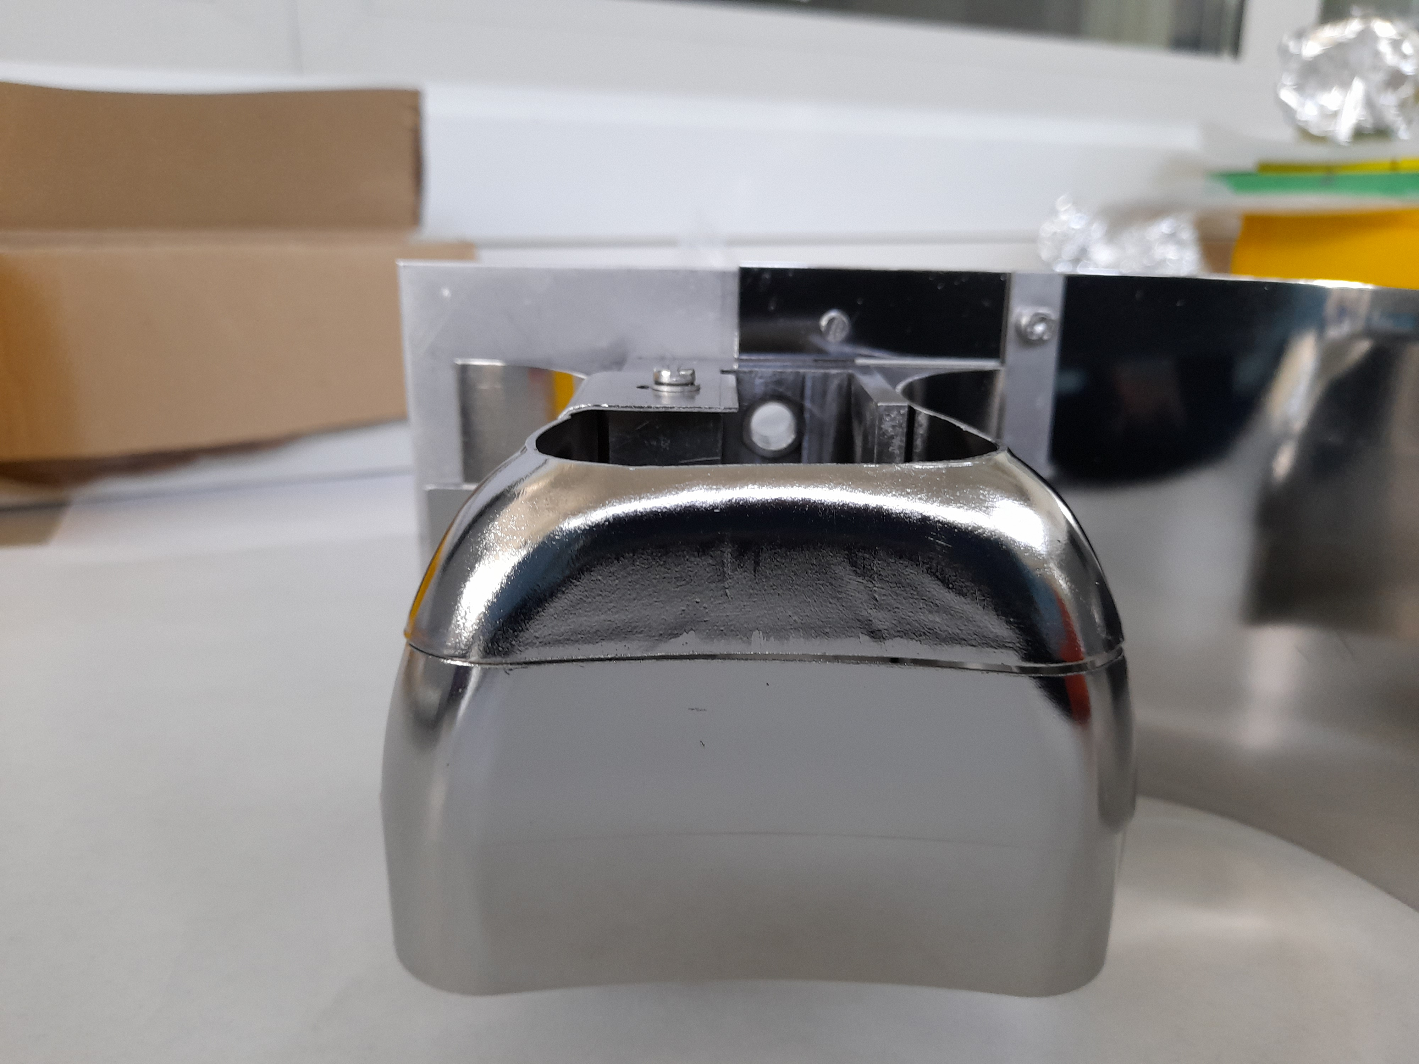
2. Coating testbench
Validate recipe, power, magnets for desired film uniformity and morphology
Three cathode coating testbench
The six-way cross
Side view
Bottom view
Stainless
steel tube
Air flow
Nb cylinders
Nb flux
Moving
magnet
Longitudinal cathode view
Before coating
After coating

Slide 8
2. Coating testbench
Validate recipe, power, magnets for desired film uniformity and morphology
Three cathode coating testbench
The six-way cross
Side view
Bottom view
Stainless
steel tube
Air flow
Nb cylinders
Nb flux
Moving
magnet
STEP1
Longitudinal cathode view
5cm
STEP2
Before coating
After coating

Slide 9
2. Coating testbench
Validate recipe, power, magnets for desired film uniformity and morphology
Three cathode coating testbench
The six-way cross
Side view
Bottom view
Stainless
steel tube
Air flow
CAT
1
Nb cylinders
Nb flux
Moving
magnet
STEP1
Longitudinal cathode view
5cm
STEP2
Before coating
After coating

Slide 10
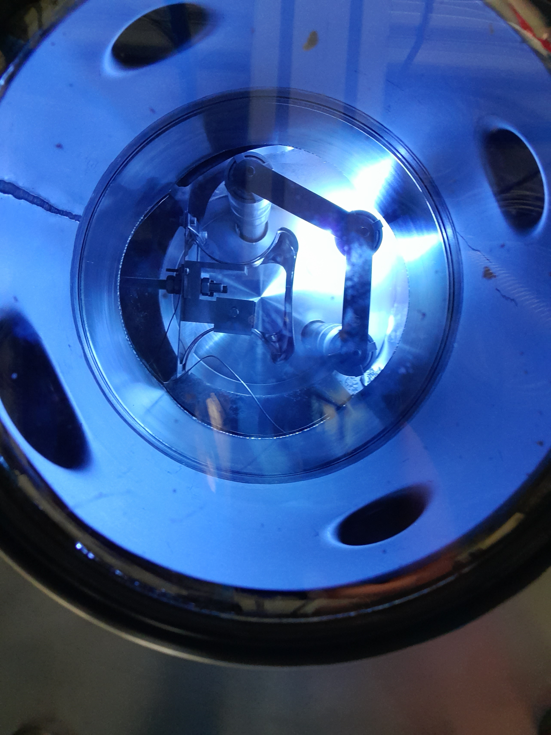
2. Coating testbench
Validate recipe, power, magnets for desired film uniformity and morphology
Three cathode coating testbench
The six-way cross
Side view
Bottom view
Stainless
steel tube
CAT
Air flow
1
CAT
2
Nb cylinders
Nb flux
Moving
magnet
STEP1
Longitudinal cathode view
5cm
STEP2
Before coating
After coating

Slide 11
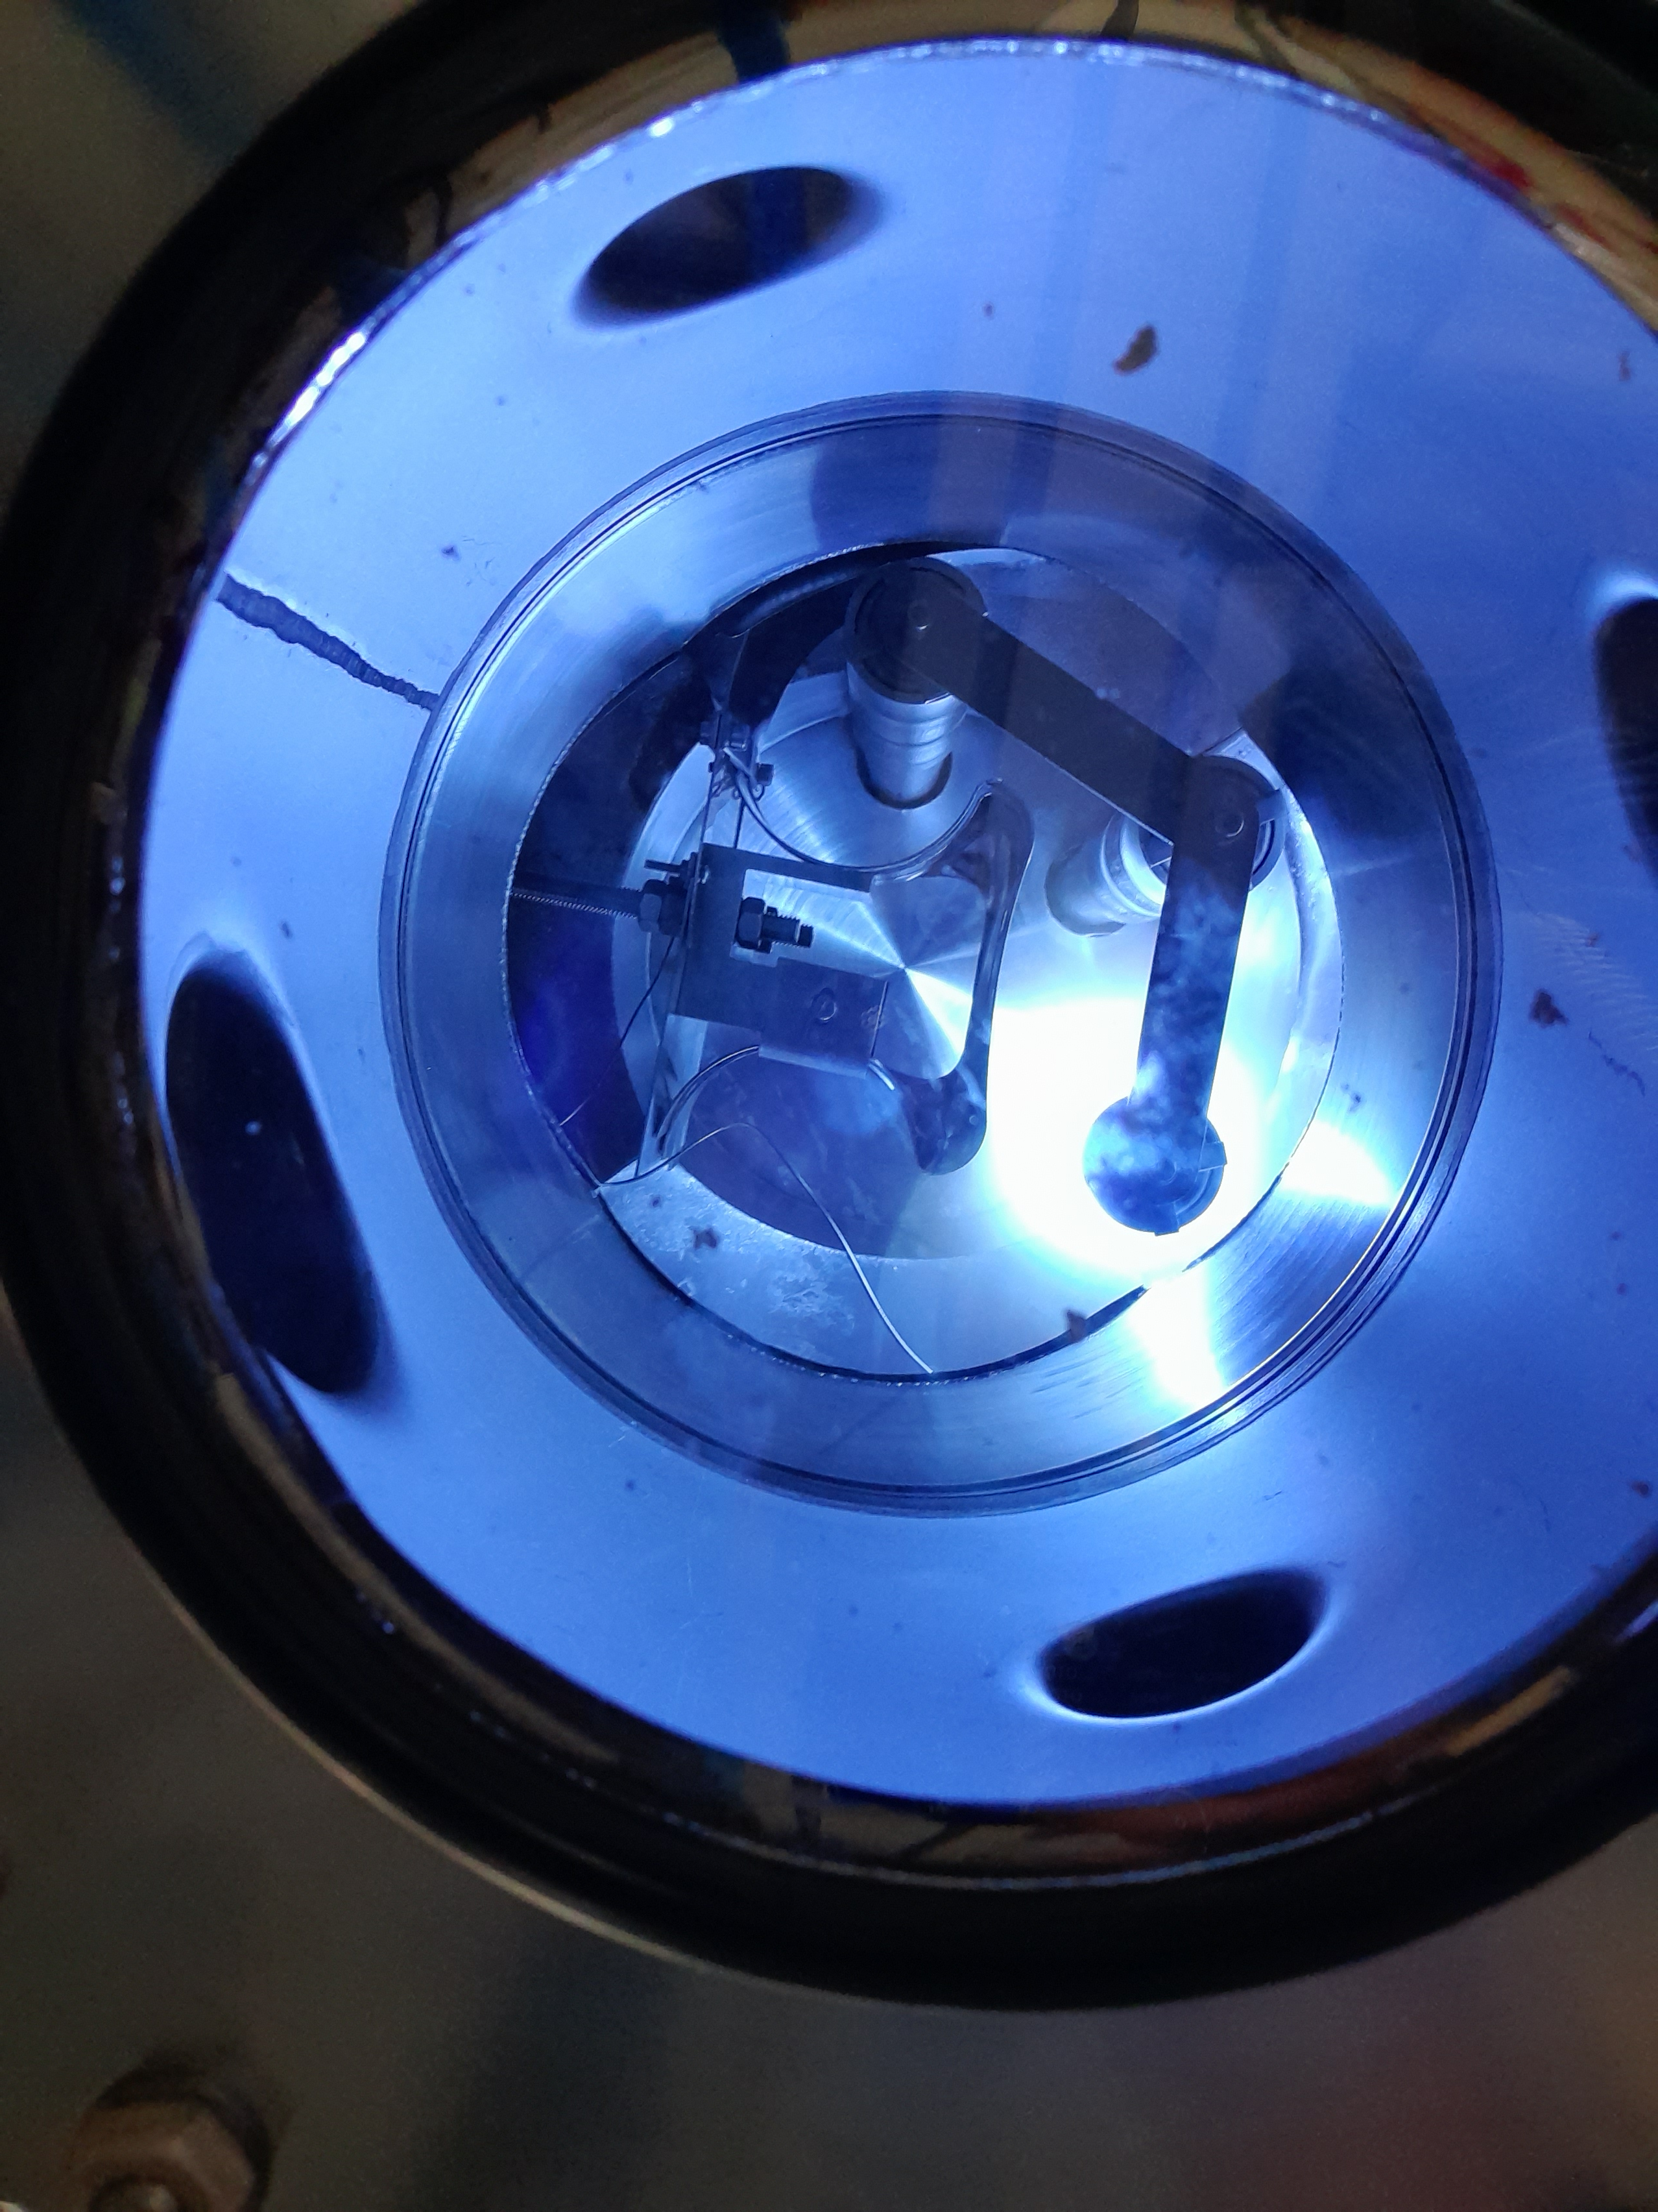
2. Coating testbench
Validate recipe, power, magnets for desired film uniformity and morphology
Three cathode coating testbench
The six-way cross
Side view
Bottom view
Stainless
steel tube
CAT
Air flow
1
CAT
2
Nb cylinders
CAT
3
Nb flux
Moving
magnet
STEP1
Longitudinal cathode view
5cm
STEP2
Before coating
After coating

Slide 12
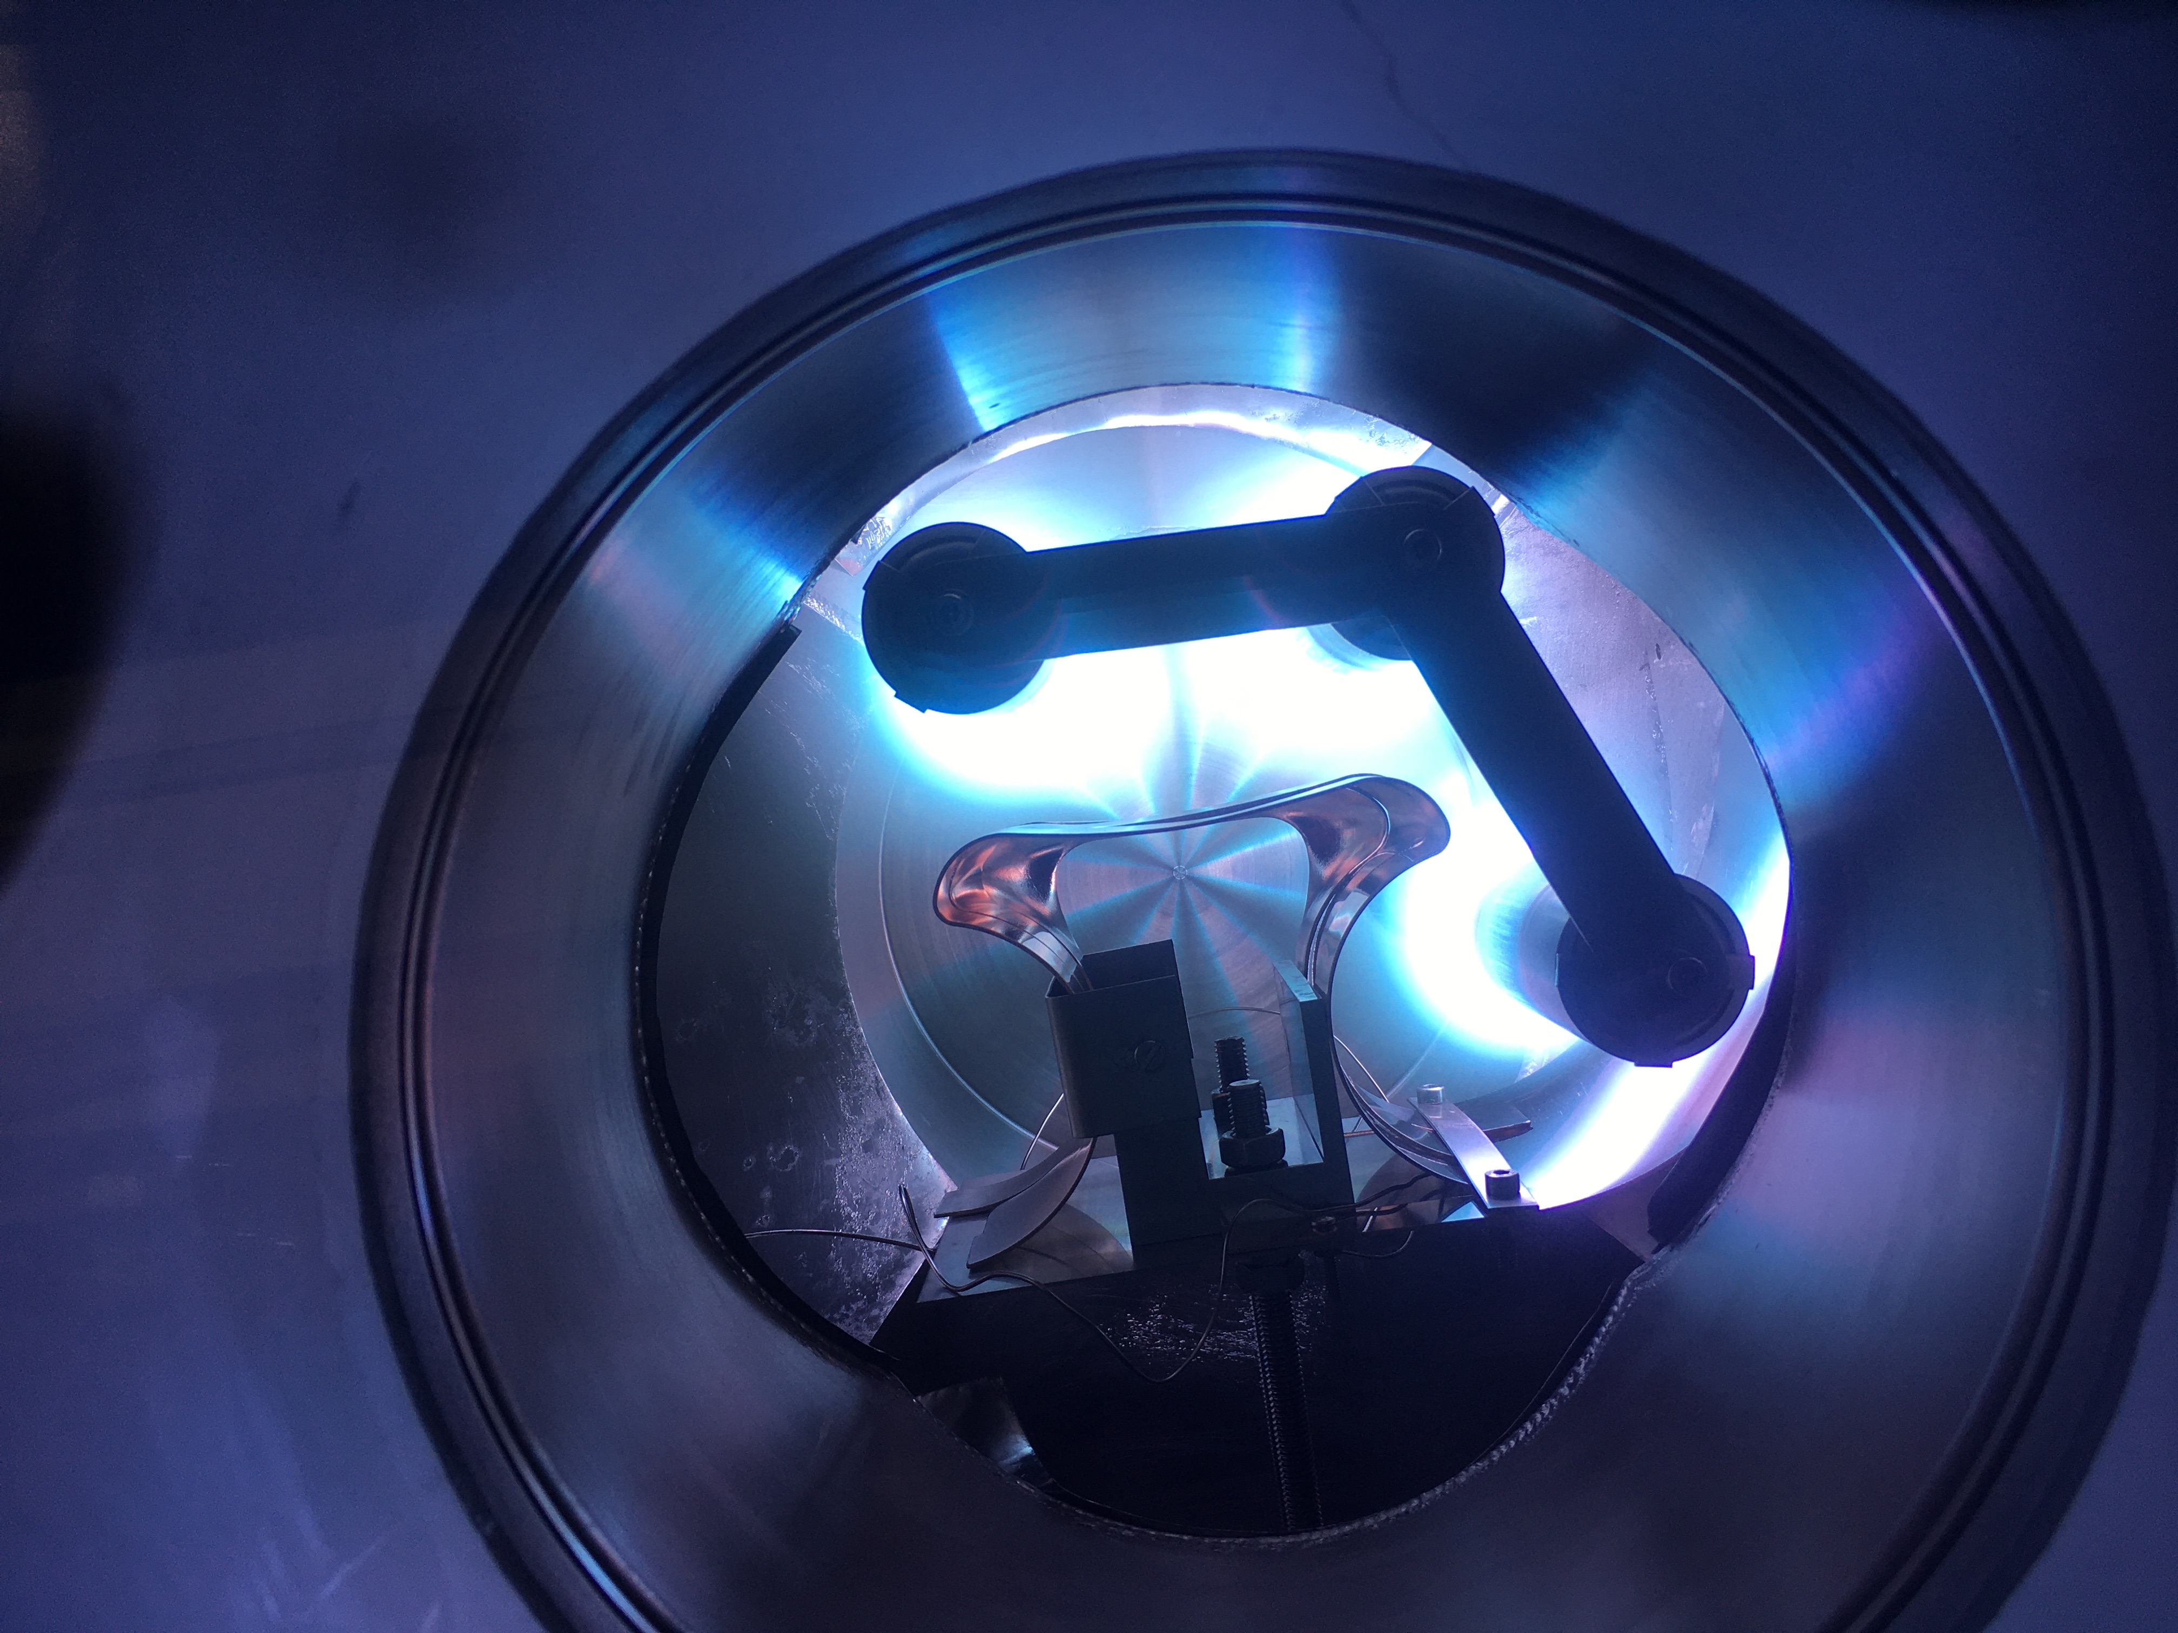
2. Coating testbench
Validate recipe, power, magnets for desired film uniformity and morphology
Three cathode coating testbench
The six-way cross
Side view
Bottom view
Stainless
steel tube
Air flow
Nb cylinders
Nb flux
Moving
magnet
STEP1
Longitudinal cathode view
5cm
STEP2
Before coating
After coating

Slide 13
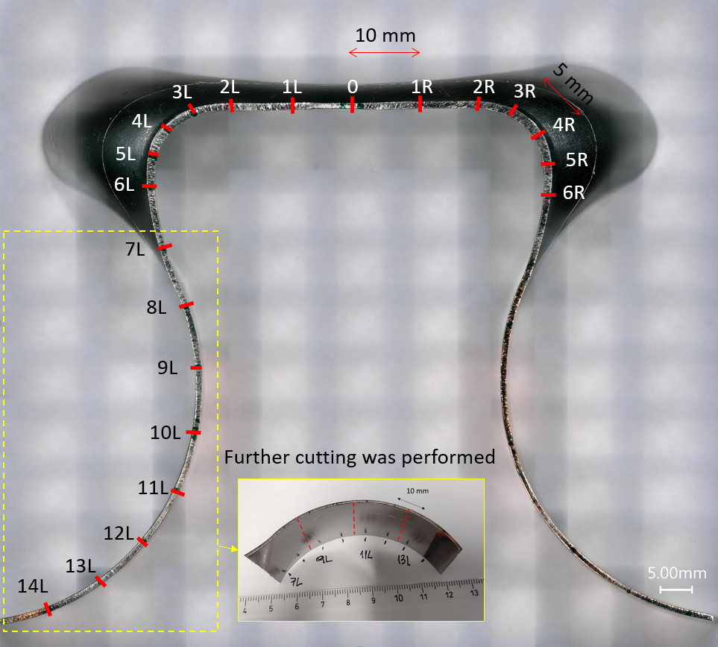
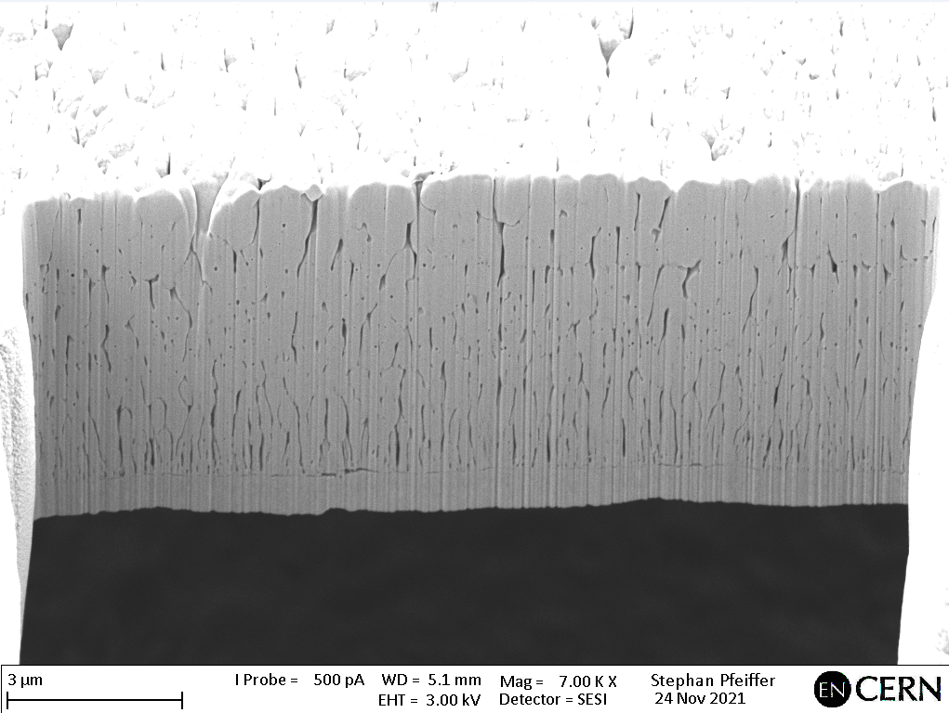
2. Thin film densification : RF hot spot
2
3
STRONG tilt along cathode axis and curve in plane
Film entirely porous and delaminated in DCMS
Still voids near substrate at 500W sequential Bipolar HiPIMS
1
DCMS, parallel, 3x1kW
BP, HiPIMS sequential, 500W
Delaminated
3 µm
2 μm
F. Manke et al, HiPIMS Today, 22/03/2023

Slide 14
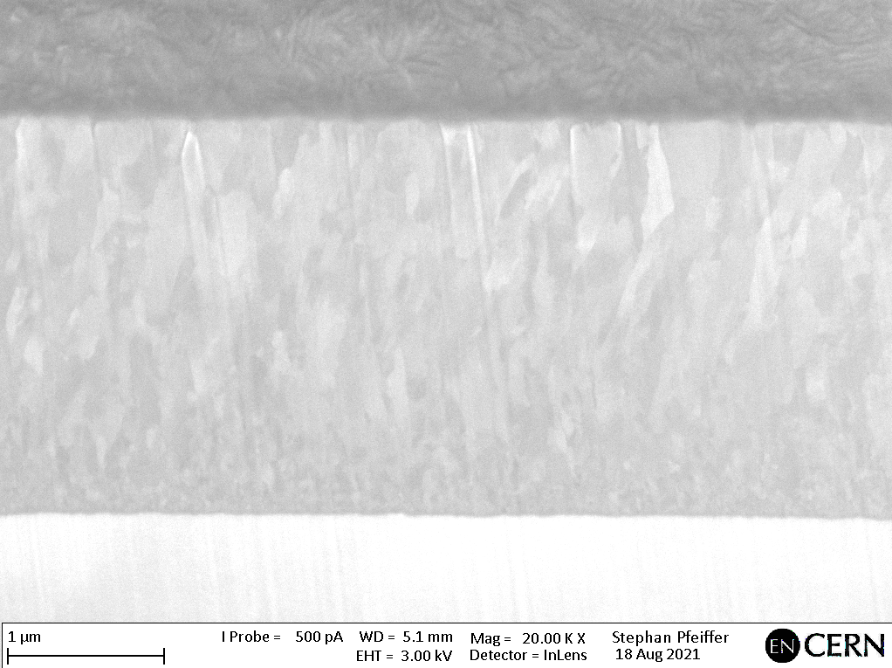
2. Thin film densification : RF hot spot
2
3
STRONG tilt along cathode axis and curve in plane
Film entirely porous and delaminated in DCMS
Dense films achieved for 1kW Bipolar HiPIMS
→ Preparing publication of 3D sample results
1
DCMS, parallel, 3x1kW
BP HiPIMS, sequential, 1kW
BP HiPIMS, parallel, 3x1kW
Reduced coating time by 30% to 15min
More recycling w. adjacent plasmas + fields ?
Delaminated
3 µm
1 µm
1 µm
F. Manke et al, HiPIMS Today, 22/03/2023

Slide 15
Outline
Principal coating set-up
Coating recipe and test bench results
Simulations and process planning
Current state: Going full-scale
Perspectives for the year

Slide 16
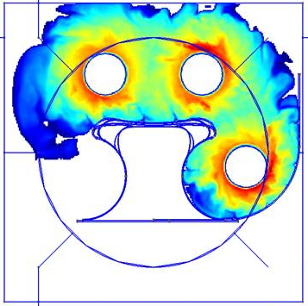
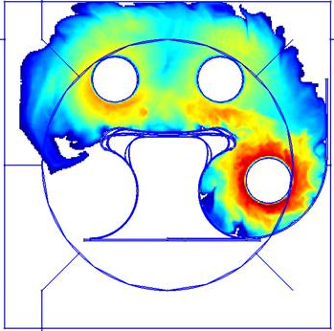

3. Simulations: mock-up geometry
Simulation: T. Richard
Confirms importance of individual powering + insulation
Breakdown voltage of -270V at 15W power matches experiment within 10%
5W individual power
15W common power
n_{e} [m⁻³]
A. Pflug, DSMC/PIC-MC Code Documentation, Fraunhofer IST, Braunschweig, Germany,, https://simulation.ist.fraunhofer.de/doku.php?id=start

Slide 17
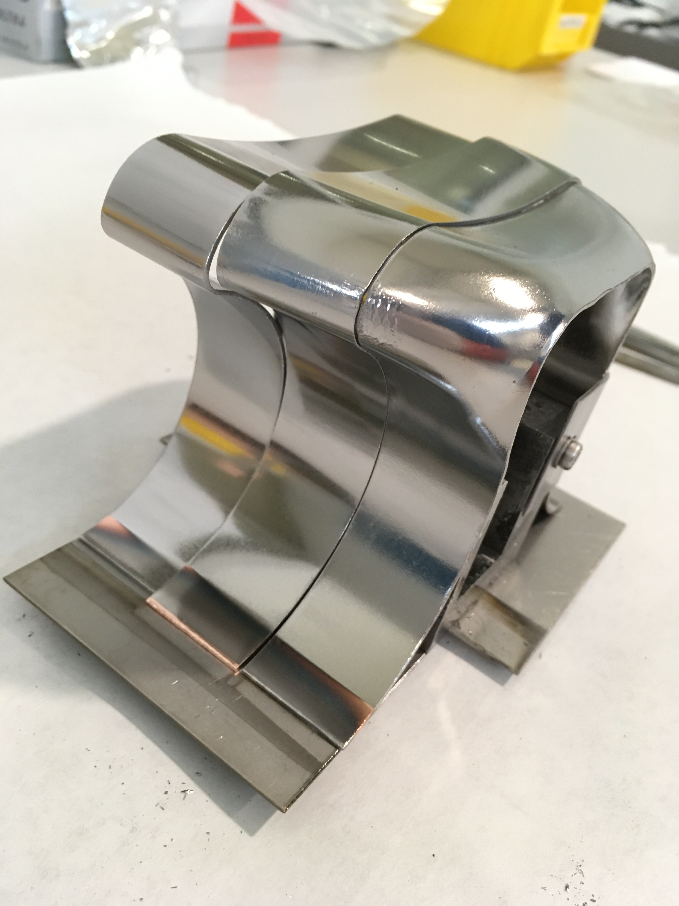

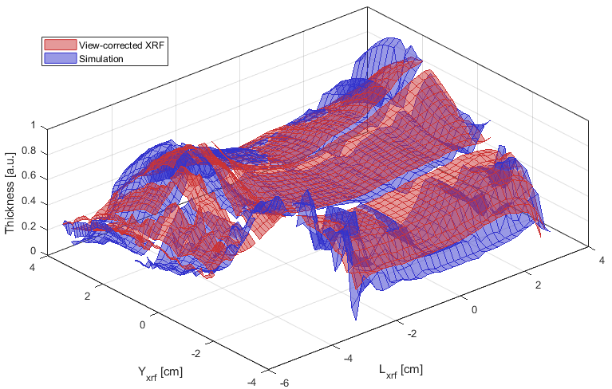
3. Benchmarking of XRF thickness measurements
Obtain Nb deposition profile from subsequent MC transport simulation
Yxrf
Compare to experimental thickness measurements with XRF
Use synthetic diagnostic for post-processing in MATLAB
Overall strong agreement (within ≈ 20%), pending local MC counting errors and slight shift of source
0
Lxrf
F. Manke et al, PLATHINIUM, 09/2021

Slide 18
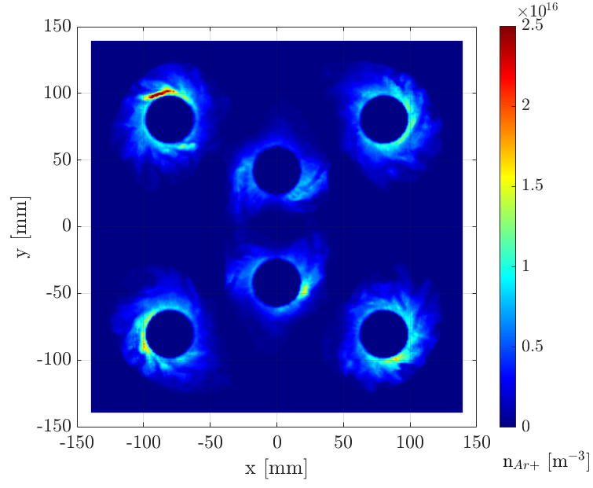
3. Full WOWCC simulations as starting point
PICMC / DSMC simulations to establish cross-sectional Nb deposition profiles
Argon plasma density from Fraunhofer PIC-MC
4µs
“Mushroom” ridge
Simulation: T. Richard
F. Manke et al, 18th PSE, Erfurt 2022

Slide 19
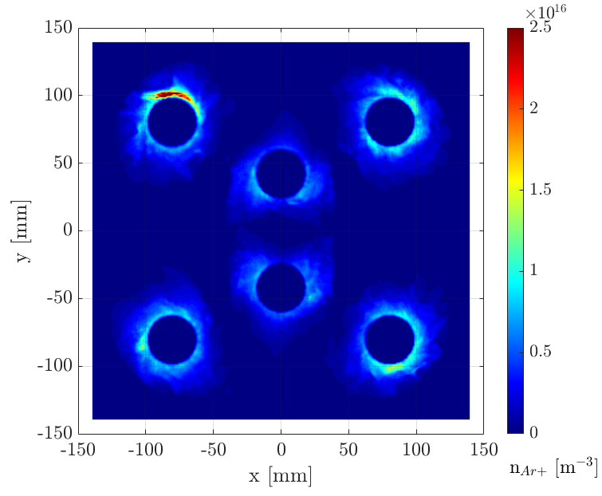
3. Full WOWCC simulations
PICMC / DSMC simulations to establish cross-sectional Nb deposition profiles
Argon plasma density from Fraunhofer PIC-MC
5µs
“Mushroom” ridge
Simulation: T. Richard
F. Manke et al, 18th PSE, Erfurt 2022

Slide 20
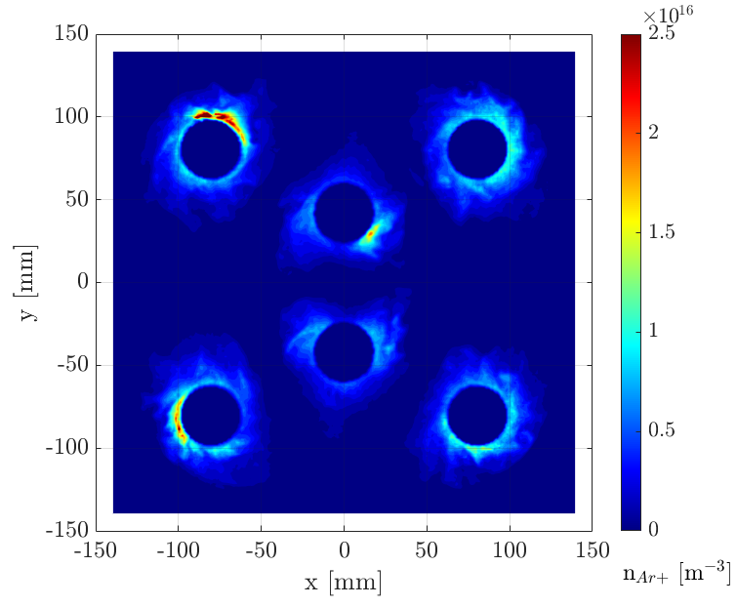
3. Full WOWCC simulations
PICMC / DSMC simulations to establish cross-sectional Nb deposition profiles
Argon plasma density from Fraunhofer PIC-MC
6µs
“Mushroom” ridge
Simulation: T. Richard
F. Manke et al, 18th PSE, Erfurt 2022

Slide 21
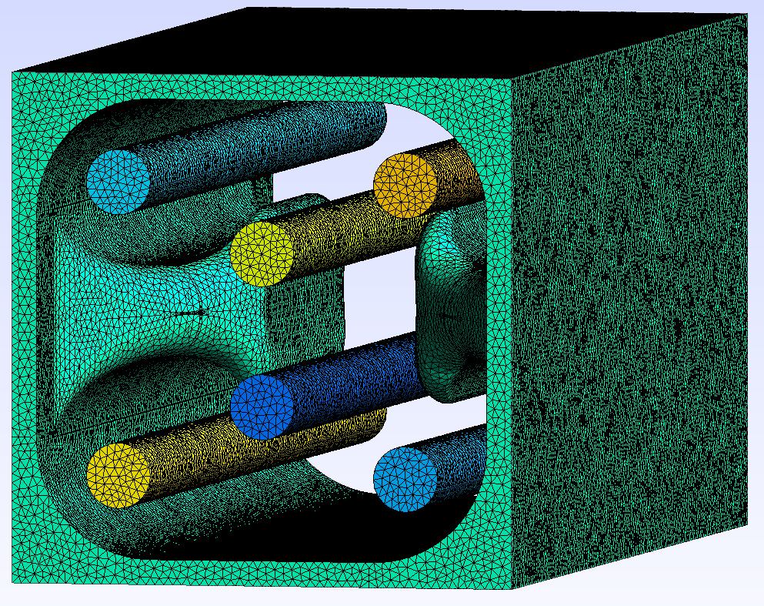
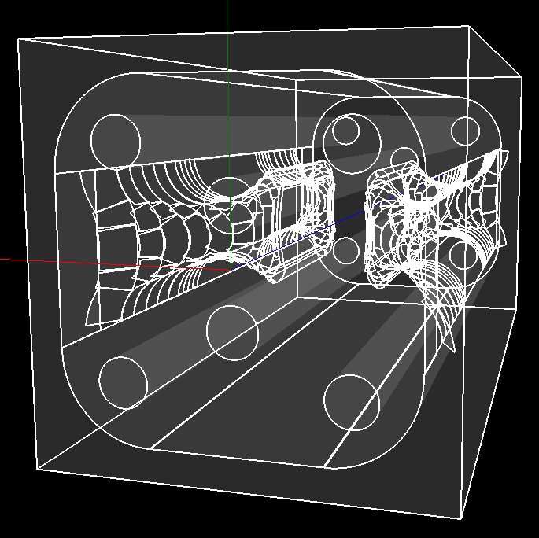
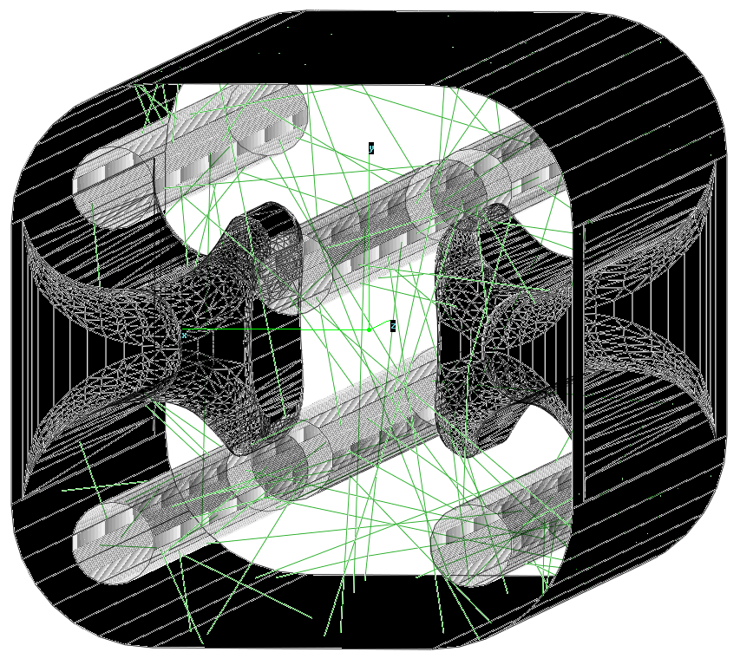
3. Synergies: transport comparison
F. Manke et al, 18th PSE, Erfurt 2022
 | Fraunhofer DSMC | SIMTRA | Molflow
Erosion profile | PIC-MC, single step | From PIC-MC / fitted | From PIC-MC / fitted
Propagation | MC particle tracker | MC particle tracker | MC ray tracer
Collisions | From customizable cross-section database | Select neutral metal + gas and potential type (Moliere) | None
Geometry | Triangulated by GMSH | Geometric primitives | Re-meshed from .stl
Resources | HPC, 1 to 10 days → Reactions + geometry | Desktop PC, ½ to 2 days → Extent of sources | Desktop PC, ¼ to 2 days → Nr. of “facets” in mesh
WOWCC imported

Slide 22
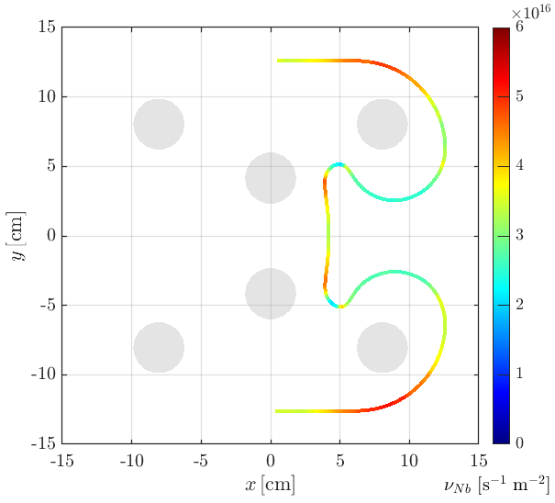
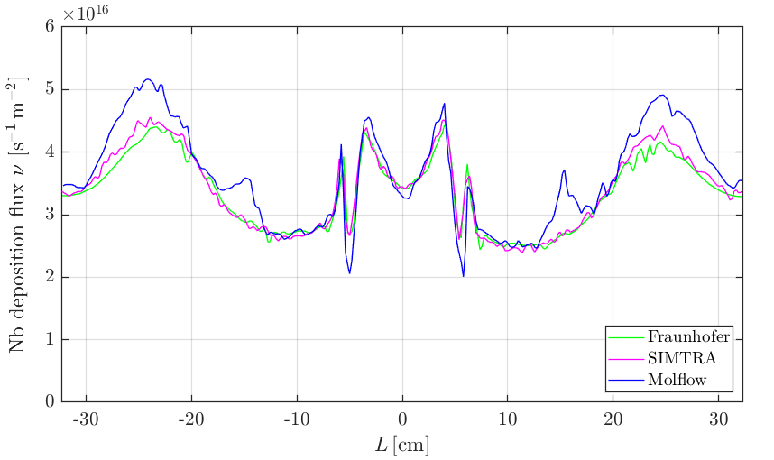
3. Synergies: Code development
PICMC / DSMC simulations to establish cross-sectional Nb deposition profiles
Spin-off: Transport code benchmarking and extension to Molflow: gas collisions
Niobium flux profile from Molflow (collisionless)
“Mushroom” ridge
L = 0
→ Local discrepancies since flux from distant cathodes did not scatter off argon gas
F. Manke et al, 18th PSE, Erfurt 2022

Slide 23
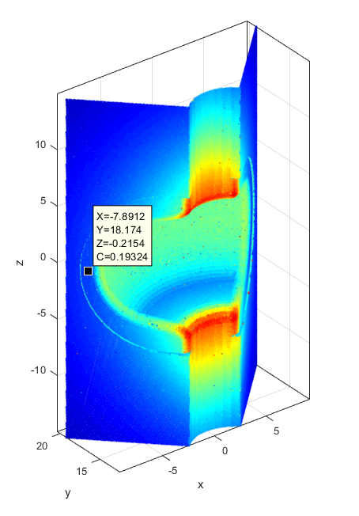
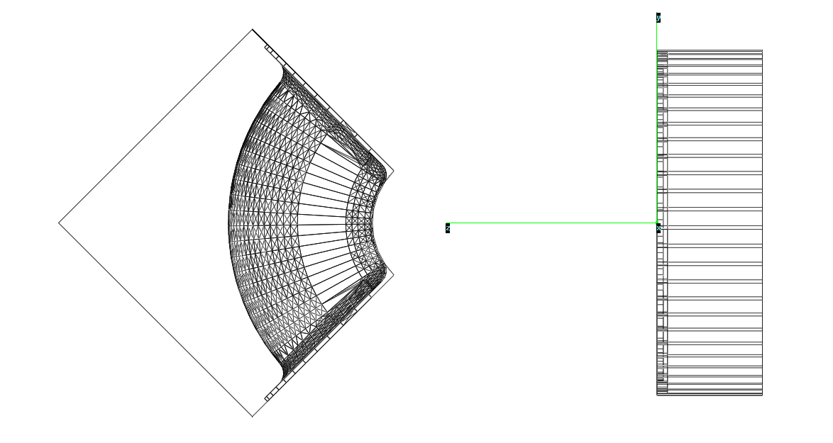
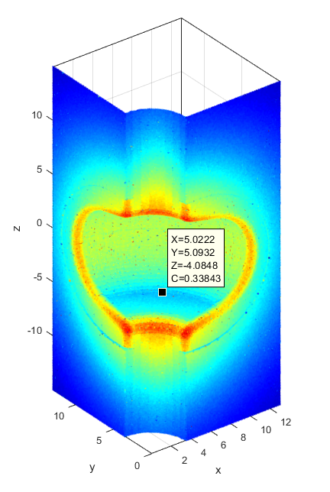
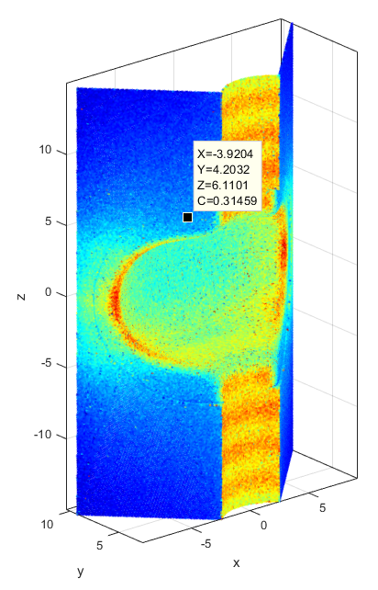
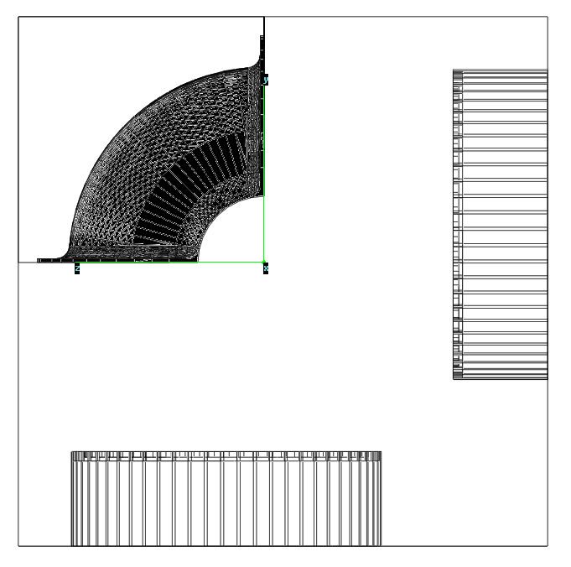
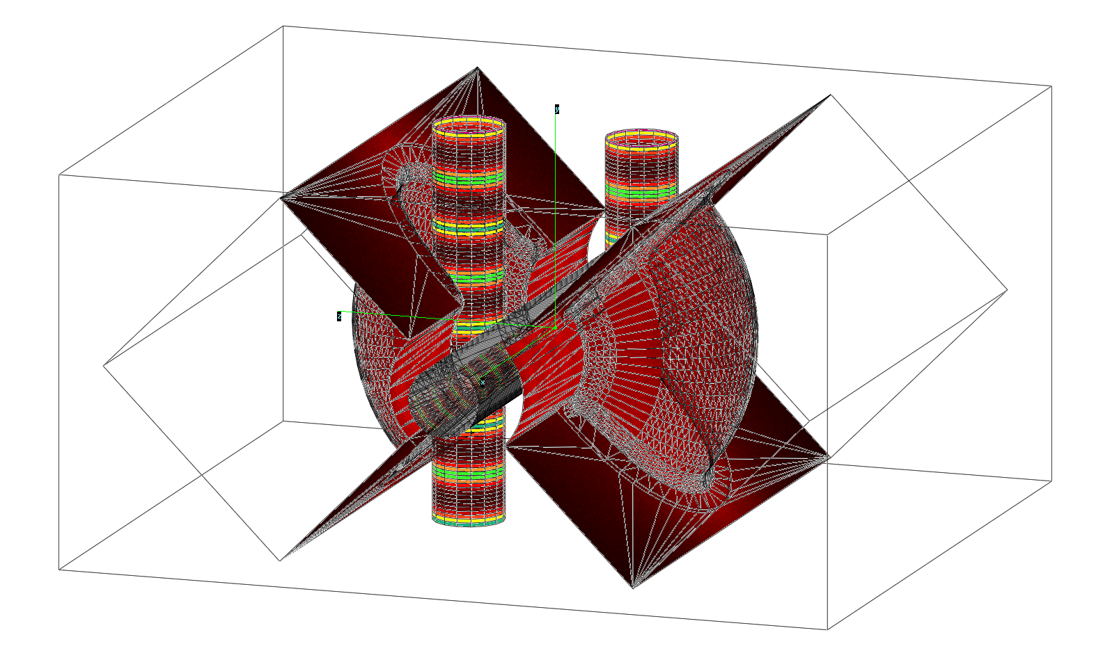
3. Synergies: The SWELL cavity
PICMC / DSMC simulations to establish cross-sectional Nb deposition profiles
Spin-off: Transport code benchmarking and extension to Molflow: gas collisions
Transport simulations for SWELL coating
D

Slide 24
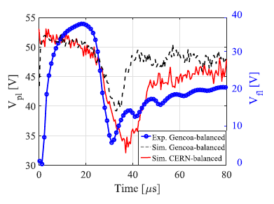
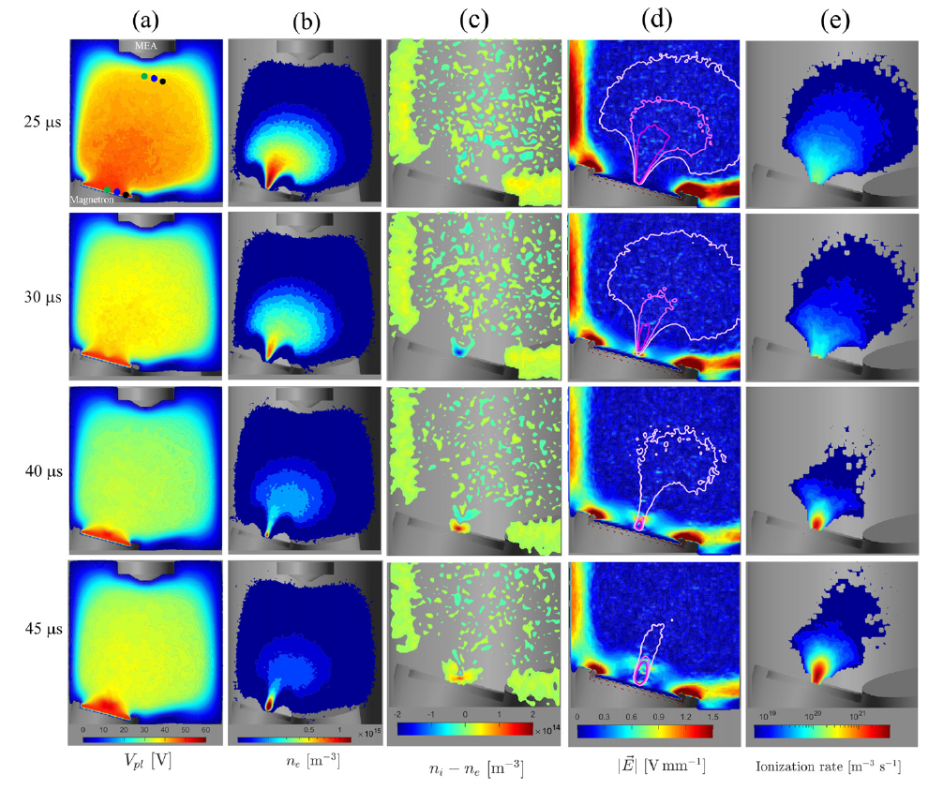
3 Synergies: Fundamental dynamics
Bipolar High Power Impulse Magnetron Sputtering
[2] F. Avino et al, Plasma Sources Sci. Technol. 28, 01LT03, 2019
[3] F. Avino et al,Thin Solid Films 706,138058, 2020
[4] F. Avino, F. Manke, A. Sublet, T. Richard:
Plasma Sources Sci. Technol. 30, 115015, 2021
Comprehensive measurements and deeper fundamental understanding of plasma potential dynamics in bipolar magnetron discharges
  Documented Potential Drop-n-Rise in various settings
  Elucidated electron funneling in balanced configurations
  Established conditions for a secondary “reverse” discharge

Slide 25
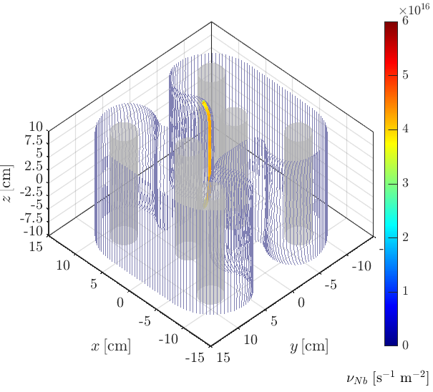
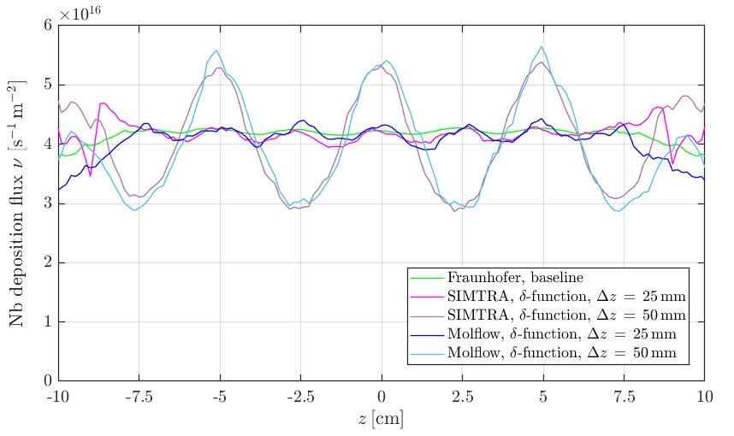
3. Process planning: Magnet step size
Across region of strongest variations → within 2 cm from nearest cathode
Chose 25 mm steps to
avoid bottle-necking by
local deposition minima
F. Manke et al, 18th PSE, Erfurt 2022

Slide 26
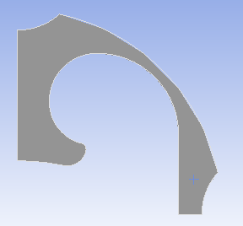
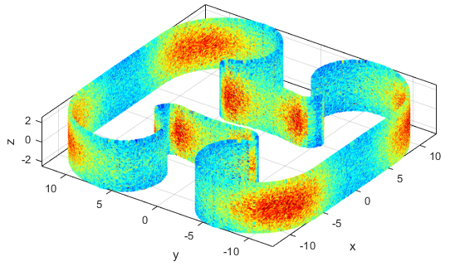
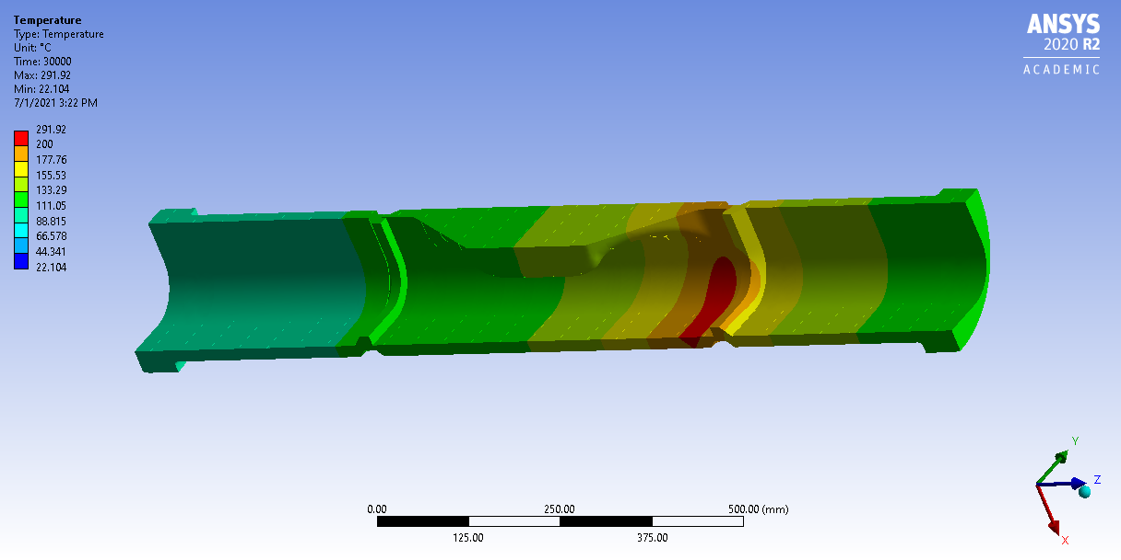
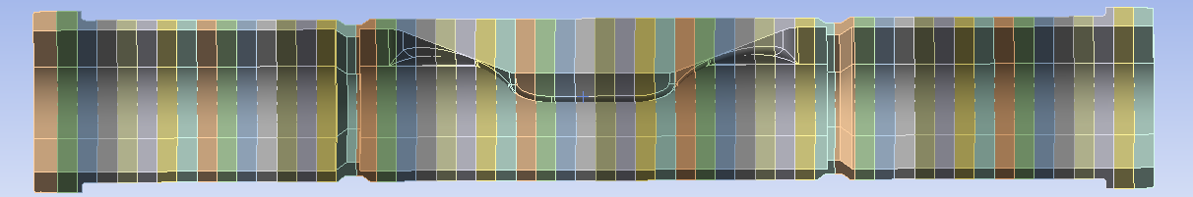
3. Heat load simulations
ANSYS simulations by L. Baudin
Molflow / Synrad heat deposition profile
ANSYS simulations of ¼ WOWCC
Process steps:
  3×5min coating with 200s breaks each, 2.5cm steps along the cavity
1500 W
1
“cut-off”
3
cavity center
“cut-off”
2
F. Manke et al, PLATHINIUM, 09/2021

Slide 27
3. Cooling requirements
ANSYS simulations by L. Baudin
Molflow / Synrad heat deposition profile
ANSYS simulations of ¼ WOWCC
Process steps:
  3×5min coating with 200s breaks each, 2.5cm steps along the cavity
1500 W
Air stationary
1
“cut-off”
3
cavity center
“cut-off”
2
F. Manke et al, PLATHINIUM, 09/2021

Slide 28
3. Cooling requirements
ANSYS simulations by L. Baudin
Molflow / Synrad heat deposition profile
ANSYS simulations of ¼ WOWCC
Process steps:
  3×5min coating with 200s breaks each, 2.5cm steps along the cavity
1500 W
Forced air convection
Air stationary
1
“cut-off”
3
cavity center
“cut-off”
2
F. Manke et al, PLATHINIUM, 09/2021

Slide 29
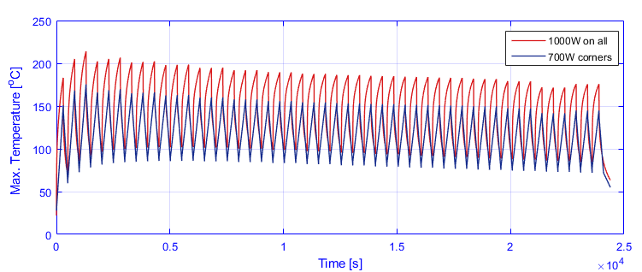
3. Cathode power limits
ANSYS simulations by L. Baudin
Molflow / Synrad heat deposition profile
ANSYS simulations of ¼ WOWCC
Process steps:
  3×5min coating with 200s breaks each,
  2.5cm steps along the cavity
Forced air cooling required
Corner cathodes at 75% power in cut-offs
1500 W
1
bake-out limit
1
“cut-off”
3
cavity center
“cut-off”
2
100% corners 75% corners
F. Manke et al, PLATHINIUM, 09/2021

Slide 30
Outline
Principal coating set-up
Coating recipe and test bench results
Simulations and process planning
Current state: Going full-scale
Perspectives for the year

Slide 31
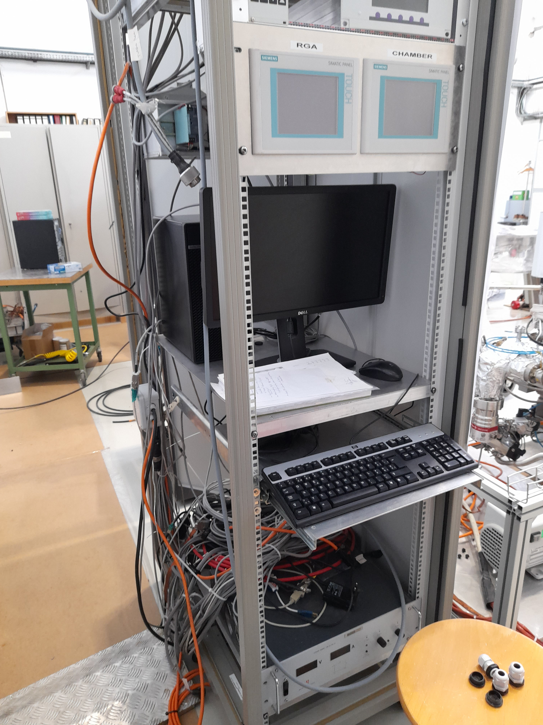
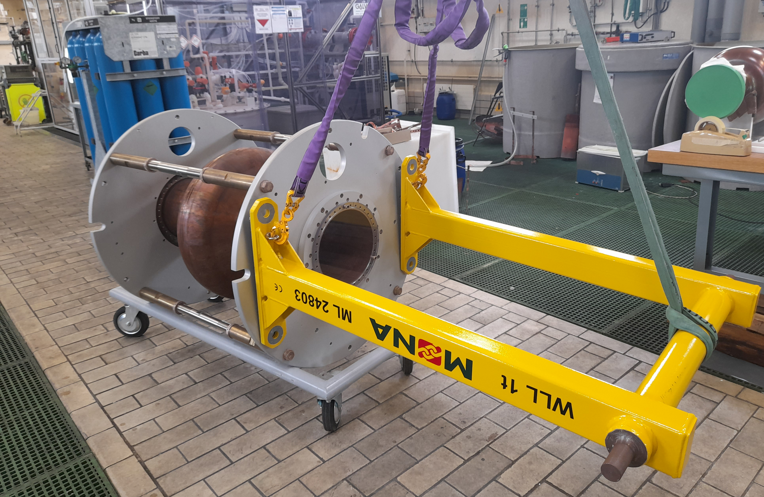
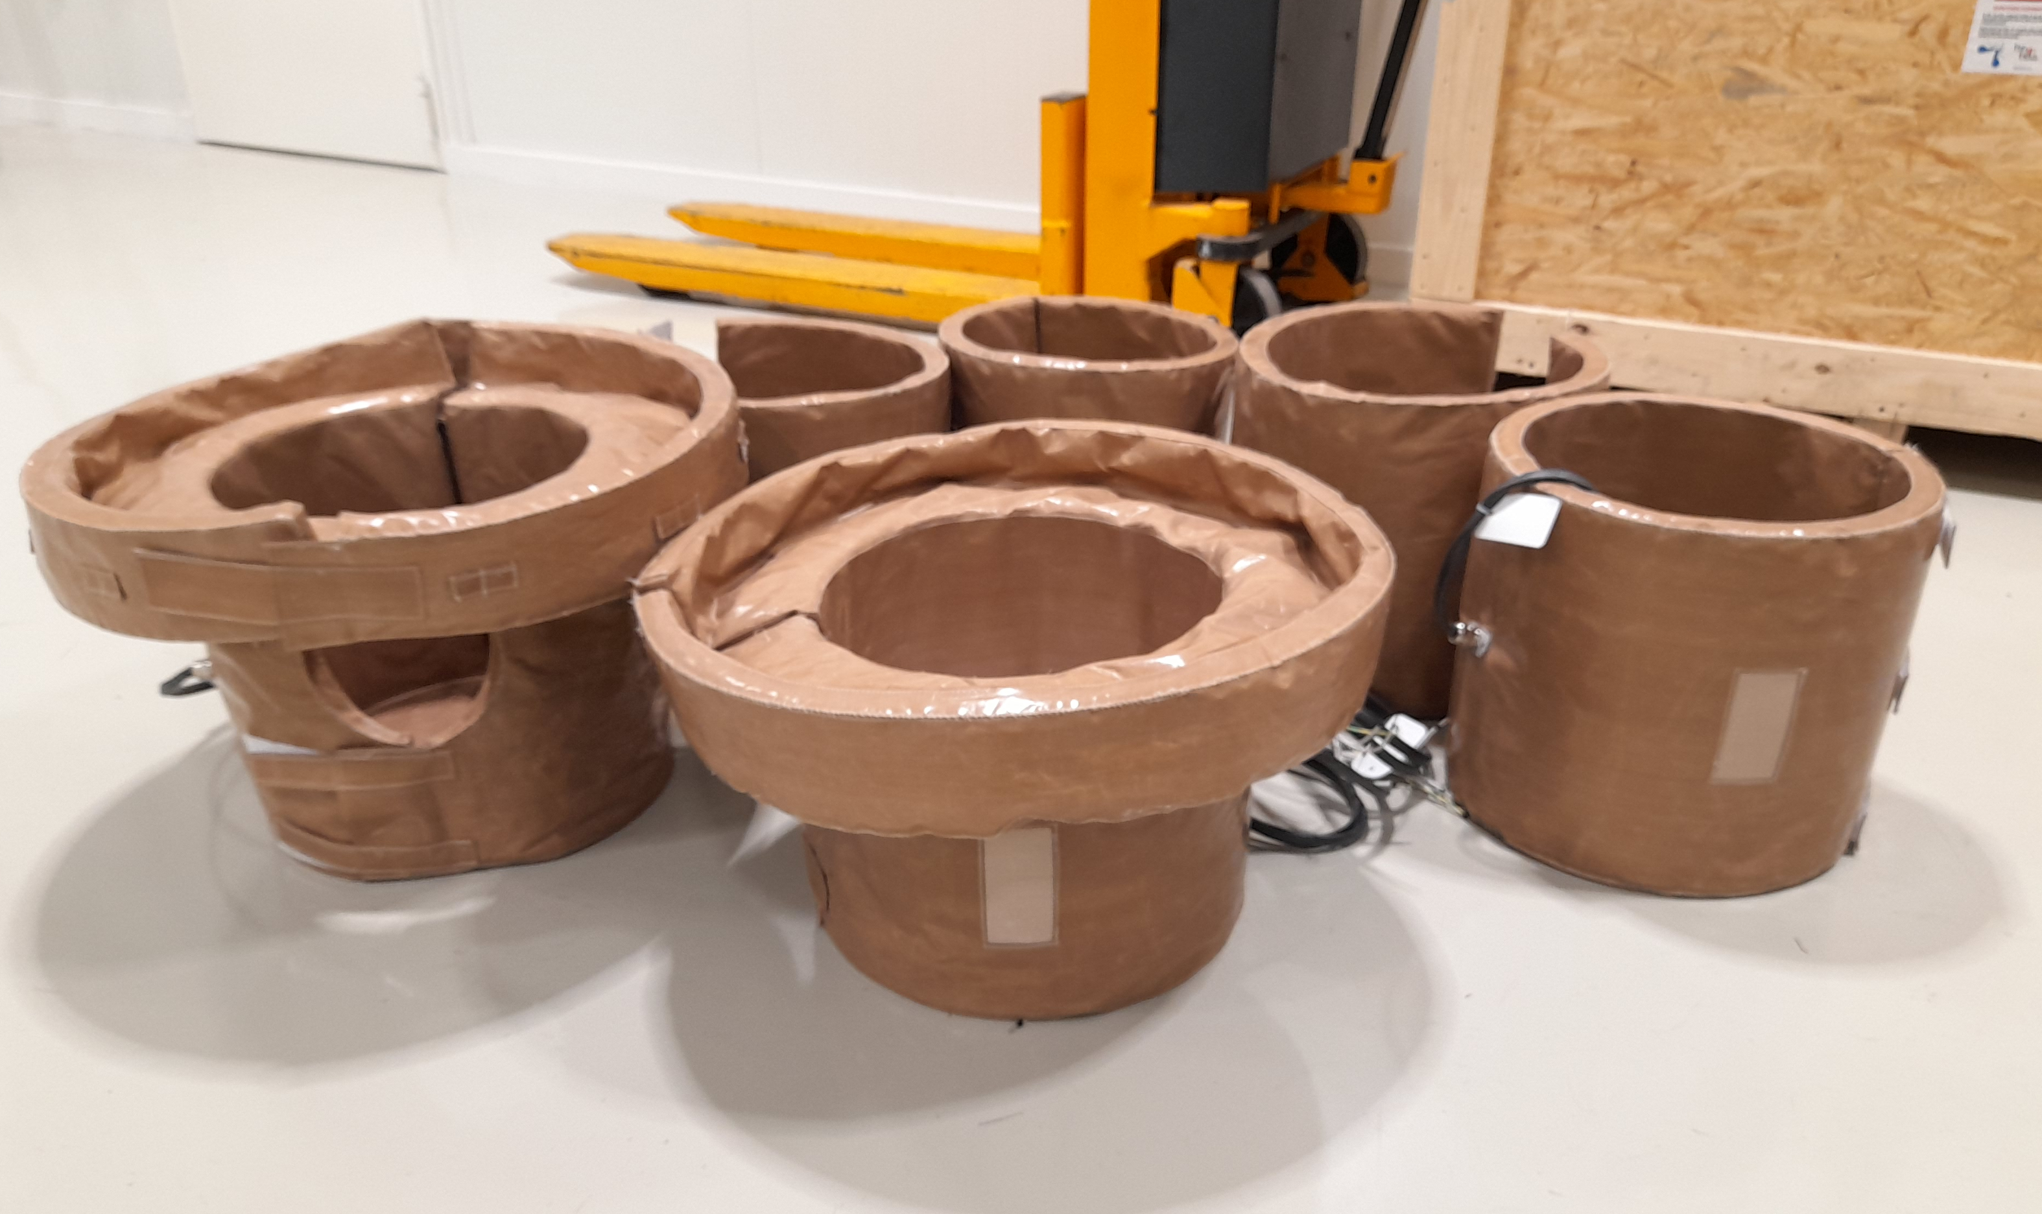
4. Infrastructure upgrade
Electrical works underway → verify pumping + bake-out control
Compressed air + breakout box for cathodes requested
→ STILL waiting: 6x HiPIMS power supplies → lab test in April (?)
Control PC for pumps, bake-out,
Later: motion, cathodes
Chemistry lifting tool + slings
WOWCC bake-out jacket set (PTFE coated)

Slide 32
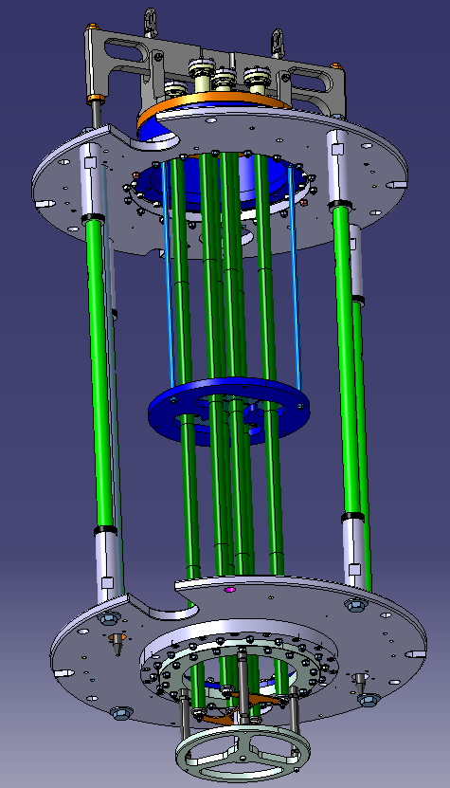
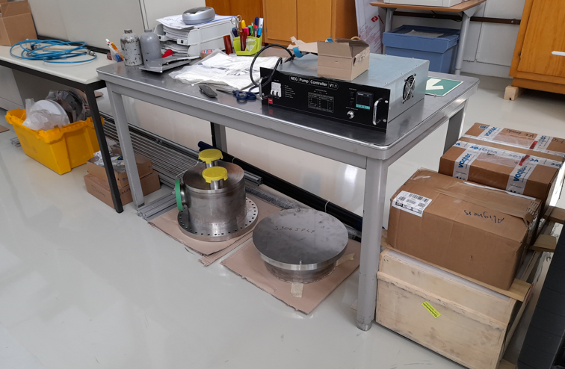
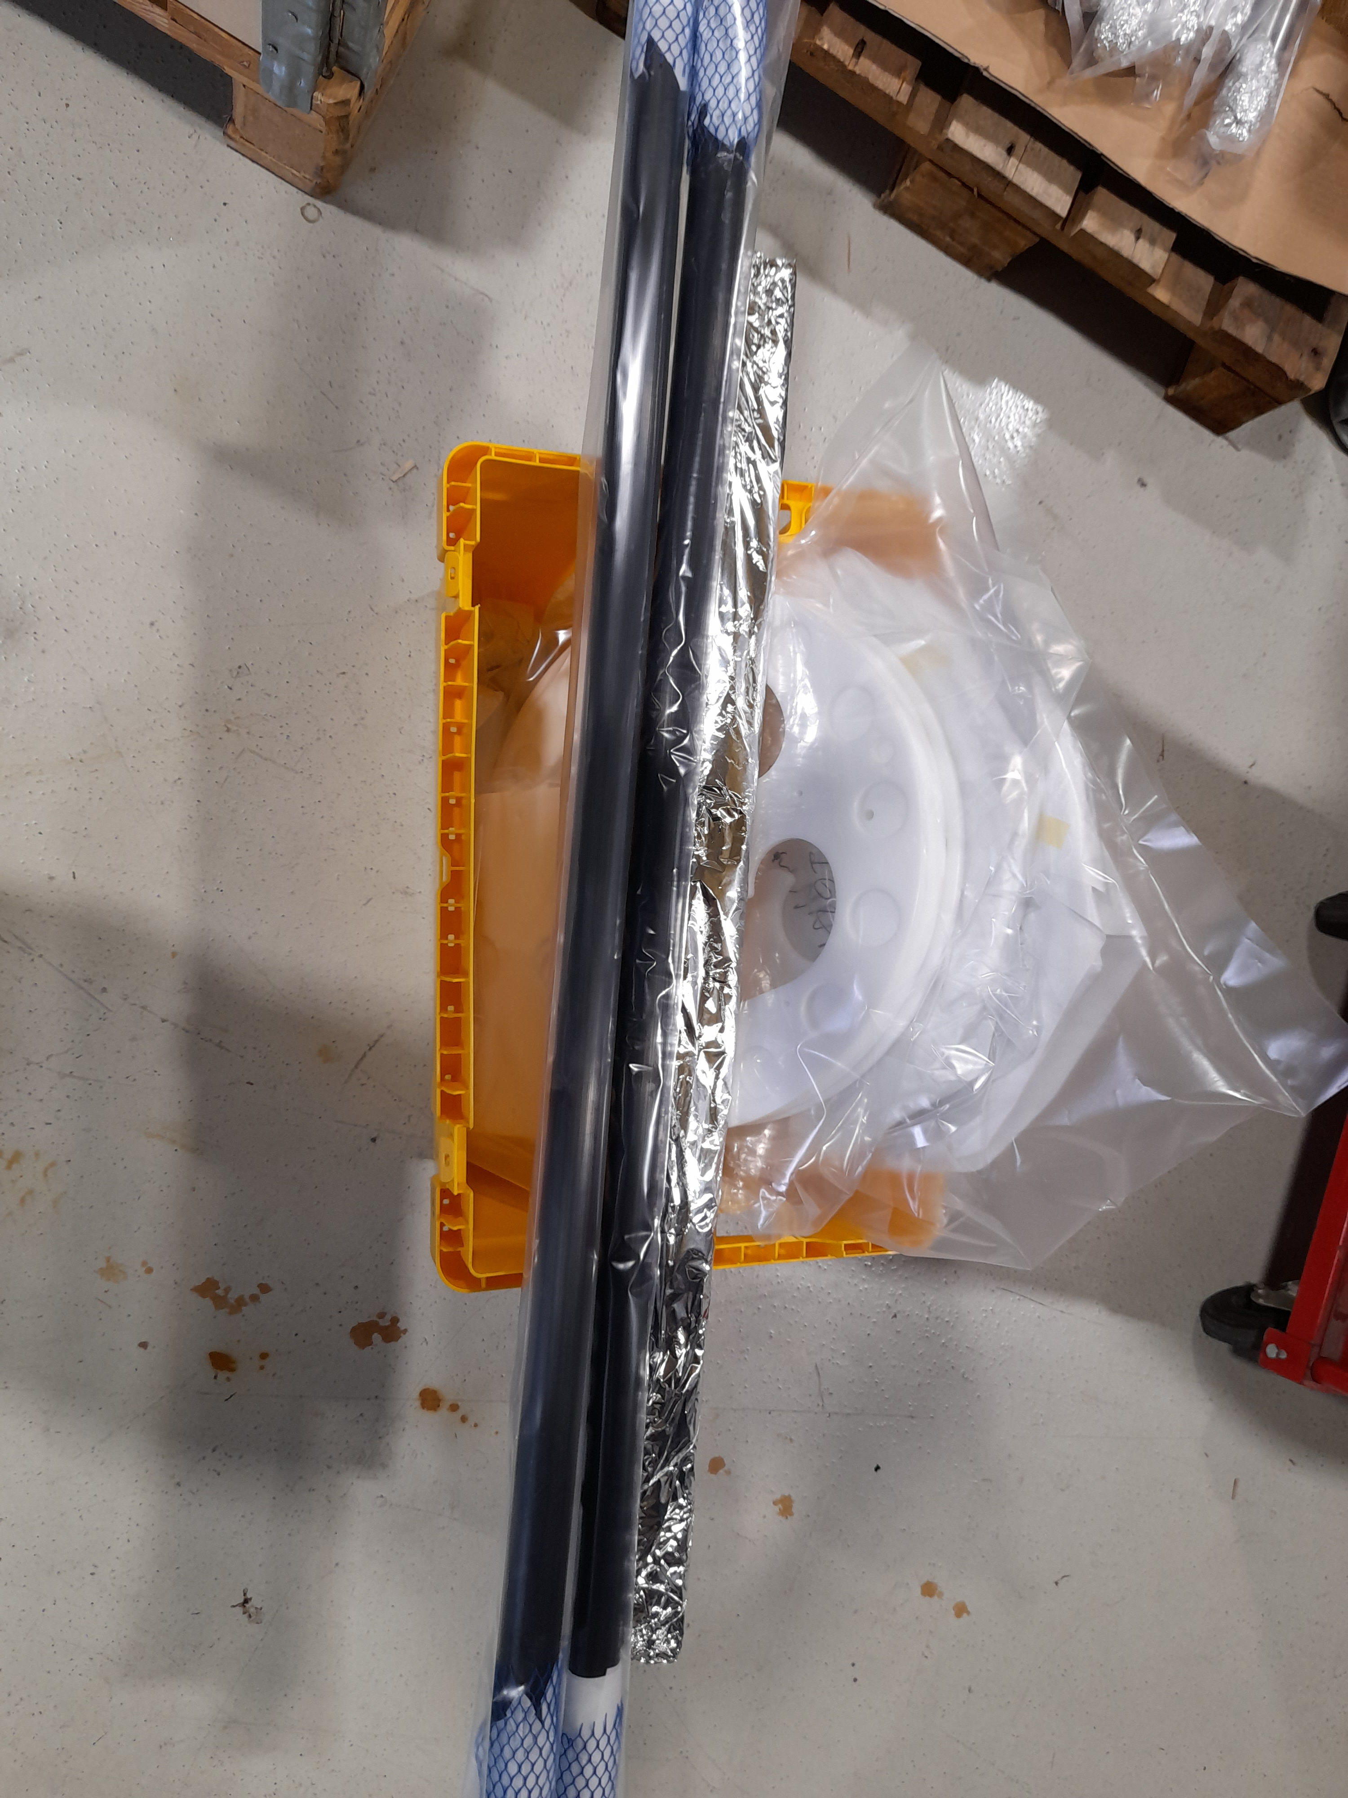




4. Coating Assembly
Design with
“Mock-up” cavity
Fabrication
Surface Preparation
Reception of main components from AP
vacuum
breaks
Mock-up parts
port
aligners
Plastics after degreasing
_{Aligners in ultrasonic bath}
bottom + top bell
Nb tubes
→ Procured fasteners, ports, ceramics
Bells + bolts after vacuum firing
_{Clean room testing}
Cathode tubes after vacuum firing
Courtesy: T. Mikkola, G. Villiger, P. Naisson and the AP team
F. Manke et al, 6th CERN SRF Workshop, 02/2023

Slide 33



4. Cathode Assembly and Storage
Cathode assembly needs support and storage
Chariot Design
Implementation
Courtesy G. Villiger
F. Manke et al, 6th CERN SRF Workshop, 02/2023

Slide 34




4. Full scale magnet motion
Single Cathode Concept
Six Cathode Design
Implementation
Stainless
steel tube
Top-bell “crown”,
coil frames
Magnetmotion wire
Stepper motors, gear heads
Niobium
cylinders
Motorized wire coil modules
Static cooling
cane
Insulated canes, anchors
Moving
magnet
Bottom stops,
ceramics
Bottom spacer
(ceramic)
Bottom stopper, wire return option
Magnets with weights
MASSIVE courtesy: P. Garritty
F. Manke et al, 6th CERN SRF Workshop, 02/2023

Slide 35


4. In-situ XRF diagnostic
XRF benchmark on samples
In-situ Diagnostic Design
Implementation
3D movable system
Yxrf
Cable guide
0
Lxrf
Vertical aligner
Rotary stage
WOWCC
Stepper driver
and XRF trigger
XRF probe casing
F. Manke et al, 6th CERN SRF Workshop, 02/2023

Slide 36
Outline
Principal coating set-up
Coating recipe and test bench results
Simulations and process planning
Current state: Going full-scale
Perspectives for the year

Slide 37
5. Timeline: State and Planning
Milestones
Final assembly concept
Void-free 3D coating
Production start
1st full cavity coating
2nd Run
Cavity
systems
Horiz. Trolley + tooling
vert. trolley
LP Rinsing
TEST
SUBU tooling
Lifting tool design
fabrication
Final prototype + publication
Cathode systems
HiPIMS power supply fabrication + testing
Control optim.
storage trolley
fixes
Insulation, integration
guiding, align, updates, release
bake-out jackets
Testing, usage
Main assembly design
fabrication
Assembly + Testing
Improvements
Coating Equipment
cavity support
Heat management + feedback to MME
magnet motion prototype
full motion system
Procedure optimization
Infrastructure (pump, air, PC)
Focus on cylind. magnetron
Triple cathode cyl. magnetron
Coating shields(?)
Test-bench
HiPIMS coating recipies
Magnet / power / process params.
Advanced interface (?)
Diagnostics
SEM + XRF: 3D samples, geometric corrections
HP Rinsing , optical inspections
In-situ XRF concept
cabling, design
Implement.
Tests, measurements, publish
Simulations
Cathode choice
Process steps, multi-code benchmark
development + publishing
Branching to other projects
2019
2020
2021
2022
2023
2024
Now
New fellow?

Slide 39

Bipolar HiPIMS coating recipe
High Power Impulse Magnetron Sputtering
  V_{c} during Main Pulses (MP), at 1kHz with with 30 μs duration (3% duty cycle)
  Same time-average power P as DC Magnetron Sputtering
  → Denser plasmas (x10) with higher fraction of Nb⁺
  → Accelerate Nb⁺ by Positive Pulses (PP) for denser, less columnar films
PP
Average Power : 500 W
→ Pulse Power : 16.6 kW
MP

Slide 40


XRF diagnostic implementation
F. Manke et al, 6th CERN SRF Workshop, 02/2023
Quantifying coating thickness uniformity : Transport simulation vs. Measurement
In-situ diagnostic
Movable system currently under testing
Update batch script control (win cmd)
XRF probe head wiring by cabling team
XRF probe casing to be produced on CNC
Final acquisition + electronics tests by supplier M. Dupayrat thereafter
Safety sign-off by RP on final diagnostic
3D movable system
XRF probe / electronics from lead-paint diagnostic
aligner
rotary stage
XRF probe casing
_{(in fabrication + cabling)}
Stepper power + XRF trigger

