Slide 1
SPS scrubbing kickoff
L. Mether for the e-cloud team

Slide 2
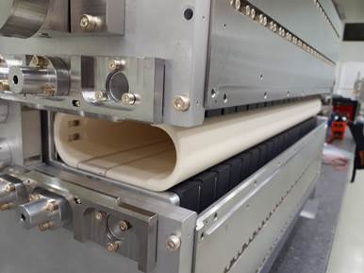
Overview
Main goal to condition the newly installed MKP-L
Considerations for the scrubbing run based on e-cloud simulations and previous experience presented at SPS MPC #29
6 days of scrubbing scheduled
Courtesy of M. Barnes

Slide 3
Scrubbing targets
Normally, the scrubbing would be divided into three main parts:
  Scrubbing on flat bottom up to intensity required for LHC operation (~1.9e11 p/b)
  Scrubbing on the ramp up to LHC target intensity (~1.8e11 p/b)
  Scrubbing on flat bottom with high intensity for LIU studies (~2.3e11 p/b)
The flat top target is most likely not possible due to the limitation in the MKDH

Slide 4
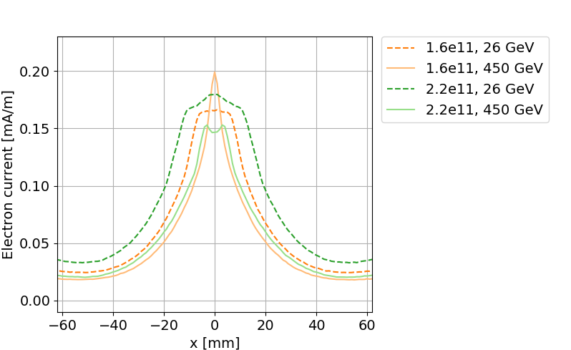
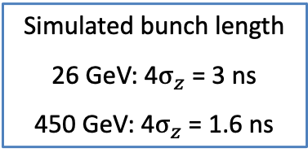
Scrubbing in MKP-L
Significant scrubbing at flat top should not be needed after flat bottom scrubbing
  Simulations predict slightly weaker e-cloud build-up overall at top energy
  Consistent with experience from old device
The spatial distribution of the electron current also points in this direction
  In particular, higher intensity at injection can compensate for the displacement due to the injection bump
PyECLOUD simulations, SEY = 1.6
Simulated bunch length
26 GeV: 4$σ_{z}$ = 3 ns
450 GeV: 4$σ_{z}$ = 1.6 ns

Slide 5
Tentative scrubbing plan
Push train length and number at flat bottom 12b → 4x72b with ~1.4e11 p/b
Push bunch intensity at flat bottom with 4x72b up to 1.8e11 p/b
No later than Thursday
Push number of trains on the ramp
72b → 4x72b with ~1.4e11 p/b
Ramp up bunch intensity at flat bottom up towards 2.5e11 p/b
Push bunch intensity on the ramp:
push number of trains for each intensity
Up to MKDH limit or
at least 4x48b@1.6e11 p/b
MKDH conditioning with increased thresholds at lower energy
~Weekend
Push bunch intensity at flat bottom with 4x72b up to 2.5e11 p/b

Slide 6
First impression in the machine
First multi-bunch beam taken for ~1.5 hours on Wed evening → 24b with ~1.2e11 p/b
  Vacuum in MKP-L calm around 1-2e-8 mbar
  Vacuum activity in a few other locations, corresponding to locations that were vented (see list by Chiara in CodiMD)
Issue with e-cloud monitors: no signal in app, only zeros in data
  Fixed yesterday thanks to Holger and Michel (CPU board changed)
  Dead channels to be fixed this morning

Slide 7
Resources
Resources
Mattermost channel
CodiMD page
Scheduling

