Slide 1
INSPIRE
A Global Digital Library for HEP
14th February 2011
Tim Smith
on behalf of
IT/UDS/CDS and GS/SI
SLAC, DESY, FNAL

Slide 2
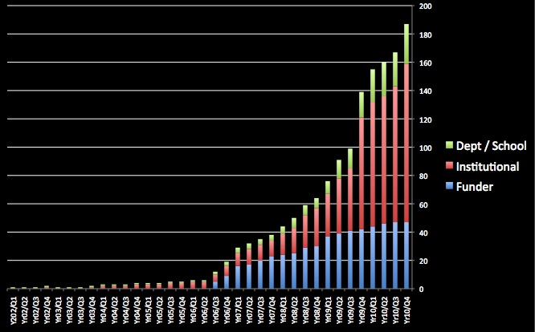
Open Access
Traditional publication agreement
  All rights, including copyright, go to publisher
  Limits or prevents your ability to disseminate your research:
    Include sections / figures in your later works
    Hand out copies to your classes or colleagues
    Put on your web site
Pre-print culture
  Rapid scholarly dialogue
  Pre-print repositories: arXiv
  No publisher services: peer review, citation indexes
OA Movement
  Green: Publish in any journal, then self-archive post-print
  Gold: Publish in a OA journal
OA Archives
  Institutional Repositories
  Subject Repositories

Slide 3
Open Access
Finding the publications
  Google Web
  Microsoft Academic Search
Citation Indexes… full-text search
  Web of Science (Thomson-Reuters)
  SciVerse (Elsevier)
…and digitize and host articles
  Google Scholar
Noise, lack of conventions, coverage, quality

Slide 4
HEP: Subject Repositories
PubMed by NLM
ADS by NASA/Harvard Smithsonian
SPIRES, CDS … INSPIRE
Meta-data Quality
  Disambiguation
    Authors, Institutes, Journal Titles
  Standardization
    Authority files
  Keywording
    Taxonomies
Coverage
  Pre-prints
  Post-prints
  Conferences

Slide 5



Building Blocks: A Quick Recap
SPIRES
  1974 Birth of SPIRES HEP DataBase
    IBM mainframe at SLAC run with DESY
  1980s email interface
  1991 Web interface to SPIRES
    First US web server
  1994 Citation services
  2000 summary formats
Invenio
  1993 CERN preprint server on web
  1996 CERN Library on Web
  2000 CERN Document server
  2002 CDSWare released GPL
    Python, Apache application server, MySQL
  2006 CDSWare became Invenio
  2010 http://invenio-software.org/

Slide 6





INSPIRE: A Collaboration
Meta-data from SPIRES
  Noise free, high quality
  Manually validated affiliation and citation data
Technology from Invenio
  Modern Open Source digital library SW
  Good performance, scalability and feature set
Feeds from information sources
  arXiv, Publishers
  Institutional repositories
Digital Librarians from the labs

Slide 7
The Extended Publication
Supporting data
  Meta data
  Figure data, and code that generated them (e.g. root files)
  Photos of apparatus
  Supplementary plots and tables (e.g. correlation matrices)
Post publication data
  Comments, rankings, reviews
Extensions
  Presentations, videos
Data sets
  High level analysis objects
  Raw data sets
  The Data Pyramid / Iceberg

Slide 8
INSPIRE Launched
Flexible search syntax
  SPIRES:
    find a richter, b and t quark and date > 1984
  Google generation:
    1985 richter quark multiplicity
  Complex:
    (symmetry or asymmetry) author:gell-mann -quark

Slide 9
INSPIRE Detailed Records

Slide 10
INSPIRE References

Slide 11
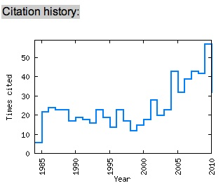
Citation Graphs

Slide 12
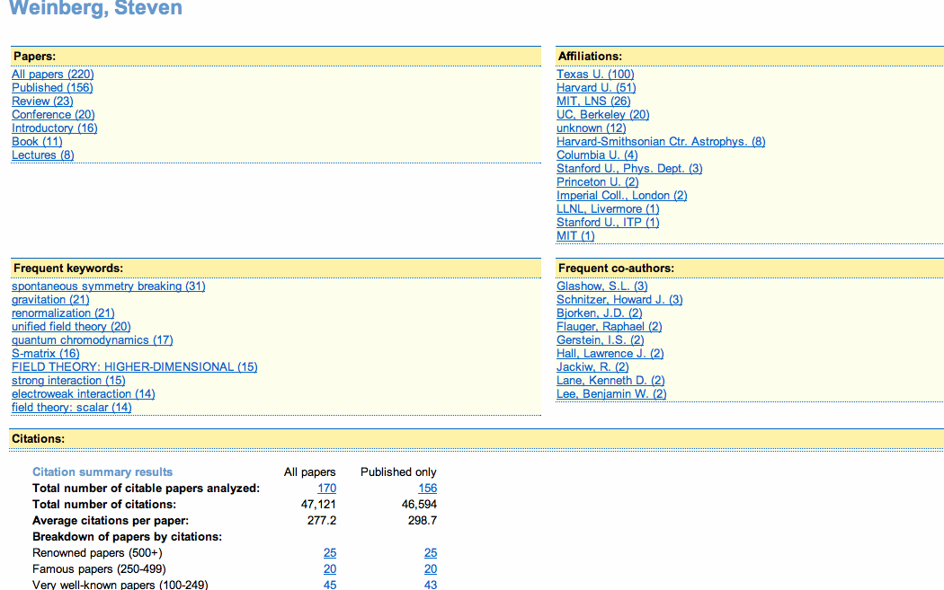
INSPIRE Author Page

Slide 13
INSPIRE Fulltext Search

Slide 14
Plot Extraction
Caption extraction… and search

Slide 15
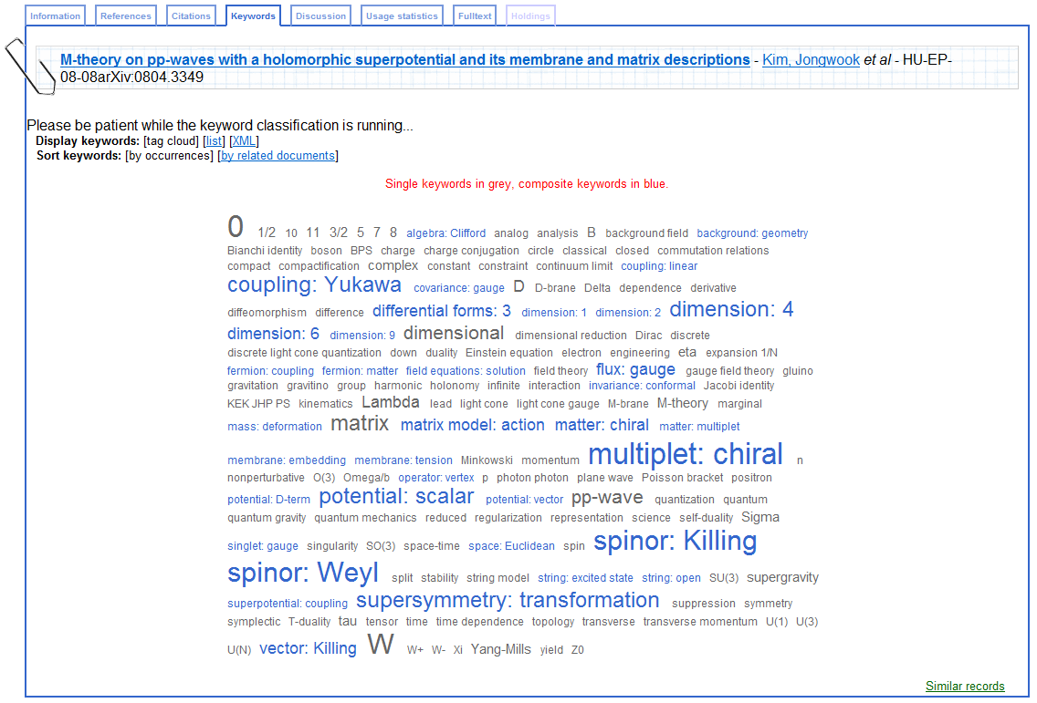
Keyword-ing
Auto-Keywording: Particle Physics Taxonomy

Slide 16
Back-end Machinery
Parallelization and dispatching of intensive tasks
Data Mining on the GRID in the Cloud
  OCR processing
    Ocropus (open source)
    De-skewing, text recognition, hOCR production (html), PDF
  Fulltext indexing
    Solr/Lucene, Hadoop, Process Execution Engine
    Extension to semantic indexing with HEP ontology
  Bibliometrics
    Scientific impact e.g. H-Index
  Author disambiguation
    Using affiliations, coauthors, research topics, etc
    G. Chen: 963 docs, 21 real authors, only 22 docs not assigned, 97.2% success rate

Slide 17
Work in Progress
Data
  Issue DOIs, agreement with TIB
  Data Citations
  Collaboration with PDG (Particle Data Group), Durham
Author ID
  Claim my paper
Search clustering and facets

Slide 18
Relevance ?
INSPIRE Workshop
  Elsevier, Thomson-Reuters, Springer, APS, Google Scholar, ADS, arXiv, PDG
OAI7: CERN Workshop on Scholarly Communication
  http://indico.cern.ch/conferenceDisplay.py?confId=103325
Master Class on Scholarly Communication
  Stanford Bernstein (a leading Wall Street company advising large investors), on STEM publishing

Slide 19
Questions ?
http://inspirebeta.net
http://www.projecthepinspire.net/
http://invenio-software.org

