Slide 1

Fast Quality Assurance (QA) Tests for LGAD Production
p. Skomina, G. Kramberger, j. debevc, a. Howard, i. Mandić, b. Hiti
JSI Ljubljana

Slide 2
Contents
Motivation
Devices & readout
Measurements & analysis
Results & extracted parameters
Conclusions

Slide 3
Motivation
During production phase of sensors for HGTD extensive Irradiation Tests (IT) will be done on each batch (50-200 wafers per batch)
Typically several tests per batch planned
Radiation hardness of LGADs is very sensitive to small variation in production (1% diff. in [B] makes a difference)
IT are meant to provide info on radiation hardness
The outcome of the IT will largely depend on statistics. Methods should therefore be:
  simple & fast, to allow large number of samples measured with little resources
  such that allow extraction of large number of sensor parameters from a single measurement
  available at several sites
CC/timing measurements with ⁹⁰Sr are slow & allow limited number of tests
Proposal: use a Scanning-TCT set-up and a 1x2 LGAD array w/ opening in IP region
Speed up the tests and provide reliable information on gain (and other important parameters)
Idea from studies of PiN and LGAD structures shown before

Slide 4
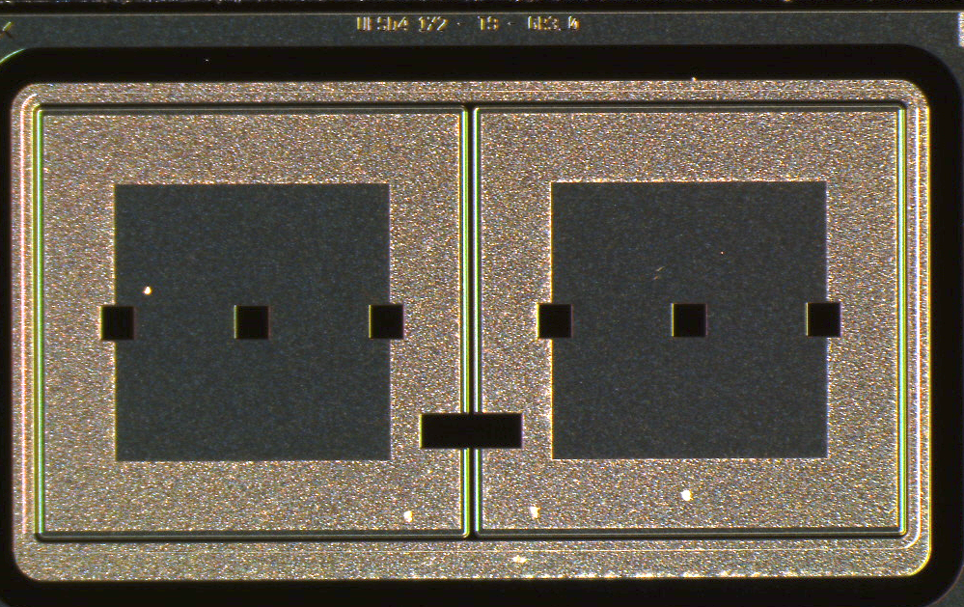
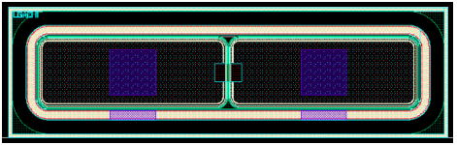
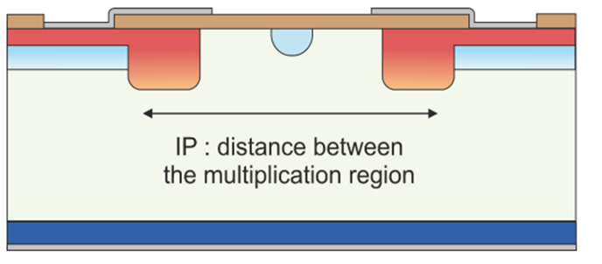
Devices used
QC-TS 1x2 LGAD sample
FBK4.0 1x2 sample
y
z
x
Instead of separate PiN and LGAD structures
1x2 LGAD (IPD measurement) w/ opening in passivation in ATLAS HGTD QC-TS
Gain only present on pads, no gain in IP region
Single measurement, multiple parameters extracted
Much faster check of irradiated samples than CC/timing
G=1
G>1
G>1

Slide 5
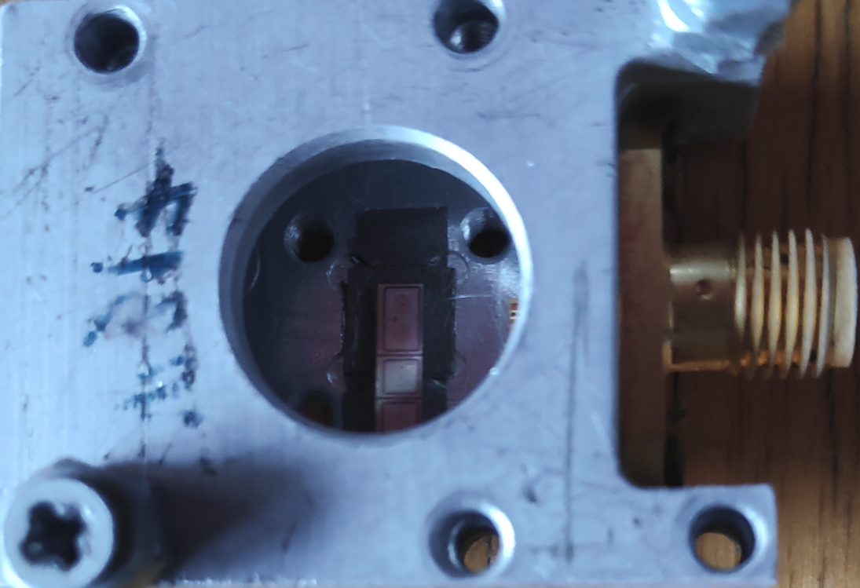
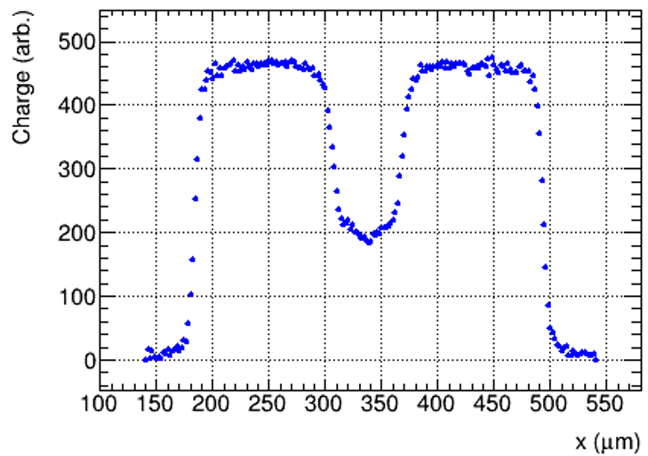
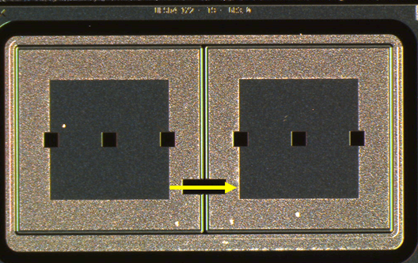
Readout of the LGADs
Sensor mounted in simple Al housing and wire-bonded (two bonds)
Single amplifier is used (explored also option with two amps)
Scan over the opening in the IP region using an IR laser (1064nm)
FBK4-W18
(deep C-GL)
1.5e15 n_{eq}cm⁻²
20°C, 190V
HV
Bias-T
GND

Slide 6
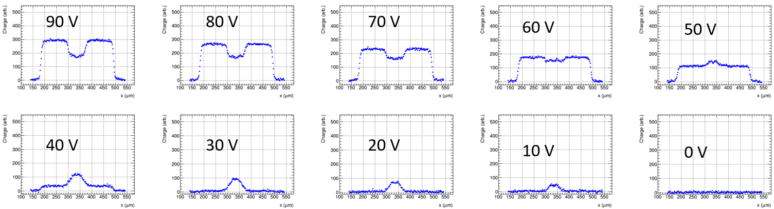
Measurement – before irradiation
FBK4.0 W18, 20°C, Voltage scan
Depletion of “no gain” region – full depletion of active layer
Depletion of gain layer – appearance of signal in GL (agrees with CV)
Full depletion of the device
Gain increases

Slide 7
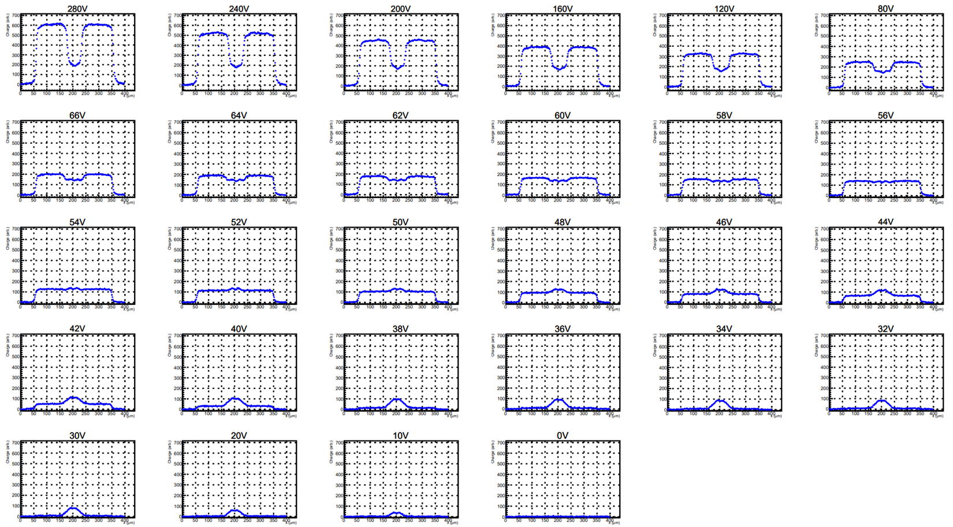
Measurement – after irradiation
FBK4.0 W18, 1.5e15 n_{eq}cm⁻²
20°C, Voltage scan

Slide 8
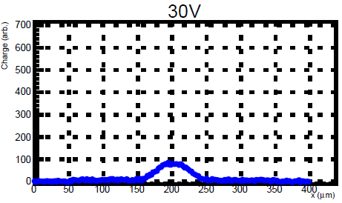
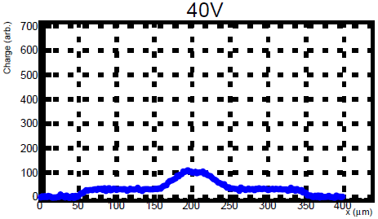
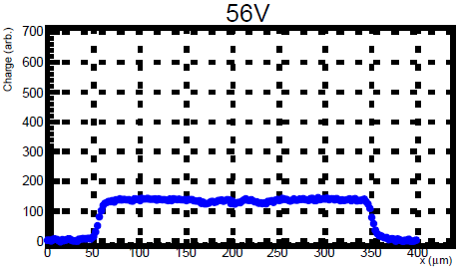
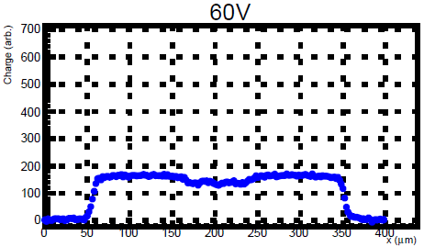
Analysis
Full depletion of “no gain” region – full depletion of active layer
Depletion of gain layer – appearance of signal in GL (agrees with CV)
Full depletion of the device
Gain increases
Extract parameters: CC in gap, CC on pad, I_{leak}, I_{gen}, G, V_{GL}, V_{FD}, IPD

Slide 9
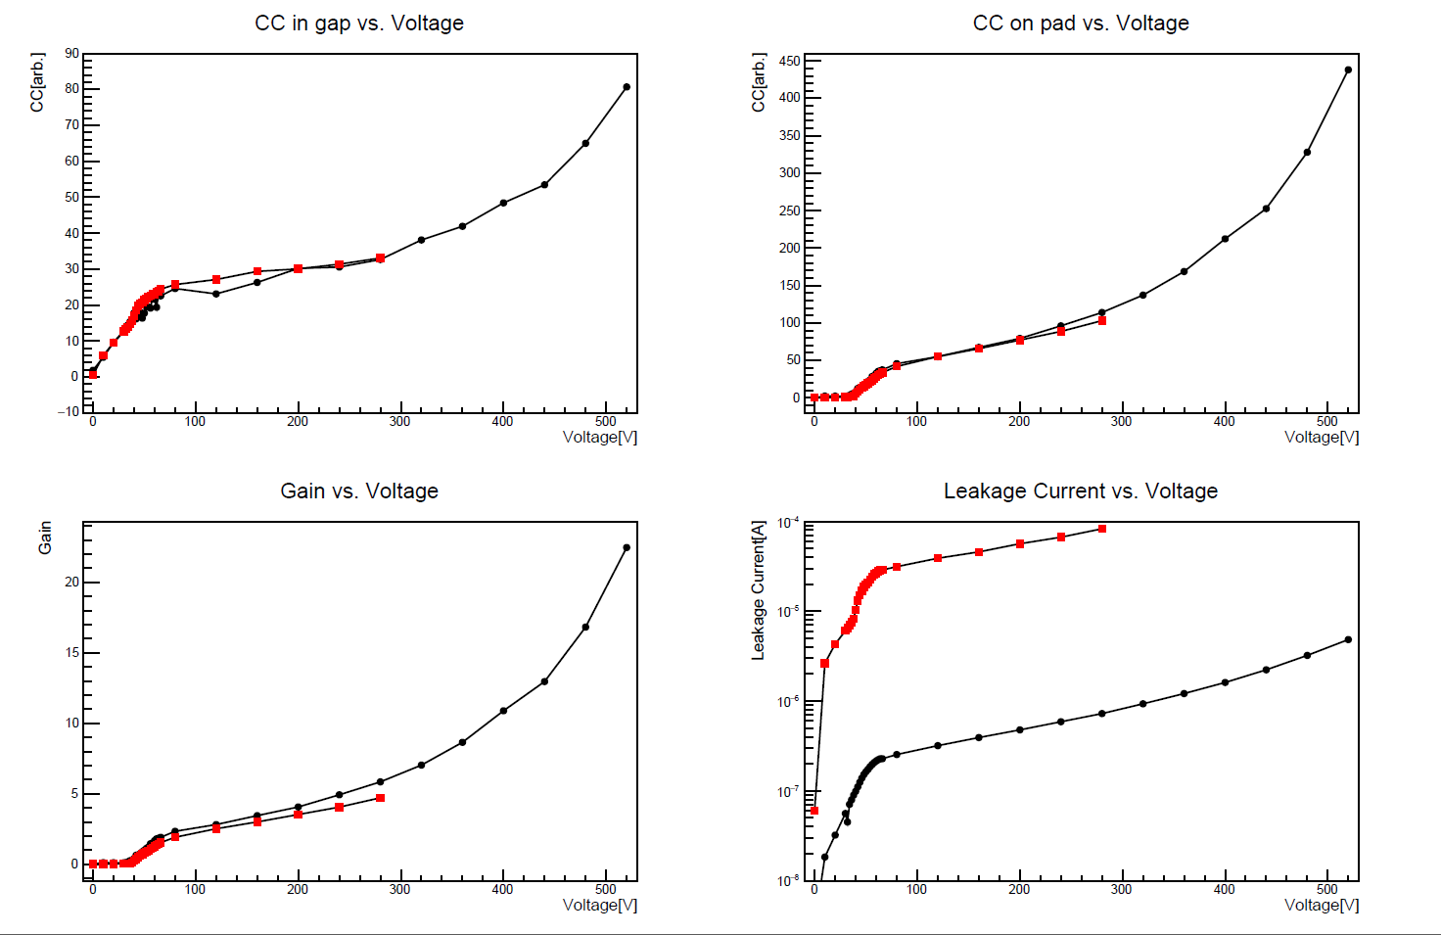
Analysis – temperature scan
FBK4.0 W18, 1.5e15
Average of several points
Scaled to correct for different laser intensities & absorption of IR light in Si
No significant difference between 20°C and -30°C in important parameters (apart from of course I_{leak})
20°C
-30°C
20°C
-30°C
20°C
-30°C
20°C
-30°C

Slide 10
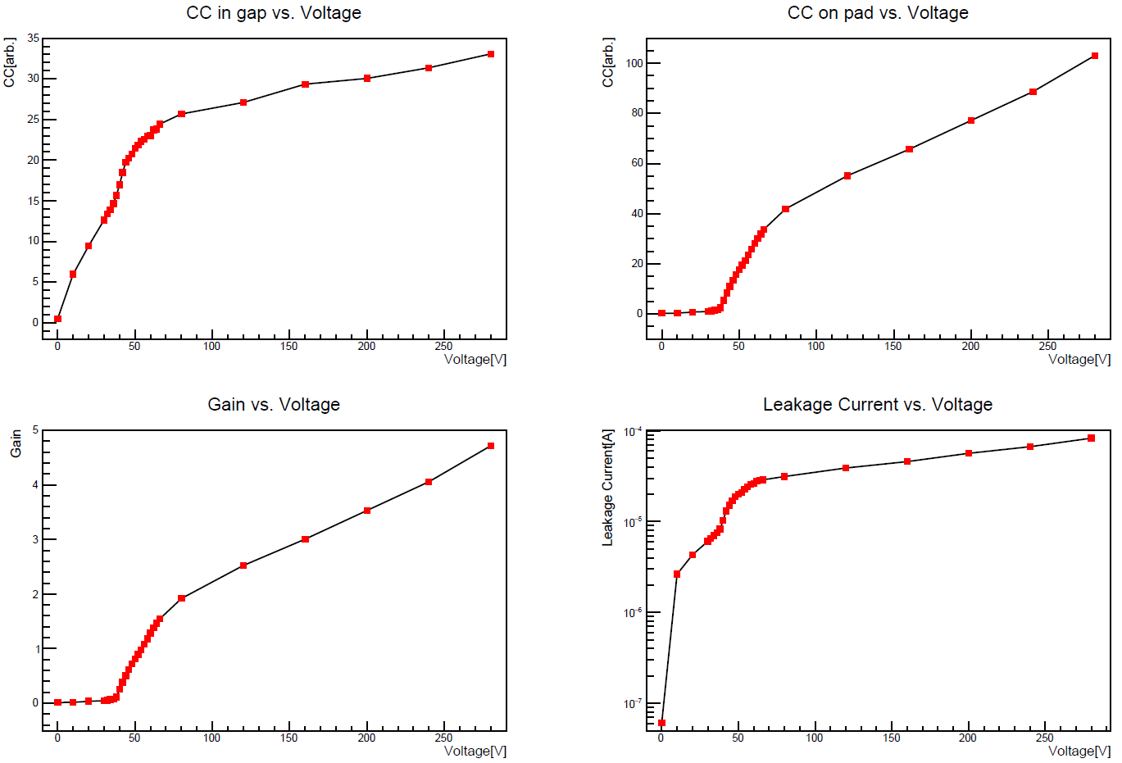
Extraction of parameters
One scan → several parameters measured
V_{GL}, V_{FD} extracted the same way as from CV
Gives good picture of radiation hardness of entire device
Analysis done with root script (can produce file ready for reporting to DB)
V_{GL} ≈ 35V
V_{FD} ≈ 75V
V_{FD} ≈ 55V

Slide 11
Conclusions
Use TCT and a 1x2 LGAD array w/ opening in IP region on the ATLAS QC-TS for QA-IT
At room temperature a full test takes around 2h – much faster than CC/timing
An analysis script will produce the output for the database with all extracted parameters: I_{leak}, I_{gen}, G, V_{GL}, V_{FD}, IPD
Very low values of gain can be measured at room temperature (with CC in ⁹⁰Sr gains at room temperature can not be observed due to noise)
Need to assure a clear correlation between gain measured for a sample with CC/timing using ⁹⁰Sr at -30°C and ≈V_{SEB} and the gain measured with TCT at room temperature
Once the correlation is established we monitor the differences with respect to the “reference” sample

Slide 12
Thank you for your attention

Slide 13
Backup Slides

Slide 14
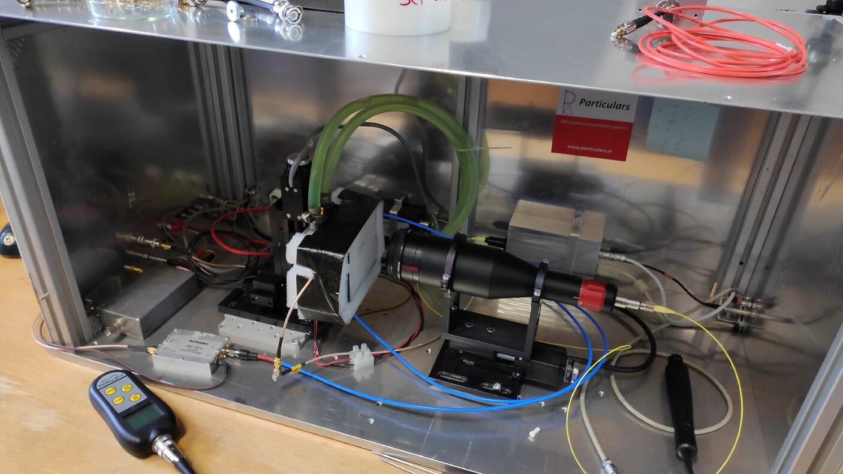
Experimental setup
Scanning TCT
XYZ tables
IR laser – focused beam of (8-10µm in waist)
HV and readout through Bias-T
Both pads connected to one amplifier
Operating conditions:
Temp. control from 40°C to -30°C
Insulation cap
Closed environment
Dry air (dew point well below measuring temperature)

Slide 15
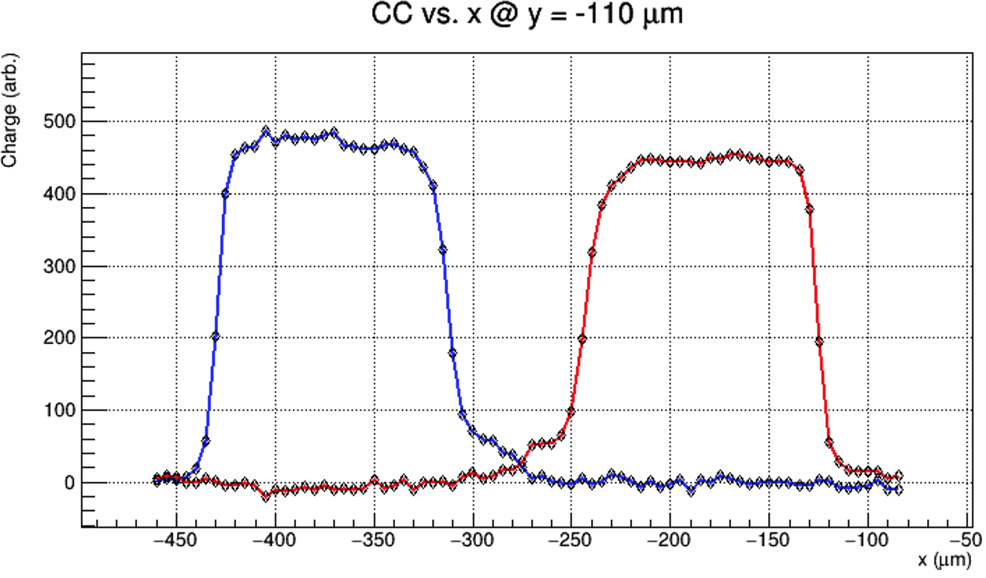
IP and gain measurement – 2 amps
FBK4.0 – W9 Type9 (not irradiated) at 100V and 293K
G=9
G=1
HV
A good agreement with measured charge in CC setup.

Slide 16
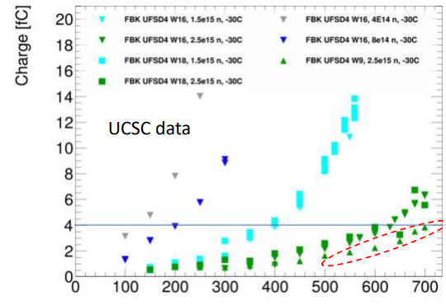
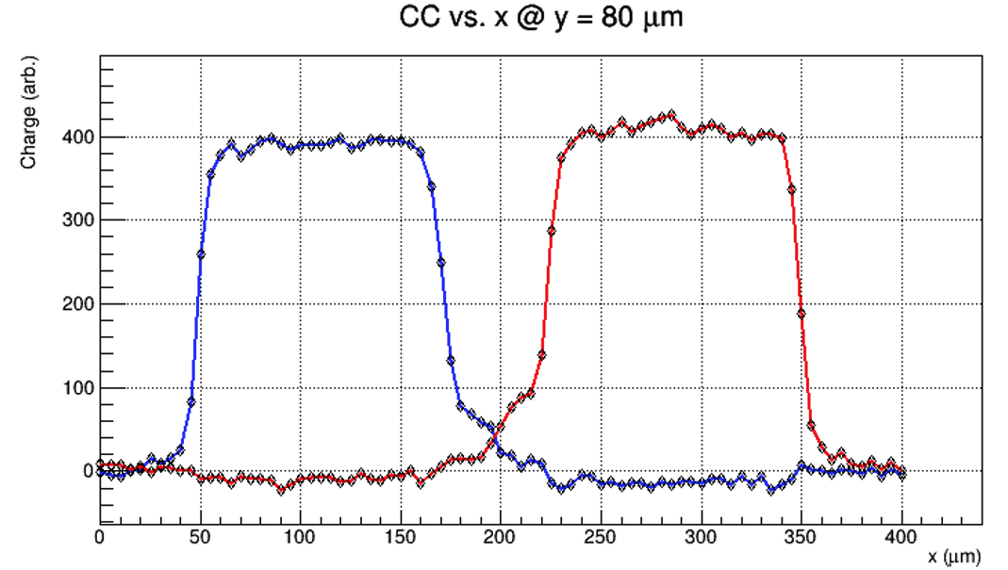
FBK4.0 correlation of TCT with ⁹⁰Sr
Note UCSC CC measurement shows 4fC for that sample type with ⁹⁰Sr!
FBK4.0 – W18 deep GL design at 400 V and 243 K , Type9 IP
1.5e15 cm⁻²
G=7 ; Q~4 fC
G~7
G~1

Slide 17
Addition to: Extraction of parameters
I_{leak} = I_{gen} x G; G = G@V_{FD(gap)}
Usually we don’t know the gain, but with this method we do and we measure the leakage current. So we can also extract the generation current.
At low gain values, the current gain is the same as charge gain (up to about G=4 for this fluence).

