Slide 1
WOWCC R&D Program: Introduction and Overview
Alexej Grudiev on behalf of WOWCC team
30 March 2023
FCCee R&D and Technology Meeting #15

Slide 2
Introduction
The WOWCC R&D activity covers design, construction and cold testing of a prototype of a compact superconducting crab-cavity for future colliders using Nb-on-Cu-coating technique.
The cavity shape is based on the ridged waveguide resonator with wide open apertures to provide access to the inner surface of the cavity for coating.
It also naturally provides damping for HOMs and rather low longitudinal and transverse impedances.
The final goal is to validate the fabrication and coating of the cavity prototype and to characterize its high gradient performance in a vertical cold test
This activity is performed in the frame-work of FCC RF R&D

Slide 3
Structure: Task responsibles
Indico link to WOWCC R&D meetings
https://indico.cern.ch/category/7356/
Task 1: RF design (Alexej Grudiev (RF))
Task 2: Mech. Design of the prototype and tooling (MME, Design Office)
Task 3: Fabrication of the copper “substrate” (MME, Main workshop)
Task 4: Surface treatment (Leonel Ferreira (TE-VSC))
Task 5: Coating and coating system (Alban Sublet (TE-VSC))
Task 6: Rinsing and clean room assembly of the prototypes for testing (Alick Macpherson (SY-RF))
Task 7: RF Tests (Alick Macpherson (SY-RF))
Finished
Finished ------------
Finished ------------
Ongoing
Ongoing
Ongoing ----------
In preparation

Slide 4
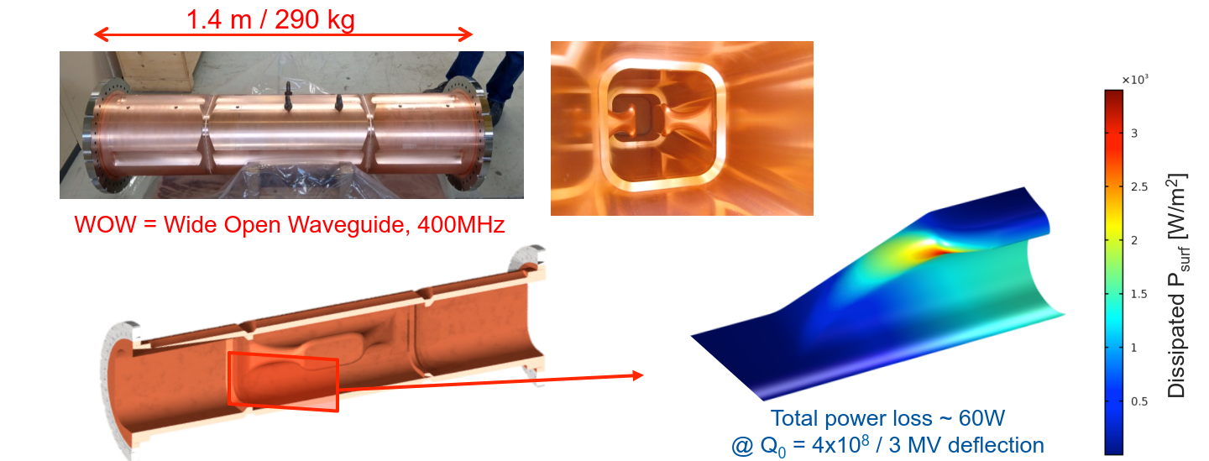
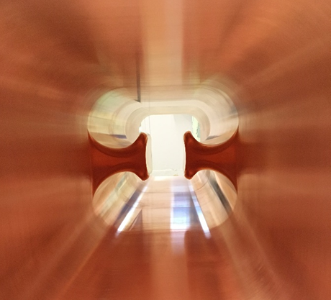
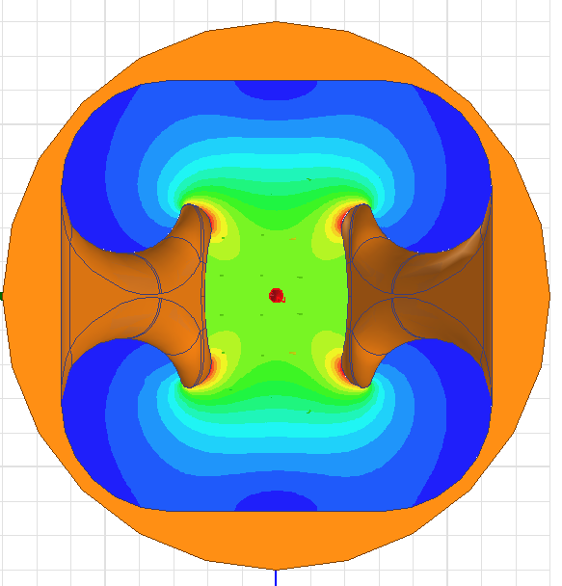
Wide Open Waveguide Crab Cavity
E-field

Slide 5
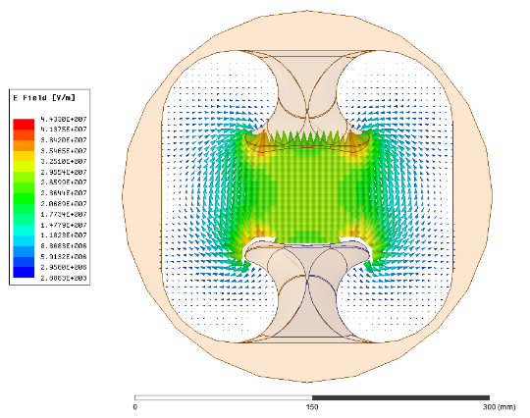
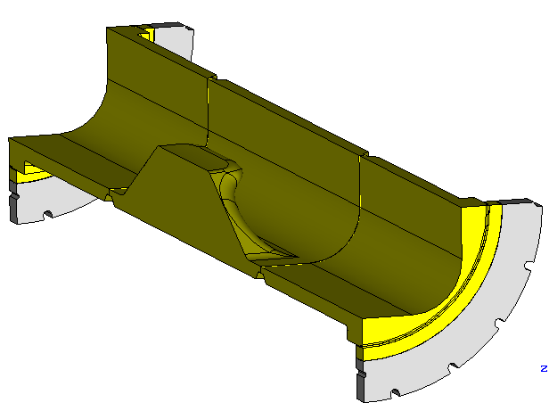
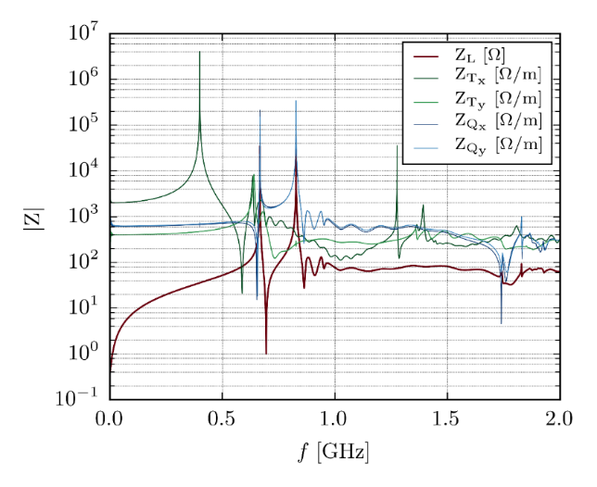
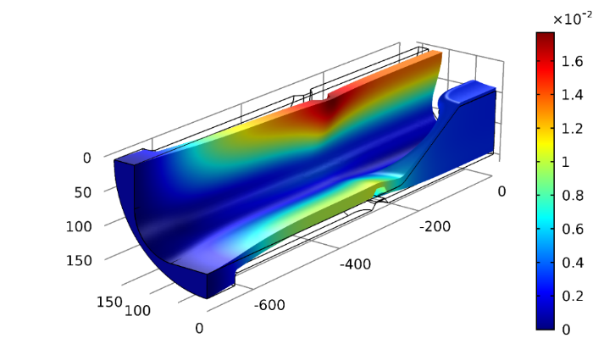
RF and engineering design studies of the cavity
Comprehensive design study has been performed including:
Cavity design and power loss calculation using different coatings
Beam coupling impedance and HOM characterization
Preliminary design of the fundamental and HOM couplers
Multipacting simulations
RF sensitivity to pressure
Preliminary design of the coupler for cold tests
See details in DOI: 10.1103/PhysRevAccelBeams.22.072001
FMC
HOM coupler
Impedance and HOM characterization
Coupler design and HOM damping
Multipacting analysis of the bare cavity
Pressure sensitivity

Slide 6
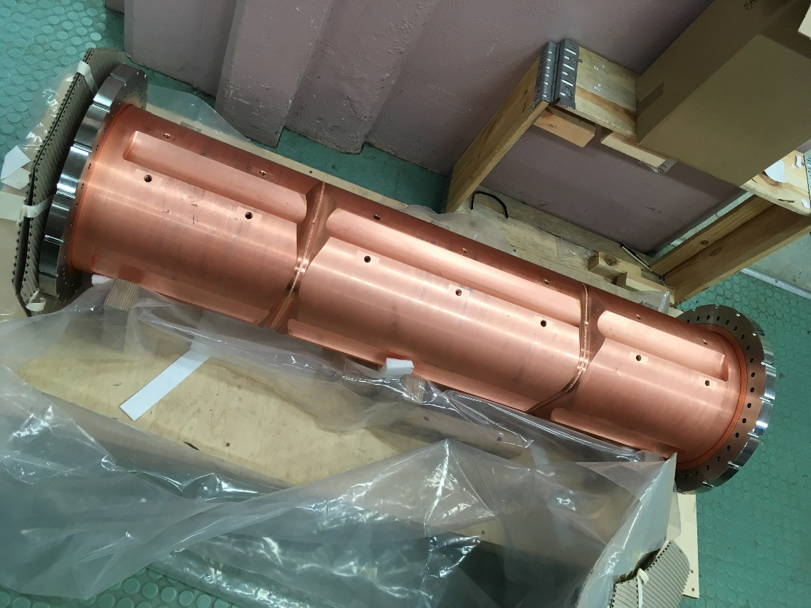
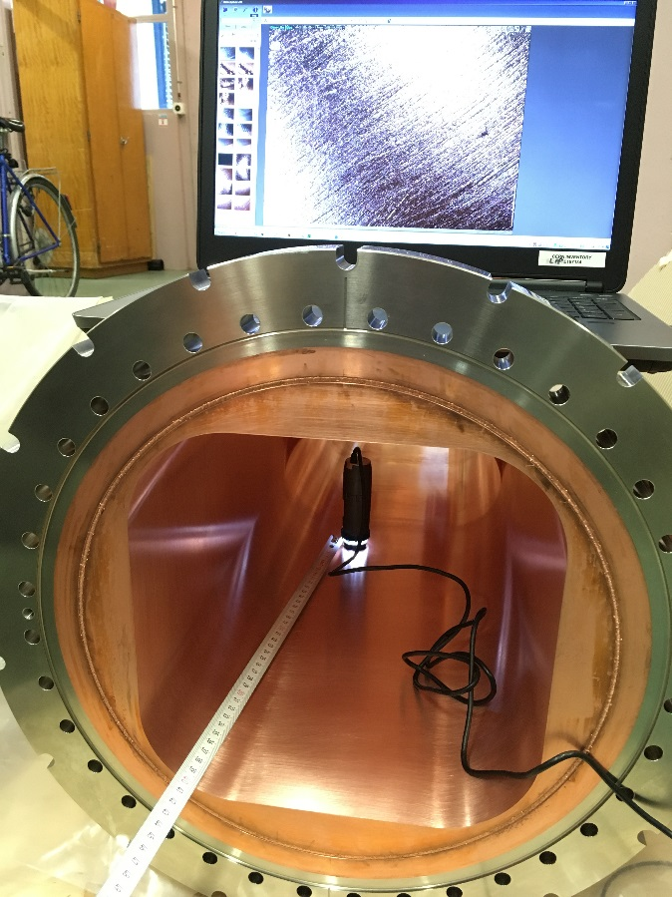
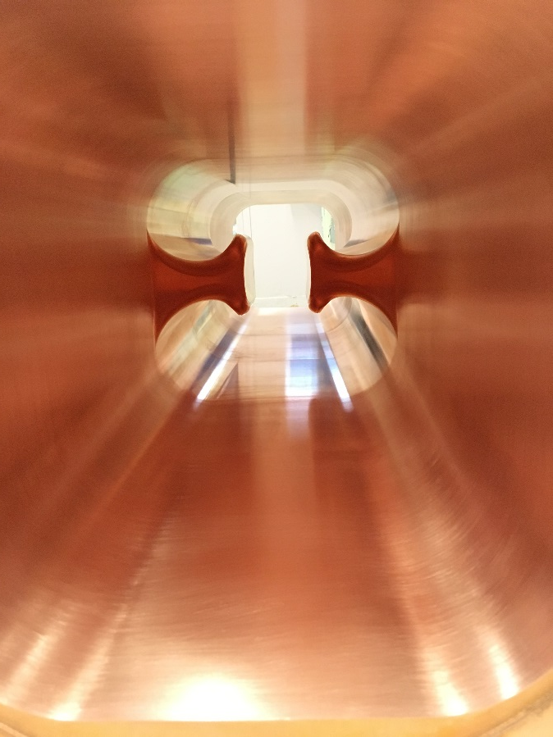
Fabrication of Copper cavity
Copper cavity (substrate) assembly has been finished end of 2018
Visual inspection has been done showing good RF surface state and no visible defects

Slide 7
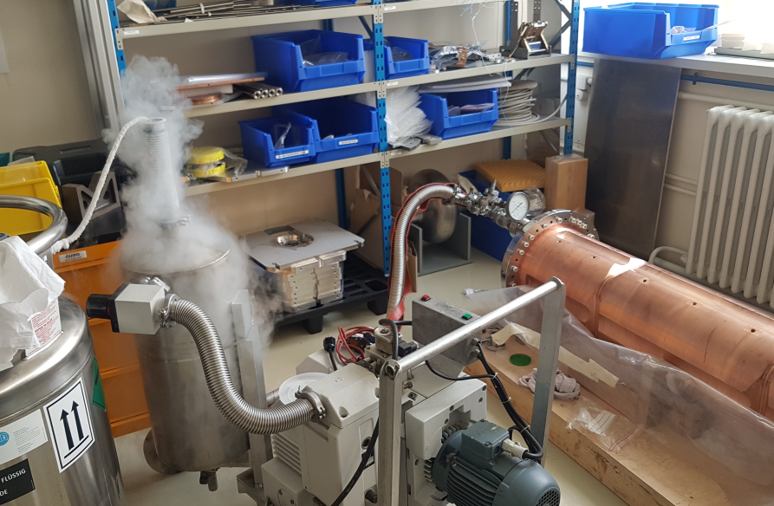
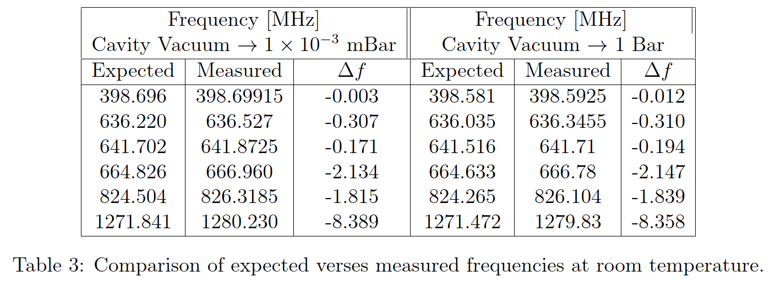
RF measurements results
RF frequency of fundamental mode and some of the HOMs have been measured at 300K.
Difference between design and measured frequency of the fundamental mode is very small: 12 kHz
This corresponds to effective shape accuracy at the level of 10 um !!!
This confirms expectations from metrology results
’Measurement of the Uncoated WOW Cavity at Warm’, J. Bastard, A. Macpherson, Report in preparation, 2019

Slide 8
Tooling and equipment for coating and testing
General approach
In order to save resources, significant effort has been put into reuse of the existing tooling and equipment for the 400 MHz LHC cavity
This cavity is the closest one by many parameters. Still there some differences:
  Internal shape. The main subject of the R&D
  WOWCC is longer: 1.4 m versus 0.9 m
  WOWCC is heavier: 290 kg versus 150 kg
  External flanges are larger DN350 versus DN300
Due to these differences new tooling and equipment have to be designed and fabricated

Slide 9
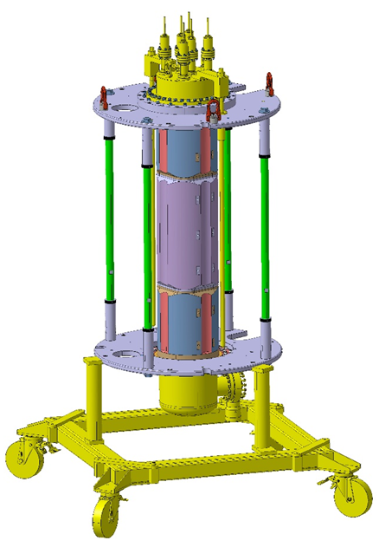
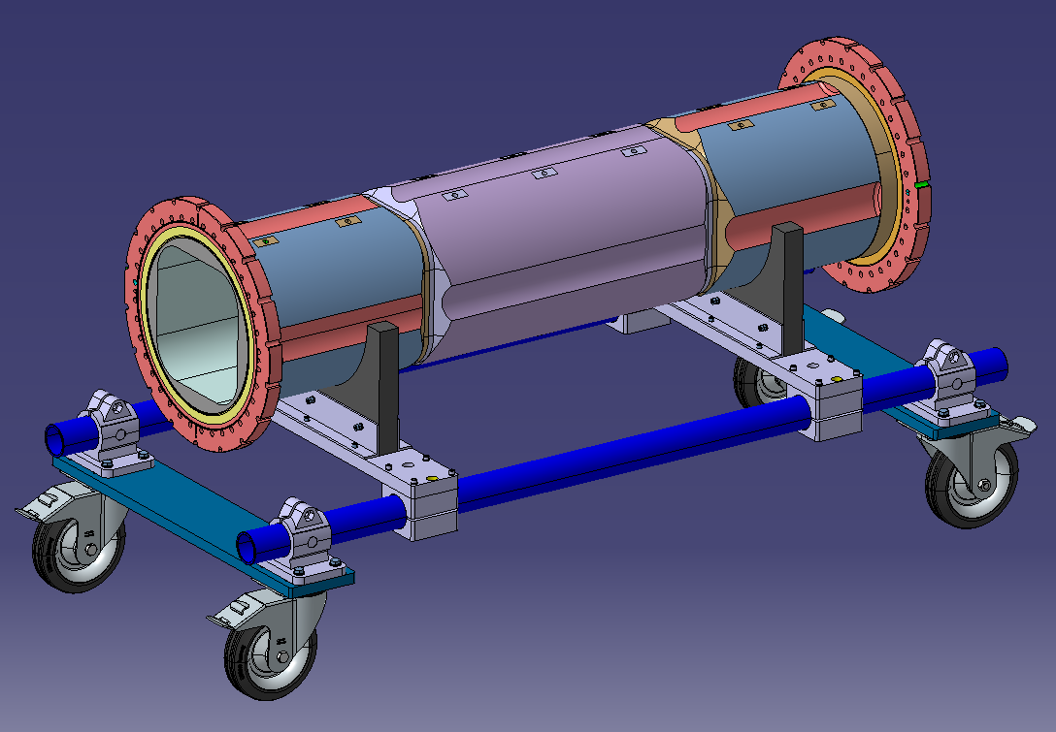
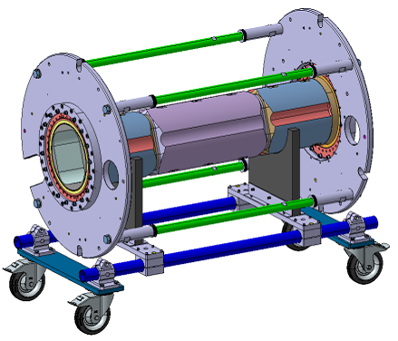
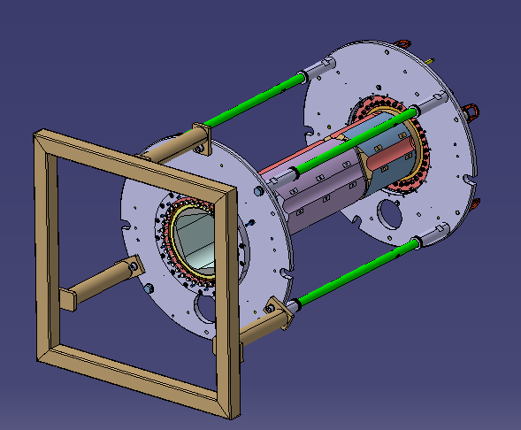
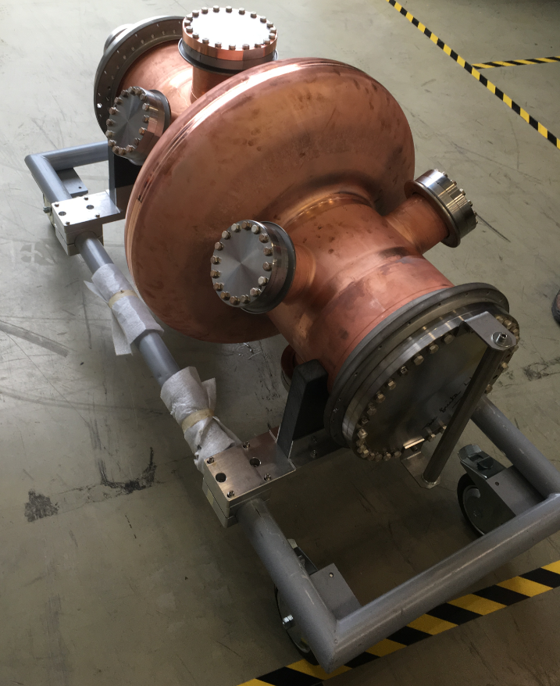
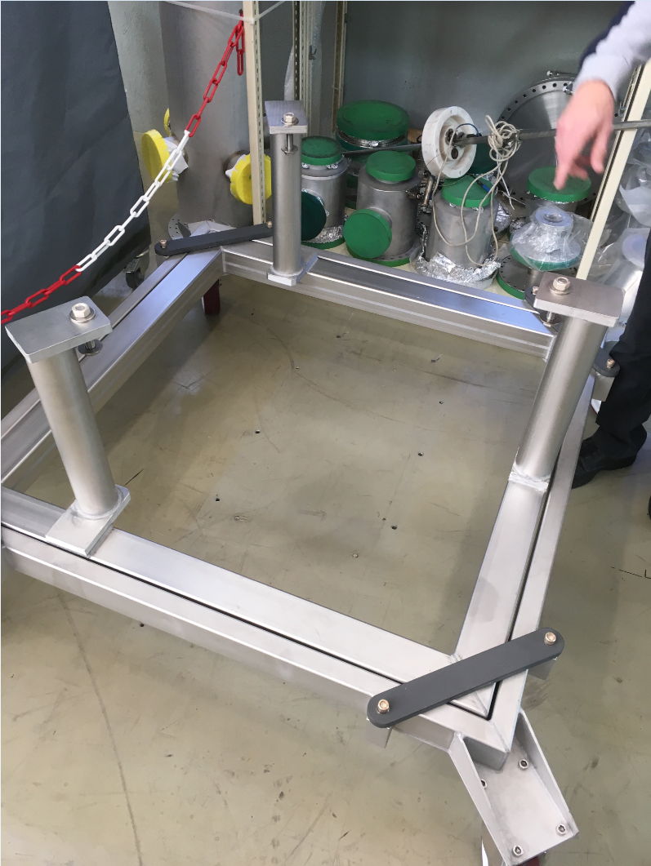
Tools for transport and handling
New tools for transport and handling has been designed based on the LHC cavity ones
  Cavity frame with the same external interface as LHC cavity frame
  Trolley for horizontal transport
  Trolley for vertical handling
One of each item will be fabricated
LHC cavity trolleys for transport and handling

Slide 10
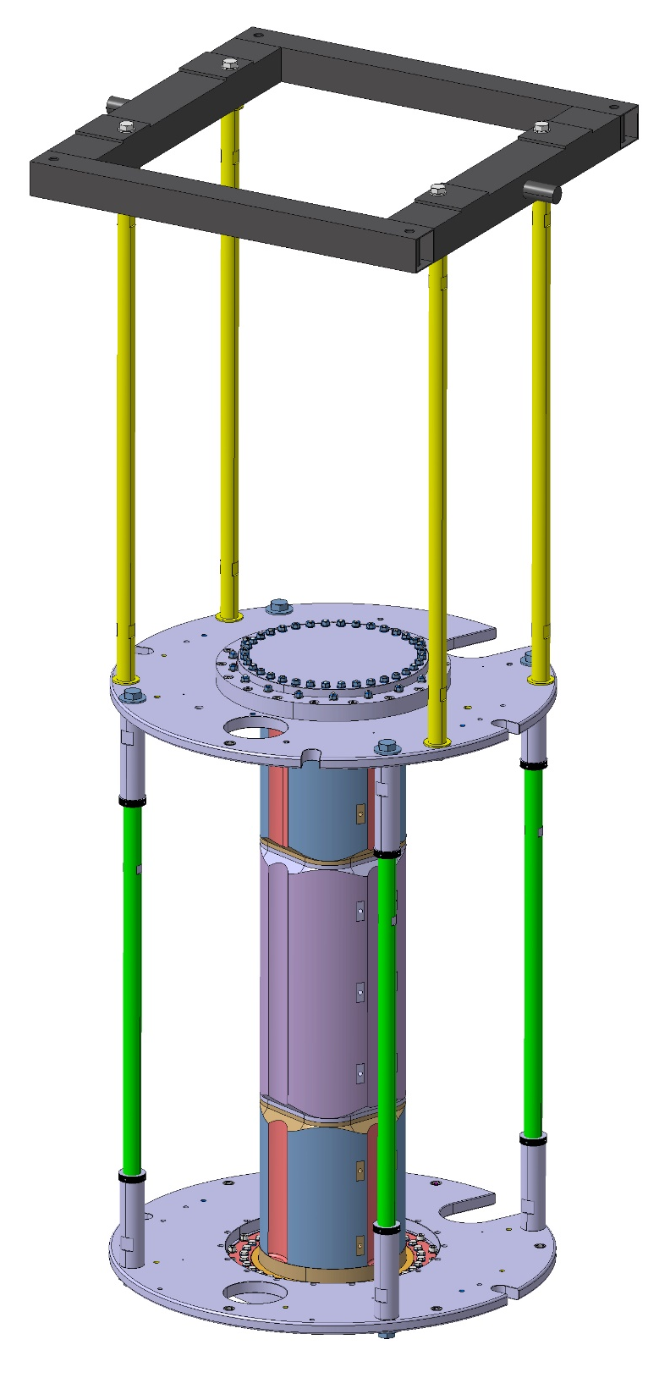
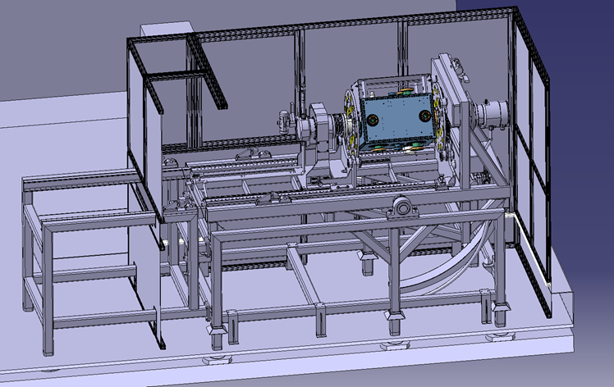
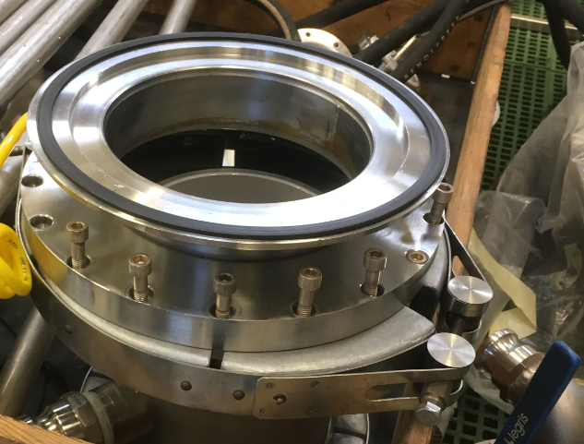
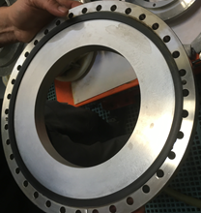
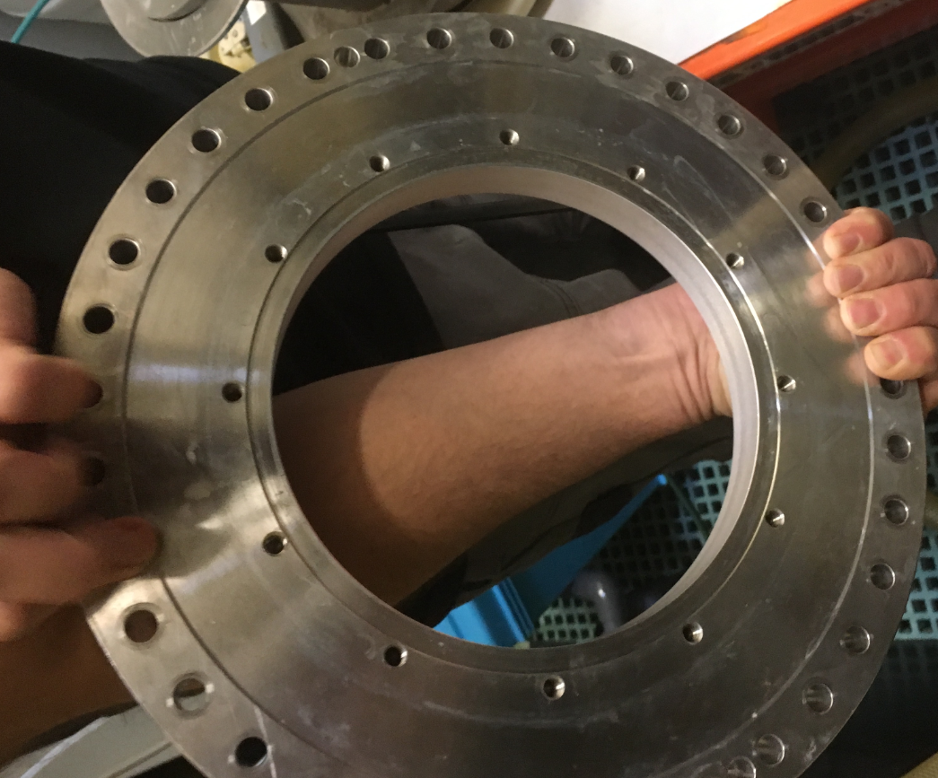
Surface treatment
Old frame
Reuse rotation tool for LEP cavities
  New rods has been designed and fabricated
Interconnection to the chemistry liquid circuit has still to be designed and fabricated
New rotation chemistry tool is compatible with WOWCC
New rotation chemistry tool
New
rods
Interconnections for LHC cavity

Slide 11
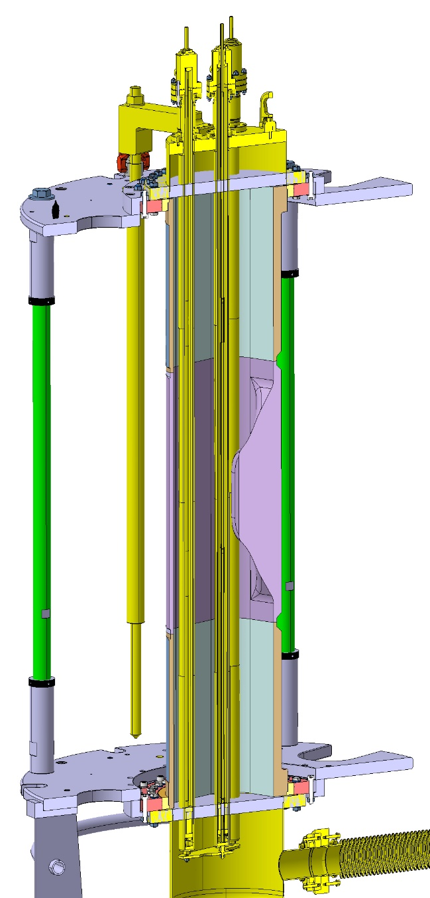
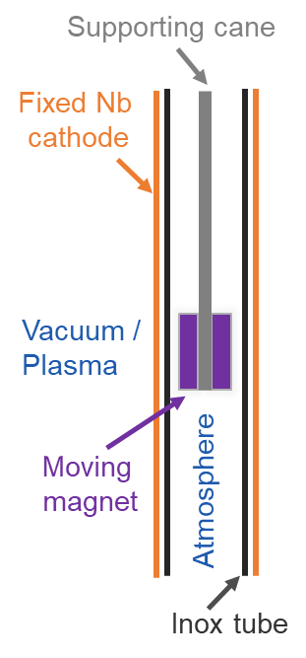
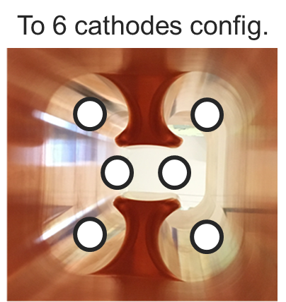
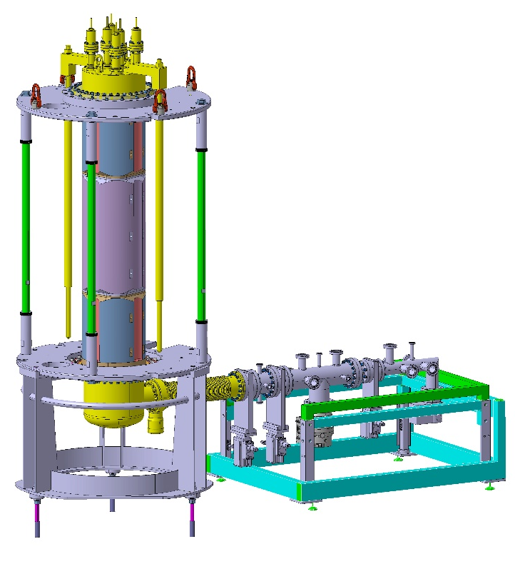
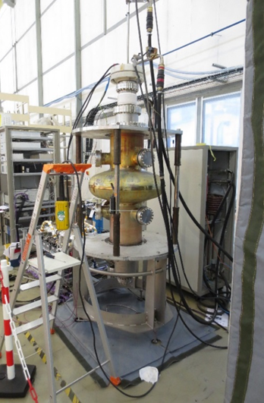
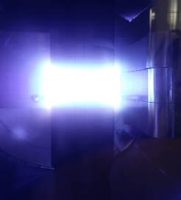
Nb-coating setup (more details in Fabian’s talk)
Coating setup concept is based on:
HiPIMS + positive pulse
6 cathodes configuration
It is in the final stage of R&D
Coating setup for WOWCC:
Use of the LHC coating benches in B252 adapted to WOWCC
New coating setup is under design (to be finished by Feb. 2020)
Fabrication to be completed by May 2020
First coating with existing infrastructure in B252: June 2020
Coating bench for LHC cavity

Slide 12
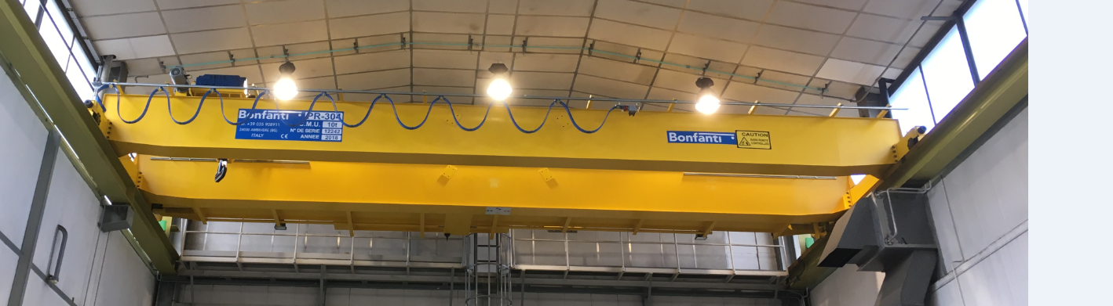
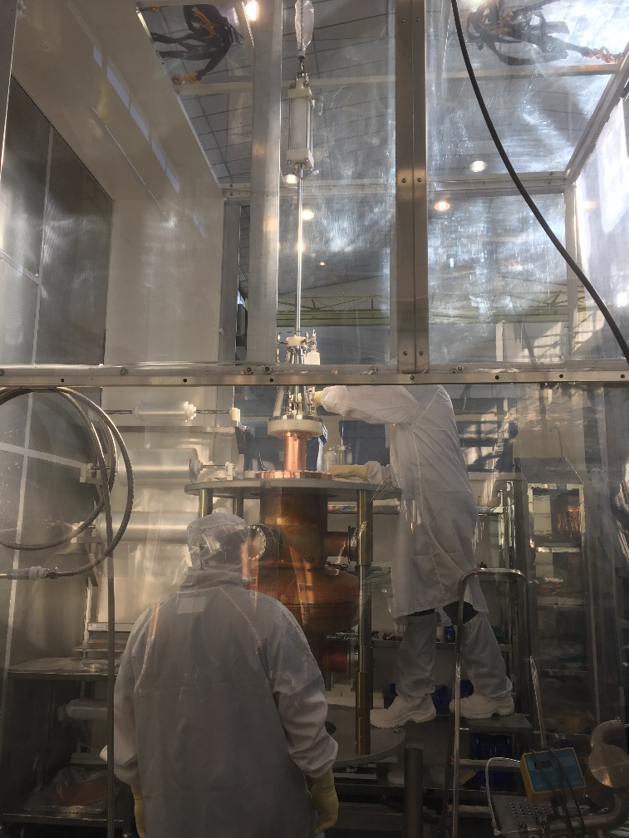
Water rinsing and clean room assembly B252 more details in Alick’s talk
B252
This facilities are needed to prepare cavity both for coating and for the cold test
This is the most critical and urgent needs:
  Rinsing the cavity before assembly in the coating setup
  Performing coating setup assembly in clean environment (baldaquin)
  Safe handling of the cavity and the coating setup assembly in B252
Preparation of cavity for the cold tests and/or for re-coatings will be done in the new infrastructure
Water rinsing in baldaquin

Slide 13
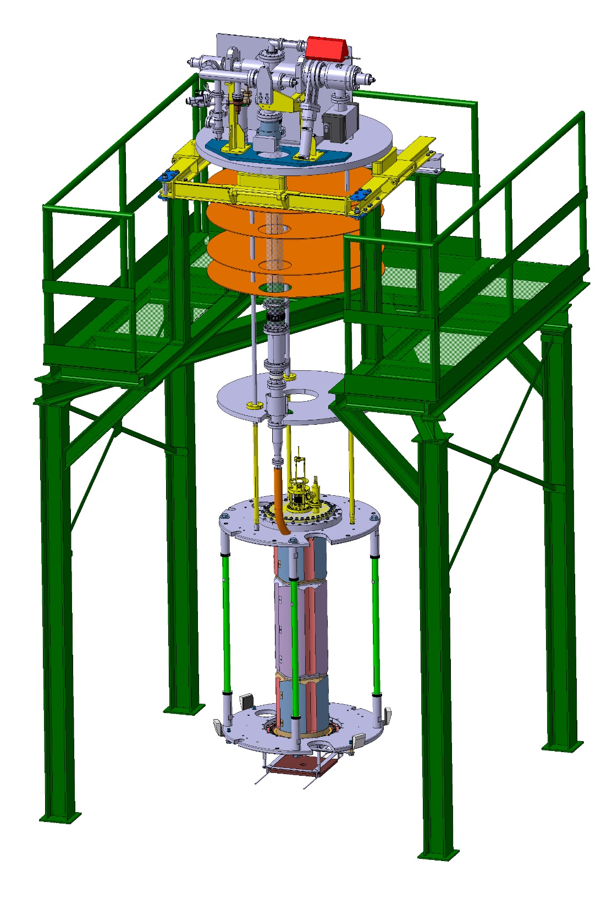
Cold test in SM18, more in alick’s talk
Assembly of the cavity for cold test will be done in B252 including:
  High pressure water rinsing
  Mounting of coupler, antenna and flanges (Design and fabrication have to be done)
After transport to SM18 it will be mounted on the cryo-insert
Recently redesigned V6 is compatible with WOWCC

Slide 14
Summary
Finished:
  Design and construction of the copper cavity
  Design and construction of the coating setup
In progress: see next talks
  Chemistry
  HP water rinsing and clean room handling in B252
  Coating mockup assembly in B252
In preparation: see next talks
  Coating in B252
  RF testing in SM18

