Slide 1
EU-Horizon
INFRA-2024-TECH-01-01
Ideas for a proposal
Compiled by L. Bottura
with contributions from M. Vretenar, D. Schulte, R. Losito, L. Rossi, J.M. Perez, L. Garcia Tabares, M. Calvi, P. Vedrine
+ on-going discussions
TIARA Council Meeting
Uppsala, 16 June 2023

Slide 2
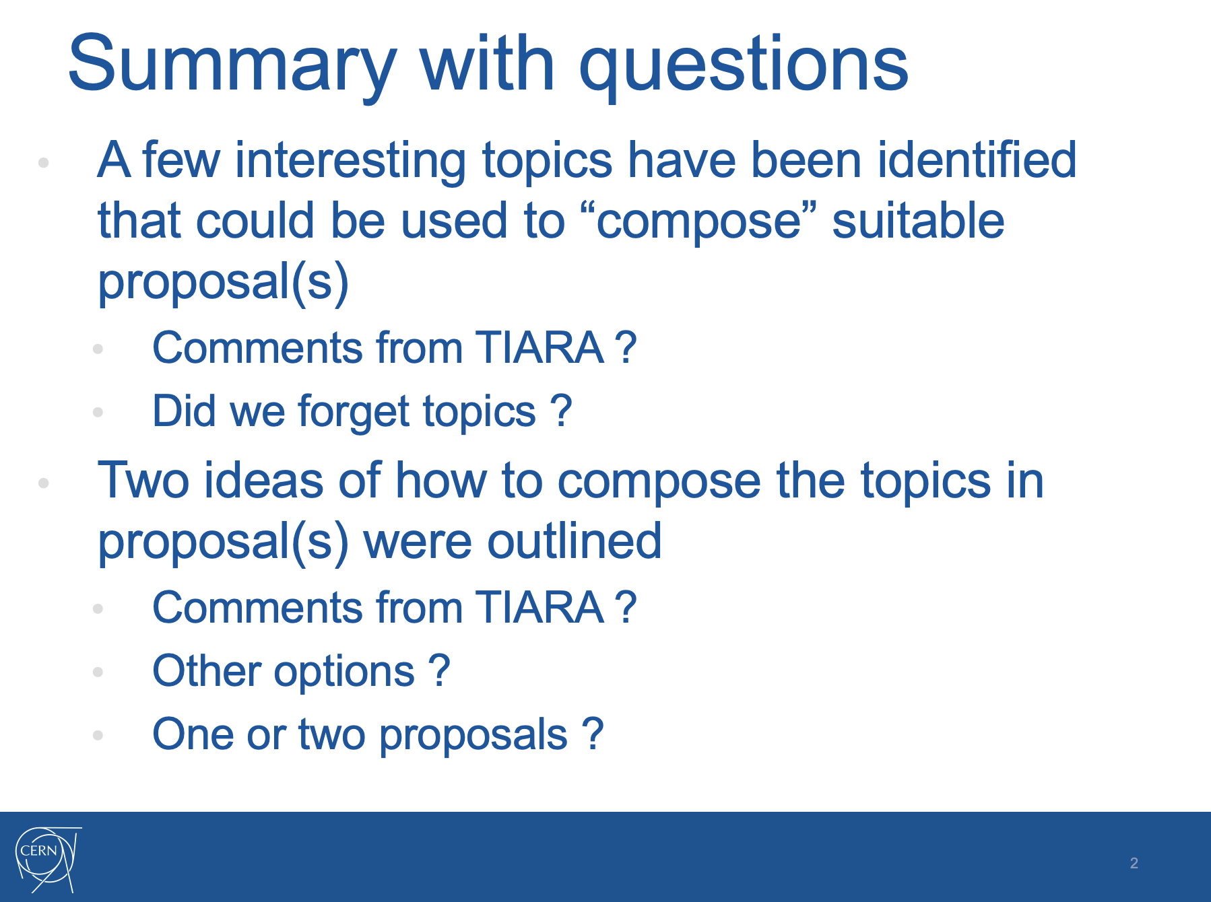
From last TIARA Meeting – 21 February 2023
Explore further
Energy consumption
Focus on HTS technology
(Not really)
One

Slide 3
Four HTS magnets challenges
Ultra-high field solenoids (from 40 T up to 60 T)
  Material science in high field
  NMR and life sciences
  Muon collider (muon beam cooling)
High field/large bore solenoids (up to 20 T, 1 m bore)
  Fusion
  Muon collider (muon beam production)
  Hybrid (SC/NC) high field magnets
High field/low consumption accelerator magnets (up to 20 T, up to 150 mm bore, up to 20 K)
  FCC-hh: 16 T…20 T
  Muon collider (collider ring): 16 T…20 T, 5 W/m
  Low consumption beam line magnets, also medical applications: 1 T…4 T
  Low consumption light source main ring magnets: ≈ 1 T
  Light source super-bends: ≈ 10 T peak, ≈ 1 Tm integral
High field undulators (up to 3 T gap field, 5 mm gap, short period)
  Synchrotron light sources
  Free Electron Lasers

Slide 4
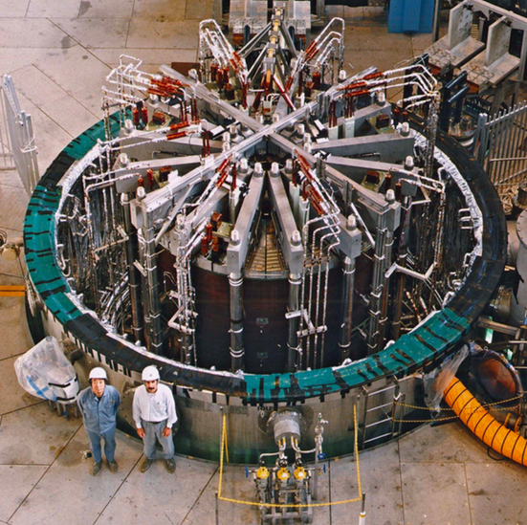
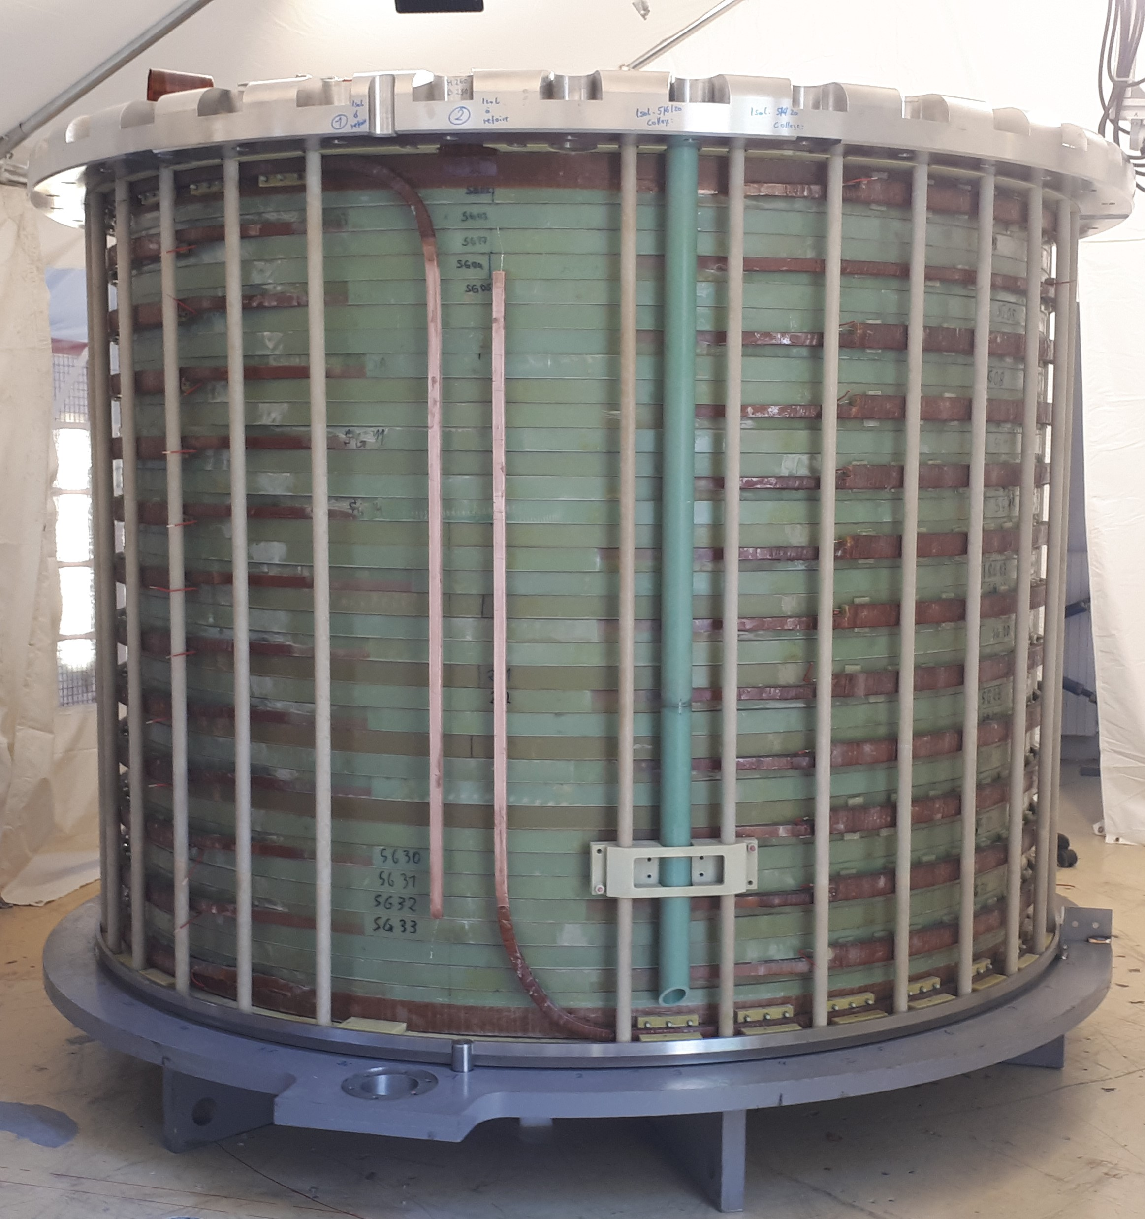
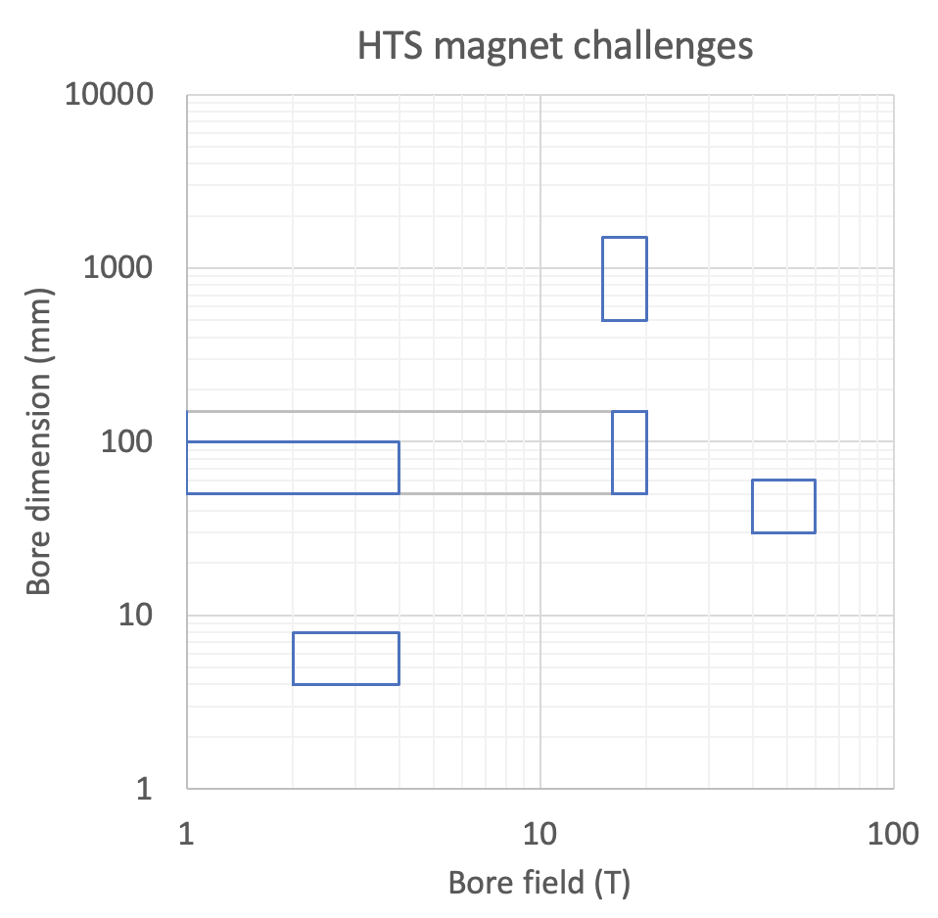
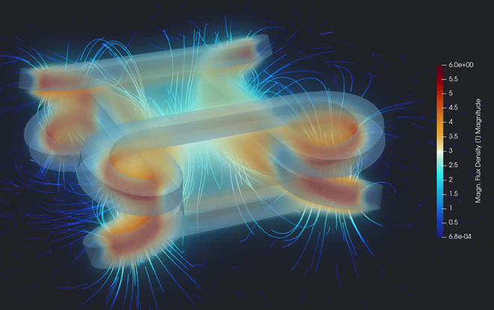
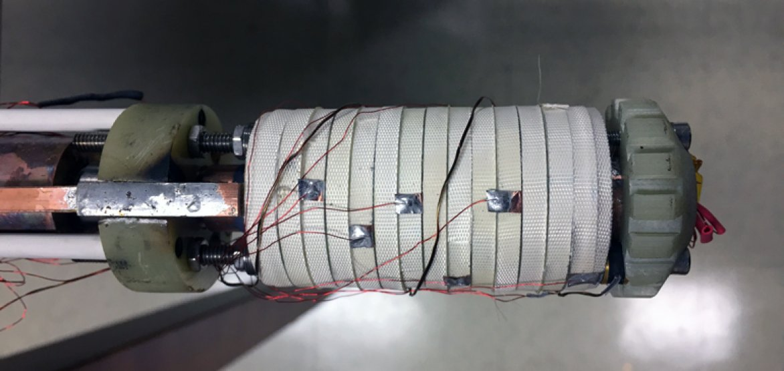
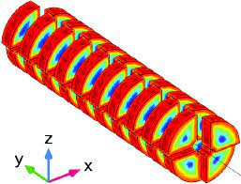
Four HTS magnets challenges
High field and large bore solenoids
Accelerator magnets
UHF solenoids
Wigglers and undulators

Slide 5
Technologies crucial to HTS
Energy efficient and sustainable cryogenic technology
  Cryogenic fluids and cycles for high temperature (20 K)
  Heat management (dry, indirectly cooled, gas cooled,…)
  Minimal cryogen (reduced fluid inventory)
HTS cables and conductors technology
  High current cables and conductors (10…50 kA)
  Cables for DC and ramped (AC) magnets
HTS winding technology,
  3D shapes (non-planar coils)
  Interturn insulation/resistance control
  Joints and terminations
Diagnostics, sensors and control technology
  Quench detection and quench protection (voltage an other techniques)
  Field control (field shaking, field feedback)
Radiation properties and radiation hardness
  HTS superconductors
  Insulators

Slide 6
Energy Efficient Cryogenics
HTS Winding
Diagnostics and Controls
HTS Cables and Conductors
Radiation Hardness
Ultra-High Field Solenoids
Large Bore High Field Solenoids
Accelerator Magnets
Undulators and Wigglers

Slide 7
Demonstrators (ideas)
Application specific engineering design, construction and test of demonstrators. Options:
  Demonstration towards an all-superconducting user facility for ultra-high field: 40 T, 50 mm bore HTS solenoid insert for test at EMFL (LNCMI) [overlap to SuperEMFL ?]
  Standalone background field for laboratory testing or as instrument in a beam line: 20 T, 50 mm bore, possibly split (?) all-HTS compact solenoid
  Demonstration of large-scale magnet technology: 20 T, 1 m bore, gas-cooled HTS solenoid model coil (or insert)
  New EU test station, beyond FRESCA, SULTAN and EDIPO: 20 T, 100 mm x 150 mm bore, 1 m long background field dipole operating with minimal cryogen and/or at temperature higher than liquid helium
  Small period undulator beyond the state of the art: 3 T gap field, 8 mm period, 5 mm gap HTS demonstrator for next generation synchrotron light sources and FEL

Slide 8
Potential partners
ESFRI - CERN and associated laboratories (INFN, CEA, CIEMAT)
ESFRI - EMFL laboratories (LNCMI, HLD, HFML)
ESFRI - Synchrotron light sources ESRF and FEL facilities EUXFEL and associated laboratories (PSI)
ESFRI - GSI/FAIR for low consumption super-ferric magnets (TBC)
ESFRI - ESS for neutron scattering experiments (TBC)
Fusion associated partners (TBC)
Industrial partners ? Which mechanism ? Discussion necessary

Slide 9
Packaging – 1
Demonstrators
WP1 - Management and Communication
Planning, follow-up, reporting
WP6 - Supporting technologies
Energy efficient cryogenics
WP7 - Test infrastructures
Applications
WP2 - Ultra-high field solenoids
WP3 - Large bore high field magnets
WP4 - Energy efficient and high field accelerator magnets
WP5 - High field/short period undulators
Cables and conductors
Winding technology
Diagnostics and controls
Strategy and roadmaps

Slide 10
Packaging – 2
WP1 - Management, communication and strategy (roadmap)
WP2 - Materials
HTS cables and conductors
Radiation effects
WP3 - Technologies
Cryogenics
Applications
Winding
Diagnostics and controls
WP4 - Energy efficiency and sustainability
WP6 - Medical applications
WP7 - High field science and NMR
WP5 - HEP applications
WP9 - Test infrastructures
WP8 - High field/short period undulators
Demonstrators

Slide 11
Packaging – 3
WP1 - Management, communication and strategy (roadmap)
WP2 - Materials
2.1 HTS cables and conductors
2.2 Radiation effects
WP3 - Technologies
3.1 Cryogenics
WP4 - Applications
3.2 Coils and winding
3.3 Diagnostics and controls
4.1 Energy, efficiency and sustainability
4.3 Medical applications
4.4 High field science and NMR
4.2 HEP applications
WP6 - Test infrastructures
4.5 High field/short period undulators
WP5 - Demonstrators
5.1 Technology demonstrator 1
5.2 Technology demonstrator 2

Slide 12
Next steps
Integrate comments from TIARA Council to select scope, structure and preferred narrative
Start contacting partners. In priority:
  EMFL
  ESS
  GSI/FAIR
  EUROFusion
Build a first draft of the project (deliverables, milestones, resources) for presentation and discussion at the next TIARA Council meeting

Slide 14
Challenge – UHF solenoids
Ultra high field (up to 60 T), small bore (50 mm) HTS solenoids
  Final cooling of muon beams as required in a high luminosity collider
  User facilities for high-field magnet laboratories devoted to experiments in material and life sciences
  Frontier of Nuclear Magnetic Resonance (NMR) systems for molecular spectroscopy and biology
  Positive impact (technology) on cryogen-free Magnetic Resonance Imaging (MRI)

Slide 15
Challenge – HF large bore solenoids
High field (20 T), large bore (1 m) HTS solenoid magnets, operating in high energy deposition and radiation environment
  Capture of charged particles (pions/muons) generated by protons on targets
  Central solenoids for fusion experiments and future fusion reactors
  Solenoids for other magnetically confined fusion configurations (e.g. mirror driven neutron source)
  Outsert (background field) magnets for future high magnetic field science facilities

Slide 16
Challenge –accelerator magnets
High field (up to 20 T), small to large bore (50…150 mm) HTS dipole and quadrupole magnets, operating in high energy deposition and radiation environment, at high cryogenic temperature (up to 20 K) for energy efficiency
  FCC-hh (NOTE: radiation hardness only relevant for IR magnets)
  Muon collider combined function arc magnets and IR magnets
  Synchrotron light sources
  Beam line magnets

Slide 17
Challenge – HF undulators and wigglers
TBD
  Synchrotron light sources - TBD
  Free Electron Lasers - TBD

Slide 18
Technology – Energy efficiency
Design magnet systems for increased energy efficiency, reduced consumption, improved long-term sustainability
  R&D topic
  R&D topic
  R&D topic

Slide 19
Technology – Cryogenics
Develop solutions to operate magnets at temperature higher than liquid helium (e.g. 20 K), either fluid- or indirectly-cooled (e.g. dry magnets)
  Heat transfer management at 10…20 K
  Fluid distribution
  Thermodynamic cycle optimization to improve energy balance, reduce consumption, and achieve better performance

Slide 20
Technology – 3D HTS winding
Develop solutions to wind coils of arbitrary shape using HTS (tapes)
  Dipole/quadrupole ends
  Multiple-in-hand winding
  Transitions (e.g. double pancakes)
  Joints integration

Slide 21
Technology – Radiation hardness
Characterize radiation hardness of HTS materials, and other materials of use in HTS magnets (e.g. insulations)
  Measurement, evaluation and material analysis (e.g. microscopy, diffractometry, …)
  Nuclear calculations in support of data, and identification of damage mechanisms

Slide 22
The call
Research and Innovation Action
Total budget estimate: 62 MEUR
EU contribution per proposal: 5…10 MEUR
Eligibility: Consortia must include at least 3 different research infrastructures, each of them being an ESFRI infrastructure, and/or a European Research Infrastructures Consortium (ERIC) or another research infrastructure of European interest

Slide 23
Expected outcome
Enhanced scientific competitiveness of European research infrastructures;
Enhanced RI capacities to address research challenges and EU policy priorities;
Foundations for the development of innovative companies;
Increased collaboration of research infrastructures with universities, research organisations and industry;
Increase of the technological level of industries through the co-development of advanced technologies for research infrastructures and creation of potential new markets;
Integration of research infrastructures into local, regional and global innovation systems and promotion of entrepreneurial culture.

Slide 24
Scope
The aim of this topic is to deliver innovative scientific instrumentation, tools, methods and solutions which advance the state-of-art of RIs in the EU and Associated Countries, and show transformative potential in RIs operation. The related developments, which underpin the provision of improved and advanced services, should lead research infrastructures to support new areas of research and/or a wider community of users, including industrial users.
Cutting-edge technologies will also enhance the potential of RIs to contribute addressing EU policy objectives and socio-economic challenges.
Proposals should ensure complementarity with actions funded under the previous 2022 call (topic HORIZON-INFRA-2022-TECH-01-01 in the 2021-2022 work programme), targeting different instrumentation, tools, methods and solutions.
Proposals should address the following aspects, as relevant:
  Research and development of new scientific instrumentation, tools and methods for research infrastructures taking into due account resource efficiency (e.g. energy consumption) and environmental (including climate-related) impacts. This could also include the development of new, more sustainable and efficient methods of collecting data and/or of providing access, including remote and digital, as well as digitalisation of instrumentation, services and results;
  their technology validation and prototyping;
  training of RI staff for the operation and use of these new solutions. When relevant,
  developing skills on technical validation to industrial standards;
  the innovative potential for industrial exploitation of the solutions and/or for the benefits of the society, including facilitating proof of concept for use by SMEs.

