Slide 1
Towards an International Network
*
For Multi-physics Modelling, Machine learning and Model-based Control in Accelerator Sciences and Technologies
Preparation for INFRA-2024-TECH-01-01 call
TIARA Council Meeting, June 16th 2023
A. Ghribi (GANIL/CNRS) & C. Darve (ESS);
on behalf of the coordination working group : A. Eichler (DESY); V. Kain (CERN); S. Lecerf (CNRS); A. Oeftiger (GSI); J. Varin (CNRS)

Slide 2
What this is all about!
Engaging experts of
accelerators and its community to use AI/ML to
tackle challenges of present and future
research infrastructures
A real game changer in the way we collaborate, share, operate and build our RI in a global context

Slide 3
European framework
• The aim of this topic is to deliver innovative scientific instrumentation, tools, methods and solutions which advance the state-of-art of RIs in the EU and Associated Countries, and show transformative potential in RIs operation. The related developments, which underpin the provision of improved and advanced services, should lead research infrastructures to support new areas of research and/or a wider community of users, including industrial users. • Cutting-edge technologies will also enhance the potential of RIs to contribute addressing EU policy objectives and socio-economic challenges. • Proposals should ensure complementarity with actions funded under the previous 2022 call (topic HORIZON-INFRA-2022-TECH-01-01 in the 2021-2022 work programme), targeting different instrumentation, tools, methods and solutions. • Proposals should address the following aspects, as relevant: • Research and development of new scientific instrumentation, tools and methods for research infrastructures taking into due account resource efficiency (e.g. energy consumption) and environmental (including climate-related) impacts. This could also include the development of new, more sustainable and efficient methods of collecting data and/or of providing access, including remote and digital, as well as digitalisation of instrumentation, services and results; their technology validation and prototyping training of RI staff for the operation and use of these new solutions. When relevant, developing skills on technical validation to industrial standards; the innovative potential for industrial exploitation of the solutions and/or for the benefits of the society, including facilitating proof of concept for use by SMEs.
INFRA-2024-TECH-01-01
call INFRA-2024-TECH-01-01
Call opening : 06/12/2023
Call deadline : 12/03/2024
Budget between 5 and 10 million €

Slide 4


European framework
Secured resources and methodology
Starting point: 10 k€ + 40 k€* (FR fund) to build the network and organize the response ;
Data storage and catalogs attributed (CC IN2P3) ;
700 k€ in processor time granted by GENCI for data generation ;
1 European project engineer granted ;
Administrative resources available.
* response in June 2024

Slide 5
Purpose, ways and methods
Multiple challenges
Sharing data and metadata with standardized software framework adapted to "feature engineering”* and machine learning, all FAIR-principle and open-source ;
Developing fast and realistic simulations ;
Designing global adaptive optimisation embedded in control systems ;
Being able to detect and classify anomalies as well as prevent majors faults … all in real time ;
  Take into account environmental challenges for design and operation of present and future research infrastructures
* Specific properties used to generate AI models

Slide 6
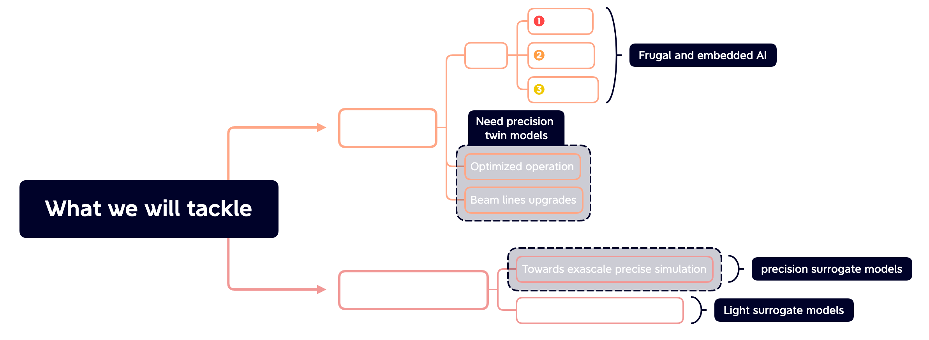
Purpose, ways and methods
Purpose
A divide and rule strategy
From development to deployment

Slide 7
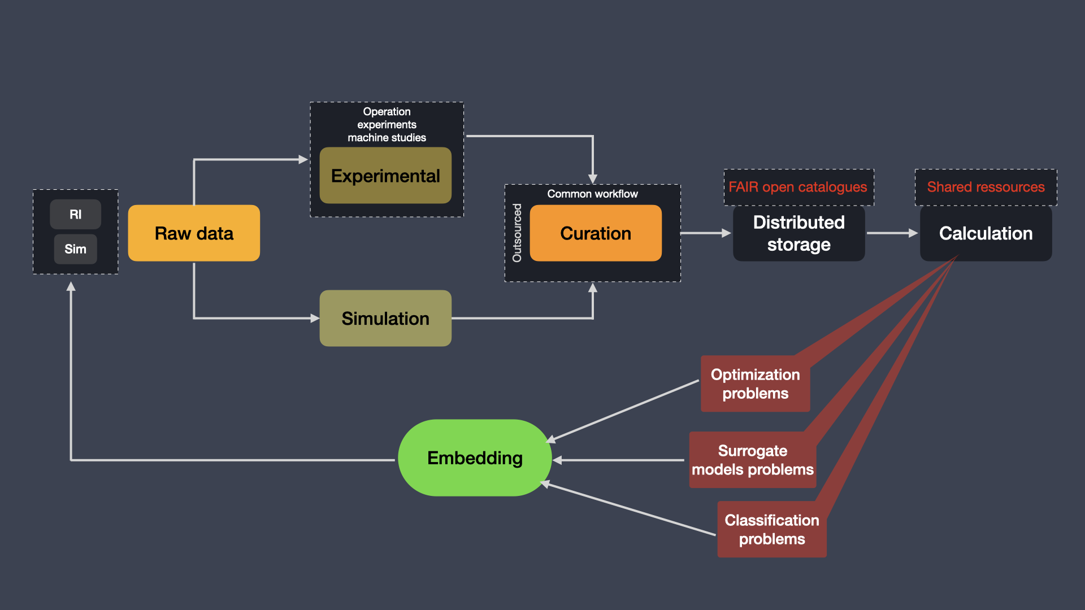
Purpose, ways and methods
Purpose
Implementation

Slide 8
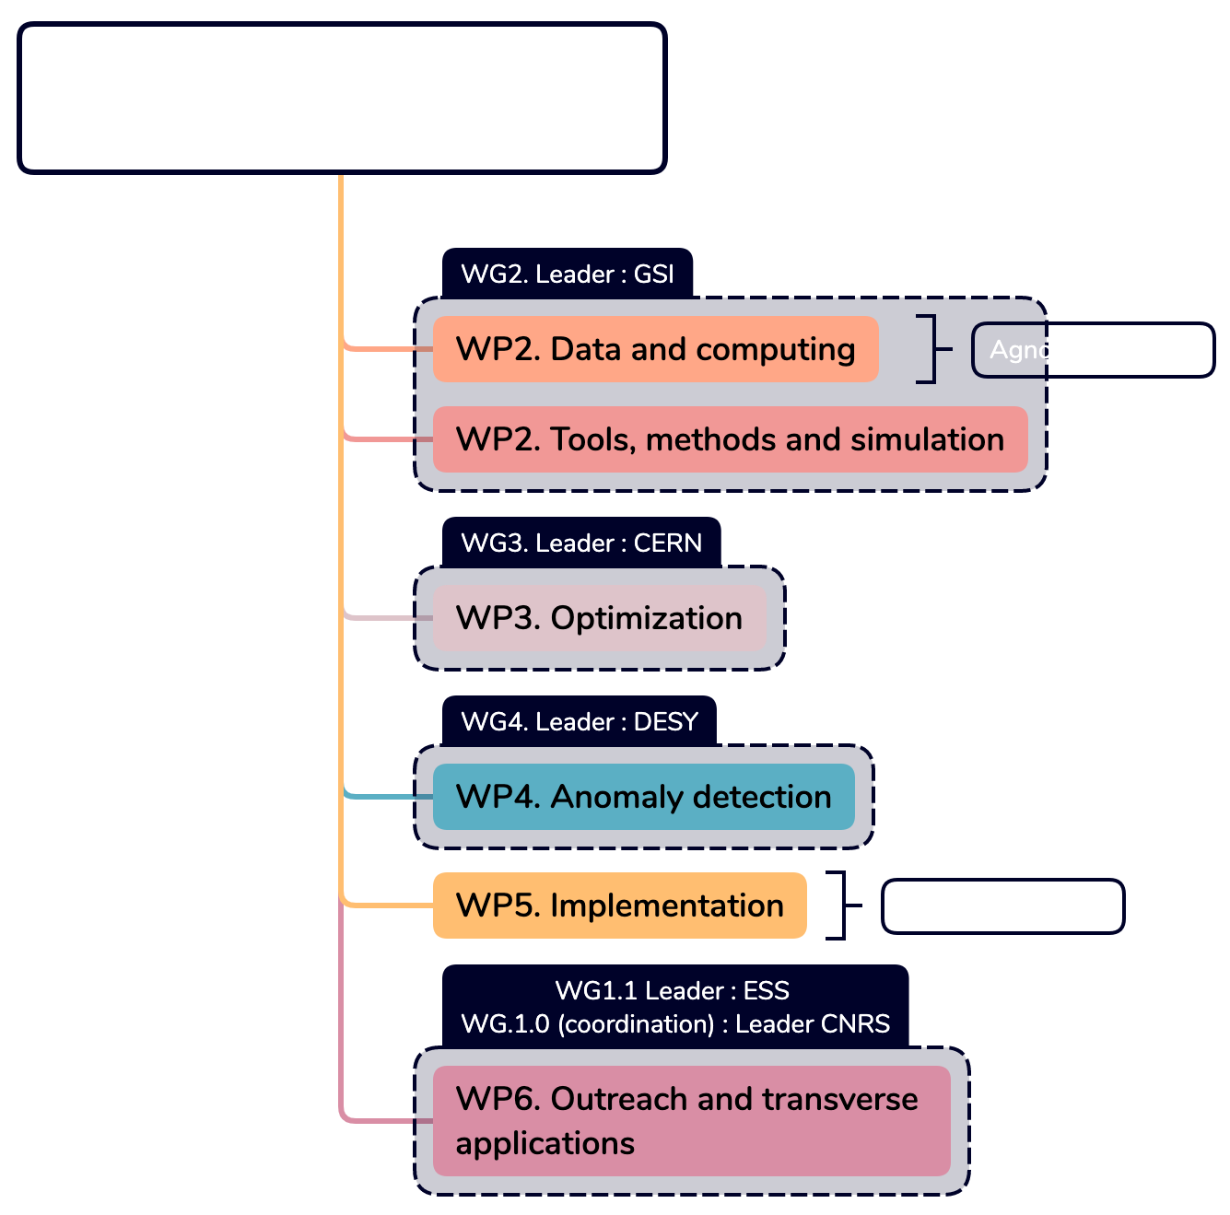
Organisation
*
Working groups and work packages
4 Working groups organized and progressing in parallel for the definition of the work-packages inputs/outputs ;
Preliminary 6 work-packages identified ;
A workshop in July will identify and freeze the organisation and enable a deeper response to the call
* Workshop in July to finalise the response draft

Slide 9
Purpose, ways and methods
Multiple challenges
Gathering, exchanging and training expertise using transverse applications
Goal: Transdisciplinary thanks to Communication / Outreach : scattering community (Light and Neutron Sources), Medical app., Astro, HEP ; from accelerator components to detector systems !
Proposed strategy:
Contribute to a cross-disciplinary European Roadmap
Towards International perspectives as a Global endeavour !

Slide 10
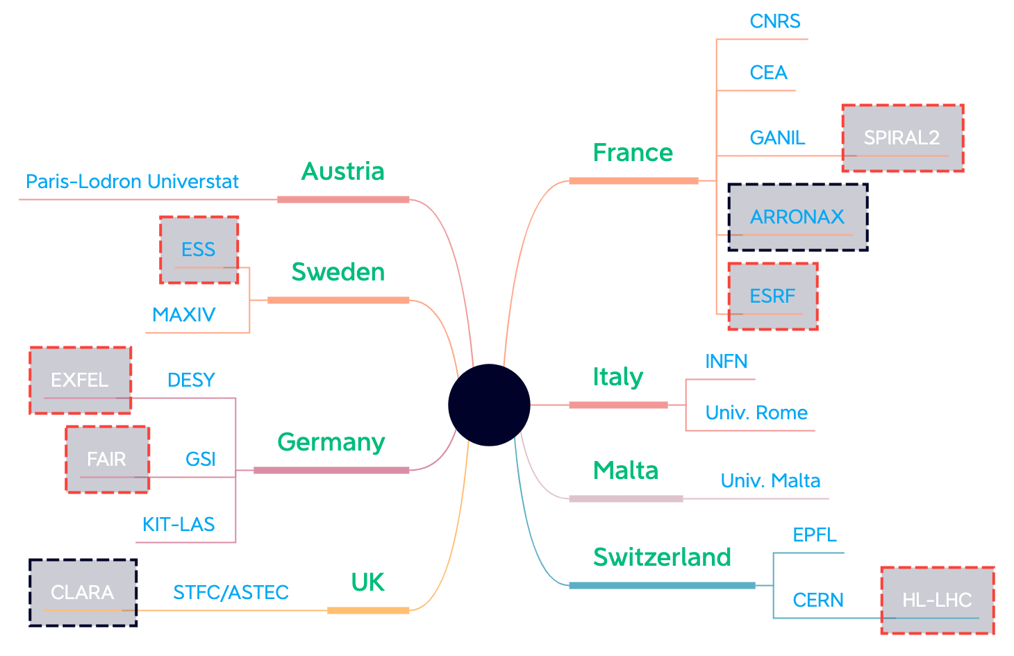
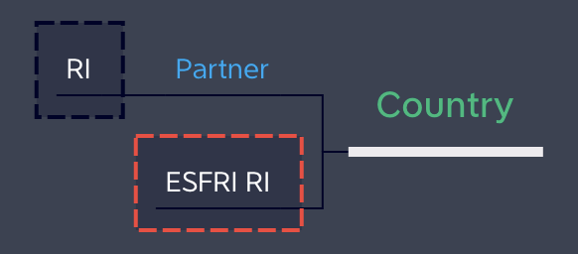
Organisation
Confirmed partners : More to come !
including Industrial Partnership
Contributors, RI and projects
+ 8 countries
+17 labs/institutes
+ 8 RI

Slide 11
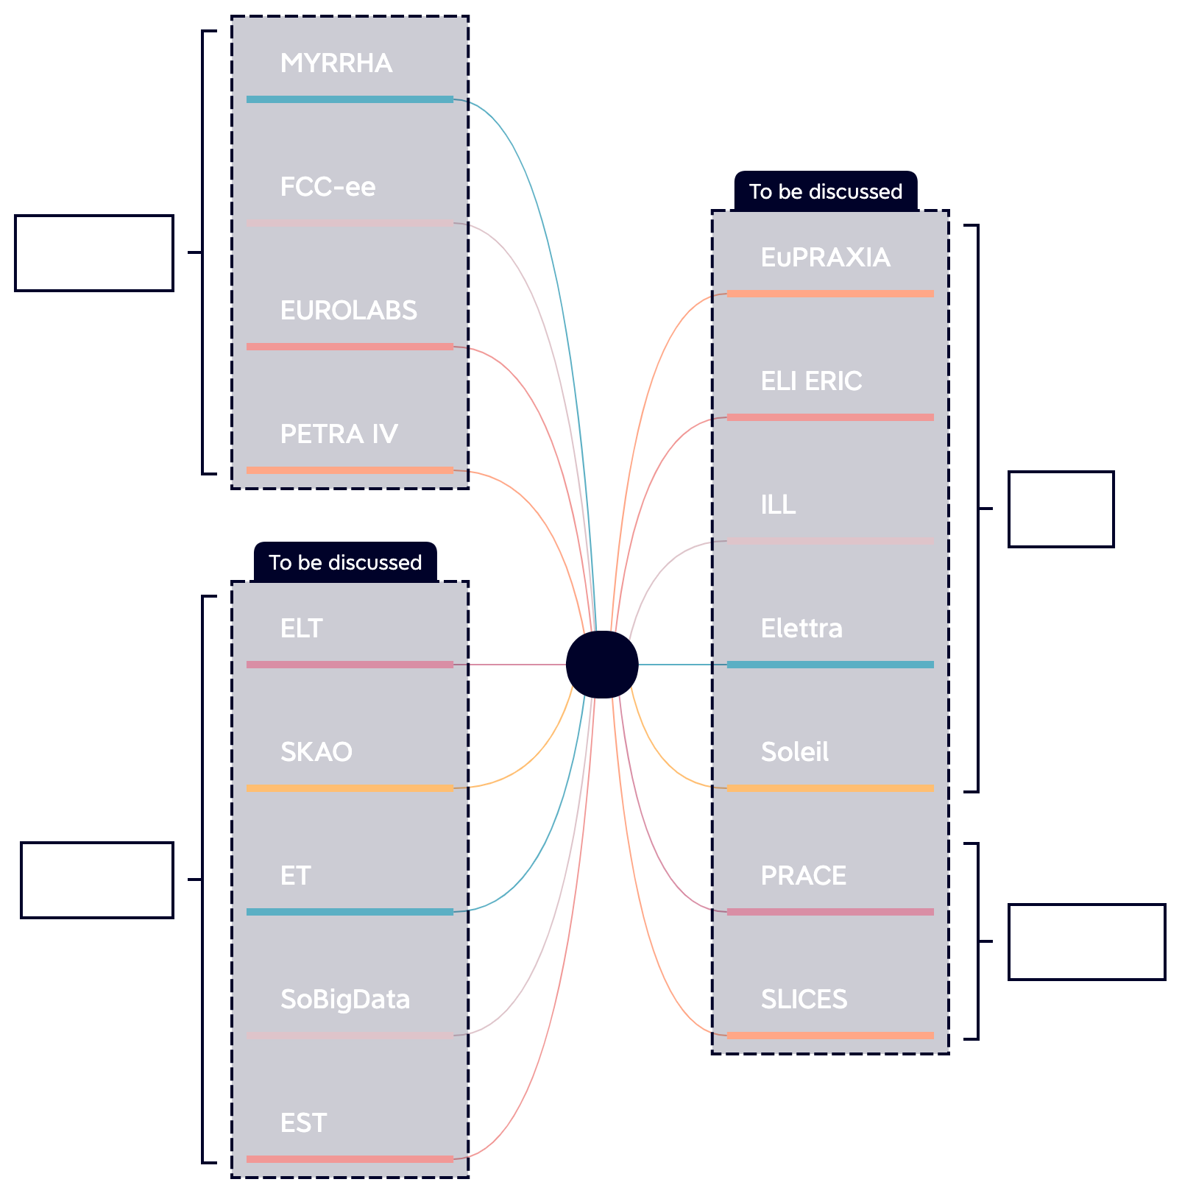
Organisation
Contributors, RI and projects
+ 8 countries
+17 labs/institutes
+ 8 RI
Crossovers to other projects

Slide 12
Organisation
Contributors, RI and projects
+ 8 countries
+17 labs/institutes
+ 8 RI
Crossovers to other projects
And many more direct and transverse links…

Slide 13
Conclusion/Summary
Environmental challenges need to be integrated into our scientific endeavours ;
An international, motivated and talented team is building up quickly ;
A big-leap in the way we see and do things for accelerator science and its user community ;
An enormous potential in the way we exchange and collaborate across RI ;
Potential big outcomes in RI services ;
Transverse applications are numerous : Industry/Research/Education and beyond.

Slide 14
THANK
YOU
QUESTIONS, COMMENTS, ADVICES, INPUTS ARE WELCOME !

Slide 15
Extra - slides
To enable…
Proof-of-concepts for a global European cluster and AI/ML hubs
  Connecting and strengthening communities around data ;
  Open Source data collection ;
  Post-doc cross-institutes ;

Slide 16
Possible WP descriptions
WP2 brings together collaborators investigating data generation in a more economic and efficient fashion. The WP aims to streamline progress in individual laboratories and provide knowledge transfer with the following goals:
1. Investigate suitable strategies for active learning queries in guided parameter scans.
2. Identify common metadata and features to simplify data collection.
3. Establish infrastructure and procedures for sharing data and results.
A pool of evaluation-costly study cases from the participating laboratories serves as a testing ground to compare strategies, identify common metadata and organically set up shared infrastructure during the collaborative exploration.
WP3 focuses on establishing a suite of state-of-the-art algorithms for more efficient parameter optimisation at design or accelerator exploitation stage. In particular the WP aims at:
1. Identifying suitable optimisation and control algorithms for the various use cases in the community. 2. Defining/reviewing infrastructure requirements to use optimisation algorithms for simulation or accelerator parameter control 3. Defining frameworks in Python for optimisation problem definition to easily share algorithms
4. Defining and driving the implementation of a pilot project for ML optimisation/control at the edge

Slide 17
Possible WP descriptions
WP4 on anomaly detection brings together collaborators investigating anomaly detection, fault diagnosis, fault prediction and prevention for a more efficient, safe, reliable and autonomous operation of accelerator infrastructure. The WP aims to streamline progress in individual laboratories and provide knowledge transfer with the following goals:
1. Identify common applications that are of high relevant for improving the operation.
2. Investigate suitable algorithms that are available and can deal with the common applications.
3. Identify common challenges, i.e., about online vs. offline implementation, dealing with environmental drifts and propose adequate solutions.
4. Establish infrastructure and procedures for sharing data and results.
WP6 on outreach, transverse applications and industrial partnership brings together collaborators exchanging AI/ML methodologies. The WP gathers expertise and exchange knowledge transfer with the following goals:
1. Infuse a global network based on transverse applications
2. Develop simulations to enable a trans- and cross-disciplinary training
3. Establish a sustainable eco-system between RI, industry and academic as a Global endeavour

