Slide 1



Holmganga: CLASH Workshop 2023
– Sumit Basu
26–30 Jun 2023 Helsingborg, Sweden

Slide 2

History
The term "holmganga" typically refers to an ancient Scandinavian practice of settling disputes through a duel or physical combat in an island
physical combat
Physics discussions,
logics, innovative ideas
→ dialogues, pen, pencil,
paper & computer
Elite Hotel Marina Plaza,
Helsingborg, Sweden
(Close to sea)
Vytautas Vislavicius
Andrecia Ramnath
Jarkko Peuron
Sumit Basu
Adrian Fereydon Nassirpour
In HEP, we all have our own (strong) biases,
weaknesses & strengths,
+ Some unknowns
+ Some areas where we dare to ask questions
+ Some hidden great ideas
+ …
Jet quenching
Particle production & freeze-out
Correlations & fluctuations
CGC versus Lund strings

Slide 3
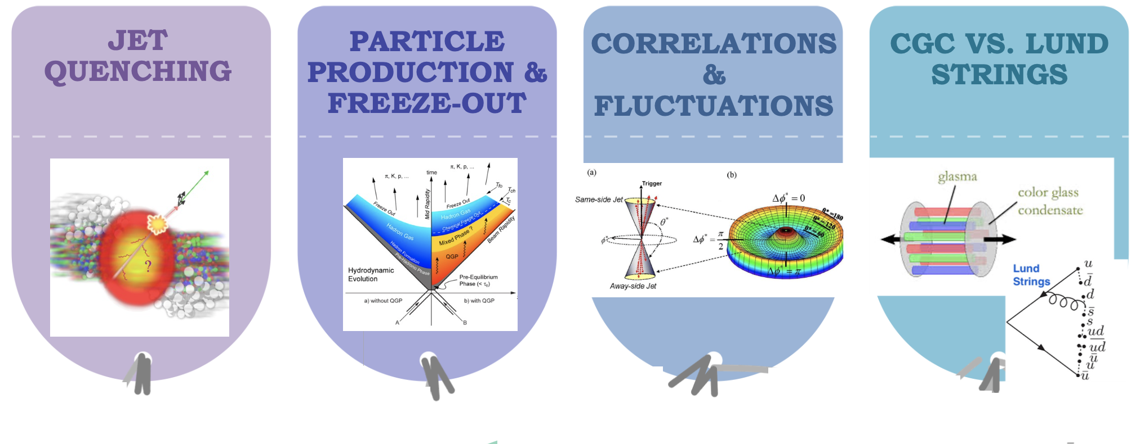



Rule of the Game
First Part:
Parallel Session
Second Part:
Summary & Duels

Slide 4
Rule of the Game
Jet quenching
Particle production & freeze-out
Correlations & fluctuations
CGC versus Lund strings
→ Will be convened by assigned
convenors
→ They could lead/trigger the discussions
But not limited to only their materials/topics
Participants are strongly encouraged to
take part/engage
Focus is to find good “clashing points”/two
side view/Holmganga
→ Please don’t forget the Change my mind
questions (in your conference kit folder)
First Part:
Parallel Session
→ Jarkko
Second Part:
Summary & Duels
Each session convenor will summarize the main outcomes of the discussion (sessions)
Any debatable ideas which came up during the discussion will be dueled over in a holmganga
We also want to discuss the change my mind questions + new ideas/questions

Slide 5
What we expect
Other conference
Holmganga Conference
We promote our work though
Talks/ poster
Limited time for interactions
on other works
Afraid/shy to try challenging ideas
stick to biases
Here we promote which is untold
Some extreme ideas, views
Full conference is open to discussion
engaging debatable thoughts
Afraid/shy to try challenging ideas
Encourage to be clashy/ask questions
Be a ”Holmgangers” !!!
We want to jolt down the possible ideas, doubts and try to come with some write up after this workshop
→ Of course, with your help!!!
Hope that will be food for thoughts for upcoming 5-10 years for this field.
Possibilities for new collaborations for longer term to try some new ideas
→ Ask us!!! Lanyard (organizers)
→ Andy
Enjoy!!!

