Slide 1
Analytical estimates of stress due to electromagnetic forces in sector dipoles
E. Todesco (CERN, TE-MSC)
G. Vallone and P. Ferracin (LBNL)
CERN, 27 April 2023

Slide 2
CONTENTS
1D estimates about stress and magnetic pressure
2D equations for azimuthal stress
2D equations for radial stress
Benchmark

Slide 3
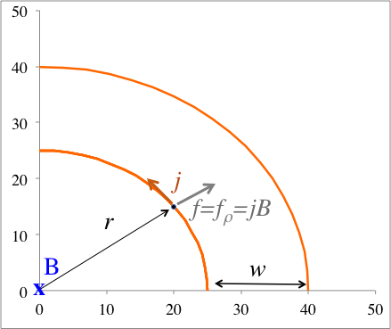
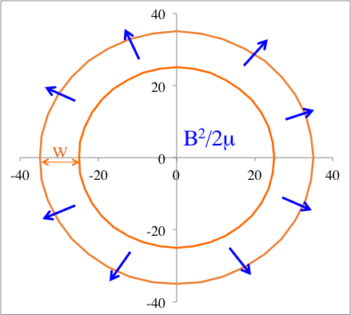
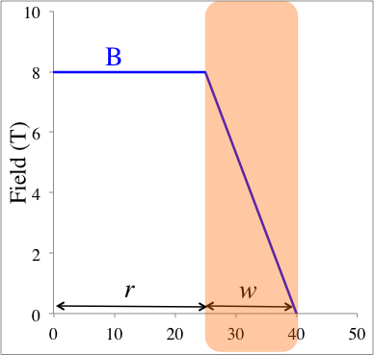
SOLENOID – 1D
In a solenoid, the radial pressure on the winding is the magnetic pressure
  Coil width w, current density j, field inside the bore B
  Force density f is in the radial direction
  Integrating the 1-D case one finds
  And since for a solenoid one has
Independent of aperture
Independent of j
Only dependent on B

Slide 4
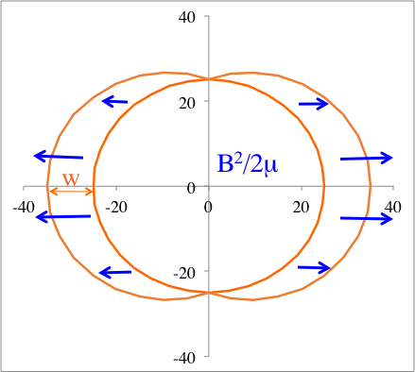
THE SECTOR DIPOLE: RADIAL STRESS
A 1D ESTIMATE BASED ON HEURISTIC APPROACH
In a dipole, things are more complicated
  Symmetry is broken
In the heuristic hypothesis that total force is the same, but is concentrated on the midplane with a cosθ dependence, one has ~60% more than magnetic pressure
Solenoid
Dipole

Slide 5
HOW MUCH IS THE MAGNETIC PRESSURE ?
4 T: 7 MPa (Tevatron)
8 T: 25 MPa (LHC)
12 T: 57 MPa
15 T: 90 MPa
20 T: 160 MPa
That’s why it is interesting to know the scaling with magnetic pressure … 60% more 90 MPa is 150 MPa, that is where we enter critical zones

Slide 6
THE SECTOR DIPOLE: RADIAL STRESS
ANOTHER 1D ESTIMATE
We assume that the field inside the winding in the midplane decreases linearly and the zero is at 2/3 of the winding
The relation current density field coil width for a sector dipole is
Therefore one has 20% more than the magnetic pressure
However, we will see in the third part of these slides that this equation has a missing piece and is severely underestimating the radial stress

Slide 7
WHAT TO RETAIN – FIRST PART
Radial pressure in a solenoid is the magnetic pressure, and depends only on B
  Not on the aperture, not on the current density, not on the winding width
  The pressure of 15 T is 90 MPa
Radial stress in a dipole coil should be larger than the magnetic pressure, due to the lack of symmetry
  How much large? Interesting question, heuristic estimates give something between 20% and 60% more, making a 15 T dipole going towards 150 MPa in the worse cases
  But we will see that these heuristic estimates based on a 1D computation are missing a significant part, coming from the intrinsically 2D cahracteristics of the problem
  (and on the top of this one has to add the structure, not considered here)

Slide 8
CONTENTS
1D estimates about stress and magnetic pressure
2D equations for azimuthal stress
2D equations for radial stress
Benchmark

Slide 9
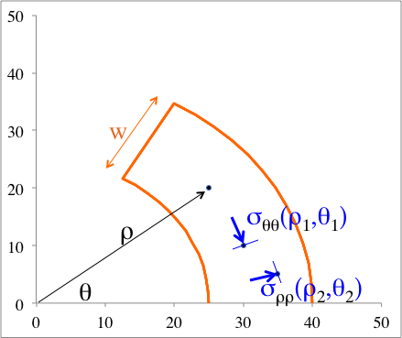
AZIMUTHAL STRESS ON THE BORE
As well-known in the community, the limiting stress in « our » superconducting magnets is not the radial one, but the accumulation of the azimuthal stress in the midplane
  Called compressive stress in M. Wilson book
The accumulation of azimuthal stress in the midplane can be easily computed on the bore
Coordinate system for radial and azimuthal stress
Azimuthal force on the bore

Slide 10
AZIMUTHAL STRESS ON THE BORE
In practical units, one has
  So for example for the LHC dipole,
  That is 50% larger than the 27 MPa magnetic pressure of 8.3 T
Another case: the HL-LHC D1 dipole: 5.6 T magnet, 440 A/mm², 150 mm aperture
    That is 7 times larger than the 12 MPa magnetic pressure of 5.6 T
Note that the dependence is different with respect to the radial stress: instead of w (coil width) we have r (aperture radius)

Slide 11
AZIMUTHAL STRESS ON THE BORE
In terms of magnetic pressure we can write
From Wilson book, pg 52:
  “Compressive (what we call here azimuthal) stress in the windings of dipoles can also be troublesome. Maximum stress occurs at the equator … An approximate value for the maximum stress may be found by assuming the stress to be uniform over the equator region, σ_{y}=F_{y}/(b-a). For a thin [cosθ] winding we have ... σ_{y}≈(B²/2μ₀)4/3(a-1), which can greatly exceed the magnetic pressure”
  Translated in our notation
  Wilson does not make the sum of the azimuthal component, he divides the forces per quadrant per the coil width in a cosθ thin model

Slide 12
AZIMUTHAL STRESS ON THE BORE
Consequences of this equation
Azimuthal stress scales with aperture, current density and field
  Azimuthal stress does not scale with B² !
In principle the azimuthal stress can be reduced by using more coil width and less current density (less effective magnet) – this does not work for the radial stress
Magnets with large aperture can have significant azimuthal stress also in case of relatively low field (as HL-LHC D1)
If the aperture is 10% larger, the stress is 10% larger: we should not make magnets larger than needed

Slide 13
2D EQUATIONS FOR AZIMUTHAL STRESS
What is the meaning of integrating the azimuthal component of the force along a circular path?
  Usually it is said: it has no physical meaning
  (you cannot sum vectors in polar coordinates)
  but it gives a good estimate of the midplane stress (it is wrong but it works)
Indeed, this integral has a very precise physical meaning:
Let us write the equations for stress in 2D polar system
Coordinate system for radial and azimuthal stress

Slide 14
2D EQUATIONS FOR AZIMUTHAL STRESS
Neglecting the shear stresses, one has
And the integration of the second equation
along a circular path gives
Therefore this is the accumulation of midplane stress in the hypothesis that there are no shear stresses in polar coordinates
  It works well for a sector coil, when the structure is very rigid and the coil slides along a concentric paths

Slide 15
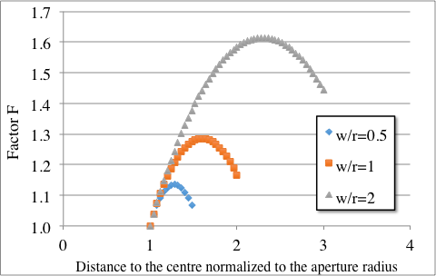
AZIMUTHAL STRESS IN THE COIL
One can integrate the azimuthal component along any circular path inside the sector coil P. Fessia, et al., IEEE Trans. Appl. Supercond. 19 (2009) 1203-7
Inside the coil, two counteracting effects:
  Integration path becomes longer → larger stress
  Field decreases → smaller stress
The first effect is stronger,
so stress increases inside the coil
  For w/r=1 (LHC dipole) the increase is 30%

Slide 16
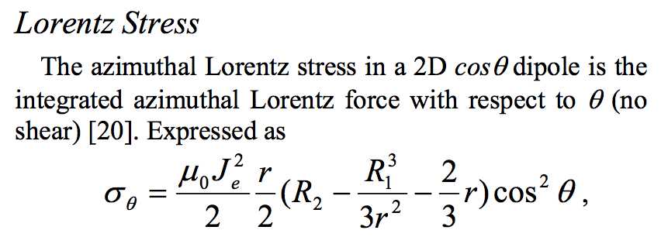
AZIMUTHAL STRESS IN THE COIL
The equation found for the sector coil is the same as what computed for a cosθ coil four years before (2005), in the significant work on scaling laws
  S. Caspi, P. Ferracin, « Limits of Nb₃Sn accelerator magnets » PAC 2005
  This is rather surprising, and gives more robustness to this equation, that is valid both for sector coil and for a cosθ coil
However, the two equations are not exactly equivalent
  When you use j, B, r you use the independent variables
  If you use only j and r you have to assume a relation between B, j and w, and you can miss a significant part that is the iron contribution

Slide 17
IRON CONTRIBUTION
Iron gives field without increasing current density, and therefore reduces stress for a fixed B, r, w (you can use smaller j)
  r: aperture radius w: coil width R_{I}: iron radius
  Case of unsaturated iron, with saturation contribution becomes smaller for high fields
For a given field, aperture and coil width, iron allows reducing stress by the same factor it contributes to the field (Example: Δ_{I}=0.17 in the LHC dipole, i.e. 17% increase of field for a fixed j

Slide 18
WHAT TO RETAIN – SECOND PART
Azimuthal stress is dominant over the radial in « our » magnets up to ≈15 T
  It does not scale with B², but with aperture, current density and field
  Good part of the story of superconducting magnets is a walk through the line of 450 A/mm²
In principle the azimuthal stress can be reduced by using more coil width and less current density (less effective magnet) – this does not work for the radial stress
Magnets with large aperture can have significant azimuthal stress also in case of relatively low field (as HL-LHC D1)
If the aperture is 10% larger, the stress is 10% larger: we should not make magnets larger than needed
Iron contribution is significant since it gives field without currents: it reduces stress of the same amount it contributes to field for a fixed j
  Place iron as close as possibile to the coil, as in MCDPT1

Slide 19
CONTENTS
1D estimates about stress and magnetic pressure
2D equations for azimuthal stress
2D equations for radial stress
Benchmark

Slide 20
EQUATIONS FOR RADIAL STRESS
Having computed σ_{θθ}, one can compute the radial stress σ_{ρρ} along the midplane
So, the integral of the force is not simply but is
and there is a second term, where the azimuthal stress feeds into the radial – this increases the first heuristic estimate given in slide 6

Slide 21
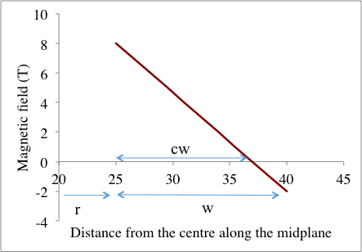
EQUATIONS FOR RADIAL STRESS
Making the hypothesis that the field in the midplane lineary decreases and reaches zero at cw
One can integrate finding
(remember Δ_{I} is the iron contribution)
Field decrease versus distance to the bore
in the coil along the midplane, and constant c
LHC dipole case

Slide 22
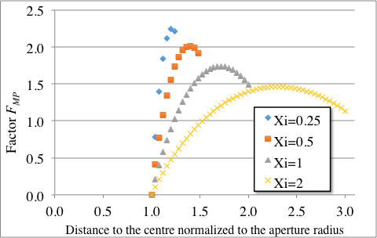
EQUATIONS FOR RADIAL STRESS
The factor F_{MP} is between 1.5 and 2, and increases for very thin coils
Factor F_{MP}, in normalized coordinates

Slide 23
WHAT TO RETAIN – THIRD PART
Radial stress scales with magnetic pressure, but is 20-80% larger than magnetic pressure
  If the coil is very thin, even more than 80%
Up to 12 T, it is still below 100 MPa
At ≈15 T, one goes well beyond 100 MPa, and becomes an issue to take into account, besides azimuthal stress
At 20 T surely requires stress management
Contrary to azimuthal stress, one cannot reduce the radial stress by using less effective coils (more coil width and less current density) i.e. making more expensive magnets

Slide 24
CONTENTS
1D estimates about stress and magnetic pressure
2D equations for azimuthal stress
2D equations for radial stress
Finite element model benchmark

Slide 25
BENCHMARK WITH FINITE ELEMENT MODEL
Any model is usually much more precise in relative then in absolute
Analytical models give a precise indication on the parameteric dependence
  For azimuthal stress, 10% more aperture, 10% more stress … etc
  For radial stress, 10% more field is 20% more stress ...
But can be also used to predict the absolute
As we will see the added value is not only the model precision and applicablity, but also directions where to go with magnet design

Slide 26
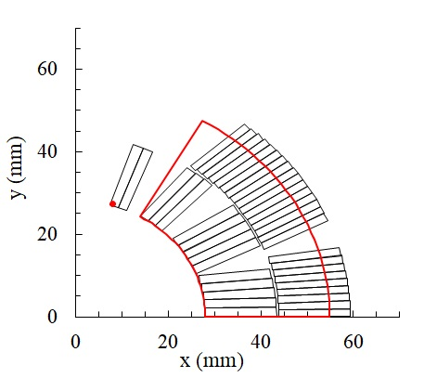
BENCHMARK WITH FINITE ELEMENT MODEL
Approximation based on the analytical model based on 60° sector coil
  Using equivalent coil width
  Using the nominal current density of the inner layer in case of grading
  Using the nominal field
Example of coil layout for the LHC MB, and sector coil approximation

Slide 27
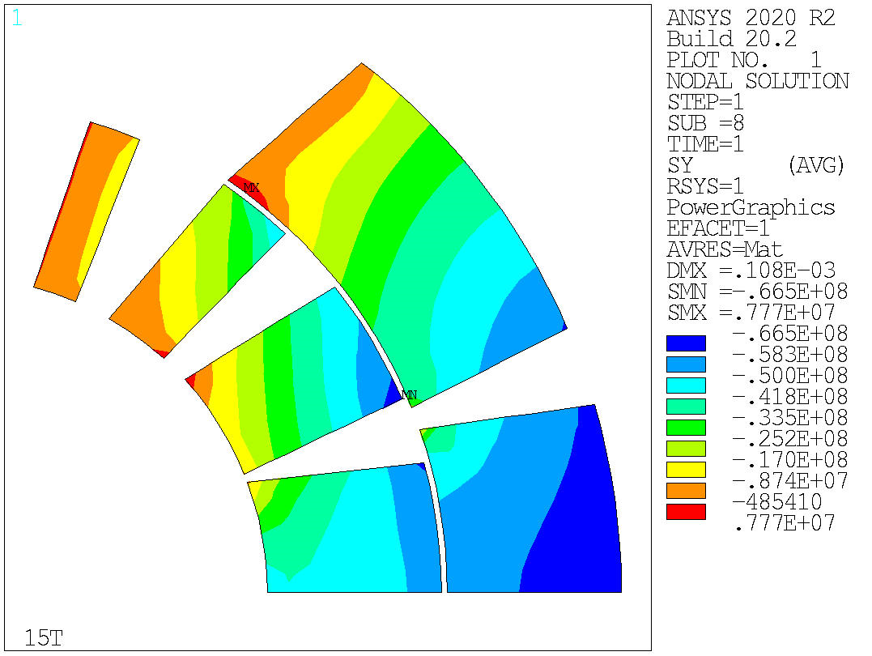
BENCHMARK WITH FINITE ELEMENT MODEL
Approximation based on the finite element model
  Infinitely rigid structure
  No friction between layers for Nb-Ti, or between Nb₃Sn layers not impregnated together
  Real geometry of blocks and current density (including grading if present), plus iron
  Mechanical properties of the coil
Example of ANSYS output for the LHC MB, azimuthal stress

Slide 28
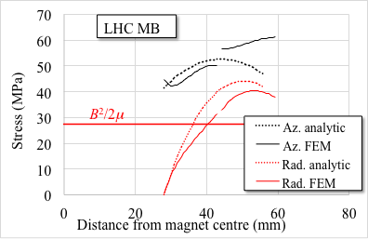
BENCHMARK WITH FINITE ELEMENT MODEL
Output and comparison
  Radial and azimuthal stress along the midplane (see black arrow)
  Dashed line is analytical, solid line is FEM
  Magnetic pressure corresponding to the nominal field is also given as reference
Comparison analytic/FEM for the LHC MB

Slide 29
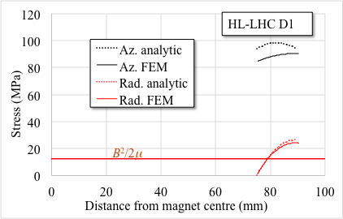
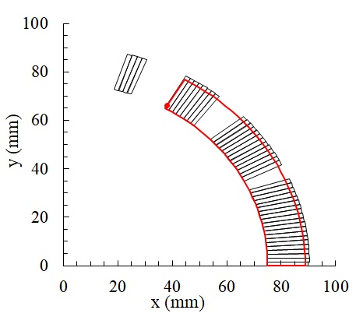
HL-LHC D1: 5.6 T, 75 mm aperture, 15 mm coil width
T. Nakamoto, et al., IEEE Trans. Appl. Supercond. 25 (2015) 4000505
Ideal case to apply the equations
  Radial stress confirms analytical estimates, it is twice the magnetic pressure
  Azimuthal is 5 times larger than radial due to the large ratio aperture/coil width
  Agreement within 10% for both radial and azimuthal stress
Coil layout (left), and comparison analytic/FEM (right) for the HL-LHC separation dipole D1

Slide 30
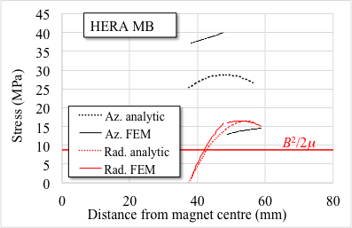
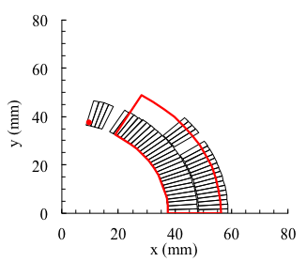
HERA MB: 4.7 T, 37.5 mm aperture, 20 mm coil width
The angle of the layers are very different from 60° (as in Tevatron dipole)
  Radial stress confirms analytical estimates, it is twice the magnetic pressure
  Azimuthal stress is obviously larger (50%) than analytical estimate in the inner layer, and smaller (half) of the analytical estimate in the outer layer
Coil layout (left), and comparison analytic/FEM (right) for the HERA main dipole

Slide 31
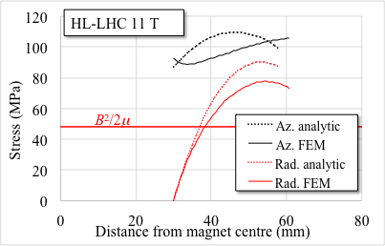
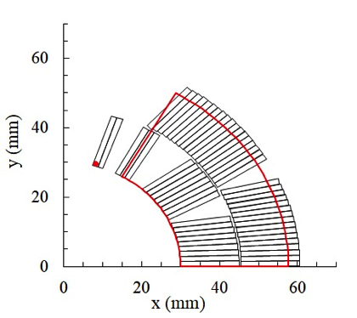
HL-LHC 11 T: 30 mm aperture, 30 mm coil width
M. Karppinen, et al., IEEE Trans. Appl. Supercond, 22 (2012) 4901504
Going to a ratio 1:1 between coil width and aperture radius
  Radial stress confirms analytical estimates, it is 50% larger than magnetic pressure
  Azimuthal stress is order of 100 MPa, 10% agreement, one sees a first trace of small (<5 MPa) bending on the inner radius of the coil
Coil layout (left), and comparison analytic/FEM (right) for the HL-LHC 11 T dipole

Slide 32
LHC MB: 8.3 T, 28 mm aperture, 30 mm coil width
R. Perin, in Encyclopedia of Applied Superconductivity (IOP, London, 1998), pp. 919–950.
Grading: what happens?
  Radial stress confirms analytical estimates, it is 50% larger than magnetic pressure
  Azimuthal stress obviously has a jump in the outer layer, since the current density is 24% larger – not in the analytical model
  Also here, little trace of bending on the inner layer bore radius
Coil layout (left), and comparison analytic/FEM (right) for the LHC main dipole MB

Slide 33
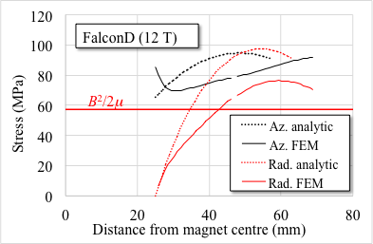
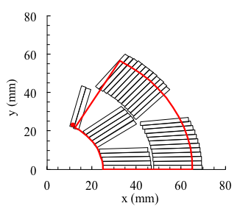
FalconD: 12 T, 25 mm aperture, 40 mm coil width
A. Pampaloni, et al. IEEE Trans. Appl. Supercond. 31 (2021) 4900905
Going to a ratio 1.5:1 between coil width and aperture radius
  Little keystoning, small aperture, the coil is less and less similar to a sector
  Radial stress is overestimated by the analytical equations by 25%
  Azimuthal stress is within 15%, with a larger bending in the inner radius
Coil layout (left), and comparison analytic/FEM (right) for the planned FalconD at 12 T

Slide 34
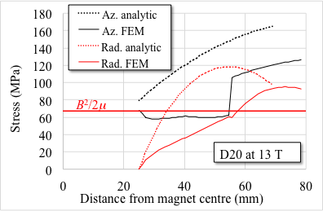
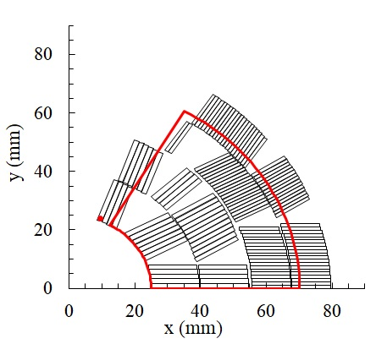
D20: 13 T, 25 mm aperture, 45 mm coil width
D. Dell'Orco, et al. IEEE Trans. Appl. Supercond. 3 (1993) 82-86
Going to coil width/aperture radius=1.8, four layers with strong (80%) grading
  Globally, not so far from a sector, as angles are close to 60°, but no keystoning
  Radial stress starts entering the 100 MPa range, in the outer layer
  The 80% jump due to grading is clear visible
  The azimuthal stress does not grow when you enter the coil since is is not keystoned
Coil layout (left), and comparison analytic/FEM (right) for the D20 dipole

Slide 35
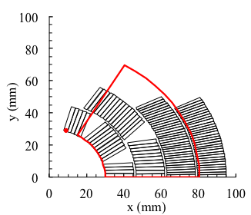
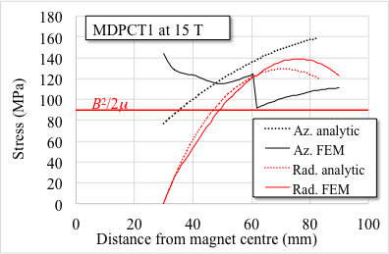
MDPCT1: 15 T, 30 mm aperture, 60 mm coil width
I. Novitski, et al., IEEE Trans. Appl. Supercond. 26 (2016) 4001007
Going to coil width/aperture radius=2.5, four layers with grading
  The keypoint of the design is that third and fourth layer do not go up to 60°, but up to 45°
  This allows transforming the jump in the 3rd-4th layers due to grading in a decrease
  Bending becomes significant, nearly doubles the analytical estimate
  Radial stress agrees with analytical equations – starts being larger than the azimuthal one!
Coil layout (left), and comparison analytic/FEM (right) for the MDPCT1 dipole

Slide 36
WHAT TO RETAIN – FOURTH PART
The analytical model works well (within 10%) up to coil width/aperture radius=1
Lowering the angle of the outer sectors allows reducing the azimuthal stress (HERA, and MDPCT1)
Grading gives a jump in azimuthal stress as expected by the analytical dependence (proportional to current density)
For large ratios coil width/aperture radius (above 1:1), a bending appears and the analytical formula of azimuthal stress on the bore becomes optimistic

Slide 37
ACKNOWLEDGEMENTS
Thanks to all colleagues working on the magnets we analysed
Special thanks to D. Tommasini and A. Yamamoto

