Slide 1
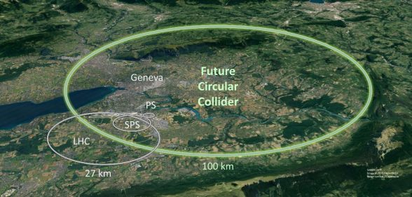

Considerations for lineshape measurements
at the FCCee
Christoph Paus
April 14, 2023

Slide 2
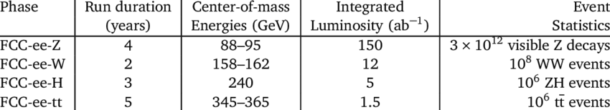
FCC-ee Run Plan
The baseline run plan for FCC-ee
  Z run produces most events followed by the WW run
  It will have highest requirements for detector and accelerator design
  Machine upgrade is well staged
Lineshape
RF system re-alignment
and modifications
Electroweak
Precision
26
Z1
Z2
Z3
Z4
W1
W2
H1
H1
H1
t1
t2
t3
t4
t5
machine
26
26
42
74
19
booster
3
10
21
100
20
time [operation years]
ΔLEP,Stat
≈
500

Slide 3
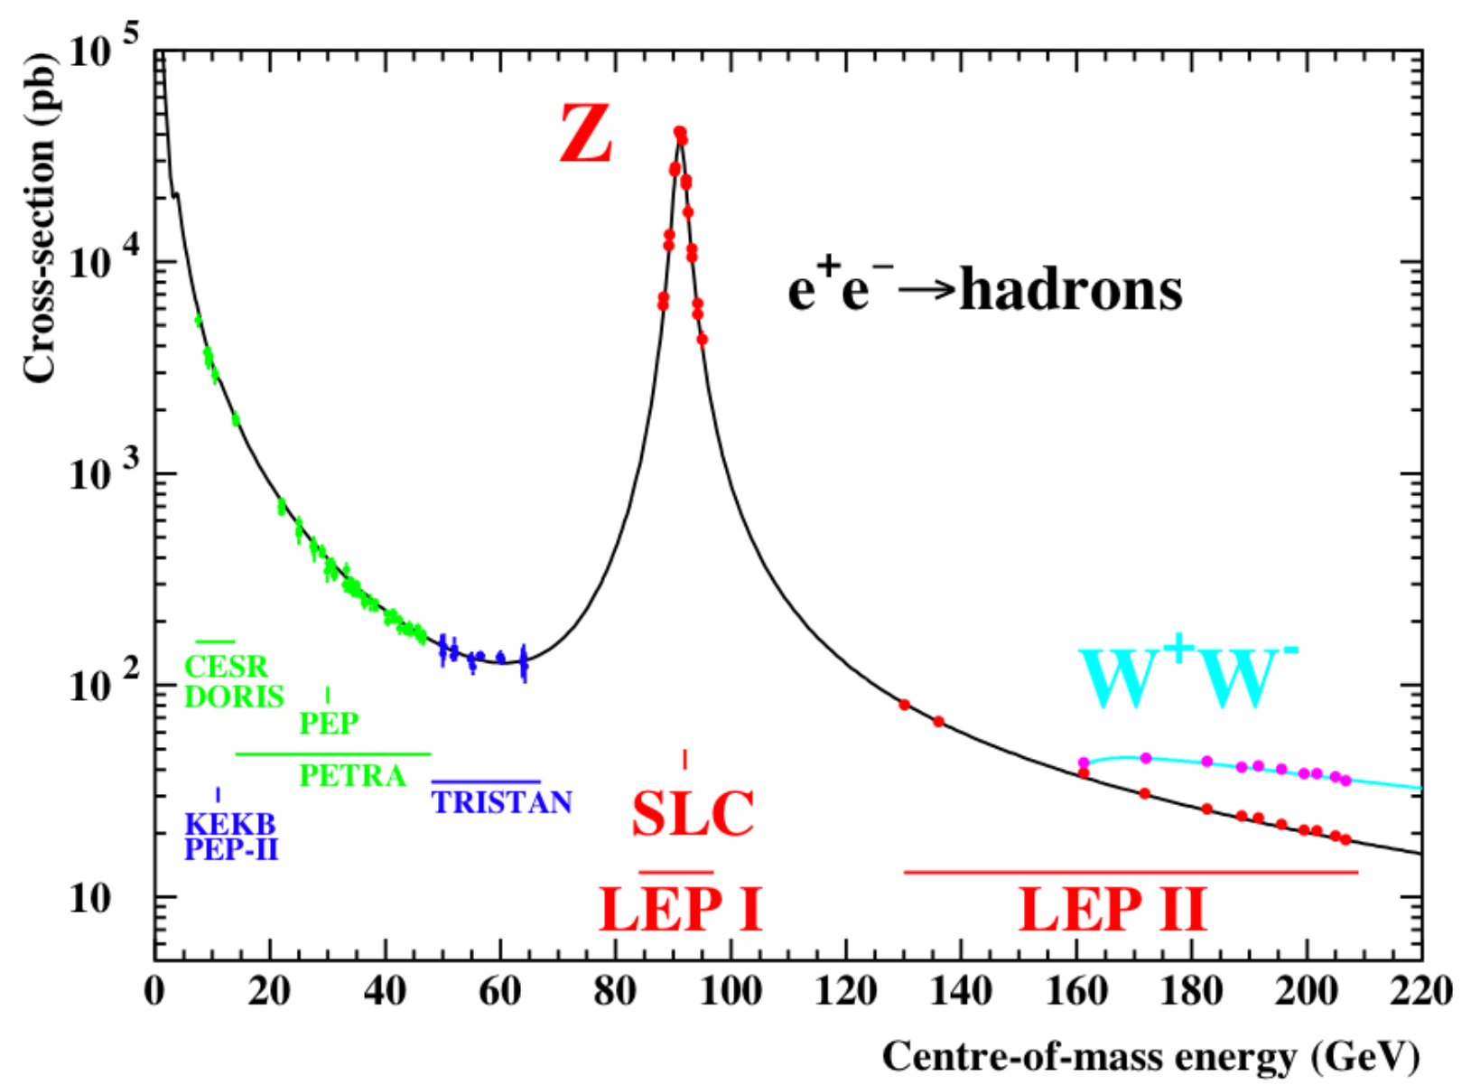
The Lineshape

Slide 4
Motivation for Precision
At LEP
  Measure crucial fundamental parameters of the standard model
  Z mass, W mass, α_{S}, α_{QED}, number of light neutrinos
  Convert direct observables like σ, A_{FB}, τ_{POL}, … to pseudo observables
  Constrain indirectly m_{t} and m_{H} by using pseudo observables as input
  Find discrepancies in the measurements indicating the SM is broken or better that there is physics beyond the standard model (BSM)
For FCC ee
  All standard model parameters are known and look to be consistent
    Last additions m_{H} (LHC, 2012) and m_{t} (Tevatron, 1995)
    … neutrinos are another story
  Consistency between all measurements will be tested about 3 orders of magnitude more stringently than before, inconsistencies will immediately invoke new physics

Slide 5
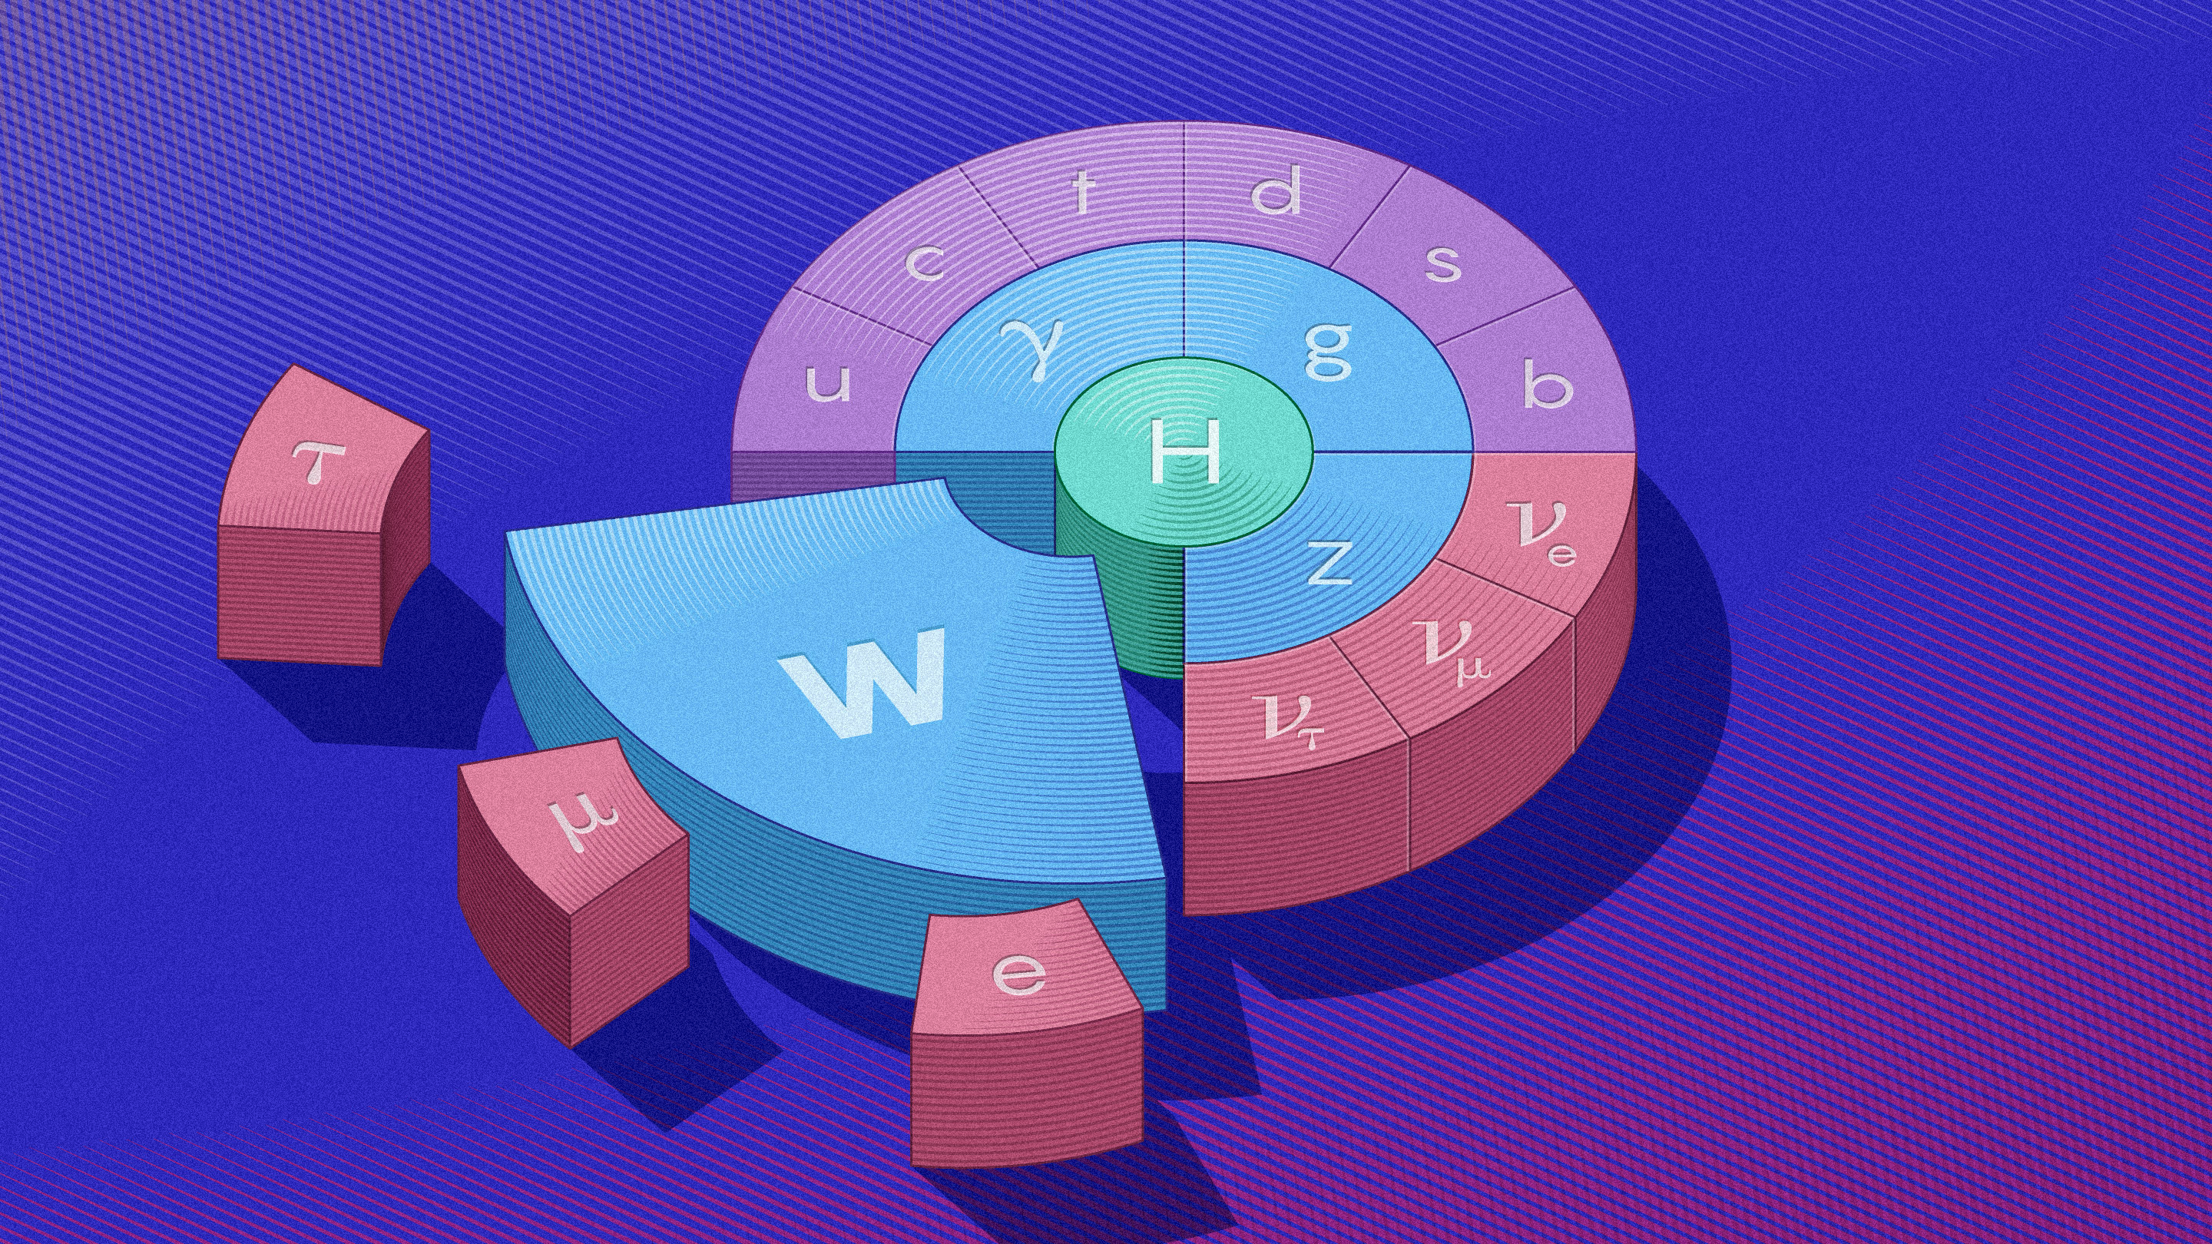
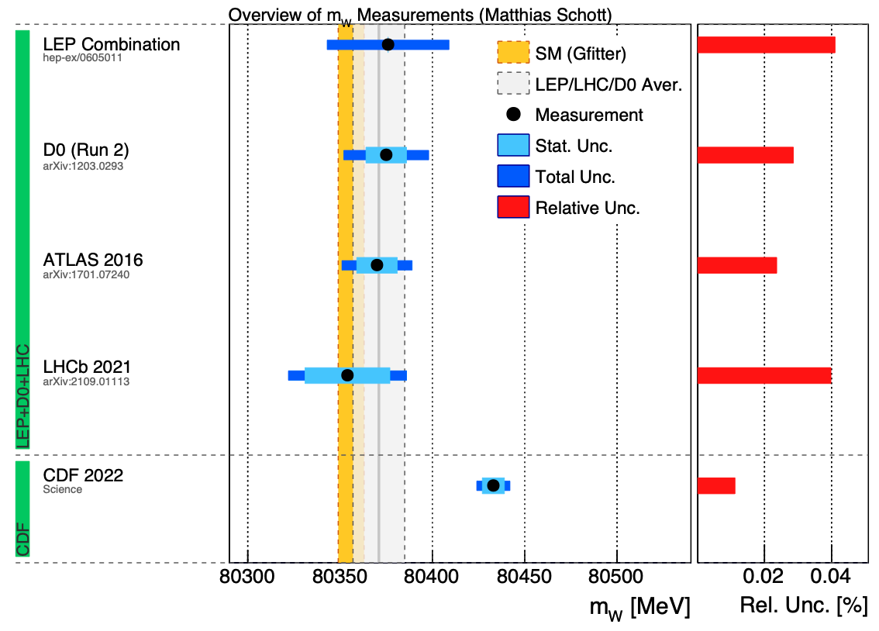
Why do precision EW?
CDF experiments last word
  W mass too heavy by seven standard deviations !
Source:https://non-trivial-solution.blogspot.com/2022/04/do-we-have-finally-found-new-physics.html
Source: https://www.quantamagazine.org/fermilab-says-particle-is-heavy-enough-to-break-the-standard-model-20220407/

Slide 6
The Lineshape
Cross section
What can we extract?
  Z mass (m_{Z})
  Z width (Γ_{Z})
  Hadronic peak cross section (σ_{0, hadr})
  Ratio of leptons (R_{ℓ})
  ( Number of light neutrinos )
Hadrons “win” (quarks have color)
  mass, width and σ₀
Typical LEP experiment
σ_{0, hadr}
Z → qq
Γ_{Z}
R_{ℓ}
m_{Z}
Z → μ+μ-
Z → qq
only

Slide 7
Ingredients
Cross section
CM energy:
  Resonant depolarization and many more ‘tricks’
Luminosity:
  How tightly packed is the beam?
  Basic idea: find accurately calculable process and count, it should not depend on the Z boson (too much).
Event counts: N_{selected}, N_{background}
  Selected events contain signal and the remaining background
Acceptance, A, and efficiency, ԑ
  Acceptance loss: particle outside detector fiducial volume
  Efficiency loss: particle inside detector volume, but not identified

Slide 8
Energy Calibration
Resonant depolarization is key
  It will be run in situ using pilot bunches during data taking
Other important feature
  Absolute calibration will be transported precisely from point-to-point
  Calibration repetition rate needs to be considered
  Beam energy spread and its uncertainty will affect Z width and α_{QED}(m_{Z})
Compared to LEP
  Main calibration idea is the same
  ... but much more precise with huge data rate and in situ calibration schemes substantially expanding the scope
  A lot more detail but not for this talk
From: arxiv:1909.12245

Slide 9
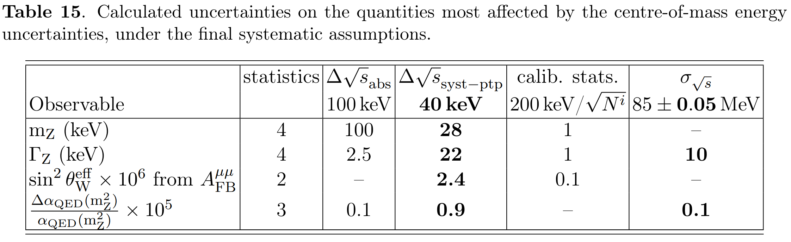
Energy Calibration
FCC calibration is still in rapid development
  Latest studies showed a much improved point-to-point uncertainty and more is to come
  The latest study is summarized below
  Overall uncertainty still needs to be shrunk...
From: arxiv:1909.12245

Slide 10
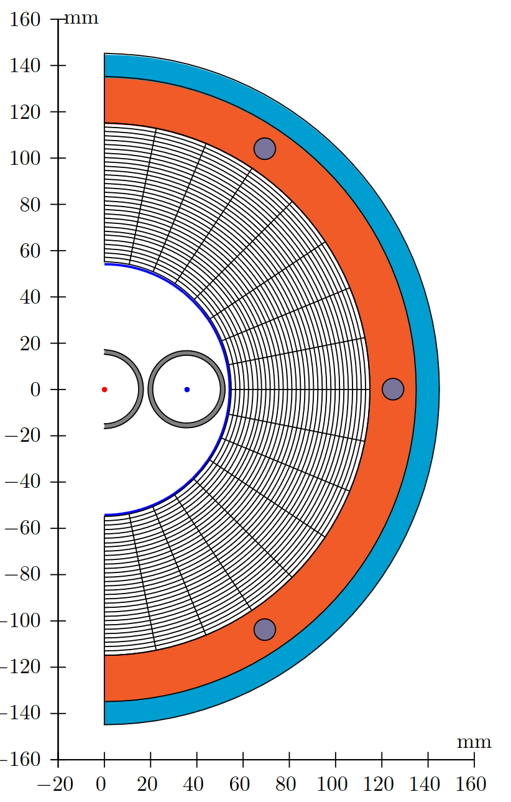
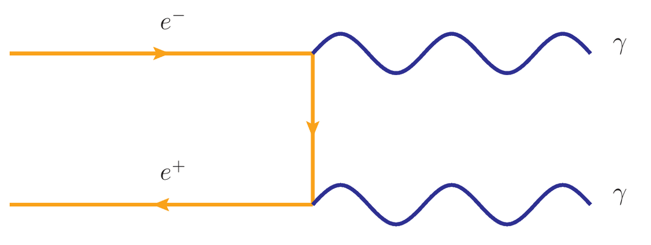
Luminosity
ℓ
r
Small angle Bhabha scattering from LEP?
  Cross section very large (78 nb): good statistical precision
  Need to have excellent control of the geometry: O(10⁻⁵ ) precision
    Precision on radial dimensions Δr ~1μm
    Half distance between lumi monitors at Δℓ ~50 μm
  Theory prediction limiting (already at LEP)
Another clean and copious process?
  e⁺e⁻ → γγ: precise prediction, no Z dependence and clean
  Not very many events (about 1 in 1000 events) – accuracy O(10⁻⁴)
  No perfect solution but pretty good
Best plan, so far Eur. Phys. J. Plus (2022) 137:81
  Use e⁺e⁻ → γγ as overall normalization (global)
  Bhabha events to extrapolate across CM energies (σ_{theory}= 14 nb)
  Loose significant precision on σ_{0, hadr} (# light neutrinos) and
  … some on mZ, ΓZ
From: Eur.Phys.J.Plus (2022) 137:81

Slide 11
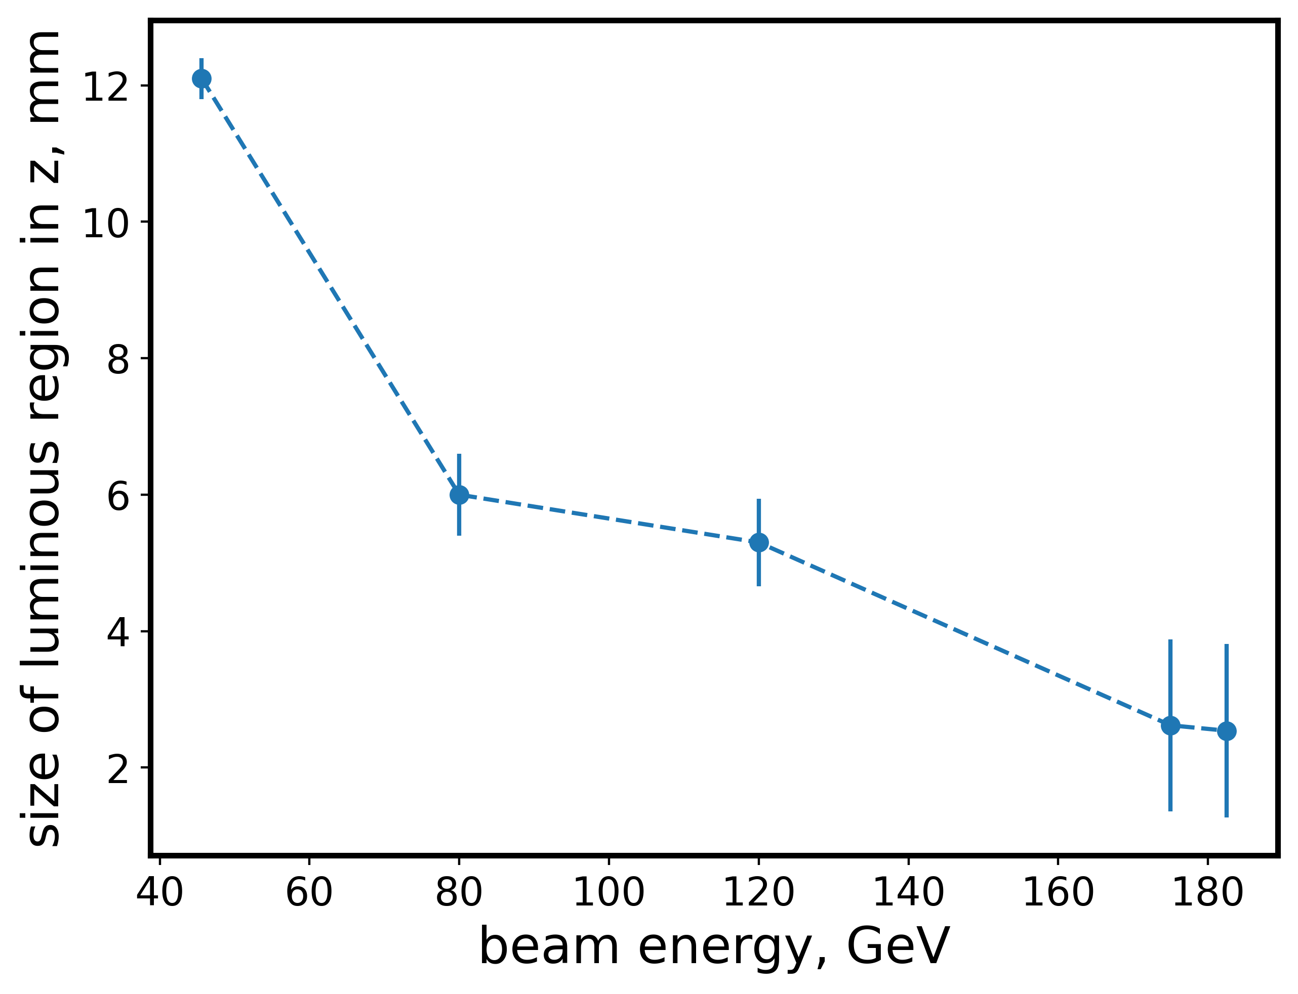
Luminous region FCC
Size of the luminous region versus beam energy
  y-direction [nm], x-direction [μm]
  z- direction [mm] … at Z pole in cm
  but uncertainty well below mm level
  vertexing uncertainty at μm level
*
z-direction
My conclusion on luminous region?
  Due to well focused beam and pristine vertex reconstruction neither significant beam crossing angle nor uncertainties on those should be an issues
  Event pileup at about 2 in a thousand events can be cleanly identified (μm vertex with cm luminous region at Z pole)
  Needs to be careful implemented in MC and confirmed!
* https://github.com/HEP-FCC/FCCeePhysicsPerformance/tree/master/General#vertex-distribution

Slide 12

Quote of the Day
At a lepton collider
every event is a signal event,
while at a hadron collider
every event is a background event.
This means that at lepton colliders we have basically no control regions and we have to heavily rely on Monte Carlo simulation to determine acceptance, efficiency and backgrounds.
– Anonymous

Slide 13
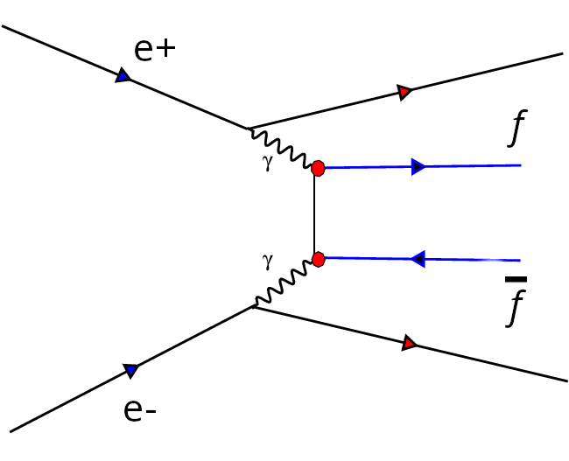
Event Counts
Number of selected events
  Statistical precision is ultimate limitation; you cannot get better
  Keep as many events as possible, but not let in too much background
Number of background events
  Monte Carlo predicts it precisely, if you have enough and it agrees
  Detailed detector description is crucial (realistic* Monte Carlo)
  Exception: two-photon collision events notoriously difficult, in particular two photons with hadronic decay products (e⁺e⁻ → e⁺e⁻ qqbar)
  Event pileup needs to be accounted for (2x10⁻³)
Two-Photon events (e⁺e⁻→e⁺e⁻ ffbar)
  Key issues: shape in visible energy and number of particles produced
  Tails are sensitive to noise, promoting them to multi-hadron events, other final states safer
  Off-peak running, or explicit tagging of e⁺/e⁻?
  Better MC is needed (theory community)
* simulate time dependent effects of detector and other running conditions: MC mapped to specific data recorded

Slide 14
Acceptance/Efficiency
Typical numbers
  Excellent control of geometry and positioning: O(10⁻⁵) precision
  In situ active laser alignment systems are crucial (μm precision)
  Definition of the fully active detector borders very important
    Calorimeters: ~ Molière radius distance from the edges
    Hermeticity more important than resolution: overlapping detectors to avoid dead areas
Different final states
  Hadrons hard to miss
    We look for jets (many particles, broadly spread)
    Fragmentation/hadronization are an issue: hard to derive systematic uncertainty
    Reproducing multiplicity traditionally problematic (QCD / Infrared divergent ...)
  Leptons easier to miss
    Cracks or dead areas crucial, definition of fiducial volume most important here
    Independent subdetectors: tracker/muon chambers, tracker/ECAL, tracker/HCAL, ...
    Final state much clearer no additional uncertainties (?), collision angle (?)

Slide 15
Z → Hadrons: A/ԑ
Statistical precision: order 10⁻⁷ – 10⁻⁶
  LEP – acceptance down to 12º → cos(12º) = 0.9781 (L3)
  FCC - acceptance down to 7º → cos(7º) = 0.9925
    Enormous improvement in number of lost clusters (2.2% → 0.75%)
    Jets are too big to not register: efficiency should be very close to 100%
    No trigger ☺, which is good but redundancy in detectors much needed
    Tracker versus calorimeter based analysis essential (add timing layer?)
    Is the detector on and is there any noise? → realistic detector Monte Carlo
    Collision angle should not matter, as long as it is simulated well
Quantity | ALEPH | DELPHI | L3 | OPAL
Acceptance | s’/s > 0.1 | s’/s > 0.1 | s’/s > 0.1 | s’/s > 0.1
Efficiency [%] | 99.1 | 94.8 | 99.3 | 99.5
Background | 0.7 | 0.5 | 0.3 | 0.3

Slide 16
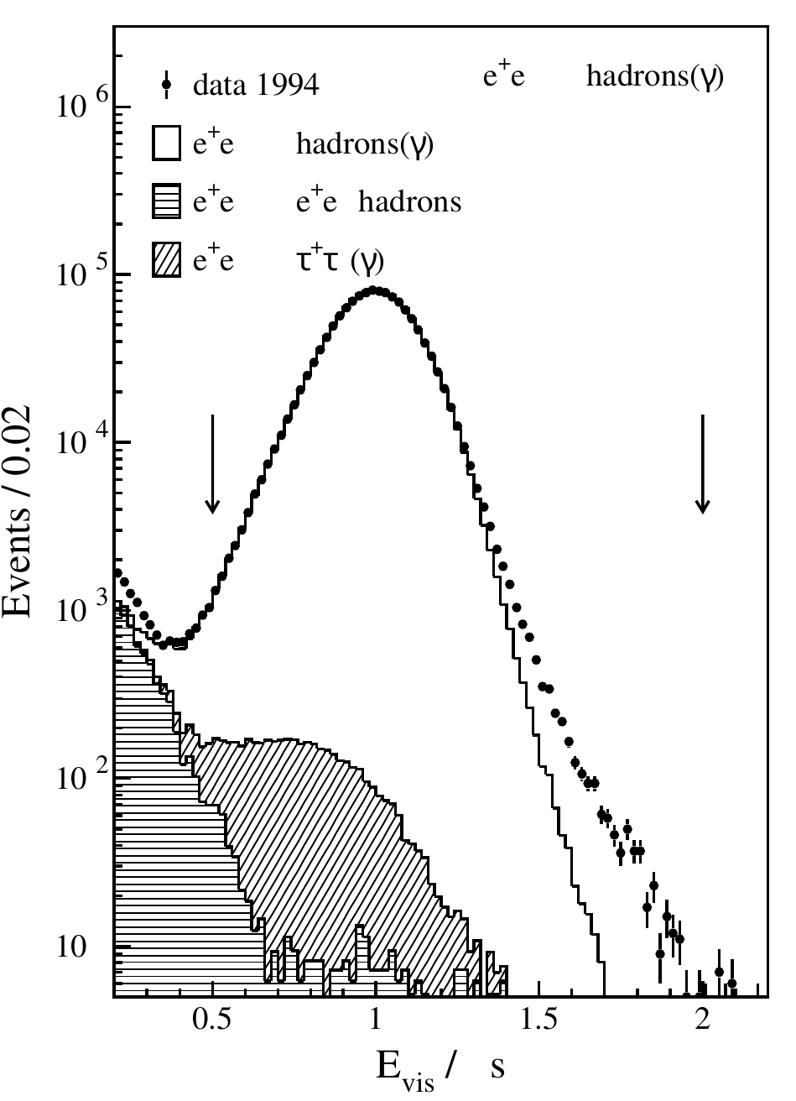
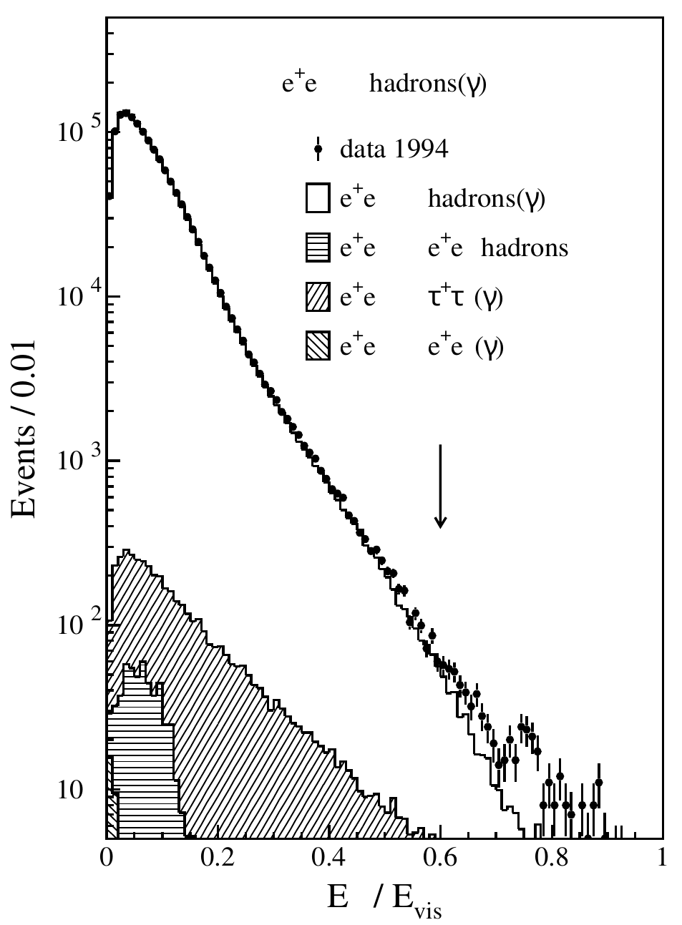
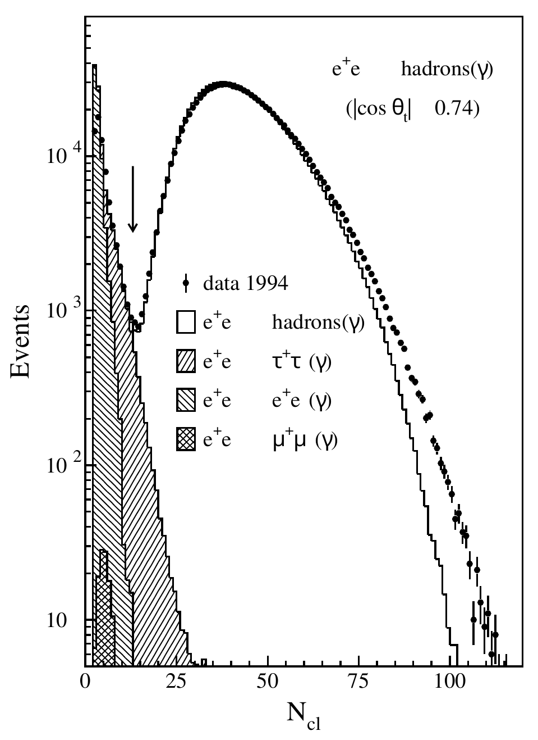
Z→Hadrons: Message from LEP
Example plots for hadron selection at L3
  There is noise, number of clusters in MC do not agree
  Two photons are leaking

Slide 17
Extracting PO ‘à la LEP’
Undusted L3 program to fit two-fermion data
  For verification the full L3 cross section and forward-backward asymmetry dataset was fit, including all details and the numbers in the last L3 paper were reproduced with minute differences
  Various theory programs are interfaced (TOPAZ0, ZFITTER, ALIBHABHA, MIBA, ….): ZFITTER is the only program used for the following studies
    If anyone is interested it is available in github but before using a proper README will be needed
    It is complex to use but with a little bit of patience it can be quite useful
    For some of us old timers it offers another chance to make your kumac skills shine, remember PAW, KUIP, SIGMA and COMIS?
    Big shout out to Martin Grünewald who saved my/our program and send me a copy from his never failing backups!
  Eventually we need to figure out how to do this for real with FCC data: Is Fortran making a come back?

Slide 18
How well can we do?
Extract Pseudo Observables: mZ, ΓZ and σ0, hadr
Inputs: hadronic cross sections, 5 points, 30/ab each
  statistical uncertainty on hadrons only, nothing else
  Add fully correlated systematic uncertainty as large as peak stat. uncertainty
  Add stat. uncertainty on luminosity corresponding to 14 nb cross section
  Add 10⁻⁴ syst. fully correlated, and another 10⁻⁵ uncorrelated
  Add 10 keV correlated uncertainty on E_{CMS}
  Or alternatively 100 keV correlated uncertainty on ECMS
Setup | delta(m_{Z}) | delta(ΓZ) | delta(σ0, hadr)
units | [keV] | [keV] | [pb]
1 | 1.2 | 3.4 | 0.044
2 | 1.2 | 3.4 | 0.044
3 | 1.7 | 5.2 | 0.076
4 | 8.4 | 26 | 4.2
5 | 13 | 26 | 4.2
6 | 101 | 26 | 4.2

Slide 19
The 2nd Lineshape
Forward backward asymmetries
  Decouples from cross section
  Measures sin²θ_{W}^{eff} and α_{QED}(m_{Z}), which mostly decouple
  Points to measure α_{QED}(m_{Z}), are just below or just above the Z peak (87.9 or 94.3 GeV)
  A_{FB} constrains sin²θ_{W}^{eff (}m_{t} and m_{W}) most significantly at peak, small stat. uncertainty
Typical LEP experiment
‘A direct determination of α_{QED}(mZ) with an accuracy deemed adequate for an optimal use of the FCC-ee precision data’ can be made.
From: arxiv:1512.05544

Slide 20
Conclusions
New era in precision electroweak physics
  Profound test of the standard model at Z pole: re-measure parameters up to 3 orders of magnitude more precisely: m_{Z}, α_{QED}(m_{Z}), ...
  Severe constraints from pseudo observables on: m_{W}, m_{t}, ...
  Far reaching consequences for predictions
We are not there yet though ...
  Luminosity measurement fundamentally limits σ_{0, hadr} (# light neutrinos) and puts some limitations on uncertainties for mZ, ΓZ
  Energy calibration of the beam is largest contribution to Z boson mass uncertainty right now, but progress will be made
  Experimental uncertainties are believed to be manageable but significant work is needed to prove this (see next slide)
  Detailed detector status monitor and in situ inclusion of it into the MC will be key for precision results
  Two photon processes most worrisome, in particular for hadrons

Slide 21
Next steps
Develop simulated data analysis setup
  Generate full Monte Carlo setup: start with LEPx10 equivalent samples
  Produce ‘modified’ MC with Delphes mixing it together so it appears as real detector data: LEPx1 equivalent
  Go through full analysis process and see how modifications affect the analyses
  Setting up a sample of 5x10¹² events is not trivial, but will be needed to test detailed systematic effects at that level once first ‘single LEP’ is completed
  Tau (polarization), Heavy flavour measurements and Bhabha’s need to follow to make the picture complete, maybe QFB?
  7 GB per 10⁶ hadronic decays → 7 PB for 10¹² events (Delphes)
A word on theory and parameter extraction
  Theory uncertainties are making good progress but more work will be needed – I did not include is but landscape looks encouraging
  Is the old LEP style fit of pseudo observables still feasible? The latest ZFITTER and TOPAZ0 implementations are pretty convoluted

