Slide 1






Parameters
D. Schulte
CERN
May 2023
Funded by the European Union under
Grant Agreement n. 101094300

Slide 2
Tentative Parameters
Need to build database with tentative parameters
Will iterate to arrive at consolidated parameters for the strategy
Important to get the structure of the data right, numbers will change
Goals:
Define realistic high-level targets for the areas and components
  Interface parameters and scalings to make studies more independent
  Reference design goals discussed at the study level
Document current designs and assumptions
  Not yet a “reference design” but a moving target
  To be provided by the areas, will be reviewed as needed
Review the document to see if it contains the relevant information
Put in parameters you consider important, even if they may change later
Note: should not consider use of existing infrastructure at this moment
in conflict with global collaboration, details distract from other key studies
Will consider use of existing infrastructure at a later stage with limited detail

Slide 3
General Status
Goal: define tentative target parameters
  basis for studies of key limits and dependencies
  documentation of specific parameters
  basis for further improved parameters (improved, consolidated)
Started to work on many key systems
  started to gain knowledge on driving factors
Are not yet ready to know where to go to
  do not move targets if not clearly supported by studies
  rather try to clarify tentative boundaries and goals
For all areas: Put in parameters that are important, even if they might change to get structure right
Need to clarify key studies to make parameter choices more robust
  no one can assume that the parameters are final
  find out the boundaries

Slide 4
Key Tentative Target Parameters
Beam parameters along the machine
  energy, charge, emittance, …
  targets for the accelerator designers
Basic machine parameters
  length, number of components, etc.
Key performance specifications for the components
  e.g. dipole field and aperture in the collider ring
  e.g. cross section of the collider ring magnet, shielding and cooling
  e.g. similar cross section for the target
  targets for the component designers and basis for the accelerator designers
Parameters will be refined later
  need to understand scaling
  e.g. cost and power scales
Obviously, need to closely interact and iterate

Slide 5
High-level Target Parameters
Luminosity
  Do we have a strong reason to change integrated luminosity target?
  How much luminosity would already make a physics case?
  Angular coverage etc.

Slide 6
High-level Target Parameters
Detector parameters
  Is 3 TeV detector based on CLIC good?
  What does need to change for 10 TeV?
  Need to develop table with key parameters:
    angular coverage
    vertex detector geometry
    resolution of tracker/calorimeter
    particle identification
    …
Background
  best to try operation with peak luminosity
  luminosity reduces as beam is circling

Slide 7
Luminosity (Collider Ring)
Beam power
neutrino flux
target and muon survival
power consumption
High energy
Collider ring circumference
Collider ring dipole fields
Filling factor
Bunch charge
target and muon survival
Emittances
cooling and blow-up
Energy acceptance
beta-function = bunch length

Slide 8
High-level Tentative Target Parameters
If there are strong opinions can change and clarify the definition of parameters
But for the moment should stay with these goals
Parameter | Unit | 3 TeV | 10 TeV | 14 TeV
L | 10³⁴ cm⁻²s⁻¹ | 1.8 | 20 | 40
N | 10¹² | 2.2 | 1.8 | 1.8
f_{r} | Hz | 5 | 5 | 5
P_{beam} (injected) | MW | 5.3 | 14.4 | 20
C | km | 4.5 | 10 | 14
<B> (average) | T | 7 | 10.5 | 10.5
ε_{L} (norm, 1σ) | MeV m | 7.5 | 7.5 | 7.5
σ_{E} / E | % | 0.1 | 0.1 | 0.1
σ_{z} | mm | 5 | 1.5 | 1.07
β | mm | 5 | 1.5 | 1.07
ε (norm, 1σ) | μm | 25 | 25 | 25
σ_{x,y} | μm | 3.0 | 0.9 | 0.63

Slide 9
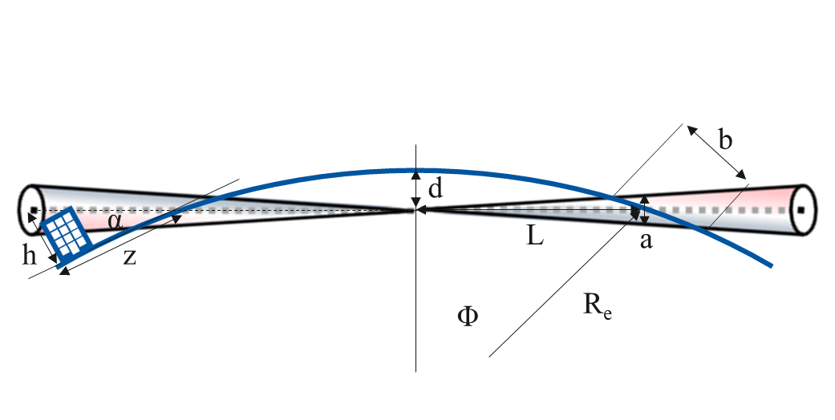
Neutrino Flux
Parameter choices have been done with the goal to have not more impact than the LHC
This should not be changed, can express in neutrino flux
Collider arcs:
Calculated that mover range should yield +/- 1 mradian
Assuming short straights are compensated with horizontal wiggling (14 TeV)
Detailed study of interaction between mover and beam
Need to identify the range of angles that can be achieved
  this might be a limit for even higher energies
Detector straights are treated independently

Slide 10
Tentative Component Limits
Educated guesses of performance limits to be developed by the experts
  required for the accelerator design
Magnets
  Potential technologies
  Performance parameters with dependencies
    field level
    field quality
    aperture
    radiation resistance
    heat load resistance
Target
  Limits for shock and radiation
  …
RF
Cooling
…

Slide 11
Muon Beam Parameters
Define parameters at the interfaces of different areas
  allows to locally optimise, e.g. acceleration chain
Ideally transmit full beam phase space to evaluate performance
  However, for target parameters use simplified approach for now
At production and cooling muons behave in a very special fashion, after cooling like protons
  Fix parameters at pivotal point at the end of final cooling

Slide 12
Muon Bunch Charge
Based on J-P Delahaye/some MAP studies
but used 2 MW target not 1.5 MW
Likely need some reserve in muon number
e.g. acceleration to 200 MeV after final cooling has not been included, I think
can be used to boost performance, if not required as reserve
Bunch charge increase is more important than power increase
Go for 800 kJ per pulse at 5 Hz?
Proton energy is a local optimisation of proton complex, target and capture efficiency
Acceptance in RCS/collider ring in range of +/- 2σ
charge should refer to muons in this range
Location | N [10¹²]
5 GeV protons at target (400 kJ) | 500
muons after front end | 48
… | …
muons after final cooling (5-20 MeV) | 6?
muons after reacceleration 0.2 GeV | 4
… | …
muons at 60 GeV | 2.7
… | …
muons in collider (3 TeV) | 2.2
muons in collider (10 TeV) | 1.8

Slide 13
Muon Bunch Emittances
Emittance target at final cooling end should remain as a target for now
  Do not know better for the moment
Emittance blow-up from final cooling to IP should remain limited
  The specifications for equipment imperfections should be made accordingly
  Would assume a total budget of 10% (most relaxed acceptable tolerance) or 1% (no issue for the moment)
  Need to distribute fractions to the different systems and imperfections (for the area team)
rel. emittance blow-up | relative tolerance | relative luminosity
0.1% | 0.03 | 0.999
1% | 0.1 | 0.99
10% | 0.3 | 0.9
100% | 1 | 0.5
1000% | 3 | 0.1

Slide 14
Conclusion
Everybody and area leaders:
  Review if required parameters are foreseen in the document
  Or can some be removed?
Area leaders and other experts
  Fill in best guesses where possible
  Provide scalings and justification
Need this to have time before the annual meeting to go through the numbers
Will then review the parameters data-base
Later will introduce formal method to update parameters
Need to also handle alternatives

Slide 15
Reserve

Slide 16
Key Considerations
Public acceptance is the key for a new collider
Energy and luminosity
  to have an attractive physics case to convince that it is worth doing it
Detector performance and background
  to be able to realise the physics programme
Cost, power consumption and environmental impact
  to ensure that people are willing to pay the price
Technical risk and schedule
  to ensure that the project is realistic

