Slide 1




Experimental and numerical assessment of the electro-mechanical limits of Nb₃Sn accelerator magnets:
The HL-LHC MQXF Quadrupole case
J. Ferradas Troitino, T. Bagni, C. Barth, B. Bordini, A. Devred, P. Ferracin, S. Izquierdo Bermudez, F.J. Mangiarotti, A. Milanese, J.C. Perez, C. Senatore, E. Todesco and G. Vallone
TE-MSC Seminar
1st June 2023

Slide 2
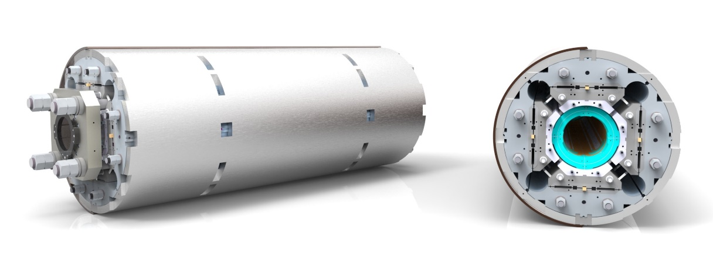
Outline
Introduction / motivation
Methodology
Results at the strand level
Results at the magnet level
Conclusions
3D rendered view of a MQXF short model magnet, whose analysis is treated in the slides.

Slide 3
Outline
Introduction / motivation
Methodology
Results at the strand level
Results at the magnet level
Conclusions
3D rendered view of a MQXF short model magnet, whose analysis is treated in the slides.

Slide 4

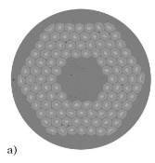
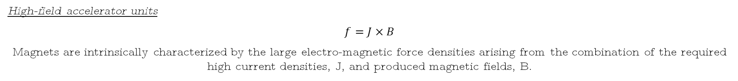
Nb₃Sn accelerator magnets
On the search for higher magnetic fields in accelerator magnets
Presently, Nb₃Sn superconductors are the preferred solution for the windings of high-field accelerator magnets:
Performance above Nb-Ti limits.
Proven large-scale industrial production.
State-of-the-art Nb₃Sn wires surpass the values of J_{c} > 1000 A/mm² (SC area) at 16 T and 4.2 K.
However, these appealing properties are impaired by:
  The strain sensitivity and brittle nature of the superconductor.
Nb₃Sn Rutherford cable. Source: [CERN]
The determination of sound electro-mechanical limits for Nb₃Sn technology becomes of paramount importance!
High-field accelerator units
$$f=J×B$$
Magnets are intrinsically characterized by the large electro-magnetic force densities arising from the combination of the required high current densities, J, and produced magnetic fields, B.
E. Todesco: Estimates of stress in accelerator dipoles
https://indico.cern.ch/event/1271255/

Slide 5
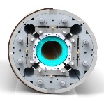

A bit of history
During the past years, our community has tried to shed some light on the electro-mechanical properties of Nb₃Sn superconductors (we focus on accelerator magnets).
- To establish safe strain/stress limits for operation.
- Developing the necessary mathematical background to describe the strain effects on the superconducting properties.
Laboratory-scale experiments
Exploring the electro-mechanical response of single wires, up to full cables, when subjected to mechanical loads. Some examples:
Back in the 1980’s by Ekin and co-workers
[1] – [2]
University of Geneva
[3] – [11]
CERN
[12] – [16]
University of Twente
[17] – [18]
NHMFL
[19] – [21]
Fermilab
[22] – [24]
Direct assessment on magnet configuration
Magnet performance studied as a function of different conductor stress levels.
Lawrence Berkeley National Lab. (LBNL)
TQ magnet
[25]
CERN
SMC magnet
[26 - 27]
MQXF magnet
[28]

Slide 6
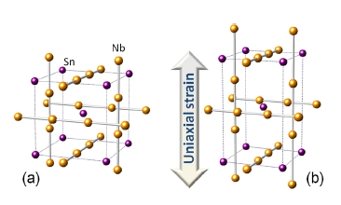
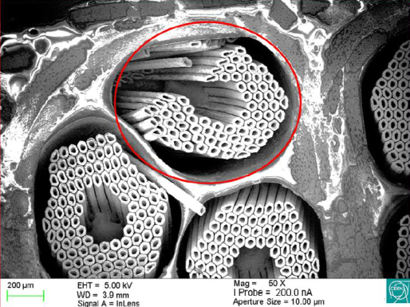
Overview on Nb₃Sn
Strain sensitive and brittle superconductor
Change in the phonon spectrum and the electronic bands
Deformation of the crystal structure
Change in superconducting properties (T_{c} and B_{c2}), and thus, critical current!
Strain
1
G. De Marzi et al. arXiv:1210.3705, 2012.
Brittle fracture of the superconducting phase
Reduction of the current-carrying surface
Reduction in conductor performance / critical current!
A. Moros et al., IEE TAS 2023
2
T. Bagni: Electro-mechanical limits of RRP Nb₃Sn wires
https://indico.cern.ch/event/1218494/

Slide 7
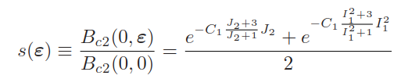
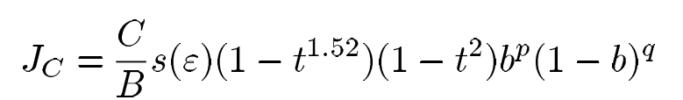
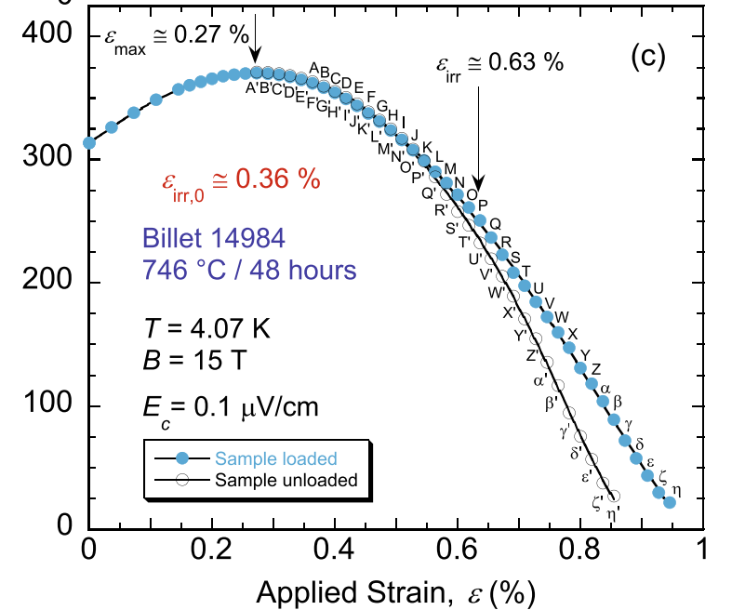

Overview on Nb₃Sn
Critical surface → Exponential scaling law proposed by Bordini, Bottura et al. [29] – [30]
Initially postulated to predict the effects of mechanical strain in axially loaded wires in the reversible / moderate strain region!
I₁ - ﬁrst invariant of the strain tensor, J₂ - second invariant of its deviatoric part (calculated as a function of the principal strains).
1
ITER parametrization [29]
Nb₃Sn wire under applied axial strain
I_{c} [A]
Plot from N. Cheggour et al.
Scientific Reports (2019)

Slide 8
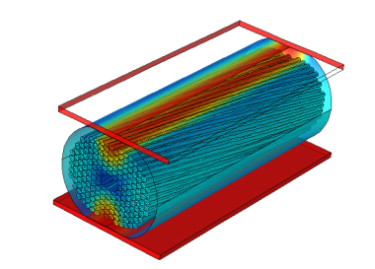
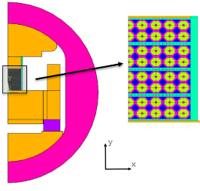
Overview on Nb₃Sn
Critical surface → Exponential scaling law proposed by Bordini, Bottura et al. [29] – [30]
Initially postulated to predict the effects of mechanical strain in axially loaded wires in the reversible / moderate strain region!
I₁ - ﬁrst invariant of the strain tensor, J₂ - second invariant of its deviatoric part (calculated as a function of the principal strains).
1
For magnet design, instrumental to apply our understanding acquired at the conductor level.
Are conductor tests applicable to magnet configuration?
Can we provide reliable limits for the technology?
Based on experimental results and numerical modelling, we will try to provide answers to these fundamental questions at the magnet scale.
Important to recognize the three-dimensional nature of the scaling law.
It has been proven that in the first regime the scaling law can be used under more complex loading conditions.
Focus on transverse loads, those usually of largest magnitude on accelerator magnets
Studies employ Finite Element models to extract the strain tensor. Validated in:
Transversally loaded wires (micro-scale models)
2D and 3D detailed models computing I_{c}
[31]-[32] Bordini, Cattabiani, Baffari et al.
[5] Senatore, Bagni, Calzolaio et al.
[33] Chiesa, Wang et al.
Transversally loaded cable stacks (macro-scale model)
[34] – [35] G. Vallone et al.
It can be applied to a 2D magnet cross-section
(already published).
Cattabiani, Baffari et al.
Vallone, Ferracin, Bordini et al.
D. Bafari: Numerical simulation of Nb₃Sn superconductors
https://indico.cern.ch/event/1075048/
G. Vallone: Computation of the strain limits in Nb₃Sn magnets
https://indico.cern.ch/event/1177999/

Slide 9
Outline
Introduction / motivation
Methodology
Results at the strand level
Results at the magnet level
Conclusions
3D rendered view of a MQXF short model magnet, whose analysis is treated in the slides.

Slide 10

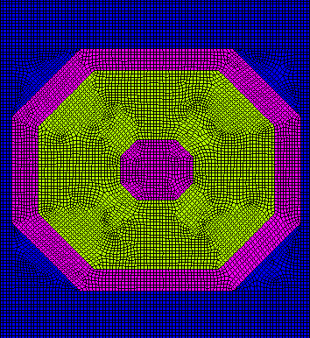
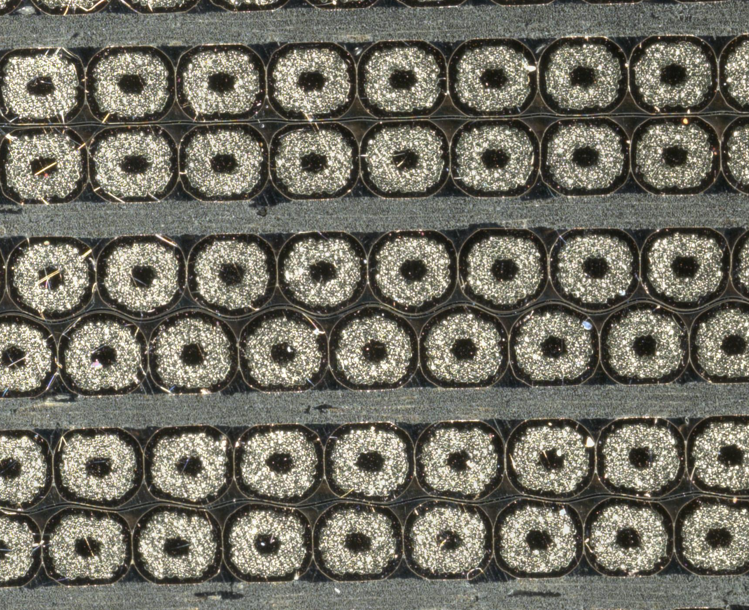
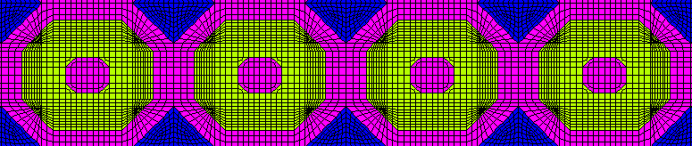
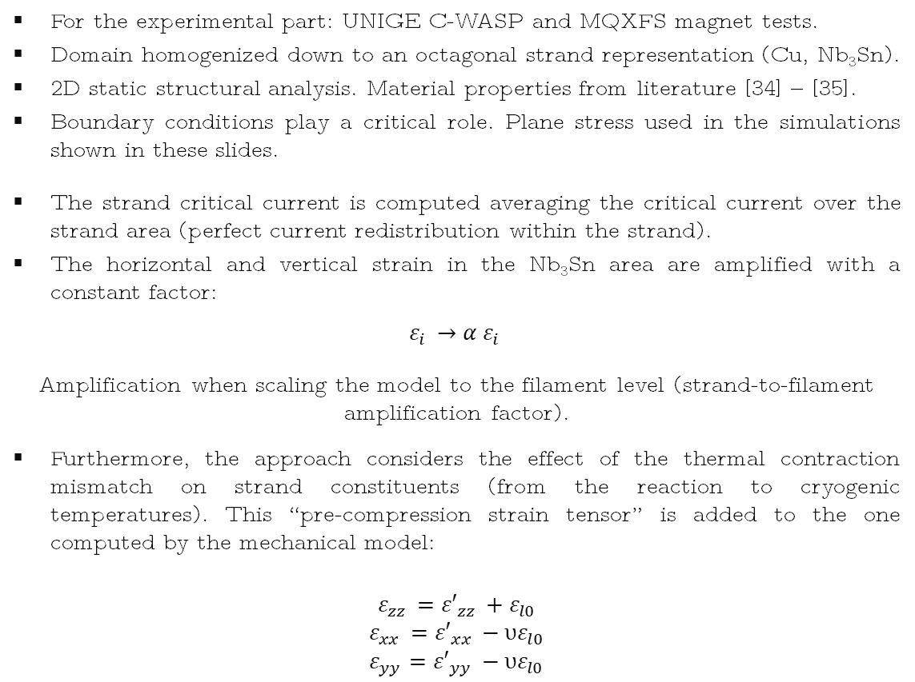
Methodology
For the experimental part: UNIGE C-WASP and MQXFS magnet tests.
Domain homogenized down to an octagonal strand representation (Cu, Nb₃Sn).
2D static structural analysis. Material properties from literature [34] – [35].
Boundary conditions play a critical role. Plane stress used in the simulations shown in these slides.
The strand critical current is computed averaging the critical current over the strand area (perfect current redistribution within the strand).
The horizontal and vertical strain in the Nb₃Sn area are amplified with a constant factor:
$$ε_{i }→{α ε}_{i }$$
Amplification when scaling the model to the filament level (strand-to-filament amplification factor).
Furthermore, the approach considers the effect of the thermal contraction mismatch on strand constituents (from the reaction to cryogenic temperatures). This “pre-compression strain tensor” is added to the one computed by the mechanical model:
$$ε_{zz }={ε′}_{zz }+ε_{l0}$$
$$ε_{xx }={ε′}_{xx }−{υε}_{l0}$$
$$ε_{yy}={ε′}_{yy }−{υε}_{l0}$$
α - strand-filament amplification factor
Epoxy
Copper
Nb₃Sn
y
x
Vallone, Ferracin, Bordini et al.
G. Vallone: Computation of the strain limits in Nb₃Sn magnets
https://indico.cern.ch/event/1177999/

Slide 11
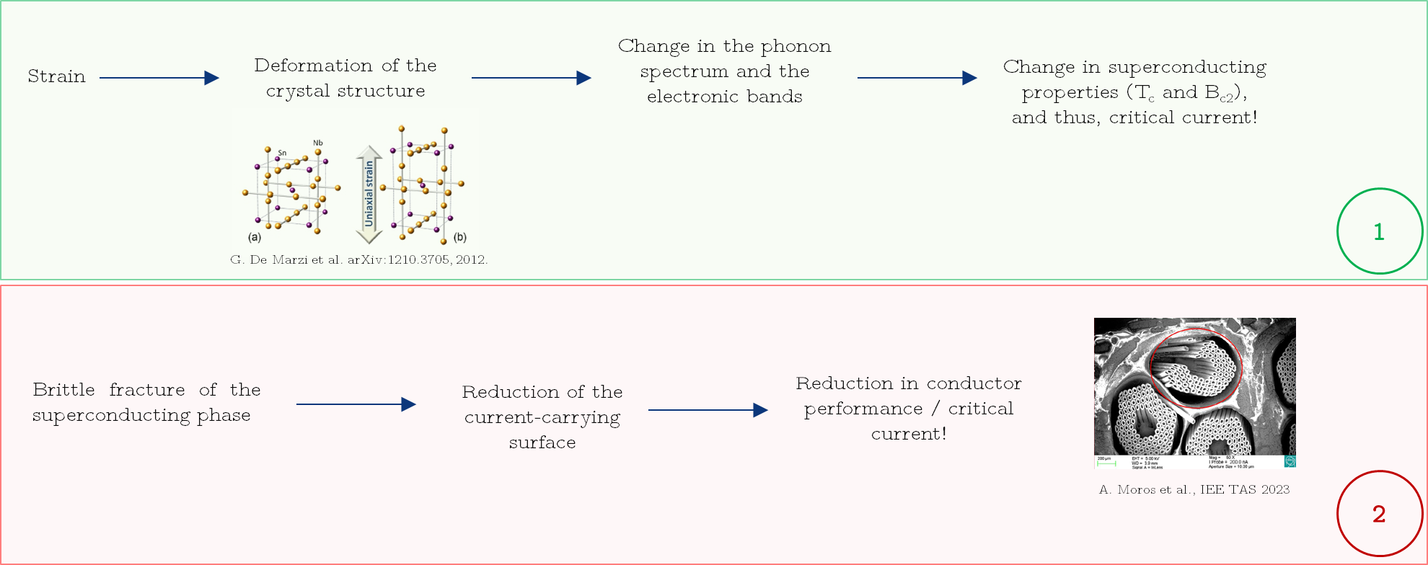
Methodology
The following fitting parameters are needed to feed the scaling law:
  Non-strain related: 𝐶₀, 𝐵_{𝑐2} (0,0), 𝑇_{𝑐} (0)
  Strain related: 𝐶₁, 𝜀_{𝑙0}
Requirement: Characterization of the desired strand using a standard WASP measurement.
Recall: This approach reproduces the effects on critical current when the mechanism governing the Ic change is a modification on the strain state of the superconducting phase:
  Elastic (recovered when the load is removed)
  Plastic (mainly coming from matrix plasticization)
I_{c} [A]
Plot from N. Cheggour et al. Scientific Reports (2019)

Slide 12
Outline
Introduction / motivation
Methodology
Results at the strand level
Results at the magnet level
Conclusions
3D rendered view of a MQXF short model magnet, whose analysis is treated in the slides.

Slide 13


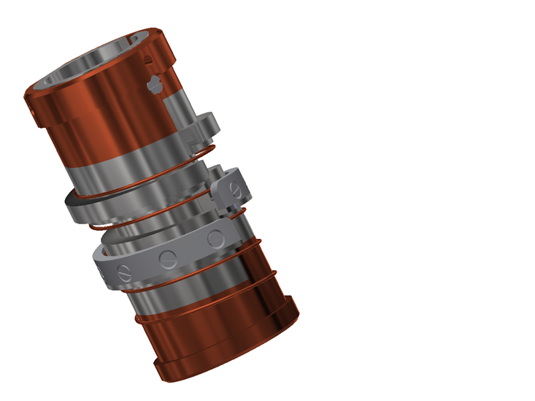
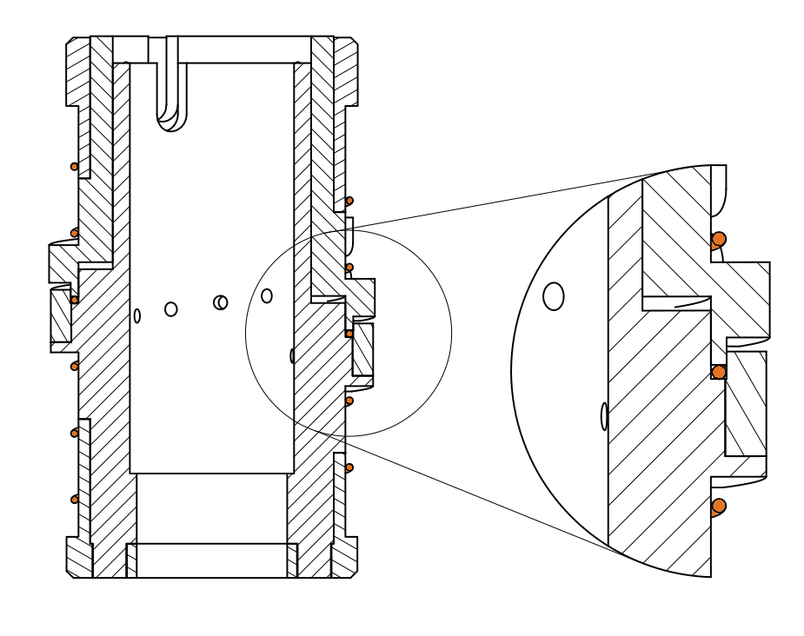
Ic vs. transverse stress on single wires
Example on measurement results
Fixed top part
Wire impregnated in the groove
[4-wall]
Applied Force
Movable bottom part
C-WASP – I_{c} vs transverse stress measurements
Trying to reproduce the operating conditions of accelerator magnets.
To compare results among wires, a conventional irreversible threshold is generally defined as the stress level leading to a permanent 5% loss of Ic.
Plot shows results at 19 T.

Slide 14


Ic vs. transverse stress on single wires
Fitting parameters extracted from Ic vs axial strain measurements.
Amplification factor assessment:
  α_{RRP} = 1.2
Detailed filament model
Strand model, α_{RRP} = 1.2
Unloaded
  α_{RRP} = 1.2
19 T
19 T
1.15 mm width groove
0.85 mm RRP 108/127 15% rolled (HL-LHC MQXF quadrupole)

Slide 15
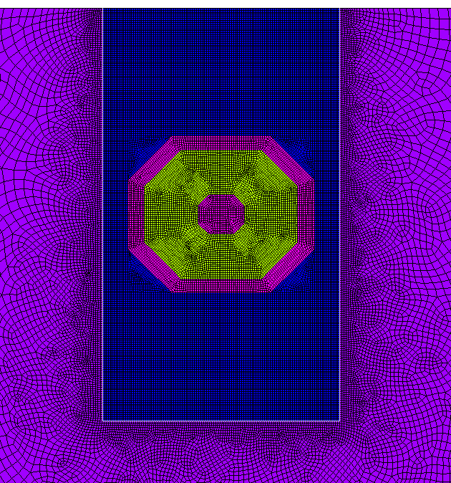
Ic vs. transverse stress on single wires
Fitting parameters extracted from Ic vs axial strain measurements.
Simulation and experimental results:
0.85 mm RRP 108/127 15% rolled
(HL-LHC MQXF quadrupole)
1 mm PIT 192 15% rolled
(FRESCA2 dipole)
P
Strand model, α_{RRP} = 1.2
Strand model, α_{PIT} = 1.4 [34]
Unloaded
Unloaded
19 T
19 T
1.15 mm width groove
1.15 mm width groove
Model catches the Ic reduction when the transverse load is applied for both wire technologies.
α_{PIT} = 1.4, consistent with cable model [34] → calculated by direct fitting of experimental data. Larger strain sensitivity than RRP (empty core, etc [32]).
Simulation results after force unload are inferred using the experimental data. Model is not predictive, but it can still provide I_{c unload} when coupled to a C-WASP measurement (additional slides). Development ongoing.

Slide 16
Ic vs. transverse stress on single wires
Fitting parameters extracted from Ic vs axial strain measurements.
Simulation and experimental results:
0.85 mm RRP 108/127 15% rolled
(HL-LHC MQXF quadrupole)
P
Model validated using the complete magnetic field range available experimentally.

Slide 17
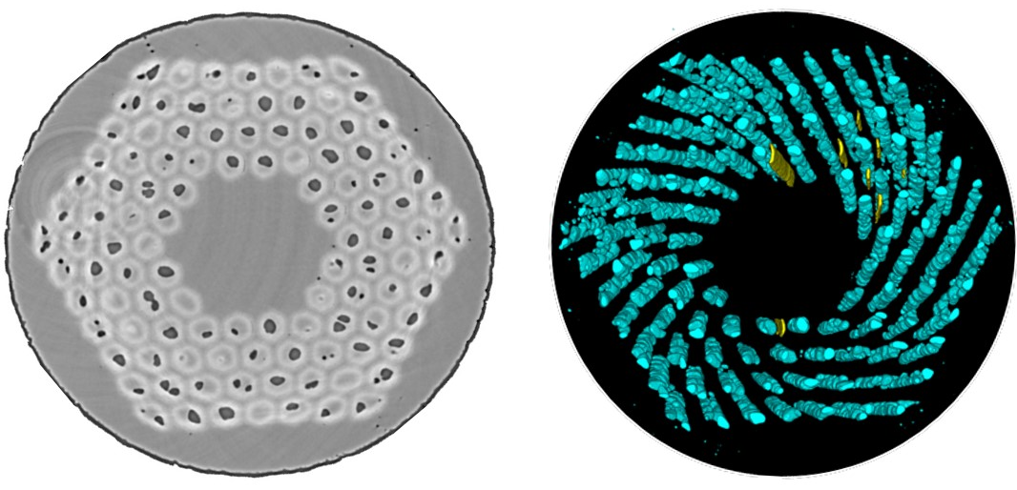

Wrap-up on tests on single wires
Important information for magnet applications:
As already shown by previously published models, the exponential scaling law is able to correctly describe the reduction in Ic due to applied transverse stresses as high as 200 MPa (for RRP).
Indication that the dominating mechanism is the strain effect on the superconducting properties
For this test configuration (4-wall)!
Independent confirmation on this behaviour is well-documented in literature:
  Senatore et al. (Experimental Bc2 evolution with applied stress) [11]
  Bagni et al. (Post-mortem inspection of C-WASP test samples) [8] – [10]
  Bordini, DeMarzi et al. (FRESCA tests on PIT cable) [12] – [14]
Bagni, et al. SUST - 2022
Under certain boundary conditions, as the fully supported 4-wall C-WASP, the dominating mechanism governing the changes in Ic is the strain effect on superconducting properties.
On this regime, the fraction of Ic lost due to transverse loads (permanent and reversible) depends on the magnetic field at which the measurement is performed.
The behavior can be successfully reproduced using the scaling law (already shown). This time, also with a simplified strand representation!

Slide 18
A quick note before going to the magnet scale…
0.85 mm RRP 108/127 15% rolled
(HL-LHC MQXF quadrupole)
19 T
This type of plot from the C-WASP experiment provides very useful information to compare the electro-mechanical response of different wires (same test conditions, 19 T).
Nevertheless, cautious interpretation of the results is needed for magnet applications:
Wires can have different initial axial strain (from mounting).
Conventional 5% limit is set at 19 T!

Slide 19
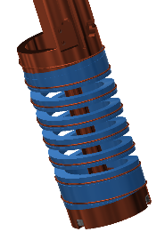
A quick note before going to the magnet scale…
Rolled – Axial WASP
Different initial axial strain (from mounting).
19 T
0.85 mm RRP 108/127 15% rolled (HL-LHC MQXF quadrupole)

Slide 20
A quick note before going to the magnet scale…
It can be reasonably well reproduced with our simple 2D model (changing the initial axial strain)
19 T
0.85 mm RRP 108/127 15% rolled (HL-LHC MQXF quadrupole)

Slide 21
A quick note before going to the magnet scale…
Let’s focus on the wire with no axial pre-tension and check the impact of the magnetic field dependency
Field dependency
19 T
0.85 mm RRP 108/127 15% rolled (HL-LHC MQXF quadrupole)

Slide 22
A quick note before going to the magnet scale…
Let’s focus on the wire with no axial pre-tension and check the impact of the magnetic field dependency
Up to now, we have not used our data to define any stress limit for the investigated wires, on purpose…
For magnet design, it would be extremely useful to extract a (simple) transverse stress limit from this kind of test, however we have shown that on the “strain-governed” regime one must consider:
Three-dimensional nature of the strain dependency (full strain tensor required)
Temperature and magnetic field dependency
Still, to extract meaningful information for magnet design, the strand model can be applied to the magnet configuration.
Field dependency
19 T
5% permanent reduction at 19 T
5% permanent reduction at 12 T
0.85 mm RRP 108/127 15% rolled (HL-LHC MQXF quadrupole)

Slide 23
Outline
Introduction / motivation
Methodology
Results at the strand level
Results at the magnet level
Conclusions
3D rendered view of a MQXF short model magnet, whose analysis is treated in the slides.
Low-beta quadrupole for the insertion regions of HL-LHC:
Nb₃Sn conductor
Nominal current: 16.23 kA
Operational gradient: 132.2 T/m
Peak field in the conductor at nominal current: 11.3 T
Iop / Iss at 1.9 K: 76 %
Large magnet aperture (150 mm)
F_{θ} layer 1 / layer 2 (per octant): -1.58 / -2.14 MN/m
Magnet stored energy density: 1.15 MJ/m

Slide 24
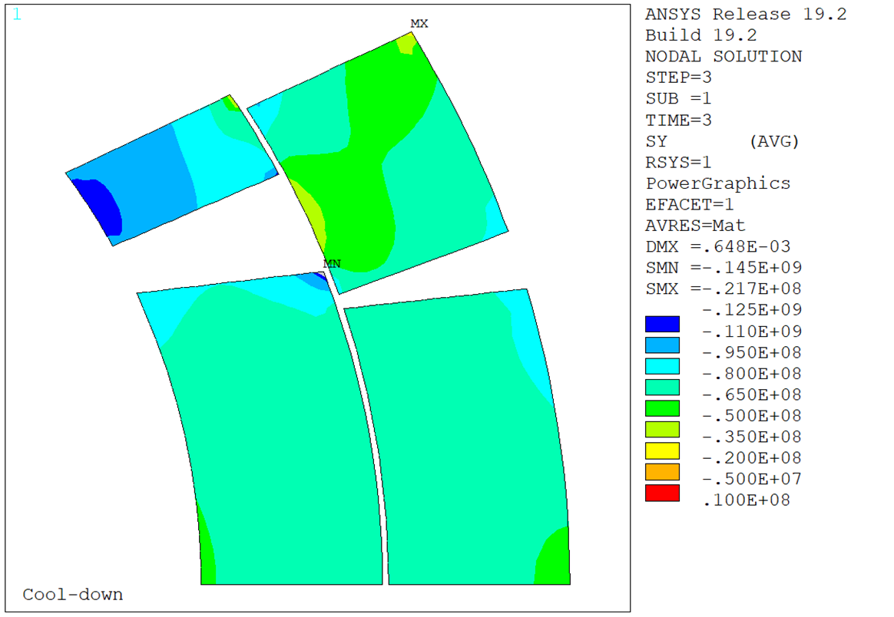
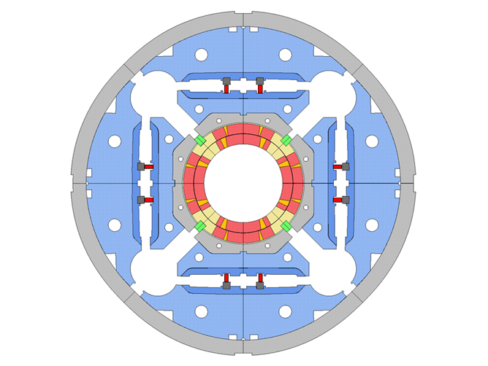
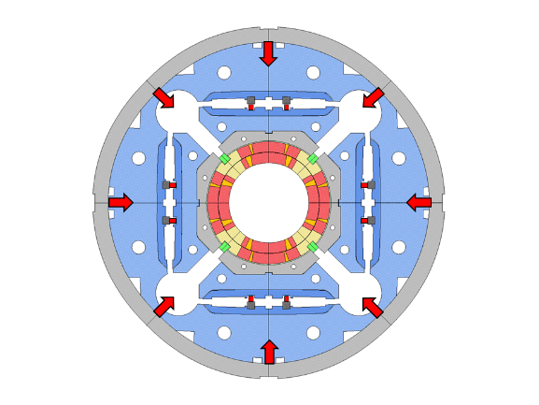
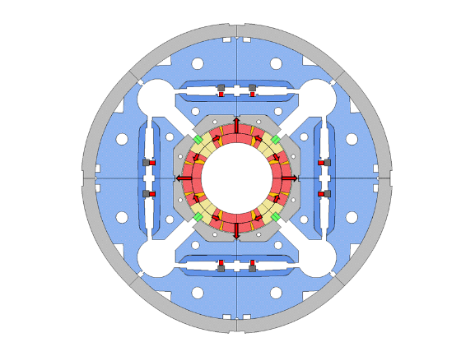
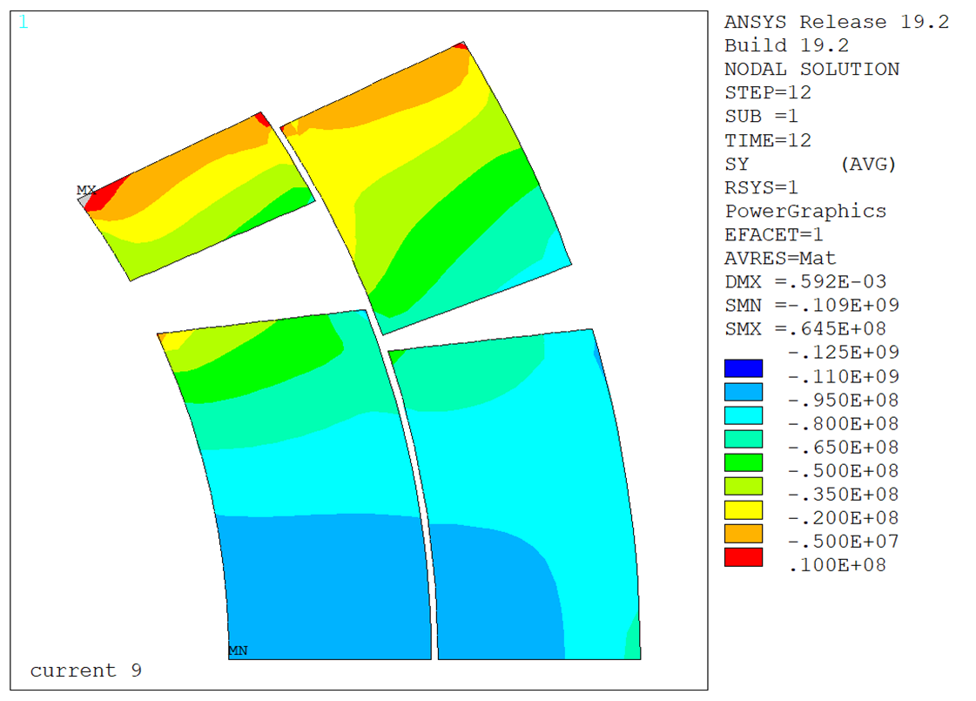
Electro-mechanical limits on magnet configuration
Reference pre-load. Standard FE model
Coil azimuthal / transverse stress
HL-LHC MQXF project:
One short model magnet is now being used to explore the electro-mechanical limits of the conductor in magnet configuration.
  MQXFS7 – 2 coils with PIT and 2 coils RRP conductor.
Magnet pre-load gradually increased searching for signs of performance reduction. Similar test as the one reported by H. Felice et al. [25].
Pre-load level at cryogenic temperature estimated using mechanical instrumentation placed on the winding pole (representative of stress in inner radius pole turn conductor, standard FE model).
4.5 K
Inner radius of pole turn conductor
σ_{y} pole = 110 MPa
Instrumentation on the winding pole (indirect assessment of coil stress)
I_{nom}
Coil pre-load / pre-compression applied by a system of interference keys.
Coil pre-load / pre-compression further increased at cryogenic temperature thanks to the larger thermal contraction of the outer Al-cylinder.
The pre-load counteracts the effect of the e.m. forces during magnet energization.

Slide 25
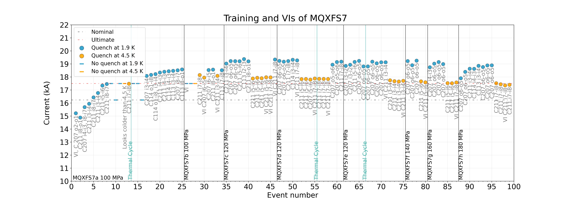
Electro-mechanical limits on magnet configuration
Courtesy of F.J. Mangiarotti, S. Ferradas Troitino
At 4.5 K all quenches (but one) are in C211. VI transitions are visible.
At 1.9 K, the location on the highest current quenches jumps from coil to coil. No visible VI transitions.

Slide 26
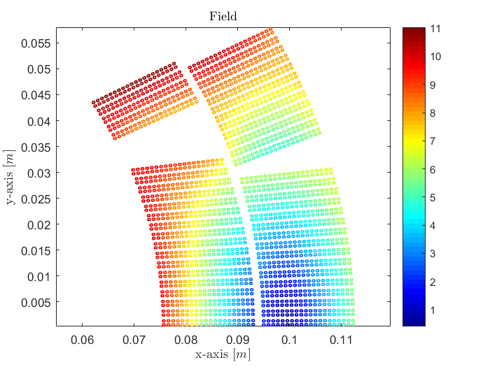
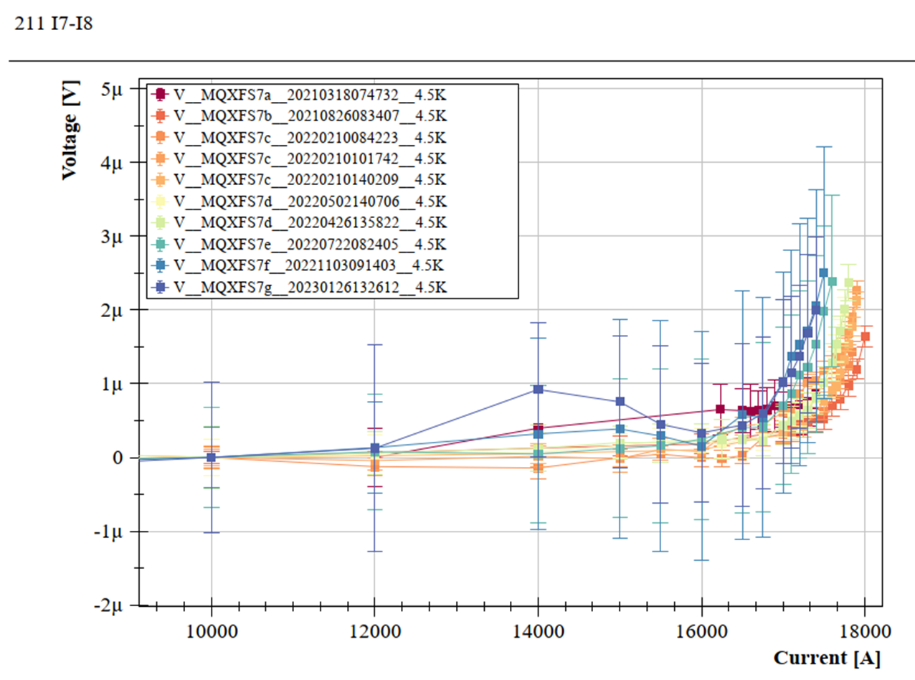
Electro-mechanical limits on magnet configuration
Magnetic field at I_{nom}
T
Results on MQXFS7 experiment so-far:
Coil 211 (PIT) being the limiting coil according to measurements on extracted strands.
Focus at 4.5 K: the magnet quenches consistently in the inner layer pole turn of coil 211.
  Peak field region.
  VI measurements suggest crossing of critical surface.
VI measurements courtesy of F.J. Mangiarotti
At 4.5 K all quenches in coil 211 – pole turn
At 1.9 K most recurrent quench location is coil 207
At 4.5 K, small decrease in quench current from 100 MPa (97% of SS) to 170 MPa (94% of SS), more assembly iterations to come!
Note that measurable variations are seen when the magnet pre-load was not changed: we are looking really at small numbers!

Slide 27
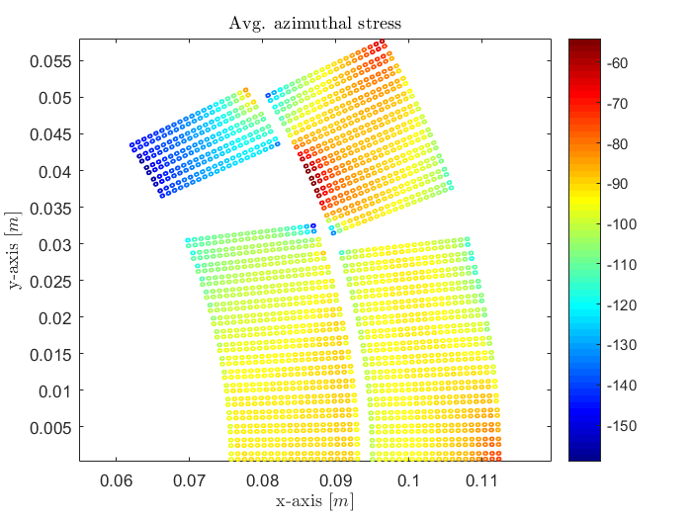
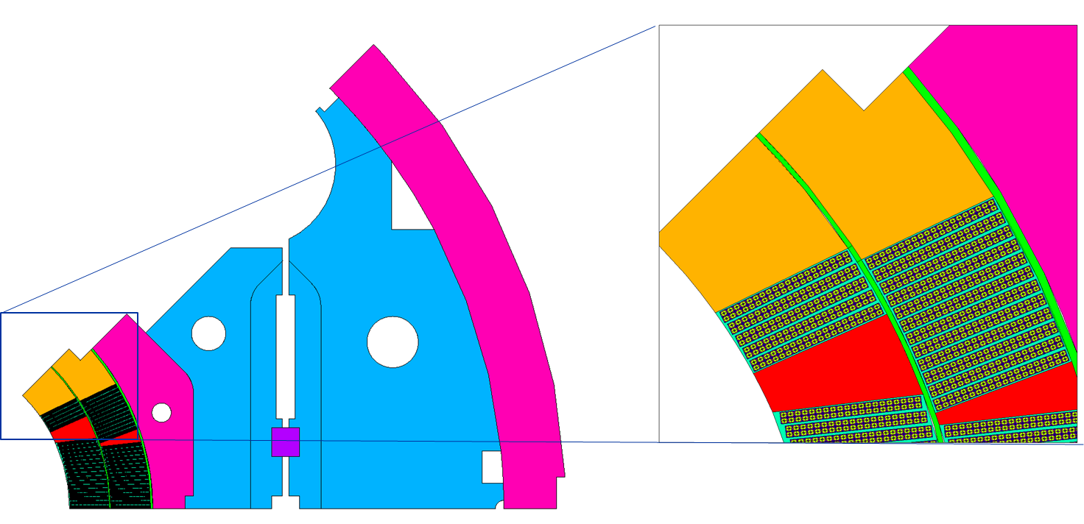
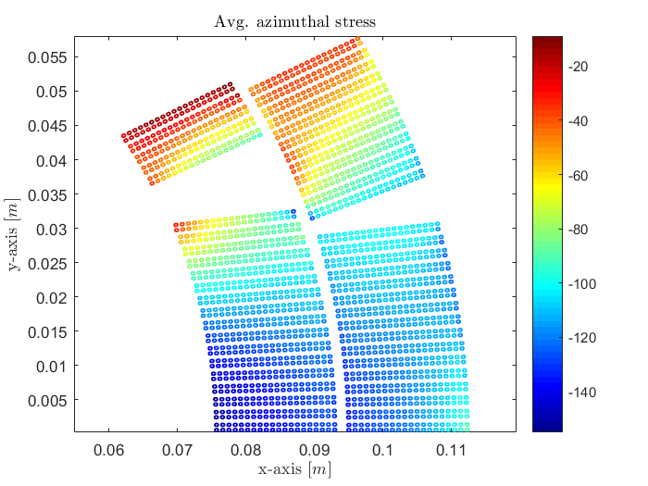
Electro-mechanical limits on magnet configuration
Simulation set-up:
MQXFS7 experiment modelled using our proposed methodology. Model validated mechanically in [35]. Recall: material properties from literature.
Strain related fitting parameters (including expected Ic decrease due to permanent strain effects): extracted from available measurements at UNIGE, 1 mm PIT192 strand (not exactly the same). Non-strain related: coil extracted strands.
For each assembly iteration, the pre-load is adjusted to match the experimental results (we match the indirect measurements at the winding pole).
The short sample limit is then computed including strain effects (current ramped).
Reference pre-load (Nb₃Sn region)
MPa
4.5 K
MPa
I_{nom}

Slide 28
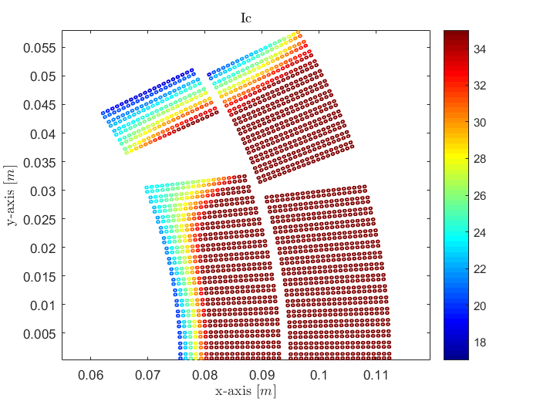
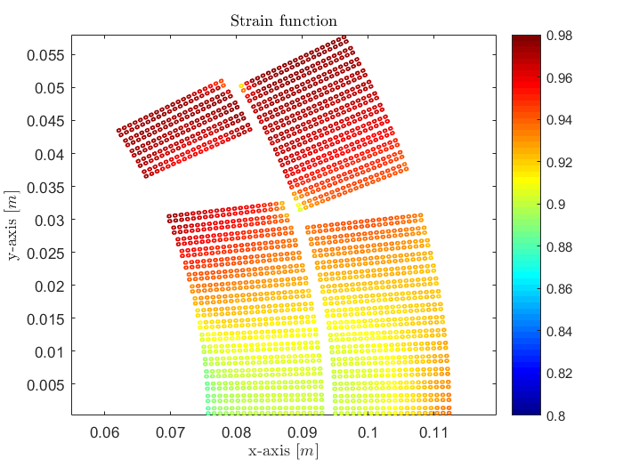
Electro-mechanical limits on magnet configuration
Results:
Reference pre-load (4.5 K /110 MPa)
I_{c}
kA
Strain function at I_{SS}
Min I_{c} location
Peak field, low stress during powering.
Lower field but high stress during powering (e.m. forces accumulate).
The peak field region during powering is found in the pole turn block, which unloads under the action of the electro-magnetic forces.
B_{p mid-plane (high stress)} / B_{p pole turn (low stress)} = 0.86
At I_{nominal} → B_{p mid-plane (high stress)} - B_{p pole turn (low stress)} ~ 1.5 T
MQXF
Note that I_{c} is similar for both locations, slightly lower in the pole turn.

Slide 29
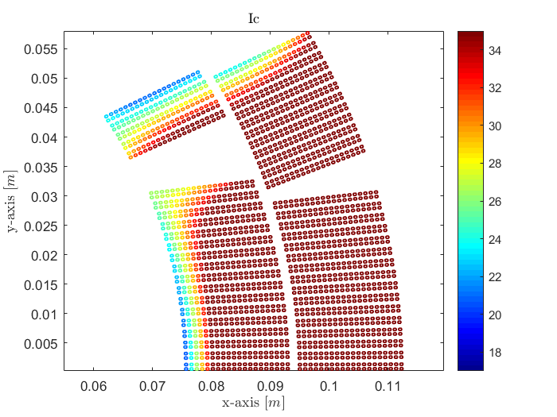
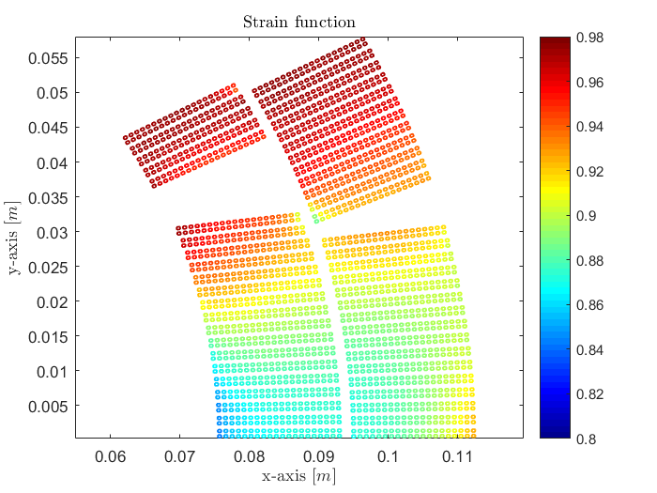
Electro-mechanical limits on magnet configuration
Results:
Reference pre-load (1.9 K /110 MPa)
I_{c}
kA
Strain function at I_{SS}
At 1.9 K instead, the short sample location moves to the mid-plane!
Larger magnet current → higher mid-plane stress
Min I_{c} location
Again, I_{c} is similar for both locations, slightly lower in the mid-plane turn this time.

Slide 30
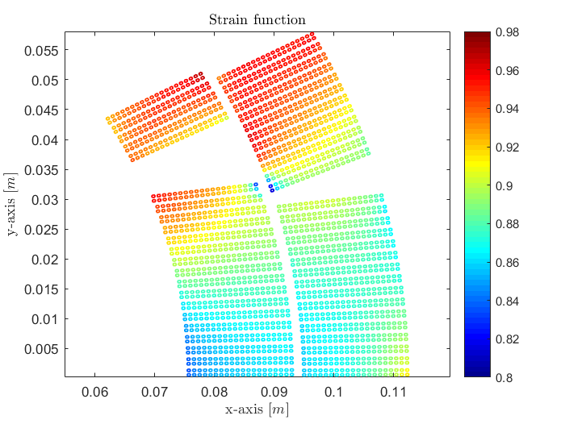
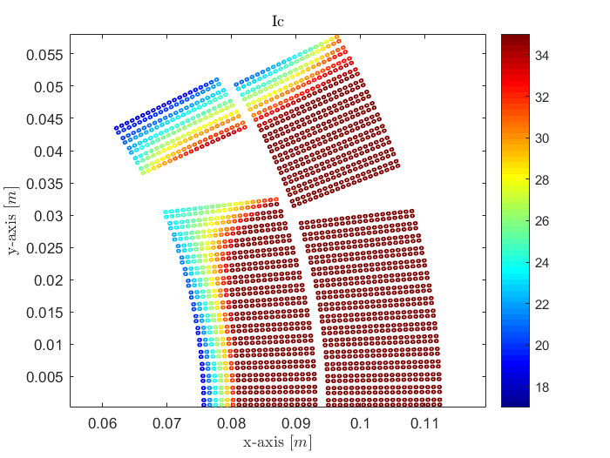
Electro-mechanical limits on magnet configuration
Results:
200 MPa pre-load (4.5 K)
Strain function at I_{SS}
I_{c}
kA
Min I_{c} location
The pole turn is unloaded. Permanent reduction of the strain function due to high stresses after cool-down.
For a larger magnet pre-load (200 MPa), a reduction of the short sample limit appears in the pole turn block at 4.5 K due to permanent effects originated by large stresses after cool-down.

Slide 31
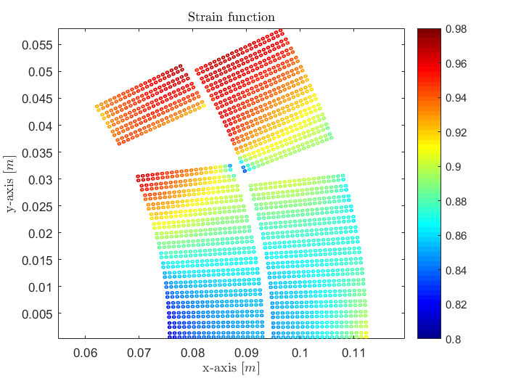

Electro-mechanical limits on magnet configuration
Results:
200 MPa pre-load (1.9 K)
Strain function at I_{SS}
I_{c}
kA
At 1.9 K and 200 MPa, the limiting location remains in the mid-plane.
The mid-plane normal stress increases by about 30 MPa due to the larger pre-load (standard homogenized model).
Min I_{c} location

Slide 32
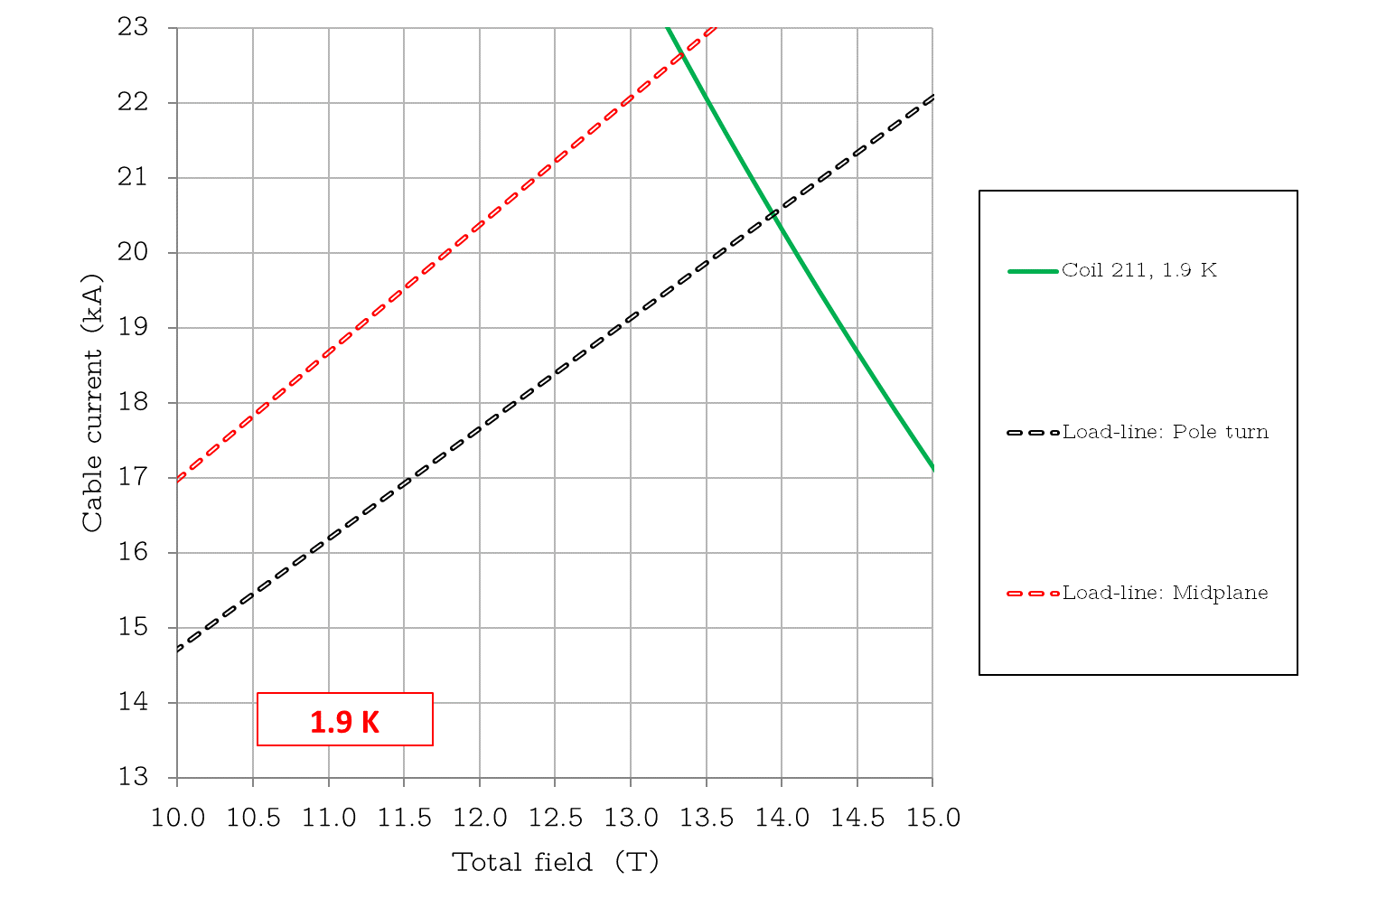
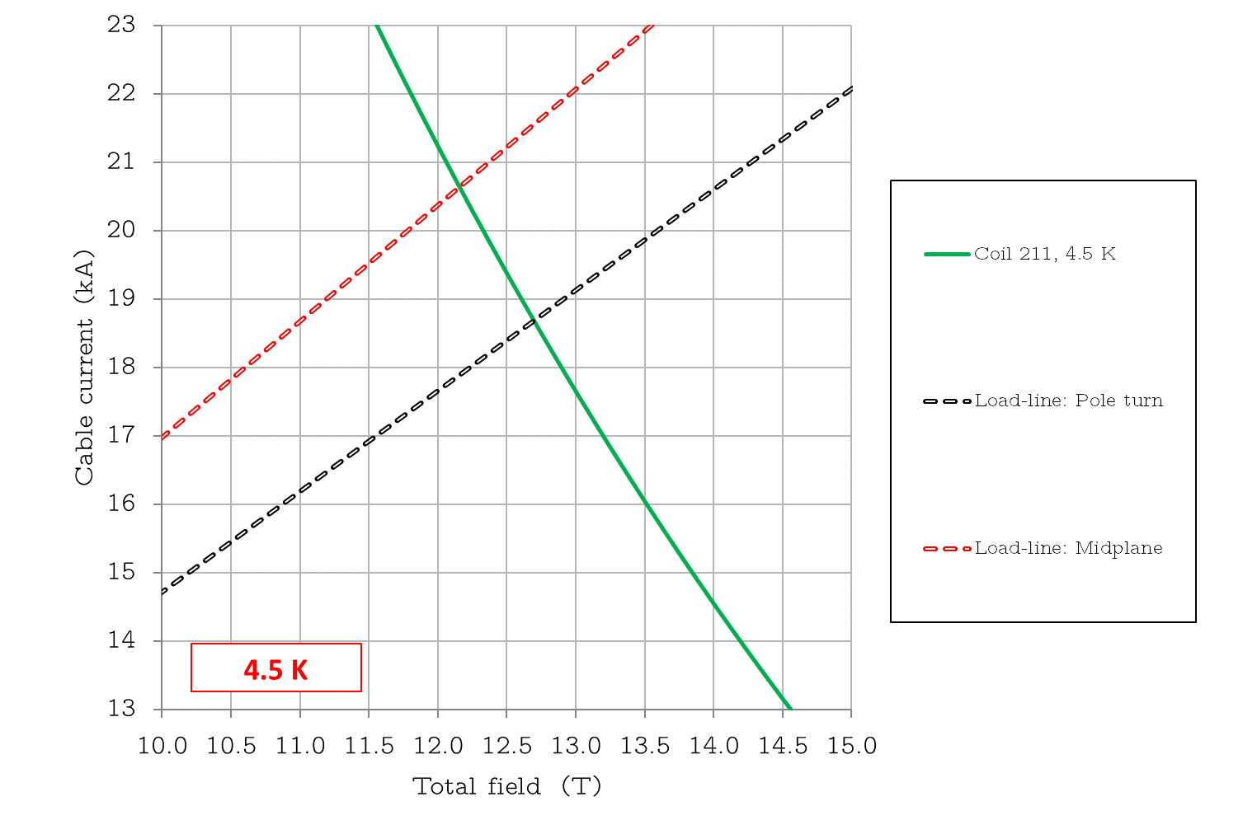
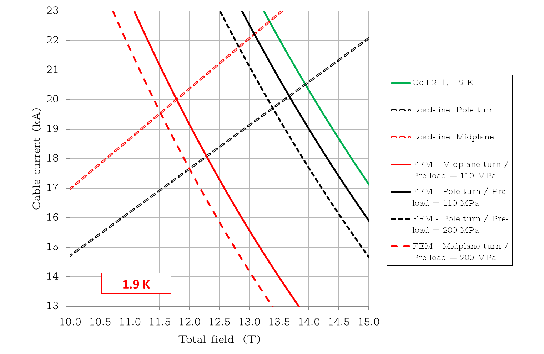
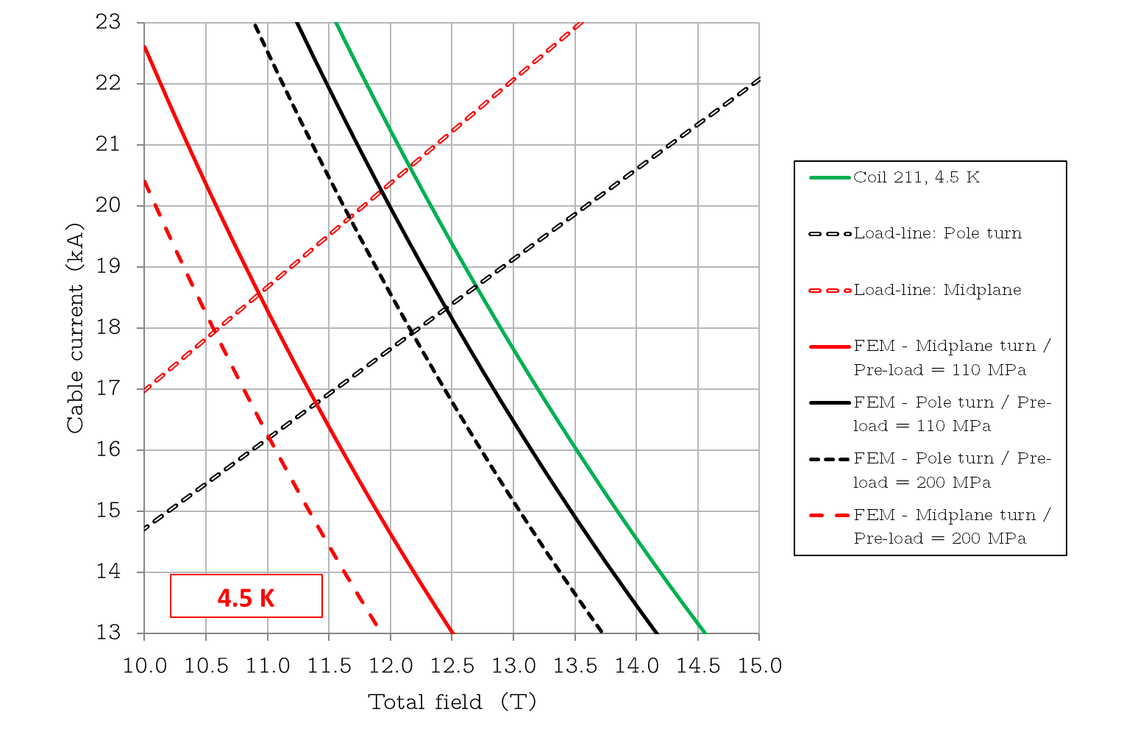
Electro-mechanical limits on magnet configuration
FEM curves computed using the value of the strain function at the limiting current.
Behavior is much better understood by plotting the corresponding load lines:
4.5 K
1.9 K
From extracted strands
From extracted strands
The short sample limit is found either in the pole turn block (4.5 K) or in the mid-plane (1.9 K):
Mid-plane → High stress during powering (higher at 1.9 K), larger critical current reduction but lower magnetic field.
Pole turn block → Low stress during powering (critical current reduction appears due to permanent effects) but peak magnetic field.
For MQXF, the loss in both regions is similar. It highlights the importance of the ratio B_{p} _{high-stress} / B_{p low-stress}. We come back to it on next slide.

Slide 33
Electro-mechanical limits on magnet configuration
I_{nom}
Few more words on the ratio B_{p} _{high-stress} / B_{p low-stress}:
1.9 K
Unloaded
19 T
Loaded
For illustration purposes
Example on RRP wire.

Slide 34
Electro-mechanical limits on magnet configuration
Few more words on the ratio B_{p} _{high-stress} / B_{p low-stress}:
I_{nom}
1.9 K
Unloaded
19 T
Loaded
For illustration purposes
Example on RRP wire.
Reduction in the mid-plane is significantly larger, however the magnetic field in this region for MQXF is lower (load line shifted upwards).
In the extreme case where the ratio would be 1: we would loose 2 kA, from 20 kA to 18 kA, in SS limit.
Magnet design: disentangling the peak field and peak stress regions!

Slide 35
Electro-mechanical limits on magnet configuration
Summary on MQXFS7, focus at 4.5 K:
The magnet strand model (fed with the data from transverse compressive strand tests) shows a similar tendency than the (so-far) measured reduction in quench current.
  Note that input data is not strictly the one for the MQXFS7 strand.
  Experimental and simulated reduction in the same order of magnitude (< 5 %).
  Results seem to be caught by the scaling law (up to 170 MPa) → indirect indication that the magnet support conditions are coherent with the conductor tests (C-WASP, FRESCA sample holder). More work ongoing to substantiate/support this statement!
Disregarding the absolute value of I_{quench}/ I₀ → Quench happens in the peak field pole turn conductor, which is unloaded during magnet ramping. Same result predicted by the model.
The small short sample reduction with increasing magnet pre-load in this case is thus due to permanent effects (plastic strain) arising from the large stress levels at cryogenic temperature in that region.
  From conductor tests: reduction in Ic under “unloaded conditions” is significantly smaller than in the loaded regime → decrease in quench current contained within 5 % even at high pre-load levels.
Measured and computed reduction in quench current.
Limit of application
Note that in the real system, geometrical tolerances/imperfections, can modify the conductor strain state. These cases can be simulated, but presented results correspond to a perfect geometry.

Slide 36
Electro-mechanical limits on magnet configuration
A last remark: could conductor results be linked to magnet configuration?
Note that LL margin is usually 1/3 of the corresponding critical surface one for Nb₃Sn.
The strand model allows to link C-WASP results to the magnet ones, by accounting for:
Temperature, field dependence and the stress/strain state of the limiting strand!
Simulated 0.85 mm PIT strand (15% rolled) in C-WASP configuration
4.5 K
9 %
3 %
4.5 K, 12.2 T

Slide 37
Outline
Introduction / motivation
Methodology
Results at the strand level
Results at the magnet level
Conclusions
3D rendered view of a MQXF short model magnet, whose analysis is treated in the slides.

Slide 38
Conclusions
The reproduction of the strain effects in the Nb₃Sn critical surface is today a well-known domain of study. A three-dimensional mathematical description is available in the form of the exponential scaling law.
  The latter has been successfully applied to detailed 2D and 3D FE models, matching experimental data at the conductor level.
Under certain support / boundary conditions Nb₃Sn conductors can withstand large stress levels (up to / above 170 - 200 MPa), where the dominating mechanism governing the Ic reduction is the effect of mechanical strain in the superconducting properties. Proven experimentally (B_{c2} evolution, post-mortem inspection) and numerically in wire and cable configuration.
In such a regime, the full strain tensor and the temperature / magnetic field dependency needs to be considered for the correct interpretation of test results.
  Strain sensitivity is larger at high magnetic fields.
The direct application of the strand model to the magnet allows to include the strain effects modifying the short sample limit. Good agreement between the obtained simulation results and recent experiment in MQXFS7.
  Indirect indication that the magnet support conditions are coherent with the conductor tests (C-WASP, FRESCA sample holder). More work ongoing to substantiate/support this statement!
The methodology provides useful information for magnet design.
  Important to disentangle the peak field and high stress regions (nothing new…).
  Peak field location is used to determine the magnet short sample limit when no strain effects are considered. Generally, this part of the coil is unloaded (low-stress) during magnet powering. The ratio (B_{p high-stress} / B_{p low-stress}) governs thus the reduction on the magnet short sample limit and needs to be carefully accounted.
  Since the strain sensitivity is larger at high magnetic fields, strain effects in the magnet short sample limit become more and more important as we move towards high field designs. We need to include them.
Finally, test at the wire level could be linked to the magnet configuration (using the strand model) by accounting for the temperature, field dependence and the stress/strain state of the limiting strand.

Slide 39
One important remark on next steps (or an anticipated question!)
Today we have not discussed the electro-mechanical behavior of Nb₃Sn conductors in the domain where cracks (of any type) dominate the critical current reduction. Neither the mechanisms governing their appearance / presence, impact on performance, etc.
  From a practical standpoint, this is the regime that the magnet design shall avoid.
In this case, a failure criteria is needed to answer to the most important questions and to set the required limits for magnet design. Some of these questions:
    Based on the acquired experience up to now, it seems that supporting conditions play a critical role. Then, which load and supporting conditions govern the brittle fracture of the Nb₃Sn phase?
    Which type of cracks appear under which conditions? What is the impact on magnet performance? Can we come up with a safe criteria dealing with Nb₃Sn conductor failure?
Works is ongoing at CERN and other institutes trying to reach this next step in our understanding of Nb₃Sn superconductors for accelerator magnets!

Slide 40
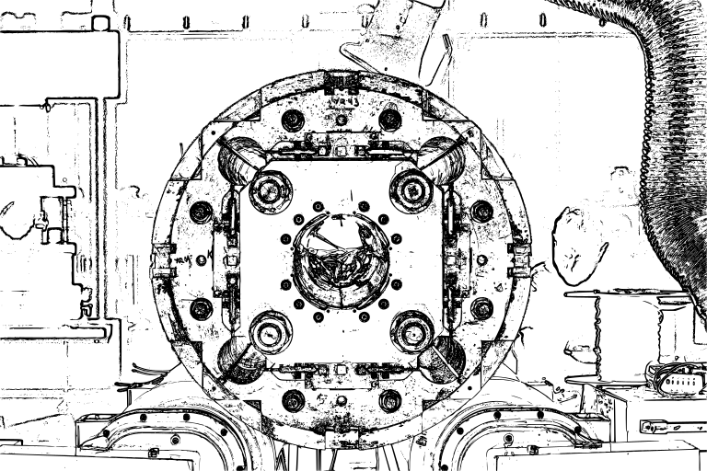
Thank you very much for your attention!
Special thanks (and credits!) to everybody involved:
Susana Izquierdo
Giorgio Vallone
Bernardo Bordini
Tommaso Bagni
Carmine Senatore
Paolo Ferracin

Slide 41
ANNEX

Slide 42

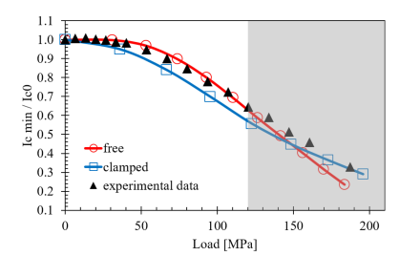
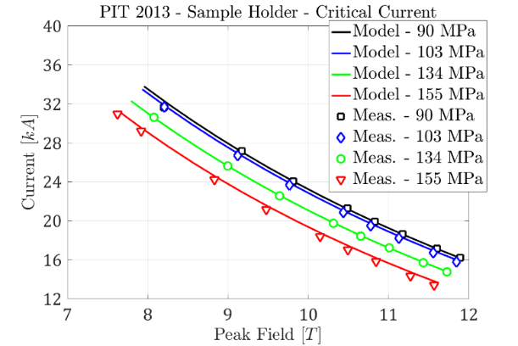
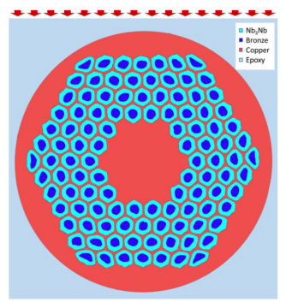
The scaling law
Important to recognize the three-dimensional nature of the scaling law.
It has been proven that for (1) the scaling law can be used under more complex loading conditions.
Focus on transverse loads, those usually of largest magnitude on accelerator magnets
Studies employ Finite Element models to extract the strain tensor. Validated in:
Transversally loaded wires (micro-scale models)
2D and 3D models computing I_{c}
Detailed sub-element geometry
[31]-[32] Bordini, Cattabiani, Baffari et al.
[5] Senatore, Bagni, Calzolaio et al.
[33] Chiesa, Wang et al.
Transversally loaded cable stacks (macro-scale model)
[34] – [35] G. Vallone et al.
It can be applied to a 2D magnet cross-section (already published).
Cattabiani, Baffari et al.
Cattabiani, Baffari et al.
Bagni, Calzolaio et al.
Vallone, Ferracin, Bordini et al.

Slide 43
Methodology
The following fitting parameters are needed to feed the scaling law:
  Non-strain related: 𝐶₀, 𝐵_{𝑐2} (0,0), 𝑇_{𝑐} (0)
  Strain related: 𝐶₁, 𝜀_{𝑙0}
Requirement: Characterization of the desired strand using a standard WASP measurement.
Recall: This approach is valid when the mechanism governing the Ic change is a modification on the strain state of the superconducting phase:
  Elastic (recovered when the load is removed)
  Plastic (mainly coming from matrix plasticization)
A failure criteria is needed (separately) to deal with the brittle fracture of the Nb₃Sn phase.
  Proposal from Vallone et al. in https://indico.cern.ch/event/1177999/
  Indications of clear differences depending on the test configuration (4-wall fully supported strand, 2-wall)
  Not covered in these slides!
I_{c} [A]
Plot from N. Cheggour et al. Scientific Reports (2019)

Slide 44
Ic vs. transverse stress on single wires
Fitting parameters extracted from Ic vs axial strain measurements.
Simulation and experimental results:
0.85 mm RRP 108/127 15% rolled
(HL-LHC MQXF quadrupole)
1 mm PIT 192 15% rolled
(FRESCA2 dipole)
P
19 T
19 T
1.15 mm width groove
1.15 mm width groove

Slide 45
Ic vs. transverse stress on single wires
Fitting parameters extracted from Ic vs axial strain measurements.
Simulation and experimental results:
0.85 mm RRP 108/127 15% rolled
(HL-LHC MQXF quadrupole)
---- FEM

Slide 46
Permanent effect based on experimental data
Under the assumption of no cracks, we can use our Tc0, Bc20, C0 obtained from the axial test and map a “experimental” strain function from the measurements at 19 T
19 T
Unload
Assuming Tc0, Bc20, C0 from axial WASP
Load
Optimization algorithm
Rolled sample, zero applied axial strain

Slide 47
Permanent effect based on experimental data
Knowing the strain function (from measurements at 19T) and using the fitting parameters from the axial WASP we can compute Ic at any field, or Bc2 at any stress.

Slide 48
Permanent effect based on experimental data
Knowing the strain function (from measurements at 19T) and using the fitting parameters from the axial WASP we can compute Ic at any field, or Bc2 at any stress.
2
1
Furthermore, we know that our FEM matches well the part under load. To infer the Ic after unload, a simplistic approach could be to use the experimental strain function plot to determine s(ε) for the unloaded sample.
Note.- If our model would catch better the residual strain, this would not be needed.
Thus, we can set our transfer function between s(ε)^{load} and s(ε)^{unload} based on UNIGE measurements.

Slide 49
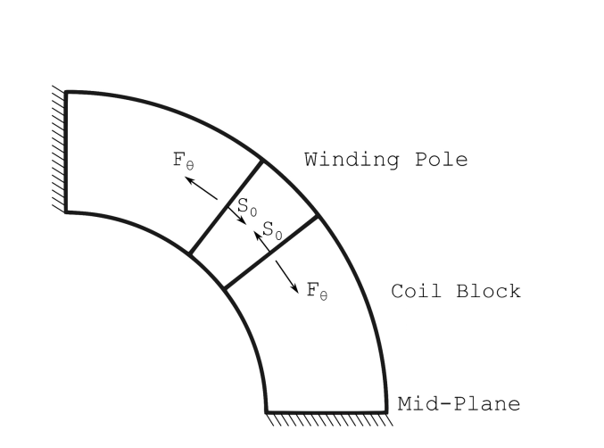
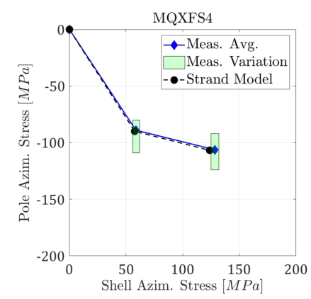
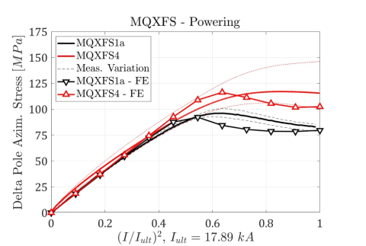
Magnet strand model
Vallone et al.

Slide 50



Coil block model – 110 MPa
Azimuthal stress
20 kA
16.23 kA
CD

Slide 51



Coil block model – 200 MPa
Azimuthal stress
20 kA
16.23 kA
CD

Slide 52




Coil block model – coil strand model (110 MPa pre-load)
IL - azimuthal stress after cool-down to cryogenic temperature
Different levels of homogenization:
Coil block → strand (Nb₃Sn octagon) → sub-element / filament
Path
Scaling factor in the strand model
Path IL – Inner radius
Path IL – Middle
Path IL – Outer radius

Slide 53




Coil block model – coil strand model (110 MPa pre-load)
IL - azimuthal stress at 20 kA
Different levels of homogenization:
Coil block → strand (Nb₃Sn octagon) → sub-element / filament
Path
Scaling factor in the strand model
Path IL – Inner radius
Path IL – Middle
Path IL – Outer radius

Slide 54




Coil block model – coil strand model (110 MPa pre-load)
OL - azimuthal stress after cool-down to cryogenic temperature
Different levels of homogenization:
Coil block → strand (Nb₃Sn octagon) → sub-element / filament
Path
Scaling factor in the strand model
Path OL – Inner radius
Path OL – Middle
Path OL – Outer radius

Slide 55



Coil block model – coil strand model (110 MPa pre-load)
OL - azimuthal stress at 20 kA
Different levels of homogenization:
Coil block → strand (Nb₃Sn octagon) → sub-element / filament
Path
Scaling factor in the strand model
Path OL – Inner radius
Path OL – Middle
Path OL – Outer radius

Slide 56



Electro-mechanical limits on magnet configuration
Magnet stress state:
Reference pre-load (4.5 K - Nb₃Sn region)
Azimuthal, radial and axial directions ~ principal.
Dominated by the azimuthal component.

Slide 57


Electro-mechanical limits on magnet configuration
MQXF limiting quenches at 1.9 K do not (usually) happen in the mid-plane…
Critical surface margin as: $\frac{I_{magnet}}{\text{min}\text{ [}\text{Ic} \text{(}\text{T}\text{,}\text{B}\text{,}\text{I}\text{,}\text{ε}\text{)}\text{]} }$
16.23 kA - I_{nominal}
19.5 kA
Lowest margin at the pole turn, peak field region.
Larger e.m. forces reduce the margin at the mid-plane: becoming the real short sample limit!
Reference pre-load (1.9 K /110 MPa)

Slide 58


Permanent effect based on experimental data.
Fixed temperature simplification:
This is valid when the Ic reduction is governed by the lattice deformation (strain, no cracks) and far from Tc.
Since in our experiment at UNIGE we have found that no cracks are present in the wires (by inspection and by consistency in Bc2 decrease), we can use the expression above.
  Bc2(ε) is obtained by Kramer extrapolation* from the different field sweeps.
  One can then compute Ic at any magnetic field and any strain, if we know Bc2(ε).
  The same applies when the load is removed, there the permanent effect comes from Bc2^{unload}(ε).
  Using the expression we can get the permanent reduction by using: Ic^{unload}(ε)/ Ic0 [as a function of Bc2^{unload}(ε) and Bc2^{unload}(0)]
  Very interestingly for us, we can also get the ratio Ic^{unload}(ε)/ Ic^{load}(ε). In this case as a function of Bc2^{unload}(ε)/Bc2^{load}(ε).
With p=0.5 and q=2:
$$\frac{I_{c}^{unload}}{I_{c}^{load}}\left(B,σ\right)= {\left[\frac{B_{c2}^{load}(σ)}{B_{c2}^{unload}(σ)}\right]}^{3/2}−{\left[\frac{B_{c2}^{unload}\left(σ\right)−B}{B_{c2}^{load}\left(σ\right)−B}\right]}^{2}$$
$$\frac{I_{c}^{unload}(B,σ)}{I_{c0} (B,σ=0)}= {\left[\frac{B_{c2}(0)}{B_{c2}^{unload}(σ)}\right]}^{3/2}−{\left[\frac{B_{c2}^{unload}\left(σ\right)−B}{B_{c2}\left(0\right)− B}\right]}^{2}$$
C. Seagal et al. , “Evidence of Kramer extrapolation inaccuracy for predicting high field Nb₃Sn properties”
doi:10.1088/1742-6596/1559/1/012062

Slide 59
Permanent effect based on experimental data.
Results
Measured Ic and computed using Bc2(ε) after force unload agrees well.
Round MQXF wire
Round MQXF wire
Rolled MQXF wire
Bc2 scaling
Bc2 scaling
16 T
Bc2 scaling
16 T
16 T
17 T
17 T
17 T
18 T
18 T
18 T
19 T
19 T
19 T
C. Seagal et al. , “Evidence of Kramer extrapolation inaccuracy for predicting high field Nb₃Sn properties”
doi:10.1088/1742-6596/1559/1/012062

Slide 60
References
[1] J. W. Ekin, “Effect of transverse compressive stress on the critical current and upper critical field of Nb3Sn,” J. Appl. Phys., vol. 62, no. 12, pp. 4829–4834, 1987.
[2] J. W. Ekin, Experimental Techniques for Low-Temperature Measurements: Cryostat Design, Material Properties, and Superconductor Criticalcurrent Test- ing. New York: Oxford University Press, 2006.
[3] B. Seeber, A. Ferreira, V. Abächerli, T. Boutboul, L. Oberli, and R. Flükiger, “Transport properties up to 1000 A of Nb3Sn wires under transverse compressive stress,” IEEE Trans. Appl. Supercond., vol. 17, no. 2, pp. 2643–2646, Jun. 2007.
[4] G. Mondonico, "Analysis of electromechanical properties of A15 type superconducting wires submitted to high mechanical loads," PhD. Thesis (2013).
[5] C. Calzolaio et al., “Electro-mechanical properties of PIT Nb3Sn wires under transverse stress: Experimental results and FEM analysis,” Supercond. Sci. Tech nol., vol. 28, no. 5, pp. 1–11, 2015.
[6] L. Gamperle, et al., “Determination of the electromechanical limits under transverse stress of high-performance Nb3Sn Rutherford cables from a single-wire experiment,” Phys. Rev. Research 2, 013211 – Published 26 February (2020).
[7] J. Ferradas Troitino et al, "Effects of the initial axial strain state on the response to transverse stress of high-performance RRP Nb3Sn wires," Supercond. Sci. Technol., vol. 34, p. 035008, 2021.
[8] T. Bagni et al., "Machine learning applied to X-ray tomography as a new tool to analyze the voids in RRP Nb3Sn wires," Scientific Reports, vol. 11, p. 7767, 2021.
[9] T. Bagni et al., "Formation and propagation of cracks in RRP Nb3Sn wires studied by deep learning applied to x-ray tomography," Supercond. Sci. Technol. , vol. 35, p. 104003, 2022.
[10] T. Bagni et al., "Tomography analysis tool: an application for image analysis based on unsupervised machine learning," IOP SciNotes, vol. 3, p. 015201, 2022.
[11] C. Senatore et al., “Degradation of Ic due to residual stress in high performance Nb3Sn wires submitted to compressive transverse force”, Supercond. Sci. Technol., Accepted for publication.
[12] B. Bordini, P. Alknes, A. Ballarino, L. Bottura, and L. Oberli, Critical current measurements of high-Jc Nb3Sn Rutherford cables under transverse compression, IEEE Trans. Appl. Supercond. 24, 9501005 (2014).

Slide 61
References
[13] J.-E. Duvauchelle, B. Bordini, J. Fleiter, and A. Ballarino, Critical current measurements under transverse pressure of a Nb3Sn rutherford cable based on 1 mm RRP wires, IEEE Trans. Appl. Supercond. 28, 4802305 (2018).
[14] G. De Marzi et al., "On the mechanisms governing the critical current reduction in Nb3Sn Rutherford cables under transverse stress," Scientific Reports, vol. 11, p. 7369, 2021.
[15] P. Ebermann et al., “Influence of transverse stress exerted at room temperature on the superconducting properties of Nb3Sn wires,” Supercond. Sci. Technol., vol. 32, p. 095010, 2019, doi: 10.1088/1361-6668/ab2e51.
[16] P. Ebermann et al., "Irreversible degradation of Nb3Sn Rutherford cables due to transverse compressive stress at room temperature", Supercond. Sci. Technol., vol. 31, (2018).
[17] H. H. J. ten Kate, H. W. Weijers, and J. M. van Oort, Critical current degradation in Nb3Sn cables under transverse pressure, IEEE Trans. Appl. Supercond. 3, 1334 (1993).
[18] P. Gao, "Transverse pressure effect on superconducting Nb3Sn Rutherford and ReBCO roebel cables for accelerator magnets," PhD. Thesis, University of Twente (2019).
[19] Cheggour, N., Stauffer, T.C., Starch, W. et al., "Implications of the strain irreversibility cliff on the fabrication of particle-accelerator magnets made of restacked-rod-process Nb3Sn wires," Sci Rep 9, 5466 (2019).
[20] Cheggour, N., Stauffer, T.C., Starch, W. et al., "Precipitous change of the irreversible strain limit with heat-treatment temperature in Nb3Sn wires made by the restacked-rod process," Sci Rep 8, 13048 (2018).
[21] N. Cheggour et al., “Influence of Ti and Ta doping on the irreversible strain limit of ternary Nb3Sn superconducting wires made by the restacked-rod process,” Superconductor Science and Technology, vol. 23, no. 5, May 2010.
[22] E. Barzi, T. Wokas, and A. V. Zlobin, Sensitivity of Nb3Sn Rutherford-type cables to transverse pressure, IEEE Trans. Appl. Supercond. 15, 1541 (2005).
[23] E. Barzi, “A device to test critical current sensitivity of Nb3Sn cables to pressure,” in Proc. AIP Conf. Proc., 2002, vol. 614, pp. 45–52.
[24] E. Barzi, D. Turrioni, and A. V. Zlobin, “Effect of transverse pressure on brittle superconductors,” IEEE Trans. Appl. Supercond., vol. 18, no. 2, pp. 980–983, Jun. 2008.

Slide 62
References
[25] H. Felice et al, “Performance of a Nb₃Sn Quadrupole Under High Stress,” IEEE Transactions on Applied Superconductivity ( Volume: 21, Issue: 3, June 2011).
[26] H. Bajas et al, “Advanced Nb₃Sn Conductors Tested in Racetrack Coil Conﬁguration for the 11T Dipole Project,” IEEE TRANSACTIONS ON APPLIED SUPERCONDUCTIVITY, VOL. 28, NO. 4, JUNE 2018.
[27] J.C. Perez et al, “Performance of the Short Model Coils Wound With the CERN 11-T Nb₃Sn Conductor,” IEEE TRANSACTIONS ON APPLIED SUPERCONDUCTIVITY, VOL. 25, NO. 3, JUNE 2015.
[28] S. Izquierdo Bermudez et al., “Performance of a MQXF Nb3Sn Quadrupole Magnet Under Different Stress Level,” IEEE Transactions on Applied Superconductivity ( Volume: 32, Issue: 6, September 2022).
[29] L. Bottura et al., "𝐽𝑐(𝐵, 𝑇, 𝜖) Parameterization for the ITER Nb3Sn Production,“ IEEE Trans. Appl. Supercond., Vol. 19, No. 3, (2009).
[30] B. Bordini, P. Alknes, L. Bottura, L. Rossi, and D. Valentinis, “An exponential scaling law for the strain dependence of the Nb3Sn critical current density,” Supercond. Sci. Technol., vol. 26, no. 7, 2013, Art. no. 075014.
[31] A. Cattabiani, D. Baffari, and B. Bordini, “A 3D ﬁnite element model of the reversible critical current reduction due to transverse load in Nb3Sn wires,” IEEE Trans. Appl. Supercond., vol. 30, no. 4, Feb. 2020, Art. no. 8401006, doi: 10.1109/tasc.2020.2977038.
[32] D. Baffari et al., “Effect of the Sub-Elements Layout on the Electro-Mechanical Properties of High Jc Nb3Sn Wires Under Transverse Load: Numerical Simulations,” IEEE Transactions on applied superconductivity Vol. 32, No. 6, September 2022.
[33] T. Wang, L. Chiesa, M. Takayasu, and B. Bordini, “A novel modeling to predict the critical current behavior of Nb3Sn PIT strand under transverse load based on a scaling law and ﬁnite element analysis,” Cryogenics, vol. 63, pp. 275–281, 2014.

Slide 63
References
[34] G. Vallone, B. Bordini, and P. Ferracin, “Computation of the reversible critical current degradation in Nb3Sn rutherford cables for particle accelerator magnets,” IEEE Trans. Appl. Supercond., vol. 28, no. 4, Jun. 2018, Art. no. 4801506.
[35] G. Vallone, E. Anderssen, B. Bordini, P. Ferracin, J. F. Troitino, and S. Prestemon, “A methodology to compute the critical current limit in Nb3Sn magnets,” Superconductor Sci. Technol., 2020. [Online]. Available: https://doi.org/10.1088/1361-6668/abc56b

