Slide 1

Stability of MQXF integrated transfer function at flattop from magnetic measurements
Lucio Fiscarelli
Guy Deferne
Susana Izquierdo Bermudez
213th HiLumi WP2 Meeting - Tuesday 4 Apr 2023

Slide 2
Stability of integral field
Introduction
Measurement instruments
Performed tests and results
Conclusions

Slide 3
Introduction
Stability of the integrated gradient of the MQXF quadrupoles on flat-top plateaus is important
Verification by means of magnetic measurements
Some tests already performed on short-model magnets (https://indico.cern.ch/event/878274/)
Recently, additional tests have been performed on full-length magnets

Slide 4
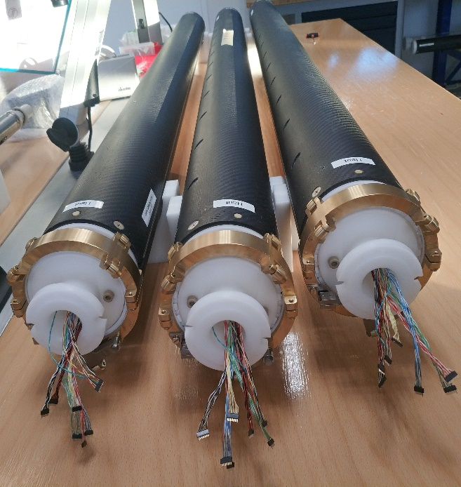
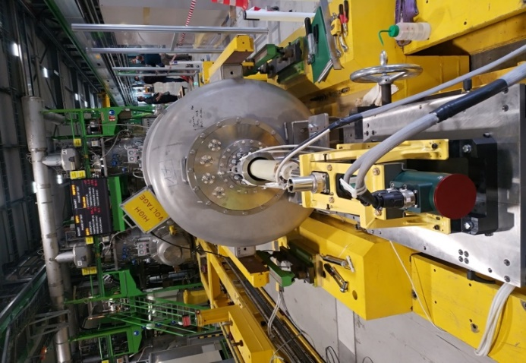
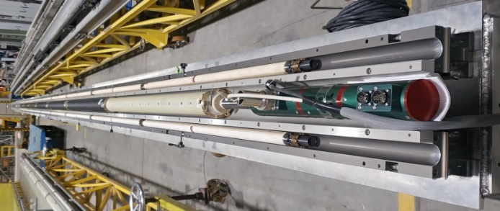
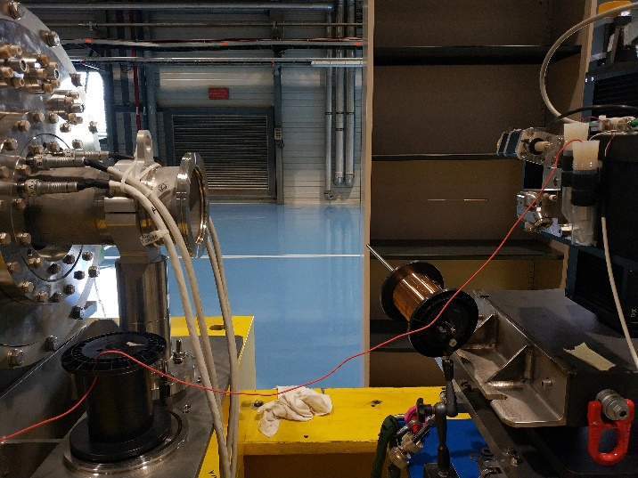
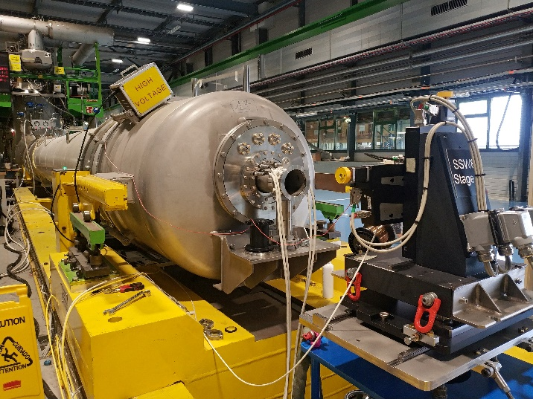
Measurement instruments
Rotating coils
  6 segments of 1.3 m
  Rectangular coils on PCB board
  Precision on gradient 10⁻⁴
  Anti-cryostat temperature
Stretched wire
  Wire diameter 0.150 mm
  Tension up to 10 N
  Displacement 30 mm
  Positioning accuracy 1 µm
  Precision 10⁻⁵

Slide 5
Performed tests
Magnet MQXFBP3
  Rotating coils - plateau at nominal for 8 h
Magnet MQXFB02
  Stretched wire - plateau at nominal for 1 h
  Stretched wire - plateau at nominal for 5 h

Slide 6
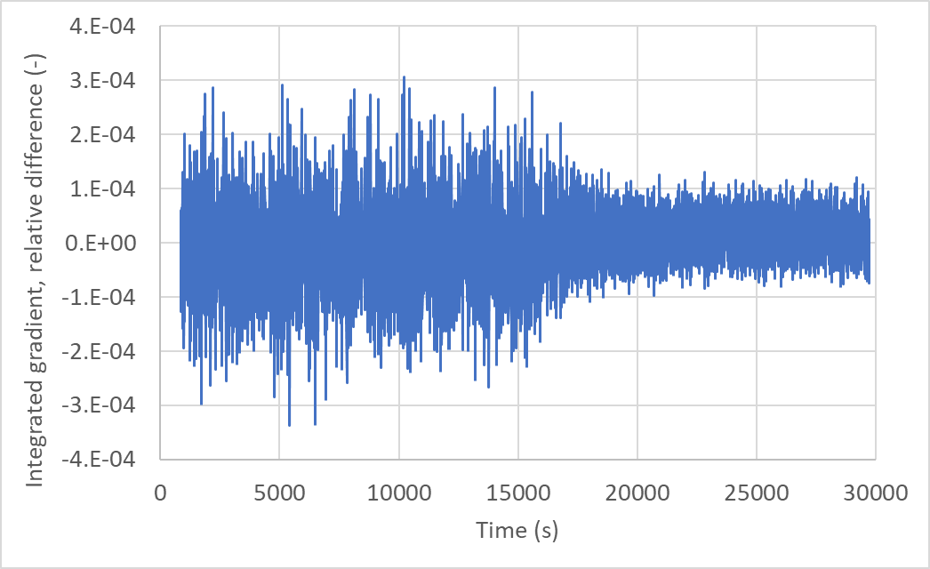
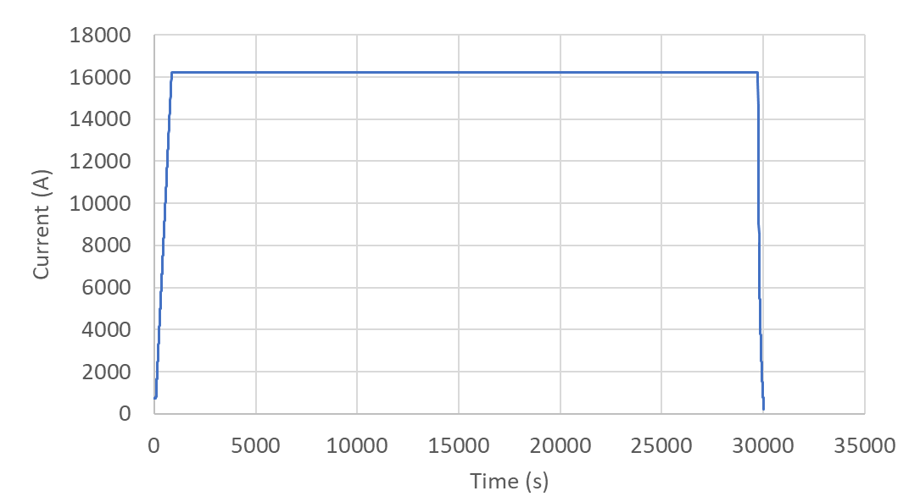
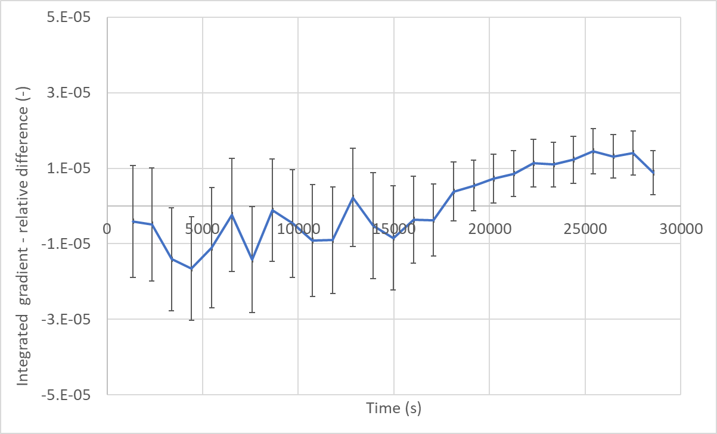
Results – MQXFBP3
  Plateau of 8 h at nominal with rotating coils
  Average of 100 measurements
  Error bar ±3 sigma
  Field stability within ±1 10⁻⁵ (measurement precision)

Slide 7
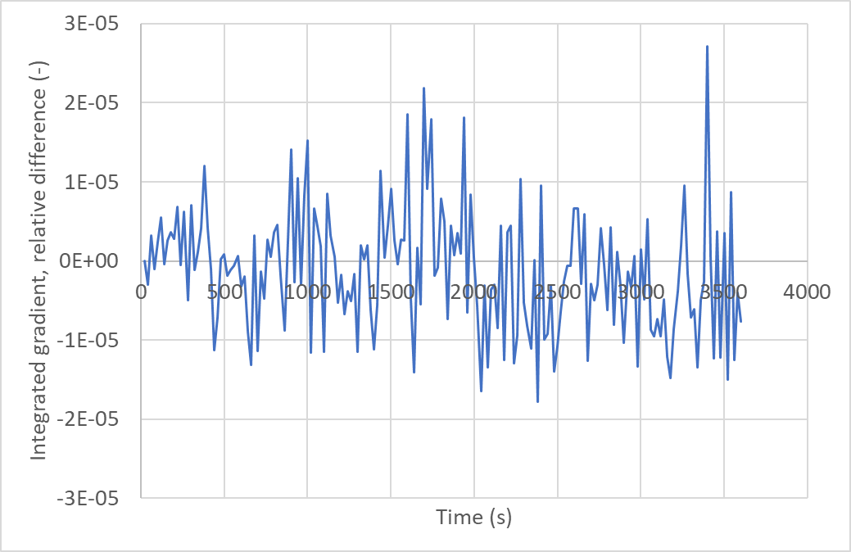
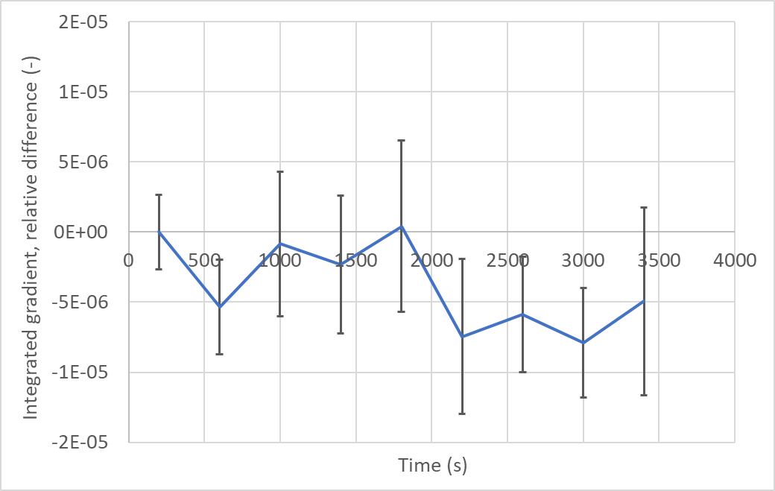
Results – MQXFB02
Plateau of 1 h measured with stretched wire
  Average of 20 measurements
  Error bars ±3 sigma
Field stability within ±0.5 10⁻⁵ (measurement precision)

Slide 8
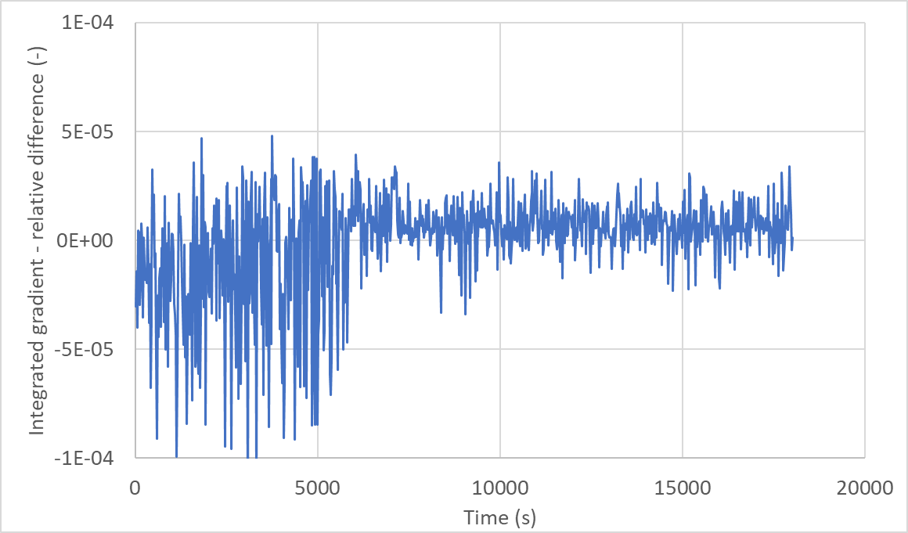
Results – MQXFB02
Plateau of 5 h measured with stretched wire
Abnormal noise affecting the measurements during the first 2 hours

Slide 9
Investigation on the noise source
Differential voltages measured on the magnet coils
No abnormal noise.
Noise from an external source.

Slide 10
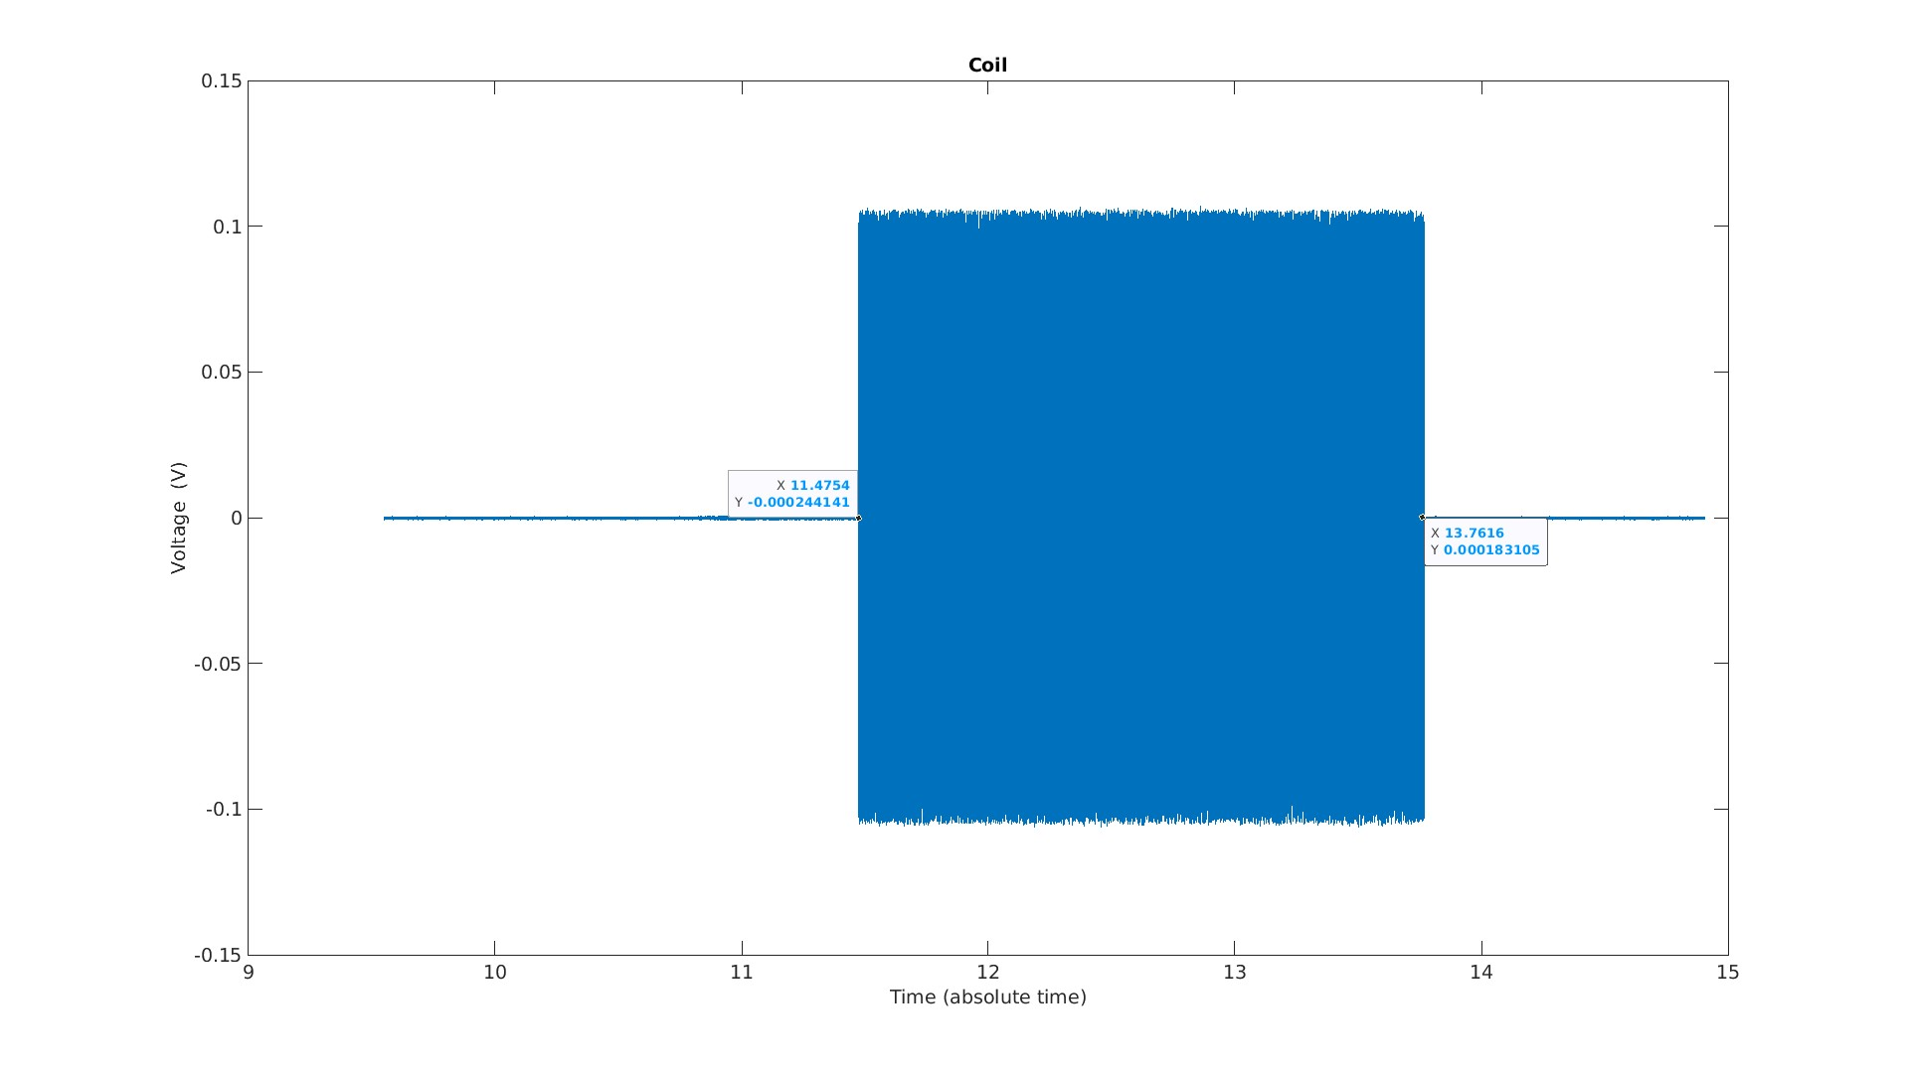
Investigation on the noise source
Acquisition from a pickup-coil near the test bench
Magnetic measurement systems, power converters, cryogenic systems are excluded as source

Slide 11
Conclusions
Stability of integral field at flat-top
  A set of magnetic measurements has been performed on full-length magnets
  Measured stability within ±0.5 10⁻⁵ on a plateau of 1 hour
  Limited by the measurement precision
  Noise from an external source affects the measurements with longer duration, investigations are ongoing
  Other tests with stretch wire will be performed on the next magnets

Slide 12
Thank you

