Slide 1
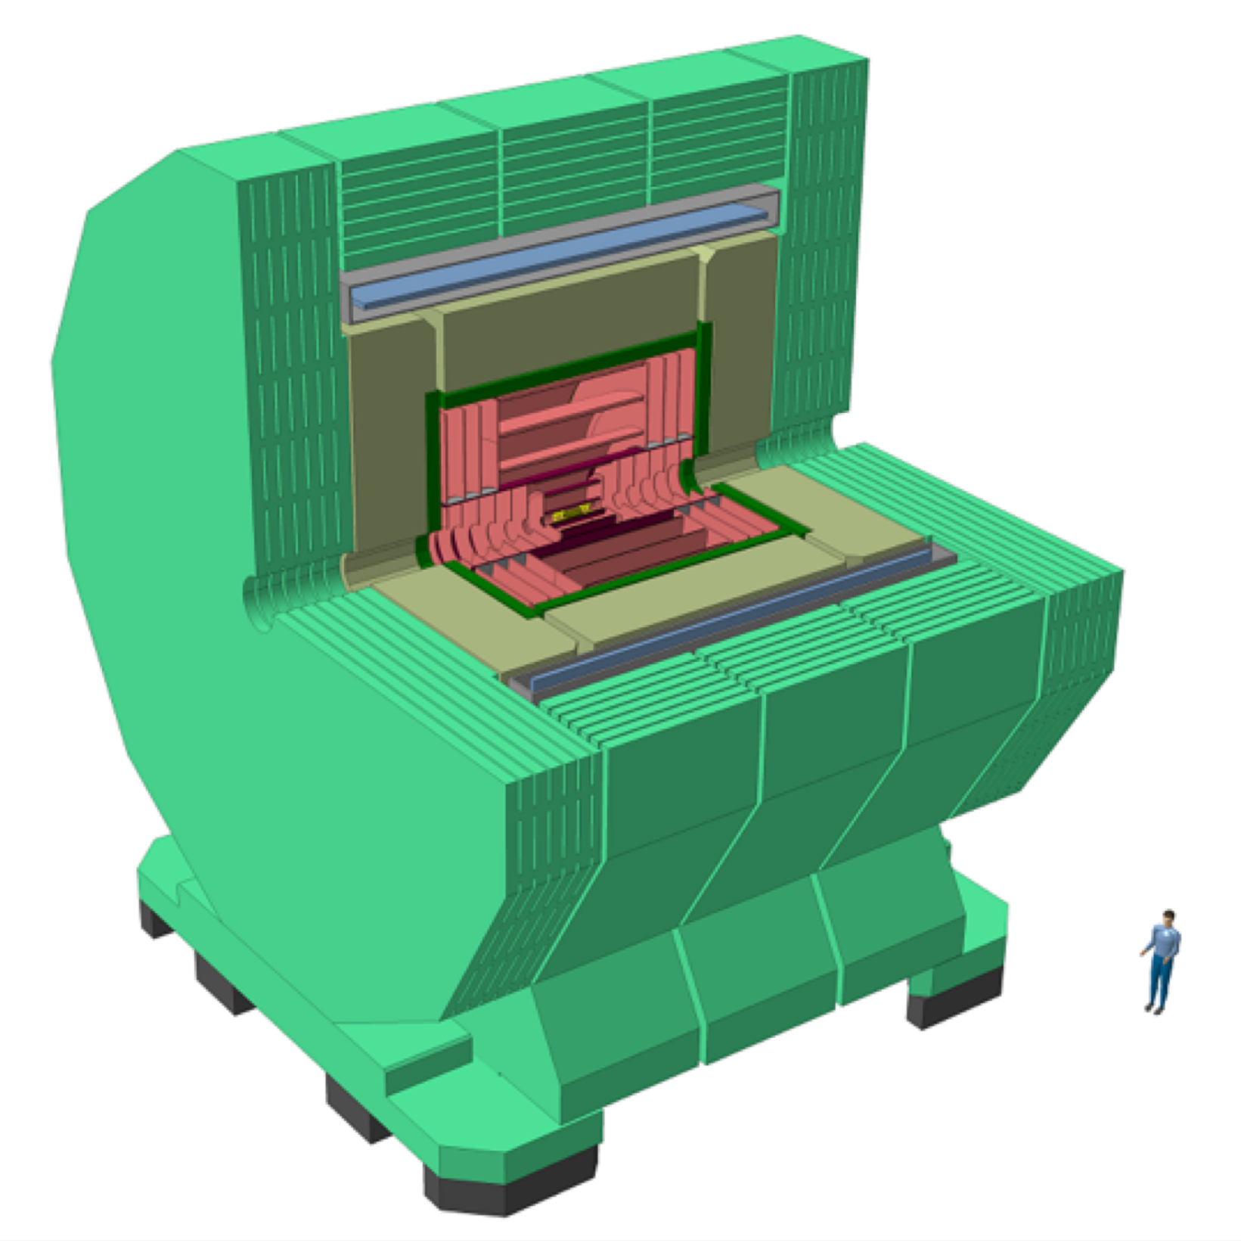

Shielding of FCC CLD fringe field:
a few initial thoughts
M. Buzio, M. Pentella TE-MSC

Slide 2
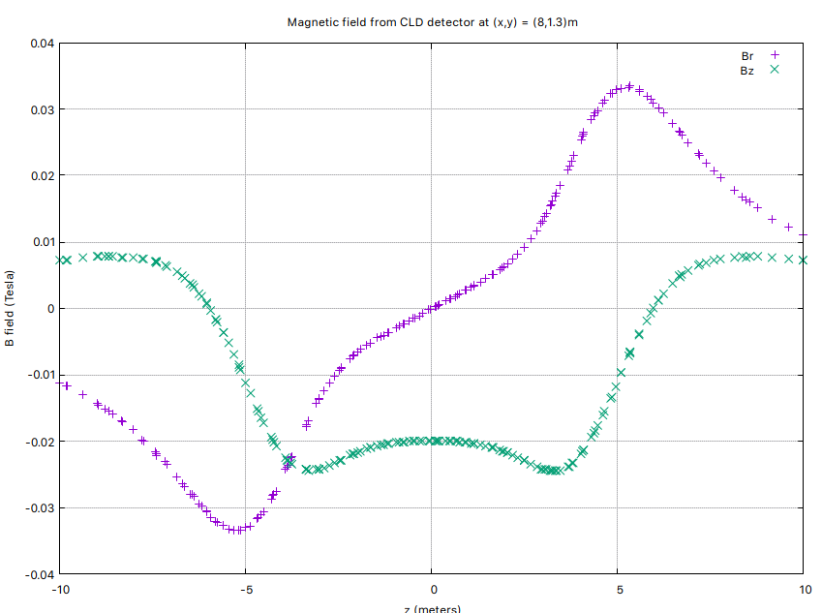
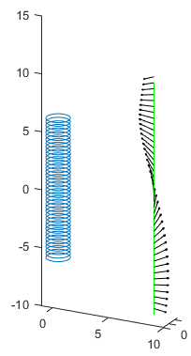

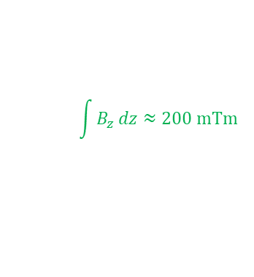
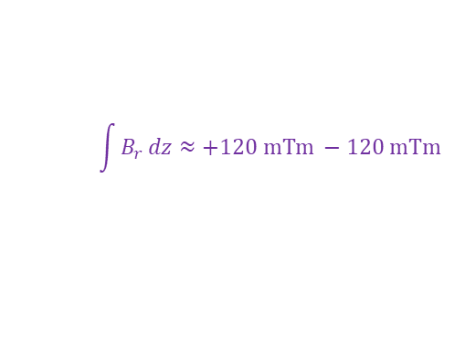
Fringe field of CLD solenoid at booster beam line
y
Ø50 mm
$$\int{B_{r}}dz≈+120 mTm −120 mTm$$
1.3 m
x
8.0 m
z
20 m
$$\int{B_{z}}dz≈200 mTm$$
x
$$\left\|B\right\| ≤35 mT$$
A few questions:
Definition of B_{r} (modulus of component transverse to booster beam line ?)
Must we cancel out B_{r} on average, or everywhere ? Down to what level ?
Must we shield also B_{z} ?
Length of booster beam line to shield ?
Qualitative Biot-Savart model

Slide 3
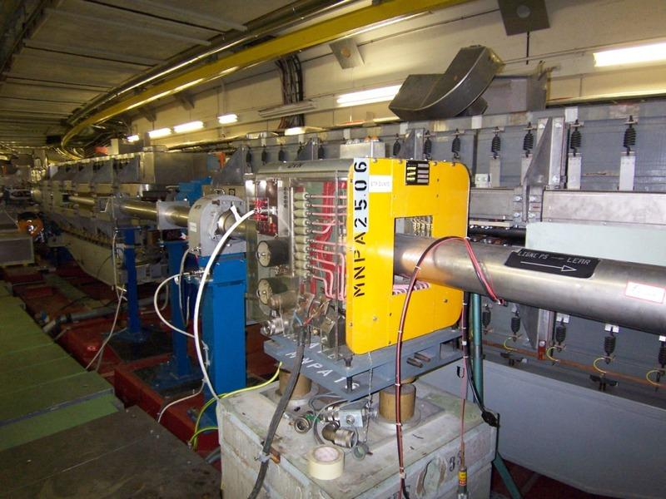
Mitigation of fringe field effects – an aide-memoire
Increase size of source magnet iron yoke (very costly ! And probably it is already optimized….)
Passive ferromagnetic shields: see next slides
- massive shield between magnet and beam line
- thin shell around beam line
Passive superconducting shields (SuShi-style): complexity, cost …
Active shielding:
- counter solenoids (like in MRI magnets): best results, costly, require full redesign
- distributed compensation coils at beam line see next slides
Classic correction with lumped magnetic elements
MNPA25-04 SPS corrector 200 mTm @ 600 A

Slide 4
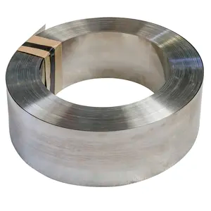
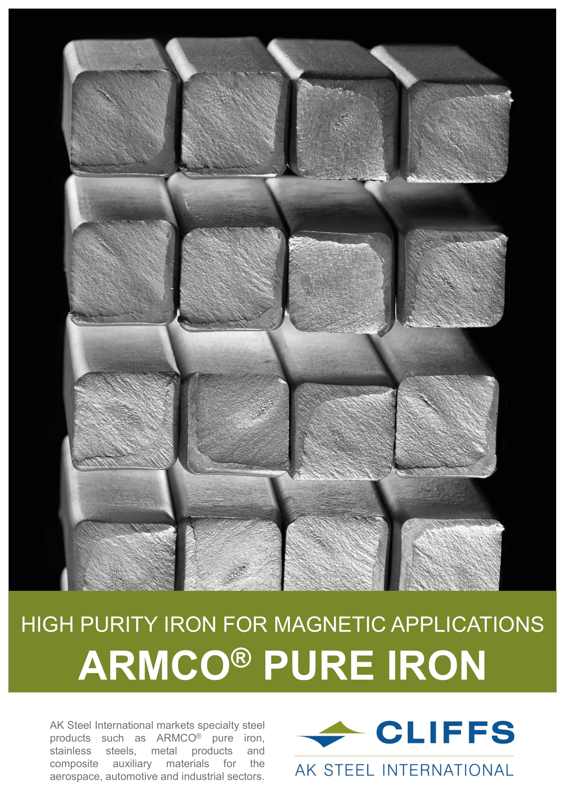
Choice of ferromagnetic shielding material for B=35 mT, H=28 kA/m
Extrapolated values
(current RT test limit 24 kA/m)
Supermendur Co50Fe48Ni1 μ_{r} ≈ 71
(tape 180 USD/kg on Alibaba)
ARMCO pure iron μ_{r} ≈ 57
(sheet 4 CHF/kg in CERN stores)
28 kA/m

Slide 5
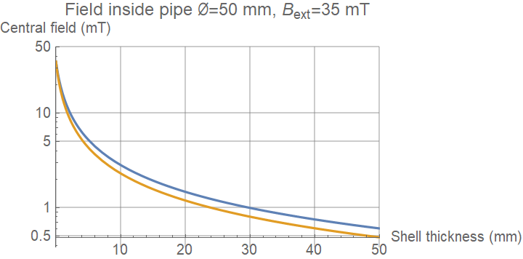
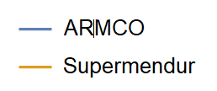

Thin, single-layer cylindrical ferromagnetic shield – transverse field attenuation
10 mm of Permendur → attenuation factor ≈ 15
Multi-layer shields (external shells with higher permability) commonly used
$$\frac{B_{ext}}{B_{int}}≈1+μ_{r}\frac{t}{∅}$$
t
Ø

Slide 6
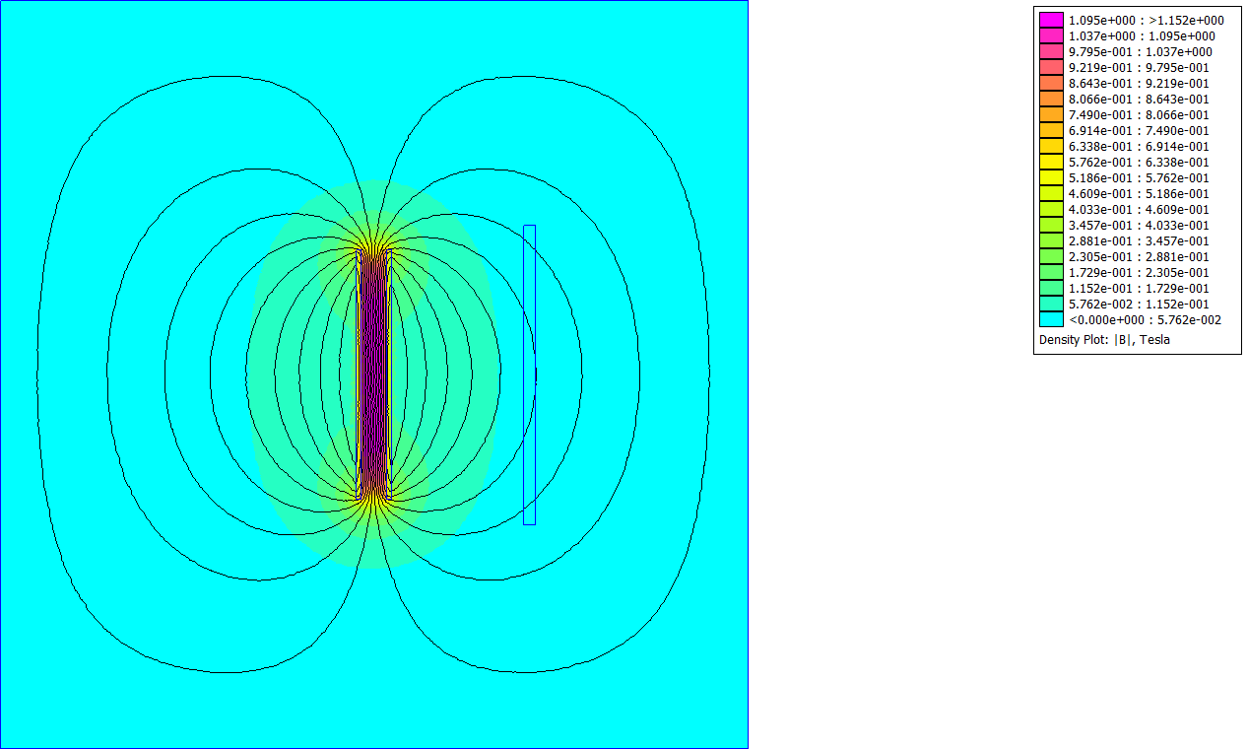
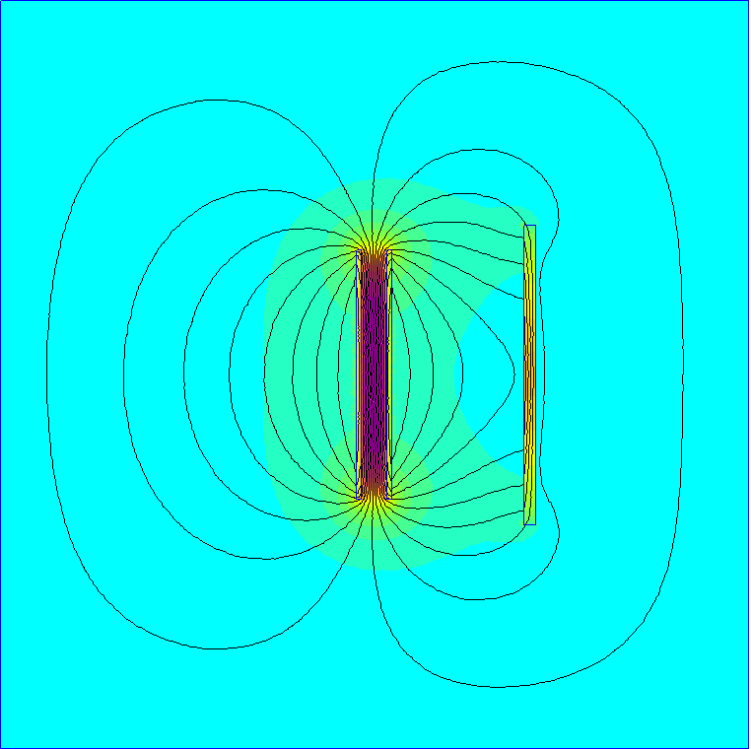
Massive iron shield between CDS solenoid and booster beam line
Example 2D calculation: yokeless solenoid B₀=1.16 T
Unshielded fringe field along booster beam line (A-B) 26∼37 mT
0.5 m thick solid ARMCO shield, µ_{r}=50
Shielded field 13∼20 mT, mean attenuation factor ≈ 2.8
Some field distortion to be expected
end regions (even with iron yoke)
z
z
B
B
A
x
A
B
A
x
0.5 m ARMCO steel

Slide 7


Active shielding – compensation coils
Longitudinal component B_{z} = 20 mT
Solenoidal winding →
(e.g. ∼8 mm² of air-cooled Cu/longitudinal mm)
Transverse component B_{r}=35 mT:
If local shielding needed in each half beam pipe →
(e.g. 440 mm² of water-cooled Cu on either side)
(Possible alternatives: SC windings, permanent magnets)
$$\frac{N_{t}I}{L}=\frac{B_{z}}{μ_{0}}≈16 A/mm$$
+I
$$I=\frac{{π Ø B}_{r}}{μ_{0}}≈4400 A$$
+I
-I
-I
+I

Slide 8
Preliminary conclusions
Shielding a 35 mT stray field is not entirely trivial ….
Passive shielding at source generally much more costly/impactful than shielding at target
Passive shielding with ferromagnetic material around beam pipe: looks feasible,
available clearance should be checked
Passive shielding with bulk superconductor (SuShi style): absolutely best performance, at a cost …
Active local compensation also seems feasible
Classic integral lumped correction: probably the simplest solution
Requirements and mechanical constraints to be detailed, for a reasonable choice to be made

