Slide 1


CENTRE NATIONAL
DE LA RECHERCHE
SCIENTIFIQUE
Dust charging and dust-surface interaction in the laboratory
Cécile Arnas
Laboratory of Physics of Ions-Molecules Interaction (PIIM)
CNRS, Aix-Marseille university, 13013 Marseille, France
Workshop on Dust Charging and Beam-Dust Interaction in Particle Accelerators, CERN (13-15 June 2023)

Slide 2
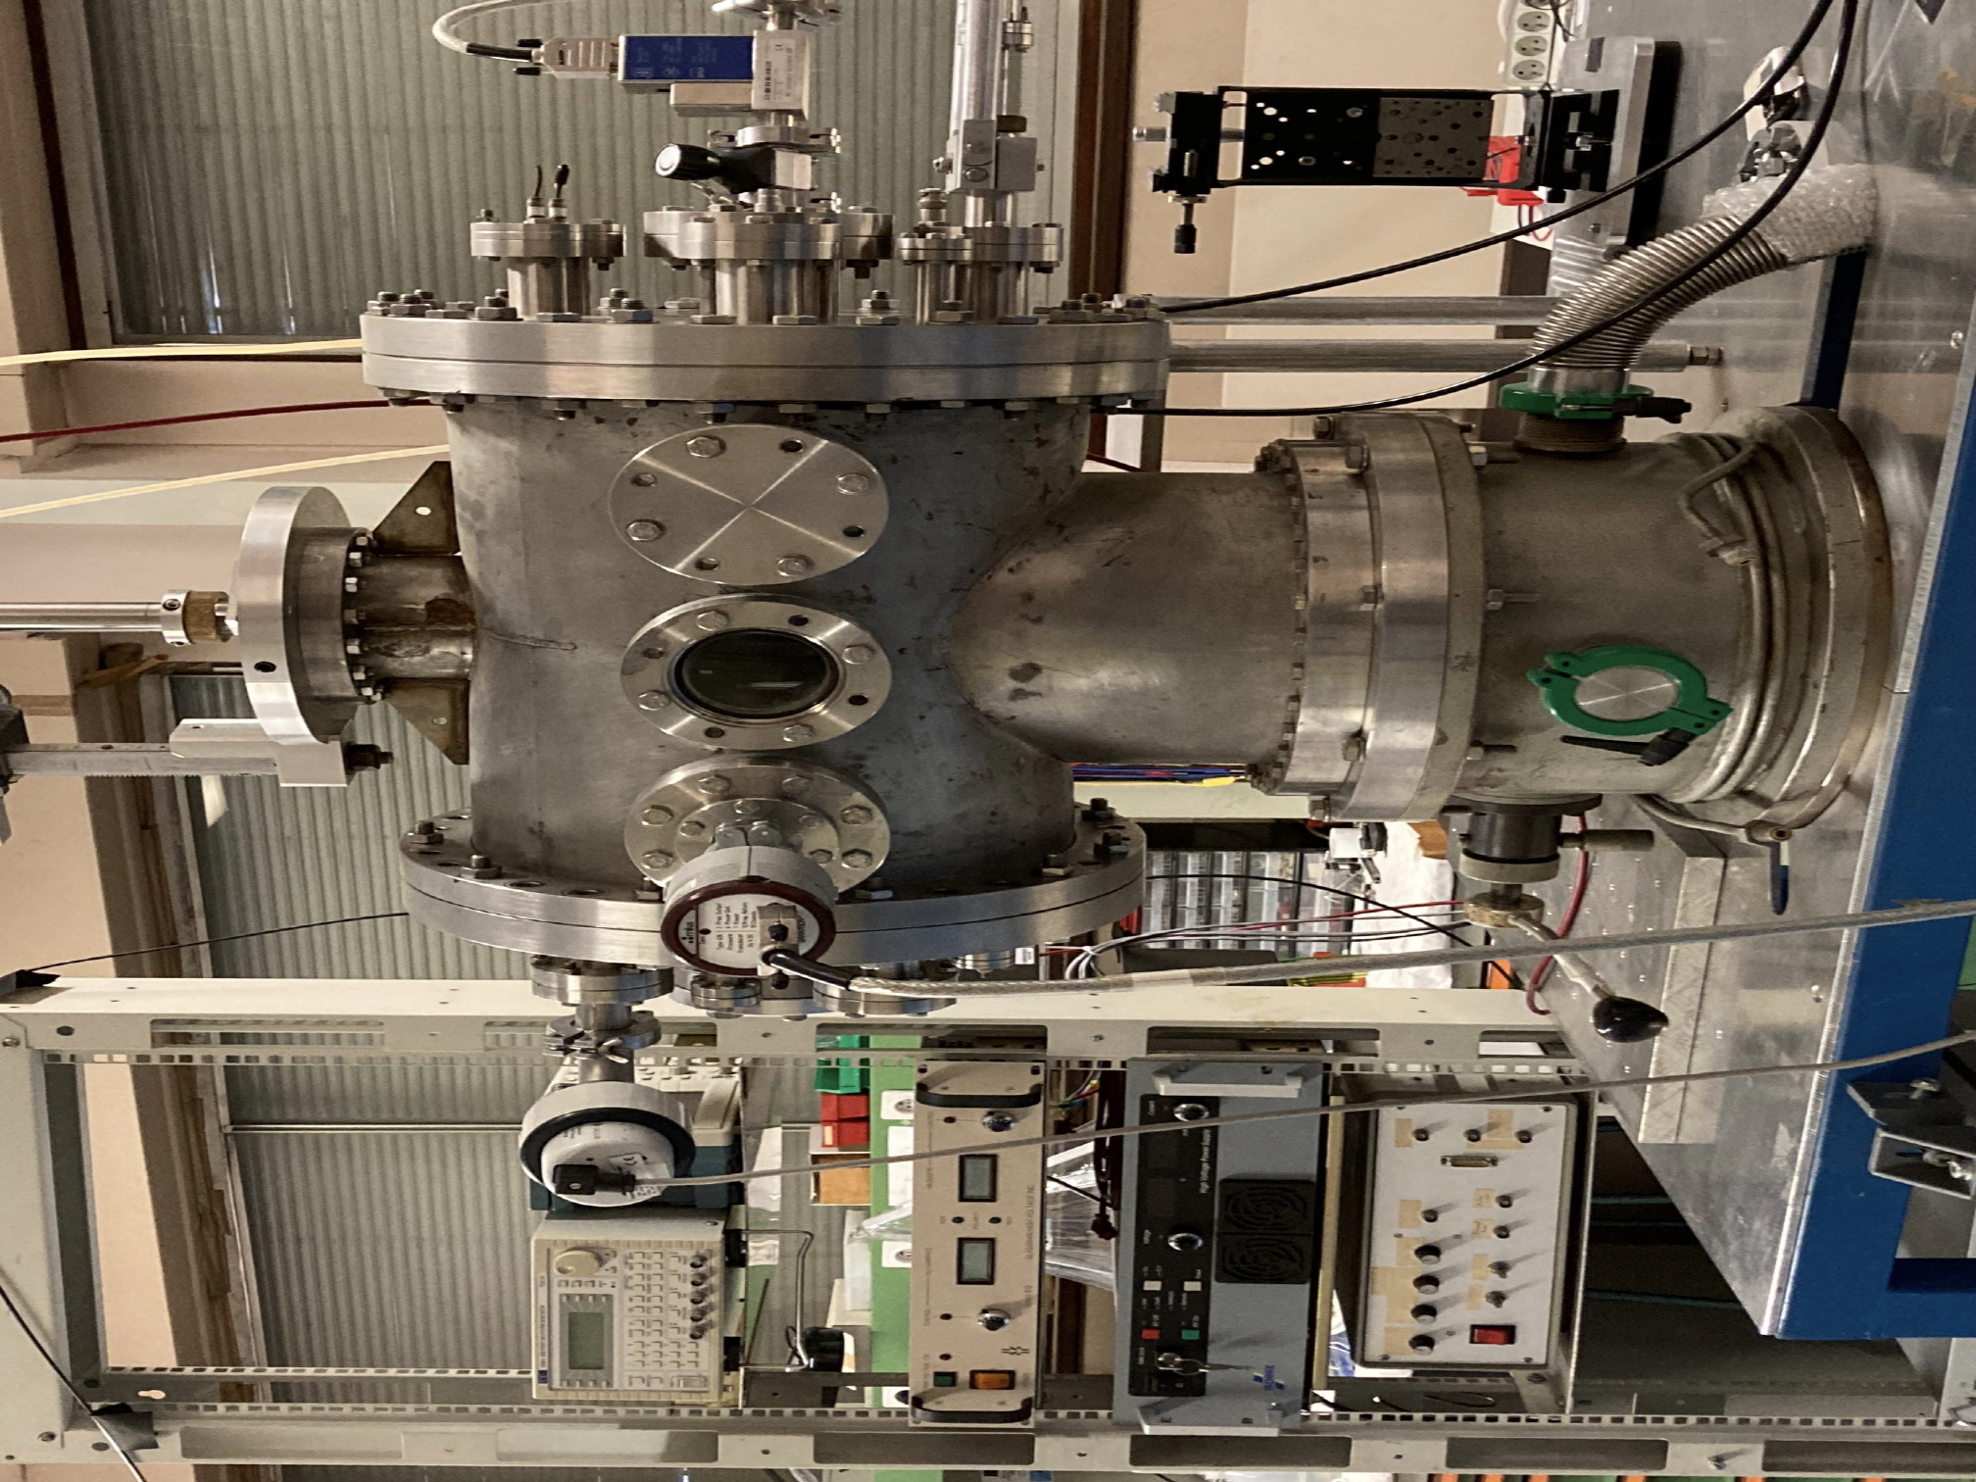
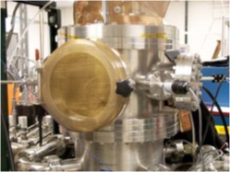
Discharge chambers for dust-
nanoparticle production
40 cm
Base vacuum: from 10⁻⁵ Pa to 10⁻⁴ Pa
Plasmas (gas): 10 - 100 Pa
2

Slide 3
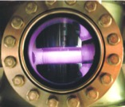
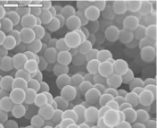
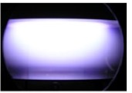
Discharges between electrodes in reactive gases
98% Ar plasmas mixed with 2% methane
carbonaceous
nanoparticles
≃ 200 nm
Ar plasma with sputtered atoms
W nanoparticles
≃ 25 nm

Slide 4
Outline
Nanoparticles produced from cathode sputtering in DC discharges
    Size evolution, density, internal structure (indication on growth mechanisms)
    Modification of the discharge parameters during negative charging
    Modeling of charging mechanisms
    Transport inside the plasma

Slide 5
Standard model of formation
Molecular (ion, neutral) precursors
    Nanoparticles
t
t
Specific collisions/reactions
(complex plasma chemistry)
Nucleation
(nuclei of 1-4 nm)
Agglomeration
Molecular sticking

Slide 6
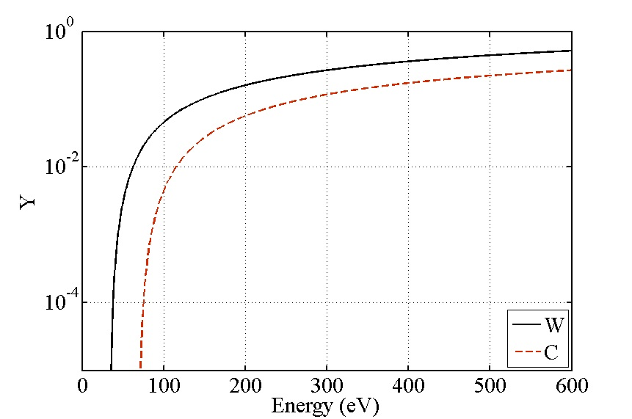
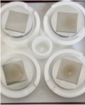
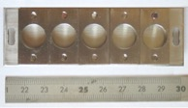
    Nanoparticle growth in sputtering DC discharges
Ar (30-60 Pa)
Ar⁺ accelerated in the
cathode sheath
Cathode sputtering with energetic Ar⁺
Cathode
sputtering threshold (Ar/C) ~ 70 eV
sputtering threshold (Ar/W) ~ 34 eV
Dust substrates
10⁰
10⁻²
10⁻⁴
W
10 s
25 s
C
Substrate holder
Sputtering Yield
0 100 200 300 400 500 E (eV)
100 s
50 s

Slide 7
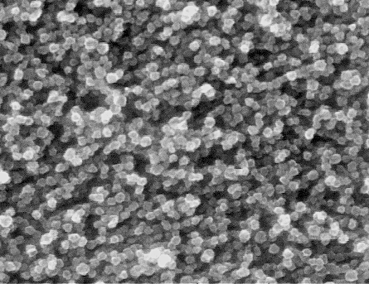
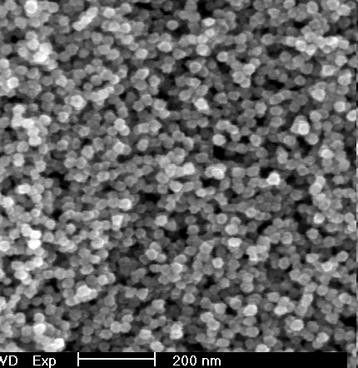
Size increase vs plasma duration
45 s
Carbon nanoparticles
Tungsten nanoparticles
200 nm
60 s
Agglomeration
Molecular sticking
Plasma duration (s)
Flux of sputtered atoms:
Γ_{C} ~ Γ_{W} ~ 10¹⁸ m⁻²s⁻¹
200 nm
200 nm
SEM images

Slide 8
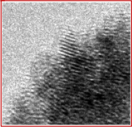
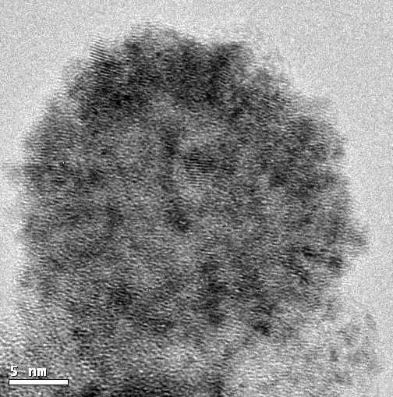
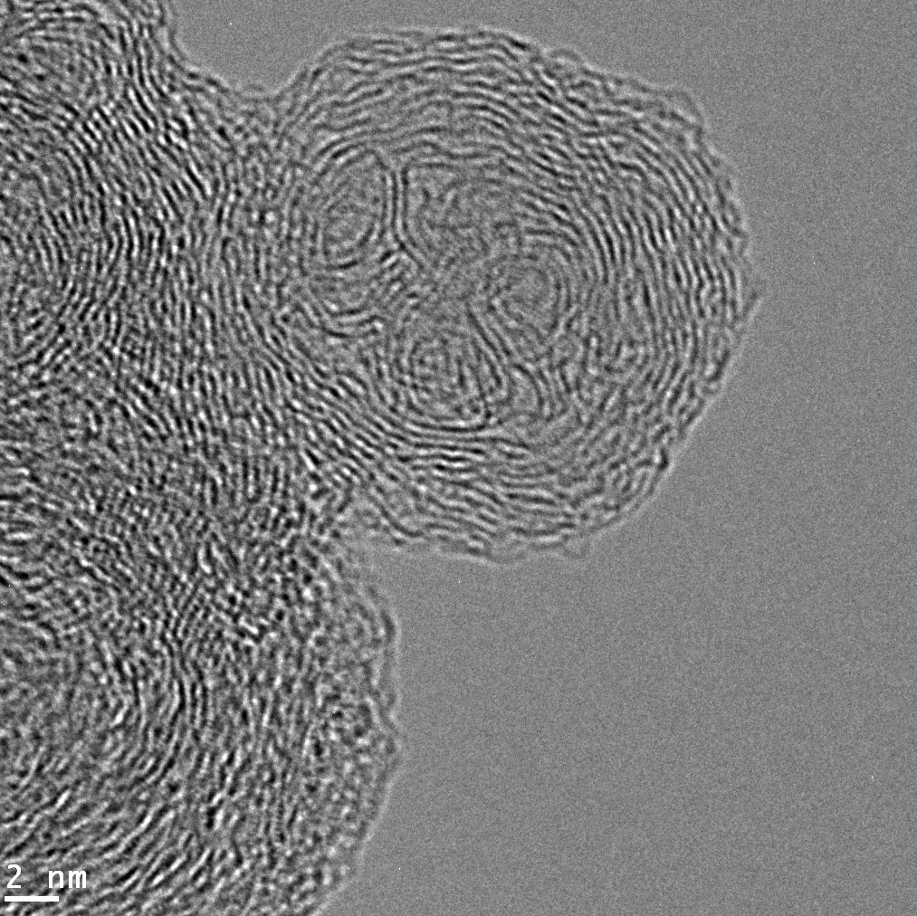
Growth by agglomeration and deposition
TEM-HR image
60 s
Tungsten crystallites
(nuclei) of 2-3 nm
Tungsten nanoparticle ~ 28 nm
Carbon nanoparticle ~ 25 nm
Nuclei of ~ 3 nm
Carbon sticking around

Slide 9
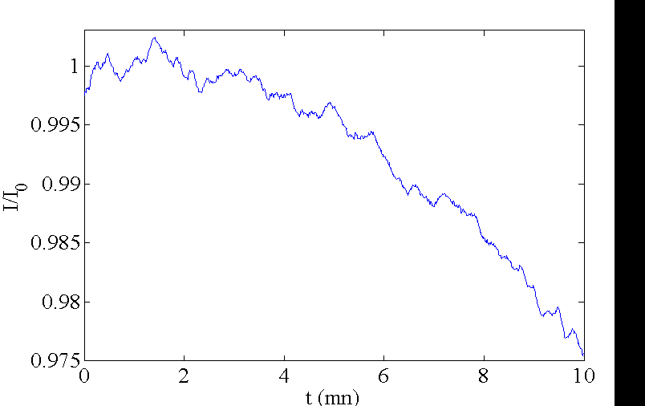

Nanoparticle density
PM
Carbon nanoparticles:
I₀
L
I
Spectrometer
Laser
0.53 μm
I/I₀
2a ~ 55 nm
t = 600 s
Beer-Lambert law:
$$I/I_{0}= exp⁡(−πa^{2}C_{ext}n_{d}L)$$
Plasma duration (min)
Extinction coeficient: C_{ext} = C_{abs}+ C_{scat} and x = 2πa/λ₀ < 0.3
m = complex refractive index of carbon nanoparticle
m = 1.3 + i 0.08
n_{NP} ~ 2 10⁸ cm⁻³

Slide 10
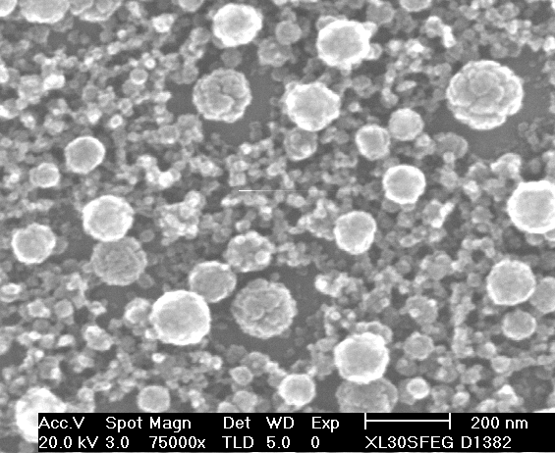
Nanoparticle-plasma coupling
Charging of carbon nanoparticles
to the detriment of discharge/plasma
Three discharges parameters : P_{Ar} = 60 Pa, I_{d} = 70 mA,
V_{d} : self-regulated parameter (control the ionization)
No sputtering: P_{Ar ,} I_{d} , V_{d} are cte
With sputtering and NPs production:
Compensation of the electron loss by the increase of V_{d}
decrease of V_{d} due to the loss of a part of NPs on the anode
Increase again due to the appearance of a new NP generation
Plasma duration (s)

Slide 11








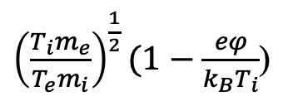
Charge of an isolated spherical dust particle
Maxwellian e⁻ and ions: T_{e} < 5 eV and T_{e} >> T_{i} ~ T_{g}
i
e
Dust charge$(vacuum approximation):$
$Q=Cφ≈4πε_{0}aφ$ = Ze
Looking for 𝜑, the floating potential :
$J_{i}\left(φ\right)−J_{e}\left(φ\right)$= 0
a
higher mobility of e⁻ : $φ<0$
Orbital Motion Limited model (OML):
$b_{coll}^{2}=a^{2}$($1−\frac{eφ}{k_{B}T_{i}} )$
Ion current :
$I_{i}={\frac{1}{4}πa}^{2}{en}_{0}v_{i}$($1−\frac{eφ}{k_{B}T_{i}})$
${\left(\frac{T_{i}m_{e}}{T_{e}m_{i}}\right)}^{\frac{1}{2}}(1−\frac{eφ}{k_{B}T_{i}}$)
exp($\frac{eφ}{k_{B}T_{e}})=$
From Boltzman law:
Electron current :
$I_{e}=−{\frac{1}{4}πa}^{2}{en}_{0}v_{e}$ exp($\frac{eφ}{k_{B}T_{e}})$

Slide 12

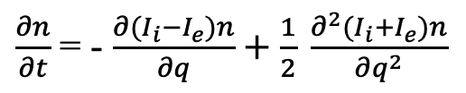
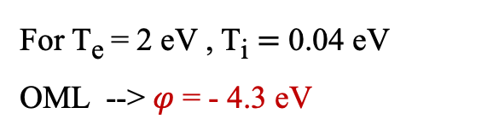
Charge during the agglomeration phase
For T_{e} = 2 eV , T_{i} $=$ 0.04 eV
OML --> $φ$= - 4.3 eV
OML cannot explain agglomeration (Coulomb repulsion)
Consider charge fluctuations --> nuclei can be briefly neutrals,
positively charged
a ~ 2-3 nm: Z ~ 6e⁻ - 9e⁻
Charge distribution (T. Matsoukas et al, J. Appl. Phys.,1995)
n_{q} : fraction of nanoparticles carrying the charge q
$\frac{∂n_{q}}{∂t}$ = $I_{i}\left(q−1\right)n_{q−1}+I_{e}\left(q+1\right)n_{q+1}−{\left[I_{e}\left(q\right)+I_{i}(q)\right]n}_{q}$
a = 14 nm: Z ~ 42 e⁻
Transformed to a partial differentiel equation:
$\frac{∂n}{∂t}$ = - $\frac{∂(I_{i}−I_{e})n}{∂q}+\frac{1}{2} \frac{∂^{2}(I_{i}+I_{e})n}{∂q^{2}}$

Slide 13
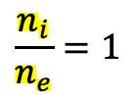
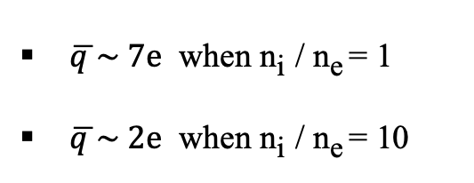
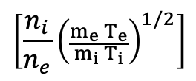

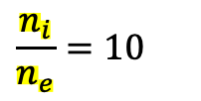
Charge during the agglomeration phase
Gaussian charge distribution: n(q) = $\frac{1}{ σ\sqrt{2π}}\exp\left(−\frac{\left(q−\overline{q }\right)2}{2σ^{2}}\right)$
Average charge: $\overline{q }$= k $\frac{4πε_{0}aT_{e}}{e^{2}}$
$$\left[\frac{n_{i}}{n_{e}}{\left(\frac{m_{e}{ T}_{e}}{m_{i}{ T}_{i}}\right)}^{1/2}\right]$$
Ln
$$\frac{n_{i}}{n_{e}}=1$$
$$\frac{n_{i}}{n_{e}}=10$$
$\overline{q }\sim 7e$ when n_{i} / n_{e} = 1
$\overline{q }\sim 2e$ when n_{i} / n_{e} = 10
1.0
0.6
Explains the nanoparticle growth by agglomeration of nuclei at the condition of n_{e} depletion
→ charging to the detriment of plasma electrons
0.2
Charge
T. Matsoukas et al , J. Appl. Phys. 77, 1995

Slide 14
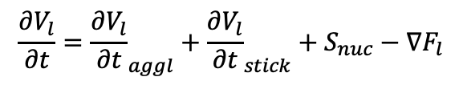
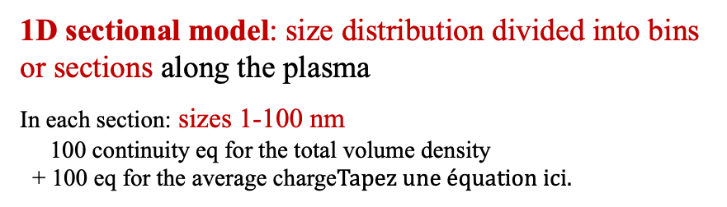
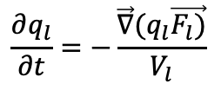
Modelling of the growth and charge evolution
3 coupled numerical modules*: argon DC discharge – molecular ions formation – NP evolution
1D sectional model: size distribution divided into bins
or sections along the plasma
In each section: sizes 1-100 nm
100 continuity eq for the total volume density
+ 100 eq for the average charge
Nucleation
Transport
Growth by sticking
Growth by agglomeration
Carbon NPs
sticking
NP volume balance in each section
$$\frac{∂V_{l}}{∂t}={\frac{∂V_{l}}{∂t}}_{aggl}+{\frac{∂V_{l}}{∂t}}_{stick}+S_{nuc}−∇F_{l}$$
q₃
q₄
q₂
q₁
size
Averaged NP charge of each section:
nucleation
agglomeration
$$\frac{∂q_{l}}{∂t}=−\frac{\vec{∇}(q_{l}\vec{F_{l})}}{V_{l}}$$
Gaussian charge distribution : smallest NPs can be neutral or > 0
Cathode
Anode
*A. Michau, K. Hassouni et al, Plasma Chem. Plasma Process. 32 (2012); J. Appl. Phys. 121 (2017)

Slide 15
Size evolution during the charging mechanism
NP density cm⁻³
n_{e} (cm³)
0 20 40 60 80 100
Sizes (nm)
0 2 4 6 8 10 12 13
x (cm)
At x ~ 2 cm from the cathode
(position of electric field reversal)
Red curve:
n_{e} calculated self-consistenly through
the coupling of the 3 numerical modules:
coupling of negative molecular ions,
negatively charged nanoparticles and n_{e}
Agglomeration can only occur between
nuclei (neutral, positively charged)
and big nanoparticles (negatively charged)

Slide 16
Outline
Nanoparticles produced from cathode sputtering in DC discharges
    Size evolution, internal structure (indications on formation), density
    Modification of the discharge parameters at large density
    Modeling of charging mechanisms (agglomeration)
    Transport inside the plasma

Slide 17
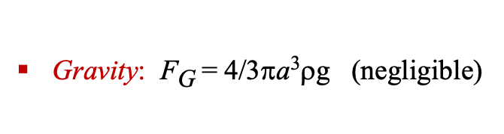
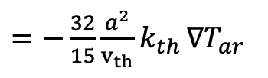
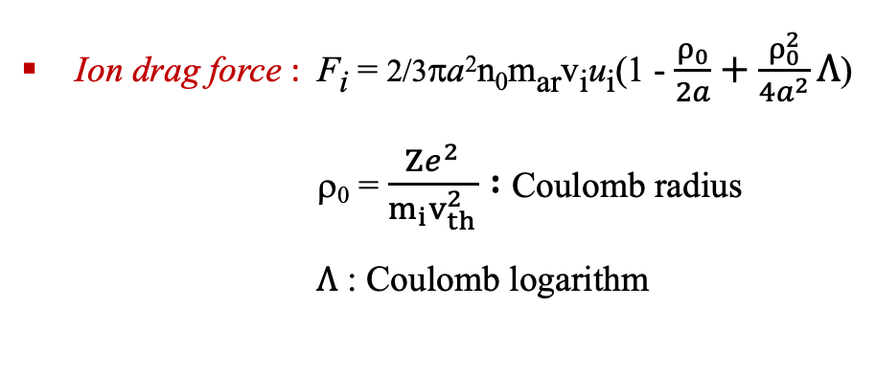
Applied forces on an isolated spherical nanoparticle
Electric force : F_{e} = ZeE (E = - ∇V_{p} where Vp: plasma potential)
Ion drag force : F_{i} = 2/3πa²n₀m_{ar}v_{i}u_{i}(1 - $\frac{ρ_{0}}{2a}+\frac{ρ_{0}^{2}}{4a^{2}}Λ$)
ρ₀ = $\frac{Ze^{2}}{m_{i}v_{th}^{2}} :$ Coulomb radius
$Λ$ : Coulomb logarithm
F_{i}
F_{e}
F_{th}
F_{G}
Thermophoretic force : F_{th}
$=−\frac{32}{15}\frac{a^{2}}{v_{th}}k_{th }∇T_{ar}$
Gravity: F_{G} = 4/3πa³ρg (negligible)

Slide 18
Sputtering DC magnetron discharges
Tungstène cathode (sputtering)
P_{ar} = 30 Pa, I_{d} = 0.3 A (V_{d} ~ 200 V)

Slide 19
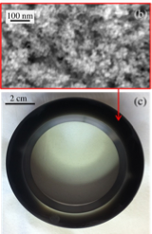
W nanoparticles produced in magnetron discharges
a ~ 5 nm
Tungstène cathode (sputtering)
P_{ar} = 30 Pa, I_{d} = 0.3 A (V_{d} ~ 200 V)
(10 successive plasmas of 200s)
Guard ring
a ~ 15 nm
NP substrate

Slide 20
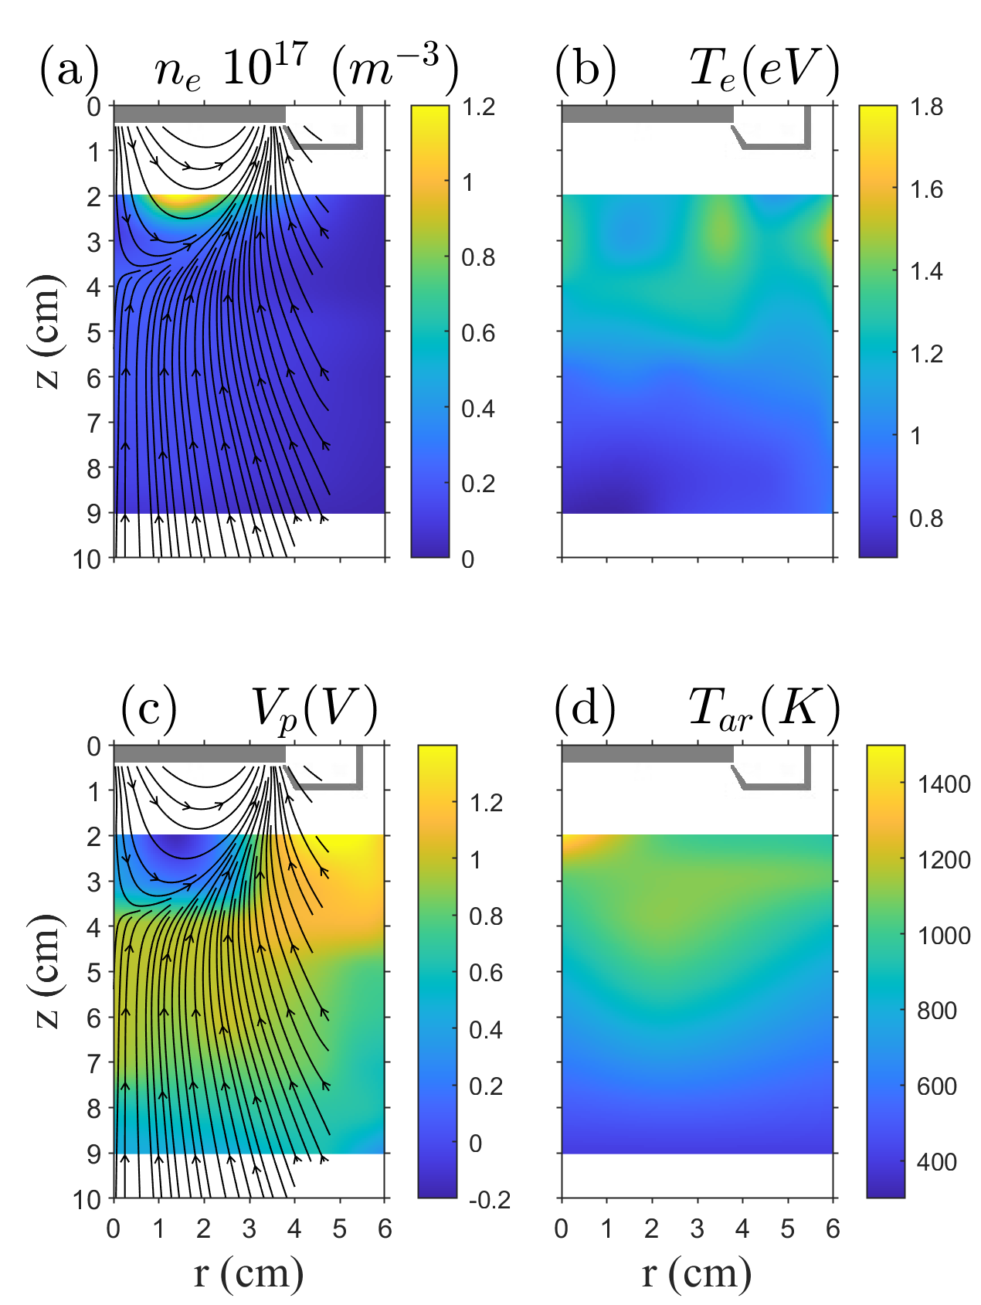
2D plasma parameters measurements
n_{e}, T_{e}, V_{P} : Langmuir probe measurements
T_{ar}: measurement byLIF
OML model; a = 5 nm
n_{e} : maximum inside magnetic arches
T_{e} : inverse variation of n_{e}
V_{P} : increase inside magnetic arches
max after the last magnetic arch
T_{ar} : Ar heating due to collisions
with sputtered atoms of <E> ~ 12 eV

Slide 21
Force balance
F_{e} + F_{th} + F_{i} =0
negligible
a ~ 5 nm
Upper part:
F_{e} and F_{th} : same range of values
nanoparticles under the guard ring
are pushed to the the guard ring
near the axis: pushed outside magnetic arches and downwards
Lower part:
F_{th} is dominant: pushed down
Guard ring

Slide 22
Force balance
F_{e} + F_{th} + F_{i} =0
negligible
a ~ 5 nm
Upper part:
F_{e} and F_{th} : same range of values
nanoparticles under the guard ring
are pushed to the the guard ring
near the axis: pushed outside magnetic arches and downwards
Lower part:
F_{th} is dominant: pushed down
Guard ring
When NPs are transported down they have
more “space, time” to grow than NPs near
the guard ring

Slide 23
Summary
Nanoparticles produced from cathode sputtering in DC discharges
    Size evolution, density, internal structure (growth by agglomeration, sticking)
    Modification of the discharge parameters due to their negative charge
    Various modeling of charging mechanisms (+ fluctuations) and growth
    Applied forces for their transport in the plasma

Slide 24
Additional slides
NP density (cm³)
0 50 100 150 200 250 // 600
t (s)
NP density reaches ~ 10⁸ cm⁻³
also found experimentally

Slide 25
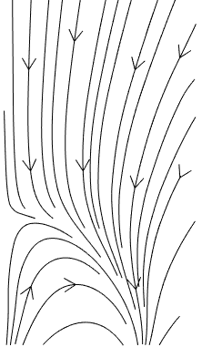
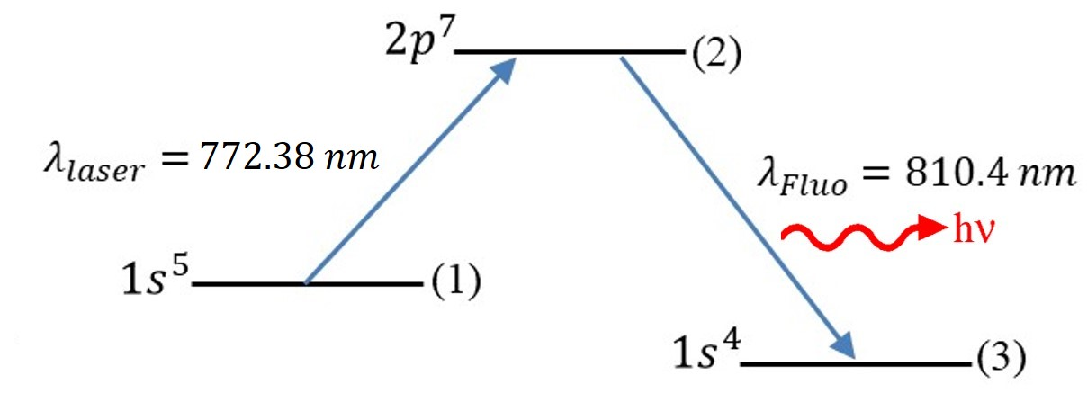
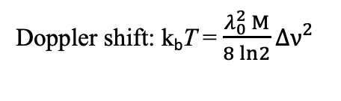
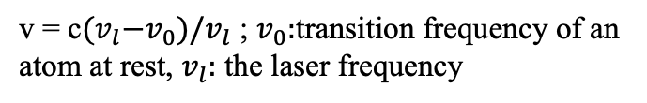
r
Cathode
S
N
S
Cylindrical Langmuir probe
r_{LP} << r_{larmor} for z > 2 cm and probe ⊥ B
(also) v_{de}/v_{the} ≤ 0.32
Classical analyses of probe characteristics
Guard ring
z
NP substrate
Laser Induced Fluorescence (tunable laser diode)
v = c${(v}_{l}−v_{0})/v_{l}$ ; $v_{0}:$transition frequency of an
atom at rest, $v_{l}:$ the laser frequency
Doppler shift: k_{b}T = $\frac{λ_{0}^{2} M}{8 ln2}Δν^{2}$
25

Slide 26
Laser scattering on the dust cloud during the transport of W nanoparticles towards the anode (classical DC discharges)
- V ~ 0.004 cm/s = 14.5 cm/h
-2nd generation appears in the space freed by the 1st generation

Slide 27
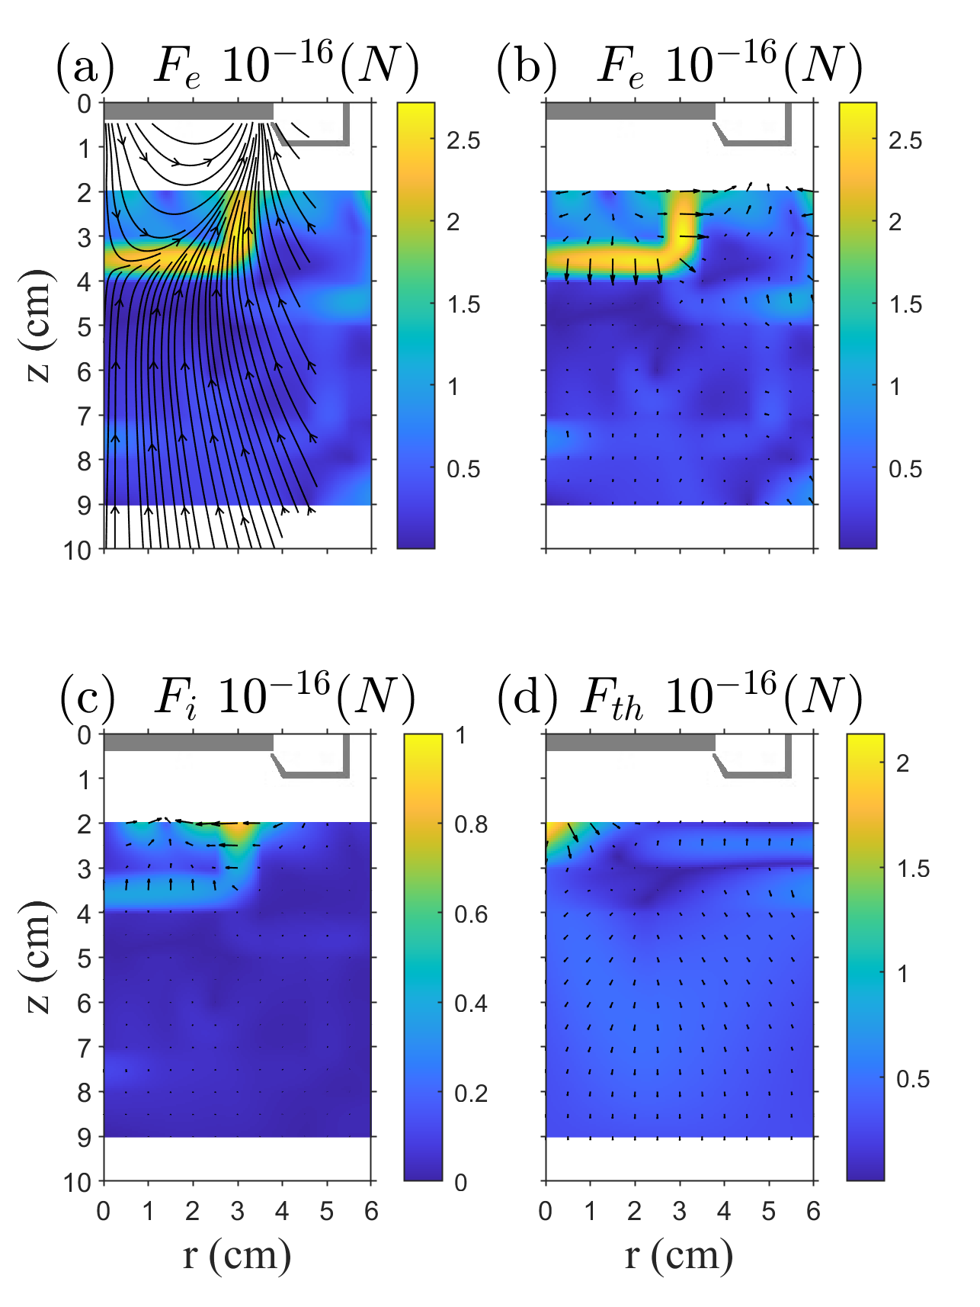

Slide 28
    Analogue of dust particles of ISM, planet satellites
New materials, technologies: superior properties to those of bulk materials
High surface area to volume ratio
Photo-emission wavelength decrease with the size decreases size
Lower melting temperature
Stronger materials
Applications:
Optics: thinner displays, photophores, UV filters
Electronics: nanodevice, single electron emission quantum dots
Energy: hydrogen storage, improvement of solar cell efficiency
Chemical: molecular sensor; catalyst
Medicine: drug carriers, in-vitro imaging, cancer treatment
28

