Slide 1
Conduction cooled demonstrator magnet
Kick-off meeting
April 14th, 2023
Emma Gautheron (CERN TE-MSC-SMT)

Slide 2
Content
Scope of the project
Main challenges
Work packages
Timeline proposal
Organization

Slide 3
Scope of the project

Slide 4
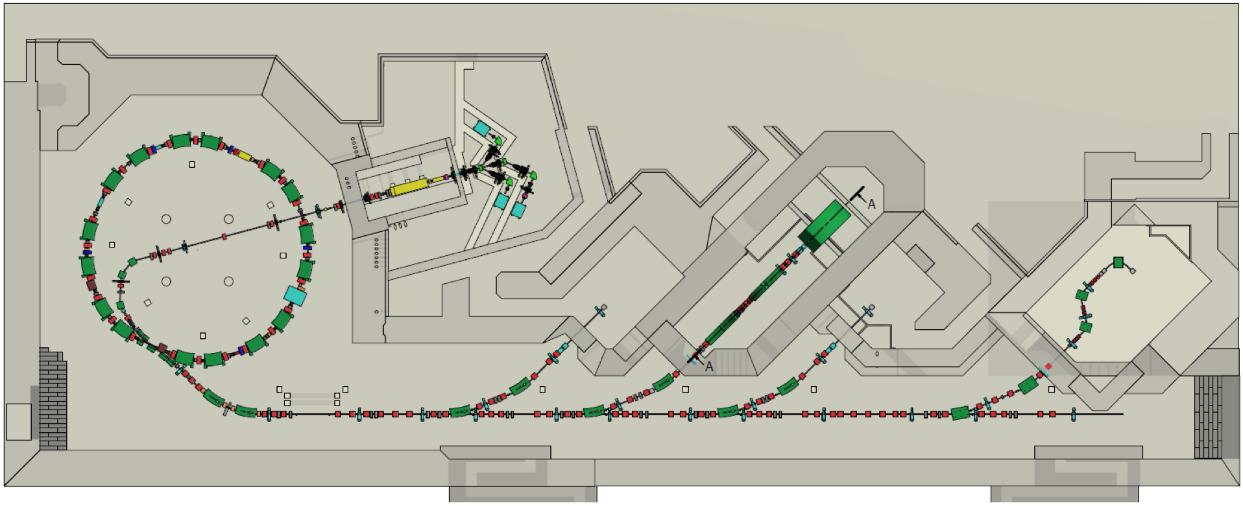
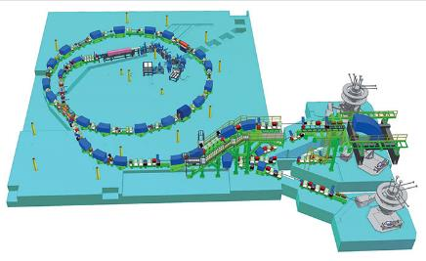
Introduction
Courtesy of Mikko Karppinen
CNAO & MedAUSTRON intend to upgrade their radiotherapy facilities with a superconducting rotating gantry for heavy ion therapy
Since spring 2019 regular meetings between CERN, CNAO, INFN and MedAUSTRON on novel ion gantry concepts
CNAO aims to complete design within the next ~3 years and to install the gantry within the next ~7 years
MedAUSTRON
CNAO
Both based on PIMMS design

Slide 5
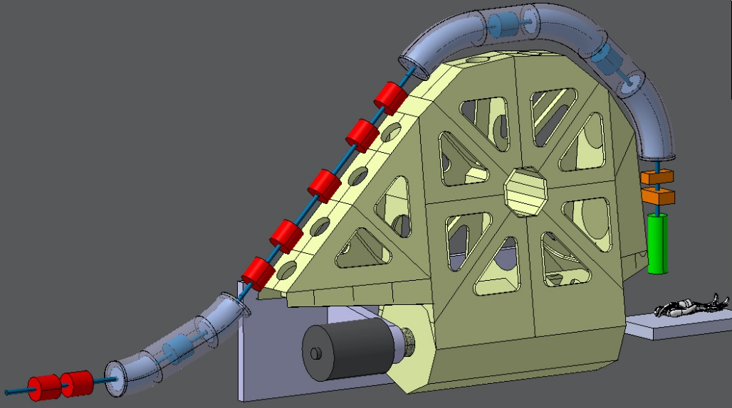
Main Bending Magnets
L. Gentini (CERN)
Reduced complexity of the main magnets for maximum reliability
Final objective of a Full scale 45° Curved Cos-Theta magnet, with optimized cooling integration
Demonstrator magnets to be built as first deliverables:
INFN: Design, build and test a curved 30° demonstrator magnet meeting the gantry specification; performance validated in He bath
CERN: Design, construct and test a ~1-m-long straight conduction cooled demonstrator, ideally with identical X-section to the curved INFN magnet.
Goal < 50 tons
Magnet aperture: ø80 mm
Maximum dipole field: 4 T
Field ramp-rate: 0.4 T/s
Courtesy of Mikko Karppinen

Slide 6
Scope of the project @CERN:
Objective: demonstrate the magnet performance with conduction cooling
Field quality is not a priority; common coil cross section with INFN-LASA.
Compatibility with rotating gantry
Main challenges:
Coils based on cored 36-strand cable using ø0.48 mm LHC strand (not optimized for low loss)
At 0.4 T/s, the heat extraction from the coils is the main challenge and may require specifically developed low-loss conductor for the final magnets
Conduction cooling of current leads requires a high power (low current needed ~2.8 kA)
Thermalisation close to the coils (Collars? Yoke? etc)
Reducing as much as possible the thermal resistance in the assembly

Slide 7
Work packages

Slide 8
Work packages
WP1: Electromagnetic design – Emma Gautheron (TE-MSC)
WP2: Thermo-mechanical design
2a: Cooling features design – Patricia Tavares (TE- CRG)
2b: Thermo-mechanical modelling – Alessandro Bertarelli & Luca Dassa (EN-MME)
WP3: Cryogenic design & assembly – Torsten Koettig (TE- CRG)
WP4: Magnet assembly – Emma Gautheron (TE-MSC)
WP5: Magnet test
5a: Tests in SM18 – Gerard Willering (TE-MSC)
5b: Tests in 165 – Torsten Koettig (TE- CRG)
WP6: Technology development – Emma Gautheron (TE-MSC)

Slide 9
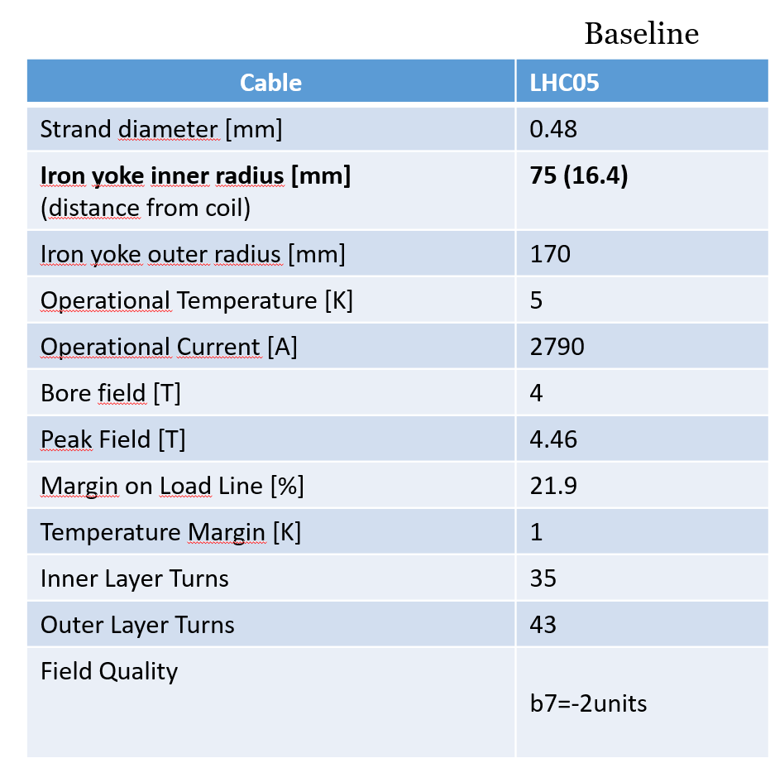
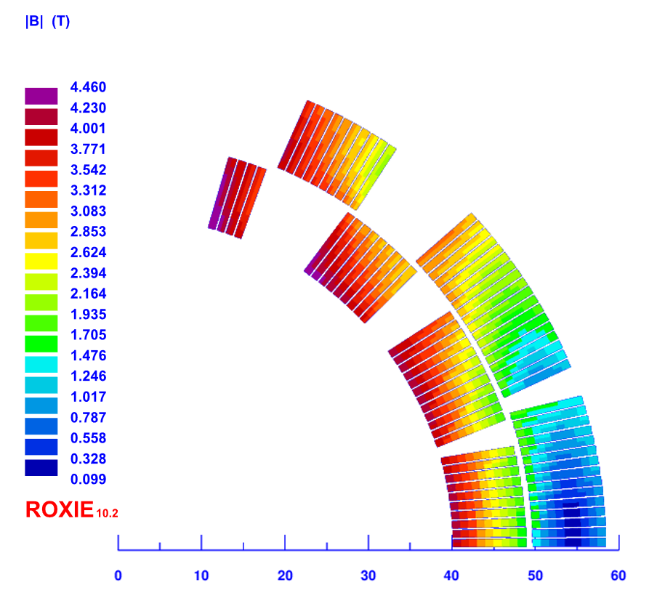
WP1 – Electromagnetic design
°
°
°
Scope:
Electromagnetic design of the magnet (cable choice, coil cross-section, end spacer definition) & 2D, 3D modelling (ROXIE, OPERA)
Associated winding tests
Transient analysis & loss calculations (STEAM-SIGMA)
Quench protection
Status:
Cable selected (LHC cable#4 with additional stainless-steel core)
36 x 0.48 mm diameter strands
Cable dimensions: 8.8 mm x 0.84 mm with 0.91 deg keystone
Common cross-section with INFN-LASA completed
2 layer coil; insulated cable with E-glass; impregnated coil
End spacers design on going
Courtesy of M. Prioli (INFN)

Slide 10
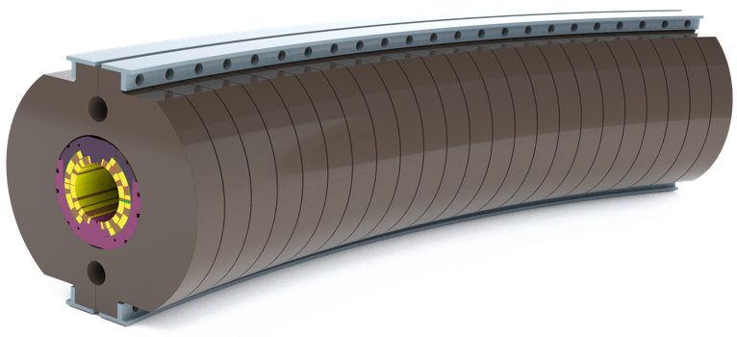
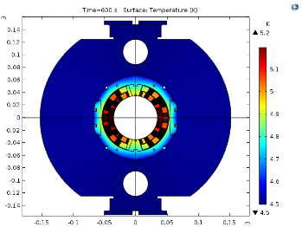
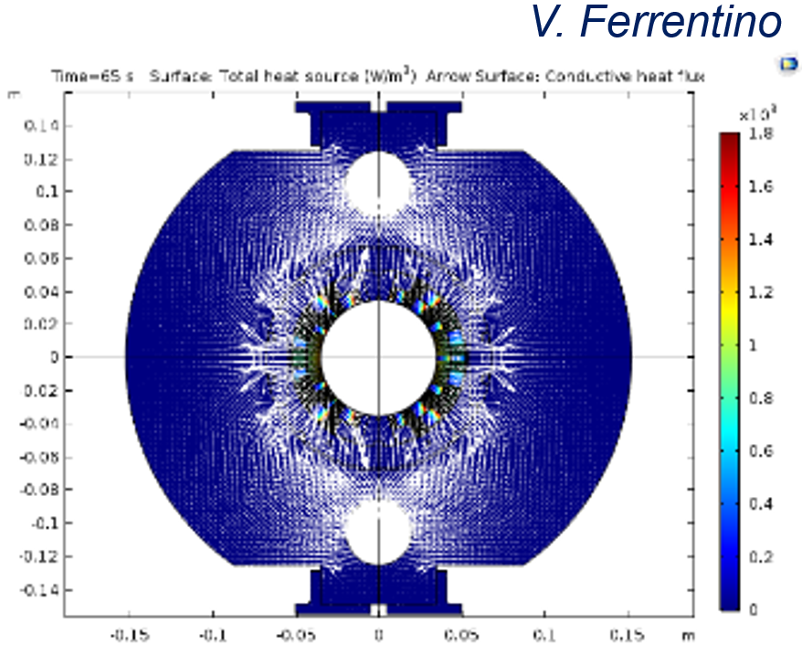
WP2 – Thermo-mechanical design
Scope 2a – Cooling features design:
Design of the cooling features for the different phases of test (using cooling pipes; dry cooling)
Extraction of the heat during cooling down at 4.5 K, ramping and powering of the magnet
Scope 2b – Thermo-mechanical modelling:
Creation of a FE model to support the thermo-mechanical design optimization (including contacts & materials)
Ensure mechanical integrity of the magnet at all stages (coil preloading & assembly, until powering at cold)
Status:
Preliminary design & analysis provided by Mikko Karppinen
First estimation of heat load: 4 W @4.5 K
Brainstorming sessions to start
Ch. Kokkinos
Preliminary design by M. Karppinen
V. Ferrentino

Slide 11
WP3 – Cryogenic system design & assembly
Scope:
Design of the cryogenic system needed to extract the heat from the magnet (cryocooler, etc)
Assembly of the cryogenic system when the magnet will be provided
Status:
Preliminary design option proposals
Discussions to be re-started soon
Two 2-stage cryo-coolers (2 W @4.5K) available at CERN
Sumitomo 9 W prototype?

Slide 12
WP4 – Magnet assembly
Scope:
Fabrication of the cable: Cu, Nb-Ti, with core (Thierry Boutboul)
Coil manufacturing: tooling design & fabrication/procurement; coil winding and impregnation
Components design & fabrication/procurement: cable insulation, assembly tooling, magnet parts
Magnet assembly
Status:
Procurement of the tooling for the cable on going

Slide 13
WP5 – Magnet test
Status:
Development of a test strategy to progressively evolve towards a dry cooling test on going
Proposal so far:
Test in LHe in the diode cryostat (ø500 x 1400 mm)
Test using two-phase flow cooling pipes + 60 K thermal screen
Test using dry cooling only + 60 K thermal shield
Scope 5a – Tests in SM18:
Magnet performance validation with mechanical & magnetic measurements
Test of the magnet for phase 1 & phase 2 (TBD)
Scope 5b – Tests in 165:
Demonstrate the magnet performance with dry cooling
Test of the magnet for phase 2 & phase 3 (TBD)

Slide 14
WP6 – Technology development
Scope:
Development of mock-ups or tests to support the thermo-mechanical design
Let’s be creative!

Slide 15
Timeline

Slide 16
Timeline
Month | 1 | 2 | 3 | 4 | 5 | 6 | 7 | 8 | 9 | 10 | 11 | 12 | 13 | 14 | 15 | 16 | 17 | 18 | 19 | 20 | 21 | 22 | 23 | 24 | 25 | 26 | 27 | 28 | 29 | 30 | Notes
 | Apr | May | Jun | Jul | Aug | Sep | Oct | Nov | Dec | Jan | Feb | Mar | Apr | May | Jun | Jul | Aug | Sep | Oct | Nov | Dec | Jan | Feb | Mar | Apr | May | Jun | Jul | Aug | Sep
 | '23 | '23 | '23 | '23 | '23 | '23 | '23 | '23 | '23 | '24 | '24 | '24 | '24 | '24 | '24 | '24 | '24 | '24 | '24 | '24 | '24 | '25 | '25 | '25 | '25 | '25 | '25 | '25 | '25 | '25
Conceptual Design | EM Design
 |  |  | Thermal FEA
 |  |  |  |  | Structural FEA
Engineering Design |  |  |  |  |  |  | Design optimization
 |  |  |  |  |  |  |  |  | Manufacturing design
 |  |  |  |  |  |  |  |  |  | Tooling design
Procurement |  |  |  |  |  |  |  | Fabrication tooling procurement
 |  |  |  |  |  |  |  |  |  | Magnet components procurement
Magnet Construction |  |  |  |  |  |  |  |  |  |  |  |  |  |  |  | Trial Coil
 |  |  |  |  |  |  |  |  |  |  |  |  |  |  |  |  |  | Mech. Model
 |  |  |  |  |  |  |  |  |  |  |  |  |  |  |  |  |  |  |  | Coil fabrication
 |  |  |  |  |  |  |  |  |  |  |  |  |  |  |  |  |  |  |  |  |  |  | Collaring
 |  |  |  |  |  |  |  |  |  |  |  |  |  |  |  |  |  |  |  |  |  |  |  |  |  | Magnet assembly
Test |  |  |  |  |  |  |  |  |  |  |  |  |  |  |  |  |  |  |  |  |  |  |  |  |  |  |  |  | Cold test
Deliverable |  |  |  |  |  |  |  |  |  | DR |  |  |  |  |  |  | Trial coil |  | Mech. Model |  |  |  |  |  |  |  |  | Magnet

Slide 17
Organization

Slide 18
Project organization
Weekly discussions within each WP
Bi-weekly meetings at the project level
Documentation in EDMS: https://edms.cern.ch/project/CERN-0000241104
Mattermost channel ?

Slide 19
Conclusion

Slide 20
Conclusion
The first objective of that magnet is to demonstrate the conduction cooling technology.
Brainstorming sessions to start – let’s be creative and think outside the box
Many stakeholders so a good communication & feedback will be necessary
A very interesting work in front of us & a motivated team!
C’est parti! ☺
Thank you for your attention! – Any questions? Ideas? Suggestions?

