Slide 1
Coming back to Earth
Carolina Faria
15.05.2023

Slide 2
What region will you work on?
What is the current state of access to clean water in the region?

Slide 3
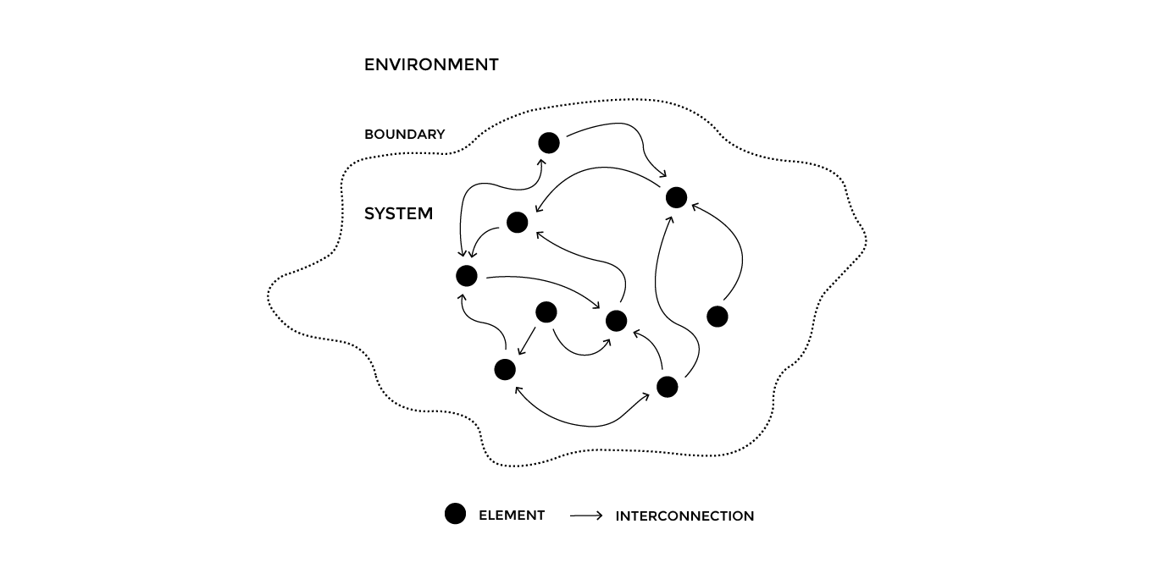
Today we will…
!
!
!
1. Intro to system mapping
2. Choose a region
2. Map out the system around access to clean in your region
3. Pinpoint environmental and societal issues

Slide 4
Understanding the system around clean water in your chosen region
Systems are mental tools for making sense of the world around us.
A system is a set of interconnected elements that appear coherently organized within a chosen boundary and produce a specific pattern of behavior over time.
Source: Systems change, Climate.now

Slide 5
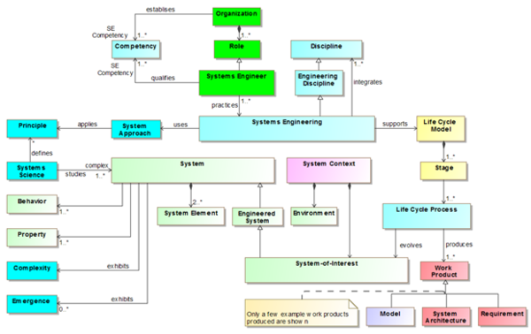
Systems maps are used in varied disciplines and can look quite different

Slide 6
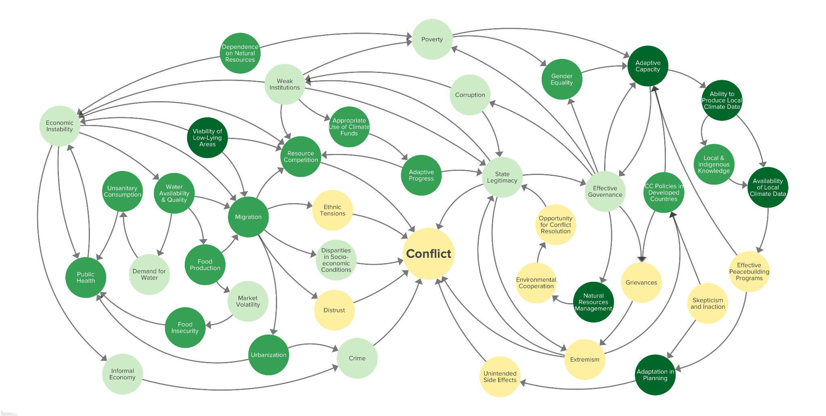
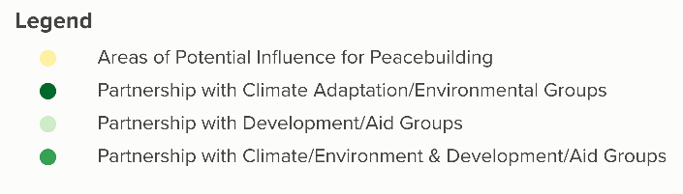
Systems maps are used in varied disciplines and can look quite different
Climate Change & Conflict Map

Slide 7
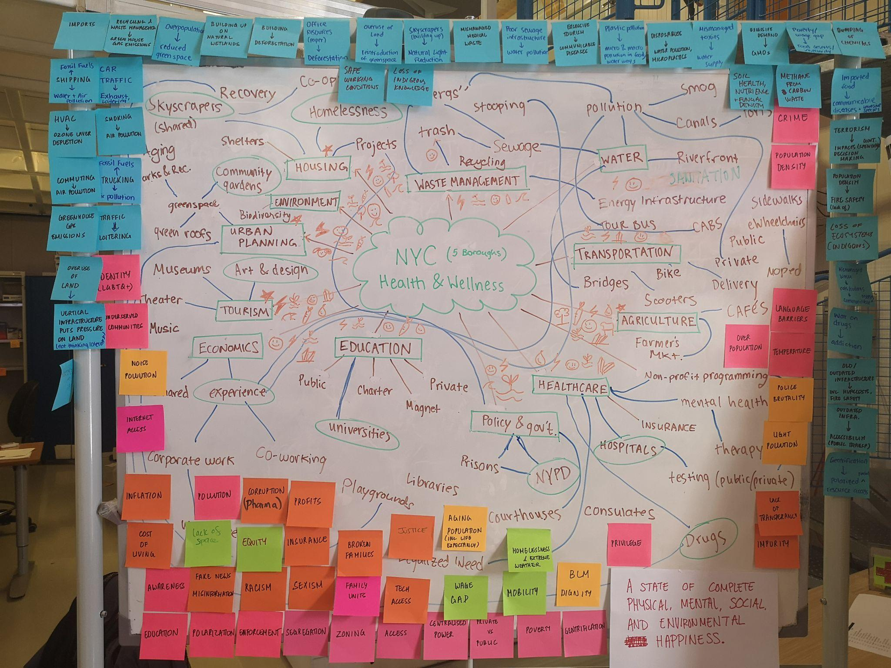
Systems maps are used in varied disciplines and can look quite different

Slide 8
Part of university system
School reputation
Admissions process
Academic excellence
Professors

Slide 9
Why map systems?
Acknowledge complexity
Look not only at the parts but at the whole
Draw new conclusions by looking at the relationships of the elements
This method helps us…
Visualise the big picture
Align with our team
Discuss how to intervene in the system

Slide 10

Map the coffee system at IdeaSquare
All together, identify the elements of the coffee system
  Each person embodies 1 element, by sticking a sticky with the element’s name on themselves
Roleplay how all elements are connected.
  Use the rope to show the connections

Slide 11
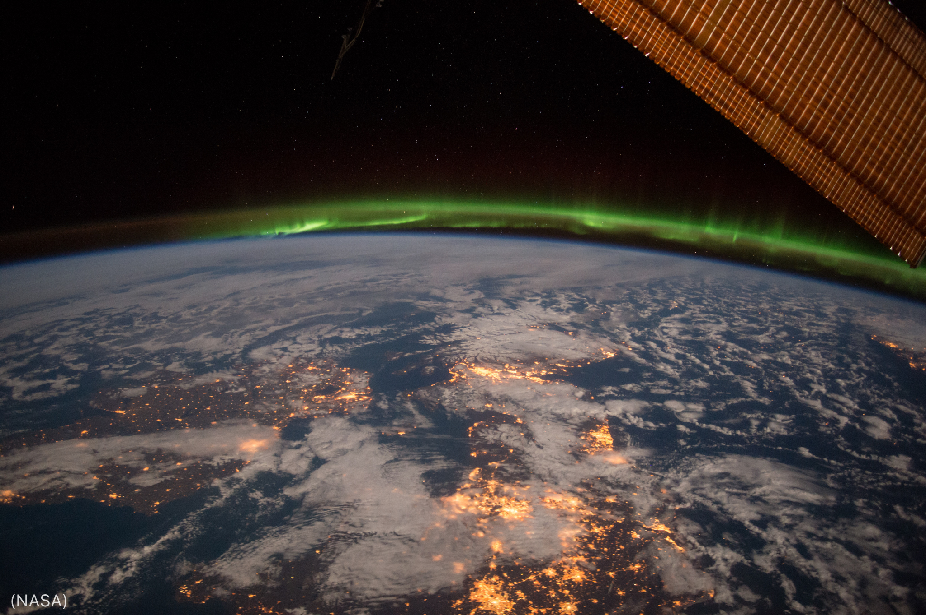
What region will you work on?
We will tackle the challenge of access to clean water on Earth.
Choose a region that you were familiar with, to work on this week.
If needed, research the SDG 6 indicators to identify issues to solve and research affected areas where these are pressing problems.
SDG Indicators - UN Statistics Division - the United Nations

Slide 12

It’s time to sense your surroundings
We will map the elements around access to clean water in your chosen region.

Slide 13
What is the current state of access to clean water in your region?

Slide 14

informs
1. Map the elements that are connected to access to clean what in your chosen region.
Stakeholders: institutions, services, people/roles, etc.
Resources: energy, land/soil, plants, animals, people, precious metals, water, etc.
Any other element that you think of
How are they connected?
If you wish, do desk research to support you in creating your map.
What is the current state of access to clean water in the region?
influences

Slide 15
Back at 11h45
Map the system around access to clean water
Decide the region where you will work on this week.
  If needed, check the SDG Indicators - UN Statistics Division (SDG 6).
Map the elements that are connected to access to clean what in your chosen region.
  Stakeholders: institutions, services, people/roles, etc.
  Resources: energy, land/soil, plants, animals, people, precious metals, water, etc.
  Any other element that you think of.
How are they connected?
If you wish, do desk research to support you in creating your map.
informs
influences

Slide 16
What are your initial takeaways on the challenges of access to clean water in your region?

Slide 17
What are the negative environmental and social impacts that you see in the system?

Slide 18
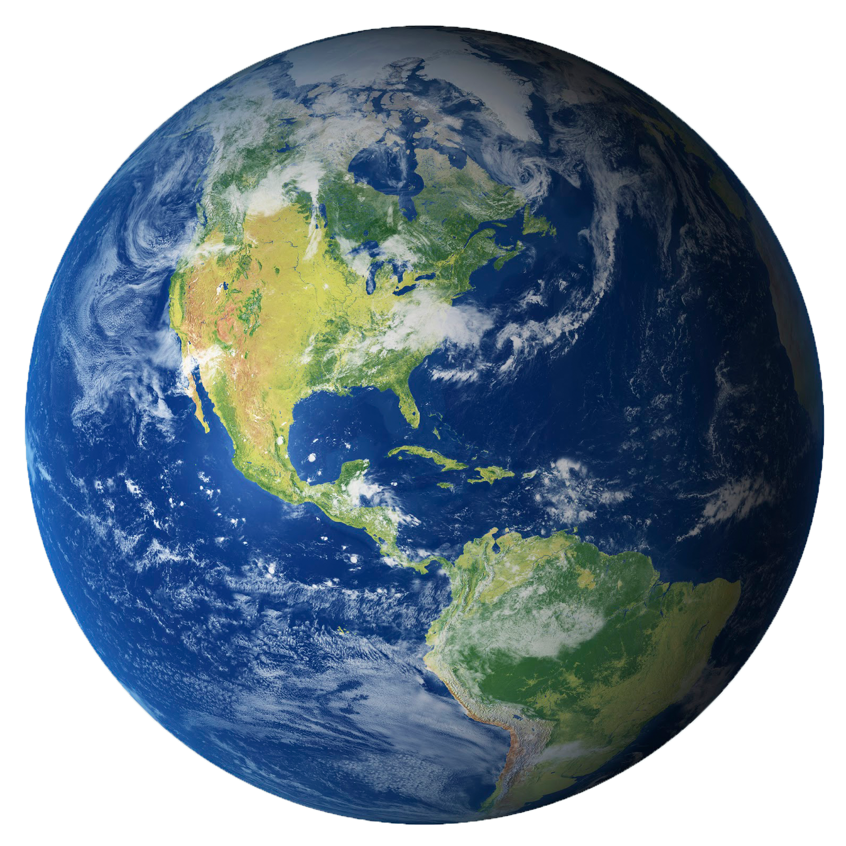
chemical pollution
food
air pollution
water
greenhouse gas emissions
health
biodiversity loss
income & work
deforestation
peace and justice
grasslands & wetlands conversion
equality and inclusion
overuse of water
respect for human rights
water pollution
preservation of indigenous communities
waste

Slide 19
20 mins
Identify the negative impacts
informs
What are the negative environmental and social impacts that you see in the system?
Air or water pollution, deforestation, biodiversity loss waste, etc.
Access to food, health, work, the respect for human rights, etc.
Write the impacts in sticky notes and place them on your map.
If you wish, do desk research to support you in creating your map.
influences

Slide 20
System map ✅

Slide 21

Please submit to the Exoplanet Settlement Bureau

