Slide 1
Prototyping session: Water Solutions
Dina Zimmermann
11.05.23

Slide 2

What is a prototype?

Slide 3
Some definitions
“A prototype is a primitive representation or version of a product that a design team typically creates during the design process”
“Any representation of a design idea, regardless of the medium” (Houde and Hill, 1997)
“An approximation of the product along one or more dimensions of interest” (Ulrich & Eppinger, 2016)

Slide 4

What is the purpose of prototyping?

Slide 5
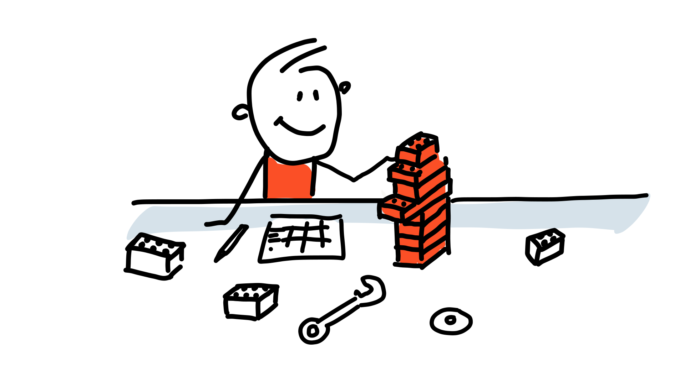
The purposes of prototyping
Learn
Feedback
Commication
Test

Slide 6

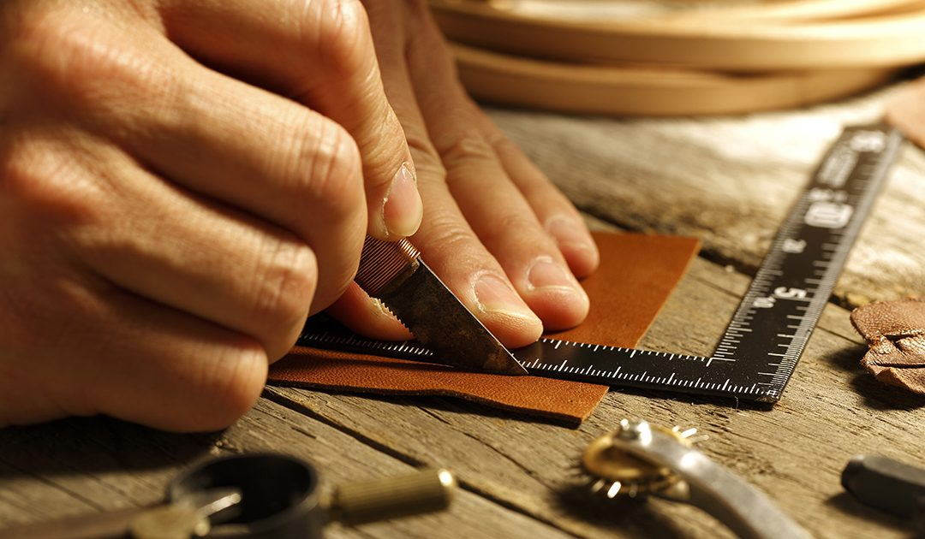

Slide 7

Different types of prototypes

Slide 8
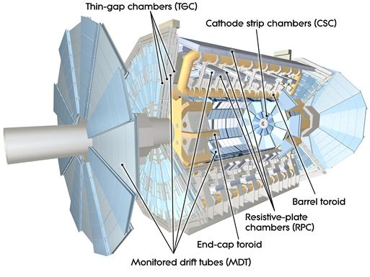
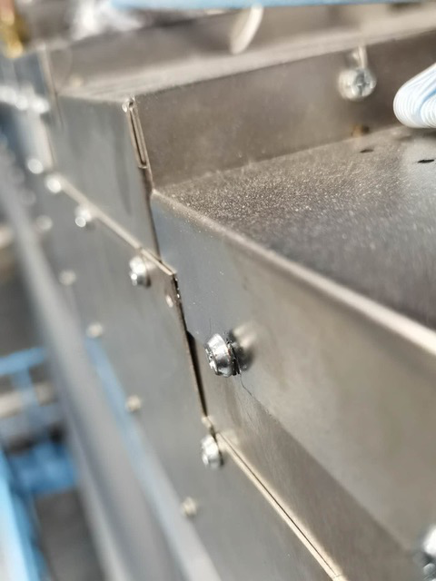
ATLAS MDT detector disassembly
Notes:
ATLAS Phase II Upgrade for High-Luminosity LHC from 2025-2027. Alt skal skje på disse to årene og alt må planlegges veldig nøye. Hver oppgave får en tidsramme som må følges. Dermed er det viktig å gjøre alle oppgavene veldig effektivt. En av gruppene har i oppgave å åpne alle dekslene til all elektronikken og gjøre oppgradering av elektronikkne.
Hvor vanskelig kan det være? Skru ut noen skruer?
Det er 1150 deksler. Dermed kan du se for deg at det vil ta en del tid å skru opp alle skruene som holder dekslene på plass. To formal:
Effektivisere (Raskt matche skrue med skrutrekker)
Unngå at skruer faller ut og at man mister de
Myoner
Linker: https://cds.cern.ch/record/2732959/files/ATL-UPGRADE-PROC-2020-001.pdf
https://atlas.cern/Discover/Detector/Muon-Spectrometer
https://cds.cern.ch/record/2770861/files/ATL-MUON-SLIDE-2021-175.pdf

Slide 9
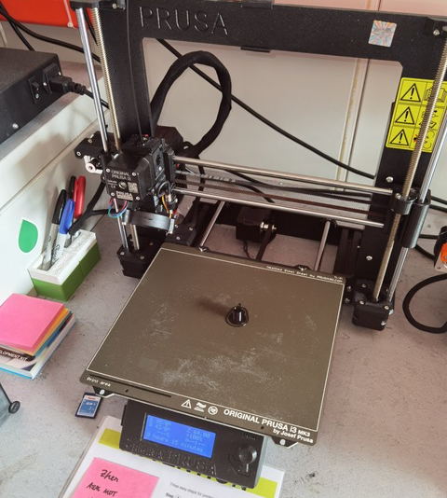

First prototype
Notes:
Utfordringer:

Slide 10

The iterative process of prototyping
Repeat
Build
Learn
Test

Slide 11
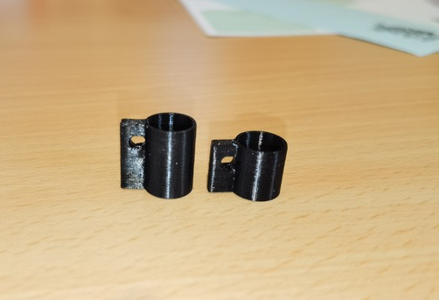
Second prototype
Notes:
Fortsatt utfordringer:
Lett å miste

Slide 12

The fidelity of the prototype

Slide 13
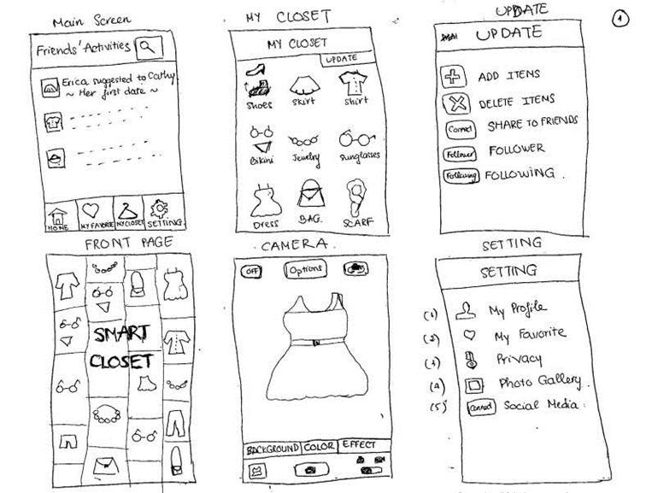
“Fidelity refers to how close a prototype is to the final product”

Slide 14
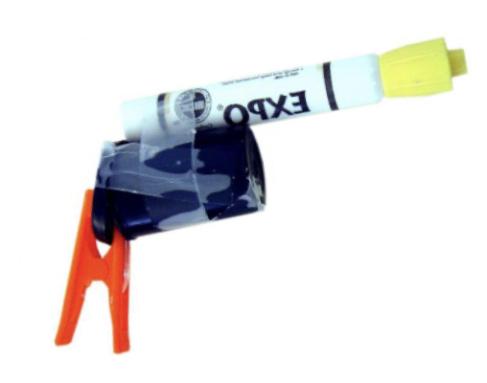
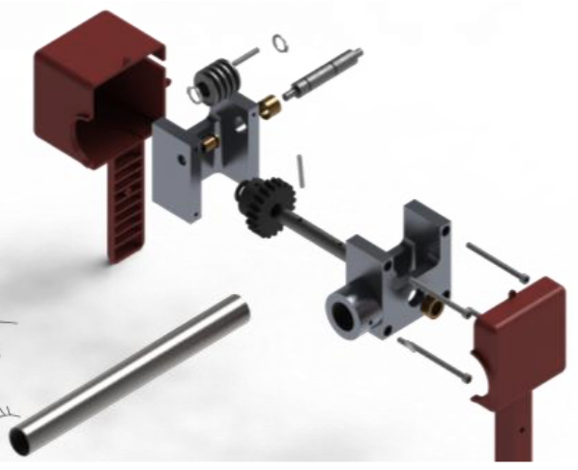
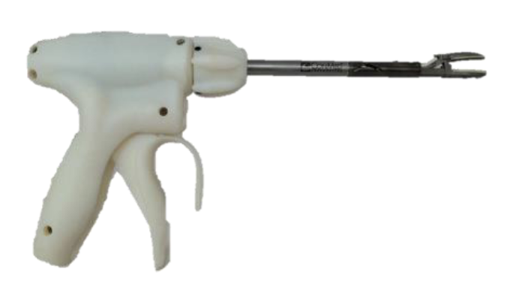
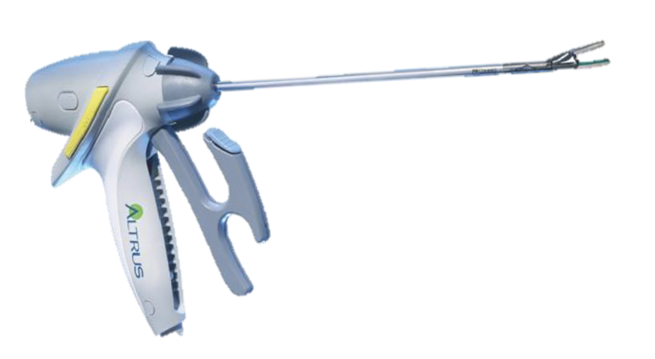
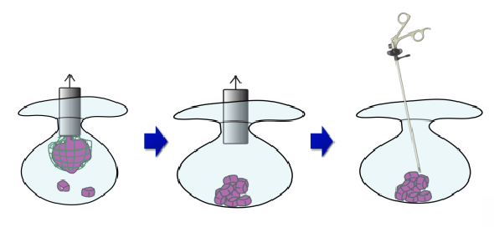
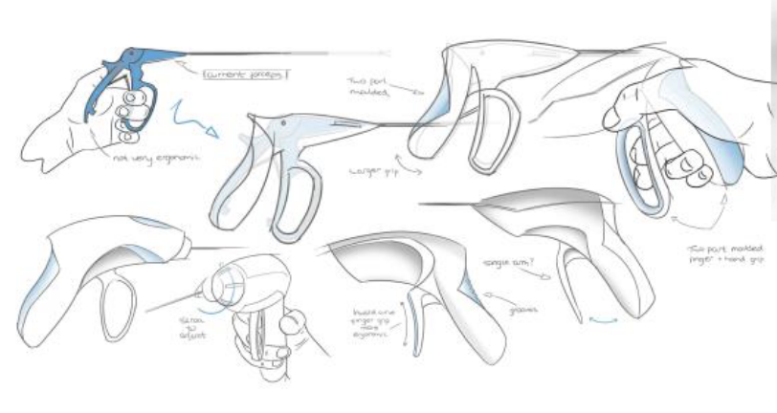
The fidelity of the prototype
Low fidelity
High fidelity
Concept
visualization
Sketching
Quick & dirty
mockup
3D model
Functional
Prototype
Pre-production
prototype
© Carlye Lauff, University of Colorado Boulder

Slide 15
The fidelity of the prototype
Low fidelity
High fidelity
FOCUS AREA TODAY
Concept
visualization
Sketching
Quick & dirty
mockup
3D model
Functional
Prototype
Pre-production
prototype
© Carlye Lauff, University of Colorado Boulder

Slide 16


But…
A prototype doesn’t have to be a product

Slide 17
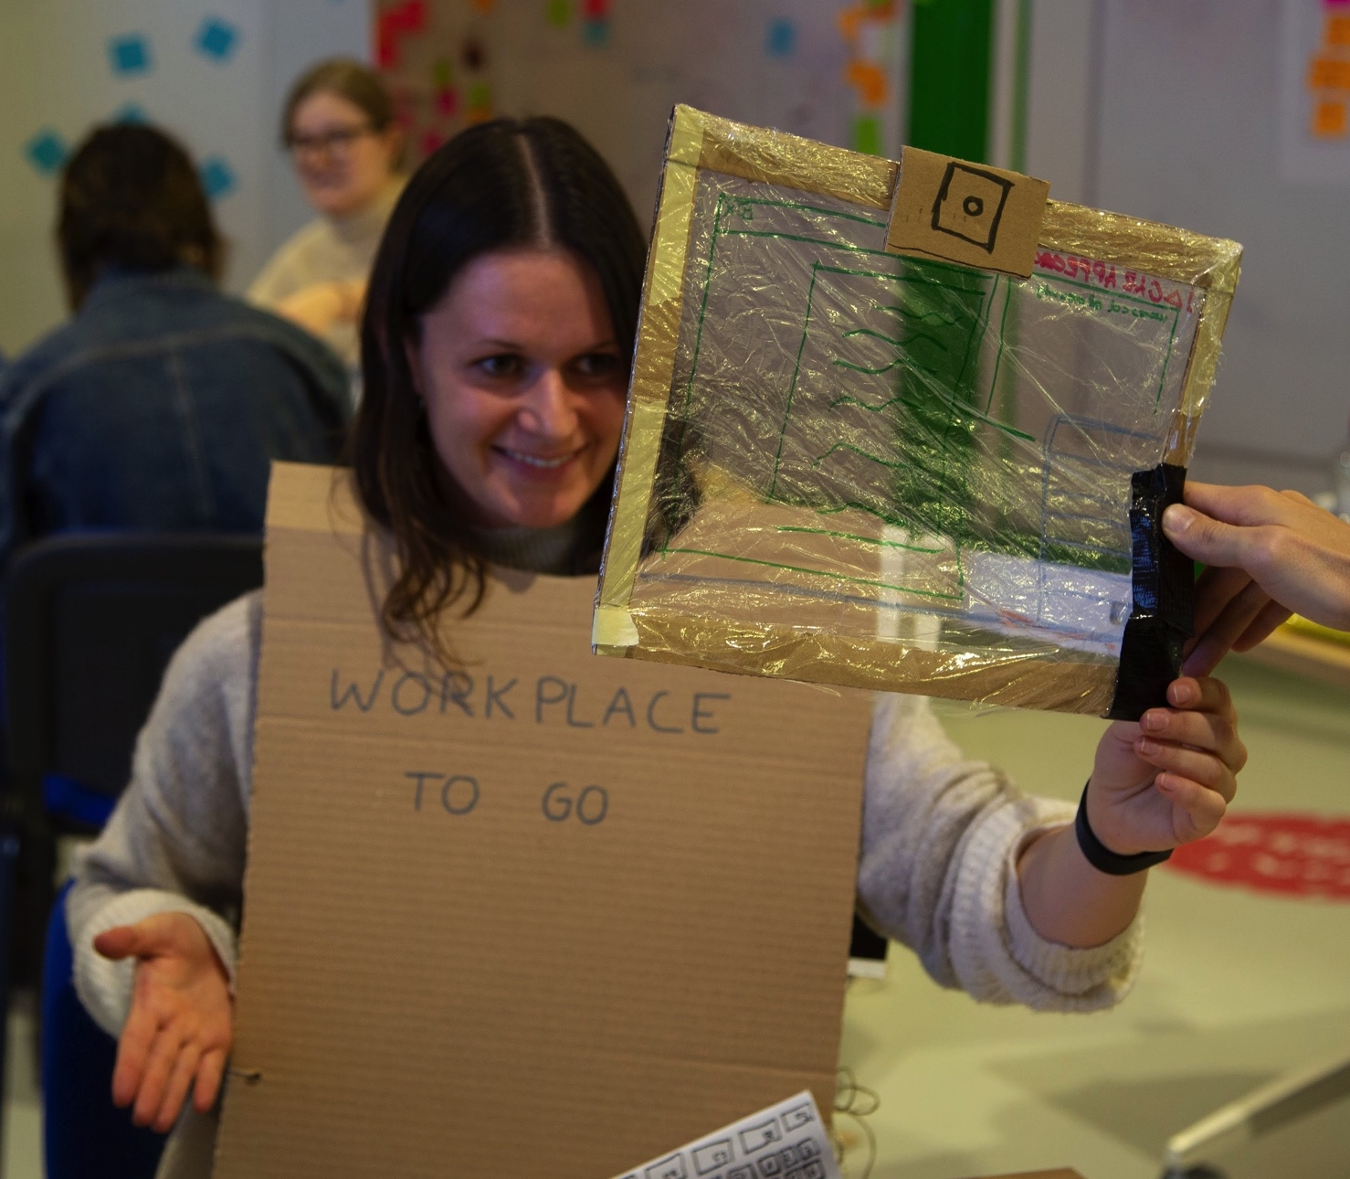
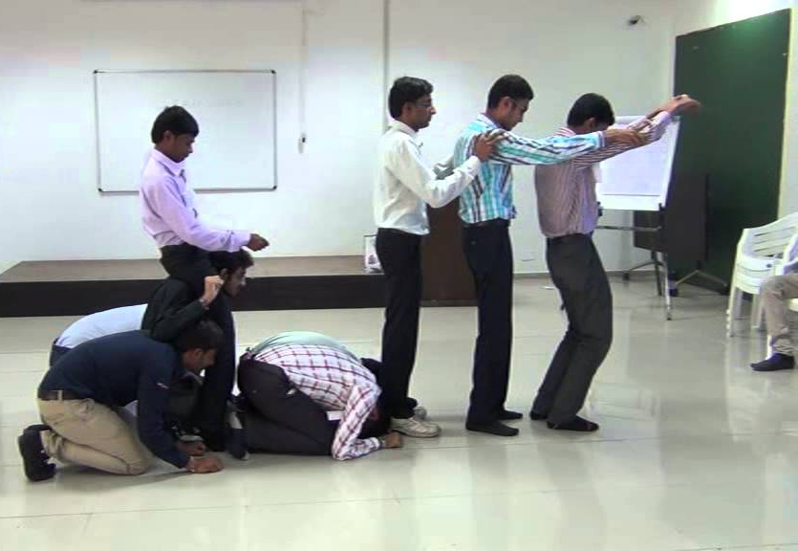
A Role-Play prototype
Playing out the components of a system or an interaction to
Get new insights
Play
Communicate
Learn
Spark new ideas
Notes:
Problem-solving: The role-play improves problem-solving skills within the group.
Fuels creatively: With multiple participants in the activity, it lets all the participants think and generate ideas quickly. It also lets the participants experiment with their creative vision.
Improves communication and social skills: Actively participating in the role-play requires basic communication skills.
Insights: The participants can get distinct ideas and inputs from other participants.
The purpose today:
To have fun
To play
To talk about the system in a new way, spark new ideas.

Slide 18
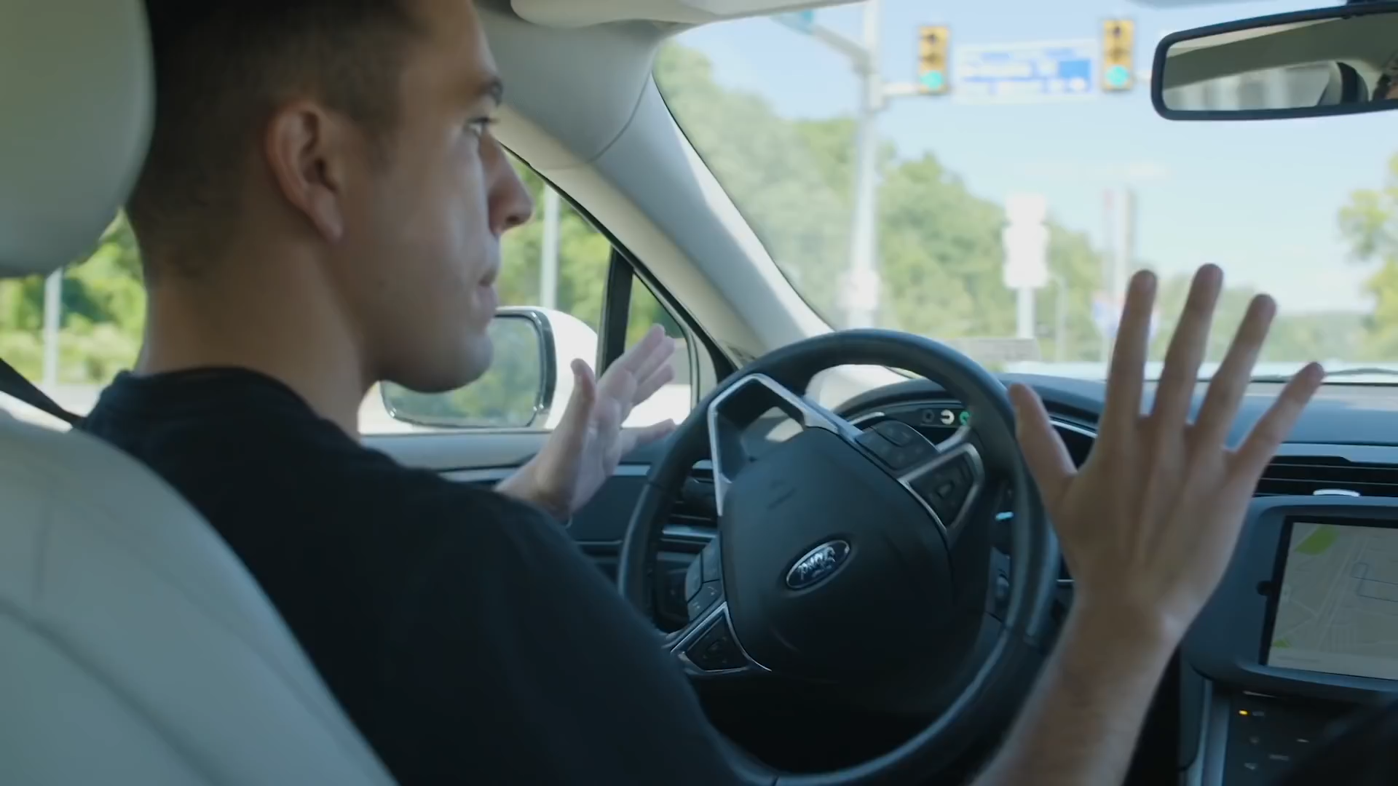

Slide 19
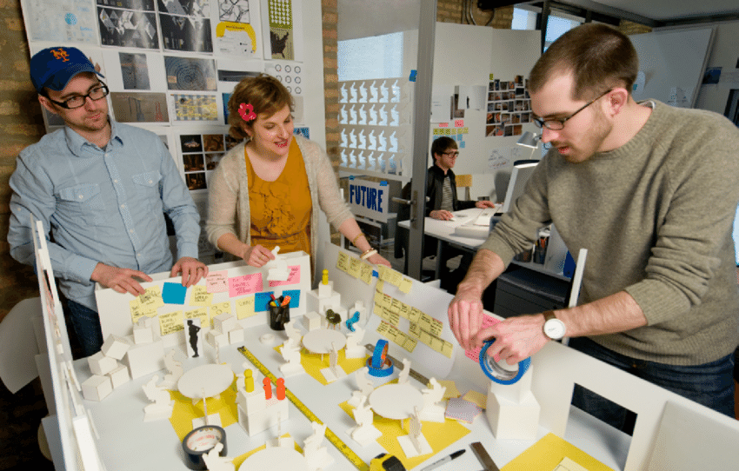
A tabletop prototype
Notes:
Suitable for systems
To vizualise and communicate

Slide 20
Have you seen the workshops?

Slide 21
Let’s move on to the prototyping session

Slide 22


Make a Role-Play Prototype!
1.
Make a Role-Play prototype of one of your water solutions with your team
2.
Feel free to use the materials you can find in the low fidelity prototyping area or in the workshops
Time’s up!
3.
Focus on communicating how the system works
10 minutes
Notes:
GIVE EVERYONE A POST-IT/SHEET OF PAPER AND PEN
5 MIN
I asked you to bring your own ideas, but before we get into the ideas.
One sentence per point
Contextualize the problem. What do we already know?
Describe the exact issue your research will address. What do we still need to know?
Show the relevance of the problem. Why do we need to know more about this?

Slide 23
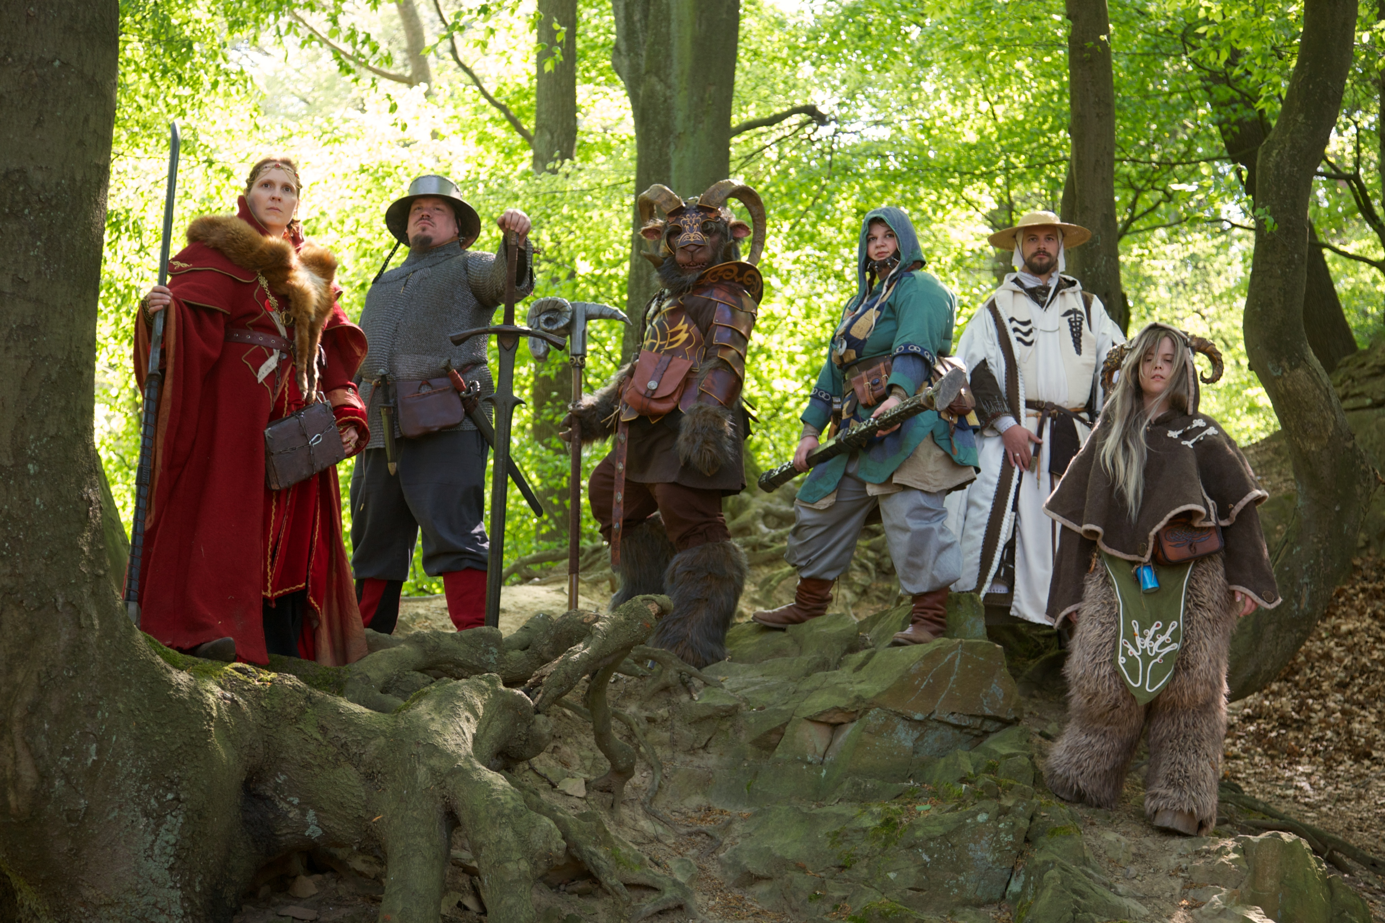
1.
Present the Role-Play
The team with the most colourful pair of socks begin!
Notes:
GIVE EVERYONE A POST-IT/SHEET OF PAPER AND PEN
5 MIN
I asked you to bring your own ideas, but before we get into the ideas.
One sentence per point
Contextualize the problem. What do we already know?
Describe the exact issue your research will address. What do we still need to know?
Show the relevance of the problem. Why do we need to know more about this?

Slide 24
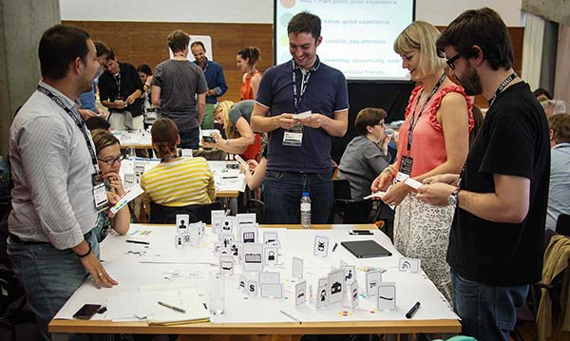
Make a tabletop prototype
1.
Get your prototyping box and start building a prototype of your team’s idea
2.
Feel free to use the materials you can find in the low fidelity prototyping area or in the workshops
3.
Focus on the system
Notes:
GIVE EVERYONE A POST-IT/SHEET OF PAPER AND PEN
5 MIN
I asked you to bring your own ideas, but before we get into the ideas.
One sentence per point
Contextualize the problem. What do we already know?
Describe the exact issue your research will address. What do we still need to know?
Show the relevance of the problem. Why do we need to know more about this?

Slide 25


Present the prototype!
Switch!
2 minutes
Notes:
GIVE EVERYONE A POST-IT/SHEET OF PAPER AND PEN
5 MIN
I asked you to bring your own ideas, but before we get into the ideas.
One sentence per point
Contextualize the problem. What do we already know?
Describe the exact issue your research will address. What do we still need to know?
Show the relevance of the problem. Why do we need to know more about this?

Slide 26
Present the prototype!
Switch!
2 minutes
Notes:
GIVE EVERYONE A POST-IT/SHEET OF PAPER AND PEN
5 MIN
I asked you to bring your own ideas, but before we get into the ideas.
One sentence per point
Contextualize the problem. What do we already know?
Describe the exact issue your research will address. What do we still need to know?
Show the relevance of the problem. Why do we need to know more about this?

