Slide 1
4. Creating your constitution
What is the purpose of your society and what are the key principles to ensure a sustainable settlement?

Slide 2
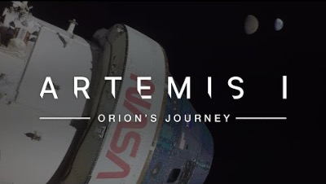

Slide 3
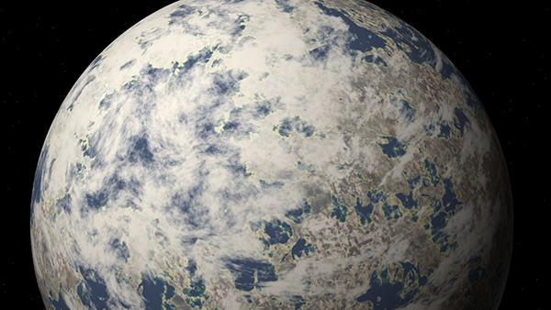


Slide 4
How will your settlement function?
What form will your society take?
What are the fundamental rights of settlers?
What is required from settlers?
What can settlers expect from the society?
How do you define equality?
Who has right to water / who is responsible of there being water / maintaining the system / how are violations prevented etc.
Consider social, ethical and environmental elements, and create a 10ish points constitution. §
(until 14.30)

