Slide 1
Exoplanet exploration
Laura Wirtavuori, Catarina Batista, Ole Werner, and Carolina Faria

Slide 2
2. Materials for travel
Considering who and what to bring with you
105min (until 17.00)

Slide 3
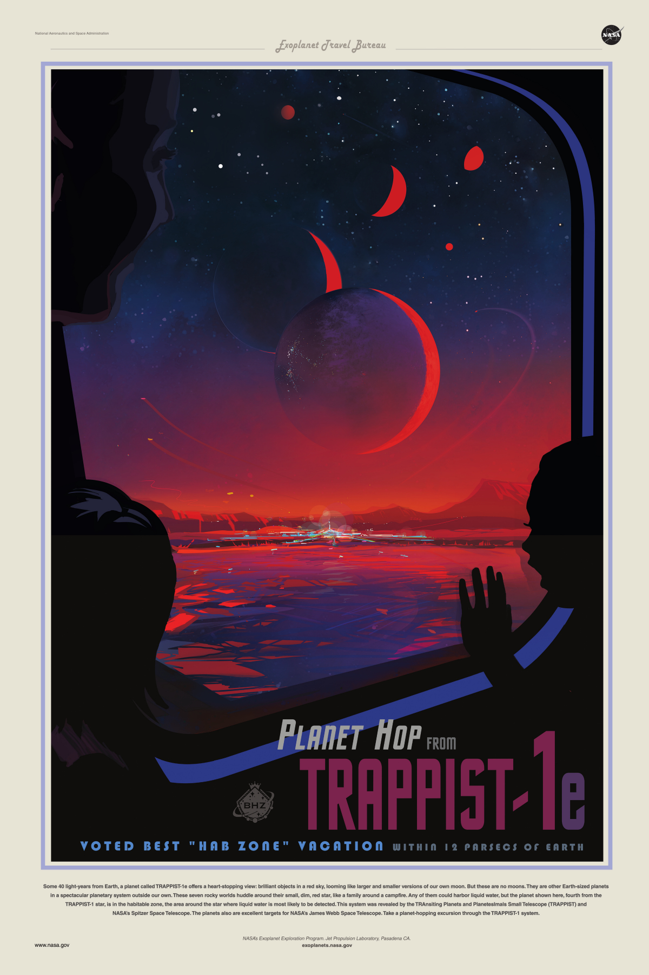
A couple words about your goals
Please bear in mind the main mission you have: to do fundamental research on the planet you are traveling to. Will humans be able to survive?
Terraforming is a big word. During this week, we focus on a simpler task: to form a settlement that survives. We do not start modifying an entire planet, although alterations to the planet are inevitable, for example in terms of extracting materials from the ground and building on the surface (under surface).
Once you arrive, your main mission will be to stay alive. The second step will be to start your first settlement on that planet.
NASA-JPL/Caltech

Slide 4
Who and what do you need on Planet X?
What are the resources available?
Who are the people you are choosing to bring with you (max. 200)? Why?
  skills, age, nationality, gender, family status, religion…
What will you bring (only what you think is going to be necessary for establishing a self-sustained settlement)? Why?
(105min)
You will have more time tomorrow (45min) to finalise your choices before discussions with the ExoSB committee, and 90 more minutes reserved for those discussions and changes to your choices.

