Slide 1

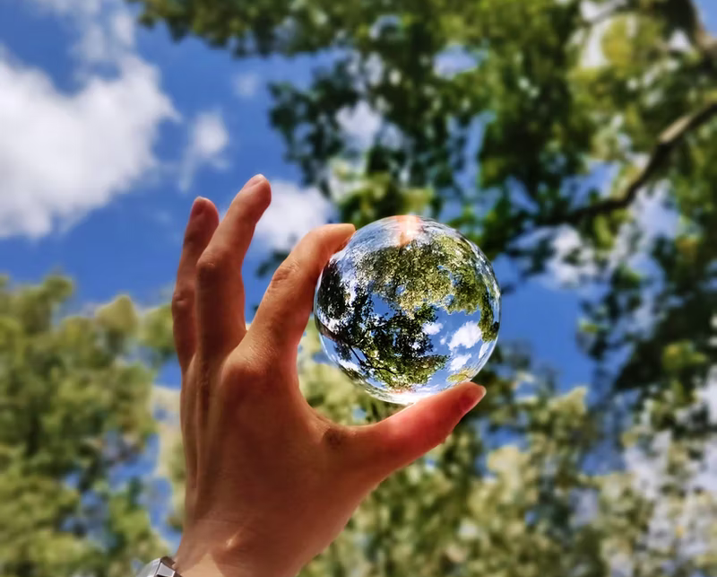

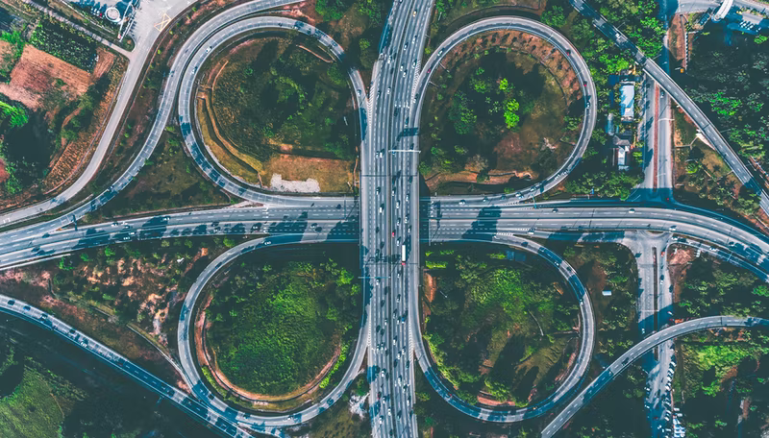

How Do We Dare?
Or: How to Think About the Universe - and Everything …
(With a little help from my friends Laura, Catarina, Dina, Ole, Tuuli and Pablo)
Introduction to Terra Forming, May 9, 2023
Markus Nordberg (CERN)

Slide 2
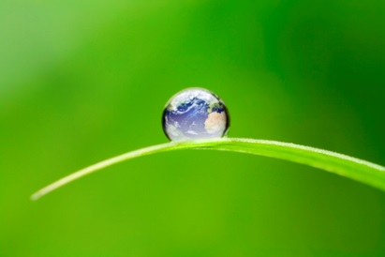
What Can/Should We Assume About the “Big Picture”??

Slide 3
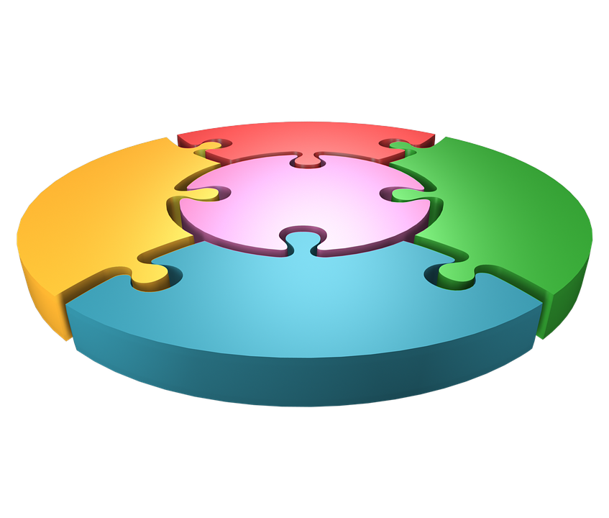
What is the “Big Picture”??
Inequality
Population
& Health
Food
Energy
Science & Technology
Adapted from: J. Rockstrom, O. Gaffney: Breaking Boundaries (2021)

Slide 4
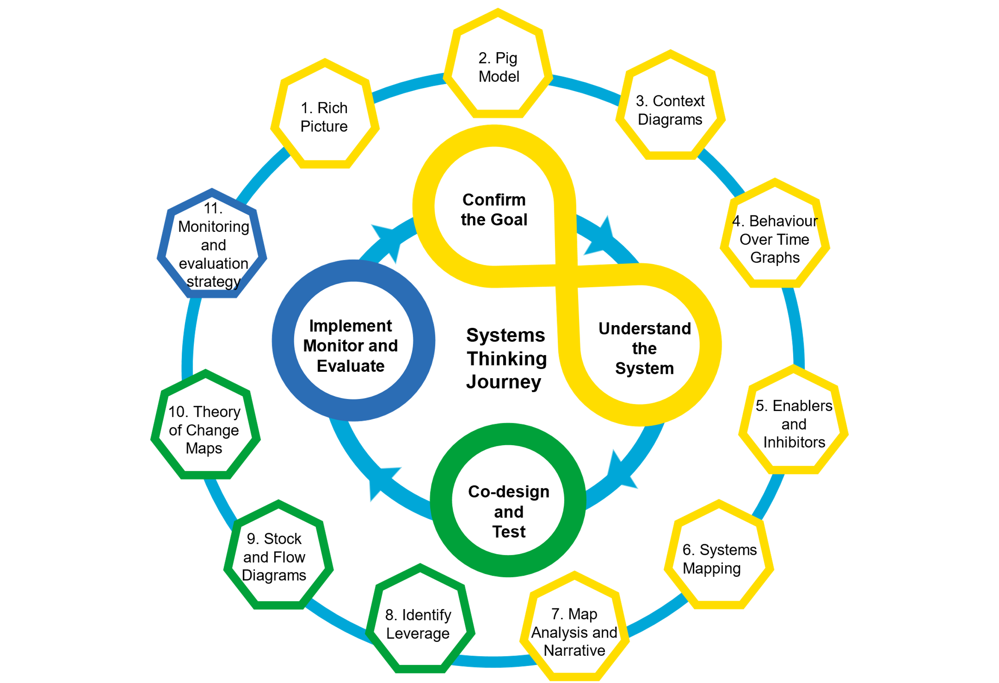
Can We Assume We Understand the “Big Picture”??
What if …
It cannot be designed (processes)??
Laws of physics do not apply (conservation of energy)??
It cannot be modelled (economically; neoclassical)??
It does not scale??
It cannot be tested or verified??
What if … we need to think about this in an entirely new way (together)?
Source: www.gov.uk

Slide 5
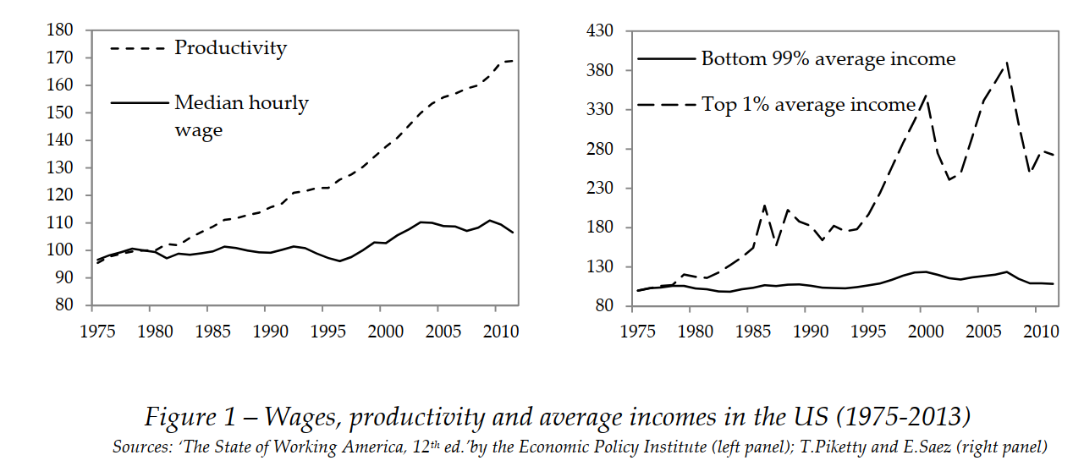
Example: Income & Employment: How can we fix this?
Source: J. Stiglitz, «Inequality and Economic Growth»

Slide 6
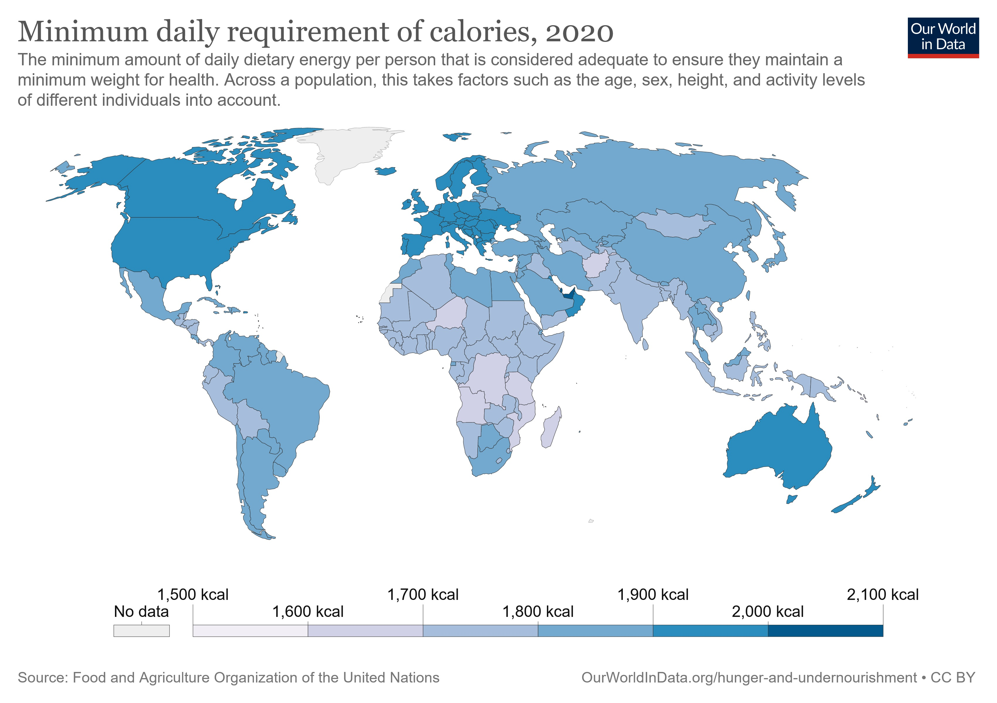
Example: Energy vs. Food: How can we fix this?
Annual world energy production: ~ 6x10²⁰J. Minimum average yearly food (energy) need for 8b people: ~ 5 x 10¹⁹J … Close but is it enough?
Source: Our World in Data

Slide 7
Things appear to develop exponentially …
Source:
“Global Change and the Earth System: A Planet Under Pressure” (2004), W. Steffen, et al., Springer-Verlag Berlin Heidelberg New York.

Slide 8
Source:
“Global Change and the Earth System: A Planet Under Pressure” (2004), W. Steffen, et al., Springer-Verlag Berlin Heidelberg New York.

Slide 9
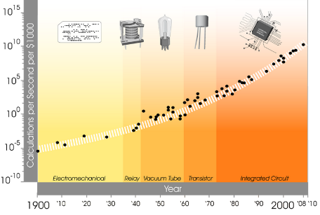
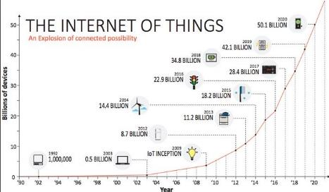
Technology seems to grow exponentially, too …
Internet of Things: online guide to the Internet of Things, http://www.i-scoop.eu/internet-of-things/ and https://exponential.singularityu.org/

Slide 10
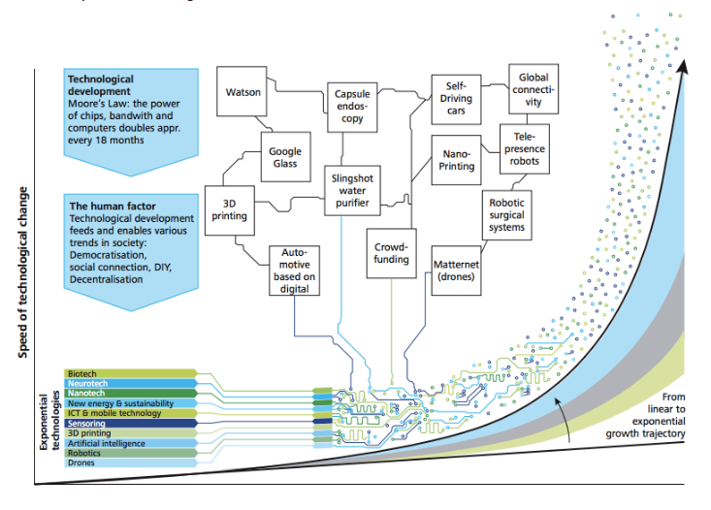
… So Will Technology Then Be The Solution?
Source: Deloitte 4.0 report 2015 https://www2.deloitte.com/content/dam/Deloitte/ch/Documents/manufacturing/ch-en-manufacturing-industry-4-0-24102014.pdf

Slide 11
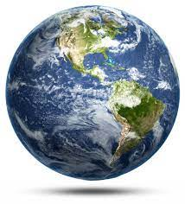
Why do we need to think “exponentially”?
Many of our global challenges are due to incremental, small scale thinking & not seeing the big, long term picture and systemic effects…
… nor the unintentional consequences

Slide 12
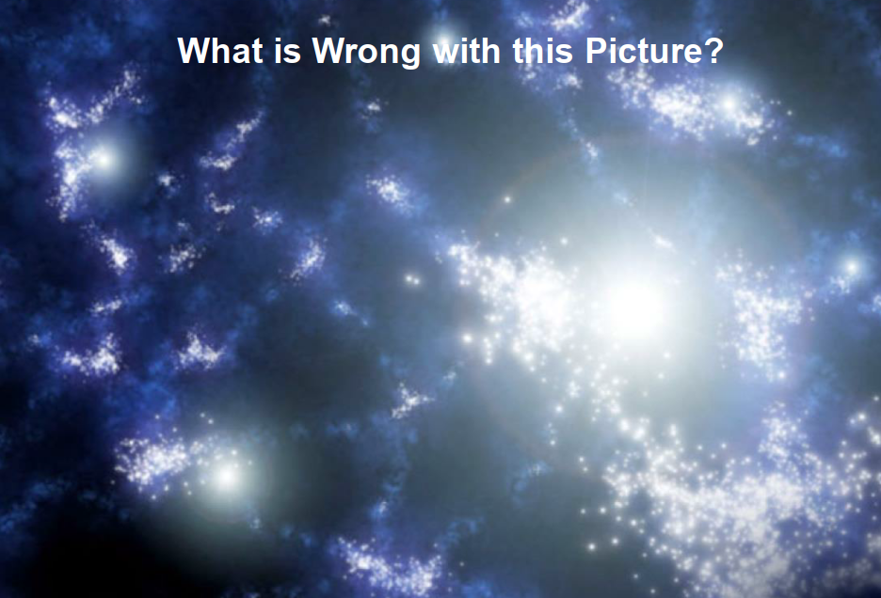
What is Wrong with this Picture?

Slide 13
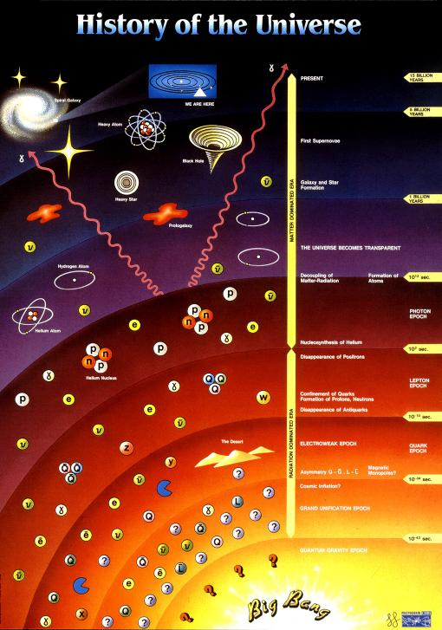


Slide 14
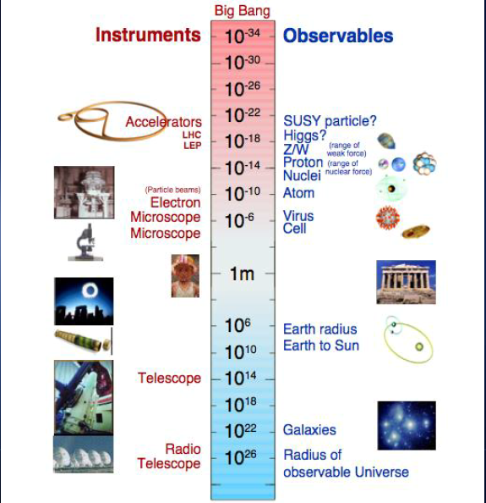

Slide 15
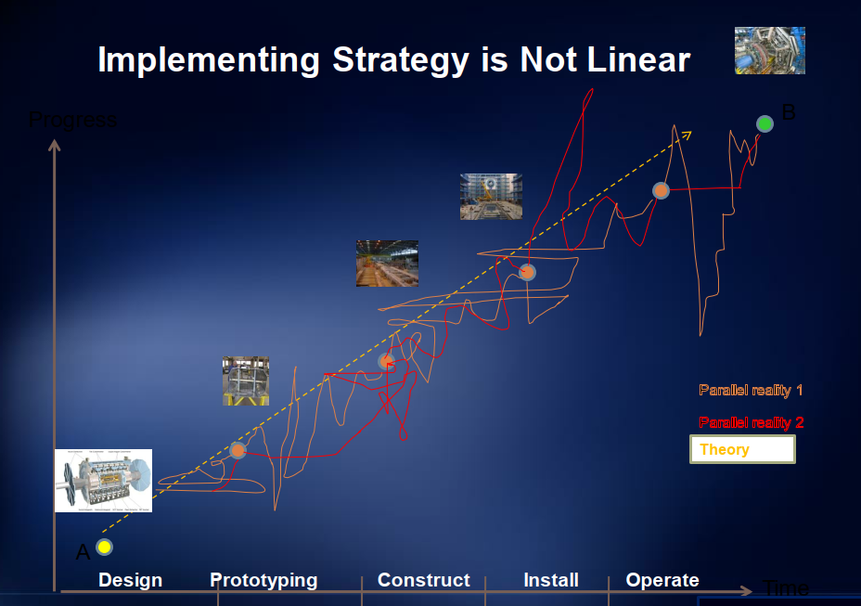

Slide 16
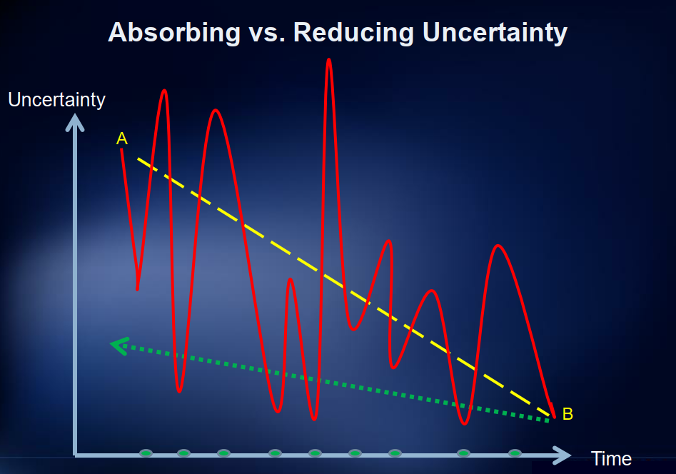

Slide 17
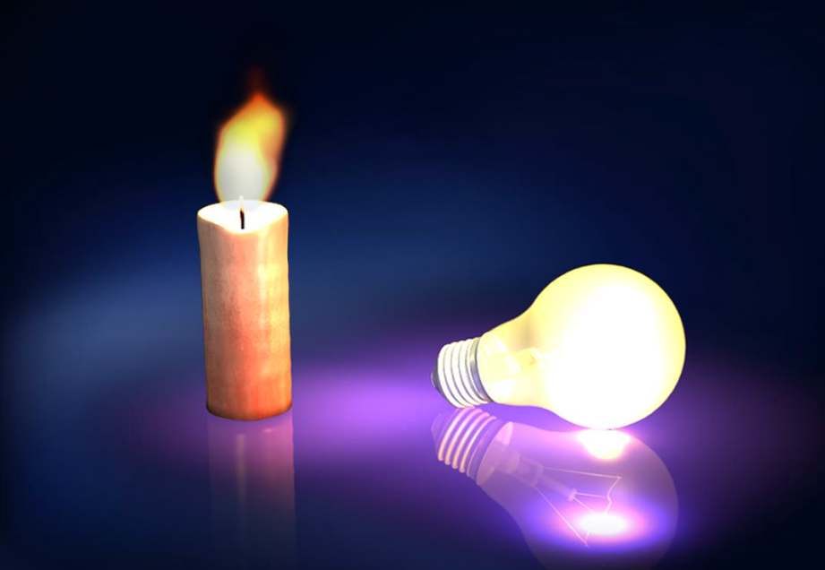

Slide 18
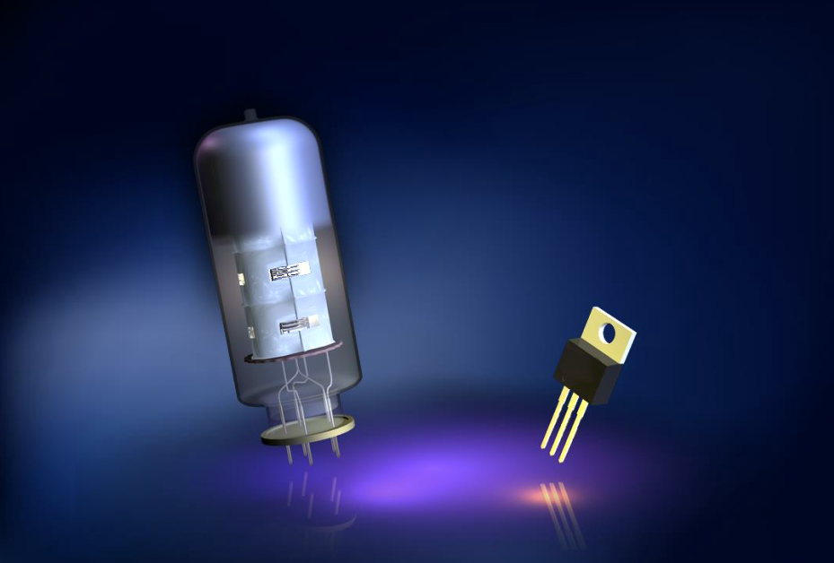

Slide 19
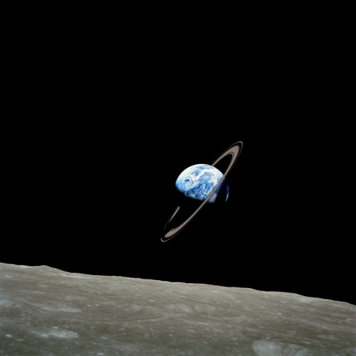

Slide 20
What is it that I now see differently?

