Slide 1
Exoplanet exploration
Laura Wirtavuori, Catarina Batista, Ole Werner, and Carolina Faria

Slide 2
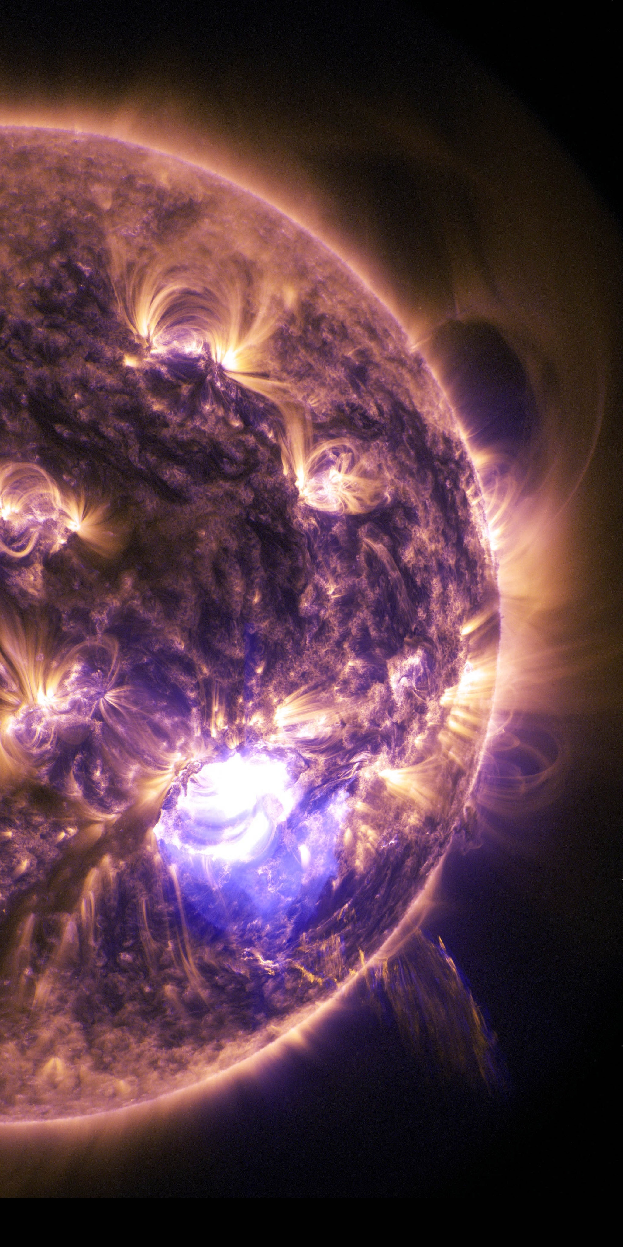
Let’s start your journey
You will be
researching your destination,
planning who and what you will take with you, and
forming a society.
Towards the latter half of the week you will be focusing on how to ensure access to clean water for everyone in your settlement.

Slide 3
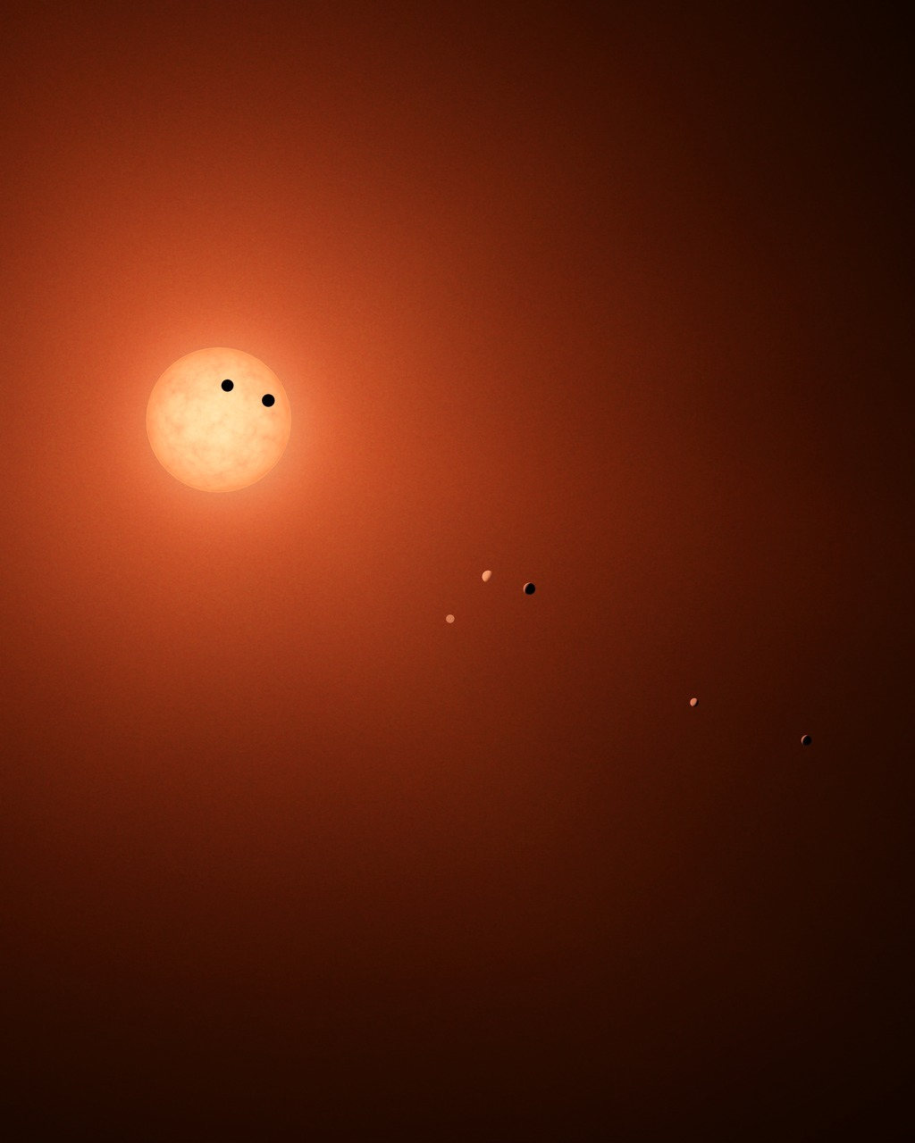
Let’s have a first look at your destination,
the Trappist planetary system
Credit: NASA/JPL-Caltech/R. Hurt (IPAC)

Slide 4
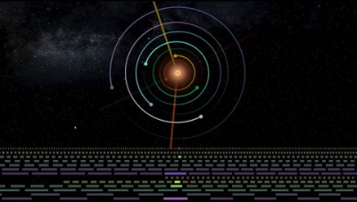

Slide 5
1. Preparing for travel
Considering conditions to choose a planet
60min (until 15.00)

Slide 6
Which Trappist planet are you traveling to? What does it look like?
What kind of geological and atmospheric elements exist?
How big is the gravity in this planet? Compared to Earth (1G).
What is the estimated surface temperature?
What is the planet made of?
Be ready to present your choices and the assumptions you’ve made to the exoplanet settlement bureau committee at 15.00. You will have 5min per team to share.
(60min)

