Slide 1
All hands on deck ideation!
Catarina Batista
Terraforming pilot
May 2023

Slide 2
Opening paths to your imagination
Pick 1-2 “How might we” questions.
Brainwrite about it.
Select 1-2 idea to take forward

Slide 3
That’s SICK!
(Small Ideas Collider before Karaoke)

Slide 4
Choose one HMW and mix teams
15min

Slide 5
Rules for Ideation
Defer judgement.
Encourage wild ideas!
Build on the ideas of others (use “and” instead of “but”)
Stay focused on the topic.
Only one conversation at a time.
Be visual.
Go for quantity.

Slide 6
Prototype!
10min

Slide 7
Choose another HMW, mix and do it again

Slide 8
Choose another HMW and do it again (if needed)

Slide 9
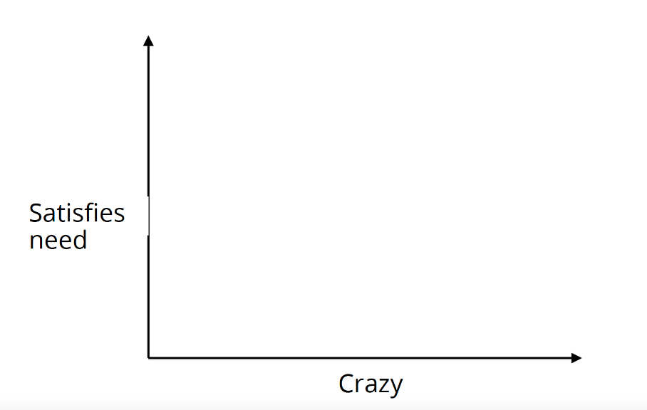
Evaluate your ideas
Sweet Spot
Impact potential

