Slide 1
Final Mission
Terraforming pilot
May 2023

Slide 2
Your final mission
Your final mission of these two weeks is to send back to earth the support they desperately need to start solving some of the critical challenges around access to clean water. Based on your experiences on Trappist 1e, you are now asked to send 2 messages to Earth:
A mission Abstract (1-2 A4 of written text)
A video message (5-10min, no powerpoint)

Slide 3
Mission abstract
Craft a mission abstract for the Exoplanet Settlement Bureau explaining what the Earthlings should consider when implementing your suggestions.
What were the key principles you learned on Trappist 1e that you incorporated to your solution for Earth (if any)
Include any assumptions and/or interview guidelines for Earthlings to validate before implementing your suggestions.
Any other insights you found enlightening during the second week
Maximum 1-2 A4 to support the video message

Slide 4
Your video message
Your video message should include the following elements:
Description of the scenario/context where this solution will exist
Problem you are solving;
Show your solution prototype and corresponding system and explain the solution;
Expected impact of solution;
Your video should not be longer than 5-10min (remember the attention span of Earthlings)

Slide 5
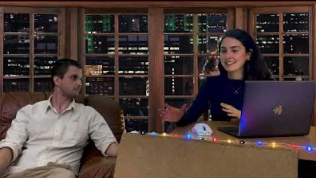

Slide 6

Our suggestion for today and tomorrow
Iterate your ideation (maybe choose another HMW and start again, take another idea from the morning session, take the selected idea and iterate the concept).
Once happy with the ideas, prototype or refine the morning prototypes and start considering systemic and behavioral aspects.
Questions to ask yourselves:
  Is our idea so big and so special, that it needs to be transmitted through space and time?
  Do we as a team feel excited about our idea?

Slide 7
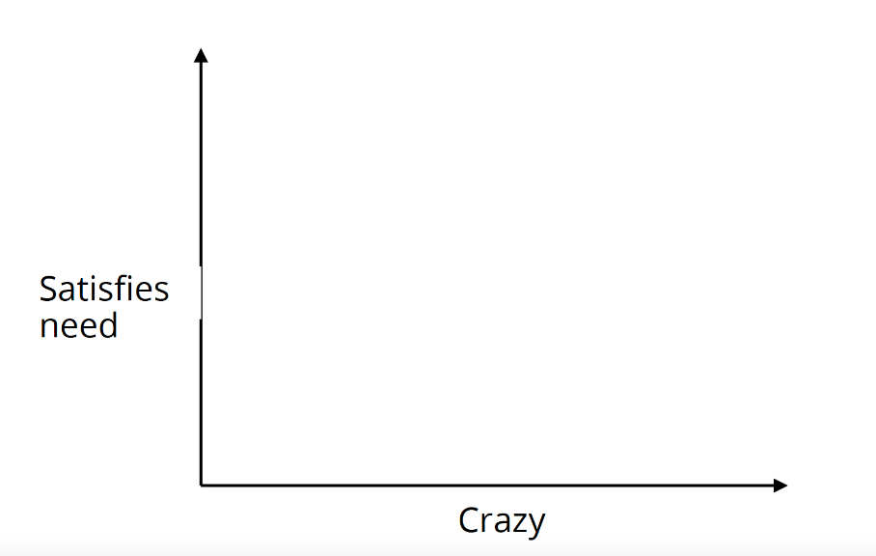
Evaluate your ideas
Sweet Spot
Impact potential

Slide 8
Agenda for Thursday and Friday
Thursday
Warm up at IdeaSquare at 10 – one extra hour for yourselves!
13.00 lunch
Open end – dinner at 7 at R1 – free dinner with music
Friday
10.30 present to IdeaSquare people and coaches
After presentations lunch, and wrapping up (instructions for reflection paper, cleaning, Design the next terraforming pilot, saying goodbye and group picture)

