Slide 1
Congrats!
You just finished Day 1!

Slide 2
Reflecting on your experience today
I learned…
I liked…
I was inspired by…
I wish…

Slide 3
Challenge for the week!
Each day, one team will be in charge of the daily warm up.
We will alternate between Team A, Team B and Teaching Team.
This means:
Tuesday → Team A
Wednesday → Team B
Thursday → Teaching Team
Friday → Team A + B
P.S: You might also want to think of a team name! ;)

Slide 4
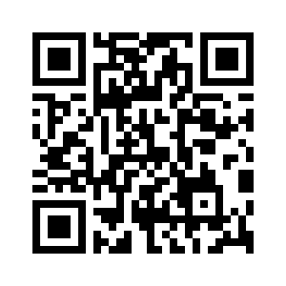

WhatsApp group

