Slide 1
The pitfalls of circular economy
&
considerations for regenerative solutions
Notes:
The goal of this session is to inspire you in ways to go deep into your ideas, not stay with what seems to be a good idea.
The danger is in staying on a superficial level: that’s where we see many of the pitfalls of the circular economy

Slide 2
Circular economy
What do you know about the circular economy? What is it about?
Notes:
Circular economy circulates materials, avoiding waste and avoiding using more resources from the planet

Slide 3
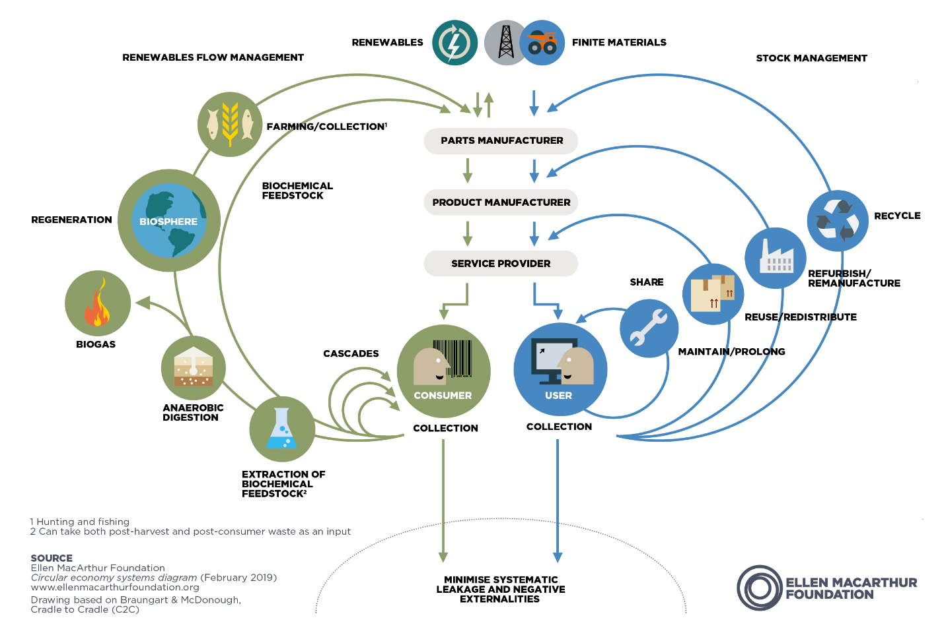
Have you seen this?
Notes:
biological cycle covers resources that are renewable and biodegrade
technical cycle finite materials that don’t biodegrade: circulate products and materials at their highest value.
In the technical cycle we aim to extend the lifecycle of a product for as long as possible by maintaining the product and avoiding it to break. We aim to , you keep the the material and energy value that was put into that product
When it breaks: Remanufacturing: disassemble and create a new engine
Last resource: recycle – transform the product into something else, but most times we are downcycling.
phones: the biggest value is in the phone itself, not the components (it’s hard to create a product with a similar value with the individual components). we want to keep them as they are for as long as possible
bioLogical cycle: aims to send resources back to earth to regenerate, to e.g. contribute to healthy soils
Tries to extend lifecycle of materials: cascading: wood from house makes a table, makes
Extraction of biochemical feedstock: biological material that can be converted into energy or fuel
composting and anaerobic digestion: process to transform bio materials into biogas or a digestate that can be composted and be used as a soil amendment. In this phase,composting is also considered, where food by-products and other biodegradable materials are turned into compost
regenerate: collect food waste, human waste and put that back in the soil and regenerate the soil. have a positive impact, make the soil better
Farming: manage farms, and other sources of biological resources such as forests and fisheries, in ways that create positive outcomes for nature. These outcomes include, but are not limited to, healthy and stable soils, improved local biodiversity, improved air and water quality. there are different techniques for regenerative farming, fishing
resources would be continually re-used, meaning that there would be no more mining activity or waste production. The stress is on recycling, made possible by designing products so that they can easily be taken apart.
It needs developing an “alternative consumer culture”. A product thus becomes a service, which is believed to encourage businesses to improve the lifespan and recyclability of their products.

Slide 4
Pitfalls of circular economy
Source: How circular is the circular economy? by Kris De Decker
Notes:
As a theory it’s great but in practice there are some issues to consider
important to not stay on a superficial level with our ideas in order to avoid these pitfalls

Slide 5
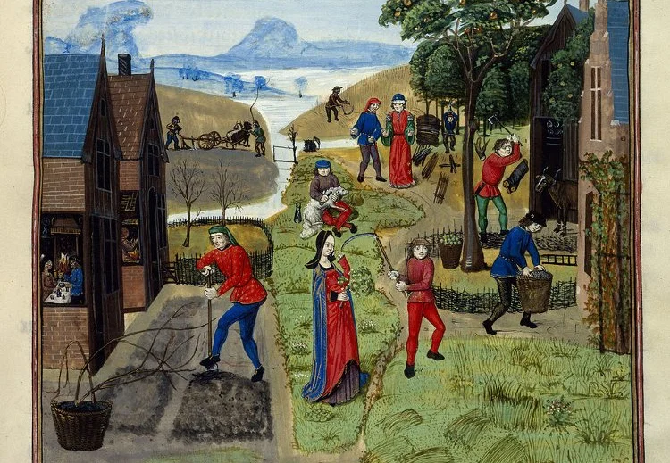
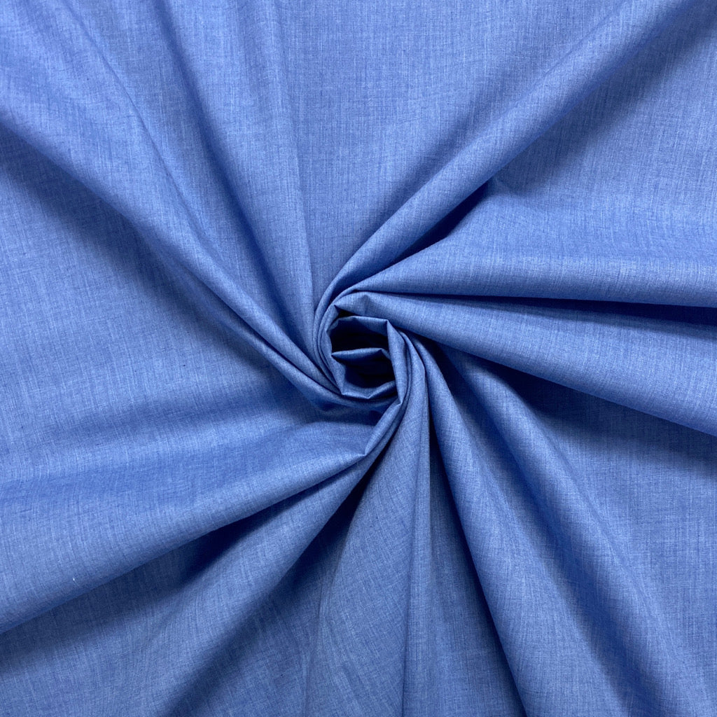
Too complex to recycle
Source: How circular is the circular economy? by Kris De Decker
Notes:
In the middle ages, old clothes were turned into paper, food waste was fed to chickens or pigs, and new buildings were made from the remains of old buildings. Before industrialisation, almost everything was made from materials that were either decomposable – like wood, reeds, or hemp – or easy to recycle or re-use – like iron and bricks.
Products are complex, the more steps in recycling process more resources and energy are lost.
A lot of recycling of plastics are downcycling, so they will become waste soon afterwards.
we combine biological and technical materials which makes it really hard to circulate (e.g. policotton used in clothes)

Slide 6
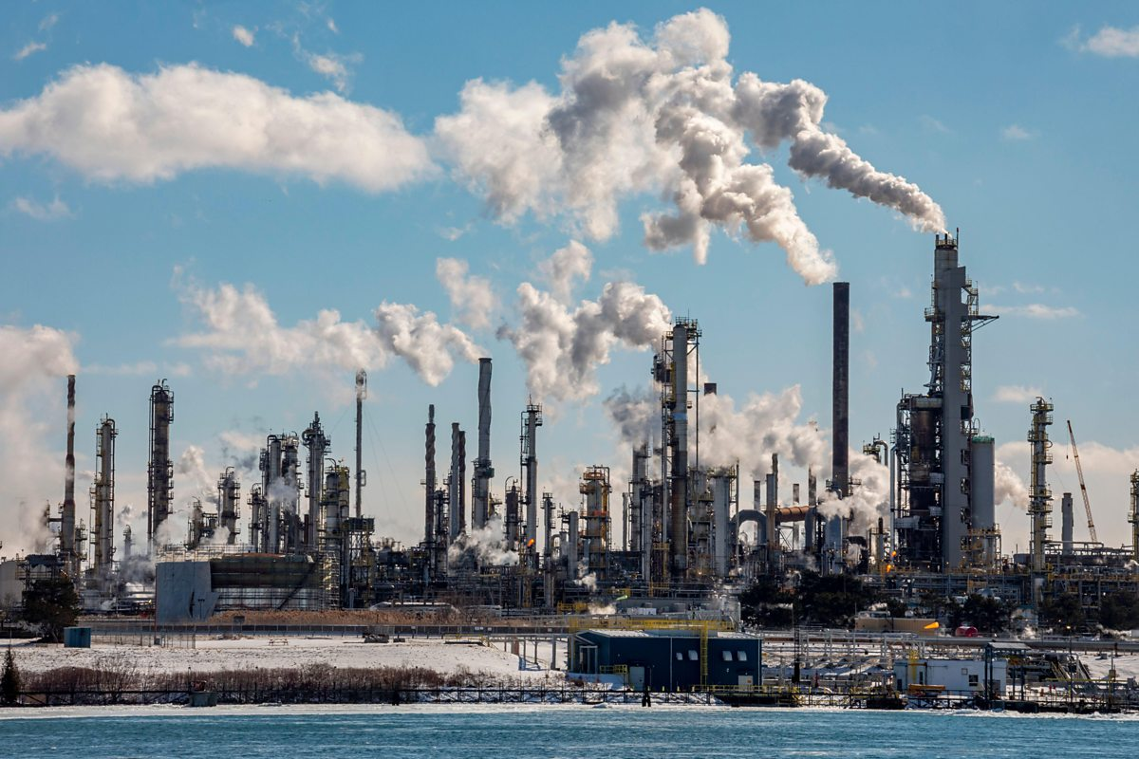
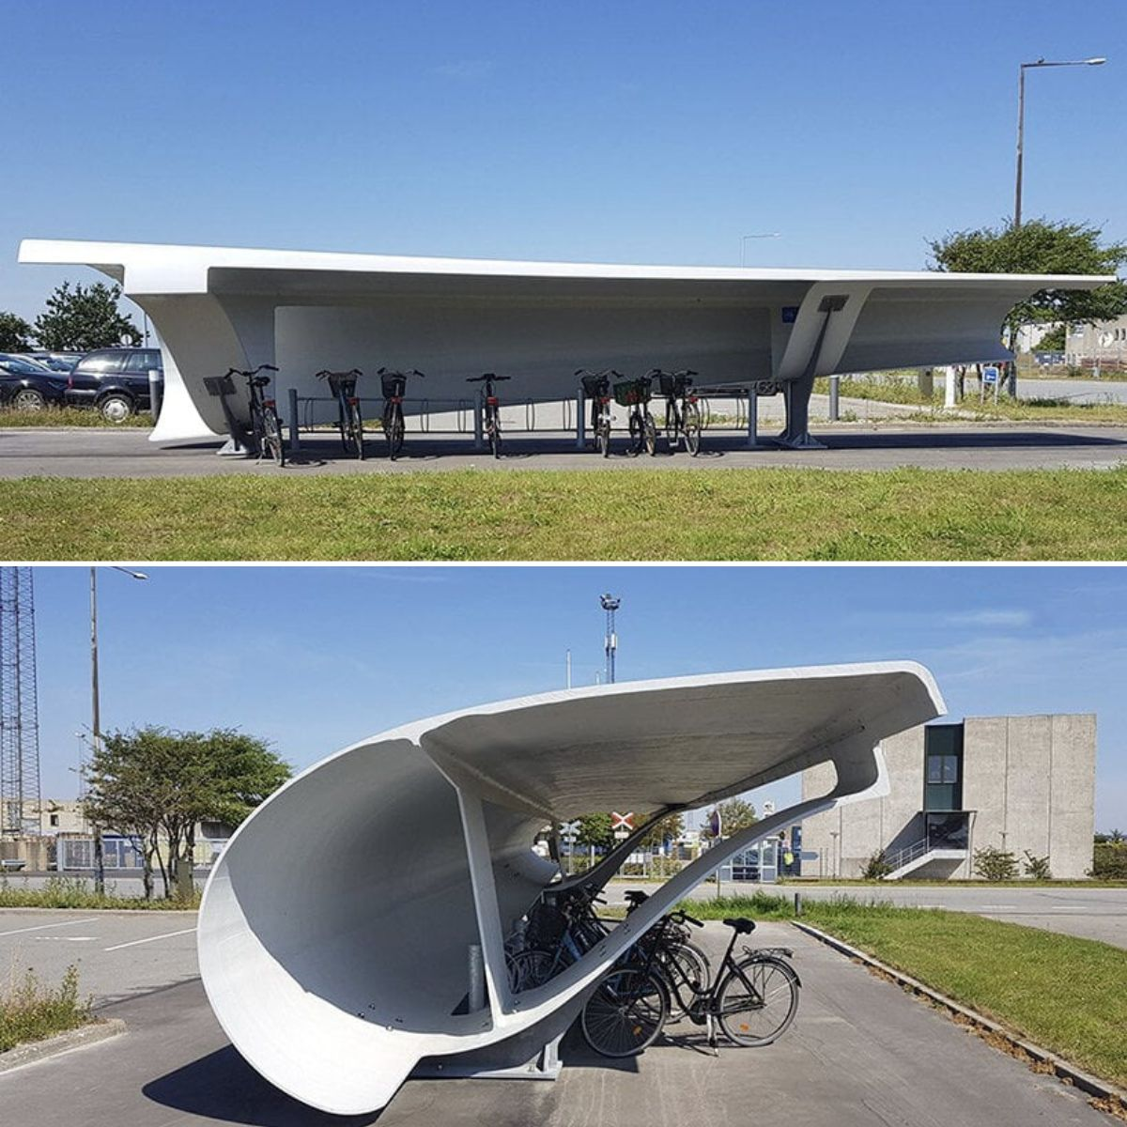
Hard to reuse/recycle energy sources
Source: How circular is the circular economy? by Kris De Decker
Notes:
20% of total resources used worldwide are fossil fuels. The majority of that is burnt as a source of energy and can’t be re-used or recycled. At best, the excess heat from, for example, the generation of electricity, can be used to replace other heat sources.
As energy is transferred or transformed, its quality diminishes (second law of thermodynamics). it’s impossible to operate one car or one power plant with the excess heat from another. So the more products we have, the more energy we need to produce to power them.
As an answer, we may say that we can go with 100% renewable energy. But in practice that doesn’t make the circle round: to build and maintain renewable energy plants and accompanied infrastructures, we also need resources (both energy and materials).
technology to harvest and store renewable energy relies on difficult-to-recycle materials. That’s why solar panels, wind turbines and lithium-ion batteries are not recycled, but landfilled or incinerated.

Slide 7
Input exceeds output
Source: How circular is the circular economy? by Kris De Decker
Notes:
the global resource use – both energetic and material – keeps increasing year by year. Growth makes a circular economy impossible.The amount of used material that can be recycled will always be smaller than the material needed for growth. To compensate for that, we have to continuously extract more resources.
Materials and energy are used in the production of products. For example, The machines used for manufacturing, the excess materials that didn’t end up on the phone. A lot is put into this phone. The more phones we produce the more materials we need to make them. Recycling 1 phone does not equal a second phone because materials lose qualities in the process.
A circular economy requires reducing total use of resources, reduce consumption and production of new things, which also reduces waste.

Slide 8
Too complex to recycle
Hard to reuse/recycle energy sources
User
Product
Supplier
Input exceeds output
Very narrow scope
Notes:
one of the causes to these issues is how small our design scope is. Often in the design phase we don’t consider how a product should be recycled, what are all the inputs it requires. If I think of my phone, the intention was to design it so that I would like it enough that I would buy more in the future.

Slide 9
Too complex to recycle
What things should we consider to increase our design scope?
Hard to reuse/recycle energy sources
User
Product
Supplier
Input exceeds output
Increase your design scope
Notes:
We need to increase our scope

Slide 10
Think about the inputs and outputs of your ideas
Too complex to recycle
Heat
Excess materials
Greenhouse gas emissions
Extracting raw materials
Production of components
Design
Manufacturing
💡
Transportation
Usage
Disposal
Land use
Water
Precious metals
Electricity
Labour
Notes:
What are the inputs and outputs of your access to clean water solution?
Look at the big picture
There are many activities needed for bringing our idea to life. If it includes a physical product, raw materials need to be extracted, etc. There are inputs and outputs for all of the activities.
For example, Land use to source the natural resources needed. In manufacturing we might need to use water, precious metals (if we are producing electronics), electricity, people’s labour and output might be excess materials, heat from fossil fuels
To think about the inputs and outputs you can think of: What needs to happen in order for me to be able to manufacture my product?

Slide 11
How could the outputs circulate back and be used in your solution or in other industries?
How could you design for recyclability?
Heat
Excess materials
Fossil fuels
Extracting raw materials
Production of components
Design
Manufacturing
💡
Transportation
Usage
Disposal
Land use
Water
Precious metals
Electricity
Labour
Notes:
what if excess material could be used in your production or for other industries?
How do you make sure that the lifecycle of the product can be prolonged with maintenance? And that its parts can be used for other products instead of becoming waste?
What if the excess heat can be used to warm up other facilities?
There a finnish company that serves companies with servers and then warms up their offices with the excess heat that comes from running the servers.
Also, Fortum and Microsoft announce world’s largest collab­o­ration to heat homes, services and businesses with sustainable waste heat from new data centre region

Slide 12
Reduce the amount of resources used
Hard to reuse/ recycle energy sources
Input exceeds output
How could you reduce the amount of energy needed to produce and operate your solution?
How could you reduce the amount of water consumed with your solution?
Notes:
other questions to consider. reduce the excess water consumed, the leakages
Can we support degrowth?

Slide 13
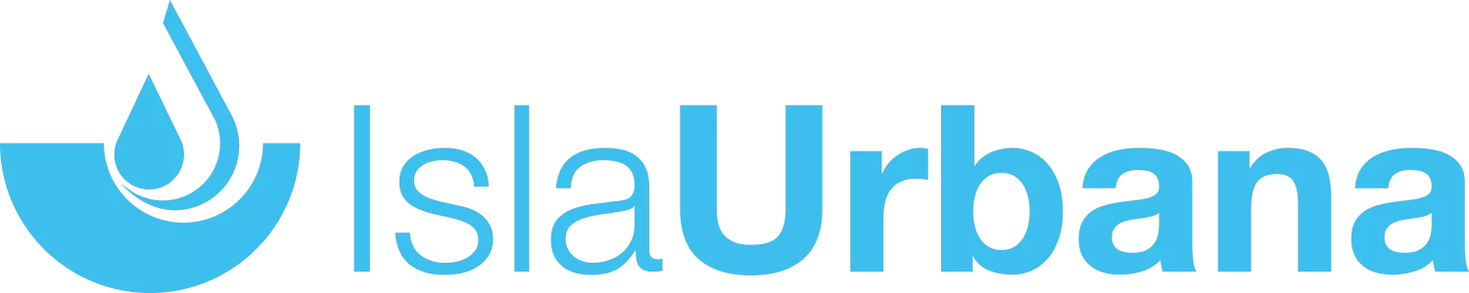
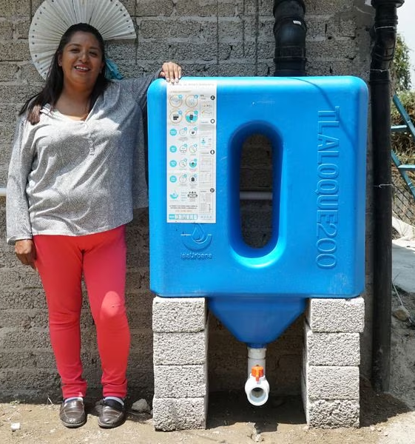
Problem:
Millions of people lack decent and secure access to water in Mexico.
Pumping water requires enormous amounts of electricity.
40% of the water in the system is lost in leaks due to old infrastructure
Mexico City spends more than 10% of its total budget pumping water to and around the city.
Hidden costs: the poorest people spend up to 20% of their income on accessing water.
Notes:
Problem: millions of people lack decent and secure access to water in Mexico. Pumping water requires enormous amounts of electricity. Addressing leaks in water-distribution networks, especially in cities, can curb water loss, energy use, and emissions.
Isla Urbana is dedicated to contributing to water sustainability in Mexico through rainwater harvesting. So they use an existing resource (rainwater) and simple system to harvest it.
Educates community on sustainable practices and efficient water use
Regenerate:
Reduced Flooding: Capturing rainwater reduces the flow of stormwater into the drains, mitigating the flooding that currently affects Mexico City.
Recharging of the Aquifers: By harvesting the rainwater as it falls during the wet season, we could reduce the pressure on our rivers and aquifers by allowing them to recharge.
It’s a circular solution that takes a renewable resource (rainwater) and puts it to use
reduce the excess water consumed, the leakages
Can we support degrowth?

Slide 14
Solution:
Local system to harvest rainwater
Education on sustainable practices and efficient water use
Secondary impacts
Reduced Flooding
Recharging of the Aquifers: reduce the pressure on our rivers during the wet season
Notes:
Problem: millions of people lack decent and secure access to water in Mexico. Pumping water requires enormous amounts of electricity. Addressing leaks in water-distribution networks, especially in cities, can curb water loss, energy use, and emissions.
Isla Urbana is dedicated to contributing to water sustainability in Mexico through rainwater harvesting. So they use an existing resource (rainwater) and simple system to harvest it.
Educates community on sustainable practices and efficient water use
Regenerate:
Reduced Flooding: Capturing rainwater reduces the flow of stormwater into the drains, mitigating the flooding that currently affects Mexico City.
Recharging of the Aquifers: By harvesting the rainwater as it falls during the wet season, we could reduce the pressure on our rivers and aquifers by allowing them to recharge.
It’s a circular solution that takes a renewable resource (rainwater) and puts it to use
reduce the excess water consumed, the leakages
Can we support degrowth?

Slide 15
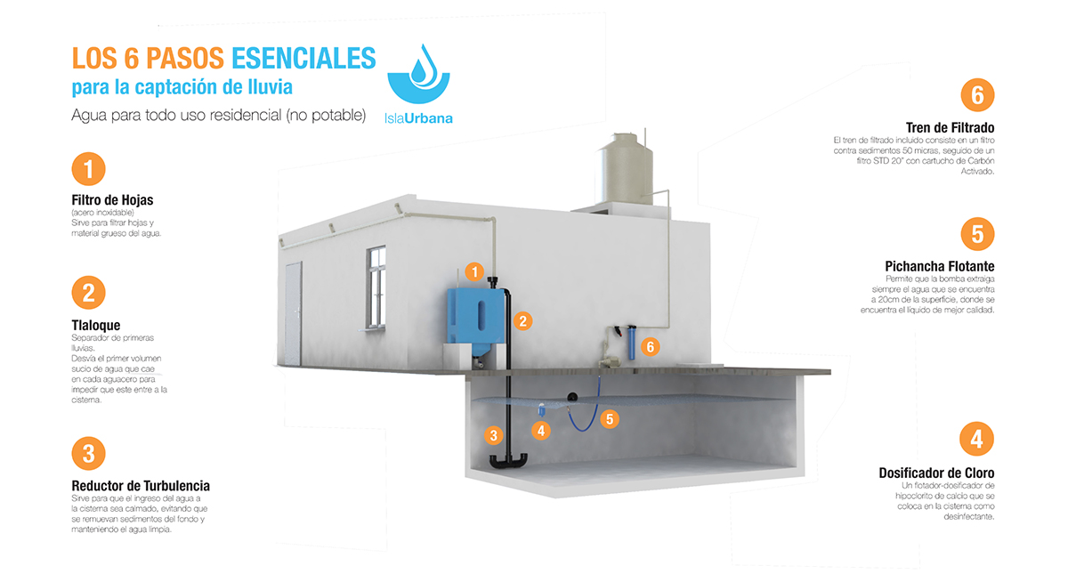
Impact:
Installed 9,000 systems, affecting +50,000 people.
Address water scarcity (UN SDG 6.4) and strengthening the participation of local communities in improving water and sanitation management (UN SDG 6.b)
Notes:
Leaf filter: thick material
tlaloque: separates the first rains, the first dirty volume that falls in the rainfall to avoid it to enter the tank
Turbulence reducer: helps water enter the tank calmly, avoiding sediments to lift from the ground of the tank, this maintains the water clean
chlorine dispenser: to disinfect water
floating pichancha: allows pump to extratc the water that is 20 cm from the surface, where you have the better quality liquid
Filter against 50 microns sediments, STD 20 filter with activated carbon cartridge
https://wdo.org/isla-urbana/

Slide 16
Considerations for regenerative solutions

Slide 17
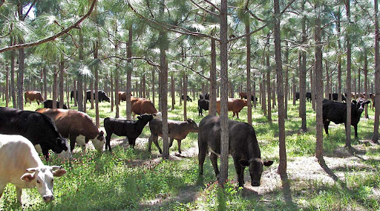
Regenerative solutions
Go beyond reducing the negative impact to restore, renew, and even improve natural and social systems.
Supporting local communities
Building soil health
Enhancing biodiversity
Silvopasture
What if you not only improve the access to clean water, but support the natural system in regenerating and increasing the amount of water available at times of drought?
Notes:
Don’t only reduce your negative impact.
How can your idea have a positive impact in natural or social systems?
What if you not only improve the access to clean water, but support the natural system in regenerating and increasing the amount of clean water available at times of drought?
Regenerative solutions aiming to restore, renew, and even improve natural, social, systems. These models are designed to create positive impacts by using regenerative principles such as enhancing biodiversity, building soil health, supporting local communities, and minimizing waste
Isla urbana was a regenerative solution:
Educates community on sustainable practices and efficient water use
Reduced Flooding: Capturing rainwater reduces the flow of stormwater into the drains, mitigating the flooding that currently affects Mexico City.
Recharging of the Aquifers: By harvesting the rainwater as it falls during the wet season, we could reduce the pressure on our rivers and aquifers by allowing them to recharge.

Slide 18
Reflect on the long-term impacts of your ideas
What can be the impacts of a phone 7 generations ahead?
What is the impact of my solution for access to clean water in 100 years?
💡
What is the impact for the 7th generation?
Notes:
How it could be hindering ecosystems from regenerating
Thinking of the long term helps us put our ideas in perspective, how they fit into the BIG picture

Slide 19
Consider who is impacted/involved in your idea
What other living being could you consider in your projects?
user
Have empathy not only with users, but with any impacted living being.
Notes:
When designing any solution nowadays, we start by thinking of how it can create value for users.
To help us increase our design scope and think of how we can have a positive impact we can think of who is involved/ affected by our ideas.

Slide 20
Consider who is impacted/involved in your idea
ecosystems where production happens
people building supplies
city hall
suppliers
user
Have empathy not only with users, but with any impacted living being.
forest
animals living in the area
sea
people living in the area
Notes:
This is not just people but any living being like animals and plants. And we don’t want to think of them as resources, we want to value them as much as we value people.
Think of the people that will use your solution, the people living in the area where it will be put in place, animals (they might be more impacted than the local people). Is there a sea/ river or forest nearby? do they get affected?
With this exercise, we aim to have empathy not only for users but also for every living thing that is involved. As much as possible go meet the ecosystems affected, not just the users
Do this with desk research and by involving different experts, asking feedback for your project

Slide 21
Think in ecosystems, not individual solutions
How does you solution for access to clean water fit in the ecosystem of your region?
Notes:
In order to potentially have a positive impact, we have to think in the big picture.
Often times we think of a circular solution as second hand clothes. But that is one part.
What happens to the clothes once they are used by the people that bought them second hand?
How do you ensure you are extending the life cycle of the clothes as much as possible? How about the end of life?
Could they be returned and recycled?
As a consumer I might think “I can wear this once and throw away because they have been already used before, so I don’t feel guilty” - that’s not sustainable at all.
Where does your solution fit in the big picture? in the ecosystem of your region? You solution is one intervention and it’s important to think about how it connects to the other initiatives happening in your region.
Also, what other initiatives you need to have in place to ensure you secure clean water for all in a responsible way.

Slide 22
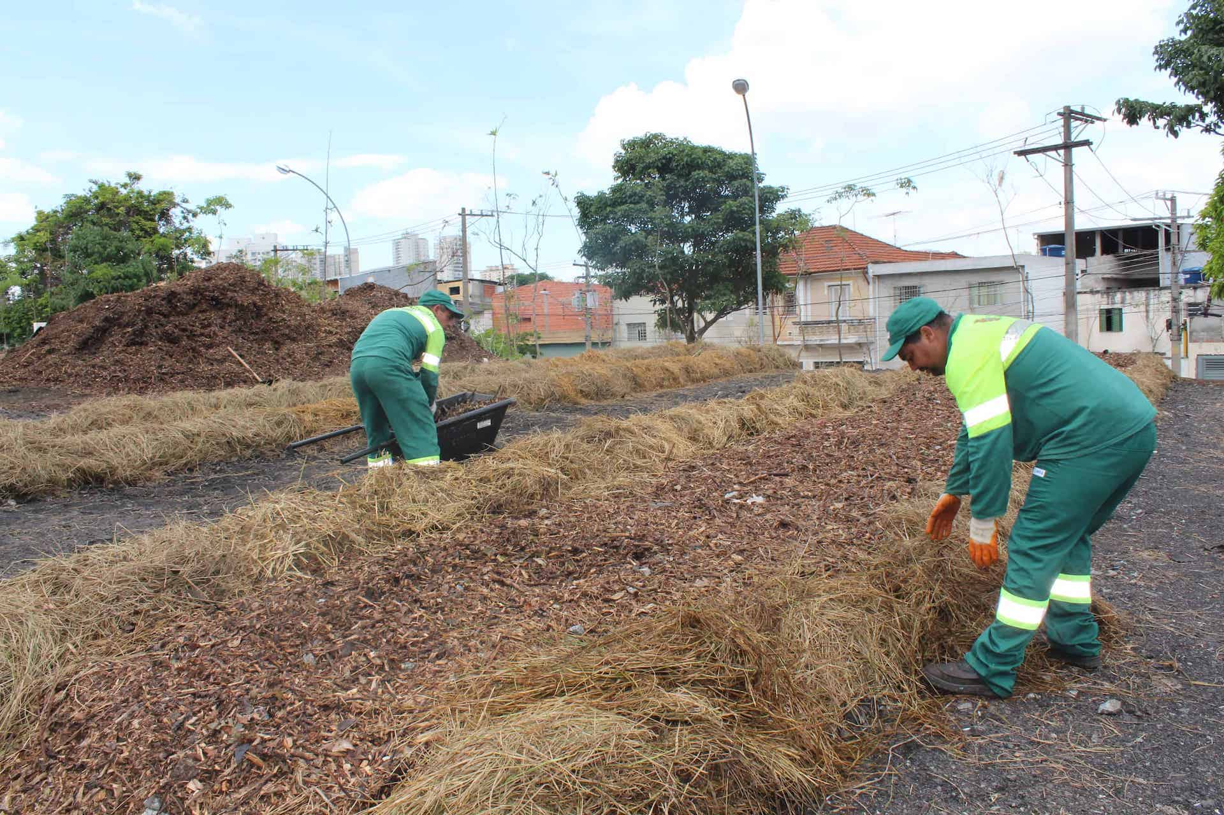
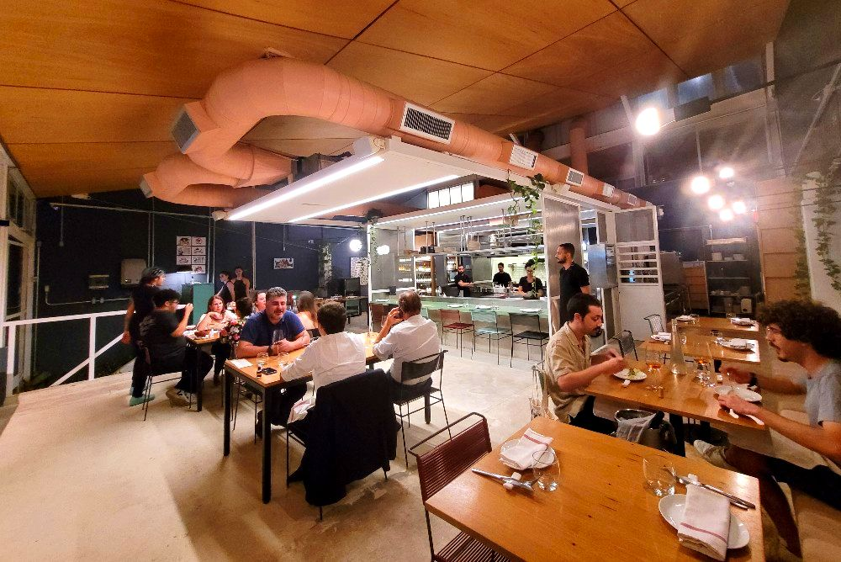
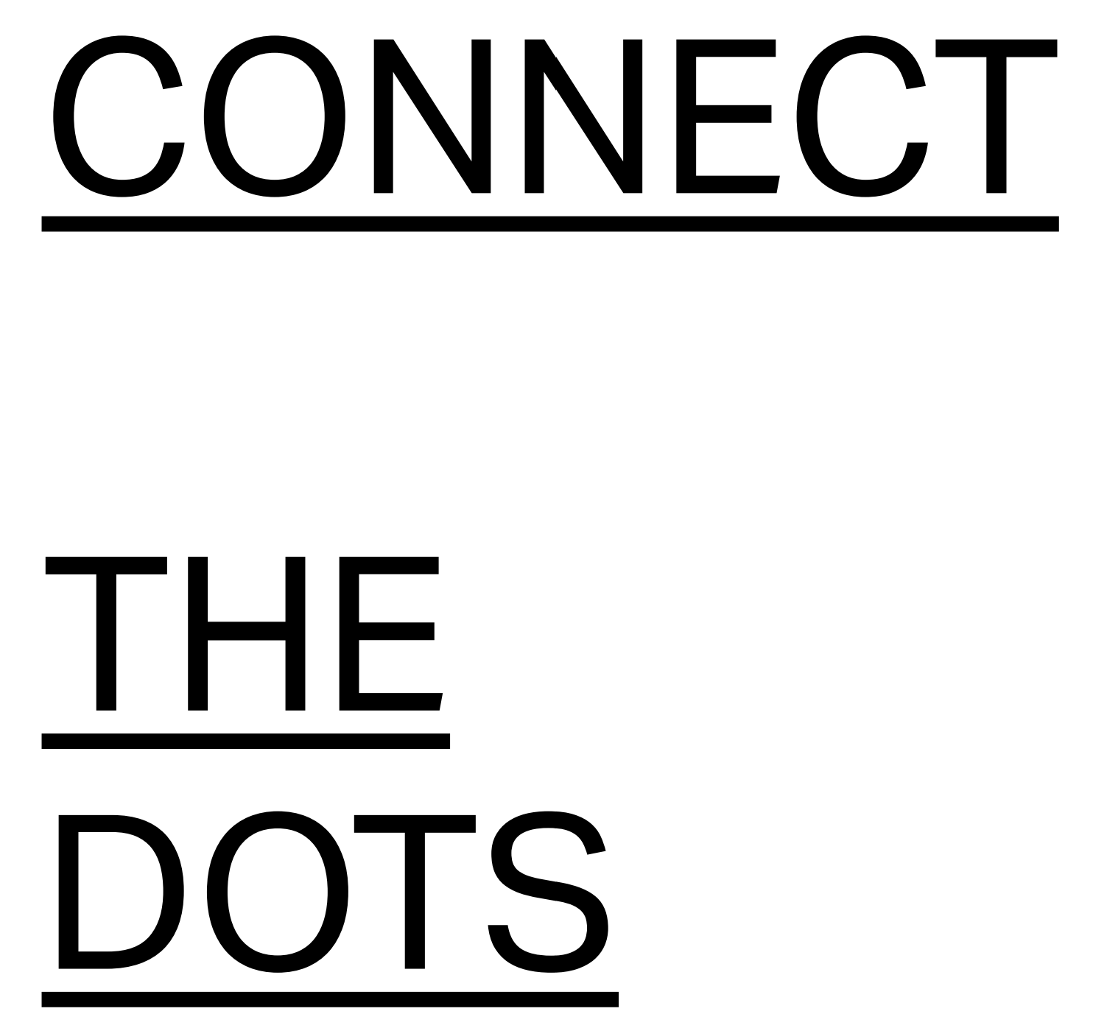
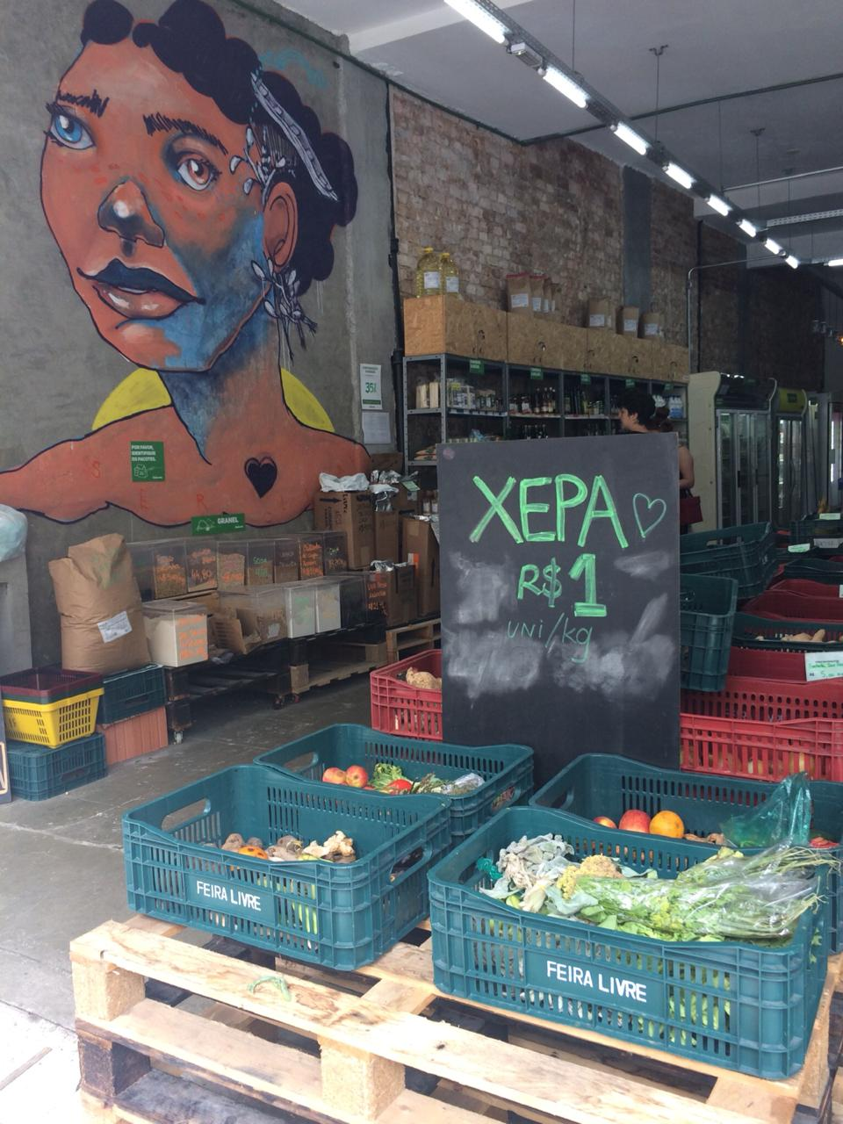
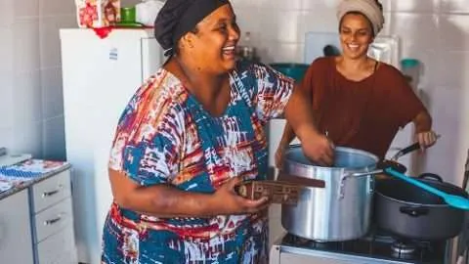
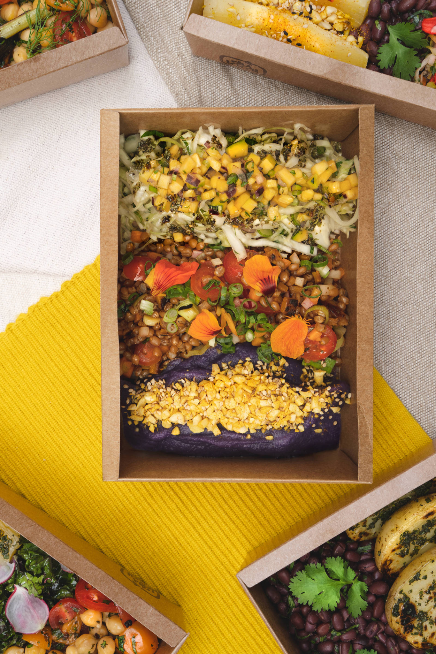
Composting centers
Corrutela restaurant
São Paulo has 15 composting centers, whose compost produced is given to farmers
They make their menu according to what the farmers send them
It sells food products without pesticides from local producers and tells consumers the price for the producer.
Instituto Feira Livre
Supports farmers in adopting and certifying in regenerative agriculture.
DuLocal
Food delivery service prepared with organic produce from family farmers and cooked by female entrepreneurs
Notes:
https://ellenmacarthurfoundation.org/circular-examples/connect-the-dots
Connect the Dots, initiative from city of Sao Paulo Brazil, is creating a circular economy for food by supporting local farmers as they transition to regenerative practices
Connect the dots: The city buys produce at 30% higher cost to incentivise them
So the connect the dots initiative fits with several other initiatives in the city. So you can think of how your solution fits in your region and what else needs to be in place for your solution to thrive.

Slide 23
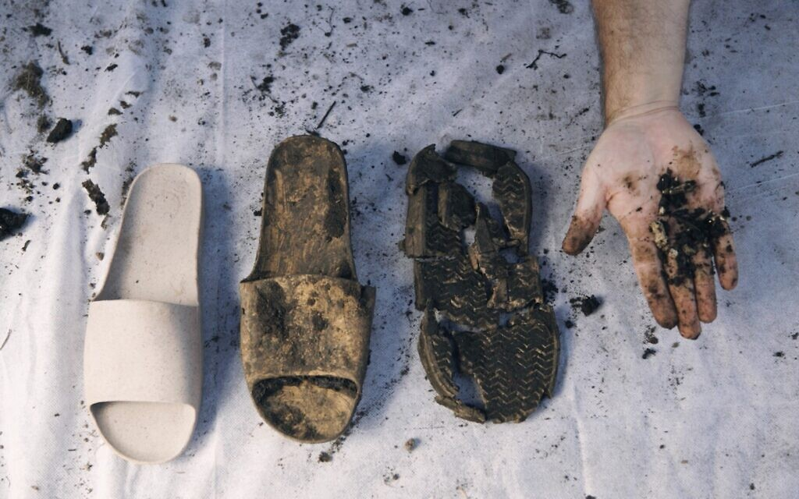

Israeli material science company
developing compostable and biodegradable thermoplastics on a mission to create circular model for consumer goods products.
Notes:
Balena slides: an example of how a company thought about an ecosystem, not just 1 product.
material science company developing compostable and biodegradable thermoplastics on a mission to create circular model for consumer goods products. Israel
The sandal is designed to become the raw material for new sandals.
they thought of the inputs and outputs, made to be recycled.
How to motivate and educate people to bring the andals back at the end of usage, instead of disposing them.
Think of the ecosystem that needs to be in place: not just a sandal but the collaboration with the people manufacturing them, making sure the materials are natural, collaborating with the drop off points.
They considered the long term impacts as their their mission is to create materials that are fully circular and find solutions to the negative impact of fashion.

Slide 24
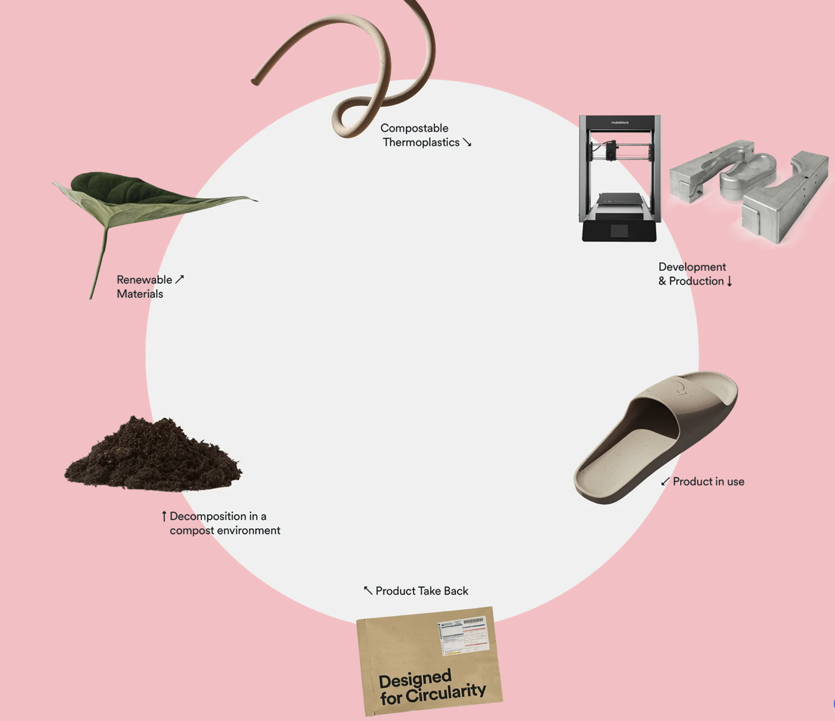
Colour: leftovers from an Israeli tea manufacturer
What could go wrong with this solution?
unintended consequences
People feel less guilty about using stuff and throwing it away fast. It could have the opposite impact. That’s why balena is doing a pilot in tel aviv and seeing how people react?
Some materials are sourced from landfills and inadequately recycled clothing
Take-back locations around the city
Notes:
Balena slides: an example of how a company thought about an ecosystem, not just 1 product.
material science company developing compostable and biodegradable thermoplastics on a mission to create circular model for consumer goods products. Israel
The sandal is designed to become the raw material for new sandals.
they thought of the inputs and outputs, made to be recycled.
How to motivate and educate people to bring the andals back at the end of usage, instead of disposing them.
Think of the ecosystem that needs to be in place: not just a sandal but the collaboration with the people manufacturing them, making sure the materials are natural, collaborating with the drop off points.
They considered the long term impacts as their their mission is to create materials that are fully circular and find solutions to the negative impact of fashion.

Slide 25
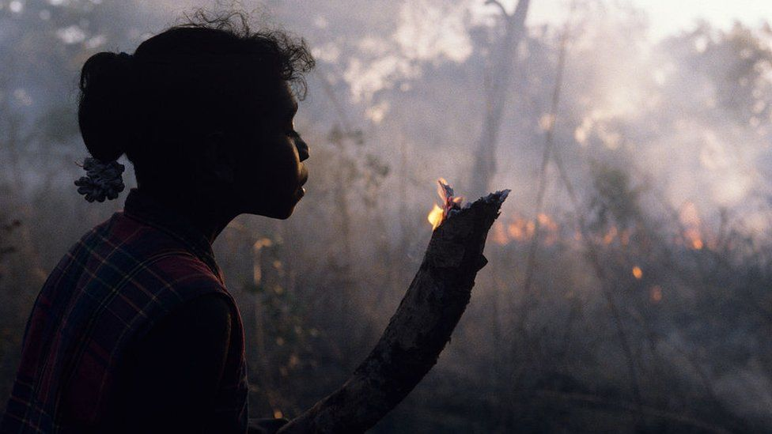
Get inspired by indigenous & traditional practices
Practices that are symbiotic with nature, created over millennia by indigenous people.
In Australia, the ancestral lands that practice Cultural burning or fire stick farming are not as affected by the fires around them. They are able to use fire not to destroy the forest but to improve the soil and clear debris.
Source: Julia Watson. Lo—TEK. Design by Radical Indigenism
Notes:
We can also investigate indigenous practices. These are Low tech innovations: technologies that are symbiotic with nature, created over millennia by indigenous people.
This is an example present in the book Lo-TEK, that shares many examples of indigenous technology.
Calcutta, instead of contaminating its rivers with sewage, they use a sewage fed aquaculture system. East calcutta wetlands roughly clean half of the rural sewage that comes out of the city of 15 M people per day. It saves the city about 22M dollars in operating costs. It’s a technology that is a fishery, a wastewater treatment plant, farmland, pasture, rice paddy, community hub and a heritage site. Fish farms produce 16% of the fish provided to the city and employees 60 000 farmers. This is done by a symbiotic process of fish, algae and bacteria
Enhancing biodiversity, supporting local community, building soil health

Slide 26
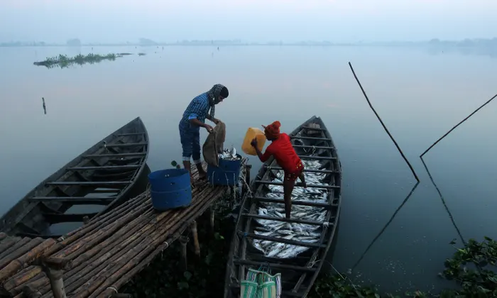
Kolkata’s sewage fed aquaculture system
Problem: Kolkata’s municipality has the capacity to treat only 24% of the city’s wastewater.
Source: Julia Watson. Lo—TEK. Design by Radical Indigenism
Notes:
We can also investigate indigenous practices. These are Low tech innovations: technologies that are symbiotic with nature, created over millennia by indigenous people.
This is an example present in the book Lo-TEK, that shares many examples of indigenous technology.
Calcutta, instead of contaminating its rivers with sewage, they use a sewage fed aquaculture system. East calcutta wetlands roughly clean half of the rural sewage that comes out of the city of 15 M people per day. It saves the city about 22M dollars in operating costs. It’s a technology that is a fishery, a wastewater treatment plant, farmland, pasture, rice paddy, community hub and a heritage site. Fish farms produce 16% of the fish provided to the city and employees 60 000 farmers. This is done by a symbiotic process of fish, algae and bacteria
Enhancing biodiversity, supporting local community, building soil health

Slide 27
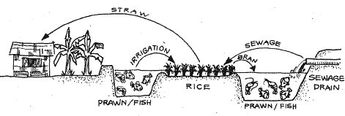
Kolkata’s sewage fed aquaculture system
12,500 hectares on the eastern fringes of the city.
Provide a living for +50,000 cultivators and fish traders
What do you think could go wrong with this solution?
Combination of sewage in the water and sunshine broke down the effluent and allowed plankton to grow exponentially.
Domestic sewage is usually free from hazardous chemicals harmful to human health
Microbial populations contained in sewage need to be checked regularly
Notes:
Combination of sewage in the water and sunshine broke down the effluent and allowed plankton to grow exponentially.

Slide 28
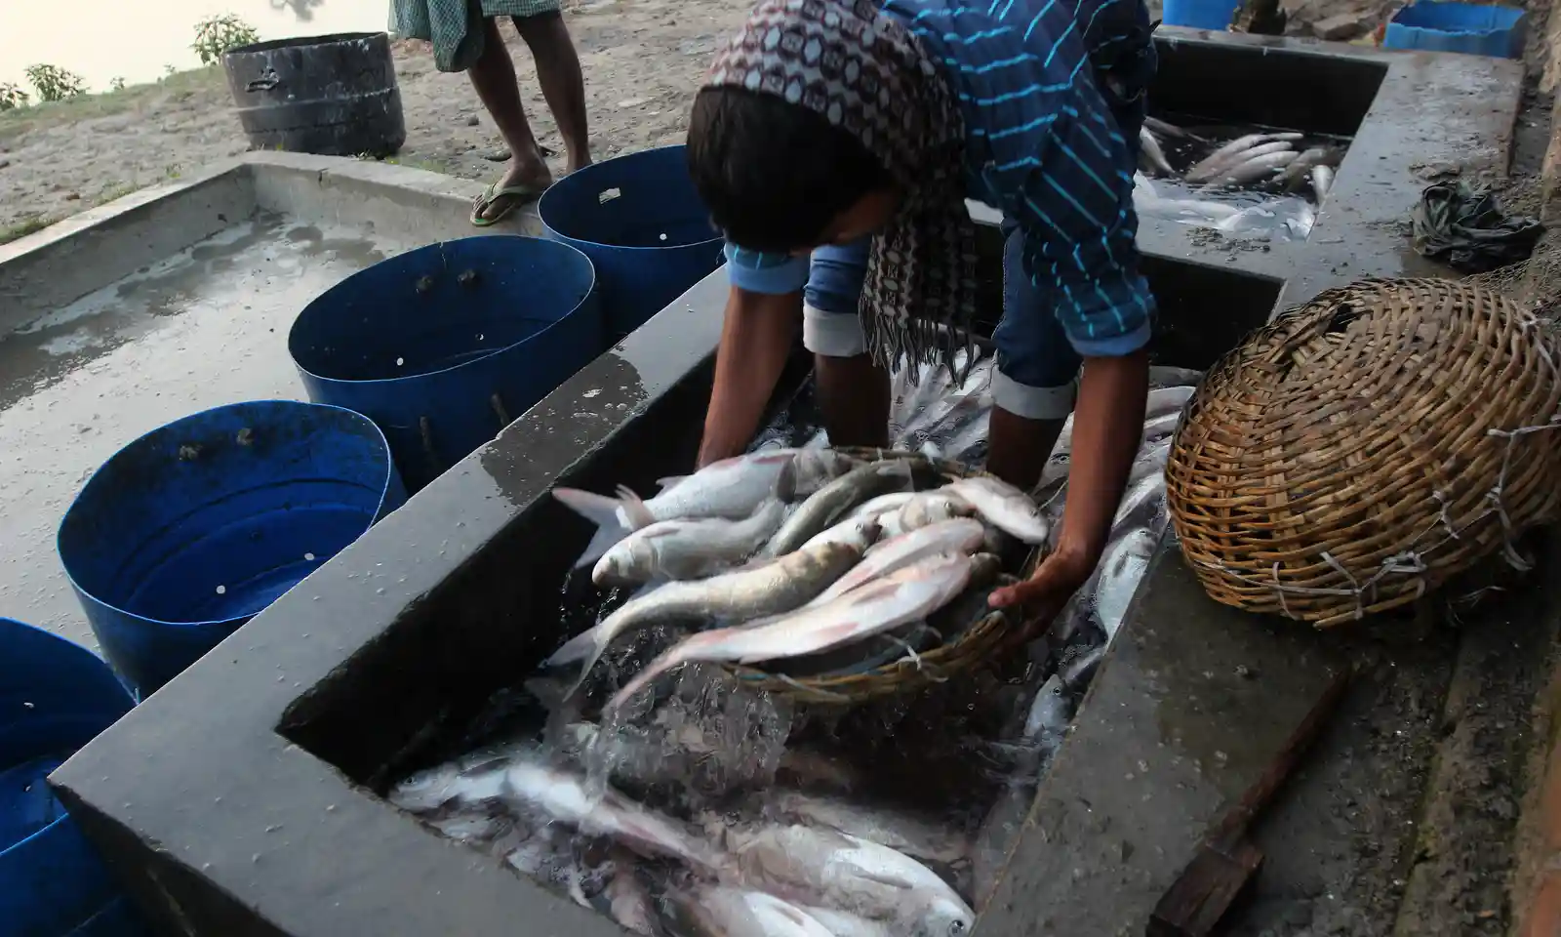
Kolkata’s sewage fed aquaculture system
Lack of regulation to manage:
Competition for wastewater for the aquaculture and agriculture sectors
With less water to share between the fish farmers, each fish pond gets shallower
Unregulated water goes to fisheries with strong smell
Notes:
need ecosystem solution to include other elements like regulations
“For good [fish] production, you need depth of around 5ft, now tey are 2ft
lack of land availability due to other industries pushing

Slide 29
You cannot solve all the problems, so prioritize in order to find a balance in your solution.
What problems will you address in your solution?
What things you cannot solve and have to live with?
Notes:
As the design team, you have to collaborate further: seek feedback, knowledge of different experts. Show your ideas and listen to feedback, listen to potential side effects you might have not considered. Afterwards you come together with your team, look at all the info that you got and you decide how to prioritize.
What problems will you address in your solution? What things you cannot solve and have to live with?
You might not be able to gather a lot of different feedback in this week, but I hope that you take this approach into your future work.
This is the same as any design challenge. In my work, when I am introducing a new concept in my company, even though it is approved by management, there will be many opinions on how it should be done in certain ways or not done at all. It is up to the design team to collect all these views and then decide on what solution to proceed with. And in all cases, we create something on a small scale, release, see how well it does once people use it, once it is in the ecosystem, and then improve, adjust what is needed

Slide 30
Ideas to take with you
How could you use these principles in your work this week?
Reflect on the long-term impacts of your ideas
Consider the livings beings impacted/ involved in your idea
Think in ecosystems, not individual solutions
Get inspired by indigenous and traditional practices

Slide 31
Improvements
I took 35 min, could have spoken slower
Generally liked the content and especially the examples. Ola knew most things but not in depth.
Chris really liked the talk: right level of information. No need to make it more engaging
Could add more engagement with questions throughout the talk (see examples in slides)
Balena: if they assume people will continue with fast fashion, is this greenwashing?
In week 1 , students were in the exoplanet, in an environment they could control, where they could design the whole society. In week 2, they come back to earth and they are not in control.
  How to avoid going to the region and telling people what to do? Just assume that the problem is that they are not educated? How do we take our responsibility in the problem?
  Show one example where education is not enough because people dont have the mandate to actually make changes. The industries are the guilty ones for example
    Conclusion: dont go for oversimplified solutions
  Example of a political intervention
Next time: how to create regenerative practical solutions: not
Yes and, yes but exercise: plan a trip with yes but. Now plan a trip with yes and. What are the differences that you saw in the 2 rounds?

Slide 32
Ideas to take with you
Think about the inputs and outputs of your ideas
Reflect on the long-term impacts of your ideas
Personify the people, fauna and flora impacted by your ideas, the same way you personify users
Think in ecosystems, not individual solutions
Regenerate, & have a positive impact
You cannot solve all the problems, so prioritize in order to find a balance in your solution.
think of ecosystems, not single solutions
think in longer-term: how does your ideas affect future generations?
think of the inputs and outputs needed: resources and waste
think how you can create value, regenerate
copy nature with pride
Personify the people, fauna and flora impacted by your projects, the same way you personify users.
Prioritization: you cannot solve everything, it’s a balance. Where do you draw the line? No hard truths

Slide 33
Source: Julia Watson. Lo—TEK. Design by Radical Indigenism
Notes:
We can also investigate indigenous practices. These are Low tech innovation: technologies that are symbiotic with nature, created over millennia by indigenous people.
This is an example present in the book Lo-TEK, that shares many examples of indigenous technology.
The author, Julia Watson, goes as far as says that wildfires are a manmade disaster, because we have ancient technology that solves this. In Australia, the ancestral lands that practice Cultural burning or fire stick farming not as affected by the fires around them. This Indigenous solution evolved over millenia, has cut down the impacts of these fires by half. These are Aboriginal methods use precisely timed, low intensity fire, they respond to soil types, geology, trees, the breeding cycles of animals and flowering cycles from plants. They are able to use fire not to destroy the forest but to improve the soil and clear debris

Slide 34
Ideas to take with you
Think about the inputs and outputs of your ideas
Reflect on the long-term impacts of your ideas
Personify the people, fauna and flora impacted by your ideas, the same way you personify users
Think in ecosystems, not individual solutions
Regenerate, & have a positive impact
You cannot solve all the problems, so prioritize in order to find a balance in your solution.
think of ecosystems, not single solutions
think in longer-term: how does your ideas affect future generations?
think of the inputs and outputs needed: resources and waste
think how you can create value, regenerate
copy nature with pride
Personify the people, fauna and flora impacted by your projects, the same way you personify users.
Prioritization: you cannot solve everything, it’s a balance. Where do you draw the line? No hard truths

Slide 35
Indigenous practices
https://www.youtube.com/watch?v=BAblFYr0NF0
8% of population lives with 80% of biodiversity
wildfire are a manmade disaster, because we have ancient technology that solves this. they have completely destroyed ecosystems. The ancestral lands that practice Cultural burning or fire stick farming they were fine with fires around them- Indigenous pyro technology evolved over millenia, has cut down the impacts of these fires by half. Aborigenous methods use precisely timed, low intensity fire, they respond to soil types, geology, trees, the breeding cycles of animals and flowering cycles from plants. Brazil: Use fire not to destroy the forest but to improve the soil. clear debris and introduce 900 plant species around which they build their homes.
The knowledge and practice of fire stick fire, we call TEK (traditrional ecological knowledge). It is passed down to generations through mythology. Storytelling is incredibly sophisticated: understanding of land, technology, practice - all these things together create sophisticated understanding of human’s kind role in the world.
Aborygenees in australia
Tribes believe it is their spiritual purpose to proctect nature.
Low tech innovation: technologies that are symbiotic with nature (created over millenia by tribes) that harness the intelligence of the ecosystem
Cascading effect. Calcutta, instead of contaminating its rivers with sewage, they use a sewage fed aquaculture system. East calcutta wetlands roughly clean half of the rural sewage that comes out of the city of 15 M people per day. It saves the city about 22M dollars in operating costs. It’s a technology that is a fishery, a waste water treatment plant, farmland, pasture, rice paddy, community hub and a heritage site. Fish farms produce 16% of the fish provided to the city and employees 60 000 farmers. Tihs is done by a symbiotic process of fish, algae and bacteria
Climate change is the biggest existential crisis of our time. And it is clear that our connection to nature is broken and te threat that that poses has recently been reframed as one of my own important questions: what are we here for? for indigenous people there is an understanding that humans are the protectors of the earth.
Notes:
https://neweconomy.net/

Slide 36
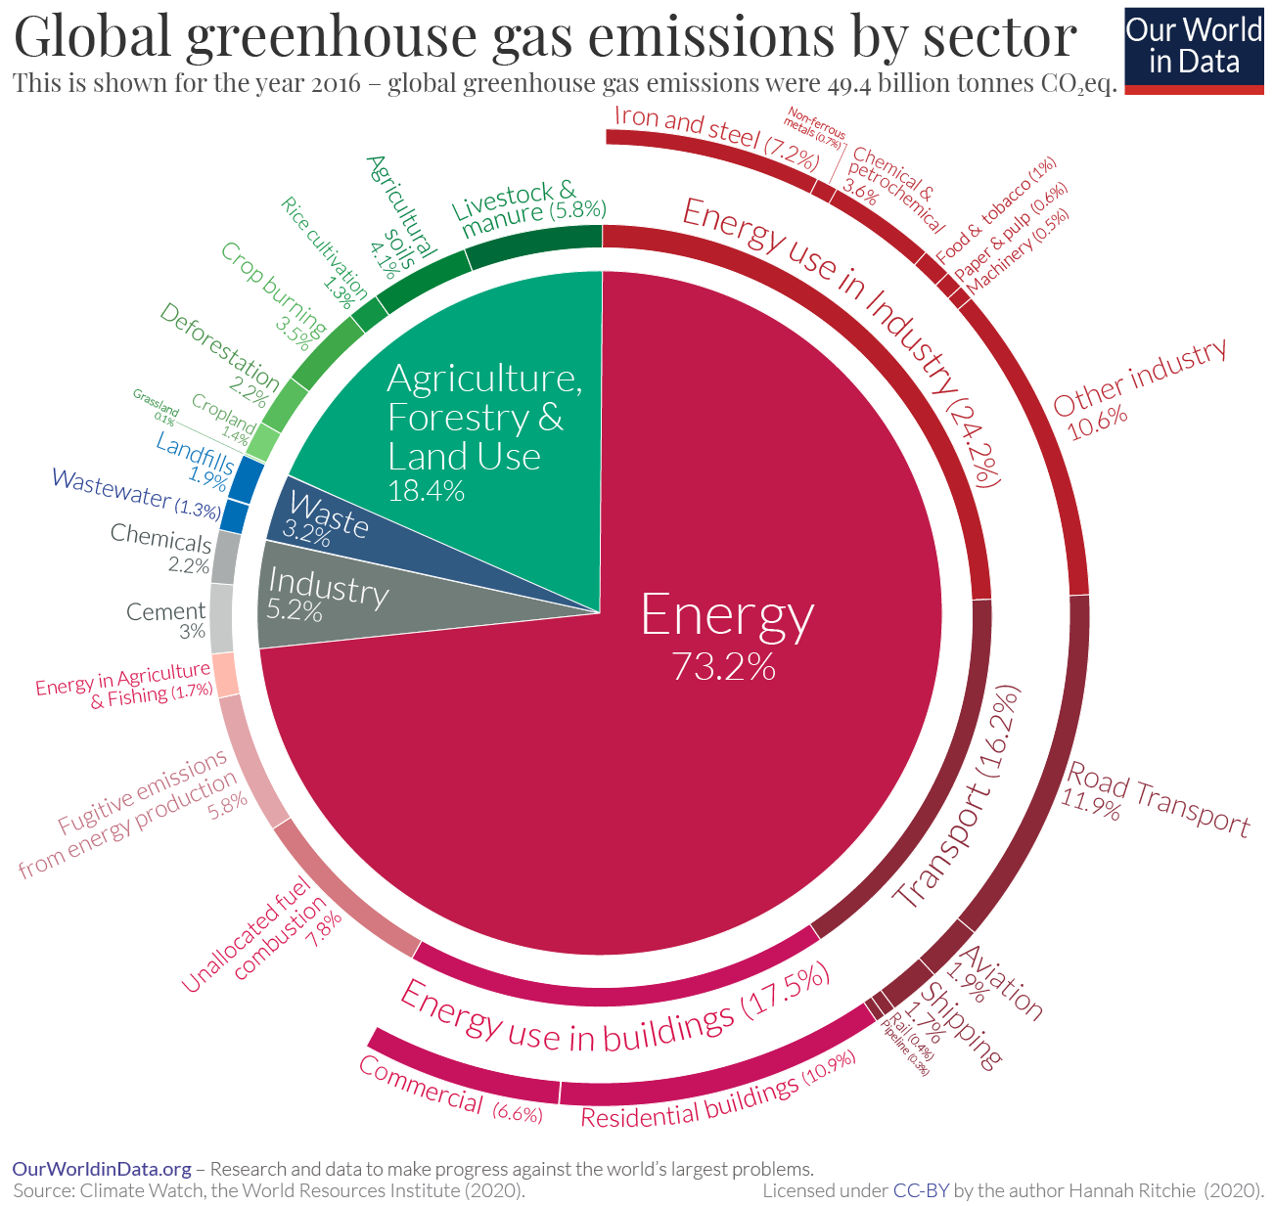
mitigate or adapt to climate change?

Slide 37
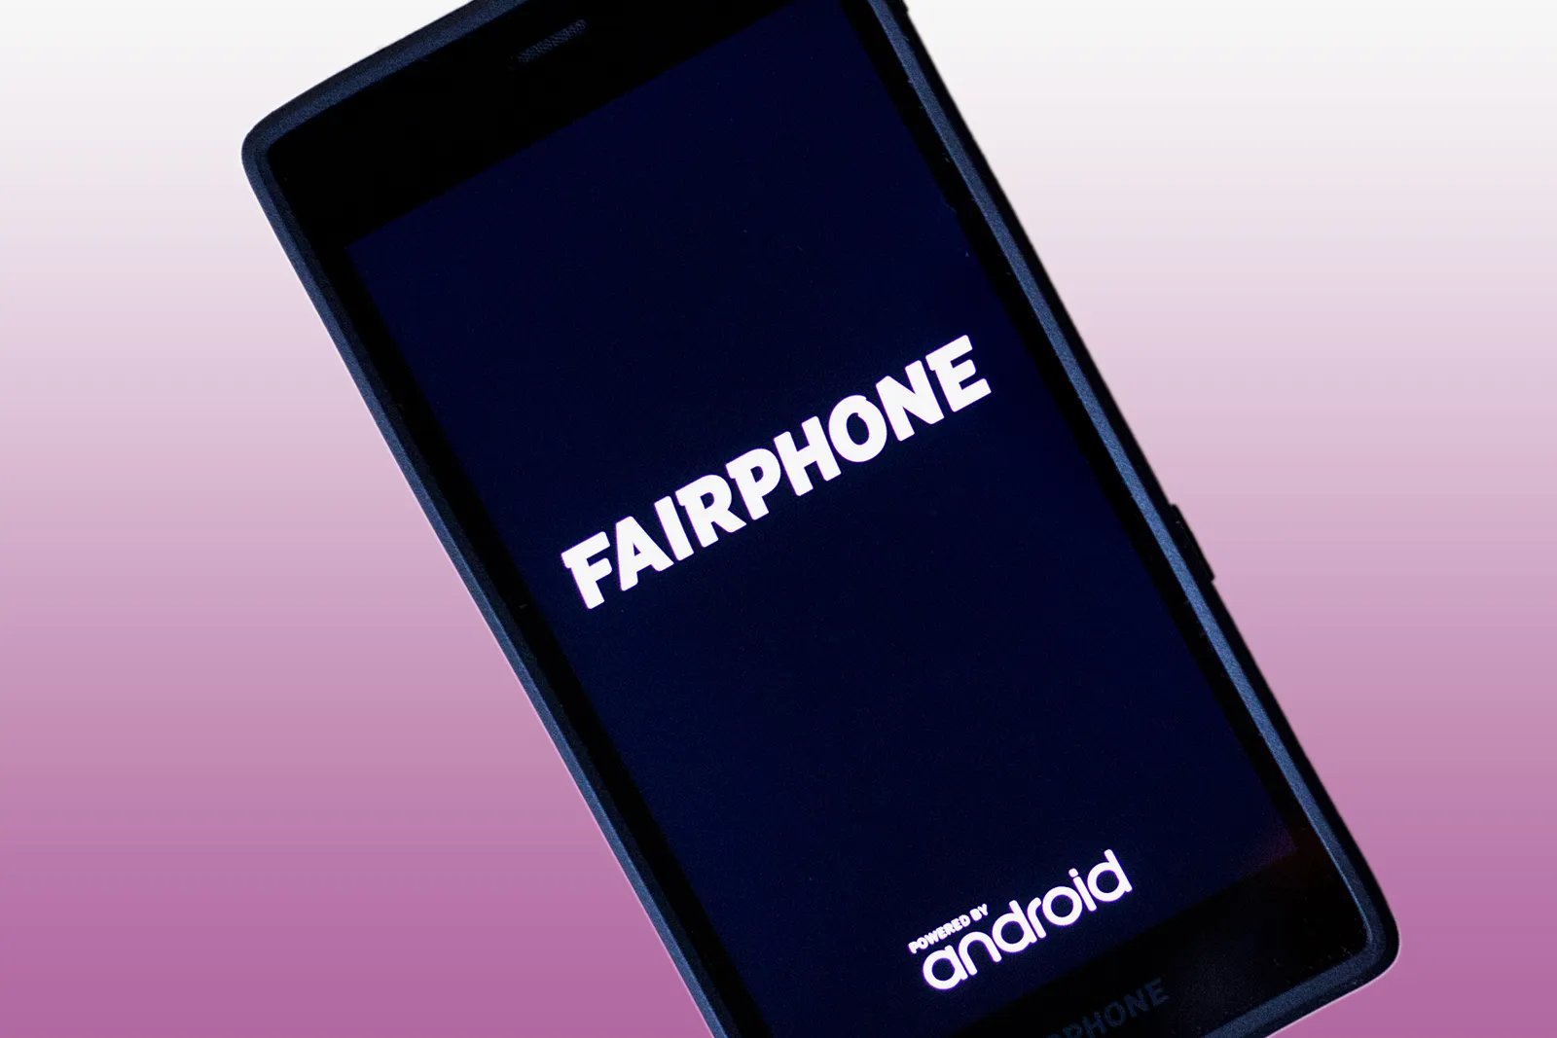
Pitfalls of circular economy
Too complex to recycle:
In the middle ages, old clothes were turned into paper, food waste was fed to chickens or pigs, and new buildings were made from the remains of old buildings. Before industrialisation, almost everything was made from materials that were either decomposable – like wood, reeds, or hemp – or easy to recycle or re-use – like iron and bricks.
Fair phone 2 – a smartphone designed to be recyclable and have a longer lifespan – with the use of synthetic materials, microchips, and batteries - Only 30% is recyclable
Products are complex, the more steps in recycling process more resources and energy are lost. Production of electronics is more resource intensive than extraction of raw materials, so recycling can only recuperate a fraction of the input. A lot of recycling of plastics are downcycling, so they will become waste soon afterwards. Low efficiency of recycling means we have to extract more planet’s resources. But recycling will get better
Hard to reuse/recycle energy sources
20% of total resources used worldwide are fossil fuels.. As energy is transferred or transformed, its quality diminishes (second law of thermodynamics). it’s impossible to operate one car or one power plant with the excess heat from another. recycling materials also requires energy, both through the recycling process and the transportation of recycled and to-be-recycled materials.
renewable energy: to build and maintain renewable energy plants and accompanied infrastructures, we also need resources (both energy and materials). technology to harvest and store renewable energy relies on difficult-to-recycle materials. That’s why solar panels, wind turbines and lithium-ion batteries are not recycled, but landfilled or incinerated.
Input exceeds output
As economy keeps growing, we need material and energetic resources to answer. The amount of used material that can be recycled will always be smaller than the material needed for growth
A circular economy requires reducing total use of resources, reduce consumption and production of new things, which also reduces waste.
Notes:
energy that goes into transformation
grounded in scientific evidence:
technical evidence: Markus book https://www.amazon.com/Physics-Future-Presidents-Science-Headlines/dp/0393337111

Slide 38
we have to think in longer term and think in ecosystems, not in one solution (sandals)
Instead of continuously degrading nature, we build natural capital. We employ farming practises that allow nature to rebuild soils and increase biodiversity, and return biological materials to the earth.
Biomimicry: When a leaf falls from a tree it feeds the forest. For billions of years, natural systems have regenerated themselves. Waste is a human invention.
Example of ecosystem biomimicry

Slide 39
Think about the inputs and outputs of your ideas
Energy production
Usage
Production of components
?
💡
Extracting raw materials
Disposal
Manufacturing
Transportation
Notes:
Consider who comes before you in the value chain, who comes after you?

Slide 40
Think about the inputs and outputs of your ideas
Electricity
Fossil fuels
Production of components
?
💡
Land use
Disposal
Manufacturing
Transportation
Notes:
Land use to source the natural resources needed
Consider who comes before you in the value chain, who comes after you?
What needs to happen in order for me to be able to manufacture my product? We need to design the solution. What needs to happen before that? Someone has to produce the components transport them. And before? someone has to source the natural resources

Slide 41
Example: from the increasing use of synthetic fertilisers, pesticides, fossil fuels, fresh water, and other finite resources to regenerative food production practises include agroecology, conservation agriculture, and agroforestry (growing trees around or among crops or pasture).
Ecosystem example
dulocal: food delivery service prepared with organic produce from family farmers and cooked by female enterpreneurs
composting centers: S’ao Paulo has 15 composting centers, whose compost produced is given to farmers
Corrutela restaurant: makes their menu according to what the farmers sends them
Instituto feira livre: sells food products without pesticides from local producers and tells consumers the the price for the producer.
Connect the dots: support farmers in adopting and certifying in regenerative agriculture. The city buys produce at 30% higher cost to incentivise them
Notes:
https://ellenmacarthurfoundation.org/circular-examples/connect-the-dots
Connect the Dots is creating a circular economy
for food by supporting local farmers as they transition to regenerative practices

Slide 42
Think about the inputs and
outputs of your ideas
Reflect on the long-term
impacts of your ideas
User
Product
Consider who is impacted/
involved in your idea
Supplier
Think in ecosystems,
not individual solutions
Increase your design scope
Regenerate & have a
positive impact

