Slide 1
How might we…?
Catarina Batista
Terraforming pilot, May 2023

Slide 2
5 + 5 = ?
Notes:
This is a problem that has one right answer

Slide 3
? + ? = 10
Notes:
Take the same mathconcept and ask it this way, you end up having infinite number of solutions // You went from one answer to an infinite number of answers

Slide 4
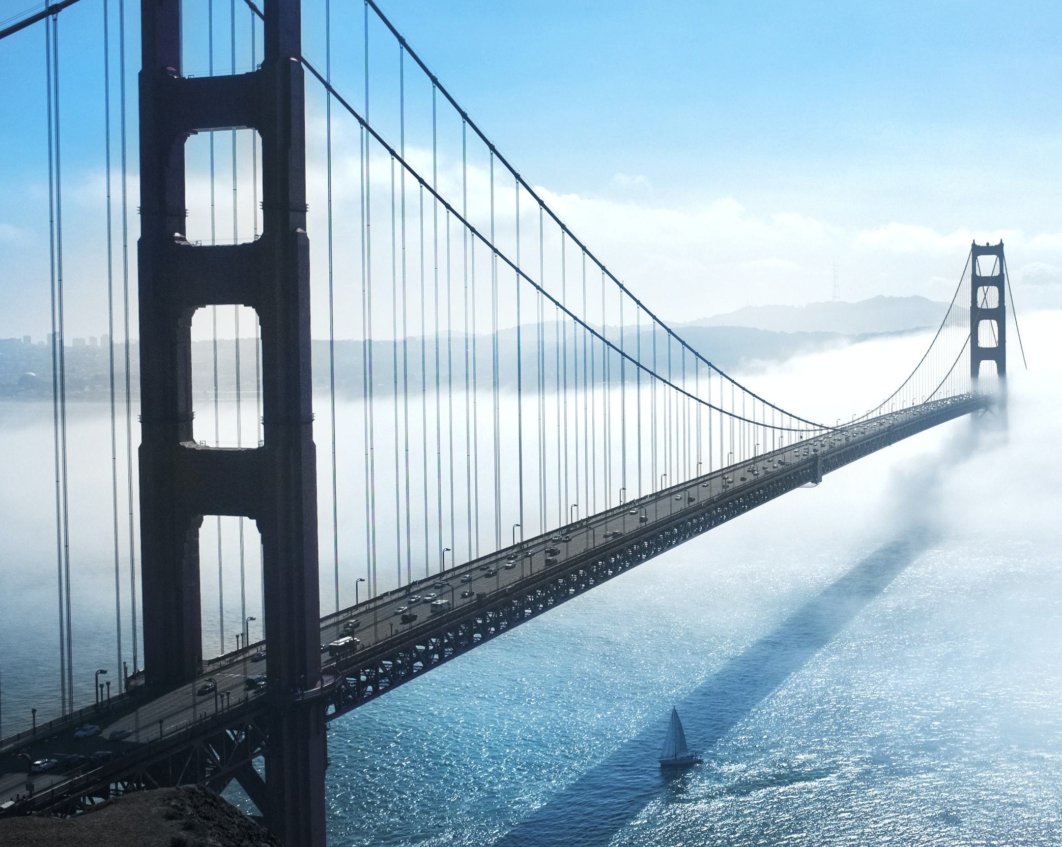
How to design a new bridge?

Slide 5
“If I had an hour to solve a problem, I'd spend 55 minutes thinking about the problem and 5 minutes thinking about solutions.”
Albert Einstein

Slide 6
It is not about solving the problem right, but solving the right problem!
Work problem
Problem
Representation

Slide 7

How might we questions help us refine our understanding of the problem, while giving us inspirational avenues to generate ideas on.
Photo by Simone Secci on Unsplash

Slide 8
How might we…?
Go back to the planetary principles you crafted yesterday.
Review them and iterate based on the session on Regenerative Design (if needed).
Write them in the form of “How might we…“ questions.
These questions help us identify opportunities for design and should be broad enough to allow us to explore multiple solutions.

Slide 9
How might we…? - Examples
Problem | Users aren't aware of our product offerings.
How might we… | How might we increase awareness of the full product offerings?

Slide 10
How might we…? - Examples
Problem | Users aren't aware of our product offerings.
How might we… | How might we make a social media campaign to raise awareness?

Slide 11
How might we…? - Examples
Problem | Users aren't aware of our product offerings.
How might we… | How might we make a social media campaign to raise awareness?
HMW questions should focus on positive opportunities and not suggesting solutions

Slide 12
How might we…? - Examples
Principle | In planet X, the impact of transportation is much lower because vehicles use readily available fuel from the atmosphere.
How might we… | How might we make fuel out of components that are already present in the Earth’s atmosphere?

Slide 13
How might we…? - Examples
Principle | In planet X, the impact of transportation is much lower because vehicles use readily available fuel from the atmosphere.
How might we… | How might we use natural elements (wind, dust, rain…) to power vehicles?

Slide 14
Opening paths for opportunities
Write as many “How might we” questions as you can.
These will be the starting ground for your ideas.
Remember, HMW are still problems, not solutions!
If stuck try asking:
Why?
What is stopping us?
What if…?
20 min

Slide 15
Yes and… yes but…

Slide 16
Opening paths to your imagination
Pick 1-2 “How might we” questions.
Brainwrite about it.
Select 1-2 idea to take forward

Slide 17
Rules for Ideation
Defer judgement.
Encourage wild ideas!
Build on the ideas of others (use “and” instead of “but”)
Stay focused on the topic.
Only one conversation at a time.
Be visual.
Go for quantity.

Slide 18
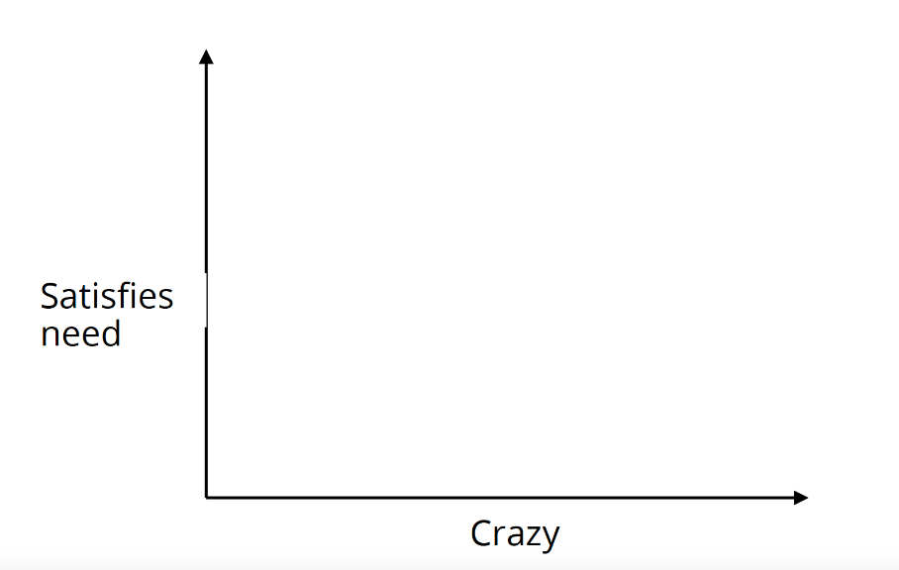
Evaluate your ideas
Sweet Spot
Impact potential

