Slide 1
Yannis and the conferences
Paul Colas

Slide 2
Yannis was the initiator of many conferences and participated in the organization of many.
The history here starts with the ‘Micromegas Workshops’
- 1998 Subatech (Alice, Gutbord)
- 1999 Saclay (Compass)
- 2000 Lausanne (where Jeanneret presented the LEMs, now often called THGEMS)
Georges Charpak attended these workshops

Slide 3
The four-seas conferences
General Particle Physics and Detectors conferences, with a concern about peace and development in the Balkans. Started at the end of the Serbo-Croatian war.
Pierre Petroff, Yves Lemoigne, Daniel Denegri, Georges Charpak, Yannis Giomataris…
Funded by UNESCO.
  Trieste, 1995
  Sarajevo, 1998
  Thessaloniki, 2002
  Istanbul, 2004
  Iasi (Romania), 2007
Stopped after this with the UNESCO funding

Slide 4
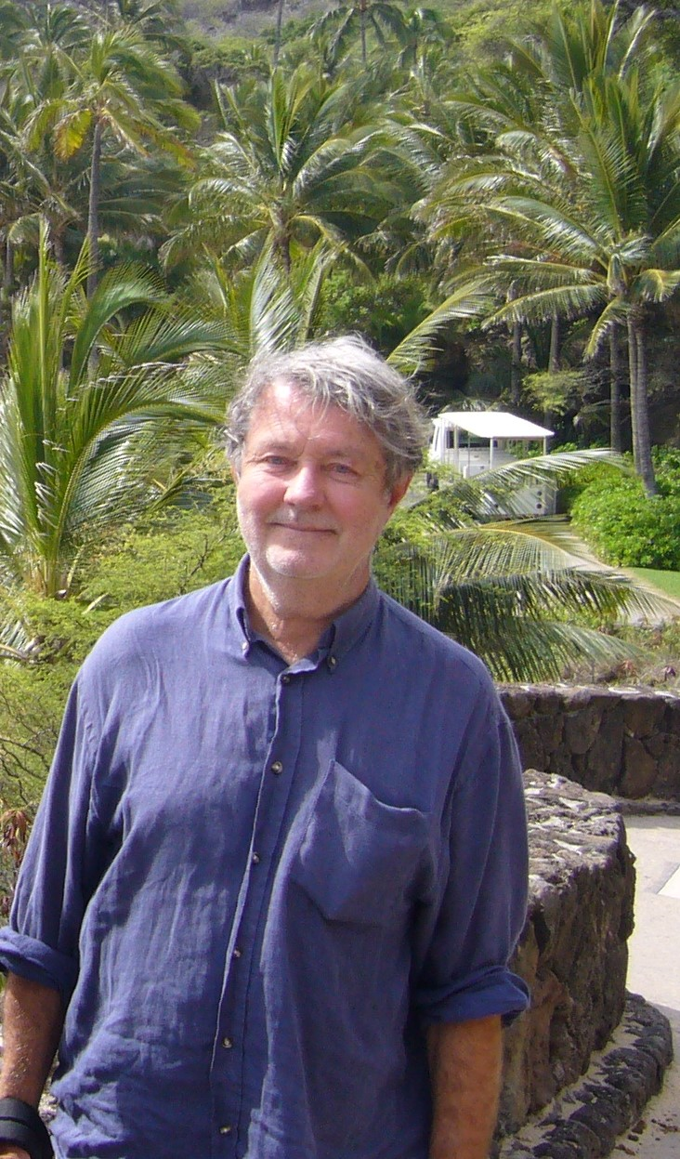
Satellite MPGD meetings of IEEE NSS
2006 -2016
Hawai 2007 : With Maxim Titov, we proposed to the General chair of the conference to have one full day on MPGDs
This was a transition to the MPGD conference series
Gaseous detector session of NSS/MIC (with Leszek Ropelewski) in various places (Dresden, San Diego, Anaheim…)

Slide 5
The MPGD conferences
In the continuity of this, it was decided to establish recurrent conferences on MPGDs, supported by RD51 community. Chair : Ioanis Giomataris
2009 Kolympari, Crete, Greece
2011 Kobe, Japan
2013 Zaragoza, Spain
2015 Trieste, Italy
2017 Philadelphia, US
2019 La Rochelle, France
2022 Rehovot, Israël
2024 Hefei, China
5 proposals for 2026

Slide 6
The ‘TPC for low-energy rare events conferences’
Physics and detectors for very rare events. Low-backround detectors.
Always in Paris intra-muros
2002 Collège de France
2004 LPNHE, Jussieu
2006 Ministry of Research, old Ecole Polytechnique
2008 Poincaré auditorium
2010 Amphi Buffon, APC
2012 Amphi Buffon, APC
2014 Amphi Buffon, APC
2016 Amphi Buffon, APC
2018 Amphi Buffon, APC
2021 Amphi Buffon, APC
2023 Back to the latin quarter and ‘in person’
Proceedings were published every year since 2006 in JOP conference series

Slide 7
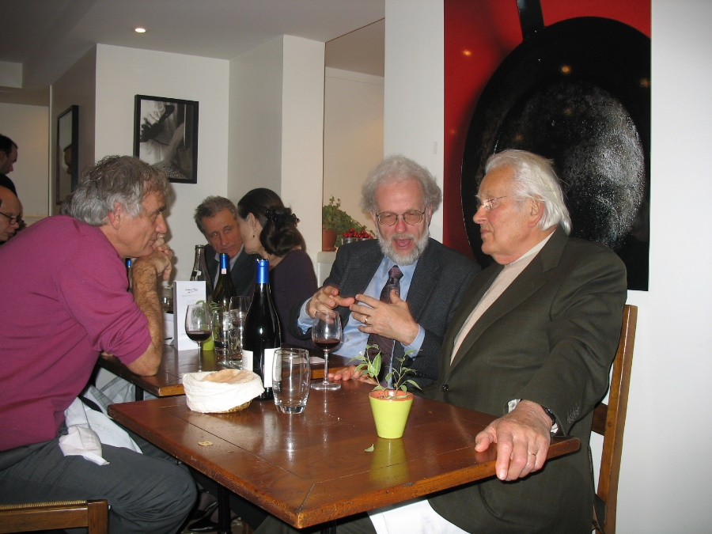
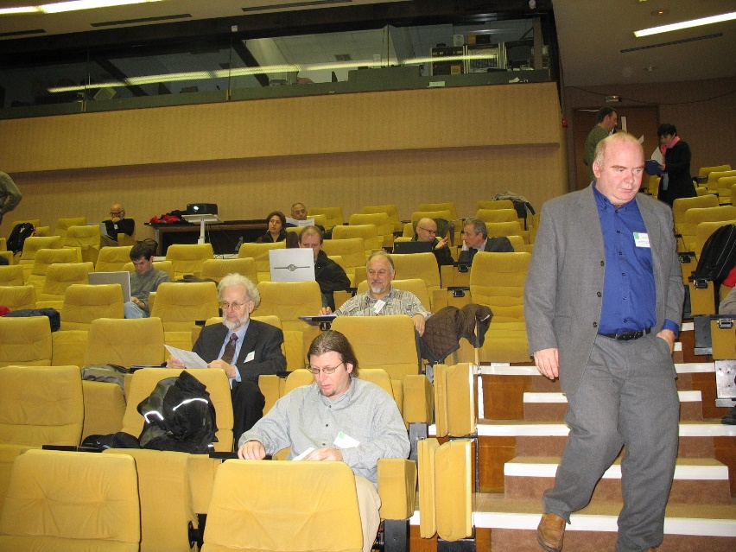
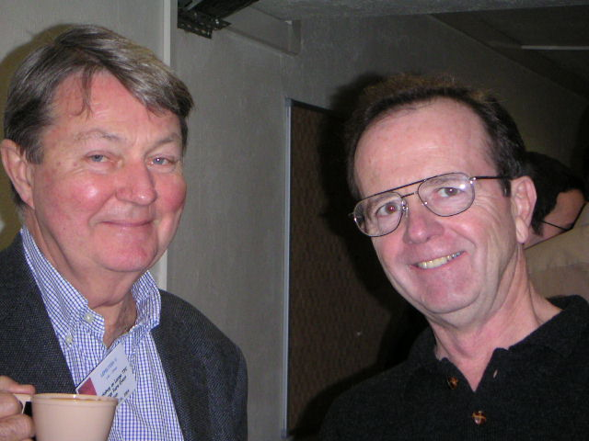
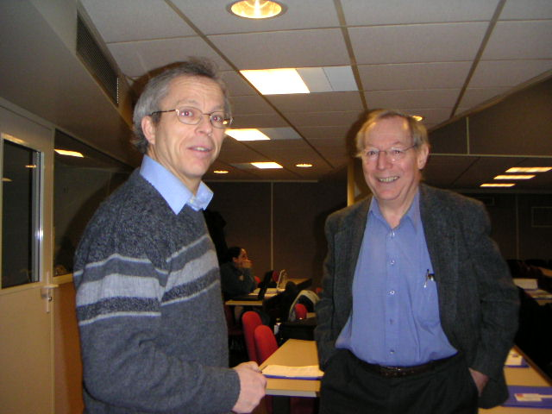

Slide 8
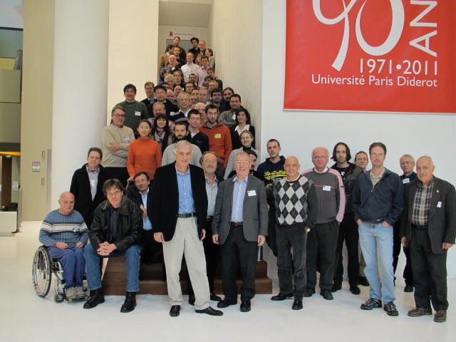
2010

Slide 9
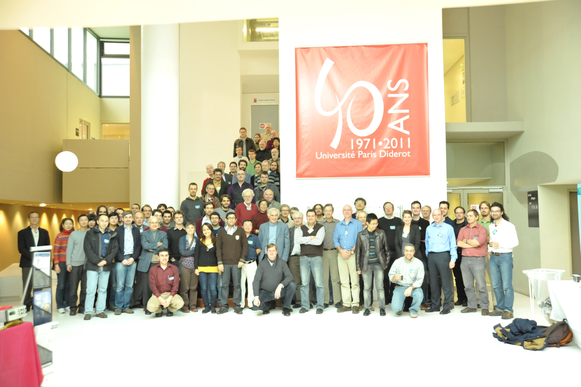
2012

Slide 11
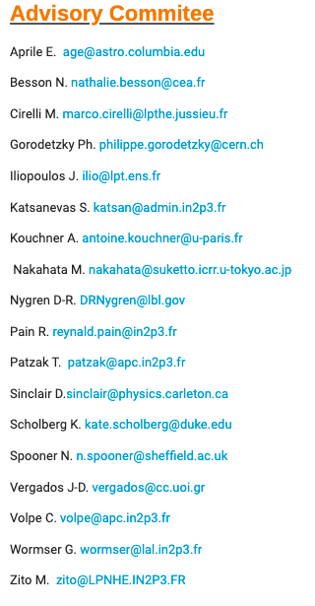
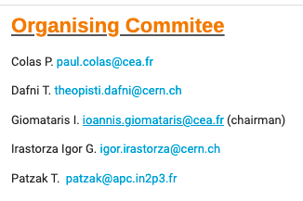
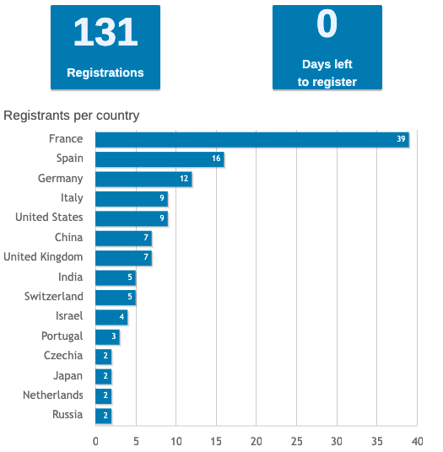
10th SYMPOSIUM, 15–17 Dec 2021
Diderot University
Postponed due to COVID adjusted to safety regulations
Check of anticovid test at the entrance

Slide 12
