Slide 1
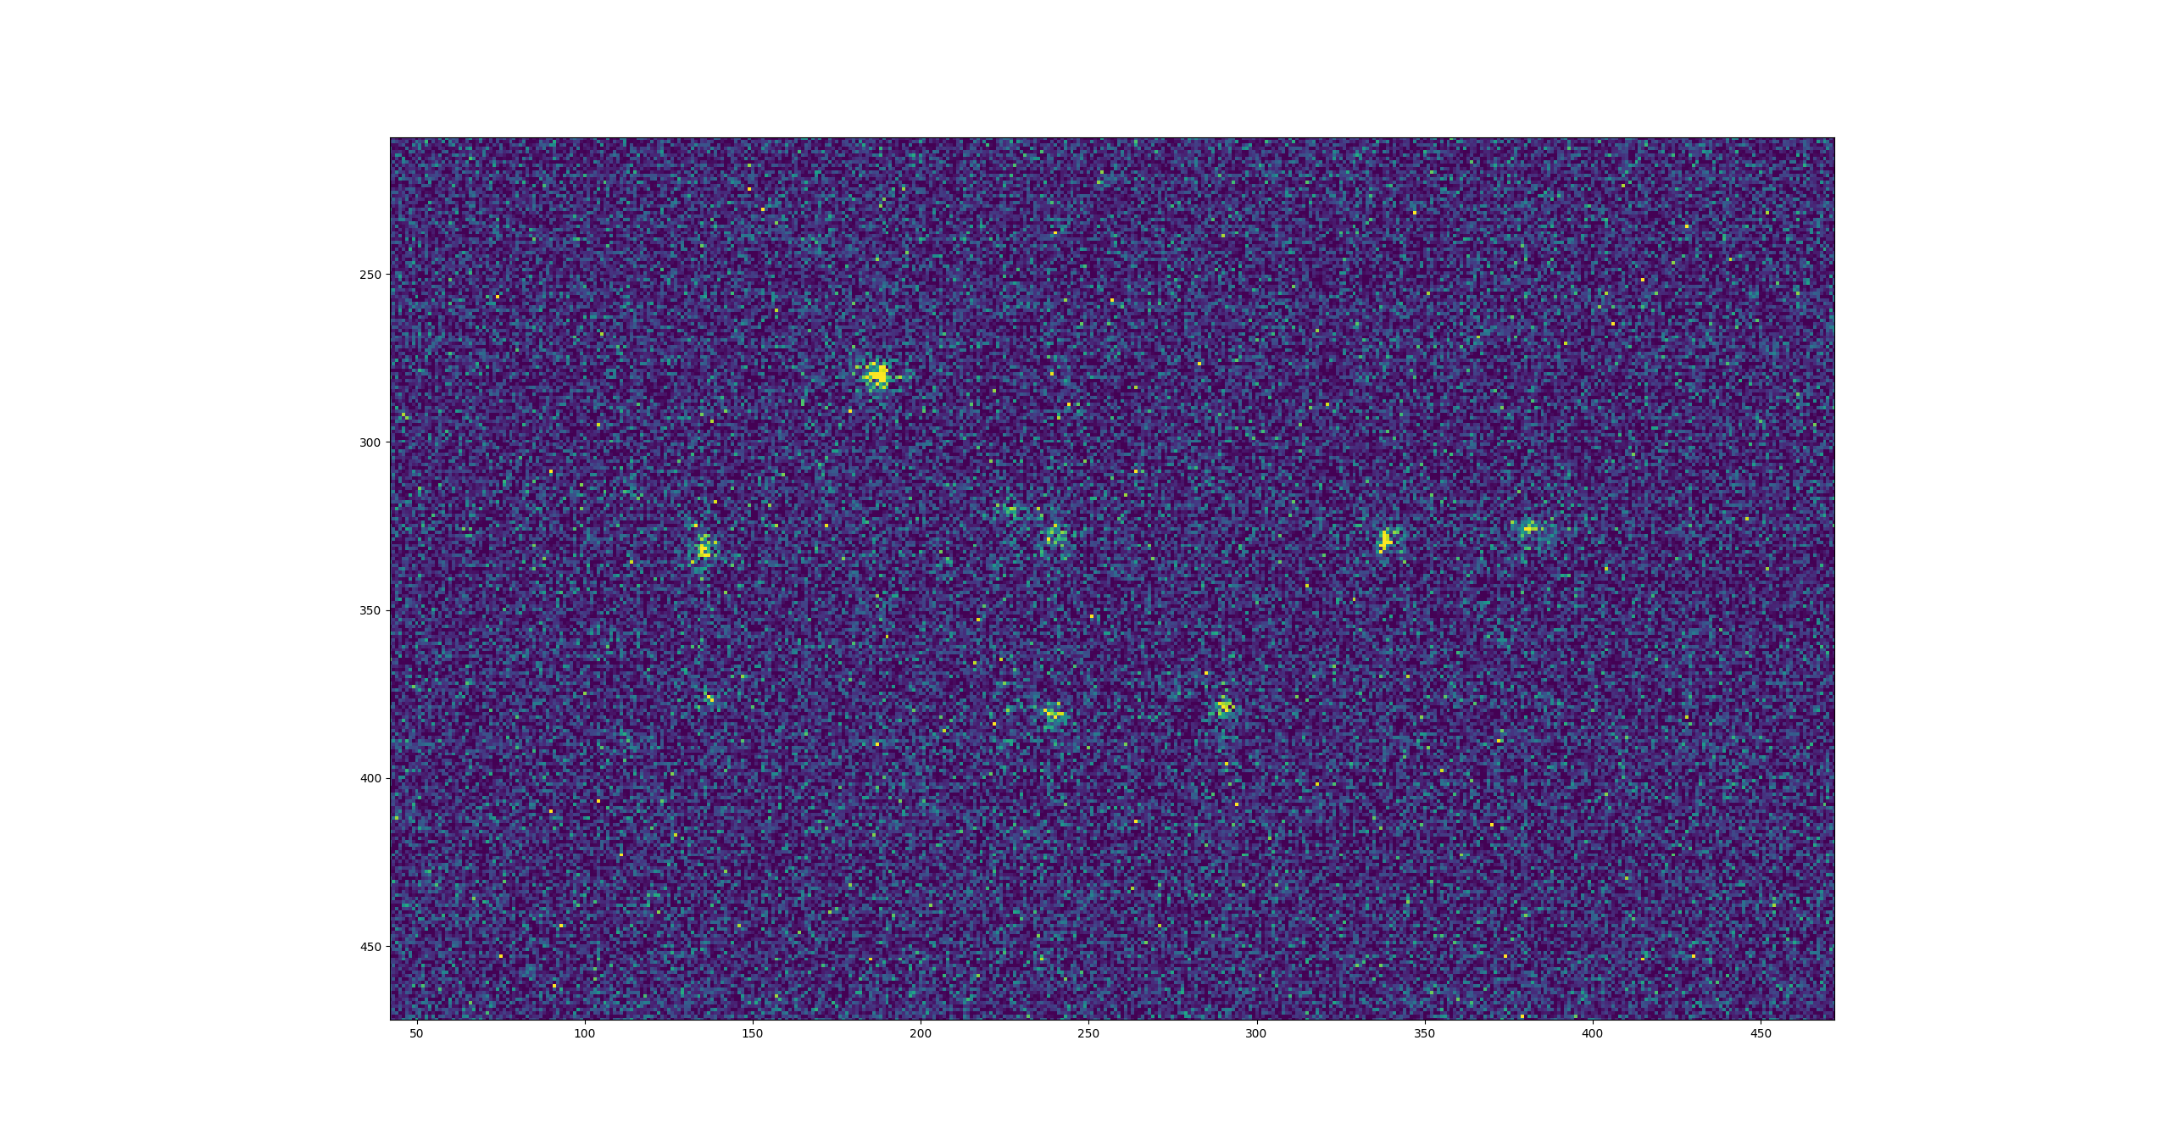
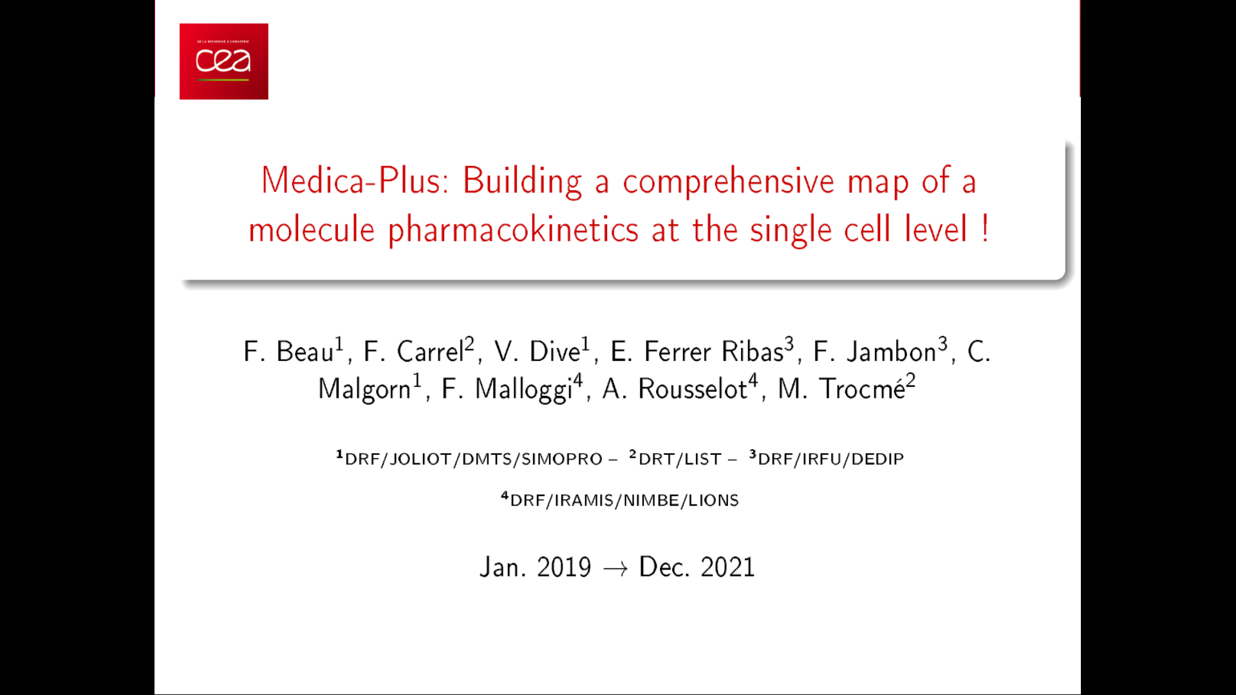
Optical readout Micromegas for neutron and beta imaging
11th Symposium on Large TPCs for low-energy rare event detection
Antoine Cools - 13/12/2023
E. Ferrer-Ribas, T. Papaevangelou, E. C. Pollacco, A. Corsi, K. Aivazelis
(Université Paris-Saclay, CEA, IRFU)
F.M. Brunbauer, L. Ropelewski, E. Oliveri (CERN)
F. Beau, L. Devel, C. Malgorn (Université Paris-Saclay, CEA, Institut Joliot)
F.J. Iguaz-Gutierrez (Soleil Synchrotron)
I. Katsioulas, O. Sidiropoulou (ESS, Lund)
A. Sari (Université Paris-Saclay, CEA, List)
1

Slide 2
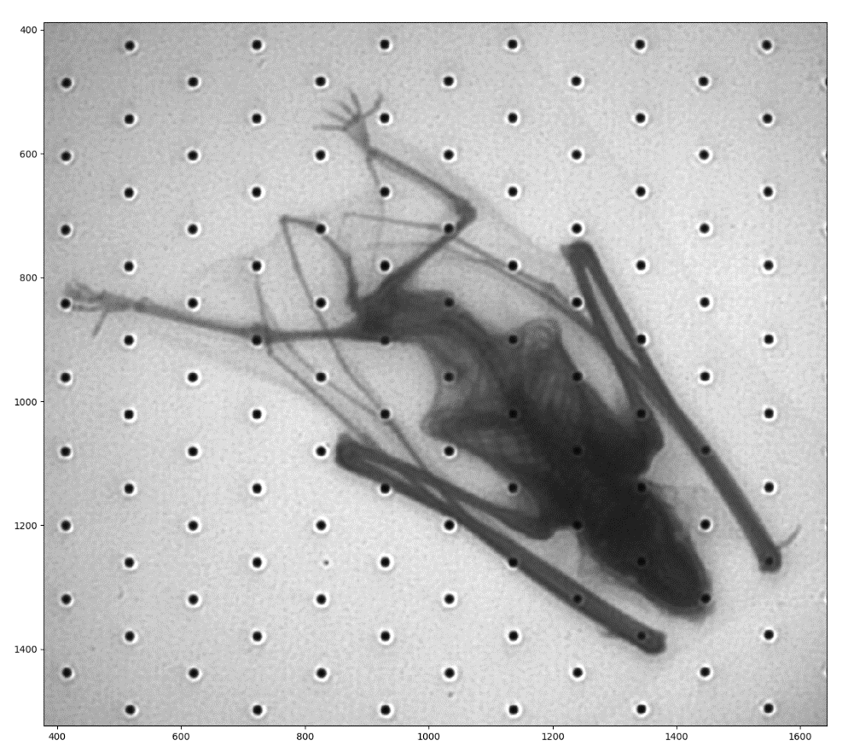
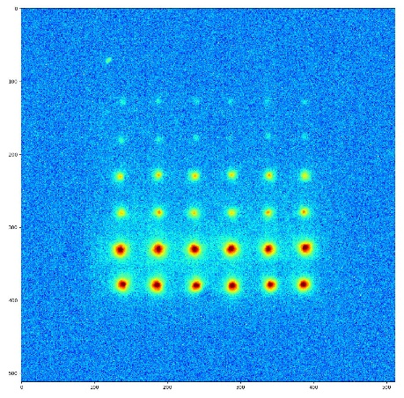
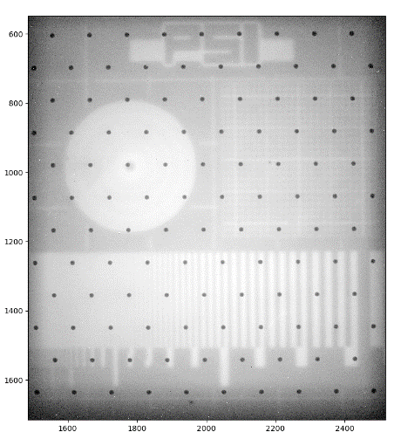
Micromegas characterization
    Description
    X-ray characterization and R&D
    Beta imaging
    Setup
    Imaging and activity counting
Neutron imaging
Setup
    Single event study
    Imaging
Conclusion and perspectives
2

Slide 3
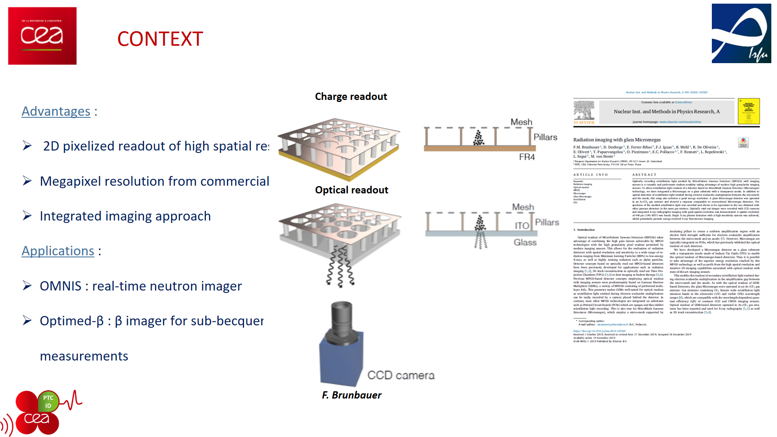
Optical readout micromegas detector
Use of camera (high granularity, large number of pixels, use of lens for large field of view)
Easy handling of the data (light intensity matrix)
Real-time imaging thanks to very low data processing and light integration approach
Camera
F. Brunbauer et al. NIM A 955 (2020) 163320
3

Slide 4
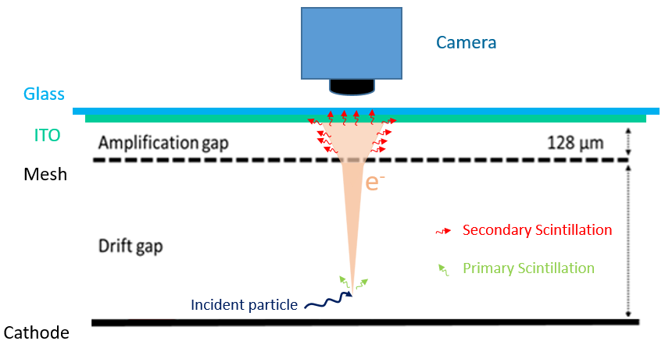
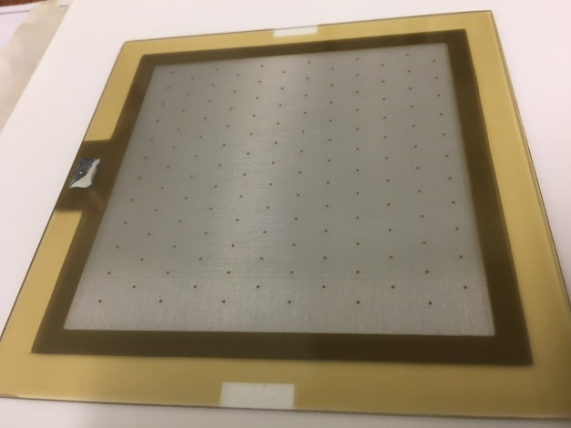
Optical readout micromegas detector
8 cm
Glass Micromegas
Produced at MPGD IRFU workshop
Gas: Ar/10%CF4
Camera: CMOS Orca-Quest
4

Slide 5
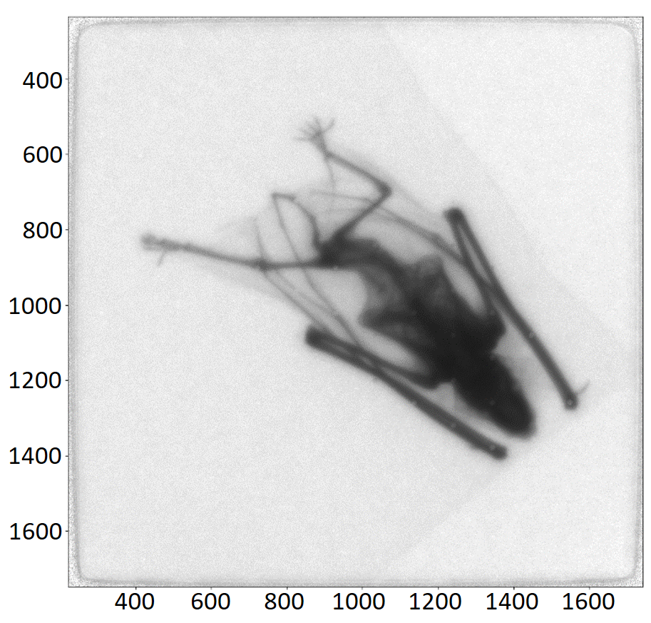
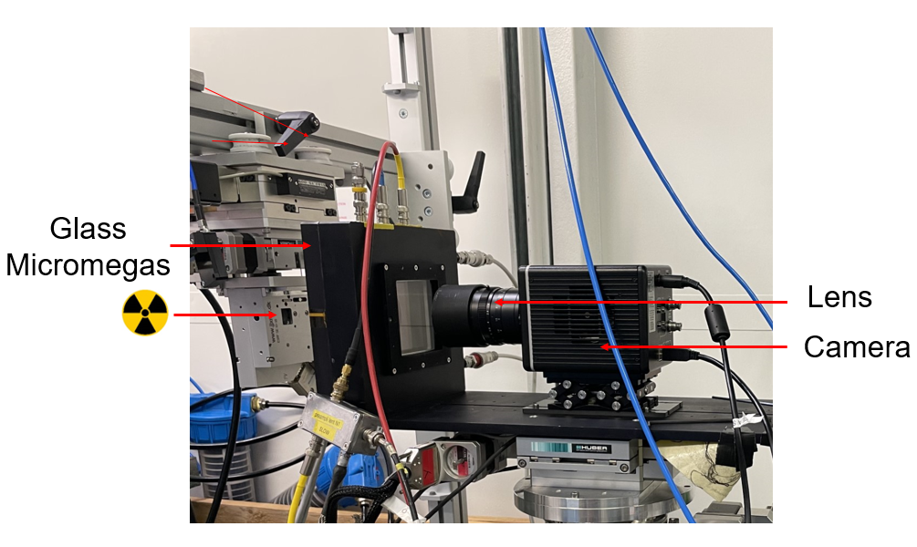
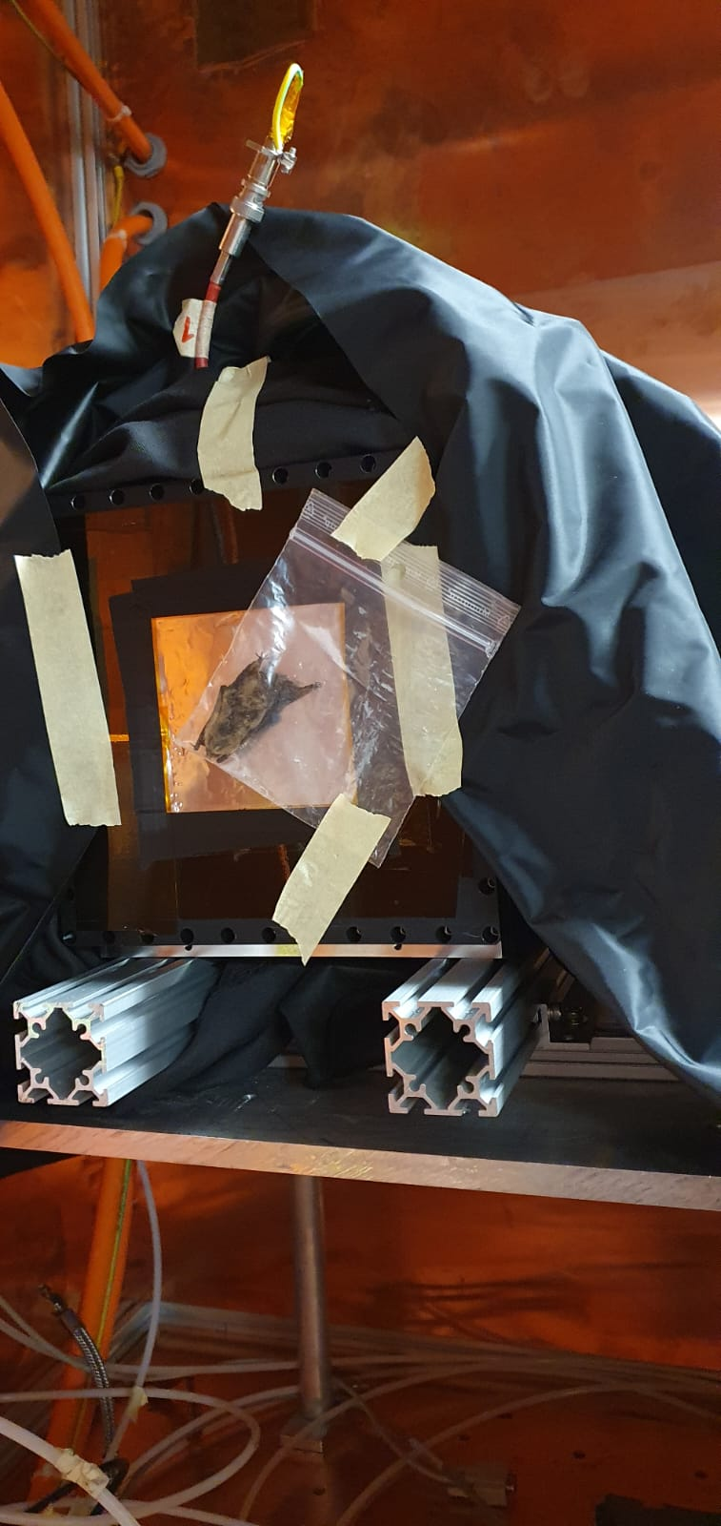
X-ray characterization
Pixel size : 50x50 µm²
Pixels
Pixels
2D light intensity profile
Radiography of a bat
5

Slide 6
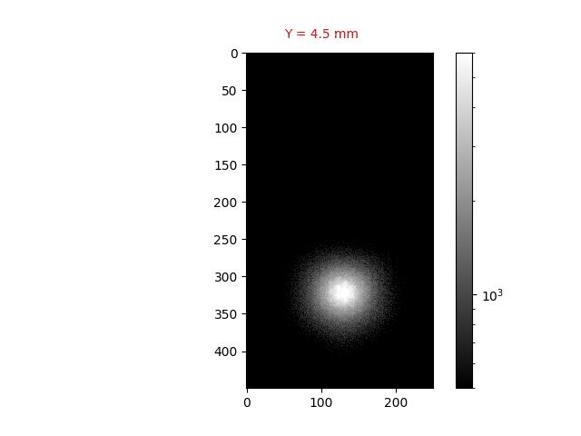
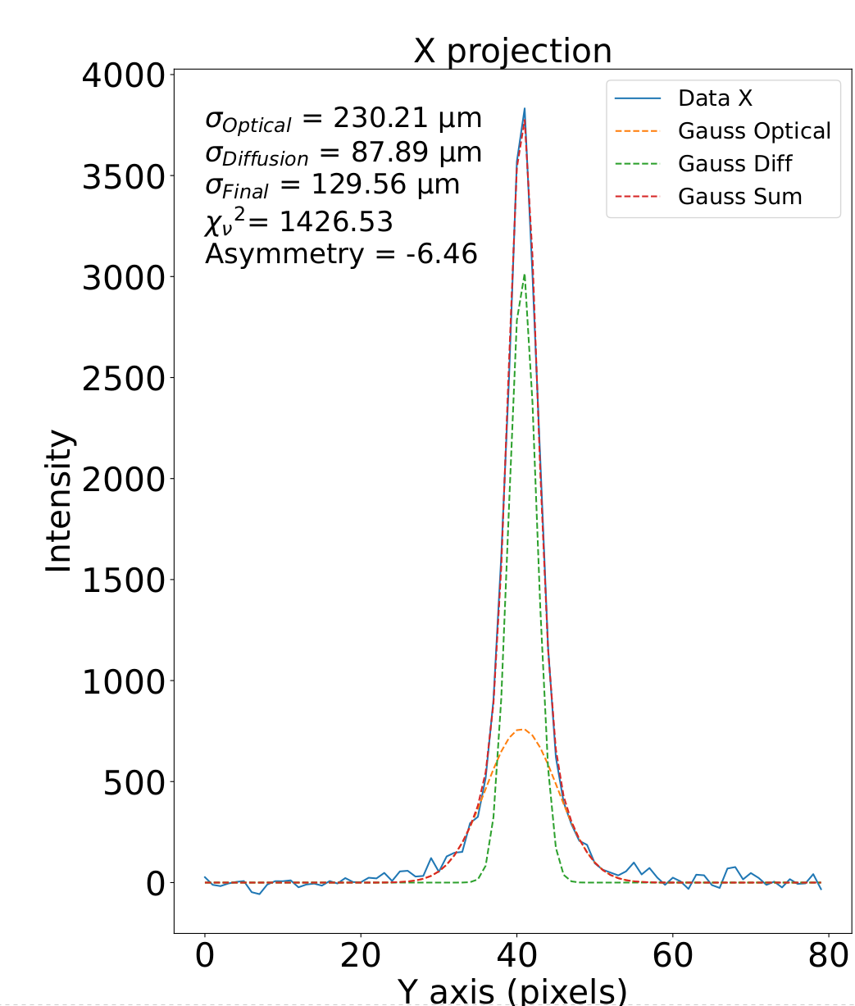
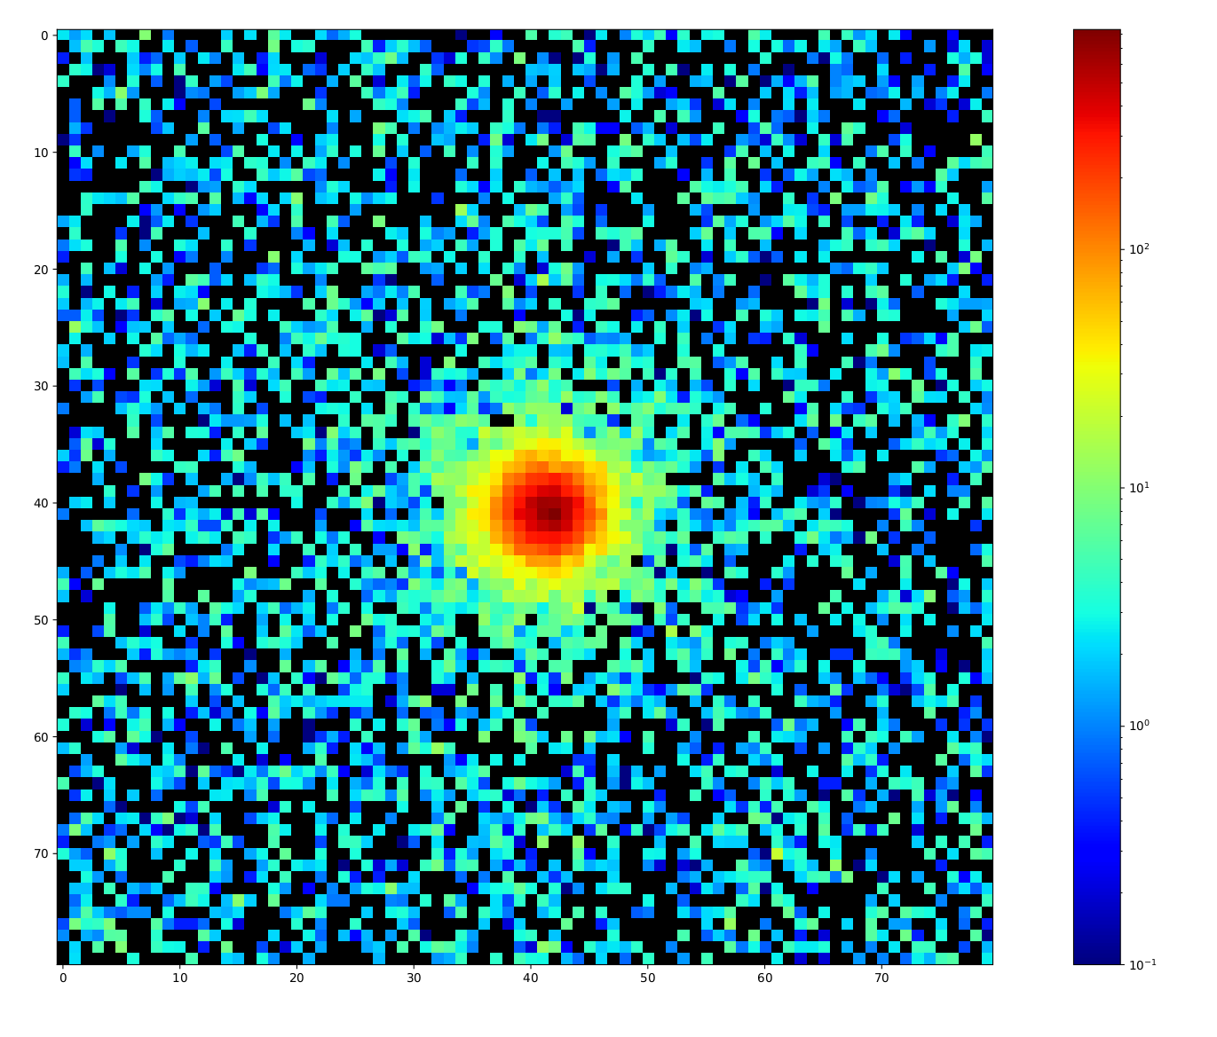
X-ray characterization : Soleil synchrotron
X-ray beam - 6keV - 50x50 µm² - Ar/10%CF4
Measurement of Point Spread Function (PSF)
Spreading origins : diffusion and optics
A. Cools et al 2023 JINST 18 C06019
Pixels
0.5 mm
1 mm
σ = 130 µm
Pixels
2D light intensity profile
50 x 50 µm² beam (Va=36 kV/cm, Vd= 350V/cm)
6
1D projection
Light intensity profile of a 50 x 50 µm² over a pillar

Slide 7
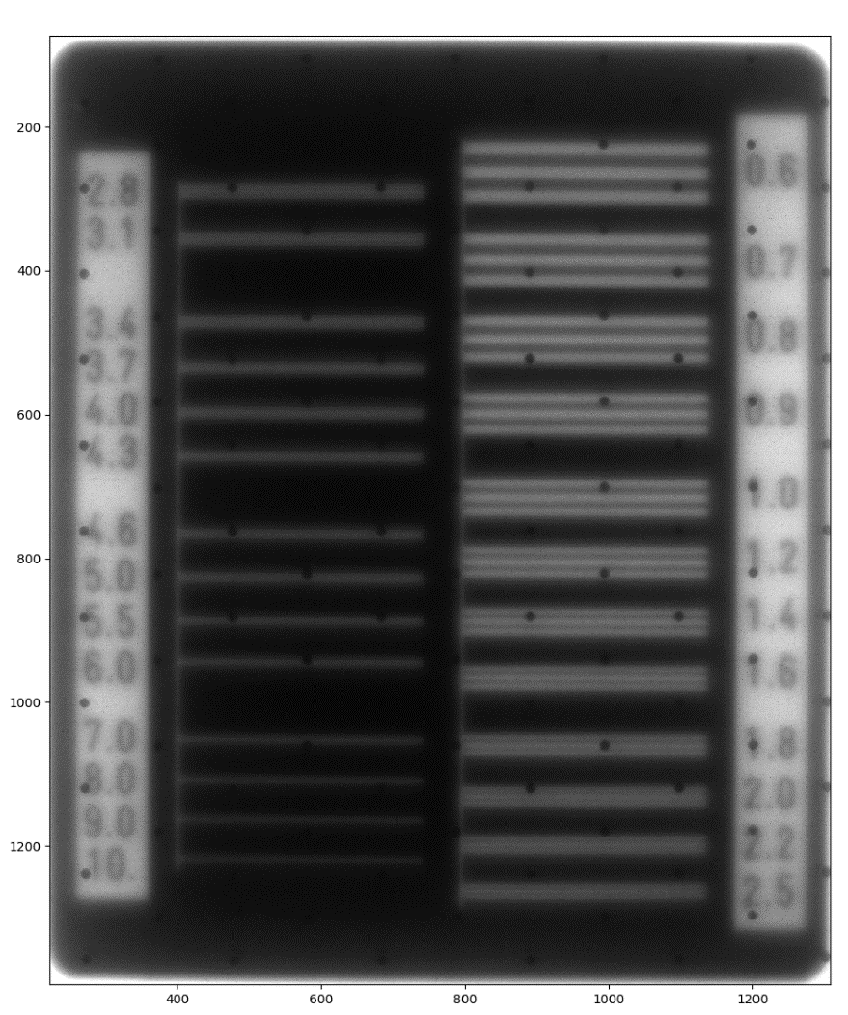
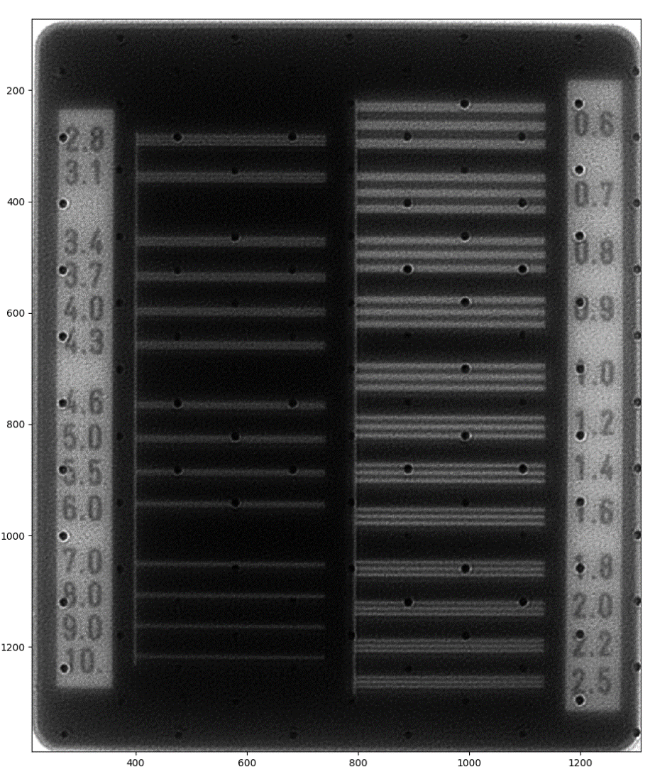
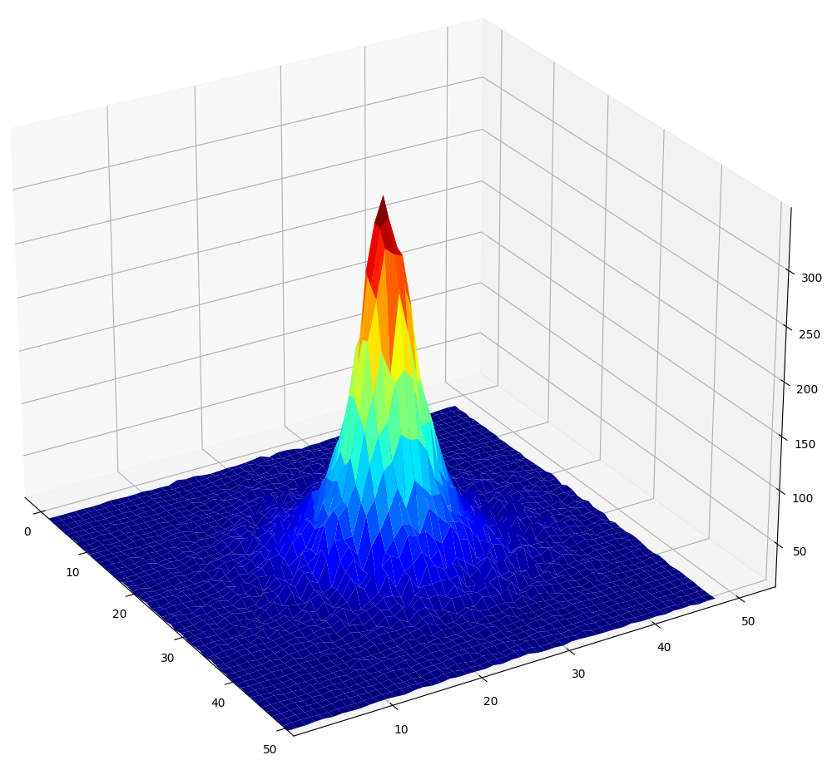
X-ray characterization
Deconvolution
Pixels
10 mm
Deconvolution
PSF from experimental data (σ = 280 µm)
MTF (10%) : 800 µm
Pixels
MTF (10%) : 281 µm
7

Slide 8
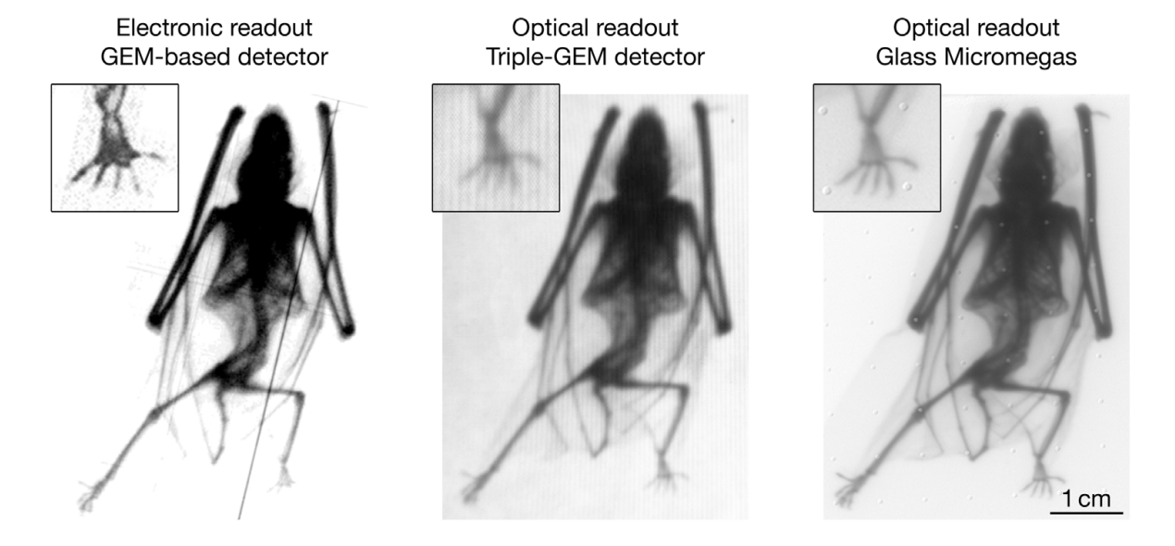
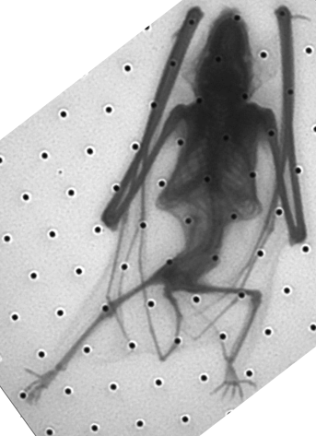
X-ray characterization
History of imaging with MPGDs
Glass Micromegas, Optical readout, deconvolution
8

Slide 9
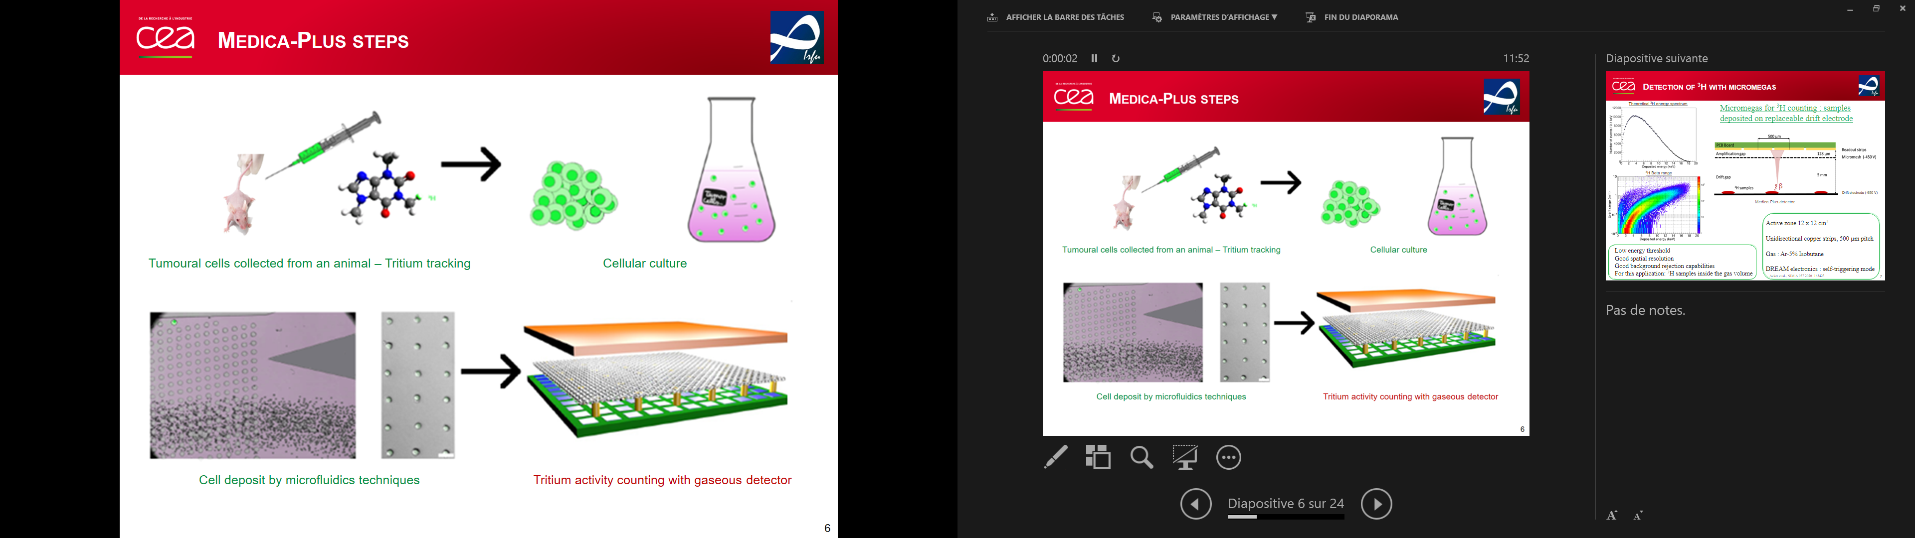
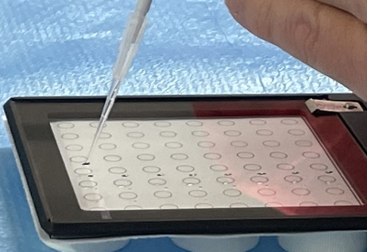
Beta imaging
Tumor heterogeneity as an effect on drug targeting
Develop more efficient drugs
Requires better detection sensibilities
Pharmaceutical needs at the cell level for drug development:
  Assess the drug distribution among cells
  Quantification of ³H concentration in single cell samples
Tumoural cells collection – Tritium tracking
Tritiated cells deposit on the cathode
Tritium activity counting with Micromegas detector
9

Slide 10
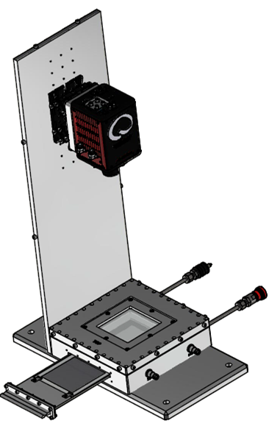
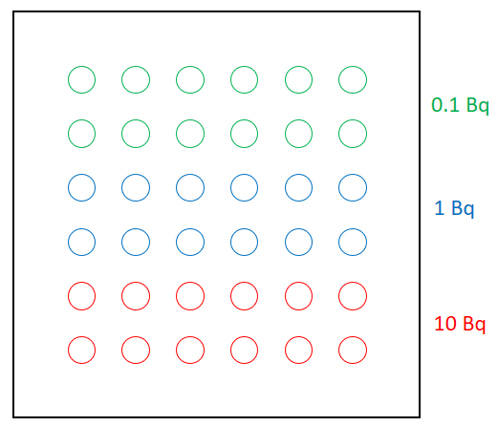
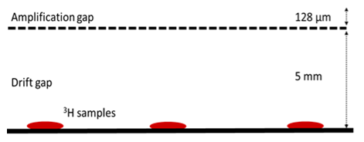
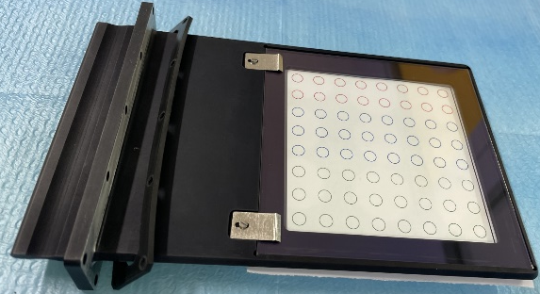
Beta imaging
First deposit : tritiated glucose
Camera
Light cover
Glass
VIS light
ITO
Mesh
e⁻
β
Cathode
Beta imager set-up scheme
A. cools 167910 (2023)
³H concentration ↔ sample activity (Bq)
Activity measurement limits and dynamic range → Activities: 0.1 Bq, 1 Bq and 10 Bq
10

Slide 11
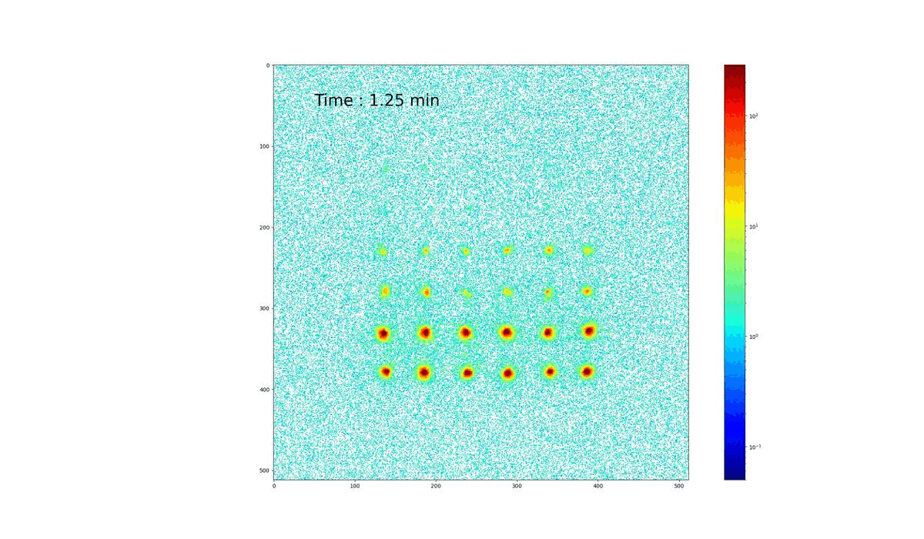
Beta imaging
Pixels
All drops positions are well assessed
0.1 Bq drops are close to the background noise
Activity measurement (Bq) – 5.2σ INTEGRATION
Reference | 0.09 | 1.055 | 9.8
Average | 0.086 | 0.84 | 11.74
σ | 0.026 | 0.18 | 1.28
Deviation | 5% | 20% | 17%
Light intensity profile over time - 20% of CF4
Pixels
11

Slide 12
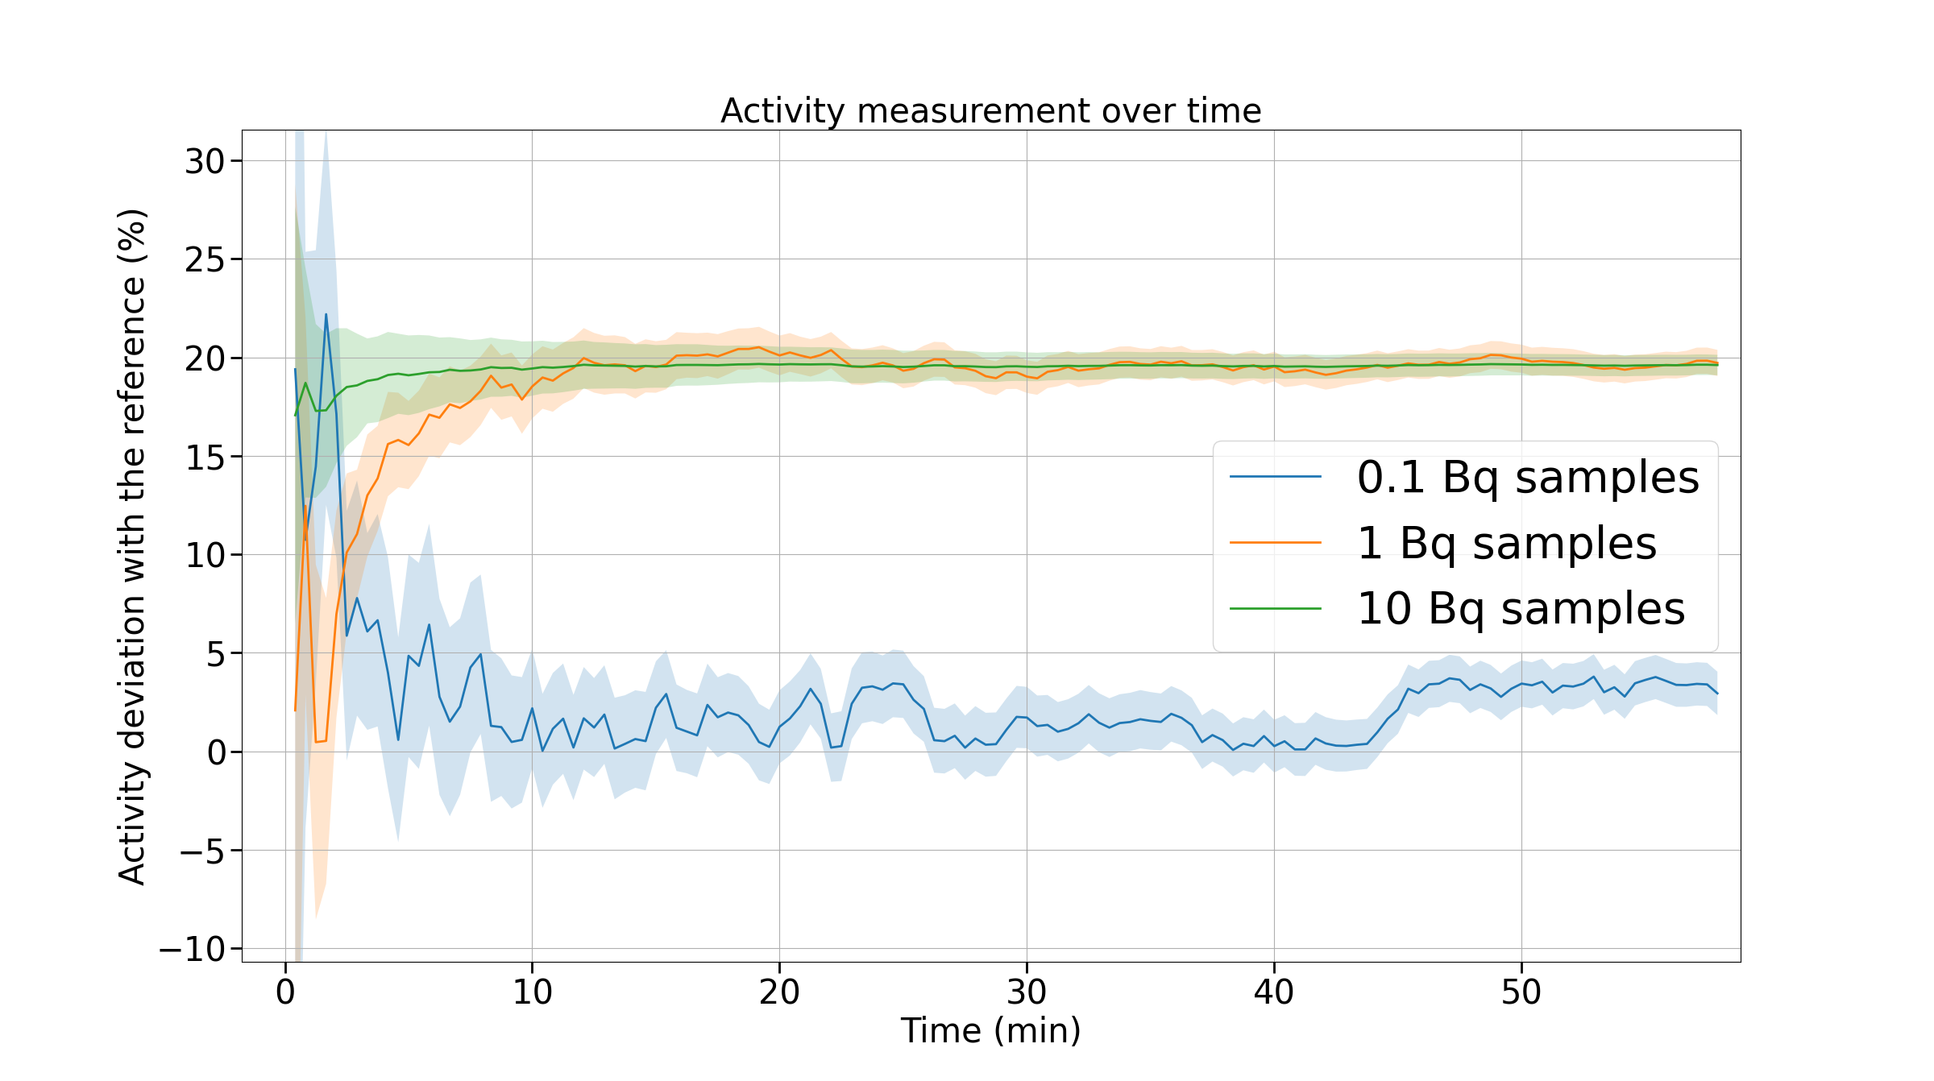
Beta imaging
12

Slide 13
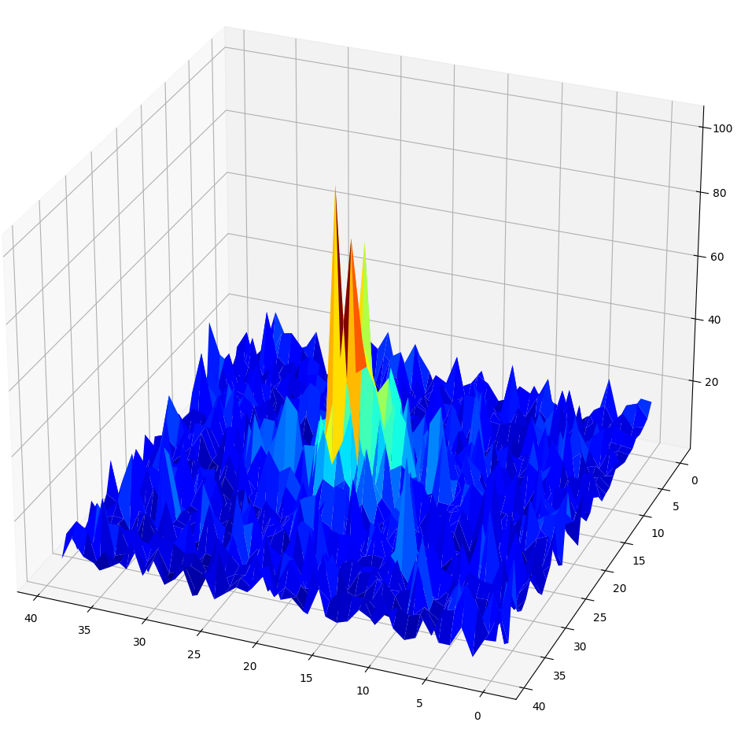
Beta imaging
Single event reconstruction
200 ms frame with single beta events
13

Slide 14
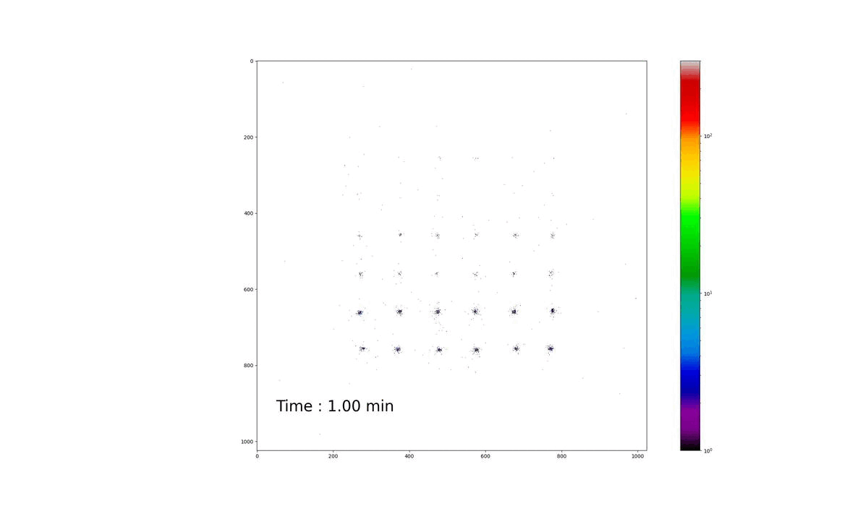
Beta imaging
Clustering method :
Pixels
Activity measurement (Bq) CLUSTERING
Reference | 0.09 | 1.055 | 9.8
Measurement | 0.108 | 0.85 | 5.13
σ | 0.014 | 0.088 | 0.38
Deviation | 17% | 20% | 48%
Clusters centroid histogram - 20% of CF4
Pixels
14

Slide 15
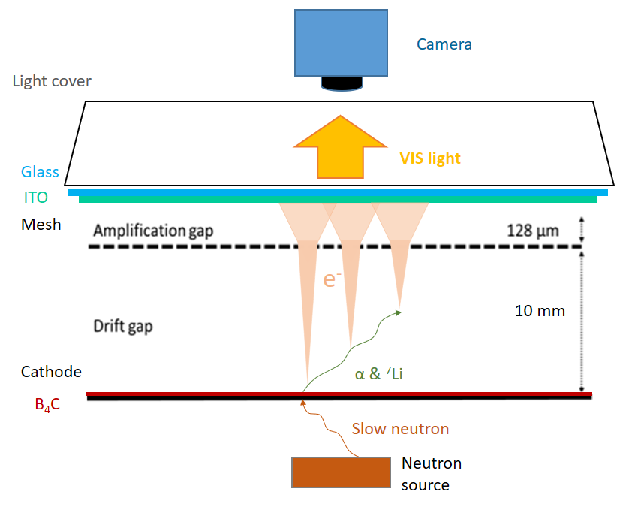
Neutron imaging
Cathode : ¹⁰B₄C neutron-to-charge converter
  Thermal neutrons absorbed by 2 µm thin ¹⁰B₄C layer
  Conversion efficiency: 5%
  (α or Li) fragments cause strong ionisation
  Limitation: fragments long range in the gas (5 mm)
A. Cools 07009 (2023)
15

Slide 16
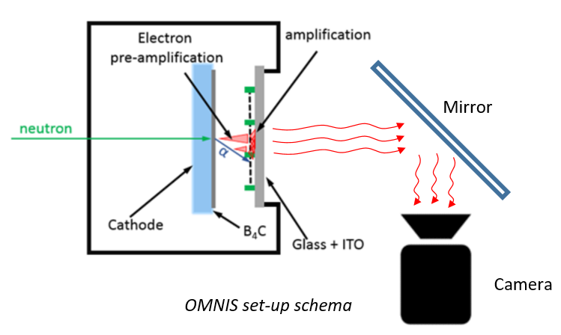
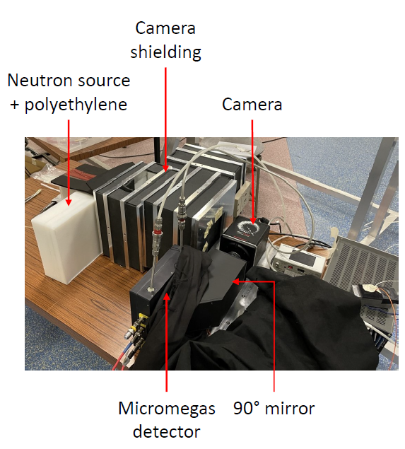
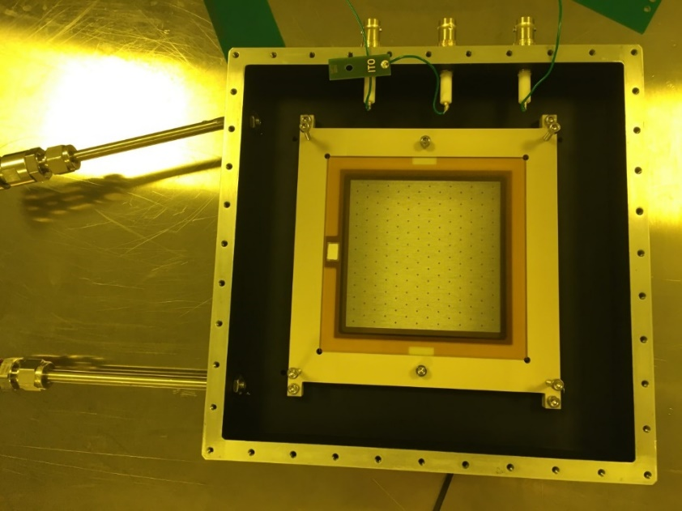
Setup
8 cm
Acquisition modes:
  Event-by-event: track reconstruction:
  Potentially higher resolution and ɣ-to-n suppression
  Integrated: real-time radiography:
  Almost no data processing
16

Slide 17
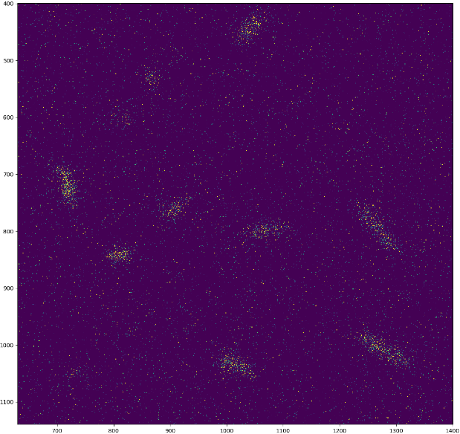
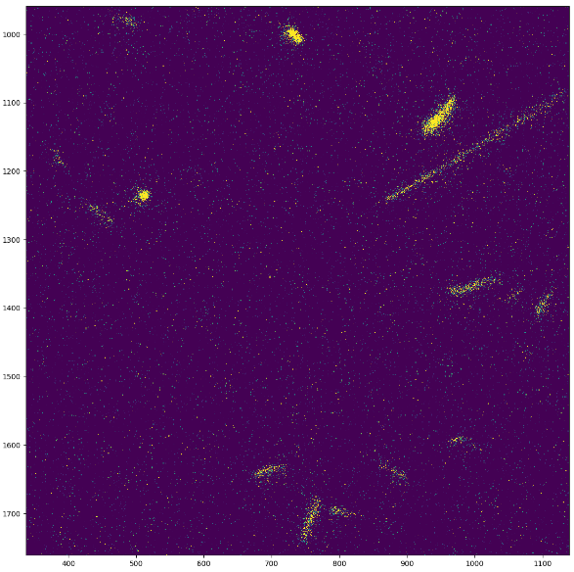
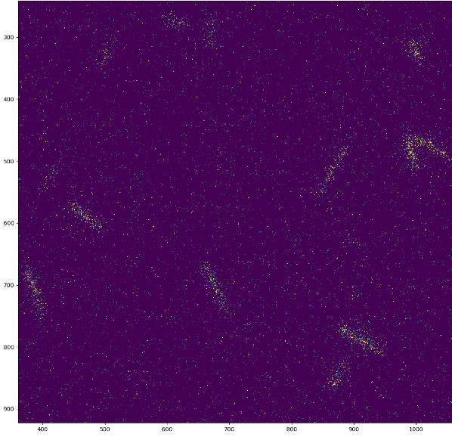
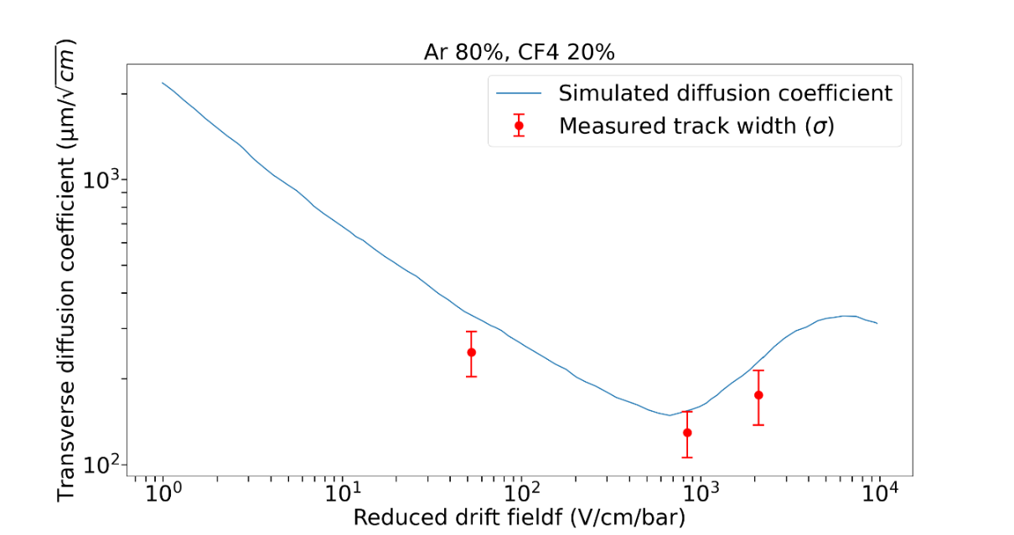
Single event study
Am-Be source – Ar/10%CF4
Pixels
Rate : 3 events/s
50 V/cm drift field
Pixels
800 V/cm drift field
2000 V/cm drift field
Drift field affects the electron diffusion
Diffusion spreads the light
50 V/cm
2000 V/cm
800 V/cm
17

Slide 18
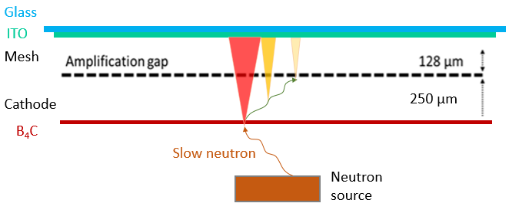
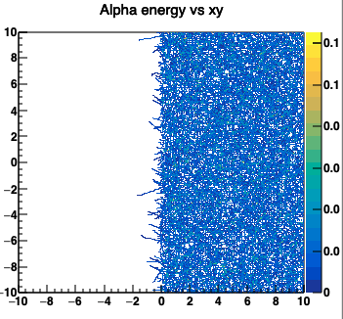
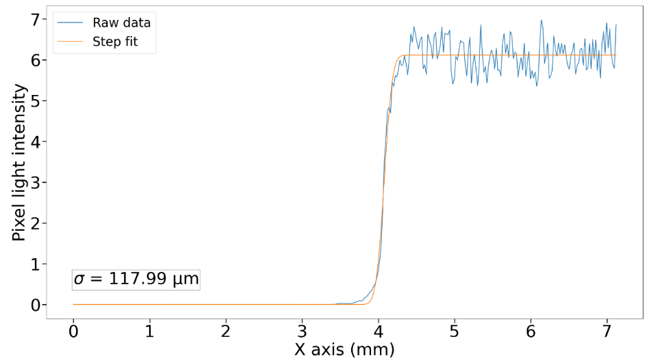
Spatial resolution measurement
Simulation
250 µm drift gap
Simulated dE/dX - maxboltz
A. Corsi
18

Slide 19
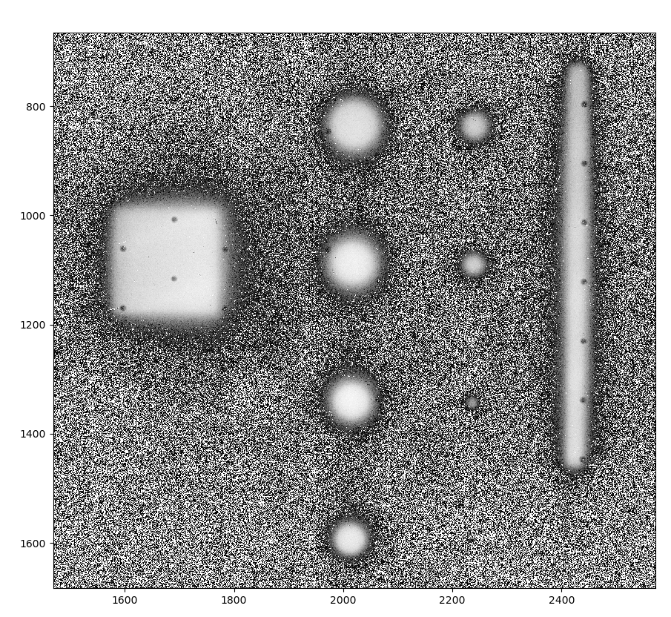
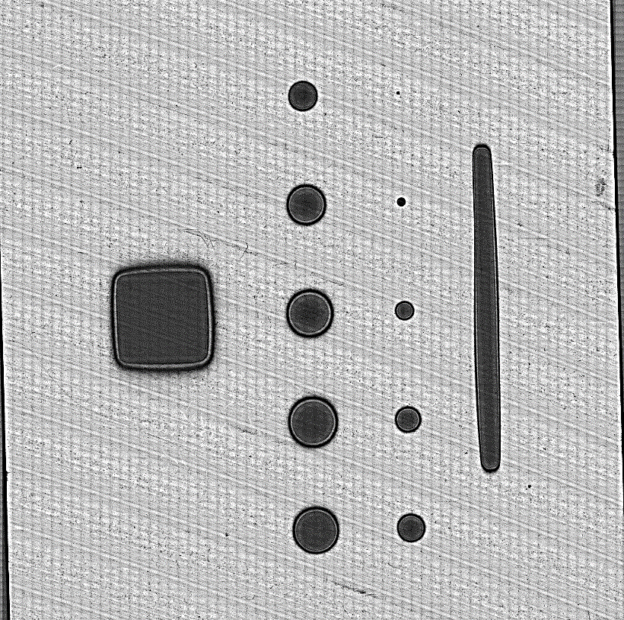
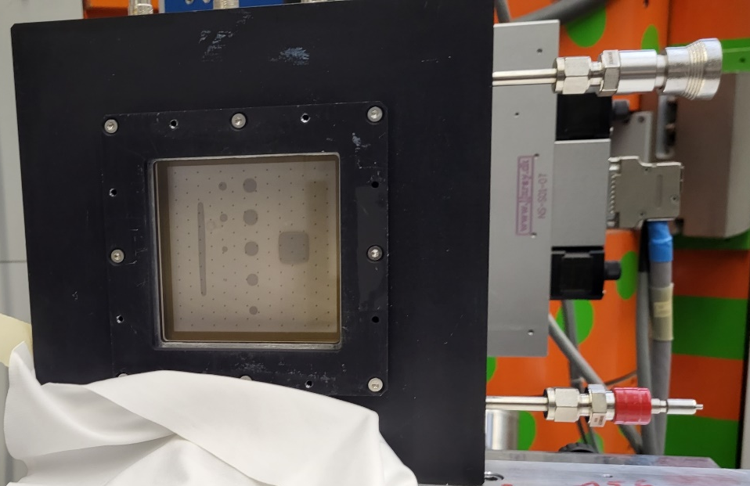
Preliminary
Spatial resolution measurement
3.4 meV Neutron beam – 10 MHz – PSI Zurich – 09/12/2023
Al cathode with ¹⁰B₄C pattern deposition
E_{amp} = 25 kV/cm, E_{drift} = 22 kV/cm, 100 s
Neutron imager with visible cathode
19

Slide 20

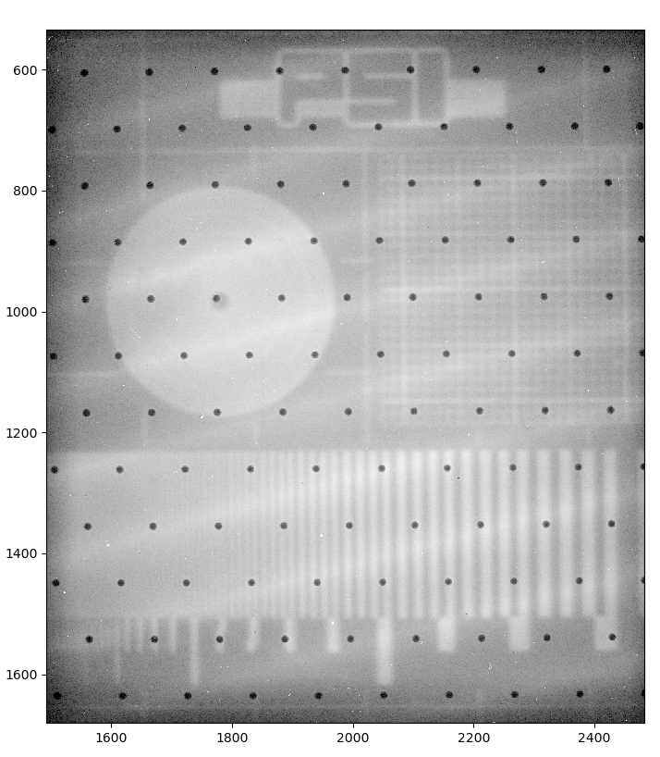
Preliminary
Spatial resolution measurement
Light intensity profile with single amplification
E_{amp} = 38 kV/cm, E_{drift} = 500 V/cm, 100 s
Light intensity profile with double amplification
E_{amp} = 20 kV/cm, E_{drift} = 24 kV/cm, 100 s
20

Slide 21
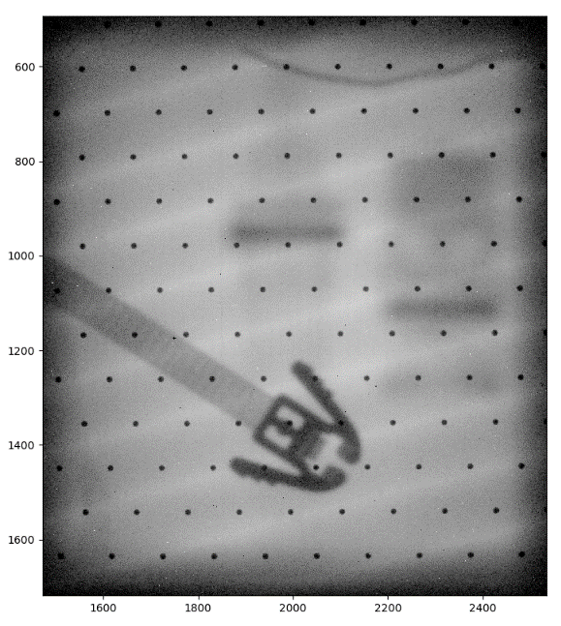
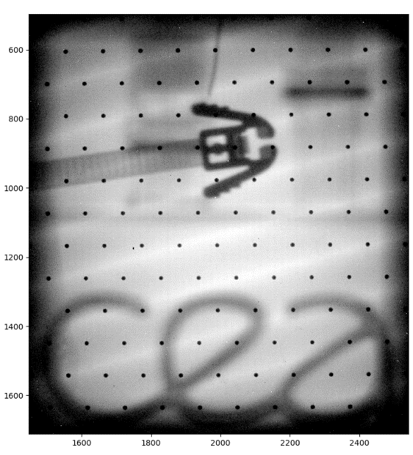
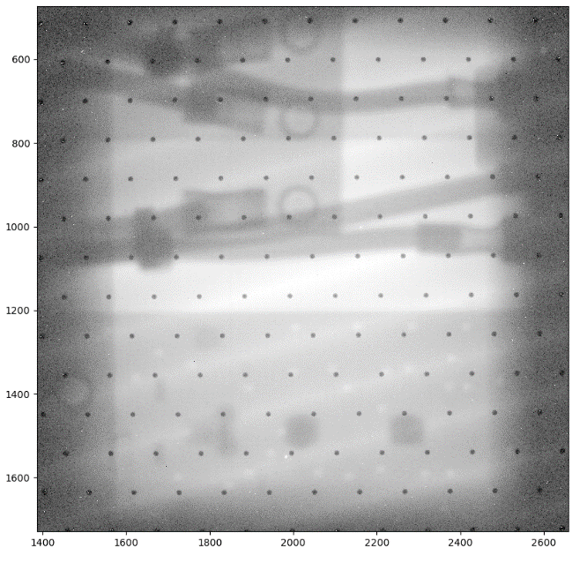
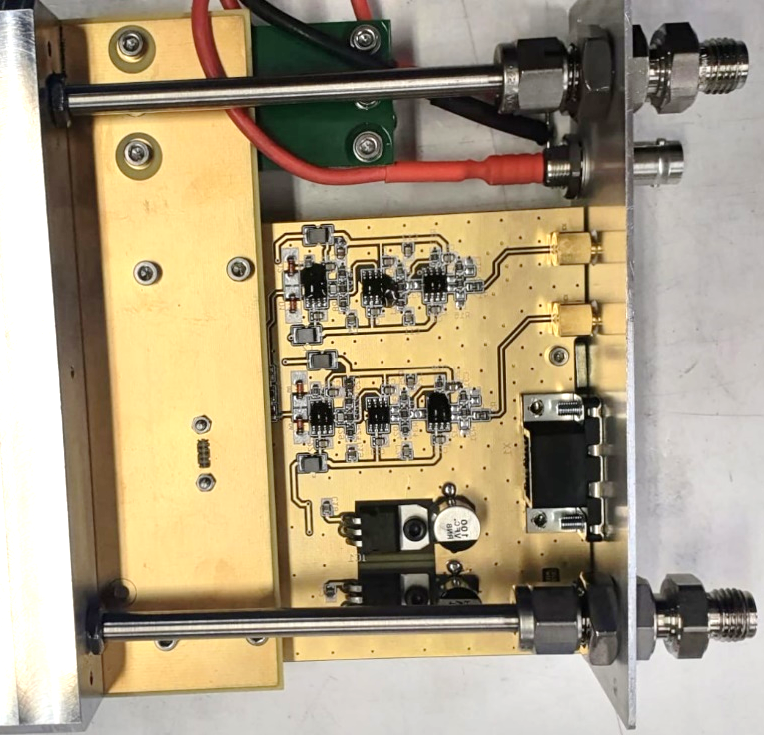
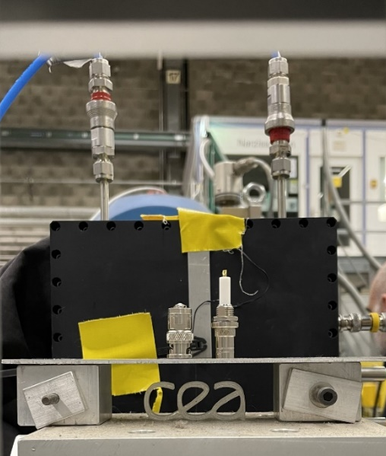
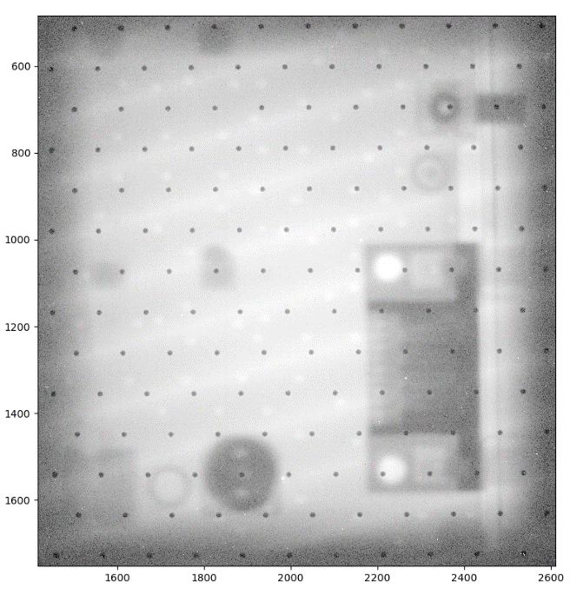
Preliminary
Spatial resolution measurement
Light intensity profile with double amplification
E_{amp} = 20 kV/cm, E_{drift} = 24 kV/cm, 100 s
21

Slide 22
Conclusion and perspectives
  Detector characterization with X-rays showed a PSF of 130 µm
  Sub-bequerel tritium activity measurement has been proven with
  optical MM Readout.
  Single cell and simultaneous ¹⁴C and ³H measurement are envisioned
  Higher spatial resolution is expected and is observed with a thin drift gap
  configuration for neutron imaging
22

Slide 23


Thank you
23

Slide 24
Backup
24

Slide 25

Optical readout micromegas detector
25

Slide 26

26

Slide 27



Imaging: Line spread function measurement
Copper tape
¹⁰B₄C cathode with copper tape
Am-Be source
27

Slide 28



Imaging
Am-Be source
Ar-10%CF4
Pixels
Integration mode
Simulated dE/dX - Garfield
mm
1 cm
6 mm drift gap
mm
A. Corsi
Pixels
Light intensity
28

Slide 29




Imaging
Am-Be source
Ar-10%CF4
Pixels
1 cm
Single event mode
Pixels
5 mm
800 V/cm drift field, 3 events/s
Pixels
Pixels
2D histogram of neutron positions reconstruction
α track light intensity profile
Bragg curve
29

Slide 30


Imaging
Am-Be source
Ar-10%CF4
Single event mode : reduced drift gap
Pixels
Pixels
1 cm
1 cm
250 µm drift gap
Pixels
2D histogram of neutron positions reconstruction
Pixels
25 kV/cm drift field, 3 events/s
30

Slide 31




Hamamatsu CMOS camera
Readout noise
Photon number resolving
Pixels
Number Size
4096 x 2304 4.6 µm x 4.6 µm
Dark current
Cooling Sensor temperature Dark current
Air - 20 °C 0.016 e⁻ /pixels/s
Minimum exposure time
Mode Rate
Standard 1 µs/frame
Ultra quiet 100 ms/frame

Slide 32
Light production mechanisms
Scintillation : excited atoms or molecules emit photons during de-excitation.
Scintillation
Phosphorescence
f Fluorescence
Electroluminescence
: Delayed emission of photons after absorption.
(1 ms to 100 s)
Prompt emission of photon after absorption of incident radiation.
(1 ns to 1 µs)
Electrons with energy lower than ionization threshold just excite atoms or molecules.
Primary scintillation
Secondary scintillation
From the creation of primary electron coming from the excitation of gaz due to incident particles.
From the creation of secondary electrons taking place during avalanche amplification.
Light yield : amount of light determines the signal to noise ratio. It depends on electric field, pressure and gas mixture.
Notes:
32

Slide 33


Slide 34

PRELIMINARY RESULTS WITH TRITIUM SAMPLES
β particle range in Ar-Isobutane gas mixture

Slide 35


Slide 36


Slide 37




Production
Gain uniformity check
Production at CEA Bulk Lab
Light intensity
T. Benoit
Planarity check : Laser diffraction measurement
Vertical scale x1000
M. Vandenbroucke
37

Slide 38



DETECTOR CHARACTERIZATION WITH X-RAYS
X-ray radiography
MTF measurement
60 sec exposure time lead target radiography with simple background suppression.

Slide 39

Beta spectrum : CF4
Overall activity : 76 Bq

Slide 40




Slide 41


Slide 42


Slide 43



