Slide 1
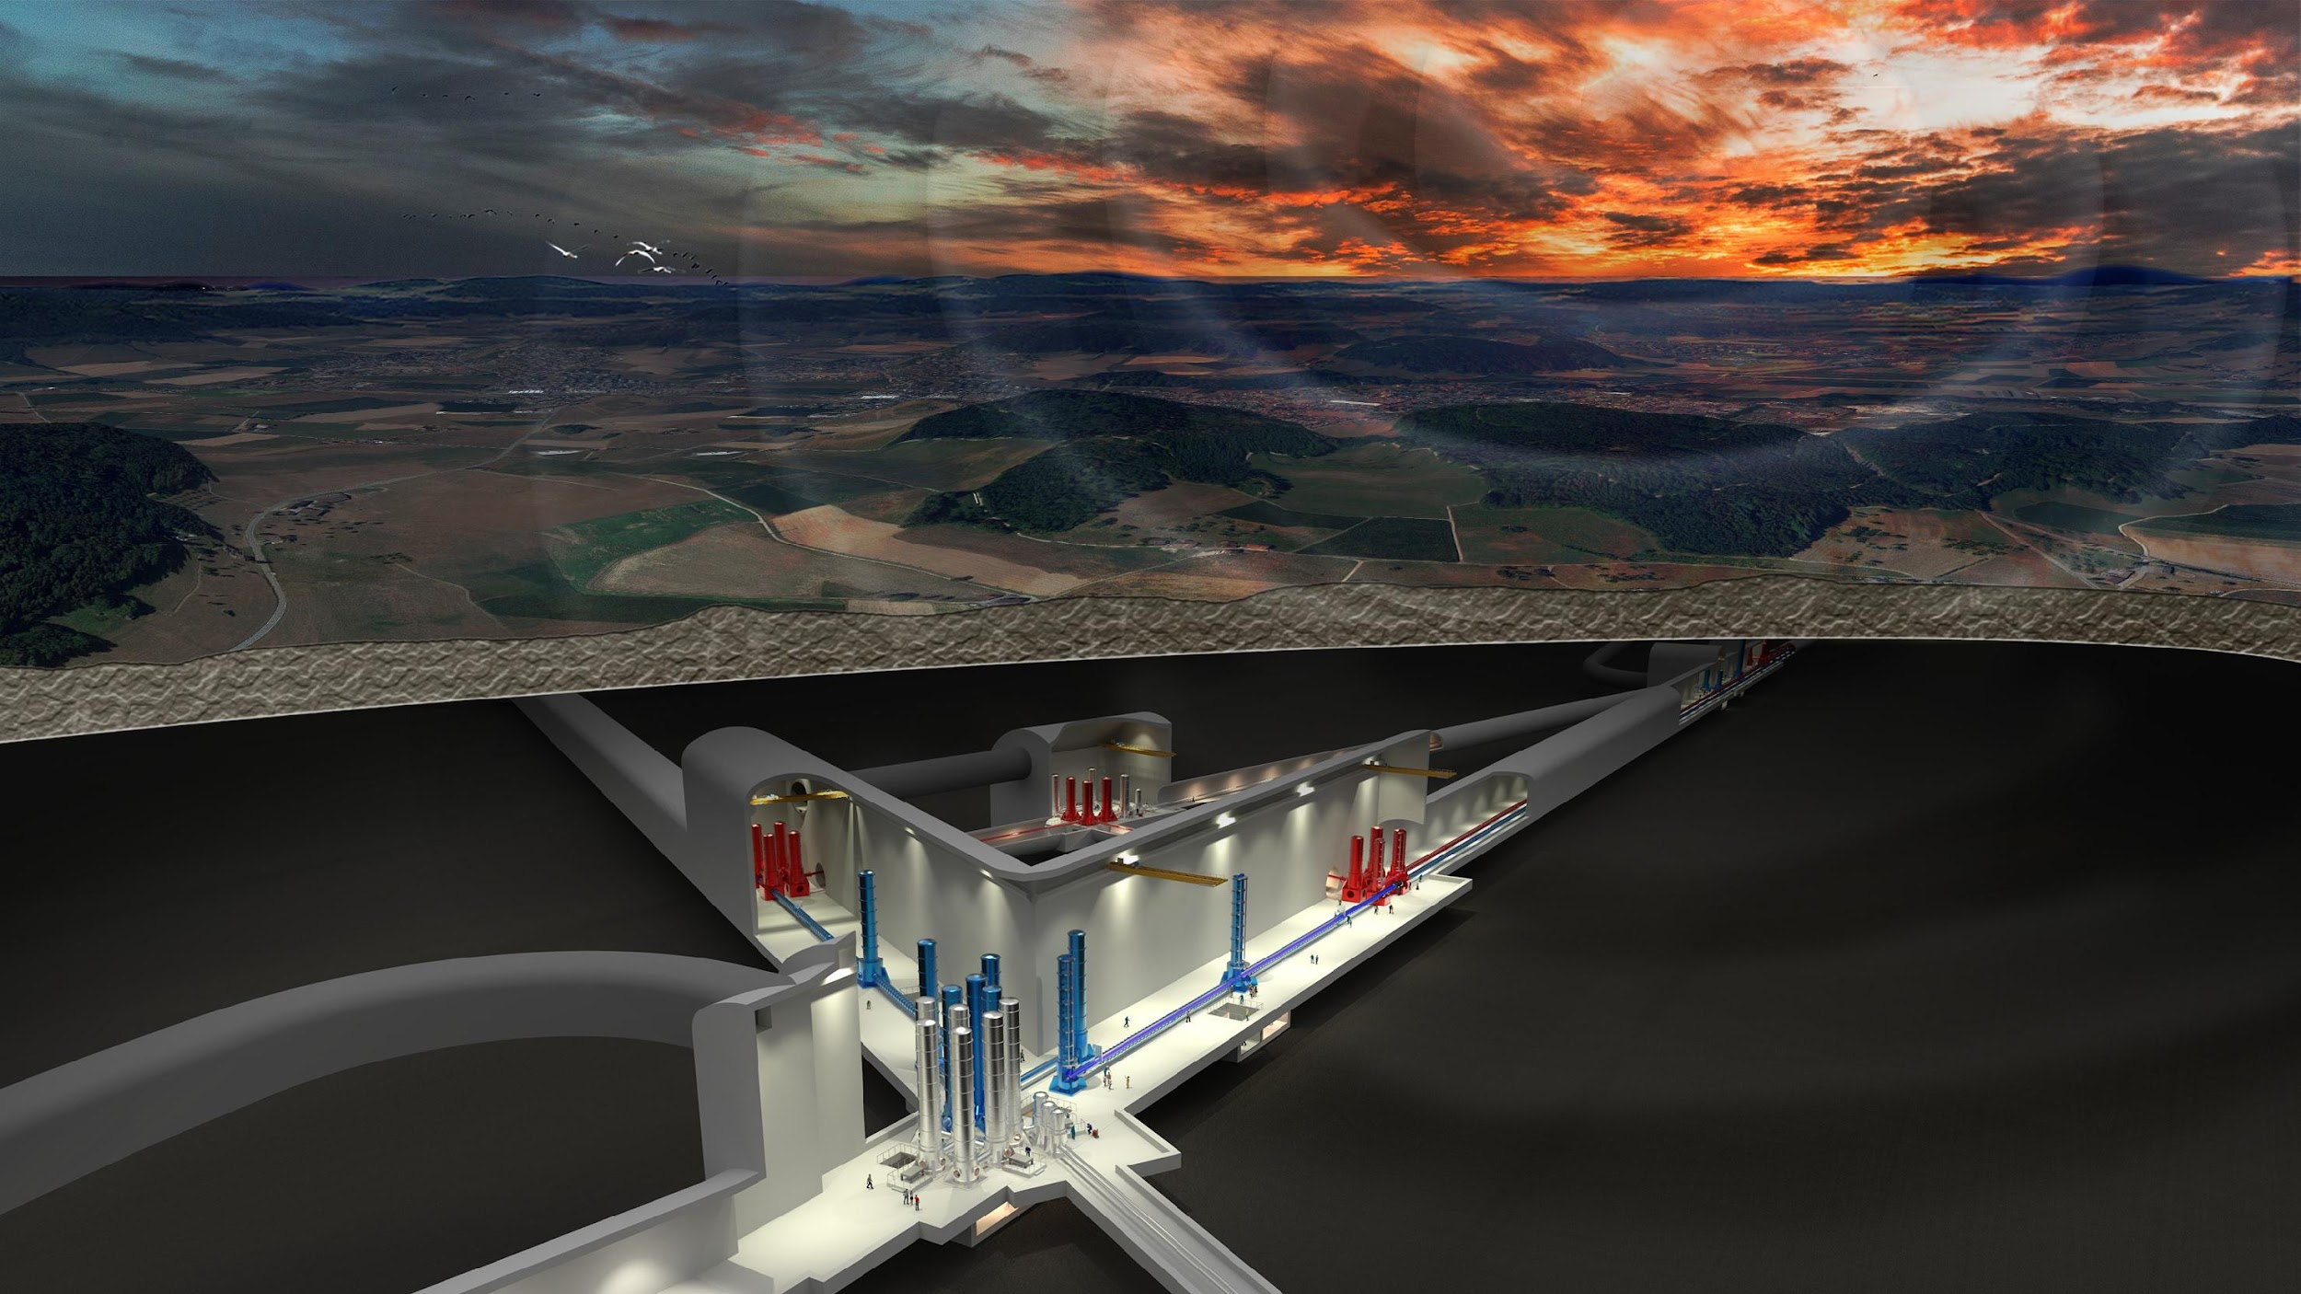
WP4
Site Characterization & Preparation Board
Updates
W. Walk & D. D’Urso

Slide 2
General Info
ET Symposium, Cagliari May 8-12
  parallel sessions on Monday/Tuesday
  poster session
  plenary sessions on Thursday and Friday
  possibility to have thematic sessions
    Newtonian Noise, Noise mitigation, etc…
WD3 Bidbook:
  Rosario De Rosa (rosario.derosa@na.infn.it) and Martijin Rumpen (m.rumpen@nikhef.nl) reference people for Sardinia and EMR respectively

Slide 3
Status Review EMR Subsurface Investigations
For SPB meeting, Wim Walk, March 28th, 2023
Geo-technical team formed, vacancies being filled (including geo-mechanical expertise)
Start of antropogenic noise studies:
- Collaborate with Universities of Münster, Liège and TNO
- Arrive at decision algorithm, relevant for EMR search area.
- Should compare with Italy studies
- Politics in all three countries are prepared to put all new construction on hold
Boreholes and ERT:
- List completed of 10 prioritized boreholes to confirm and refine Baseline Geologic Model
- For each borehole an ERT will be done first
- Licenses and permits work started
Seismic:
- DMT data are being reprocessed by DUG and evaluated
- Innoseis sensor data have been processed (early review quite positive)
- Seismic Megatronics data are being processes
- Expect conclusion on effectiveness of future active seismic in May
- Passive seismic campaigns 1 and 2 completed, next one being planned

Slide 4
Updates from Sardinia
All the documentation for the call for a “Preliminary Design” of ET infrastructure in Sardinia has been completed and submitted to the INFN management. The call should become public in a couple of weeks (I suppose)
  ~ 20 Meuro funded thanks to ETIC (Einstein Telescope Infrastructure Consortium) project support by the Next Generation EU
Visit of Italian Minister of University and Research, Bernini, and of the President of Regione Sardegna
  Strong support to ET
  Plan to define a good preservation strategy of Sos Enattos area
Windmills measurement campaign started at beginning of March (see Luca and Carlo slides)
Acoustic campaign measurement on surface in preparation
Preparation of new magnetometer station on going (may we plan to install it first @ EMR for a couple of weeks ?)

Slide 5
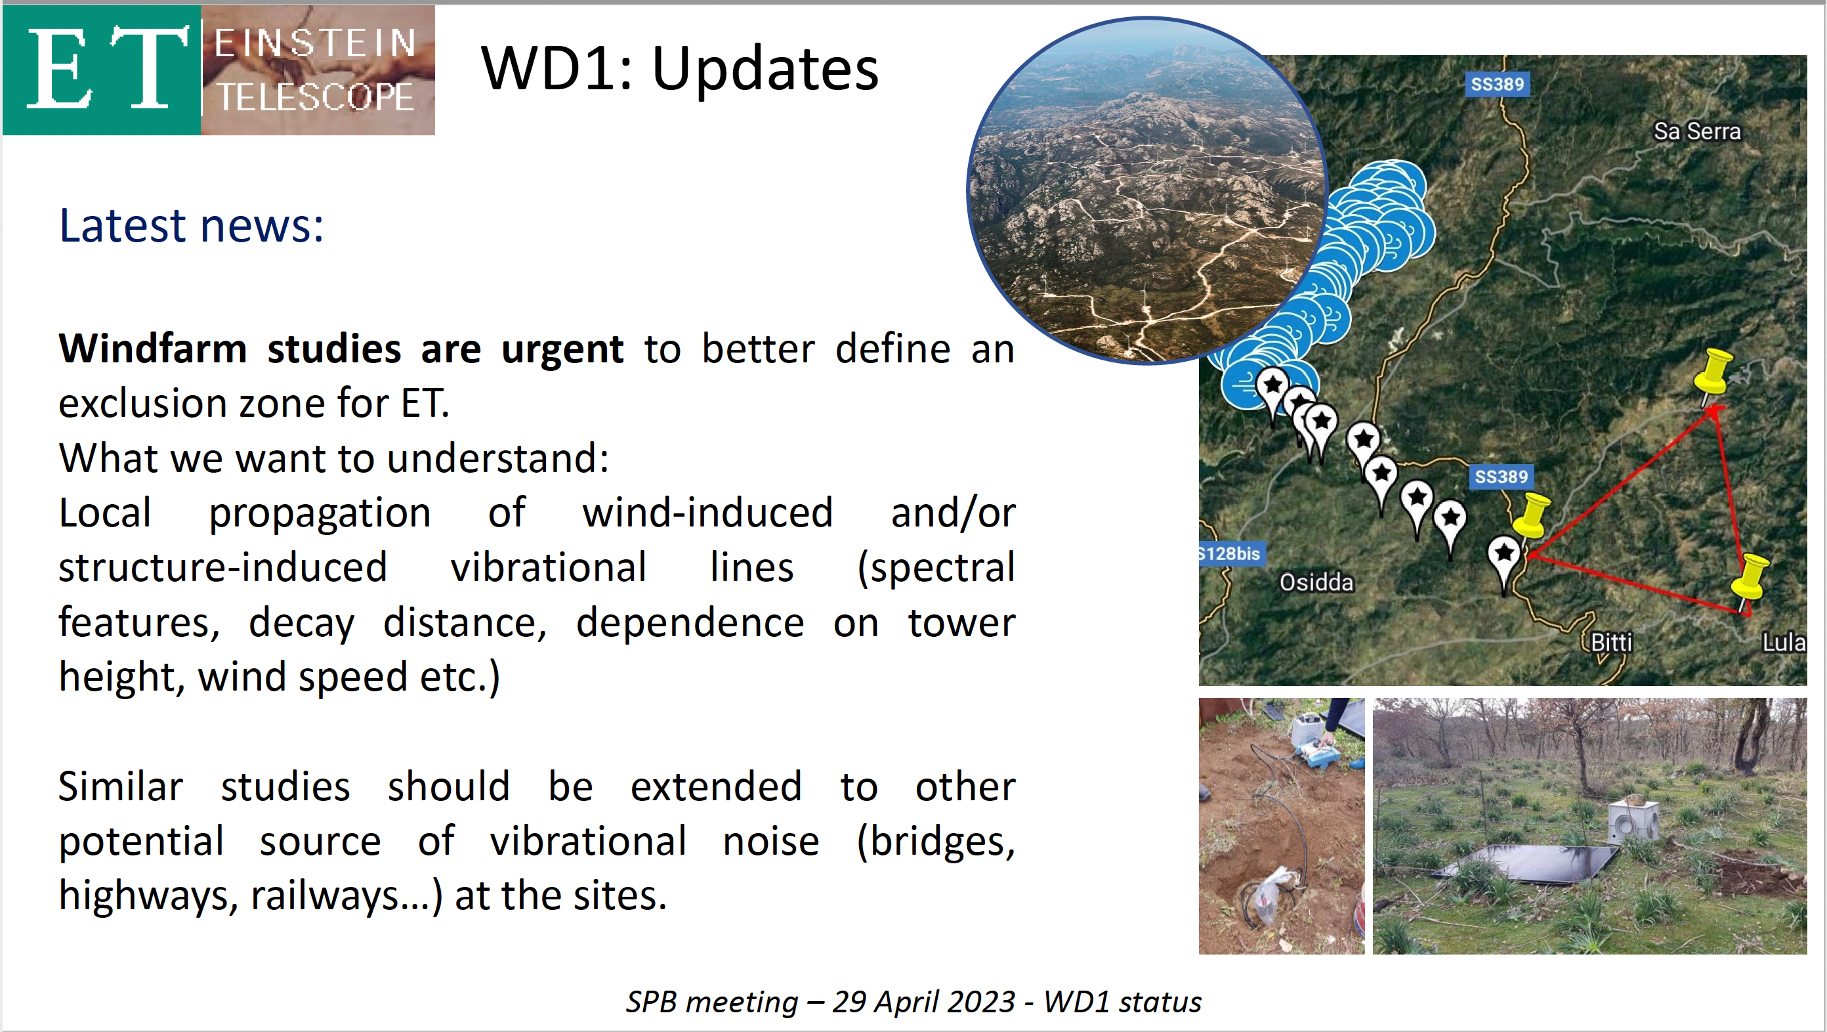
Credit to L. Naticchioni & S. Kadmiel

Slide 6
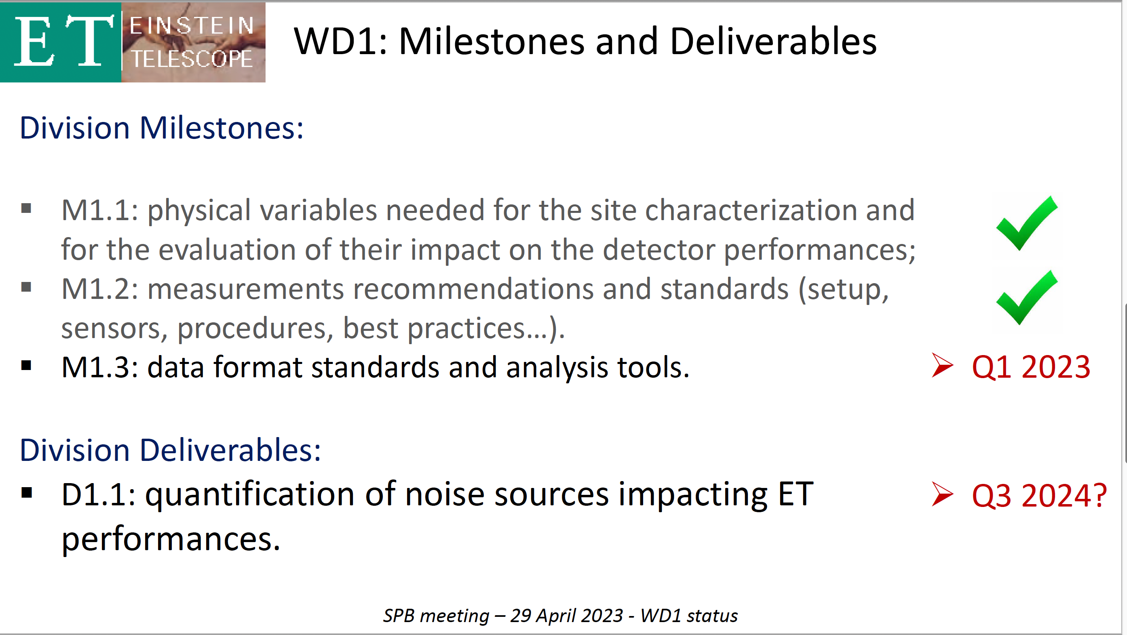
TDS code ET-0012A-23
TDS code ET-0013A-23
Credit to L. Naticchioni & S. Kadmiel

Slide 7
Doc in preparation
site-specific characteristics that impact ET sensitivity and its duty cycle (ET-PP) (to be uploaded in the ET-PP repo)
General Strategy (ET-PP):
  Concerns, challenges and requirements
  Sites descriptions
  Characterizations measurements description (SPB WD1, M1.1)
  standards (SPB WD1, M1.2)

